Slide 1
One Step Fitness

Slide 2
Motives
The idea of the app came from two main motives:
The trend of adopting a healthy lifestyle.
Including healthy diet and exercising.

Slide 3

About the project
The idea of the project is to create a cross-platform application for health support. The application included mainly two main concepts: Healthy diet and exercising. We merged between the two concepts to create a comprehensive app that combines the two main elements for a healthy lifestyle. Moreover, we added two more ideas: Water tracking, and vital signs.

Slide 4



Tools & Technologies
01
02
03
Flutter
Node JS
Mongo DB

Slide 5
User side
To begin with, the user must have an account, and once they open the app, it automatically asks them to create an account and sign in afterwards. Upon signing in, the app starts collecting data on the user's weight, height and age to help calculating the BMI indicators which will help them later to specify the suitable plan in accordance with their indicators.

Slide 6
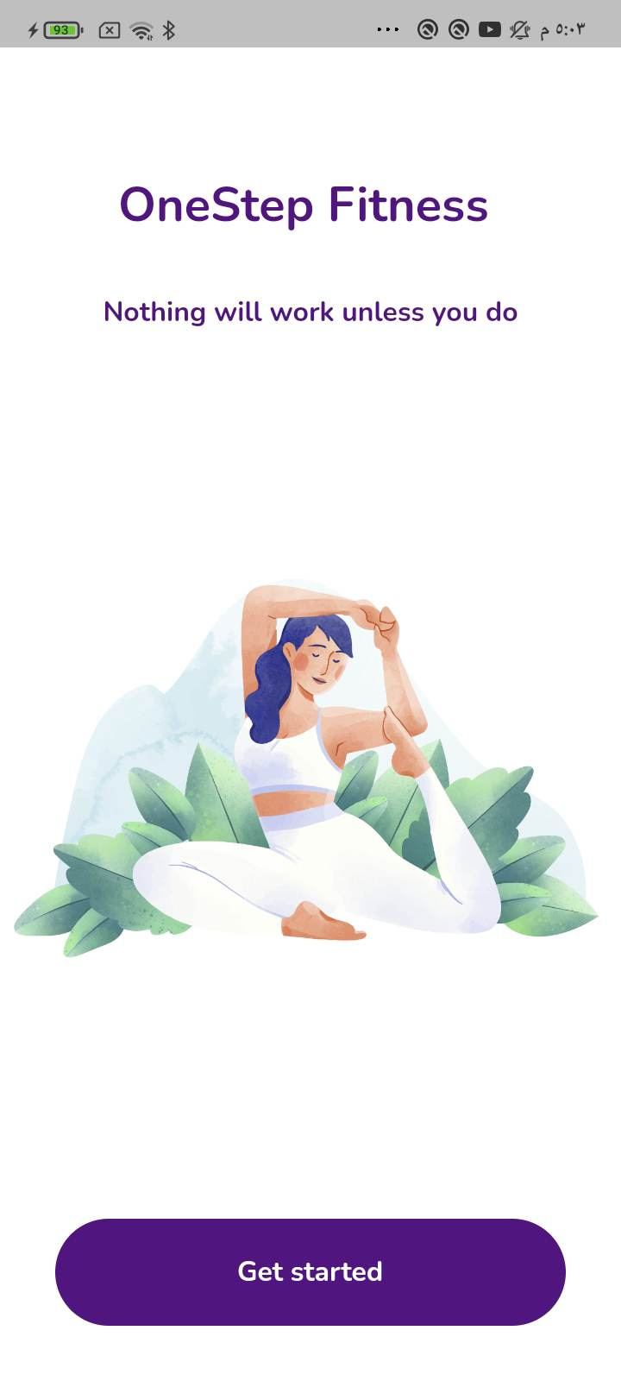
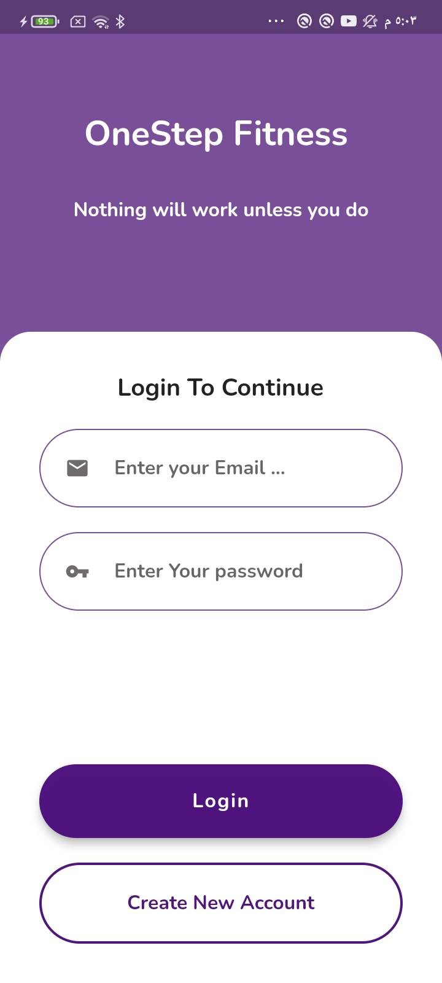
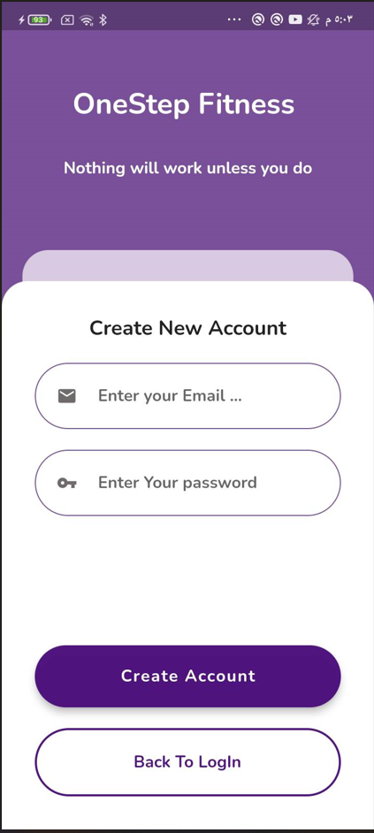
Home page , Sign in, Sign-up

Slide 7
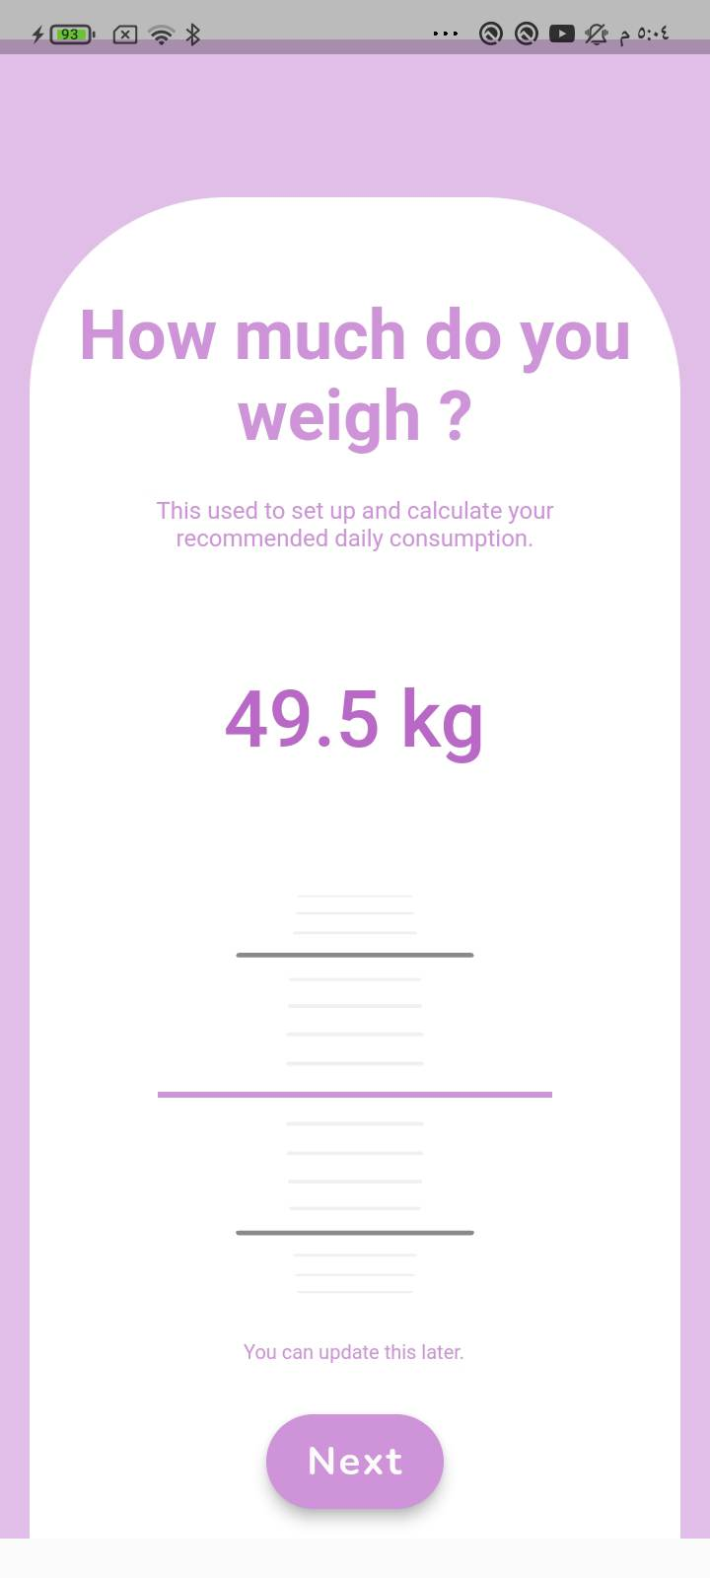
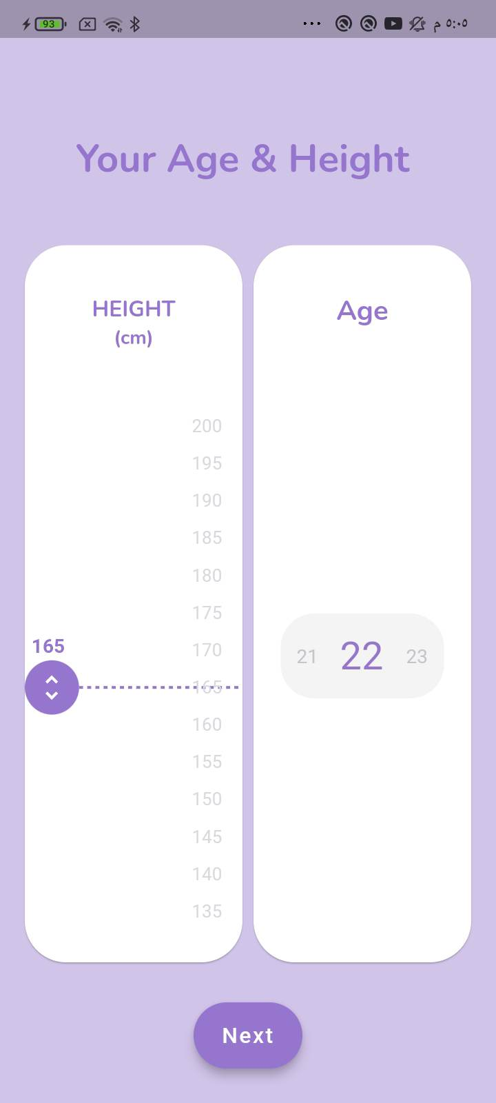
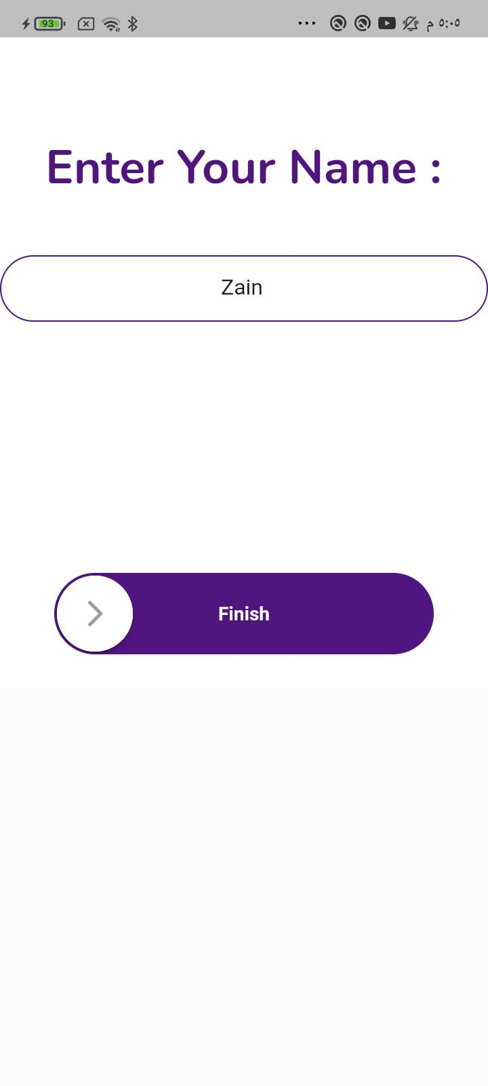
Questions
When user create account, he must enter his weight, height ,age and his name.

Slide 8
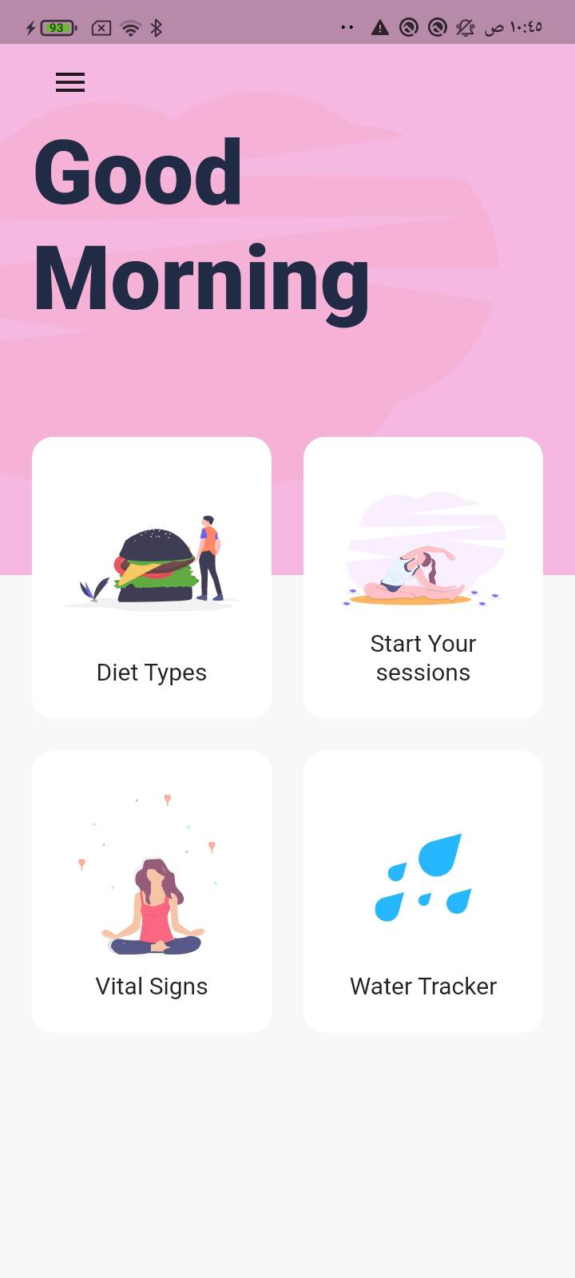
Main page
Once the user signs in, this screen will appear, of which includes these options:
Diet types
Start your sessions
Vital signs
Water tracker
The user chooses one of the aforementioned options.

Slide 9
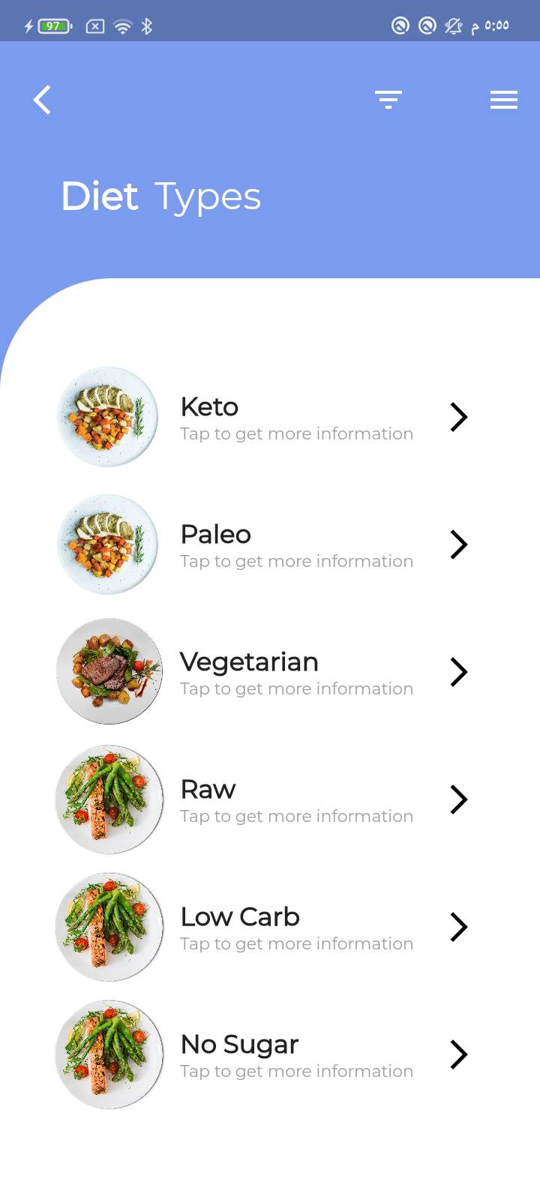
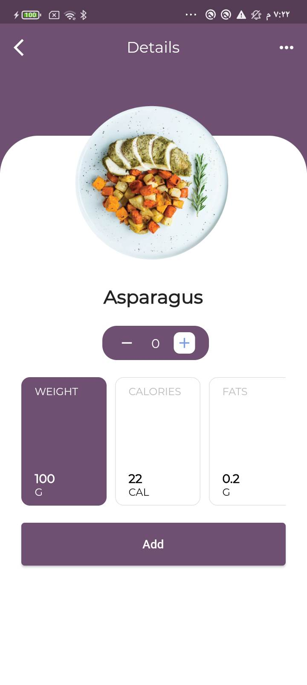
Diet Types
This option includes 6 types of healthy diet; each type includes a set of meals with their calories, protein, fat, and other food elements being calculated.

Slide 10
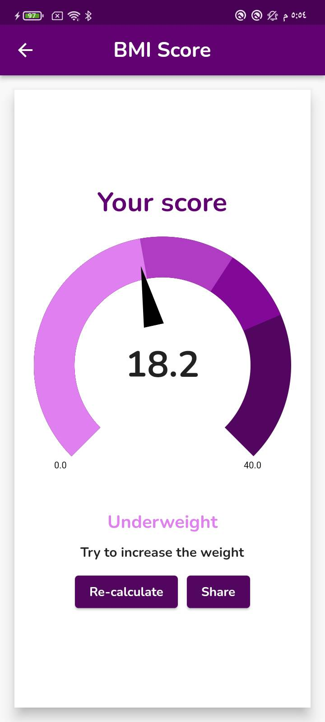
Your BMI
Each user has his own BMI score, which depends on weight and height, and the sport he will practice depends on his BMI.

Slide 11
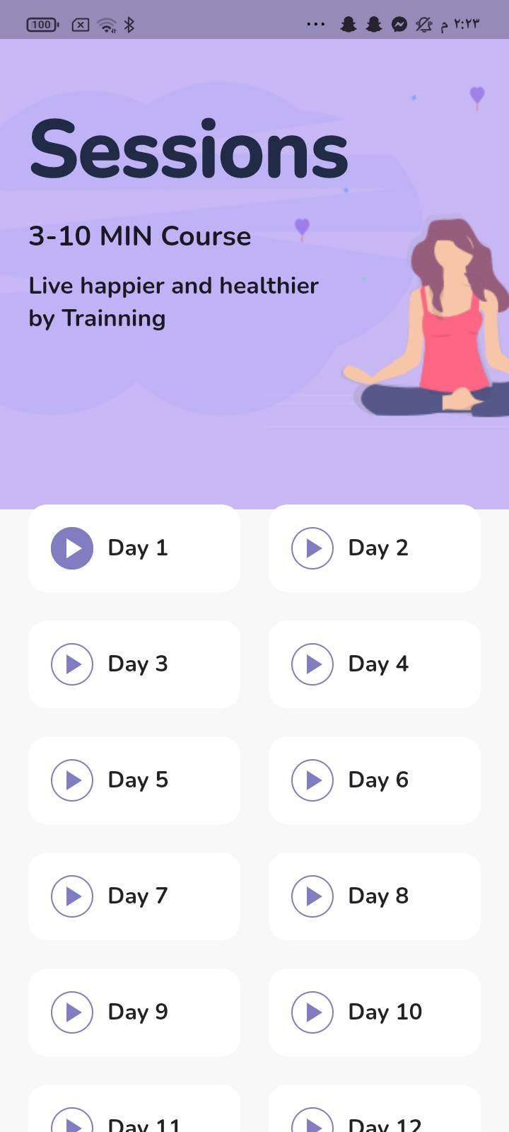
Start your sessions
Displays the exercise plan for a month.

Slide 12
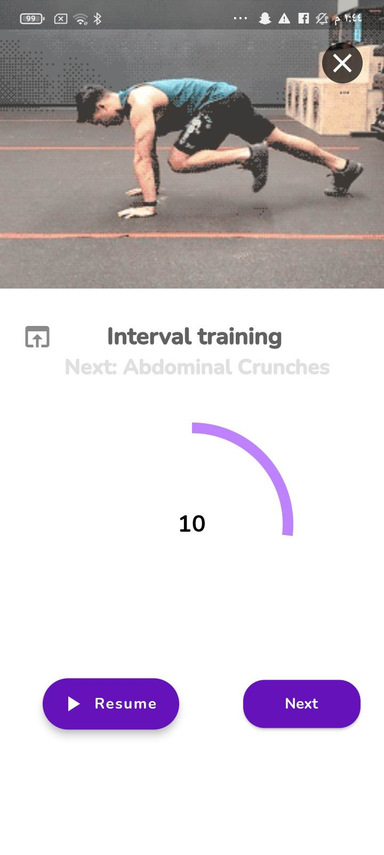
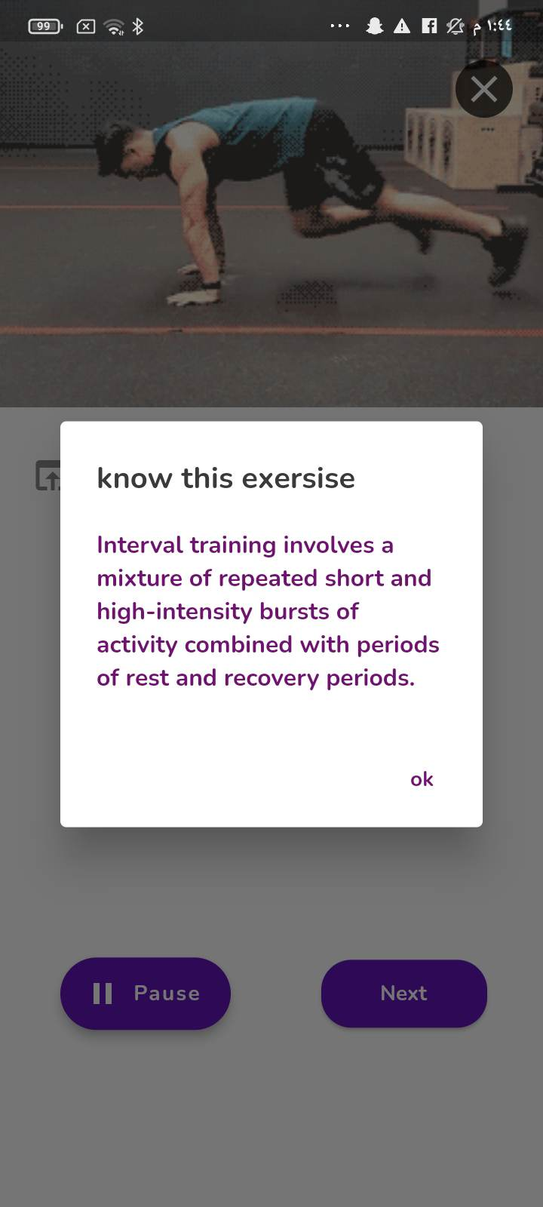
Start your sessions
This option depends on the BMI result of the user. It includes many exercises recommended to the user; each with timer and instructions. This exercises plan extends for a month.

Slide 13
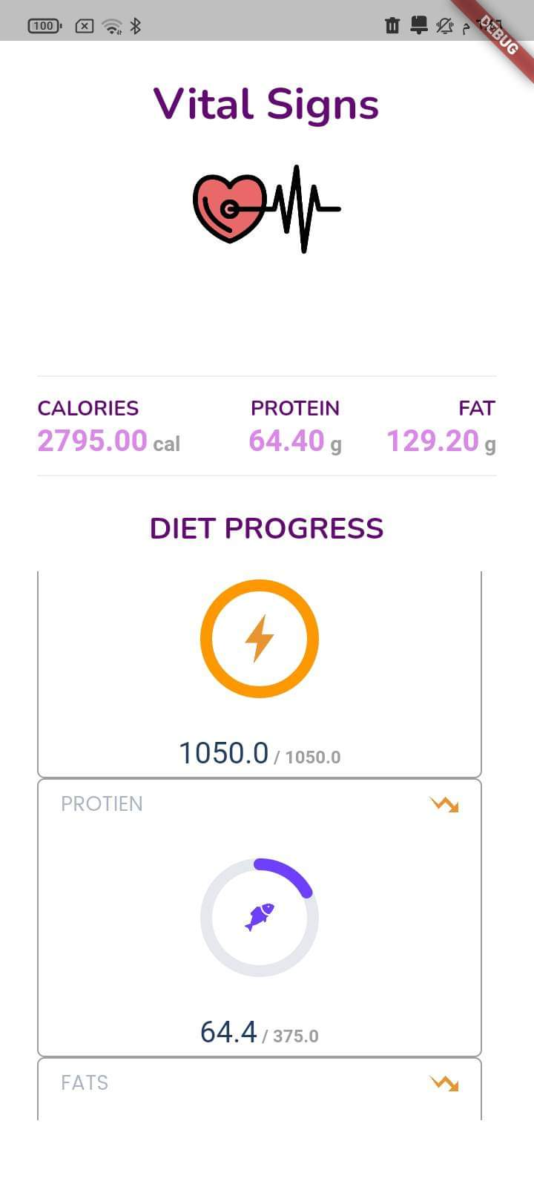
Vital signs
This option can also be known as "body composition analysis". Depending on the diet plan that the user adopts, this option shows a detailed analysis on protein, fat, calories within the types of food the user has already chosen and eaten.

Slide 14
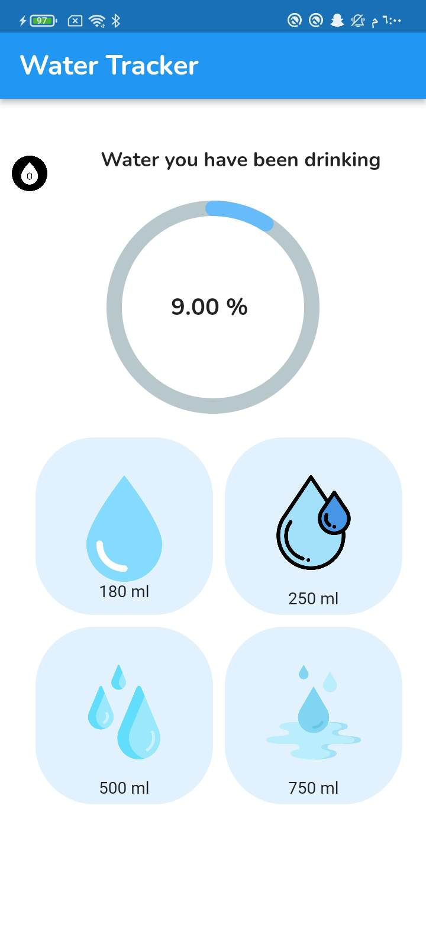
Water Tracker
This option tracks the amounts of water the user drinks per day. It also recommends and reminds them each 2 hours to drink water until the user completes the ideal amount of water they should drink every day.
Each person needs no less than 2.7 litres/day.

Slide 15
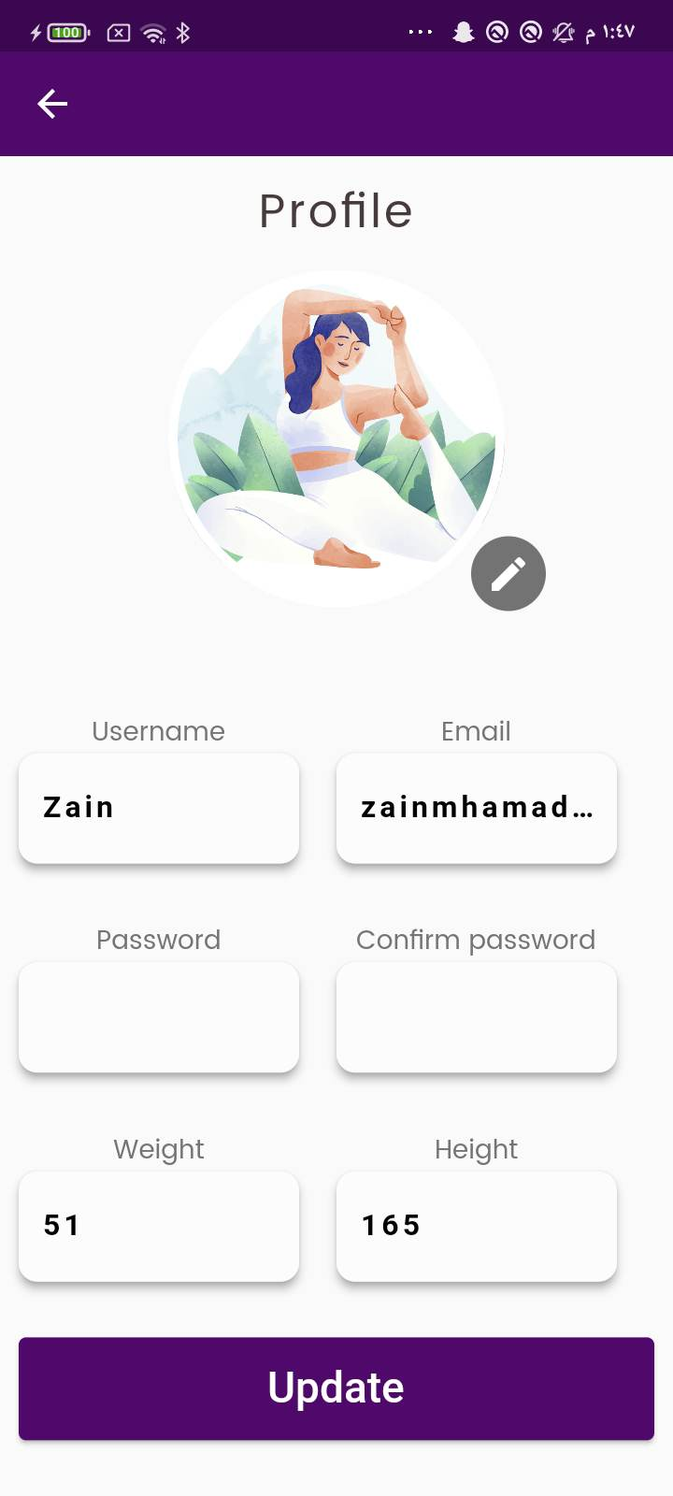
User Profile
The user can edit his name, weight, height and their password at any time.

Slide 16
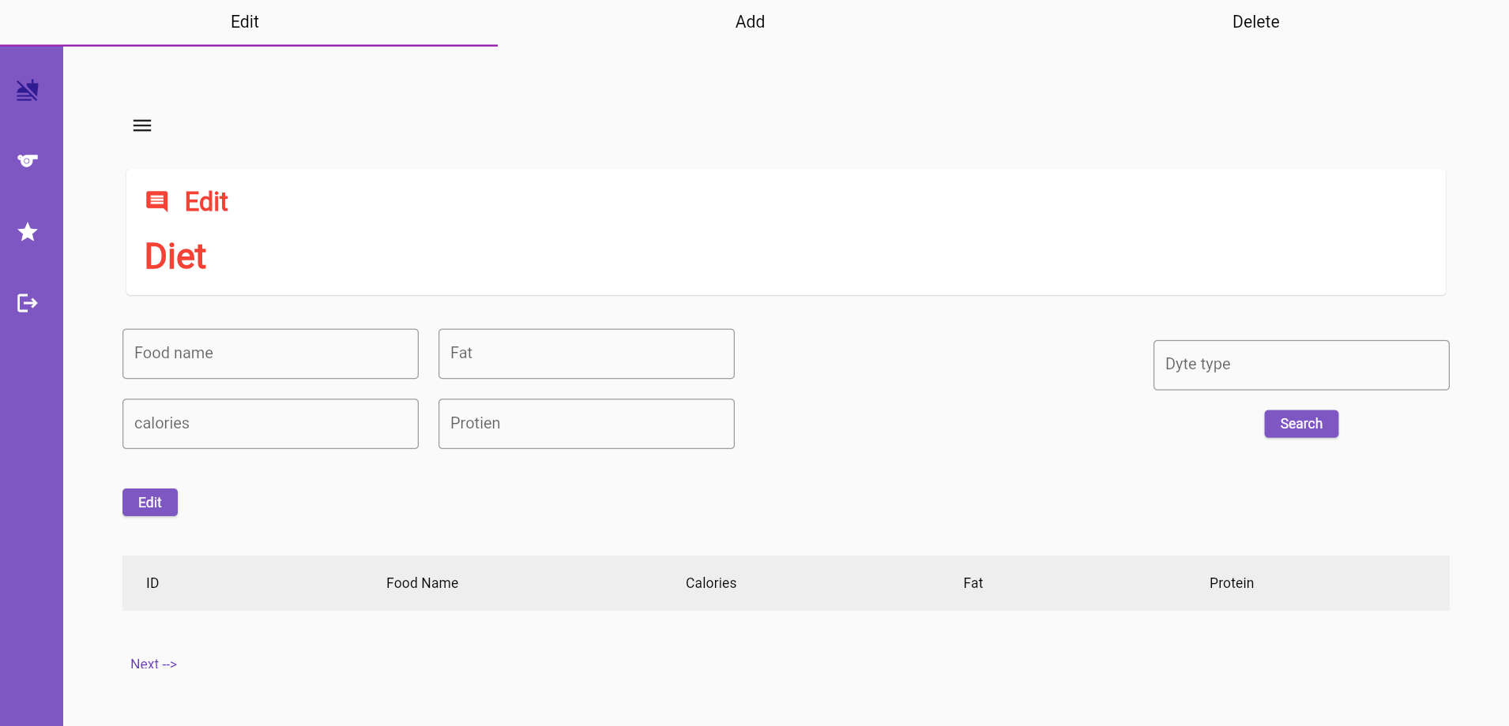
Admin Side
The admin can add, delete, edit, and review the schedule of diet types at any time.

Slide 17
Future Work
We aim to design a recommendation system to the diet plans to suggest meals suitable to the users' BMI.
We also plan to include Personal Training sessions in coordination with professional personal trainers and sportswomen.

Slide 18
Thanks
Do you have any questions?
Done by:
Zena Badran
Zain Abu Al Soud
Supervised by: Dr. Manar Qamhieh

