Slide 1



Your Nearest Path App
SSWC
Supervised by: Dr. Aladdin Masri

Slide 2
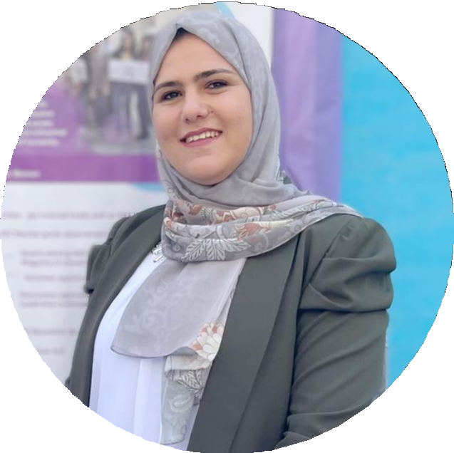



Our Team
Dalia Omar
Roaa Barq

Slide 3







01 Introduction
Main Problem:

Slide 4







Project Objective:
organize the process of collecting waste throughout the day with the least possible

Slide 5





Who uses the project?
02
Citizens
Admin
Head of waste department
Drivers

Slide 6

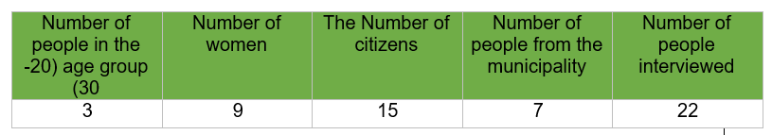

03
Human-centred design
02.
03.
Implementation phase
Feedback and satisfaction.
Programming languages.
Testing the app.
01.
Inspiration phase Ideation phase
Interviews. Visited the municipality.
Shortest Path .
The collection at the evening.
Collection waste process in an easy.

Slide 7
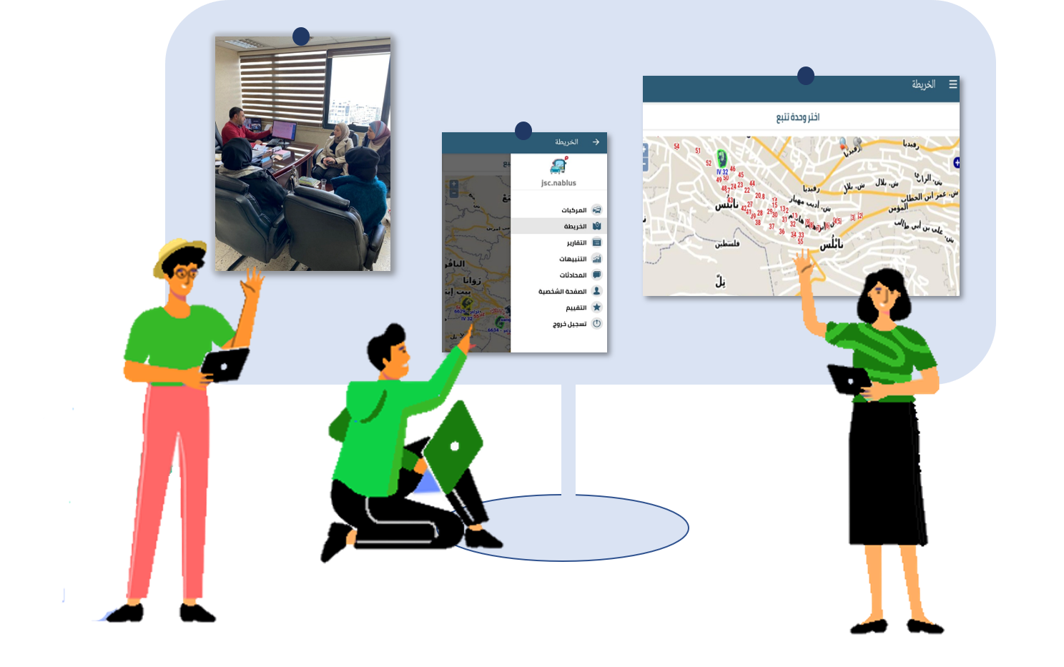
Ideation phase:
Municipality Visit

Slide 8







Arrow Timeline Features
04
Registration system
Shortest Path
Citizens tracking
Adding employees and Basket
Agenda One
Agenda Two
Agenda three
Agenda Four

Slide 9
05
What makes us better than others?

Slide 10






06
Future works
01.
02.
03.

Slide 11


