Slide 1

An-Najah National University
Faculty Of Engineering
Building Engineering Department
Graduation project II
Integrated Redesign of Rehabilitation Center for Mentally Disabled

Slide 2
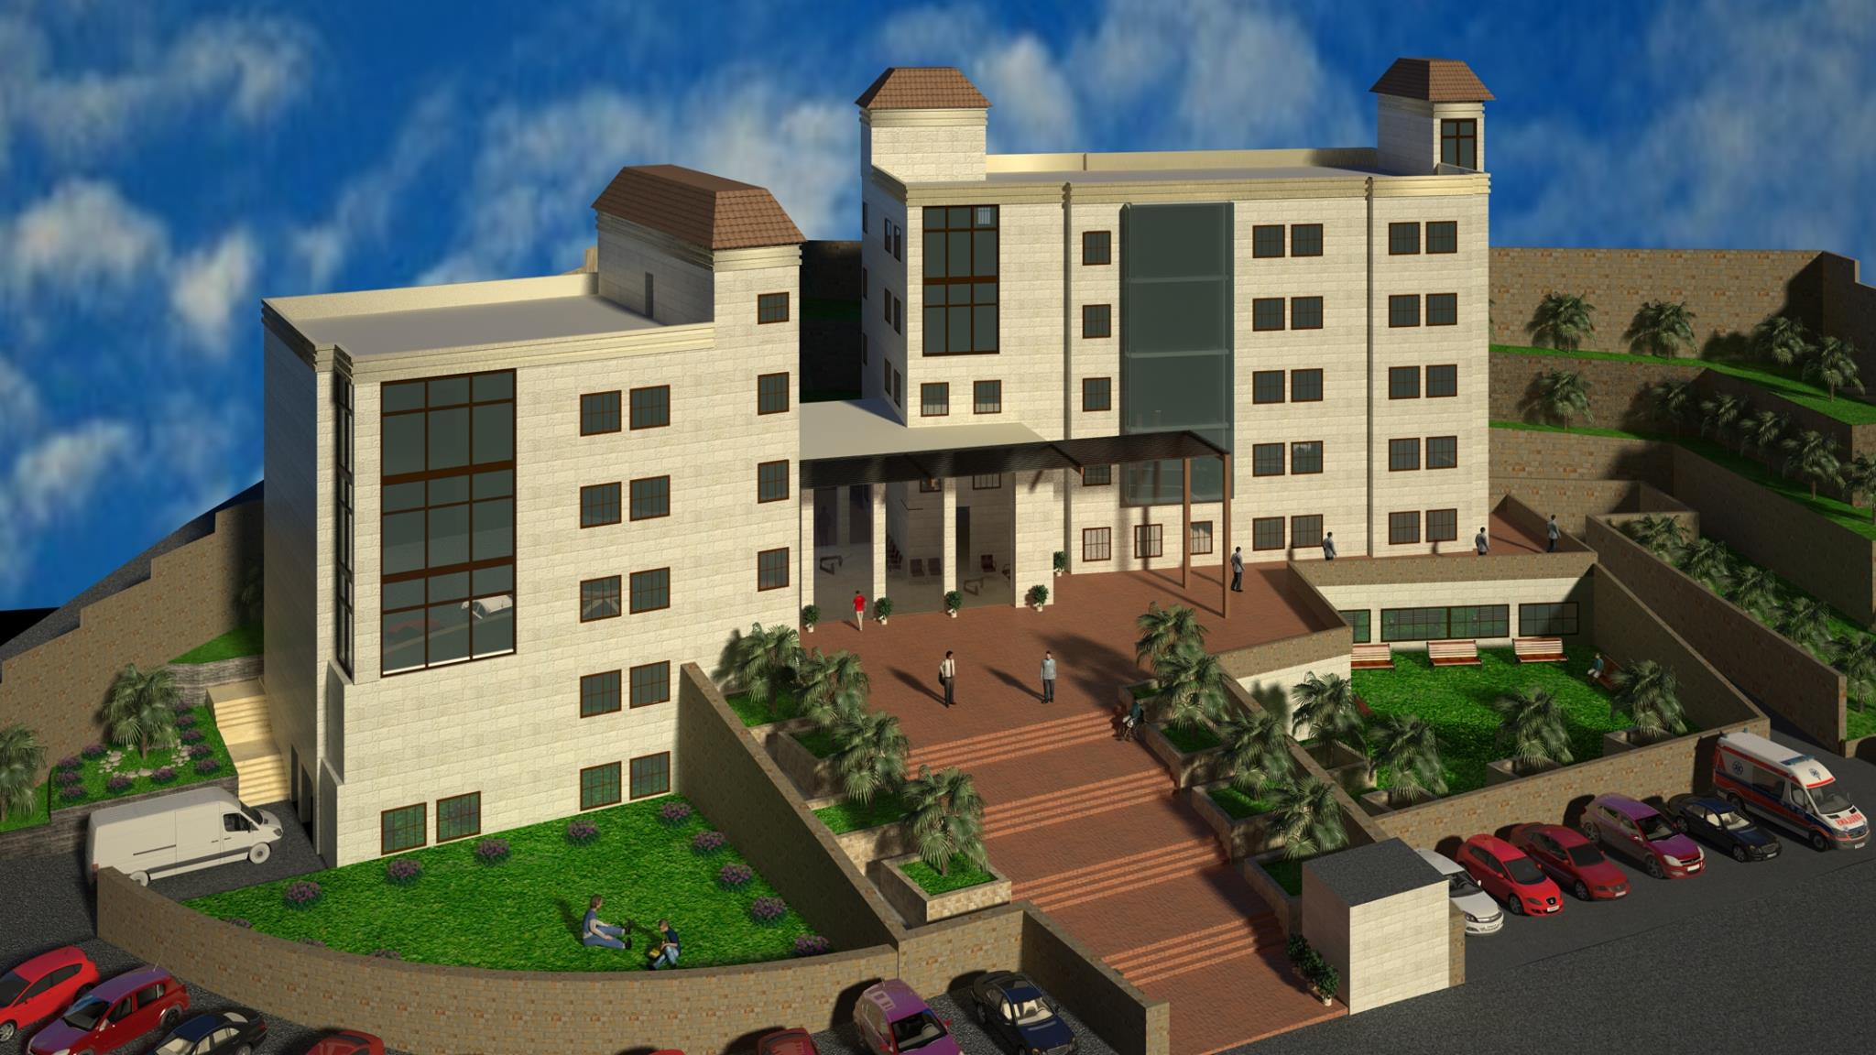
Prepared By:
Omar Shoman
Raya Bizreh
Sahar Homran
Solaiman Odeh
Supervised By:
Dr. Mutasim Baba’

Slide 3
Outline:
Site of the project
Architectural Design
Structural and Seismic Design
Environmental Design.
Electrical Design
Mechanical Design
Safety Design
Conclusion.

Slide 4
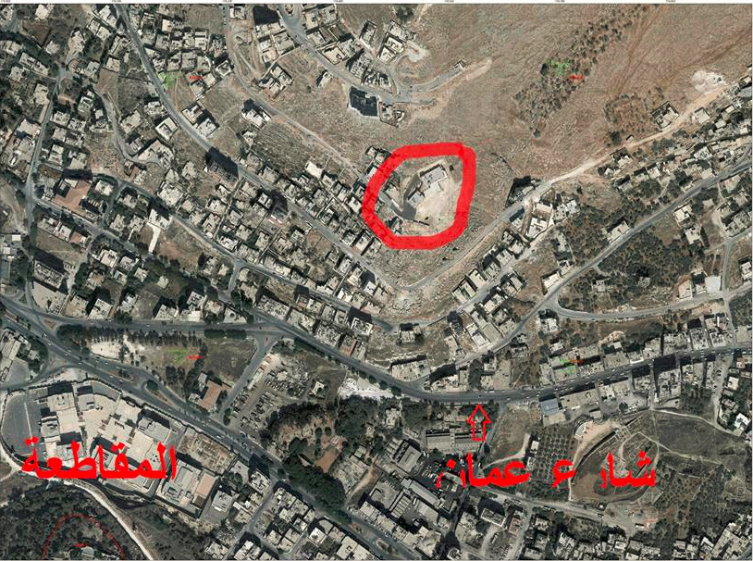
Site of the project: Location and Site: Area = 5000 Square Meter.

Slide 5
Architectural Design

Slide 6
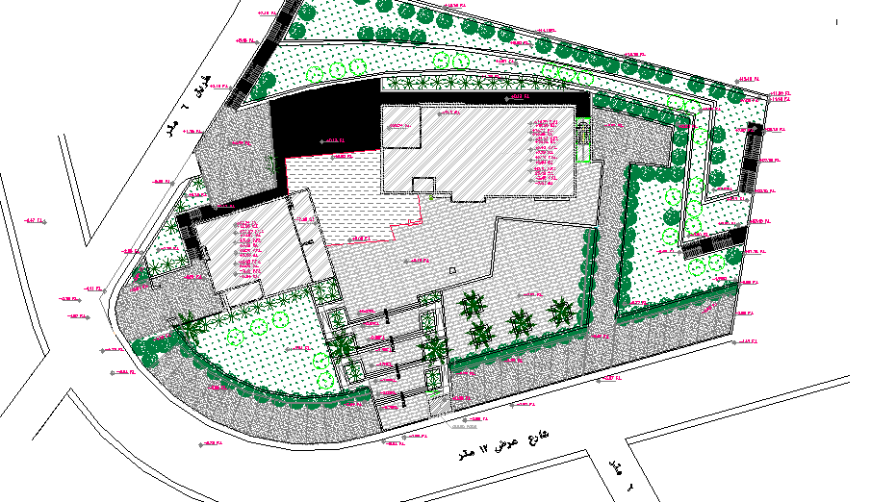
The site plan for the project

Slide 7
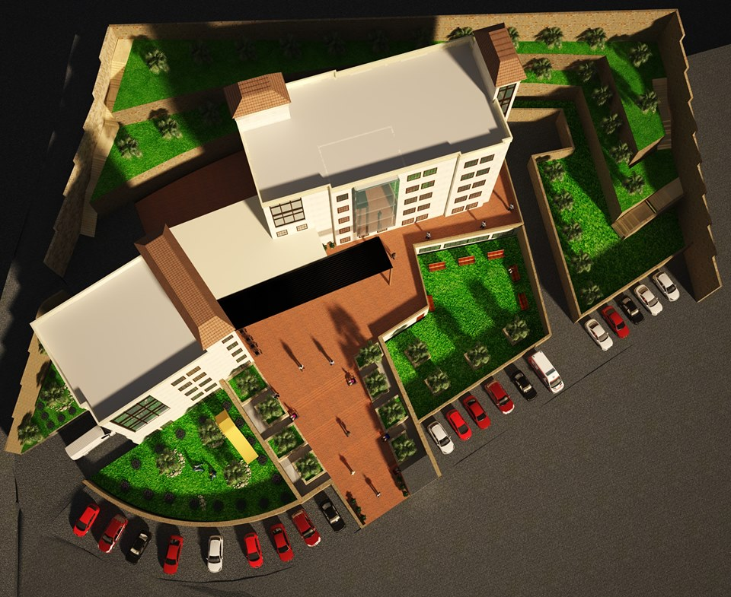

Slide 8
3D MAX

Slide 9
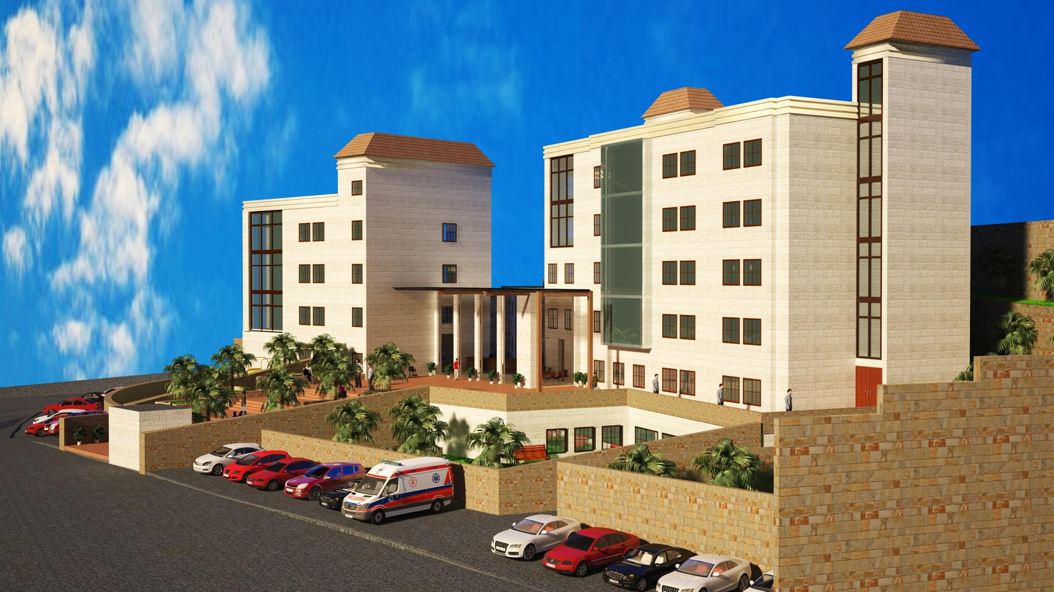

Slide 10
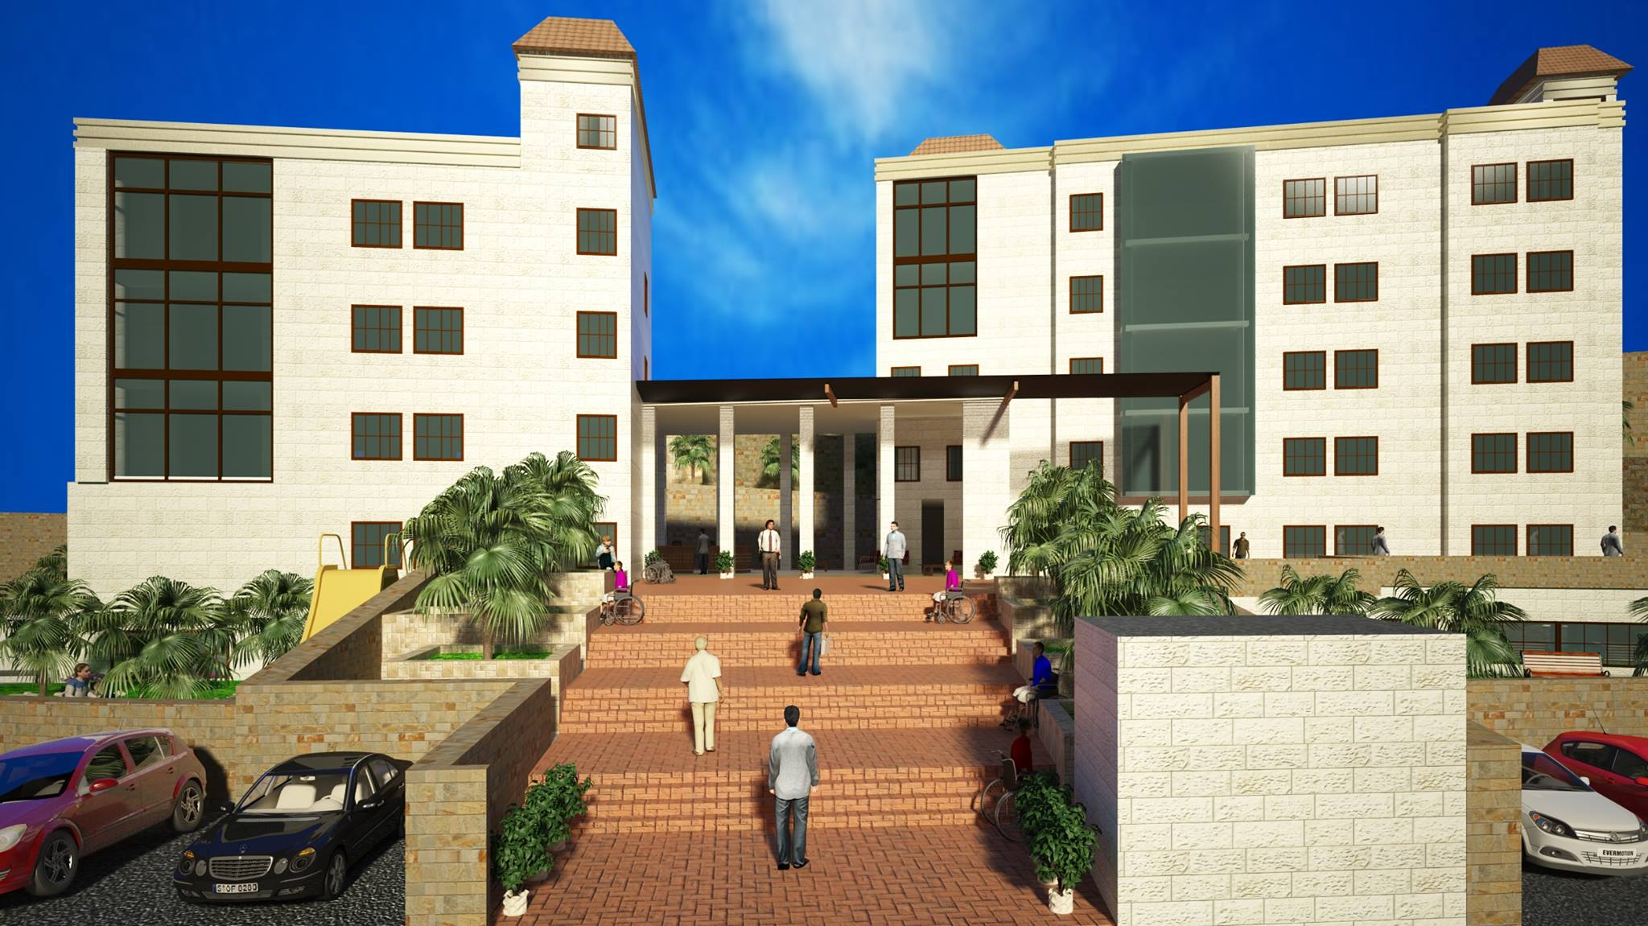

Slide 11
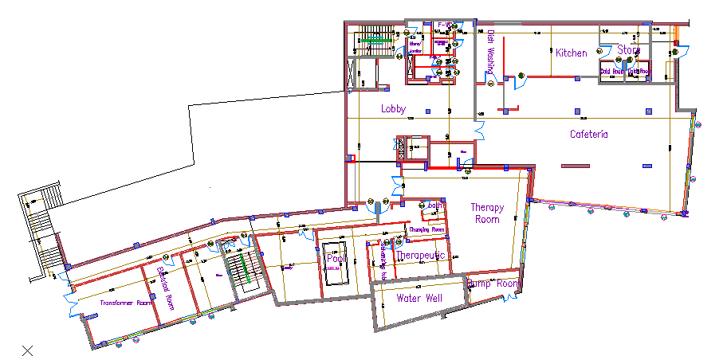
Basement floor plan (Area = 980 m²)

Slide 12
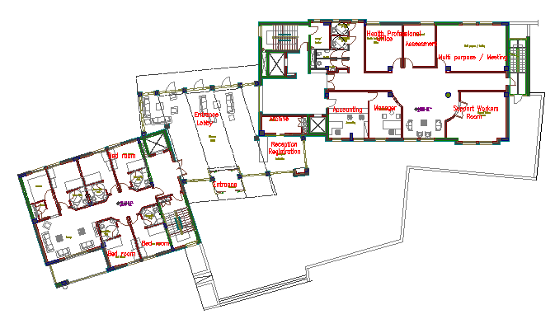
Ground floor plan (Area = 907m²)

Slide 13
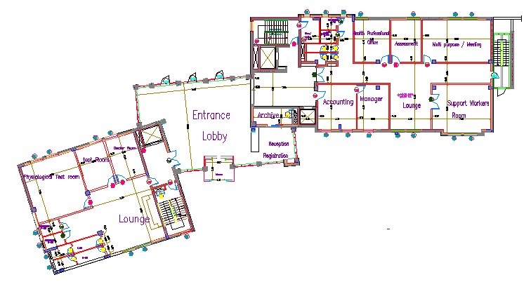
Ground Floor (Area = 907 m²):

Slide 14
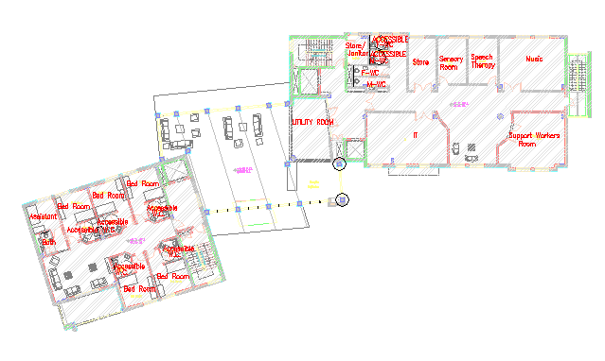
First floor plan (Area = 698 m²):

Slide 15
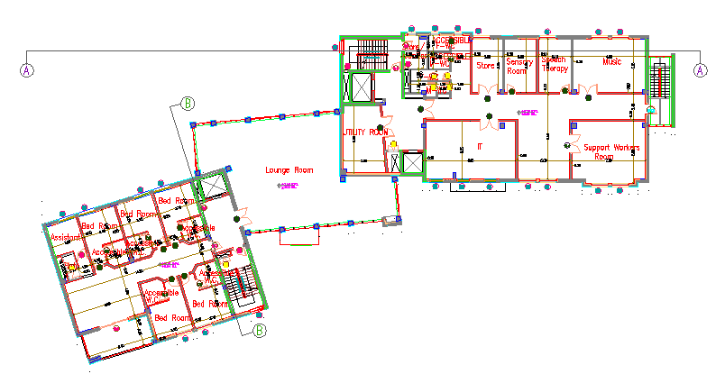
First floor plan (Area = 698 m²):

Slide 16
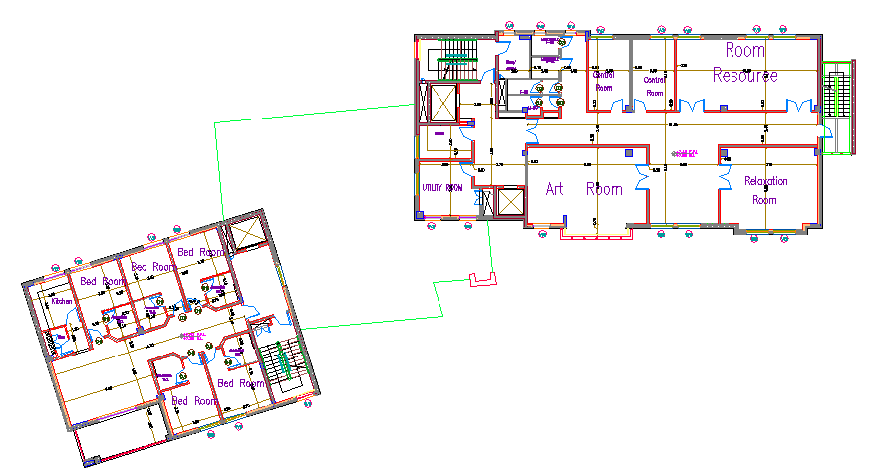
Second floor plan (Area = 695 m²):

Slide 17
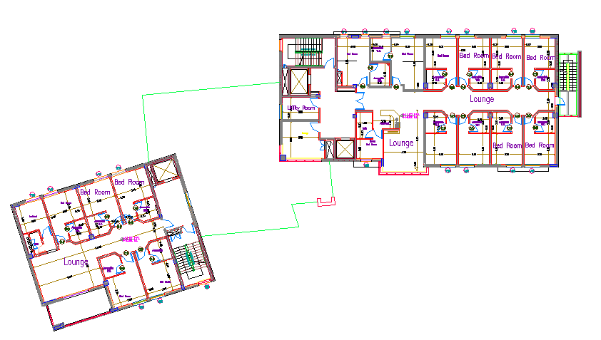
Third floor (Area = 691 m²):

Slide 18
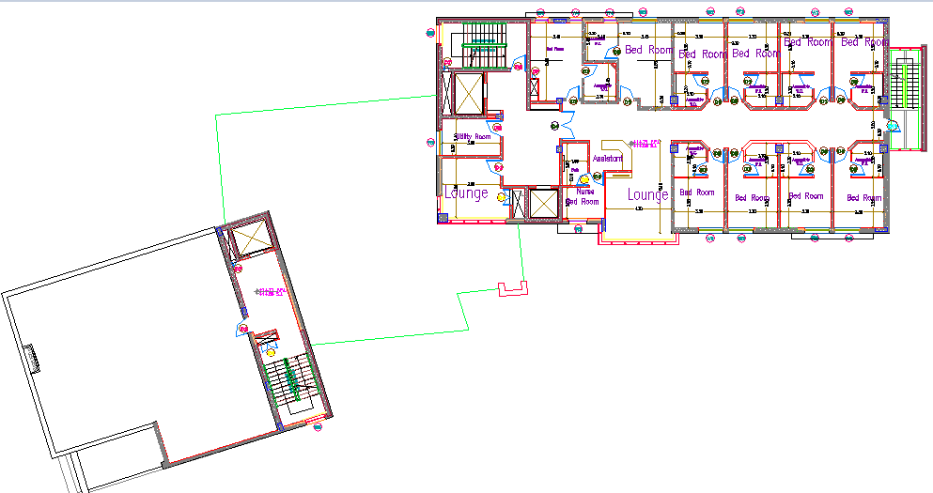
Forth floor (Area = 434 m²):

Slide 19
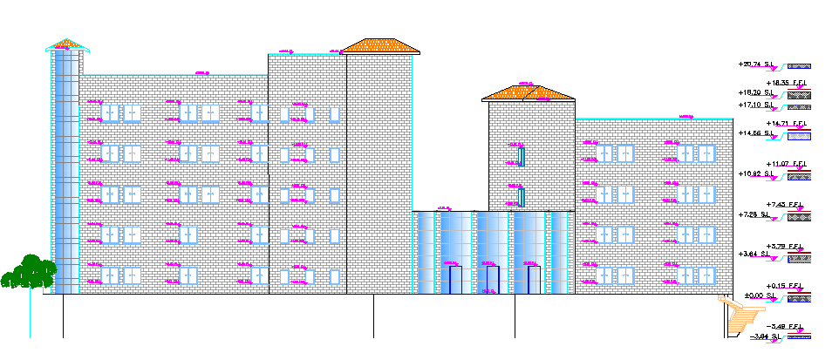
North Elevation

Slide 20
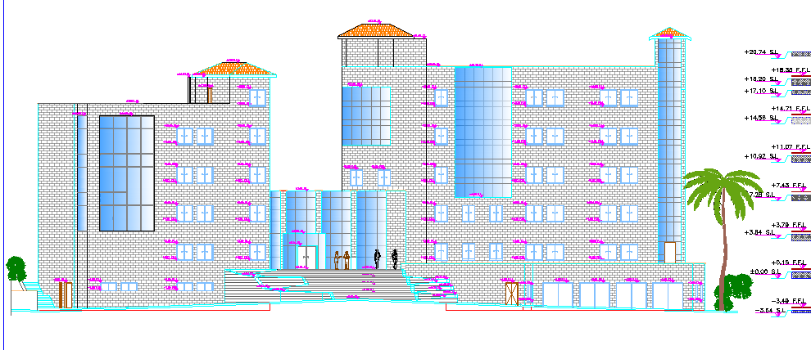
South Elevation

Slide 21
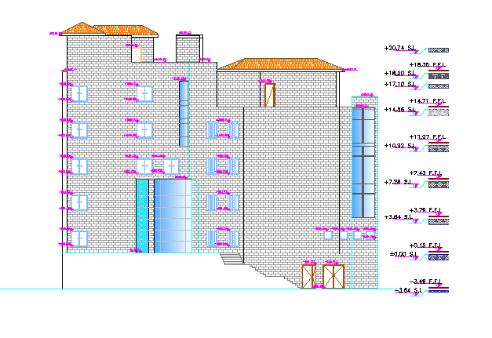
West Elevation

Slide 22
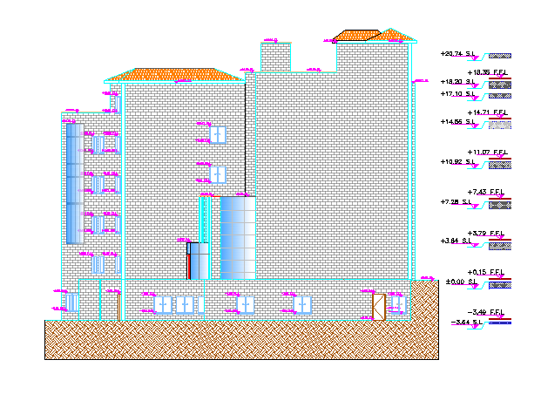
East Elevation

Slide 23
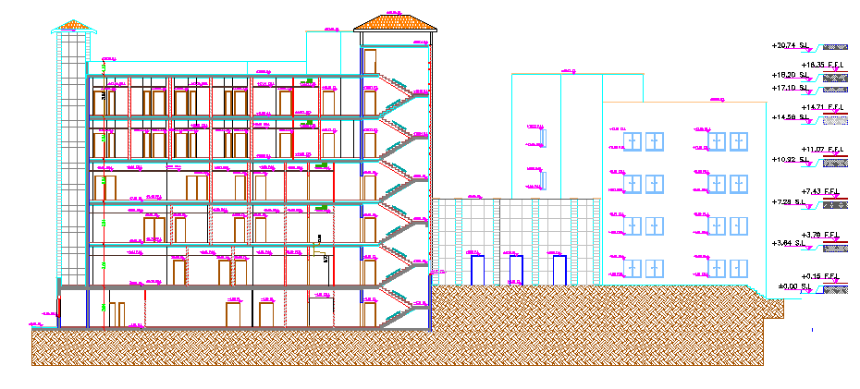
Section A-A

Slide 24
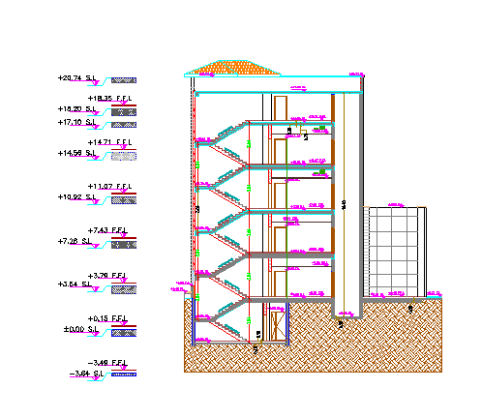
Section B-B

Slide 25
Structural and Seismic Design

Slide 26
Codes of design:
Structural Design
The American Concrete Institute code ACI 318-08.
The seismic design according to UBC-97.
The analysis and design were done using ETABS program.

Slide 27
Design Data :
Structural Design
Concrete Compressive Strength :
F’c =24 Mpa For Slabs, Beams, Shear Wall, Retaining Wall And Footing .
F’c =28mpa For Columns.
Yielding Strength Of Steel :
The Yield Strength Of Steel Fy= 420mpa

Slide 28
Structural Design
Structural System :
Solid slab with drop beams
The longest span (two end continues) = 700 Cm.
The Thickness Of Slab (H) = Ln/28 = 700/28 = 25cm
The Thickness Of Slab (H) = 30cm
Thickness of slab :

Slide 29
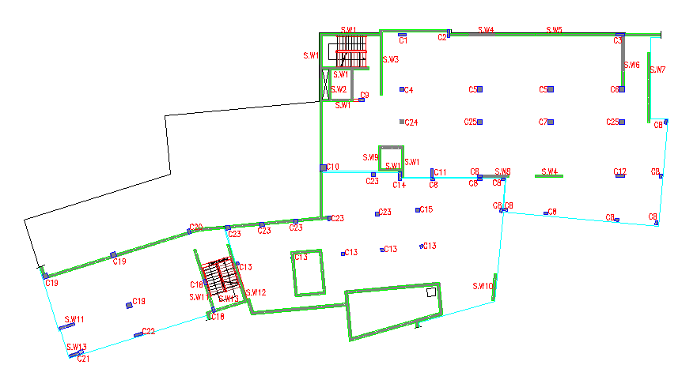
Structural Design
The distribution of columns and shear walls in the building:

Slide 30
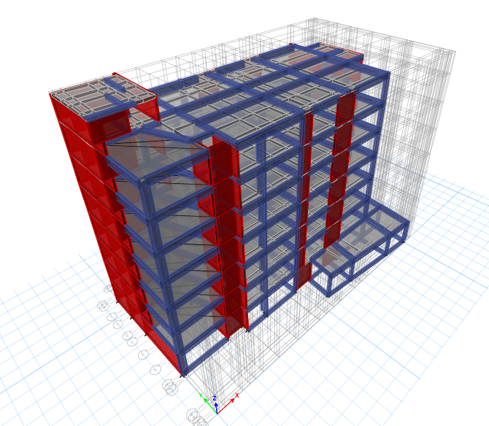
Structural Design
3D modeling from ETABS Program:

Slide 31
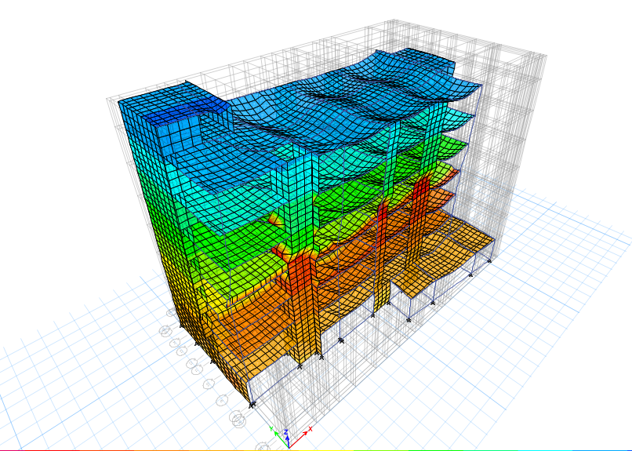
Structural Design
Check model: Compatibility Check

Slide 32
Structural Design
Equilibrium Checks:
Error% | ETABS | Manual
3.2% | 65081.21 | 67291.65 | Dead load + S.I.D.L
2.9% | 15096.9416 | 15561.985 | Live load

Slide 33
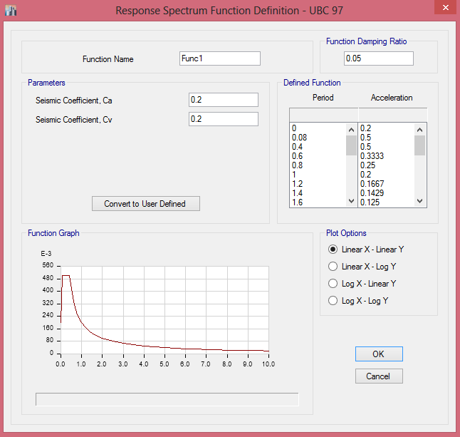
Structural Design
Seismic Design Using Response Spectrum – UBC 97:
W = 61720.8 KN
Soil type SB
I = 1.25
R = 8.5
C_{v} = 0.20
C_{a} = 0.20
T = 0.52 sec.
V = 3490.9 KN

Slide 34
Structural Design
Natural Period (T) for the building:
T(sec)
0.73 | From ETABS
0.52 | Manual

Slide 35
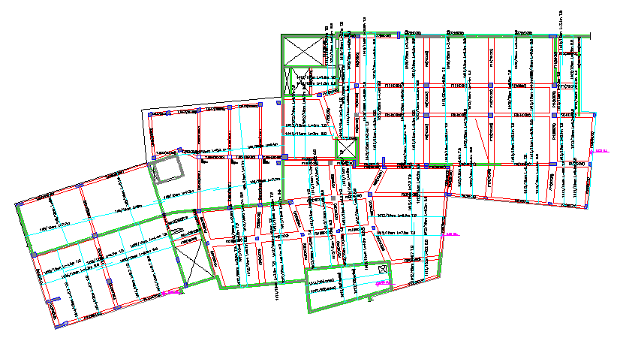
Structural Design
Structural systems design :
    1. Slab Design :

Slide 36
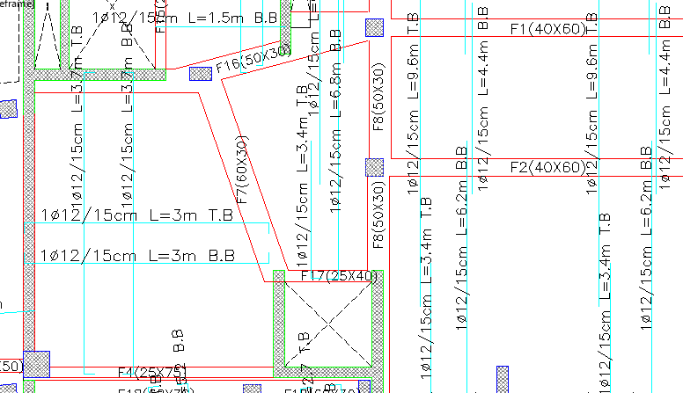
Structural Design
    1. Slab Design :

Slide 37
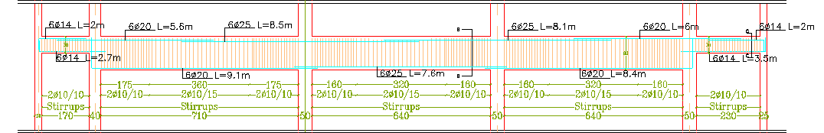
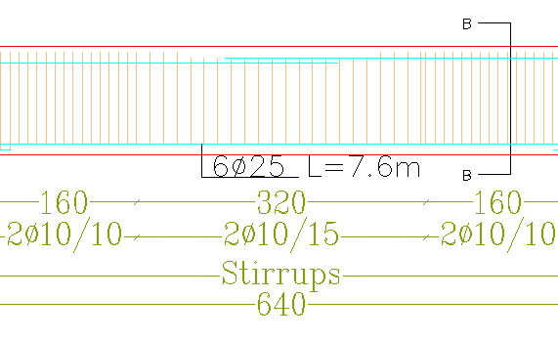
Structural Design
    2. Main Beam Design :

Slide 38
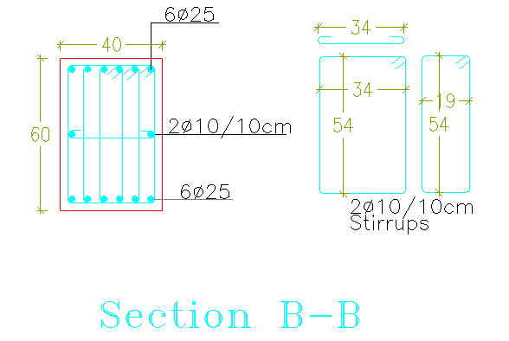
Structural Design
    2. Main Beam Design :

Slide 39
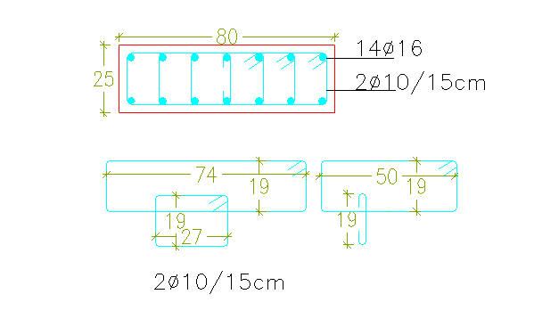
Structural Design
    3. Column Design :

Slide 40
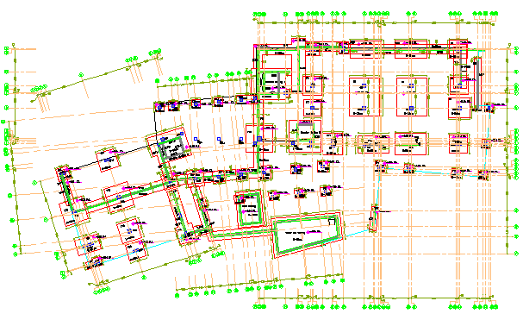
Structural Design
    4. Footing Design :

Slide 41
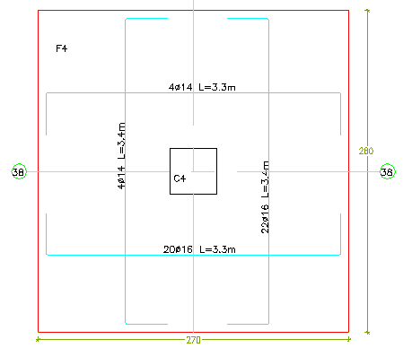
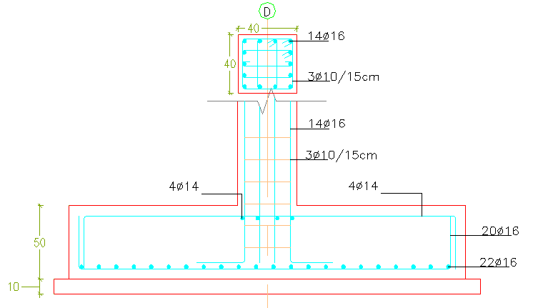
Structural Design
    Footing design
    (Isolated Footing):

Slide 42
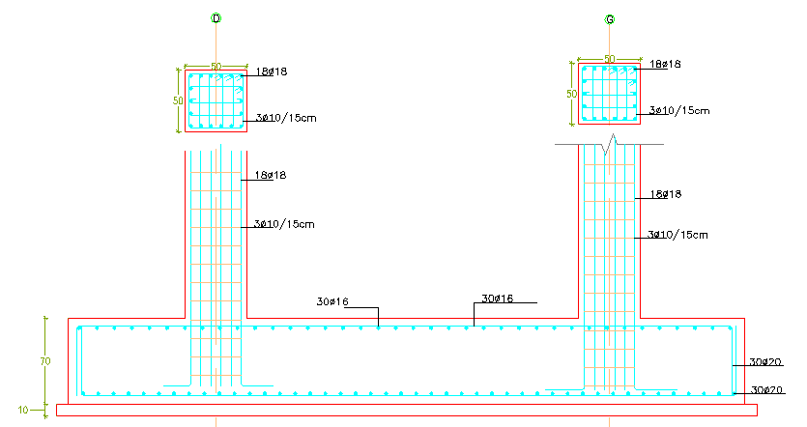
Structural Design
    Footing Design
    (Combined Footing):

Slide 43
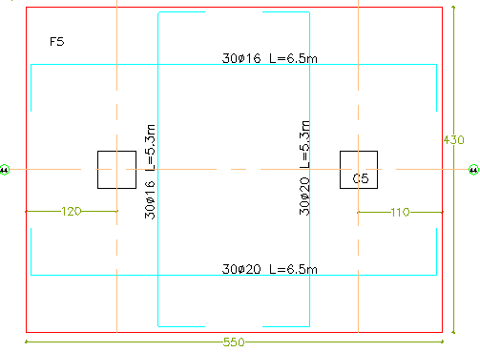
Structural Design
    Footing Design
    (Combined Footing):

Slide 44
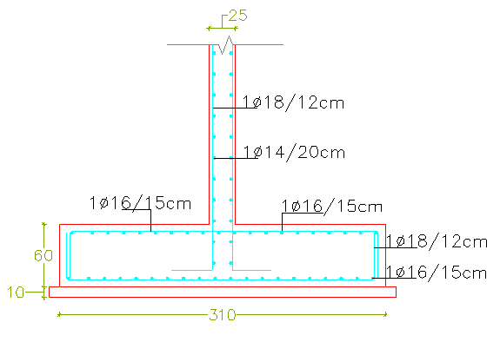
Structural Design
    4. Footing Design
    (Wall Footing):

Slide 45
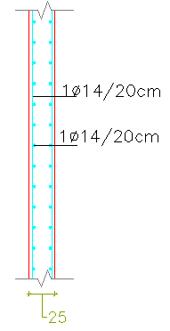
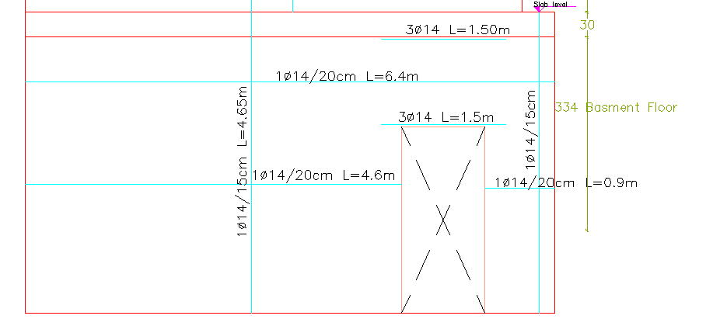
Structural Design
    5. Shear wall design :

Slide 46
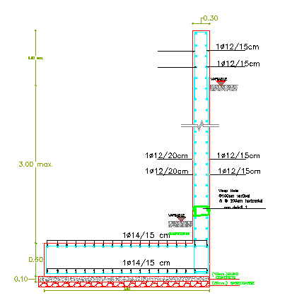
Structural Design
    6. Retaining Wall Design :

Slide 47
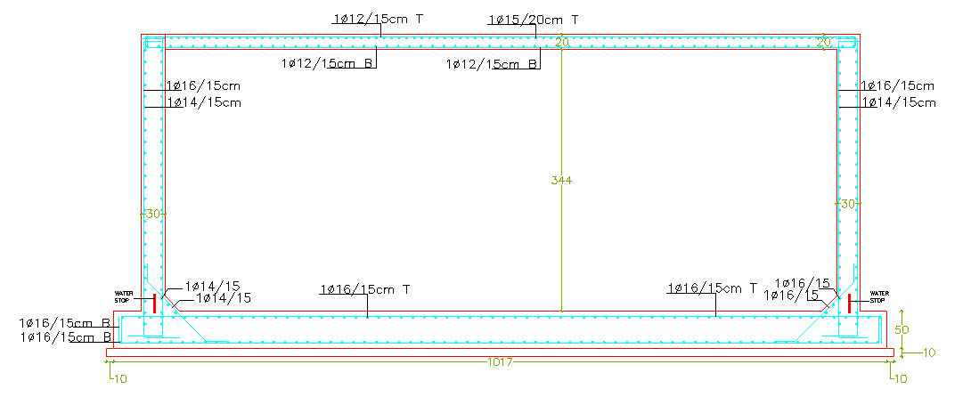
Structural Design
    7. Water tank design :

Slide 48
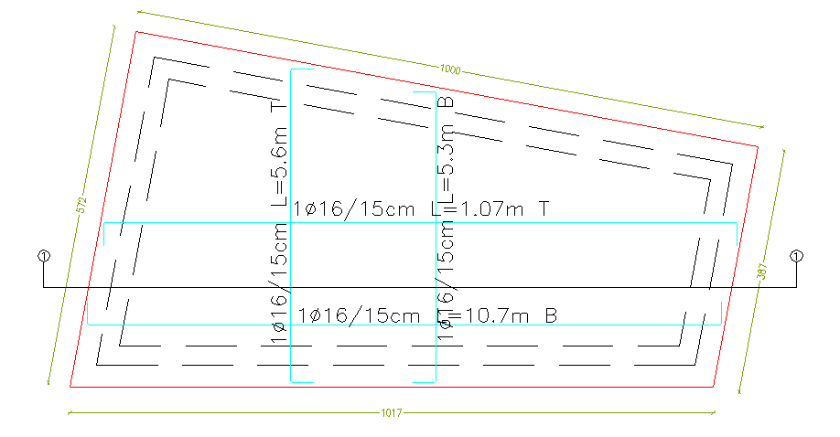
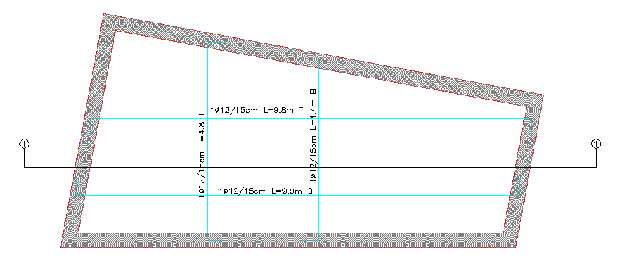
Structural Design
    Water tank design :

Slide 49
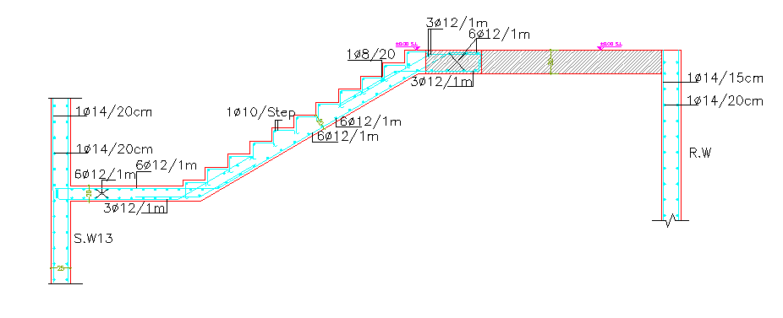
Structural Design
    8. Stairs design :

Slide 50
Environmental Design

Slide 51
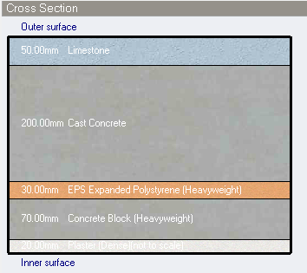
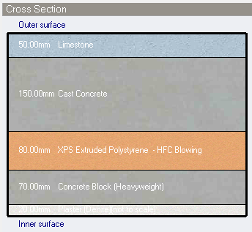
Environmental Design
DesignBuilder Was used for Thermal performance analysis and Simulation
1. Insulation : insolation increased from 3cm to 8cm.
Layers of external walls in original building
U(original) = 0.757 W/m²-k
Layers of external walls after modified building
U(modified) = 0.324W/m²-k

Slide 52
Environmental Design
2. Selection of optimum glass : Dbl LoE Spec Sel Clr 6mm/13mm Arg
Thermal properties of glass:
3. We used efficient lighting by using LED lamps
4. We used linear control of lighting, to integrate daylighting and artificial lighting for energy saving
Total solar transmission (SHGC) | 0.419
Direct solar transmission | 0.345
Light transmission | 0.8
U-value (W/m²-k) | 1.338

Slide 53
Environmental Design
5. Mixed Mode of Mechanical ventilation and natural ventilation
6. Shading:
In the south windows we used one horizontal louver above the window and vertical louvers in both left and right of the windows.
In south curtain wall in reception block we used solar pergola .

Slide 54
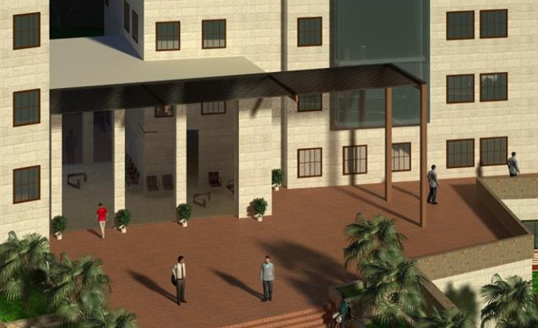
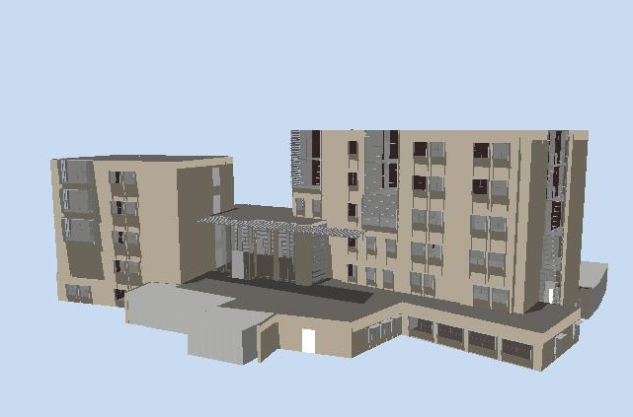
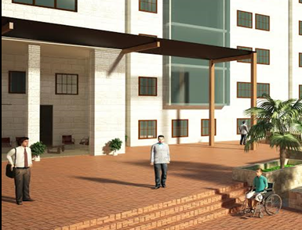
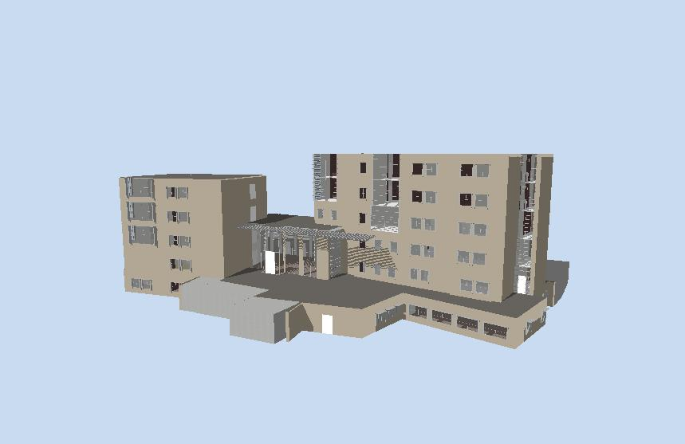
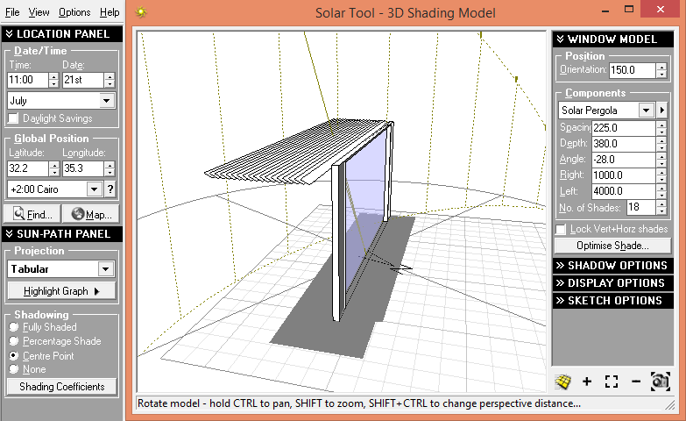
Shading
Building in summer
Building in winter

Slide 55

Environmental Design Results - Simulation
Energy consumption intensity per total building area in after modification
= 152.86 kWh/m²
For original design = 270.32 kWh/m²
The energy consumption
intensity per total building
area was reduced by 44%
from original design
The design is energy efficient
Simulation internal gain and solar for after modified building
The Energy Intensity baseline = 396 kWh/m²
The energy consumption intensity for after modification is less than 40 % of the energy intensity baseline

Slide 56

Environmental Design Results - Simulation
Simulation figure for Fanger PMV for thermal comfort of modified building
range between -1.5 and +0.56

Slide 57


Environmental Design Results – Heating Design
        Heating Load design:
Total design heating capacity for original building = 126.84 kW.
Total design heating capacity for after modified building = 84.67 kW.
Heating Capacity was reduced by 30.9% from original design.
District heating intensity per total building area in original design = 50.45 KWhr/m²
District heating intensity per total building area in after modified design = 47.55 KWhr/m²
Heating loads for after modified building
Total heating loads for after modified building

Slide 58

Environmental Design Results – Cooling Design
        Cooling Load design:
Total design cooling capacity for original building = 352.59 kW
Total design cooling capacity for after modified building = 273.33 kW
The total cooling was reduced by 22.5% from original design
District cooling intensity per total building area in after modified design = 54.69 KWh/m²
District cooling intensity per total building area in original design = 109.38 KWh/m²
The district cooling intensity per
total building area was reduced
by 50% from original design
Cooling loads for after modified building

Slide 59

Daylight Analysis
Reception hall:
Type of glass used: Dbl LoE Spec Sel Clr 6mm/13mm Arg
Light transmission = 80%
Average calculated DF= 3.87%
Recommend value from
specifications = 325/9500=3.42%
Calculated value> Required
Pass
Daylight factor diagram for reception hall
Generated by DesignBuilder

Slide 60

Daylight Analysis
The most case was passed except the following :
Art Room:
Average calculated DF= 4.28%
Recommend value from specifications = 540/9500=5.68%
Calculated value < Required
So this value will be compensated by
artificial lighting using the sensor to
control lighting level in the space to
provide the required value.
Daylight factor diagram for art room generated
by Design Builder

Slide 61

Daylight Analysis
Bedroom:
Average calculated DF= 2.94%
Recommend value from specifications = 325/9500=3.42%
Calculated value < Required
So this value will be compensated by artificial
lighting using the sensor to control lighting level
in the space to provide the required value.
Daylight factor diagram for bedroom by Design Builder

Slide 62
Acoustical Design

Slide 63

Acoustical Design
Absorptive materials we used in the building:
Acoustic wall panels
NRC vary from 0.5 to 0.85

Slide 64

Acoustical Design
Acoustic tiles
NRC vary from 0.45 to 0.95

Slide 65

Acoustical Design
Floor rubber tiles
Sound absorbent : elasticity can reduce noise from walking and wheel chairs by up to 18 decibels.
Resistance to heavy impact loads.
No health or environmental concerns.
Recyclable.
Easy to maintain.

Slide 66

Acoustical Design
Sound Transmission Class (STC):
 | STC values | Recommended values
Bed room to bed room | >52 | 52
Offices | 52 | Min 45
Impact Insulation Class (IIC):
Using rubber tiles will increase IIC .
Using high pile carpet in physiological room will improve IIC by 24 dB or more.

Slide 67

Acoustical Design
Reverberation Time (RT60):
A sample of therapy room

Slide 68

Acoustical Design
Reverberation Time (RT60) results before improving :

Slide 69

Acoustical Design
Reverberation Time (RT60) after improving :
Acoustic tiles
Acoustic wall panels
Floor rubber tiles

Slide 70

Acoustical Design
Reverberation Time (RT60) after improving :

Slide 71

Acoustical Design
Reverberation Time (RT60):
Reception hall

Slide 72

Acoustical Design
Reverberation Time (RT60) before improving :

Slide 73

Acoustical Design
Reverberation Time (RT60) after improving :
Acoustic tiles
Low-E (Double glass)
Floor rubber tiles

Slide 74

Acoustical Design
Reverberation Time (RT60):
Reception hall

Slide 75

Acoustical Design
Reverberation Time (RT60):
Meeting room

Slide 76

Acoustical Design
Reverberation Time (RT60):

Slide 77


Acoustical Design
Reinforcement Sound System:
Angle of sound distribution for the selected type = 70˚
BOSCH LBD 0606/10

Slide 78

Acoustical Design
Reinforcement Sound system Distribution:

Slide 79

Acoustical Design
Distribution of loudspeaker in reception hall ceiling

Slide 80

Electrical Design

Slide 81



Artificial Lighting Design

Slide 82



Artificial Lighting Design
Main Types of lamps:

Slide 83

Artificial Lighting Design
Therapy room:
Illuminance level in therapy room
= 500 -540 Lux

Slide 84



Artificial Lighting Design
Average illuminance on therapy workplace =537 Lux
Uniformity =0.58
Max. UGR =19.6

Slide 85

Artificial Lighting Design
Multi-purpose
/meeting room:
Illuminance level in =500lux

Slide 86



Artificial Lighting Design
Average illuminance on therapy workplace = 541 Lux
Uniformity =0.57
Max. UGR =18.5

Slide 87

Artificial Lighting Design
Reception hall
Required illuminance level in
=300- 325 lux

Slide 88


Artificial Lighting Design
Average illuminance on therapy workplace = 346 Lux
Uniformity =0.55
Max. UGR =19.3

Slide 89


Artificial Lighting Design
Water pool
Average illuminance = 245
Average illuminance = 531
Lounge room

Slide 90


Electrical Design
    Sockets calculation
    Lighting calculation

Slide 91


Artificial Lighting Design
    Sockets Arrangement
    Lighting arrangement
Pass
Pass

Slide 92

Mechanical Design

Slide 93


Water Supply Design

Slide 94


Water Supply Design
small roof tank (10m³) with basement water wall (110m³) and pump is used according two reasons:
1- Small water tank is to ensure adequate water pressure in the building. And it allows the user to have both water pressure and water supply in case where there is no electrical power.
2- Basement wall and pump is to minimizing the possible seismic load in the building.

Slide 95


Water Supply Design
Water supply for fourth floor

Slide 96


Water Supply Design
Drainage system for ground floor

Slide 97

Rain Drainage System
Roof and Storm water Drainage

Slide 98




HVAC System Design
We use VAV terminal unit, variant TVT type for all building
Total design cooling capacity = 273.33 kW
Diffuser selection:
We selected 450*450 mm size
and air flow is 304 L/S
For ground floor right block :

Slide 99


HVAC System Design
For ground floor block right we used VAV terminal unit, variant TVT 600 x 400 (2450 L/S) system
Duct design
Number of diffuser

Slide 100




HVAC System Design
Mechanical shaft system in WC
HVAC detail:

Slide 101

Safety Design

Slide 102


Safety Design
Emergency Exists for ground floor

Slide 103





Safety Design
Types of fire systems:

Slide 104


Safety Design
Fire hose
Emergency stairs
Extinguishers
DOME COLOR CAMERA
EXTERNAL CAMERA
Fire hose
Sprinkler
Smoke detector

Slide 105


Quantity Surveying

Slide 106
Quantity Surveying
Total cost of building = 6,495,654 NIS.
Unit cost of building = 6,495,654 / 4,518 = 1,438 NIS/m²

