Slide 1
Causes and effects of delayed payments in public projects
By :
Lana Juma
Hend Taha
Under Supervision of : Dr.Reema Nassar
  2024

Slide 2
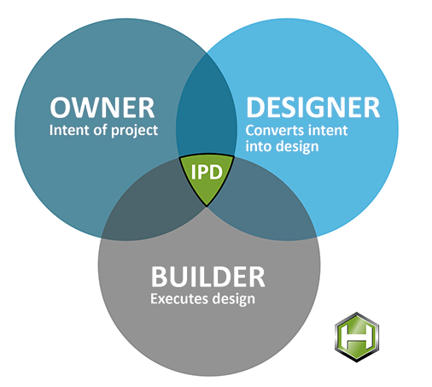
Project construction
Project participants:

