Slide 1
Smart Windows
Students:
Ghadeer Bdair.
Anwar sholi.
Supervisor:
Dr. Hanal Abu Zant.

Slide 2
Outline
The objective of the project.
Project life-cycle.
Tools.
Constraints.
Future Work.
Demo.

Slide 3
The objective
To get rid of curtains.
To clean windows manually or automatically without any human efforts.
To know the ambient temperature.

Slide 4
Game life-cycle
Skelton
Preparing
PDLC circuit
Wiper circuit
Start
Temperature circuit

Slide 5
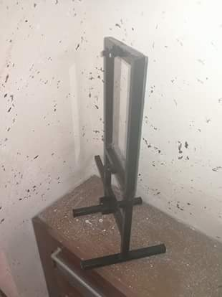
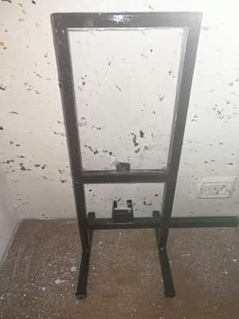
1. Glass & Iron Preparing
Skelton Preparing:

Slide 6
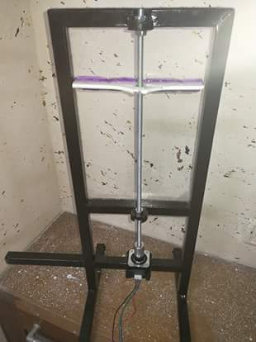
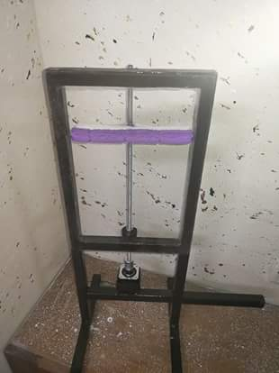
2. Adding Wiper and stepper motor.

Slide 7
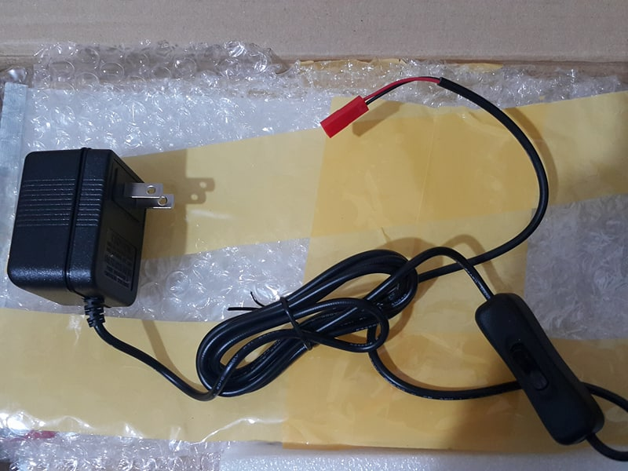
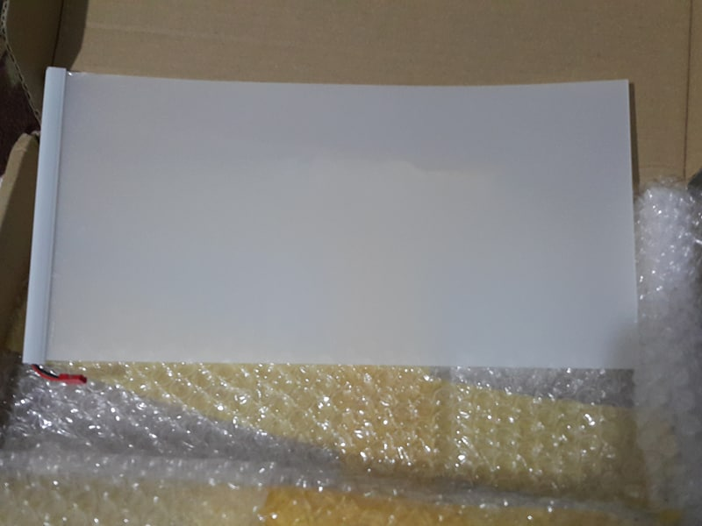
PDLC Principle

Slide 8
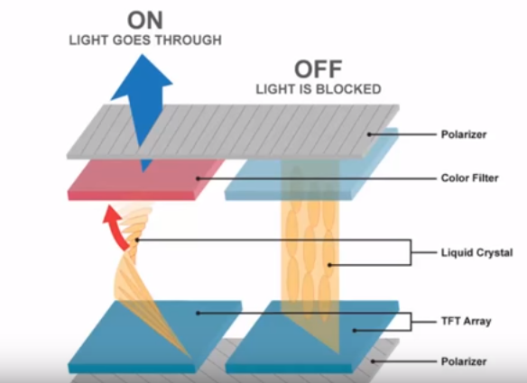
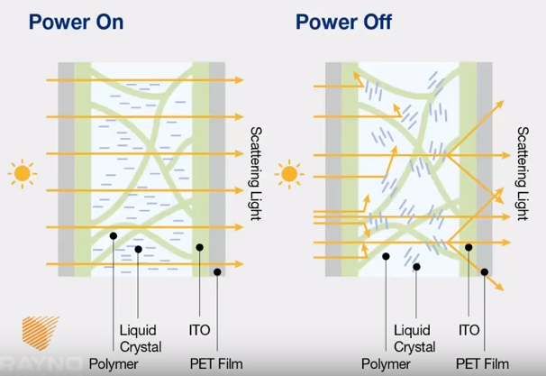
PDLC components.

Slide 9
1. Controlling PDLC automatically:
By default it is automatic, depending on LED sensor.
We controlled the transparency degree of the PDLC using a light sensor that measures the intensity of the light outside the home.
1. If it high (middle of the day) the PDLC will be transparent.
2. If the intensity of the light was low then the PDLC will be dark.

Slide 10
2. Controlling PDLC manually:
At first, the user send capital 'M' character to the Arduino, and then he can send one of the characters in the range A-F, each one of these characters represent a transparency degree of the PDLC.
A: B: F:
Note: If we in the manual mode and want to return to the automatic mode then we send ‘O’ to the Arduino using Btduino application.

Slide 11
wiper Principle
1. Controlling wiper automatically:
By default it is automatic.
The wiper automatically moved from above to below and vice versa each three minutes.
1. Controlling wiper manually :
At first, the user send small 'm' character to the Arduino, and then he can send small 'r' character to move the wiper up if it was down and down if it was up.

Slide 12
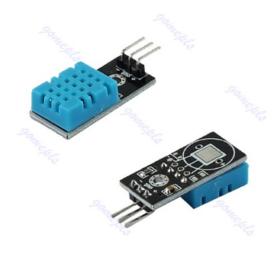
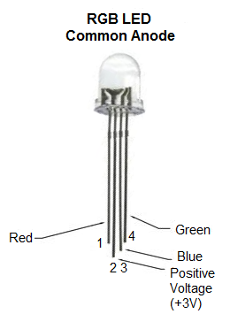
Temperature displaying Principle
We use DHT11 Humidity and Temperature Sensor to measure the temperature outside and display the read value on the RGB LED.
DHT11 Sensor
RGB LED

Slide 13
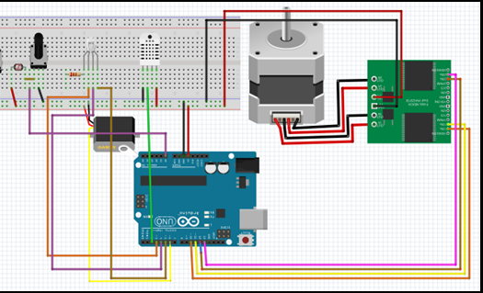
The Whole Circuit
The whole circuit of this project is designed using the software 123D circuit

Slide 14
Tools
ARDUINO 1.8.5 software.
BTduino Mobile Application.

Slide 15
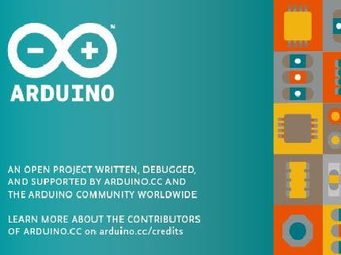
ARDUINO 1.8.5
The open-source Arduino Software (IDE) makes it easy to write code and upload it to the board. It runs on Windows, Mac OS X, and Linux. The environment is written in Java and based on Processing and other open-source software. .

Slide 16
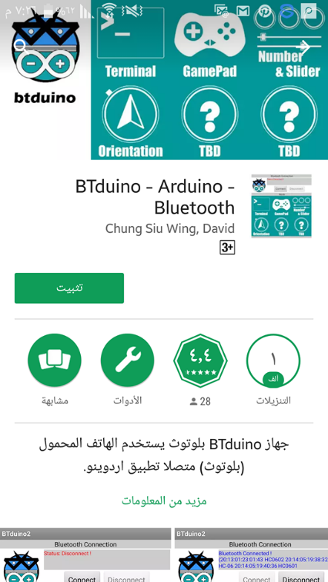
BTduino Mobile Application
The main concept of the BTduino app is to send data through the serial interface in text form. Every set of data contains the name of the event, a colon and the value.

Slide 17
Constraints
We took one month in waiting for PDLC, which is not existed, in our country, which limited our trial and limited the options could be added to the whole project.
The PDLC has burned after one day since the day of starting the use of it for unknown reasons. Then we ordered another one, and actually it reached after 15 days.

Slide 18
Future Work
Storing solar power.
Developing separate application to control it.

Slide 19
Demo

Slide 20
Any Questions?
Thank you!

