Slide 1
Haifa Project
Supervisor: D.Mohammad Dwikat
Presented by : Mahmoud A Nasra
Shayma M Zyoud

Slide 2
RFM Model
What’s RFM ?
RFM is a method used for analyzing customer value. It is commonly used in database marketing and direct marketing and has received particular attention in retail and professional services industries.
RFM History .
direct mailing marketers for non profit organizations . (people who donated once were more likely to donate again ).
RFM Model Importance .
determine how to improve customer retention and focus marketing efforts.

Slide 3
Data Requirements & Model description
Minimum data requirements
Transaction Date .
Amount of transaction.
Customer identifier .
Model Description :
recency score.
frequency score.
monetary score.

Slide 4
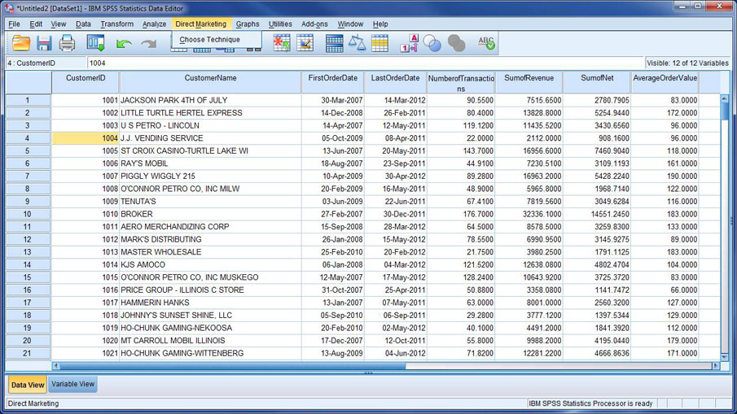
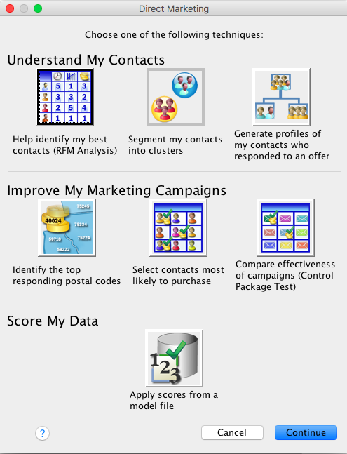
Model figuration

Slide 5
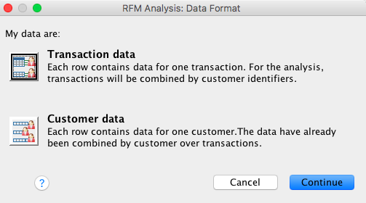
Model figuration cont.

Slide 6
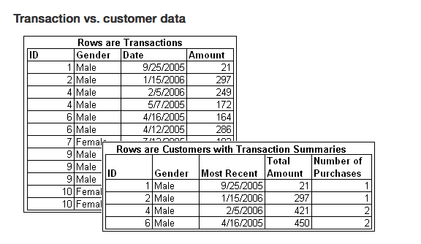
Model figuration cont.

Slide 7
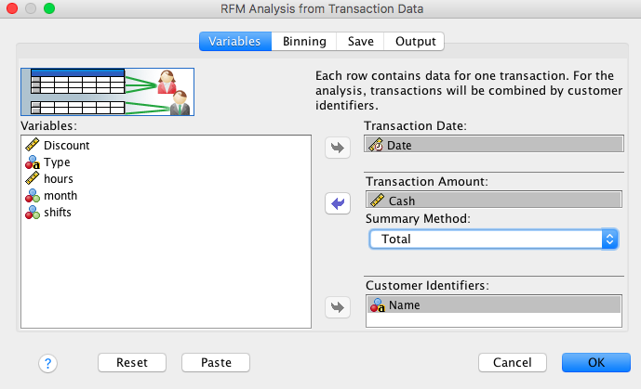
Model figuration cont.

Slide 8
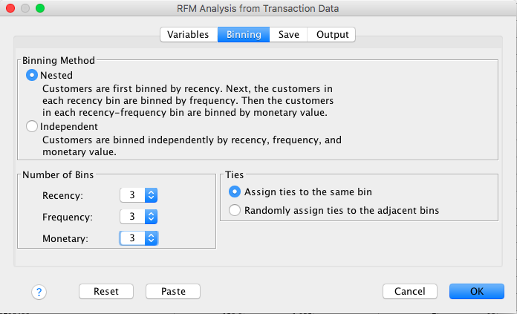
Model figuration cont.

Slide 9
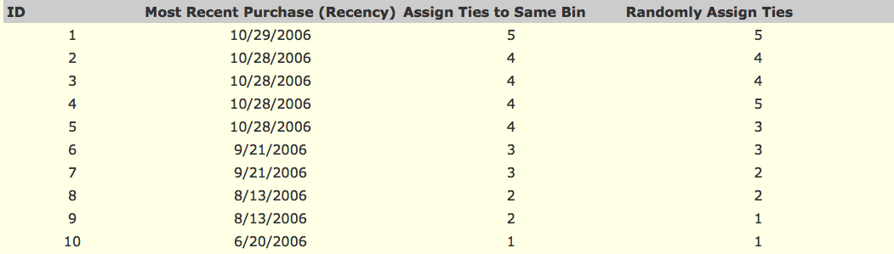
Model figuration cont.

Slide 10
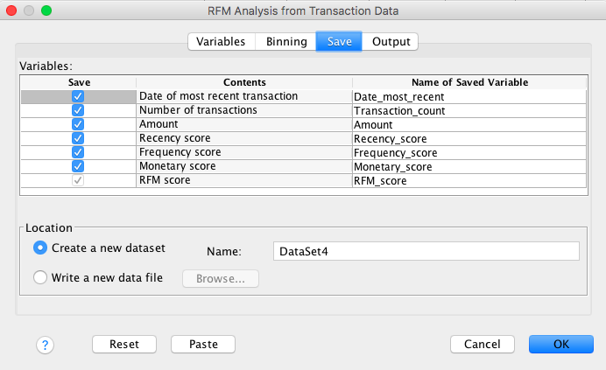
Model figuration cont.

Slide 11
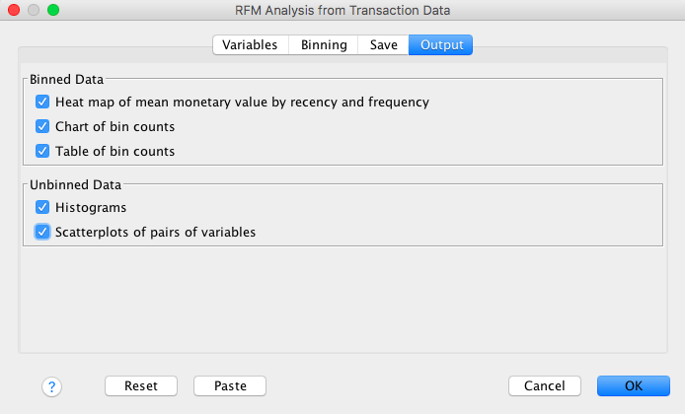
Model figuration cont.

Slide 12
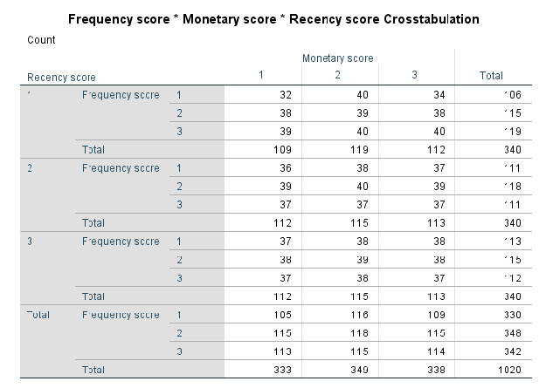
Results ( Score 3 )

Slide 13
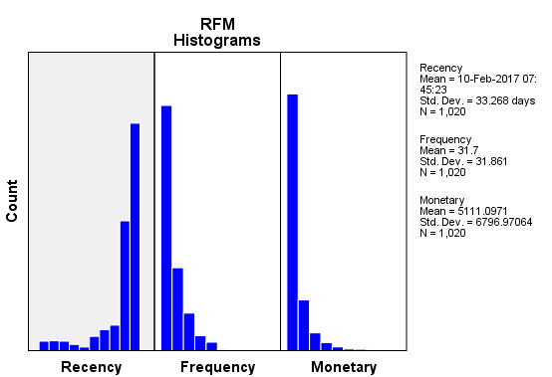
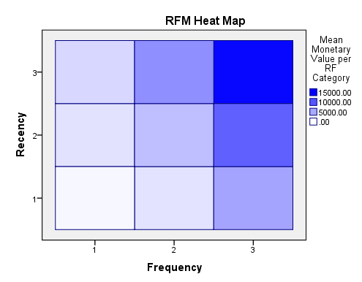
Results ( Score 3 )

Slide 14
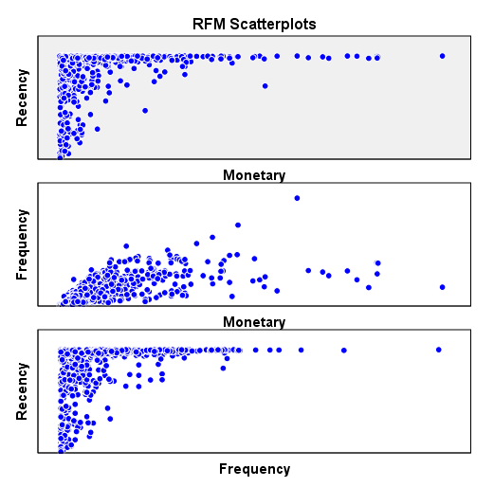
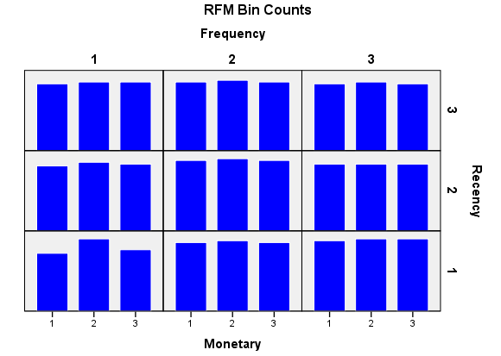
Results ( Score 3 )

Slide 15
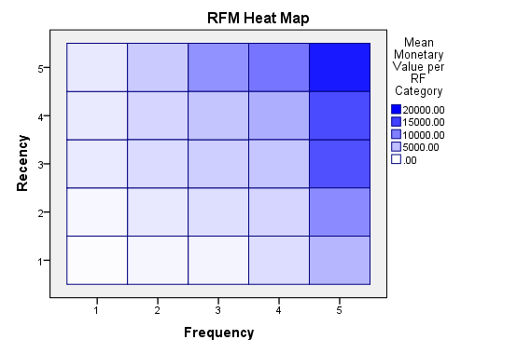
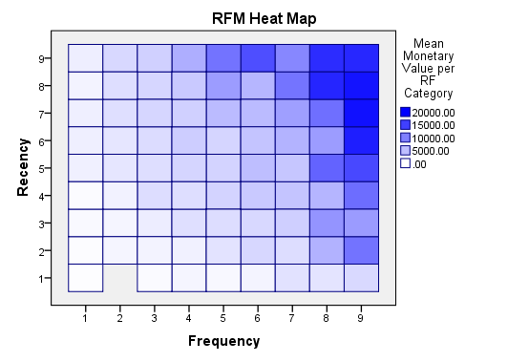
Result Comparison

Slide 16
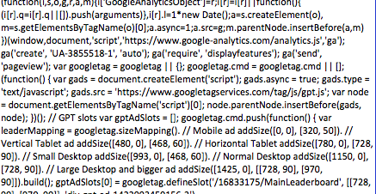
Challenges
1.Data Acquisition
Open web page
Save as page source
Open via excel
Delete scripts(useless data)
Save new data

Slide 17
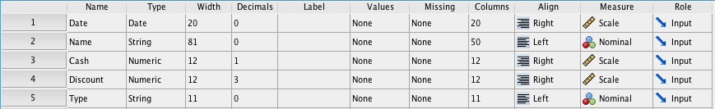
Challenges
2.Merging :
merge the data together so we can apply the RFM analysis , but the data couldn’t be merged because the width of some variables were unequal and to merge them they need to be equal in width .
for the Date it wasn’t the width the only problem the type was too .
Because of this Date problem it didn’t show the date and it was invisible we modified it and the merge was successful and was done correctly .

Slide 18
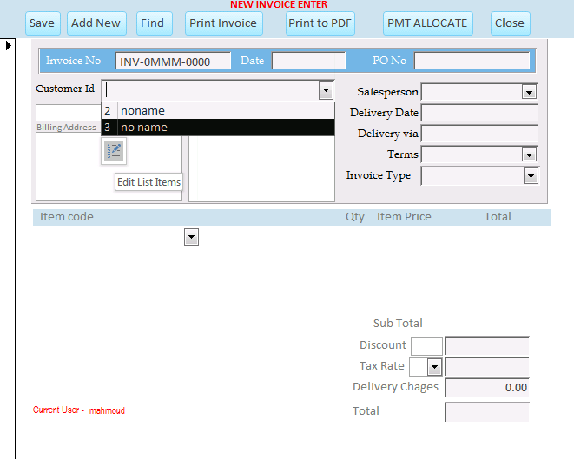
Challenges
3.Customers without a card :
Here we decided to use a
tool called
“WYGW Invoicing Billing &
Inventory Control System”
this tool help solving this problem
by adding new customers
to the database (that could
be imported to excel ) .
New customer

Slide 19
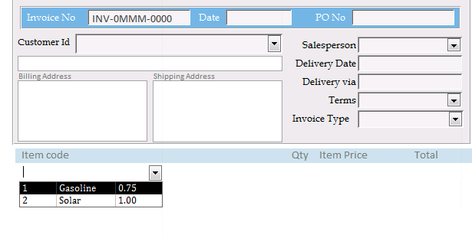
Challenges

Slide 20
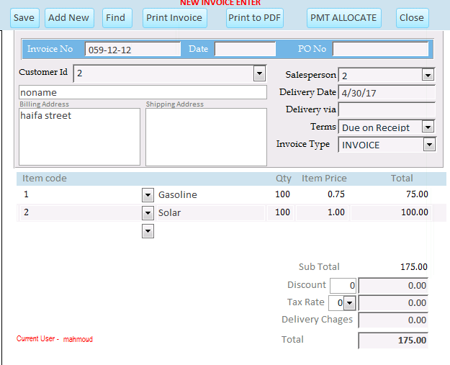
Challenges

Slide 21
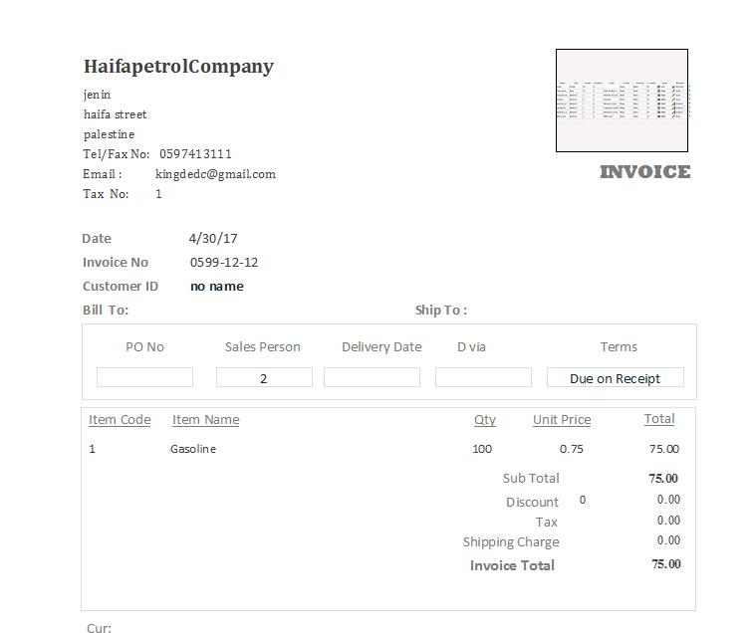
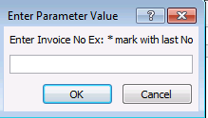
Challenges
Printing the invoice

Slide 22
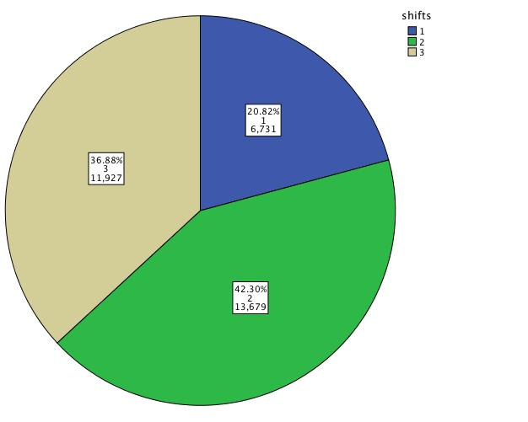
Customer census
1.Number of customers within ALL Shifts :
Shift 1 (00 to 08)
Shift 2 (09 to 16)
Shift 3 (17 to 24)

Slide 23
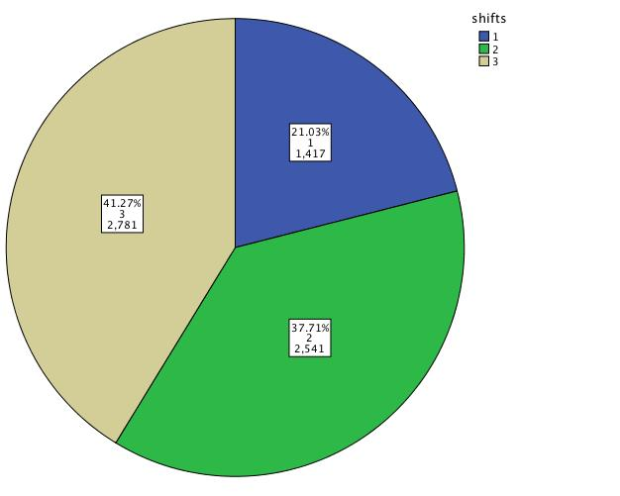
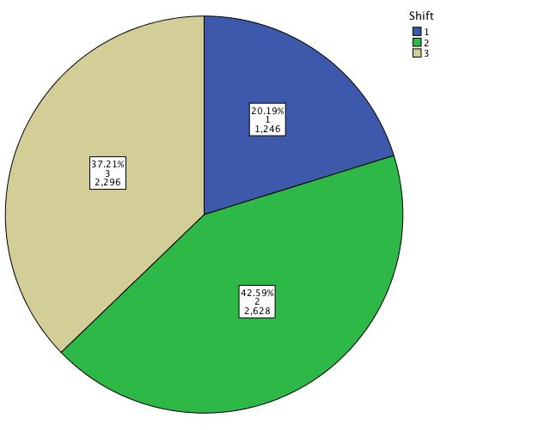
Customer census
October
November

Slide 24
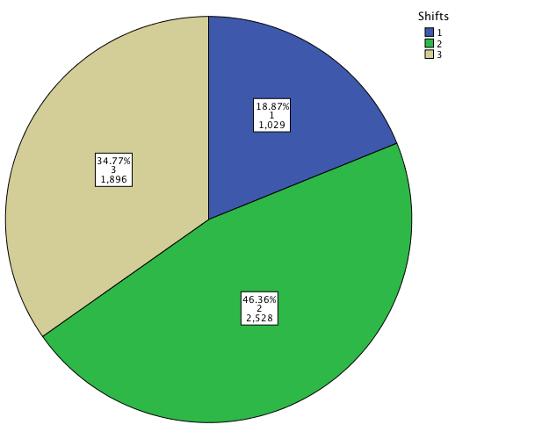
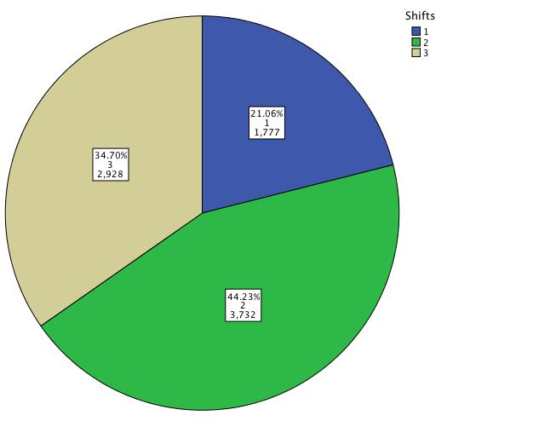
Customer census
December
January
February

Slide 25
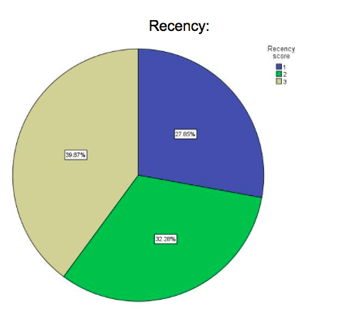
Customer census
2.Number of transactions according to (Recency, Frequency, Monetary score) /shift within all months:
Shift 1 :
Recency score 1 =27.85%
Recency score 2 =32.26%
Recency score 3 =39.87%

Slide 26
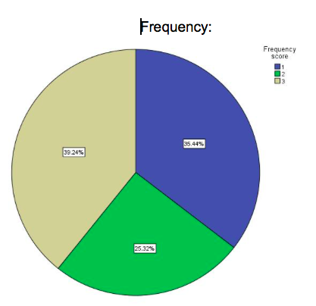
Customer census
2.Number of transactions according to (Recency, Frequency, Monetary score) /shift within all months:
Shift 1 :
Frequency score 1 =35.44%
Frequency score 2 =25.32%
Frequency score 3 =39.24%

Slide 27
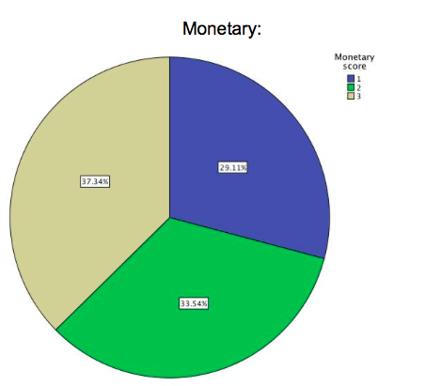
Customer census
2.Number of transactions according to (Recency, Frequency, Monetary score) /shift within all months:
Shift 1 :
Monetary score 1 =29.11%
Monetary score 2 =37.34%
Monetary score 3 =33.54%
ALL

Slide 28
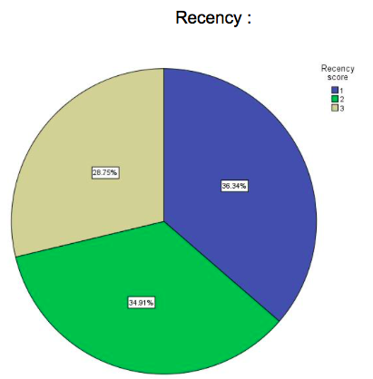
Customer census
2.Number of transactions according to (Recency, Frequency, Monetary score) /shift within all months:
Shift 2 :
Recency score 1 =36.34%
Recency score 2 =34.91%
Recency score 3 =28.75%

Slide 29
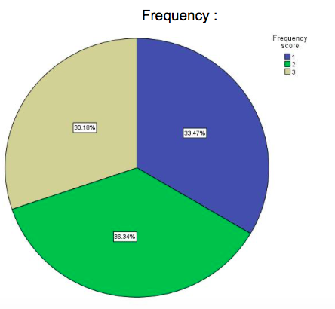
Customer census
2.Number of transactions according to (Recency, Frequency, Monetary score) /shift within all months:
Shift 2 :
Frequency score 1 =33.47%
Frequency score 2 =36.34%
Frequency score 3 =30.18%

Slide 30
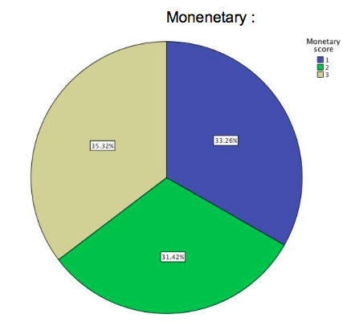
Customer census
2.Number of transactions according to (Recency, Frequency, Monetary score) /shift within all months:
Shift 2 :
Monetary score 1 =33.26%
Monetary score 2 =31.42%
Monetary score 3 =35.32%
ALL

Slide 31
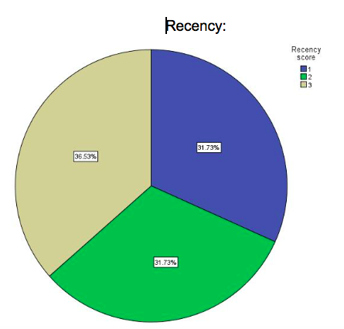
Customer census
2.Number of transactions according to (Recency, Frequency, Monetary score) /shift within all months:
Shift 3 :
Recency score 1 =31.73%
Recency score 2 =31.73%
Recency score 3 =36.53%

Slide 32
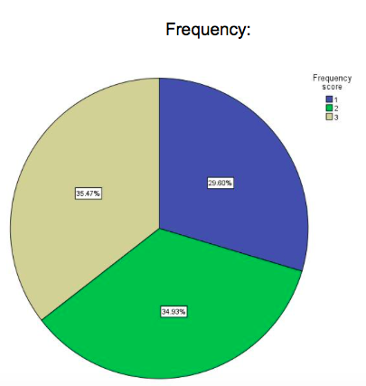
Customer census
2.Number of transactions according to (Recency, Frequency, Monetary score) /shift within all months:
Shift 3 :
Frequency score 1 =29.60%
Frequency score 2 =34.93%
Frequency score 3 =35.47%

Slide 33
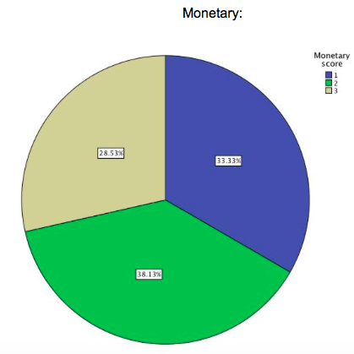
Customer census
2.Number of transactions according to (Recency, Frequency, Monetary score) /shift within all months:
Shift 3 :
Monetary score 1 =33.33%
Monetary score 2 =38.13%
Monetary score 3 =28.53%
ALL

Slide 34
summary
By focusing on the highest score which is 3 in each shift , SHIFT 1 has the highest factors’ score ; which indicates that SHIFT 1 has the best customers according to each factor (R recent date, F number of transactions , M amount of transactions).

