Slide 1

PLASTIC CLASSIFICATION
USING INFRARED RADIATION
supervised by: DR Manar Qamheieh

Slide 2

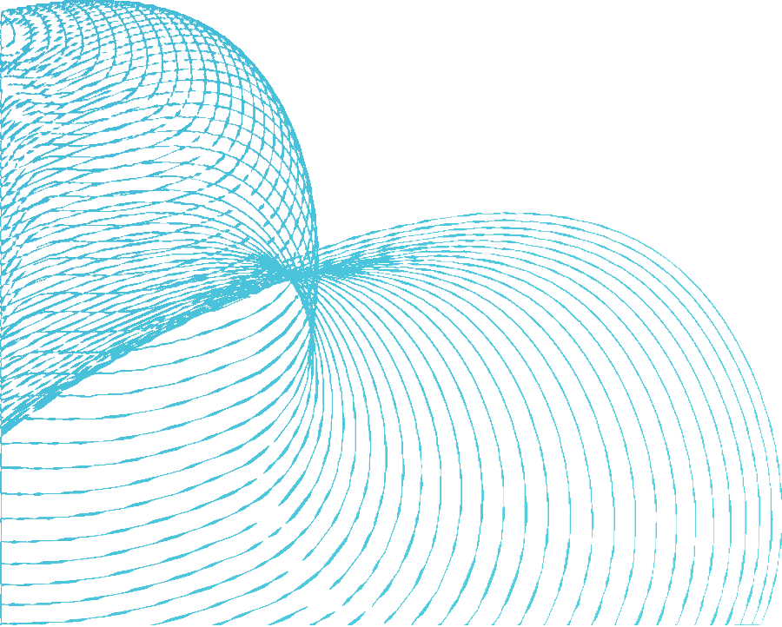
Manual classification in factories
PROBLEMS
large quantities of waste

Slide 3


SOLUTION
AUTOMATIC SEPARATION SYSTEM USING INFRARED RAYS

Slide 4
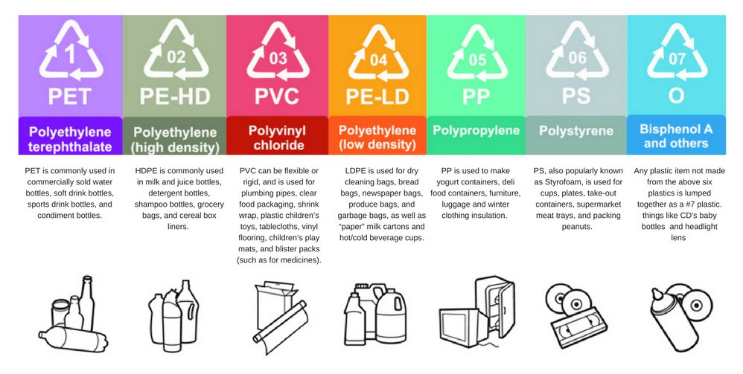
Selected types

Slide 5
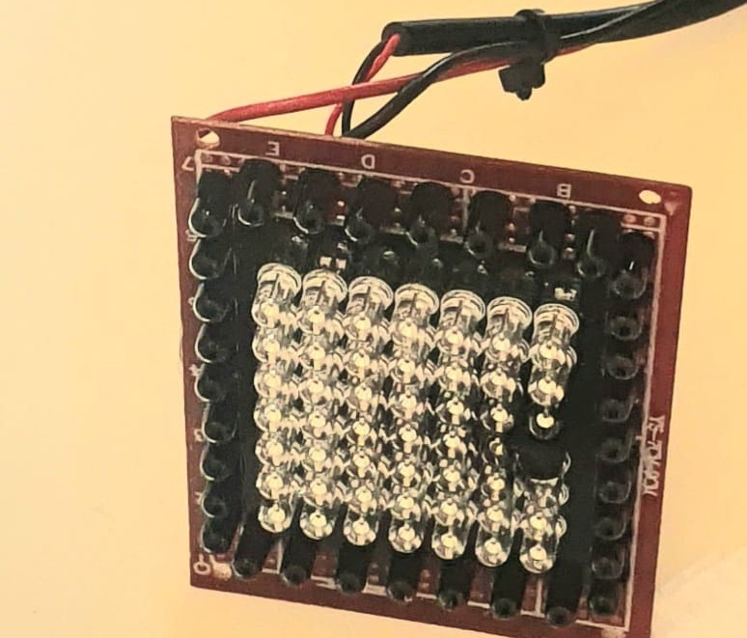
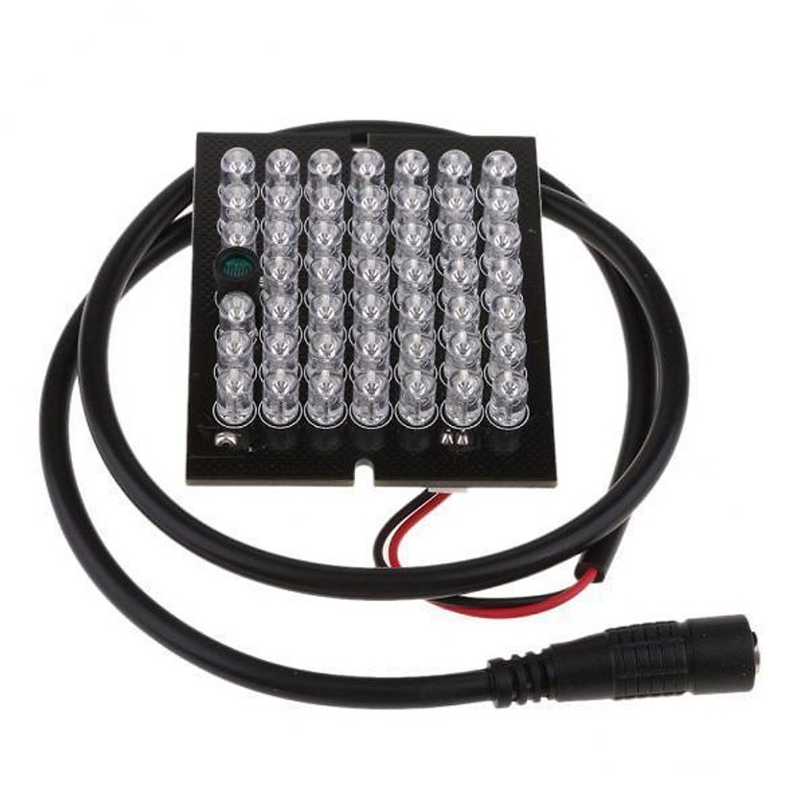
TESTING PROCESS

Slide 6
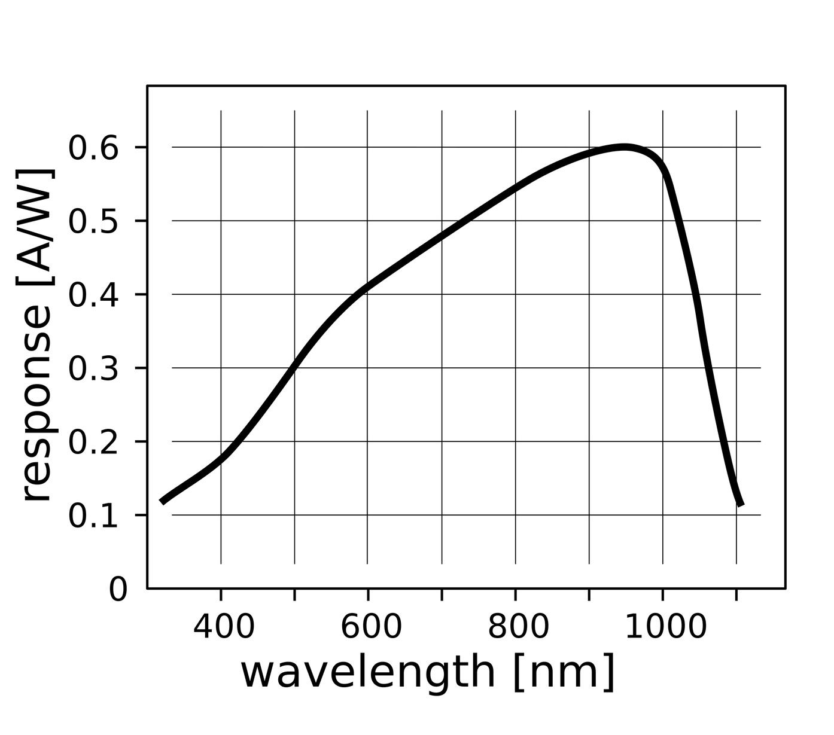

Slide 7
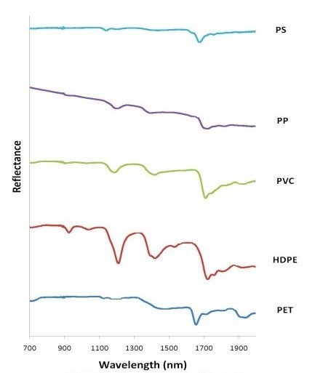
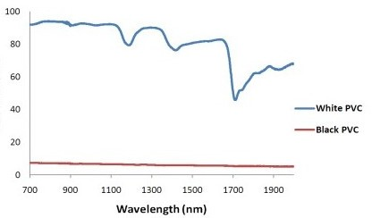
IR WORKING PRINCIPLE

Slide 8
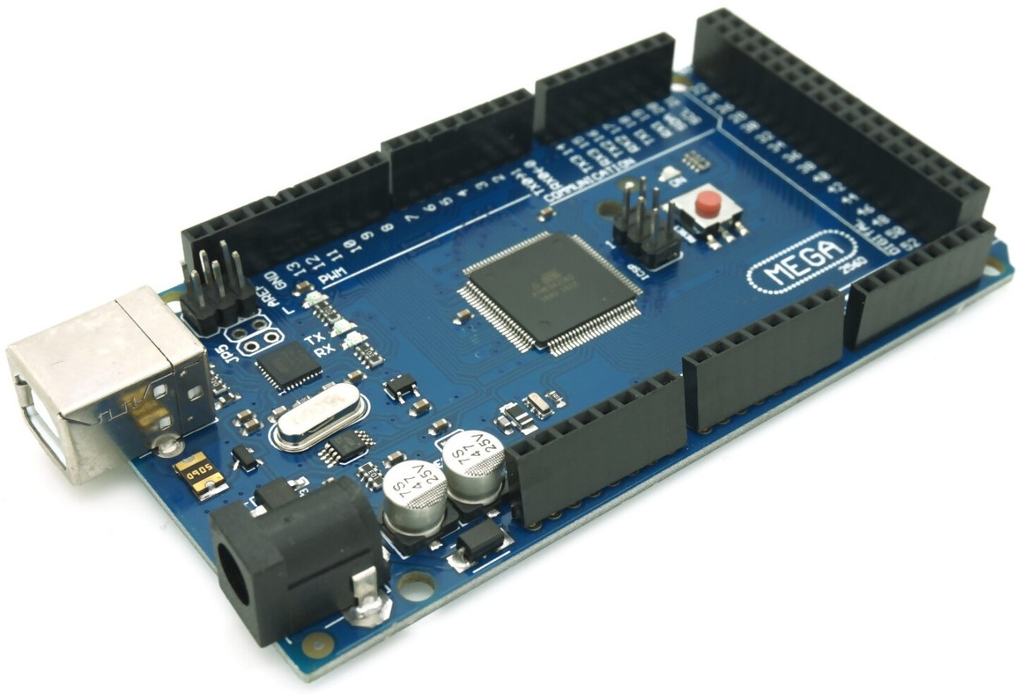

MICROCONTROLLER

Slide 9
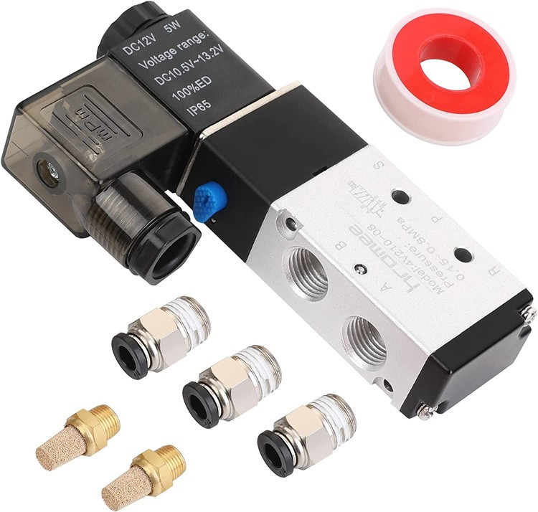
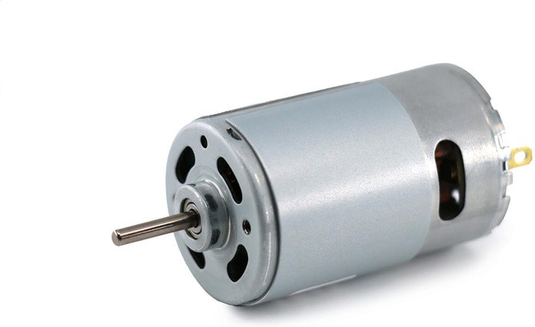

COMPONANTS

Slide 10
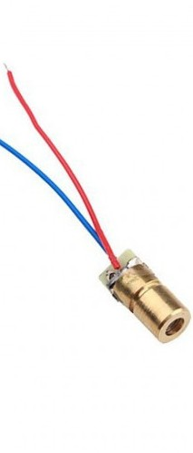

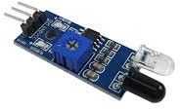
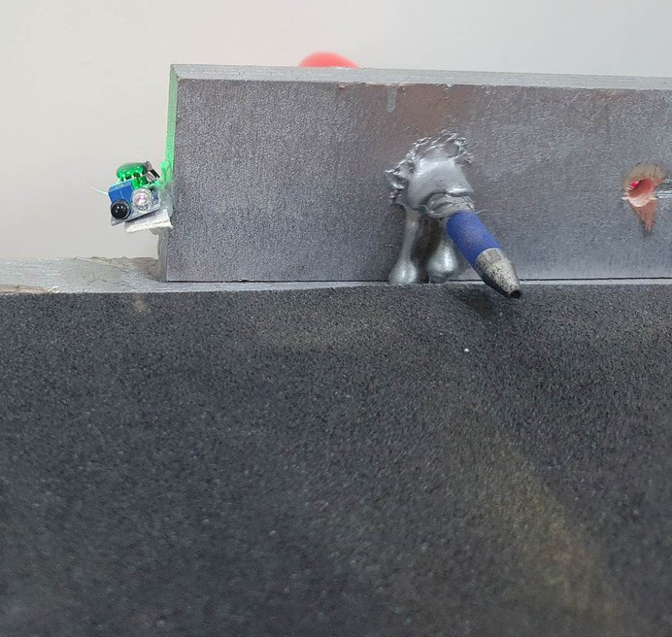
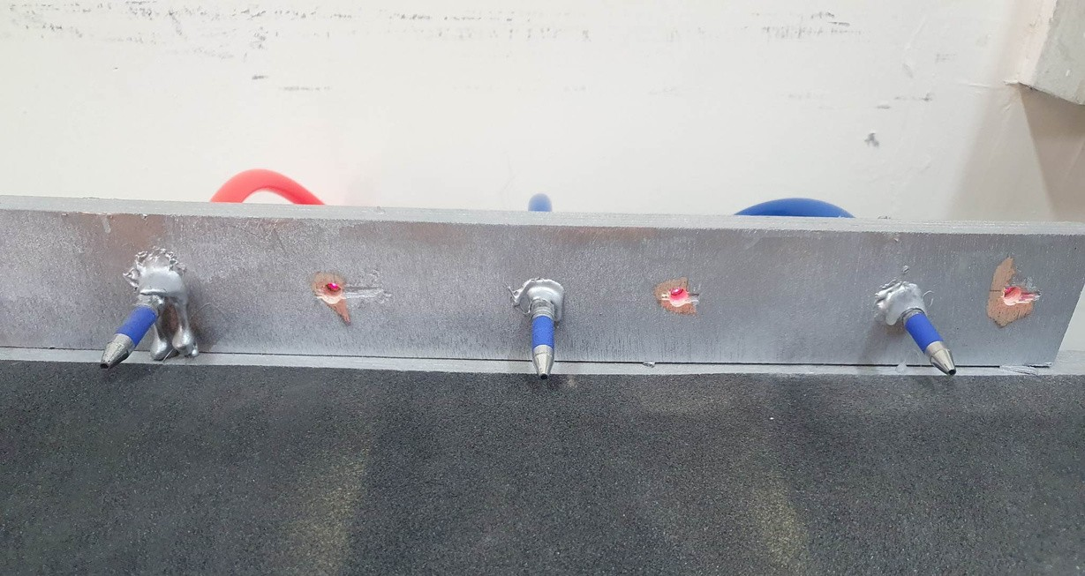

Slide 11
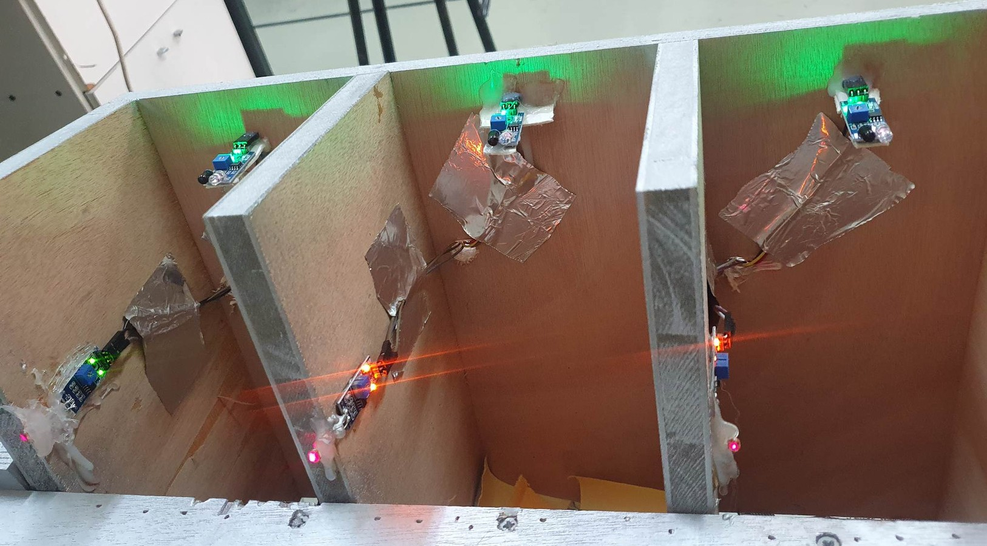

Slide 12

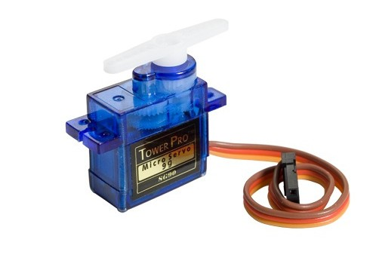
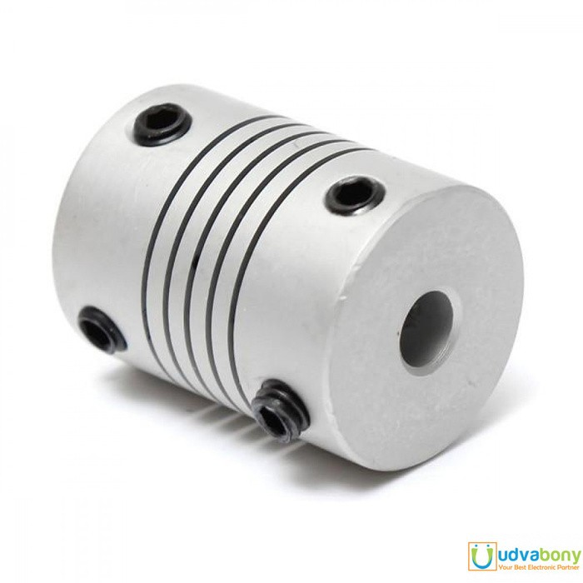

Slide 13

Time
Finding the proper IR LED
CONSTRAINTS
Building the project model to fit our needs

Slide 14

FUTURE WORK
COMPLETE THE CYCLE

Slide 15
THANK YOU

