Slide 1

The Strike Game
Seif darwazeh
Moath Antar
Superviser :
DR.Othman Othman

Slide 2
Content
Overview
Why Game ?
Describe of Game
structure of Game
Component of Game
Design of Game (code , design)
Tools Design
Game

Slide 3

Why Game ?
It has a large audience
Social Media includes Hundreds of thousands
Game To join more users

Slide 4
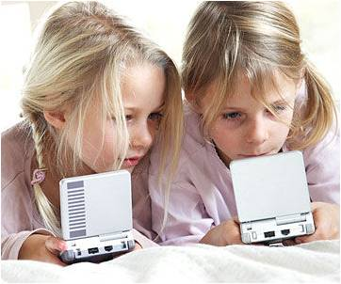
Why Game ?
Improve of Quick thinking & planning
video games can be a powerful
tool to help children develop
certain life skills

Slide 5

Overview
The Strike is Game 2D
Game is one shot
Game made with unity engine .
More level Game
Game Desktop
More Player's

Slide 6
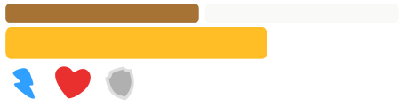

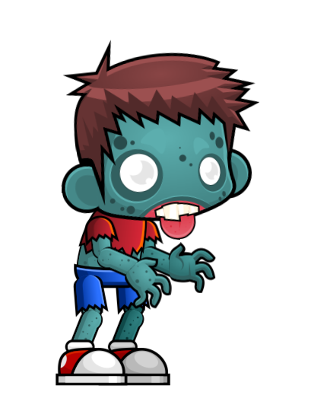
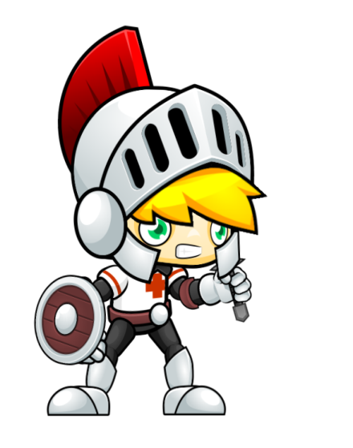


Game Component

Slide 7
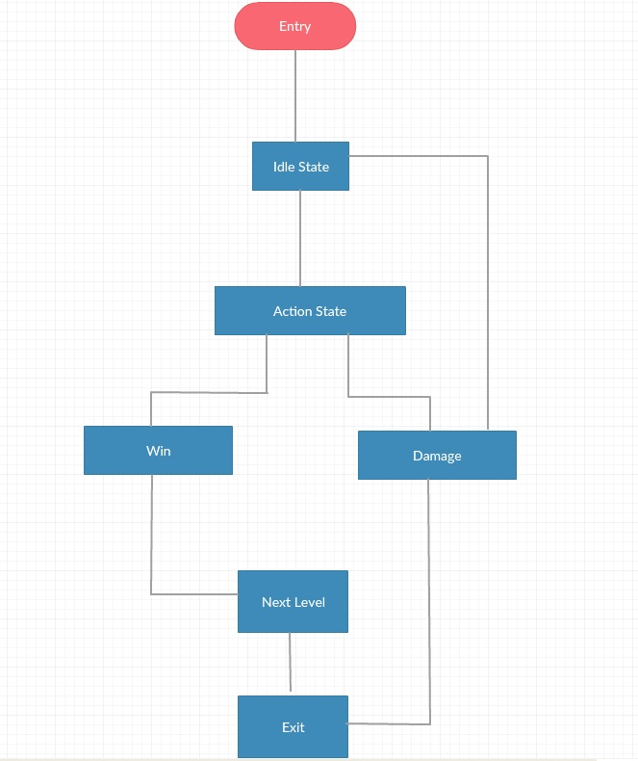
Structure Game

Slide 8

Game Interface
Main
Contains Button of :
Play
setting
face book

Slide 9
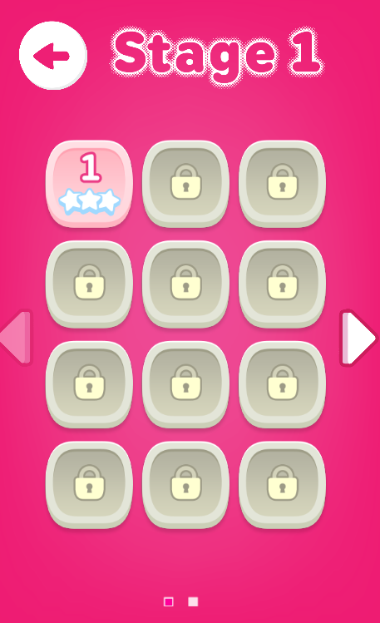
Game Interface
Stages
Contains of :
Levels
Using Data base (Can you continue
when finish Last time )

Slide 10
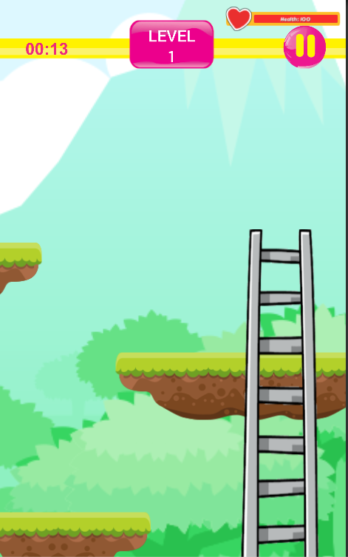
Game Interface
Game
Contains of :
Healthy bar
Coin
Player
Strike
Article
Dead zone
Win zone

Slide 11
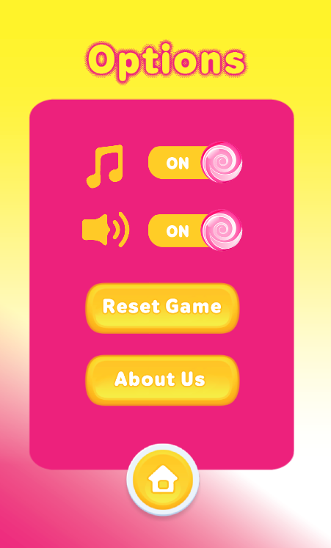
Game Interface
setting
Contains of :
Control sound
Reset game
about us
Return main layout

Slide 12
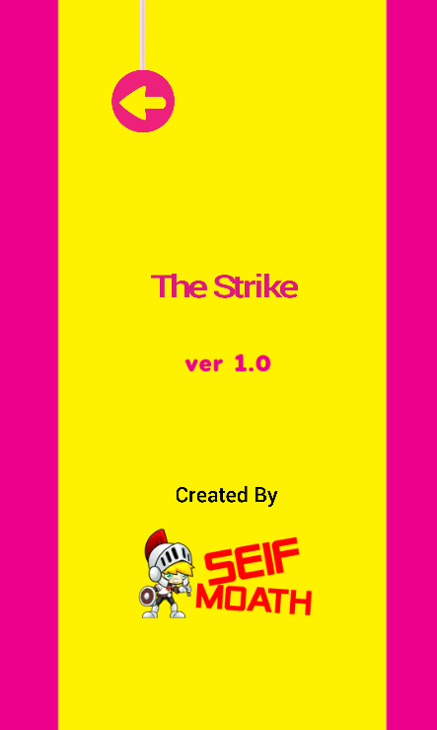
Game Interface
About Us
Contains of :
Information about Desiger
Of game
Back to main layout

Slide 13



Tool’s Using Game
unity engine
Photoshop
(Design background)
illustrator
(Design logo , character)

Slide 14
Thank You

