Slide 1

Data Analysis
The effectiveness of the application of e-learning at An-Najah National University, from the point of view of students.
مدى فاعلية تطبيق التعليم الالكتروني في جامعة النجاح الوطنية من وجهة نظر الطلاب.
Supervisor:
Dr. Mohammed Dwikat
Team Members:
Sereen Habaiba
Azza Zetawi

Slide 2

Outline
Introduction
Data Acquisition
Data Analysis
Recommendation

Slide 3
Introduction
Project Goals:
To measure the effectiveness of e-learning application at An-Najah National University, Birzeit University and the Arab American University were taken as a model
1.Measuring the extent of student satisfaction with himself
2.The extent of satisfaction with the evaluation methods and marks
3. Measuring student satisfaction with the teacher
4. Measuring the extent of benefit compared to face education
5. Measuring the level of satisfaction with internet services

Slide 4
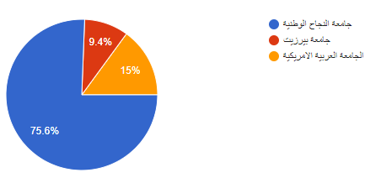
Data Acquisition
collect data by questioner and published it in three universities
Najah National University
Arab American University
Birzate University

Slide 5

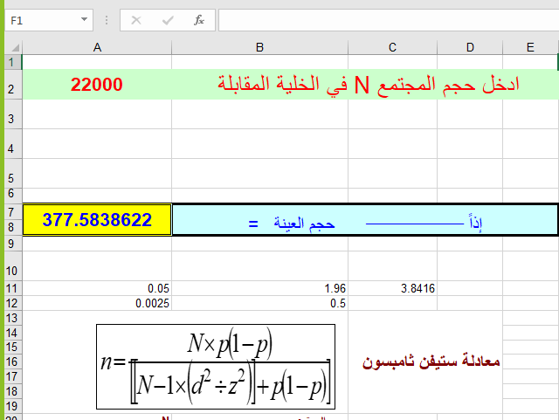

طريقة حساب حجم العينة عن طريق معادلة ستيفن ثامبسون

Slide 6


Data Analysis
  Used tool:
SPSS
Excel

Slide 7
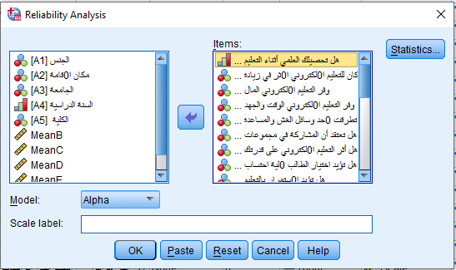
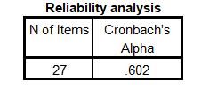
Data Analysis

Slide 8
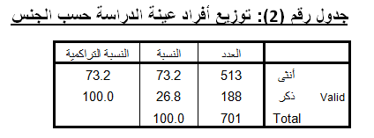
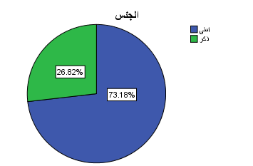
Data Analysis
Descriptive statistics For Personal Information

Slide 9
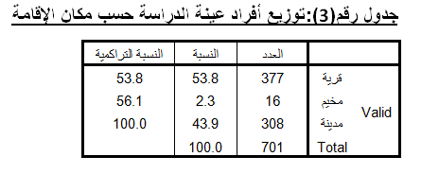
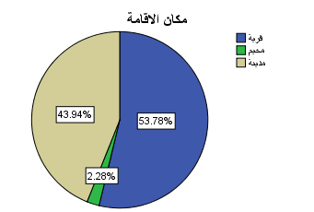
Data Analysis

Slide 10
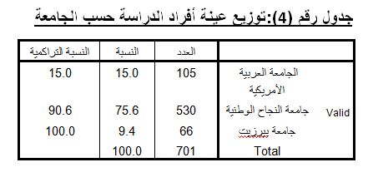
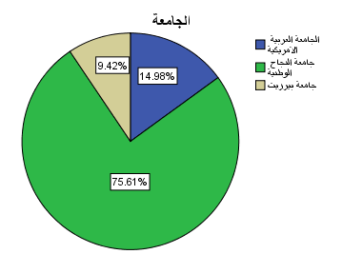
Data Analysis

Slide 11
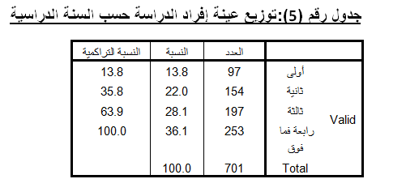
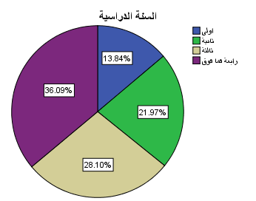
Data Analysis

Slide 12
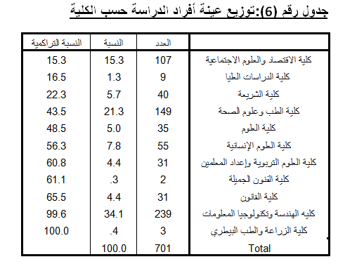
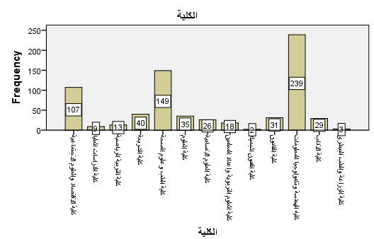
Data Analysis

Slide 13
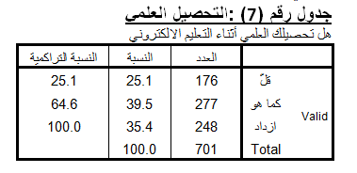
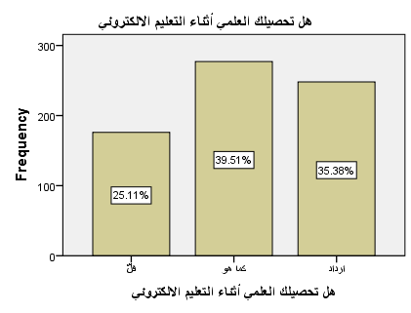
Data Analysis
Analysis of student satisfaction with himself

Slide 14
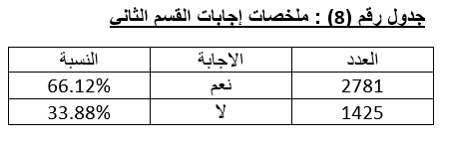
Analysis of student satisfaction with himself
Data Analysis

Slide 15
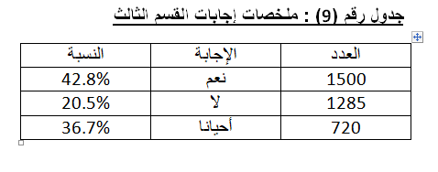
Data Analysis
The extent of satisfaction with the evaluation methods and marks

Slide 16
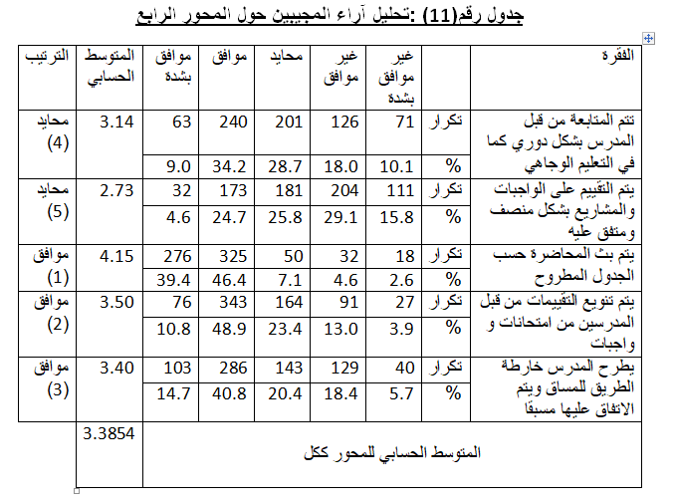
Data Analysis
Measuring student satisfaction with the teacher

Slide 17
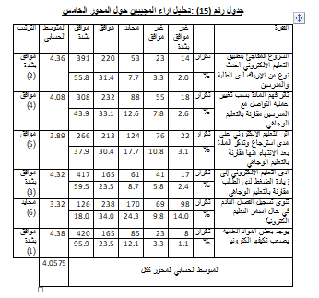
Data Analysis
Measuring the extent of benefit compared to face education

Slide 18
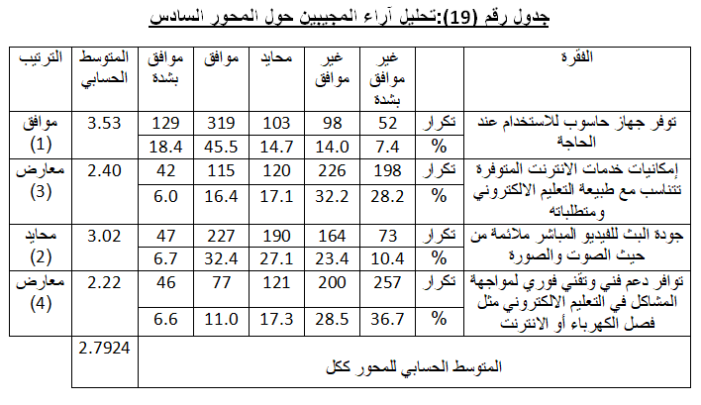
Data Analysis
Measuring the level of satisfaction with internet services

Slide 19
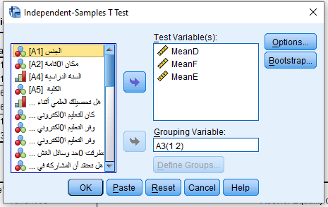
Independent Samples Test
Ho : The average teacher satisfaction is equal between An-Najah National University and the Arab American University.
Ha: The average teacher satisfaction is not equal between An-Najah National University and the Arab American University.
Significance value (sig) <.05 This means rejecting the null theory.
The satisfaction rate is not equal between the two universities

Slide 20
Independent Samples Test
Ho: the benefit rate compared to the face education is equal between An-Najah National University and the Arab American University.
Ha: the benefit rate compared to the face education is not equal between An-Najah National University and the Arab American University.
Significance value(sig) >.05 This means acceptance of the null theory .
The benefit rate compared to the face education is equal between the two universities.

Slide 21
Independent Samples Test
Ho: The Average of satisfaction with the availability of devices and Internet service is equal between An-Najah National University and the Arab American University.
Ha: The Average of satisfaction with the availability of devices and Internet service is uneven between An-Najah National University and the Arab American University.
The significance value is <0.05 (sig)
which means rejecting the null theory and thus the rate of satisfaction with devices and internet service is uneven

Slide 22
Independent Samples Test
Ho: The average teacher satisfaction is equal between An-Najah National University and Birzeit University.
Ha: The rate of teacher satisfaction is uneven between An-Najah National University and Birzeit University.
Significance value (sig)> .05
This means acceptance of the null theory and thus the satisfaction rate is equal between the two universities.

Slide 23
Independent Samples Test
Ho: the benefit rate compared to the face education is equal between An-Najah National University and Birzeit University.
Ha: the benefit rate compared to the face education is uneven between An-Najah National University and Birzeit University.
Significance value(sig)>0.05
which means acceptance of the null theory and thus the rate of benefit compared to the face education is equal between the two universities.

Slide 24
Independent Samples Test
Ho: The rate of satisfaction with the availability of devices and Internet service is equal between An-Najah National University and Birzeit University.
Ha: The rate of satisfaction with the availability of devices and Internet service is uneven between An-Najah National University and Birzeit University.
The significance value(sig) is >.05
which means acceptance of the null theory, and thus the rate of satisfaction with devices and internet service is equal between two universities
Note that there is rapprochement and agreement between An-Najah National University and Birzeit University in Satisfaction.

Slide 25

Thank You!!

