Slide 1
Design of PV system focusing on protection , grounding ,wiring &Improvement
Students: Ezedeen Al-sayyed, AhmedGhazal& Adham AL-ashqar
Supervisor : D.Moien Omar

Slide 2
outline
Overview
Design & protection
Output Energy
Economical study
Conclusion & Recommendation

Slide 3
Idea
In the first project we focused on how to design and protect the solar systems in all its details and we found that in most small projects from 1 to 10 kW the cost of projects is close.
In large projects larger than 10 KW there are many options in the design and installation, we decided in the second project to compare the different scenarios for one project
The projects are compared with several factors considered , including: the resulting energy, the cost of investment, the recovery period and the reliability .

Slide 4
Design 60KWp SOLAR SYSTEM
-choosing the Inverter:3phase SMA inverter
**Scenarios:
1-one 60KW inverter
2-Three 20kw inverters

Slide 5
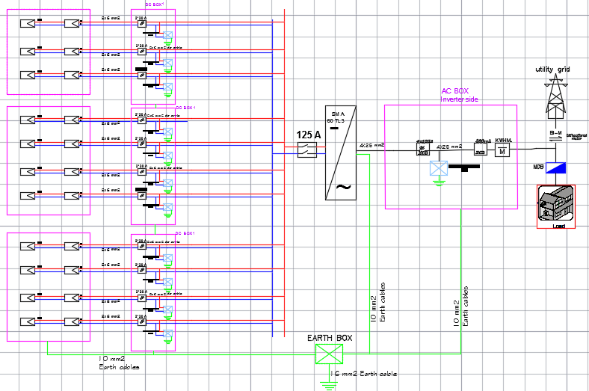
one 60KW inverter

Slide 6
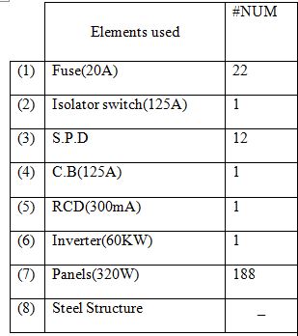
System components

Slide 7
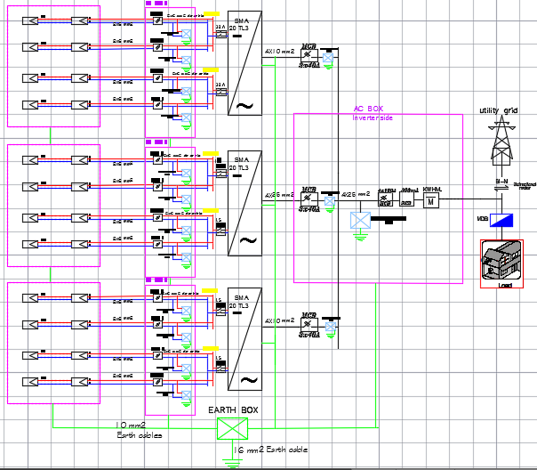
Three 20kw inverters

Slide 8
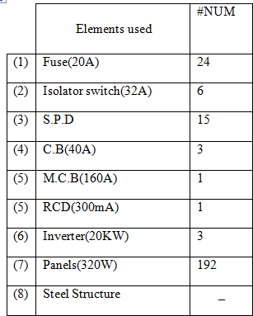
System components

Slide 9
OUTPUT ENERGY
Any PV system project should calculate the expected output energy because it represents the profits for the investor who expects the profits of the project and the output energy depends on several factors, including the type of pv panels used, solar radiation , the design , temperature and many other factors.

Slide 10
METHODOLOGY
1. Solar radiation and temperature should be known for 8760 hours per year.
2 - Find the pin value of the inverter.
3- Find the pout of the inverter

Slide 11
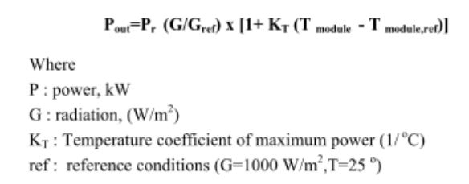
Pdc:

Slide 12
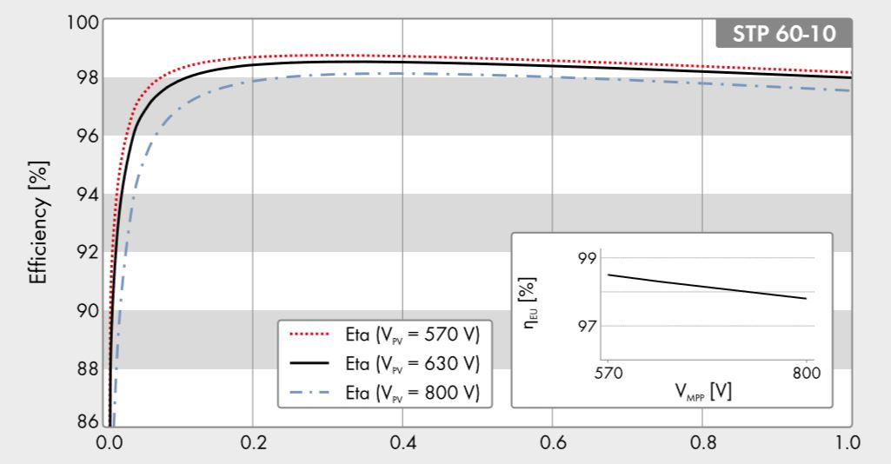
1-60 kw inverter

Slide 13
1-60 kw inverter

Slide 14
We Find the equation from the graph
Eq: Pout of inverter=0.9817767778*P input
And the table in attachments shows the full data.
So, take sum energies of 8760H along a year so we got the output Energy =121.183773MWH

Slide 15
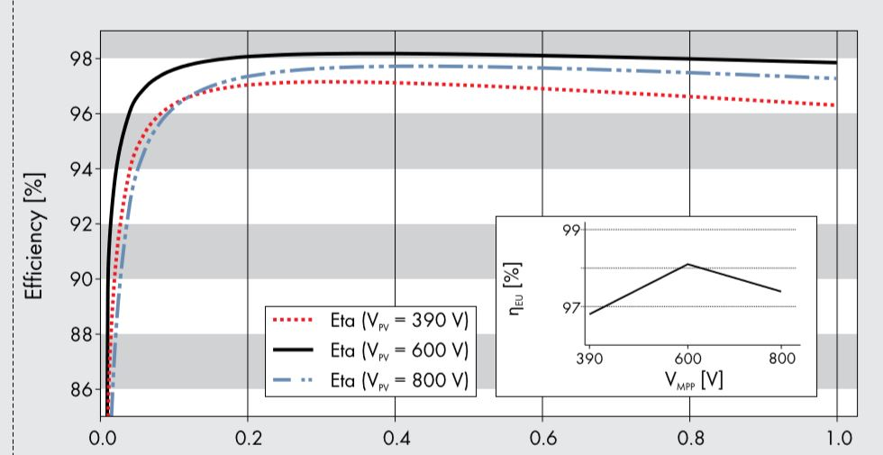
3-20kw inverter

Slide 16
3-20kw inverter

Slide 17
We Find the equation from the graph:
Eq: Pout of inverter=0.980006*Pinput And the table in attachments shows the full data. So, take sum energies of 8760H along a year so we got the output Energy = 120.972140MWH

Slide 18

Economical study
In the investment projects, the economic efficiency of the project is taken into account mainly because the project is based on the economy.

Slide 19
1-60KW INVERTER
We have to put all the costs and profits:
**Costs: Initial cost , maintenance cost.
**Profits: resulting from selling the output energy annually , salvage value.

Slide 20
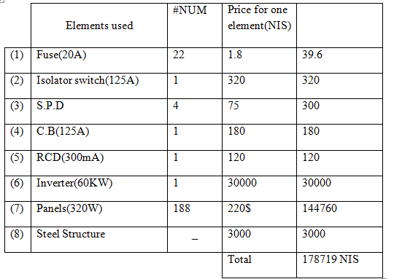
Costs
*Initial costs = 178719 NIS
*Maintenance cost = 1.5% * Initial Cost = 2681 NIS

Slide 21
profits
profits include the energy yield from the system and the salvage value at the end of the life of the project.
The energy yield from the system=121.183773MWH/year.
to calculate the profits from the energy we take into consideration the Selling price of 1kwh which is 0.54NIS/kwh.
So,profits=121183.773kwh*0.54NIS/kwh=65439.23742NIS
Salvage value= 10% *investment cost
=10% *178719 NIS= 17871.9NIS

Slide 22
CASHFLOW

Slide 23
PAYBACK PERIOD
Payback period =p0/ capital cost =619926.8363NIS/179319
= 3.45 year.=3 year and 6 months.

Slide 24
NET ANNULA CASHFLOW
A(+)=Salvage value(A/F,8%,20)+ Annual profits
A(-)=Initial cost (A/P,8%,20)+ maintenance cost
**Total annual profit= A(+) – A(-)
=65831.94561NIS -20962.3861NIS
= 44869.55951 NIS.

Slide 25
3-20KW INVERTER
We have to put all the costs and profits:
**Costs: Initial cost , maintenance cost.
**Profits: resulting from selling the output energy annually , salvage value.

Slide 26
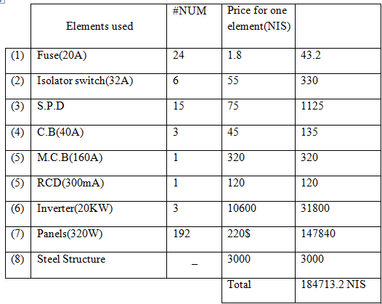
Costs
*Initial costs = 184713.2 NIS
*Maintenance cost = 1.5% * Initial Cost = 2770.698 NIS

Slide 27
profits
profits include the energy yield from the system and the salvage value at the end of the life of the project.
The energy yield from the system=120.972140MWH/year
to calculate the profits from the energy we take into consideration the Selling price of 1kwh which is 0.54NIS/kwh.
So,profits=120972.14kwh*0.54NIS/kwh=65324.9556NIS
Salvage value= 10% *investment cost
=10% * 184713.2 NIS = 17871.9NIS

Slide 28
CASHFLOW

Slide 29
PAYBACK PERIOD
Payback period =p0/ capital cost
=618126.0458 /184713.2 =
3.346 year= 3 years and 3 months

Slide 30
NET ANNULA CASHFLOW
A(+)=Salvage value(A/F,8%,20)+ Annual profits
A(-)=Initial cost (A/P,8%,20)+ maintenance cost
Total annual profit= A(+) - A(-)
= 62958.77951 NIS - 21592.97308
= 41365.80643 NIS.

Slide 31
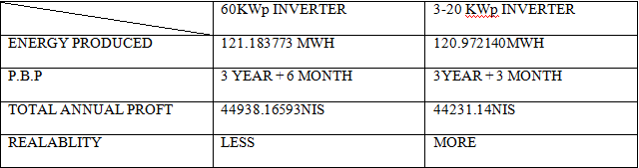
CONCLUSION AND RECOMMENDATION
We can conclude the two scenarios by this table:

Slide 32
CONCLUSION AND RECOMMENDATION
It can be seen from analysis that both configurations of pv systems approximately have same MWH (energy produced) .
On the other hand, Reliability of the second system (3-20 KW inverters) is much better.
Hence, we recommend to use system design with multi inverters instead of central inverter.

Slide 33
Thank you
☺

