Slide 1
Nail Making Machine Design
Prepared by:
Abed Al Hakeem Abu Al-Rob
Eyad Othman
Jehad Nasser
Muhannad Asmar
Supervisor: Dr. Eyad Assaf

Slide 2
Outline
Introduction
Experimental Design Method
Finite Element Method
Mechanical Element Design
Kinematics Analysis
Problems and Restrictions
Future Look

Slide 3
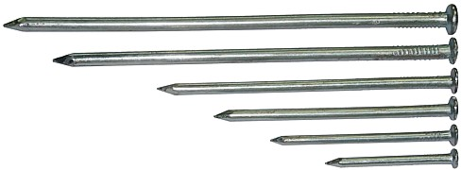
Introduction
The aim of this project is to design a nail making machine.
A nail is a pin shaped object of metal that is used in construction to hold two parts or more together.
Nail making machine is a function of mechanical systems that produce nails in an excellent sequential way.

Slide 4
Mechanical Systems
In this project there is four systems:
Power Driving System
Head Punch System
Wire Cutting System
Wire Feeding System

Slide 5
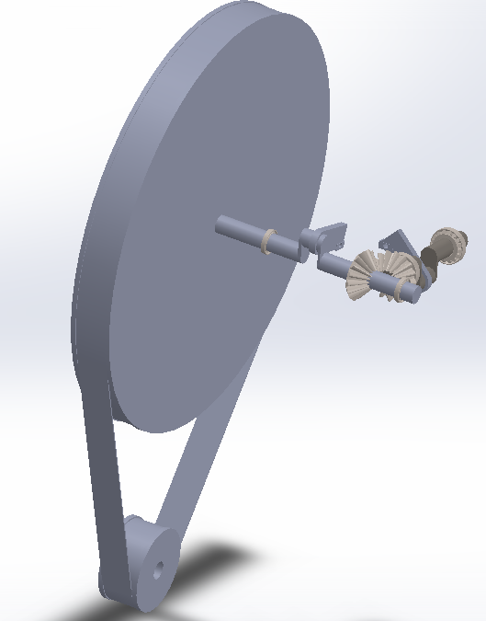
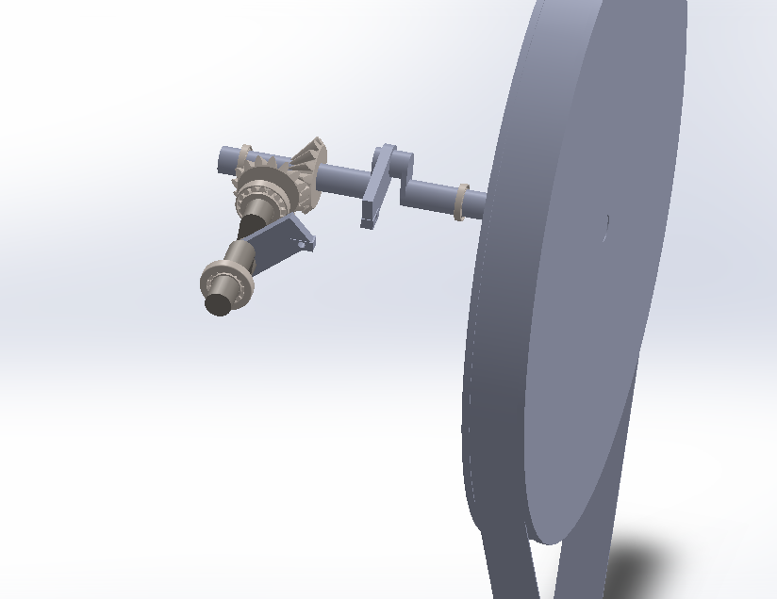
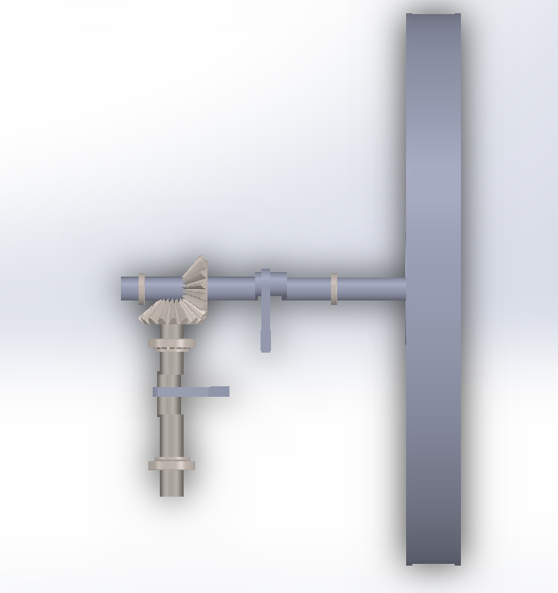

Slide 6
Experimental Design Method
The main objective of a laboratory report is to present the results and discuss these results.
We focus on the force that act on the nail to form the head and obtain the results from the experimental data
Compare this results with the results are obtained from finite element design by using the Abaqus program and results are obtained from theoretical equation.

Slide 7
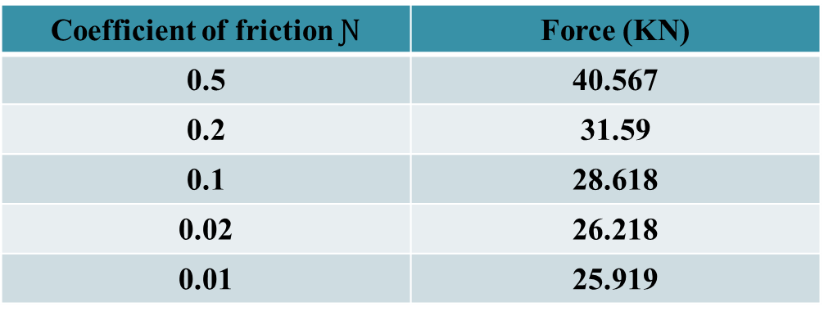

Theoretical Method: Calculate Forging and Cutting Forces
F= Y_{f} (π) (r²_{f}) (1+ $\frac{2 Ɲ rf}{3hf}$ )
Coefficient of friction $Ɲ$ | Force (KN)
0.5 | 40.567
0.2 | 31.59
0.1 | 28.618
0.02 | 26.218
0.01 | 25.919

Slide 8
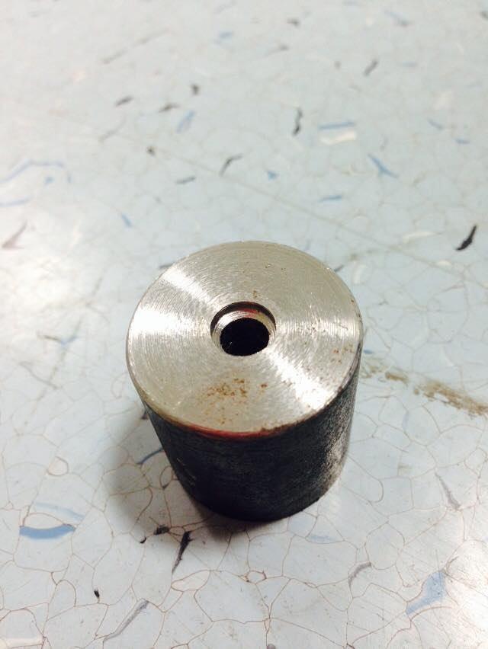
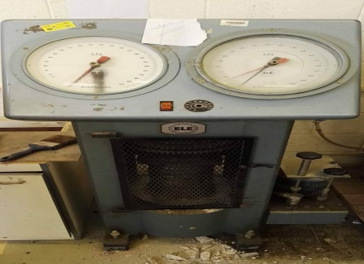
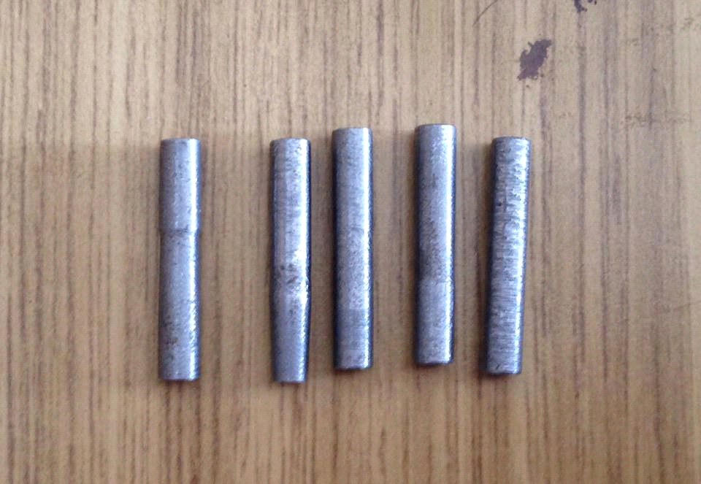
Parts of Experiment
Wire Samples
Mold
Compression Machine

Slide 9
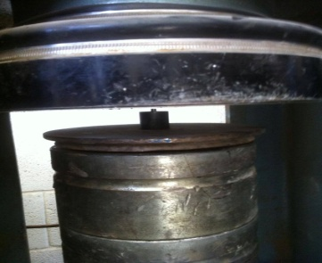
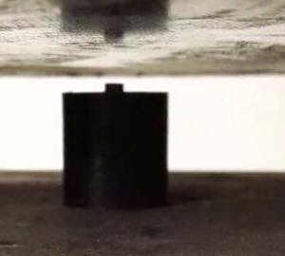
Forming the Nail Head

Slide 10
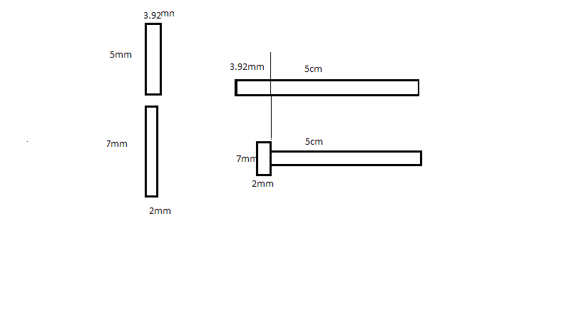
Head Forming (before and after)

Slide 11
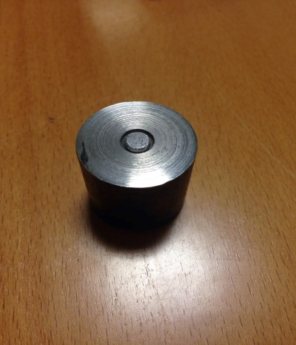
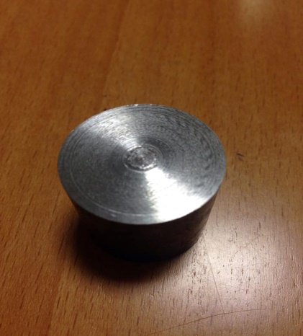
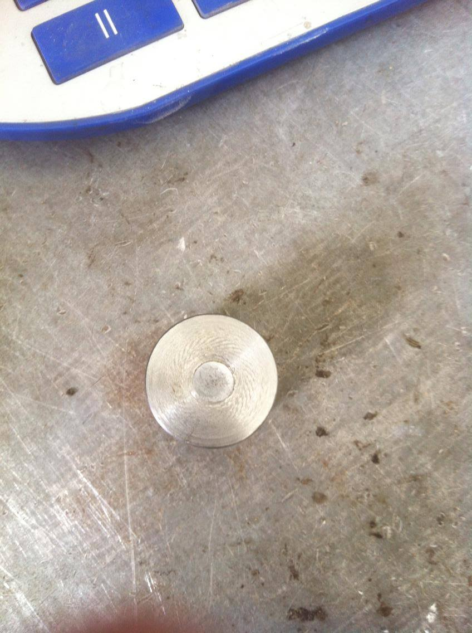
Results of Experimental Method
First Sample:
Force = 140 KN
Second Sample:
Force = 40 KN
Third Sample:
Force = 32 KN

Slide 12
Finite Element Method
The forging force was determined by experiment to design the nail-making machine.
Finite Element model is developed and checked against experimental and theoretical results. The aim is to determine the force required to form the head of nail and design the cutting die.

Slide 13
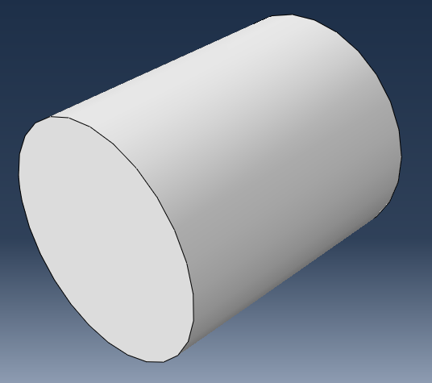
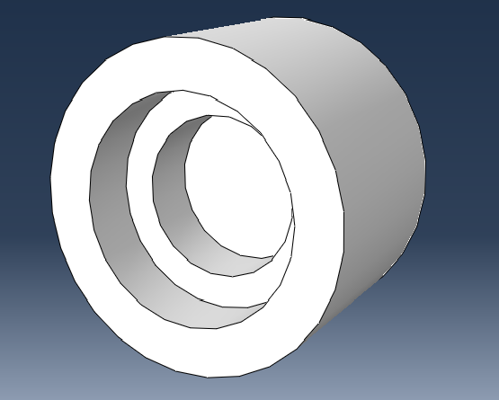
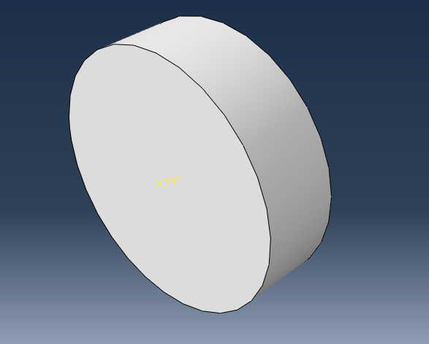
Abaqus models
Wire: Deformable part
Mold: Deformable part
Head punch: discrete rigid

Slide 14
Material of Parts
Wire material is defined by using elastic and plastic regions of the material and the plastic strain as shown in this table:
Mold material is defined by using the elastic modulus 1000 GPa.
 | Yield stress (MPa) | Plastic strain
1 | 180 | 0
2 | 298 | 0.049
3 | 333.5 | 0.094
4 | 356.5 | 0.138
5 | 381.6 | 0.18
6 | 400 | 0.22

Slide 15
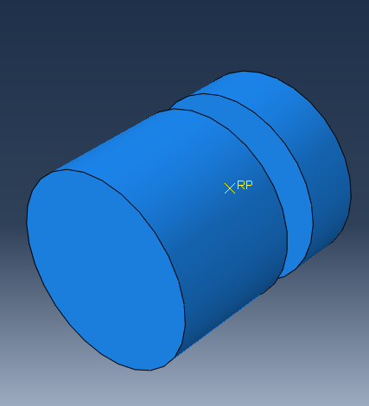
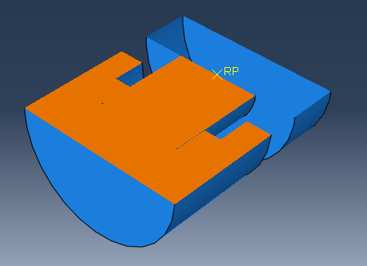
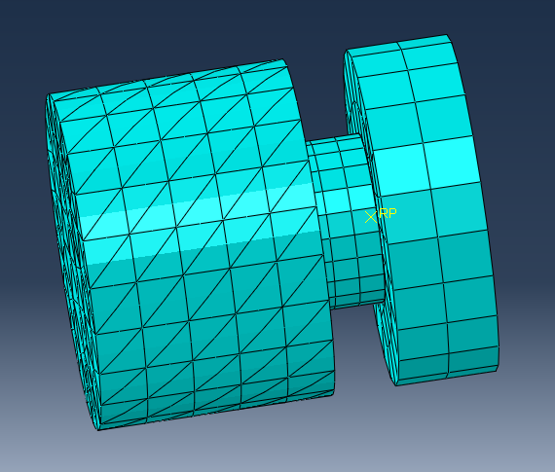
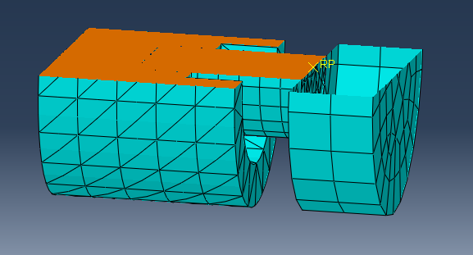
Assembly and Mesh Models

Slide 16
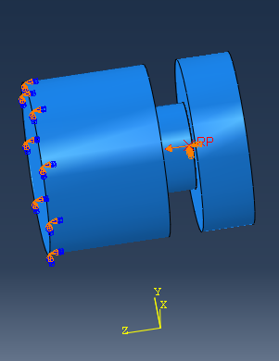
Boundary Condition of Models

Slide 17
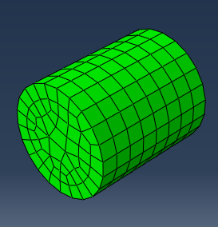
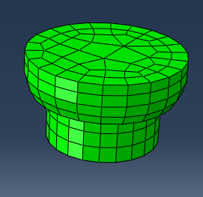
Results
Before and After applied the boundary condition

Slide 18
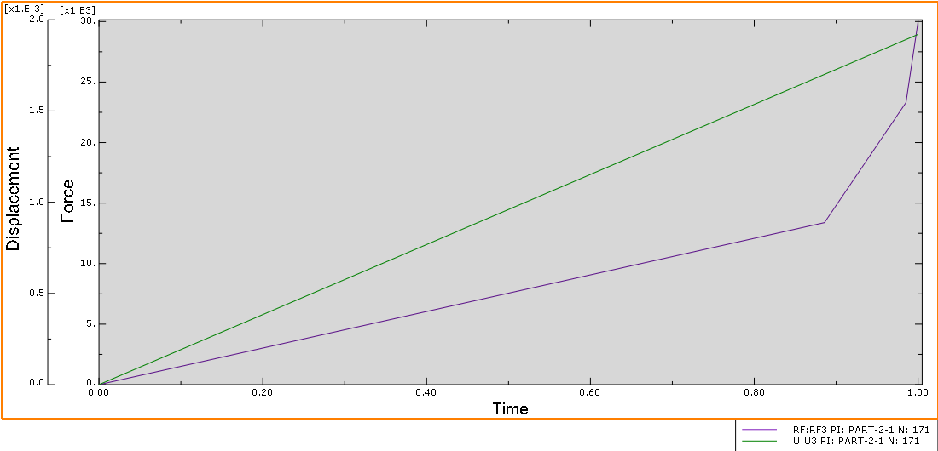

Slide 19
Selection of Materials
The materials of the mechanical parts of the machine should be hard and strong to avoid failure.
Element | Type of Material
Bevel Gears | Carburized & Case Hardened grade 1 steel
Flat-Belt | Polyamide A-5
Shaft | AISI 1080 steel
Bearing | Stainless steel

Slide 20
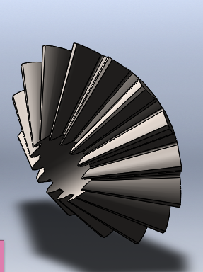
Mechanical Element Design
Bevel Gear Design
Property | value
Teeth | 16:16 tooth
Safety factor | 2
Diametral pitch | 2 teeth/in
Face width | 11 in
Diameter for two gears | 8 in

Slide 21
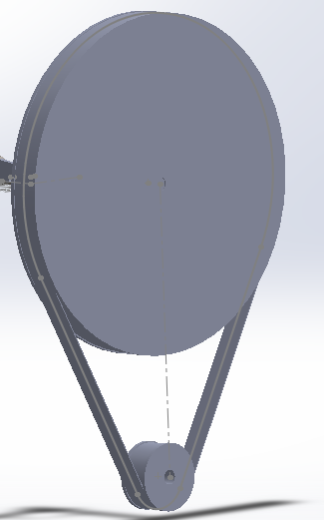
Flat-Belt Drive Design
Polyamide A-5, t = 0.25 in
Width = 6 in

Slide 22
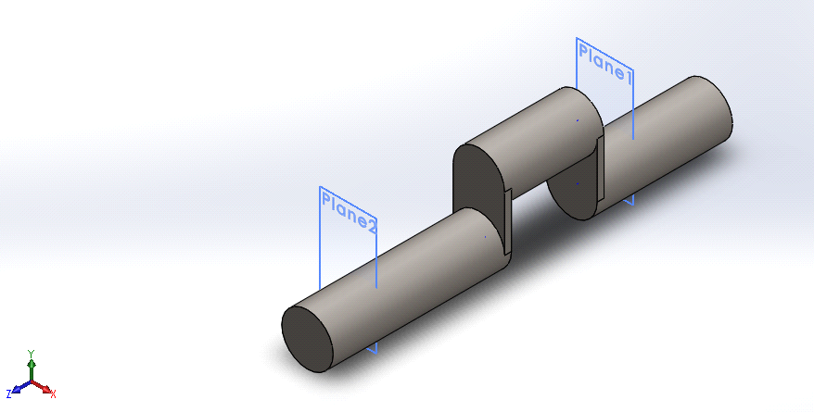
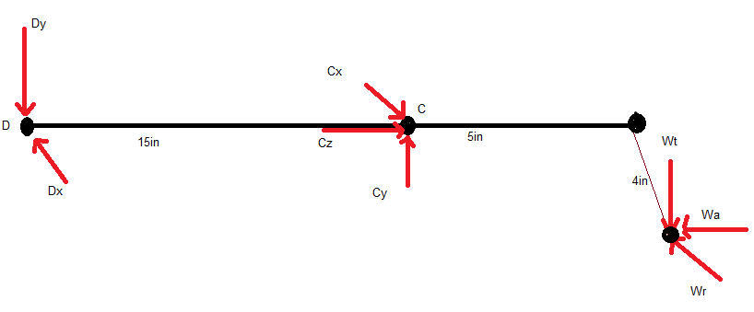
Shafts Design
Diameter = 3 in.

Slide 23
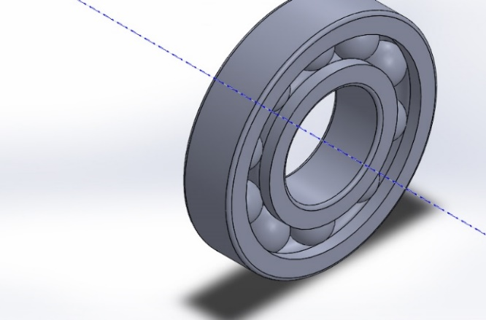
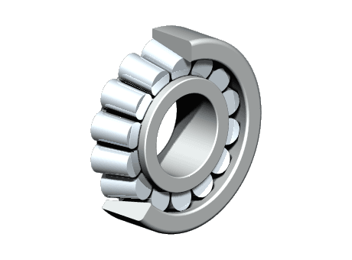
Bearing Design
Single row ball bearing
No. 6015 with inside diameter
3 in. and outside diameter 4.53 in.
Single row roller tapered bearing
No.32015A with inside diameter 3 in.
and outside diameter 4.53 in.

Slide 24
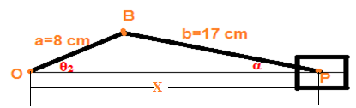
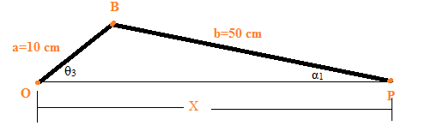
Kinematics Analysis
Forging and Cutting Mechanism
Wire Feeding Mechanism

Slide 25
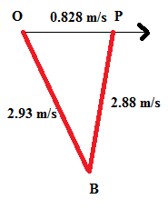
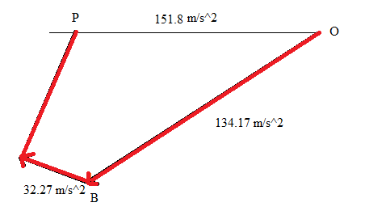
Velocity and Acceleration Diagrams

Slide 26
Problems and Restrictions
We have some problems and restrictions in this project:
1. Financial problems.
2. We don’t have the appropriate materials and parts in our country.

Slide 27
Future Look
Hope to see this project in our colleagues’ graduation projects.
Hope to see this machine in an automotive situation with electronic controlling system.

Slide 28
Thank You!

