Slide 1

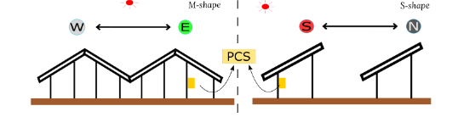
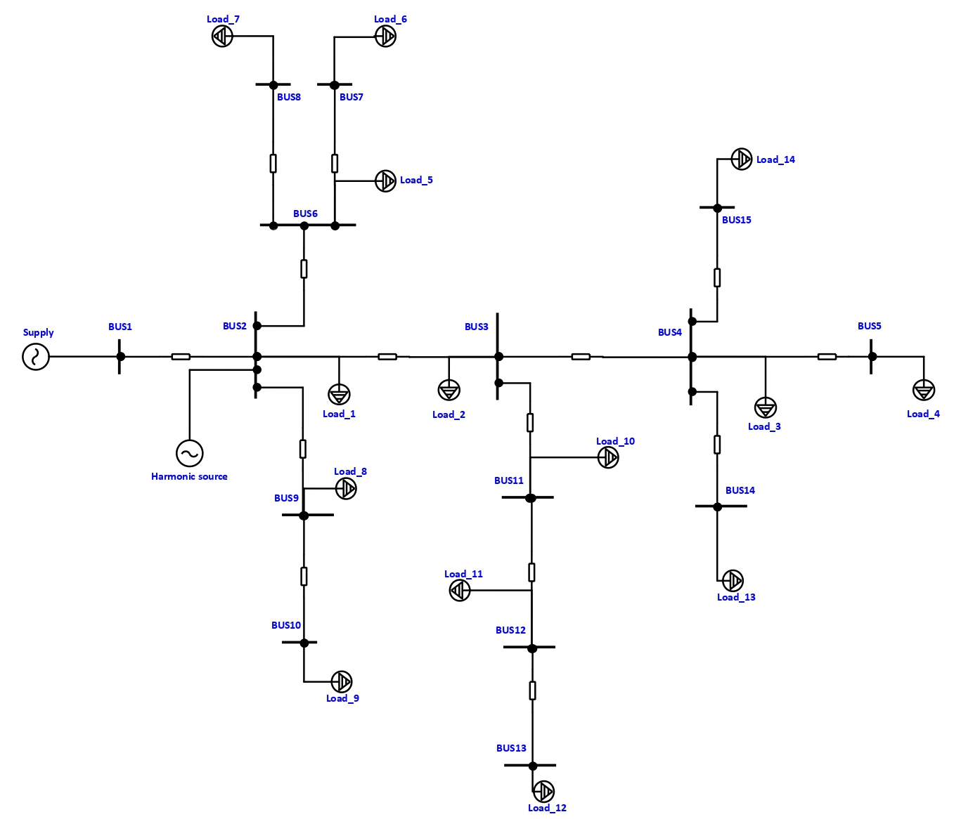
An-Najah
University
Comparison Between South-North and East-West PV Installation in terms of the effect of Harmonics on the network
Introduction
Results
Grid-connected Photovoltaic (PV) systems use inverters to connect to distribution networks that utilize alternative voltage. However, harmonic currents generated by PV systems may downgrade the electrical network's quality and change other electrical equipment's performance.
This project investigates the effect of the injected harmonics from the PV through the inverter on the network by injecting them on the IEEE 15-Bus network for East-West (M-shape) and South-North (S-shape) PV arrangements.
Note that Sungrow (SG320HX) inverter datasheet’s harmonics were used to obtain more accurate and realistic results.
Figure 1: Diagrams of a standard PV array arrangement (S-shape) and an M-shape PV array arrangement (M-shape)
Methodology
Conclusion and recommendations
The results above demonstrate that the EW system has the least power losses compared with the other systems. Furthermore, we found that the SN-30 system performed better at different tilt angles than the other SN systems. As the solar radiation is high, the harmonic currents will decrease leading to reduce power losses.
Figure 2: IEEE 15-Bus network.
The THD of currents and voltages are the least in the EW system, and the SN-30 system was the best compared with the other SN systems at different tilt angles.
Figure 2 above shows the IEEE 15-Bus network. The generated harmonics by PV were injected at the source side using current sources as shown above . The values of the harmonic currents were obtained form the inverter’s datasheet by multiplying the percentages with the fundamental current.
The arrangement of PV system should be considered in the design stage to reduce the generated harmonics effect.
The tilt and azimuth angles also should be considered because it has an effect on the generated harmonics.

