Slide 1

PALESTINE JOB ONLINE
BY :
Layla Abu Asbah
Raghad Jawabreh
Hadeel Marwari
Dr.Maher Arafat

Slide 2

PROBLEM
Many graduate students have problems finding a job upon completion of their education, which leaves many graduates with degrees without work.
Many companies face problems in not finding the right employee for the job, which makes some companies employ unqualified, and therefore companies must train employees on the job, monitor them and bear the errors arising from them and their commitment to correcting mistakes and thus taking time, effort and cost.

Slide 3
BRIEF HISTORY:
A website founded in 2021 for recruitment and advertising plays an important role in providing comprehensive and integrated employment solutions for work in Palestine for employers and job-seekers in Palestine (in future international) where the site is building lasting relationships with local and international institutions operating in Palestine based on professional services.

Slide 4
GOAL
Providing effective recruitment services to companies and institutions by promoting their brand through their recruitment platform, thus helping private and government companies to promote their brand and jobs to the best candidates and job seekers using marketing tools .

Slide 5
MISSION:
Providing comprehensive and integrated employment solutions for employers and job seekers in Palestine, as the site is based on building permanent relationships with all local and international institutions in Palestine based on providing professional services, and providing suitable places for students to train in. Providing employment services Effective for companies and institutions by promoting their brand through their recruitment platform thus helping private and government companies to promote their brand and jobs to the best candidates and job seekers using marketing tools.

Slide 6
VISION
Our vision is to strive to aggregate the available jobs in the Arab world and then the world.

Slide 7

الصفحة الرئيسية

Slide 8
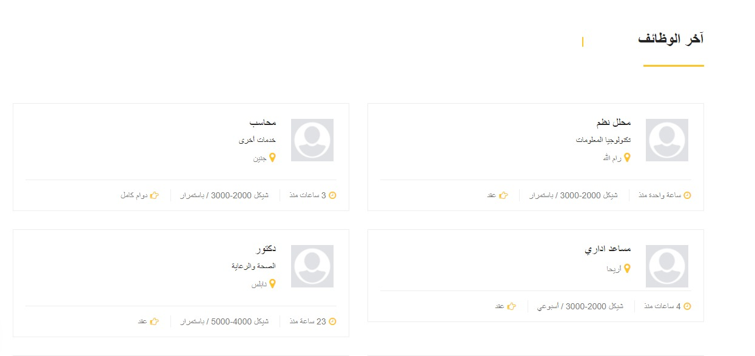

Slide 9
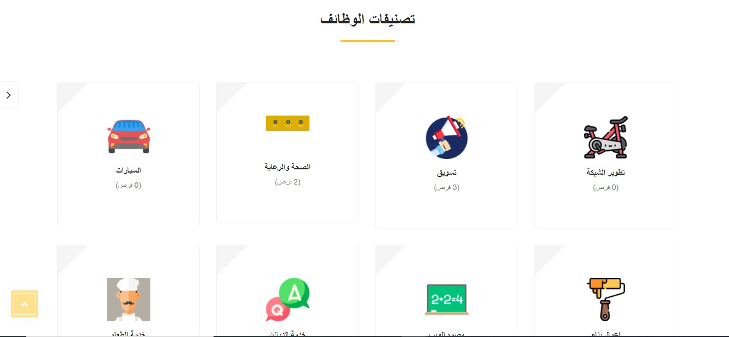

Slide 10


Slide 11
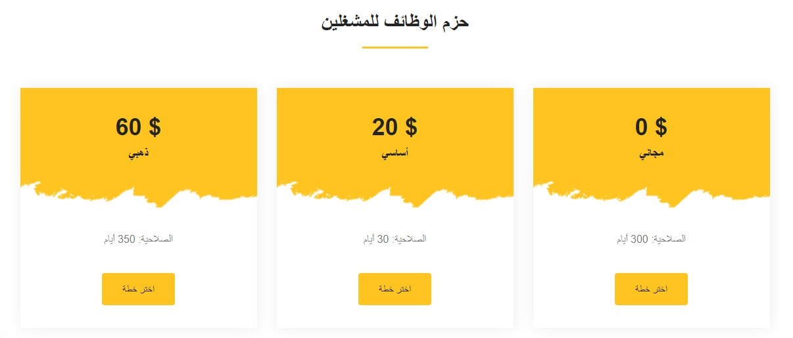

Slide 12
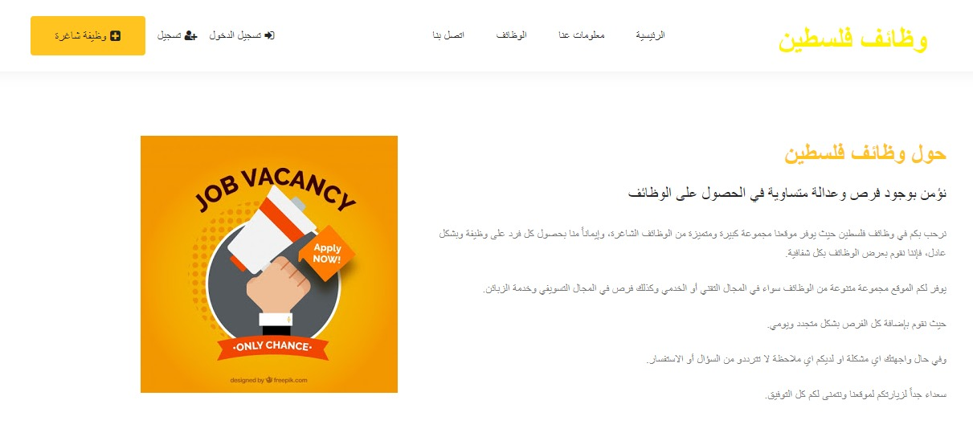
معلومات عنا

Slide 13
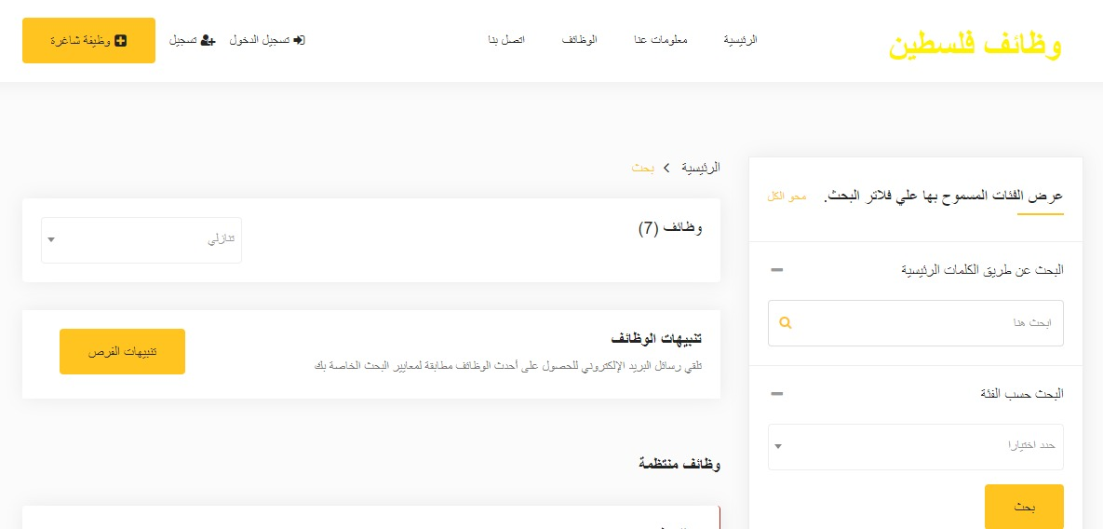
الوظائف

Slide 15
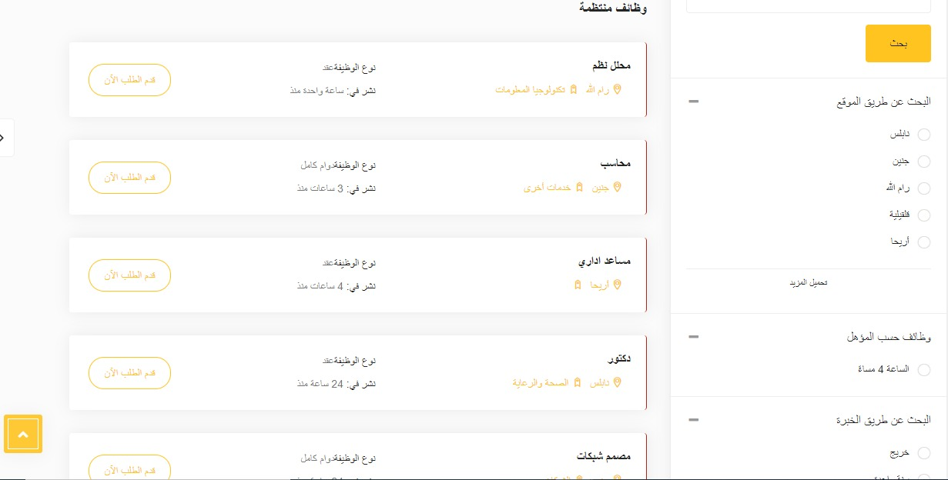

Slide 16
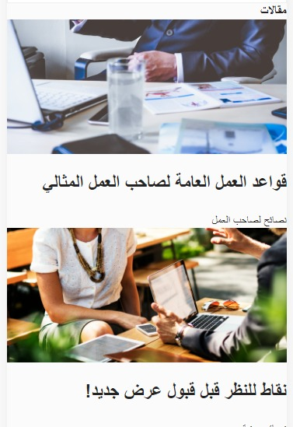

Slide 17
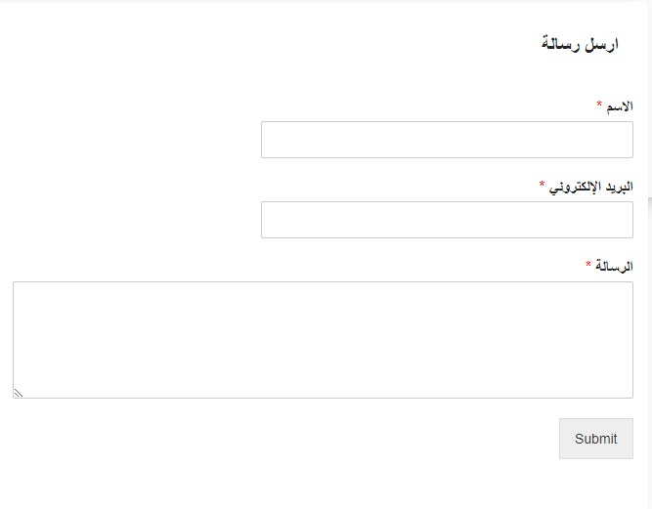
اتصل بنا

Slide 18
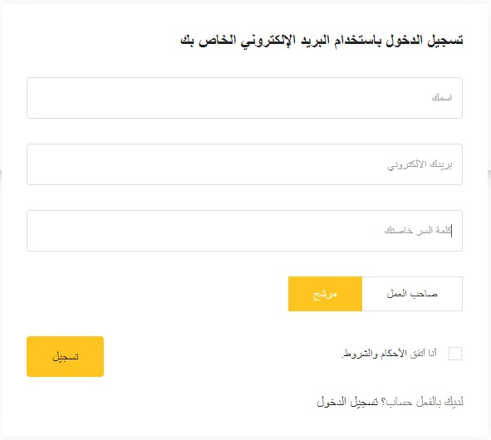
التسجيل

Slide 19
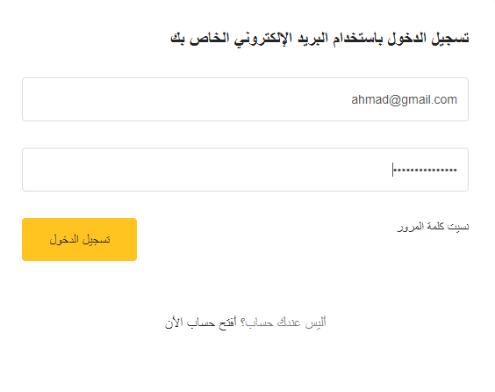
تسجيل الدخول

Slide 20
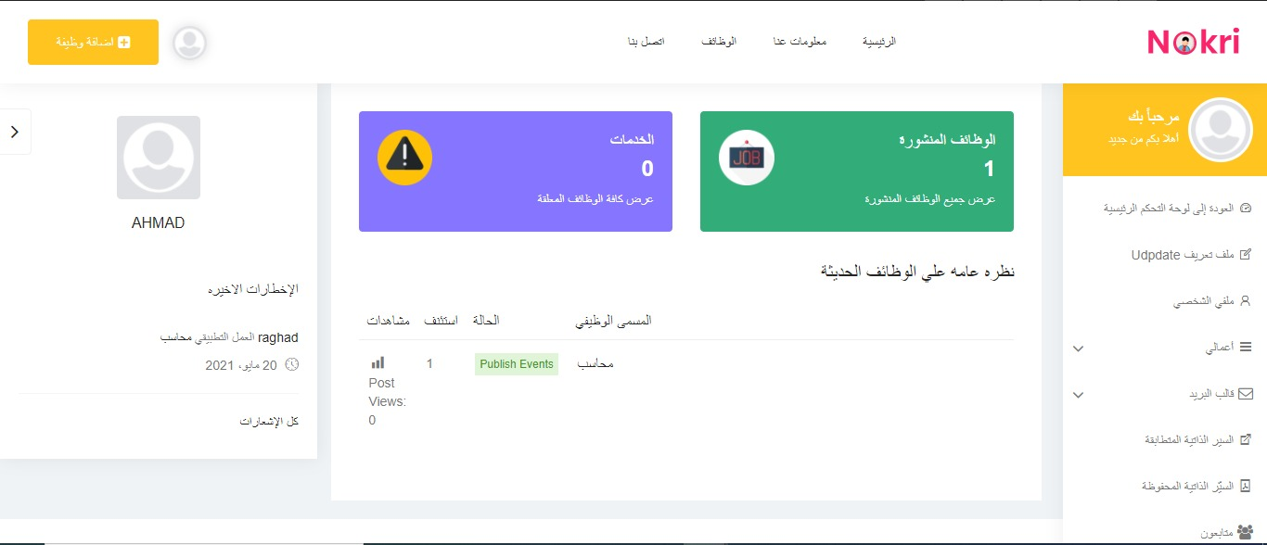
حساب صاحب عمل

Slide 21
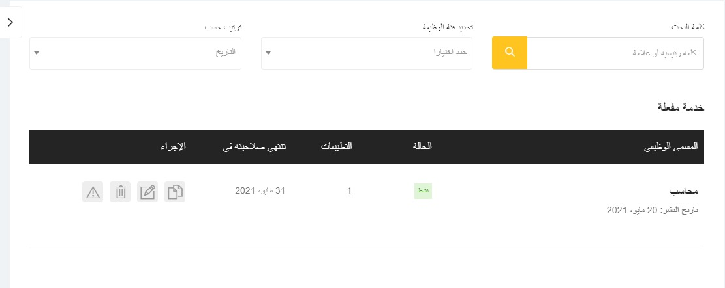

Slide 22
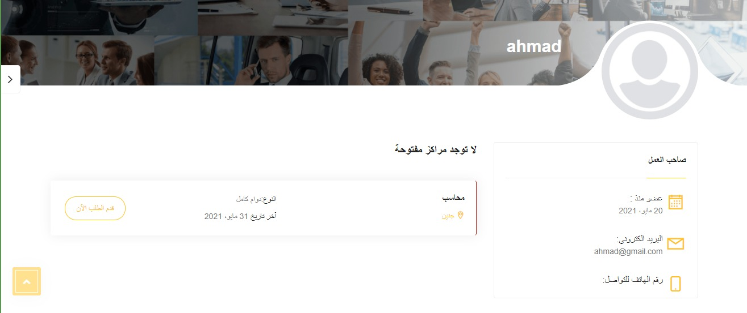

Slide 23
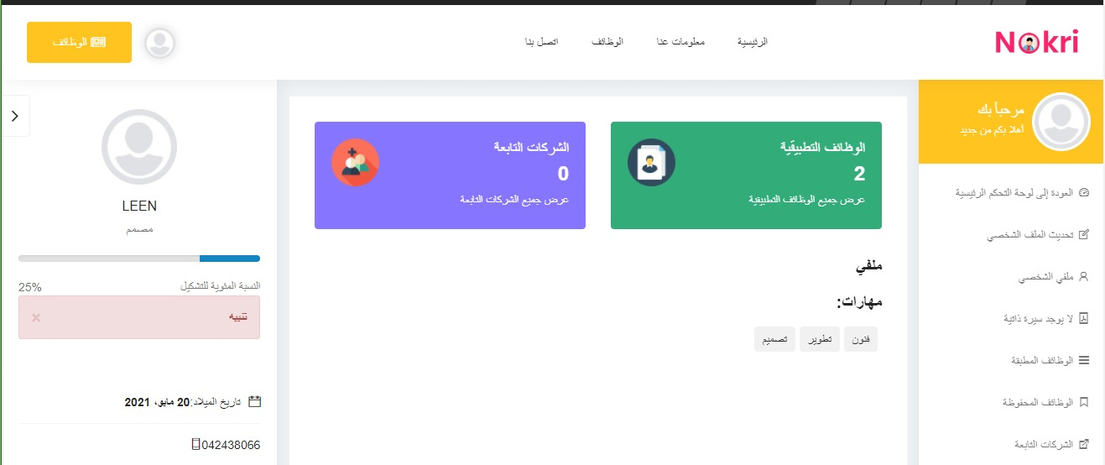
حساب مرشح

Slide 24
WebSite Link:
https://palestinejobs.online/
canvas link:
https://canvanizer.com/canvas/w1H3UZAHm7Orb
Facebook: https://www.facebook.com/Palestine-jobs-online-101591552034723/

Slide 25
THANK YOU
WOODGROVE BANK

