Slide 1
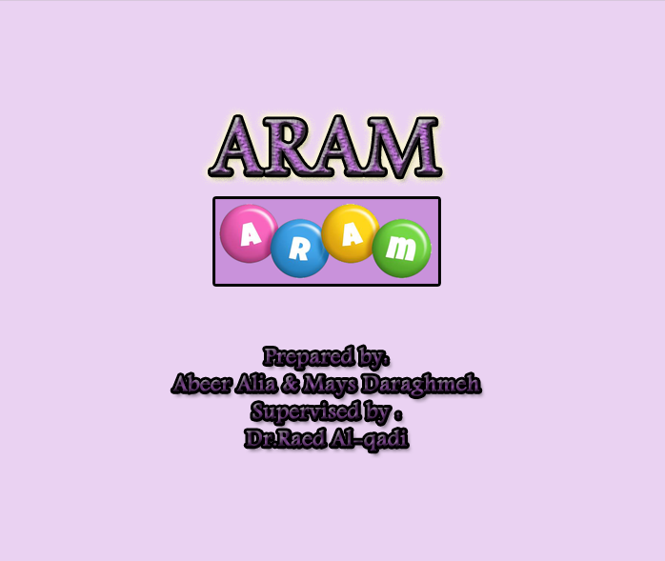

Slide 2
Outlines
Overview
Scope
Generation life-cycle
Tools
Our project in general
Why to use Vuforia ?
Constraints
Solutions
Recommendations and conclusion
Demo

Slide 3
Overview
Nowadays, multiple learning resources but sometimes boring or require a Wi-Fi connection.
Kids need to achieve knowledge with entertainment .
ARAM app allows you to detect some predefined images/texts with rendering.

Slide 4
Scope
The app is planned to be used by kids and students of early school stages to add an interactive environment and achieve the desired knowledge.

Slide 5
Generation Life-Cycle
Create
Data set
Link objects with targets
Prepare assets and URLS
Compile
Prepare objects
Start

Slide 6
Tools
Vuforia
OpenGL
3dmax
Photoshop
Commons-io-1.3

Slide 7
Our Project In General
ARAM project is divided into two parts :
ARAM studio
ARAM mobile app :
  Image Targets
  Text Recognition

Slide 8
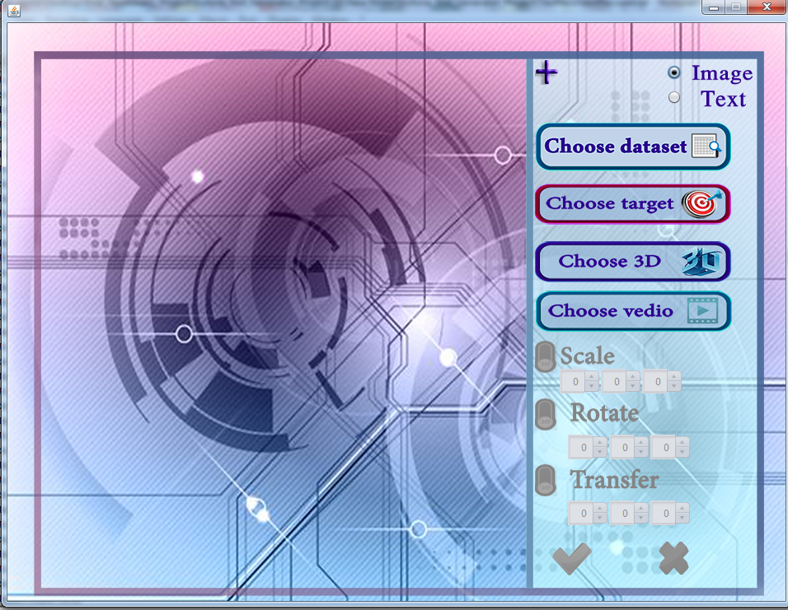
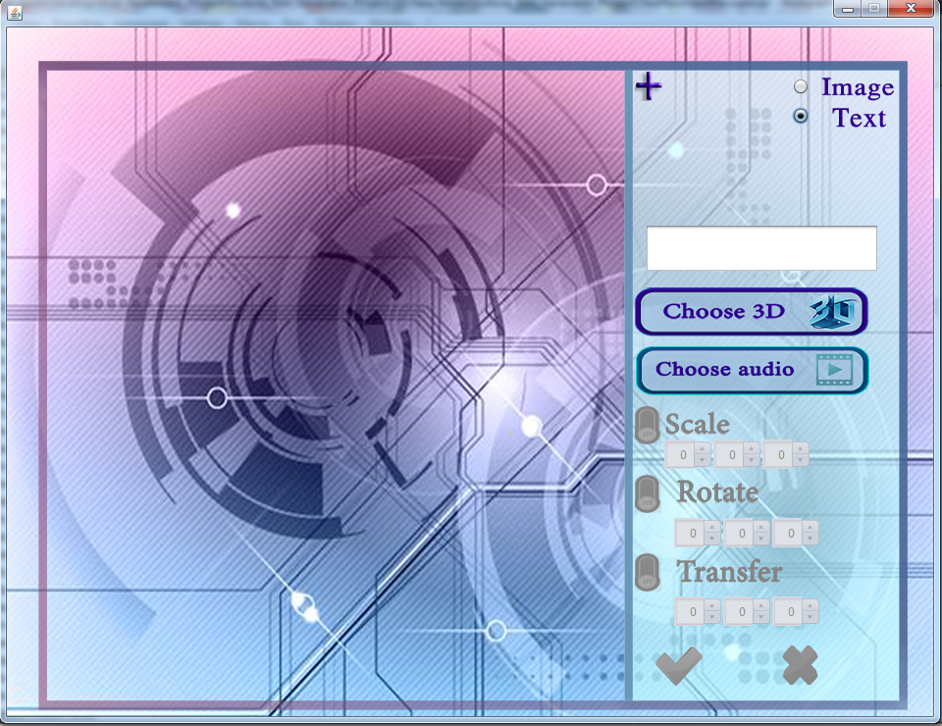
ARAM Studio Interface
For image :
For text:

Slide 9
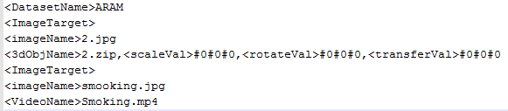
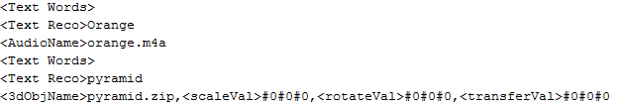
ARAM Studio Generated Xml Files
For image :
For text :

Slide 10
ARAM Mobile App-Image Targets
This part is used to detect image targets and render either 3d-Objects or play videos .
Also it provides the following options :
  Home .
  Full screen for videos .
  Flash : used in dim light .
  Autofocus for clarity .

Slide 11
ARAM Mobile App-Text Recognition
This part is used to detect custom words and render either 3d-Objects or play audios .
Technique used : Filter's white mode .
Options provided :
  Home .
  Flash : used in dim light .
  Autofocus for clarity .

Slide 12
Features
Main features :
Tracking
Rendering
Extra features :
Animation
  Scale
  Rotate
  Transfer
Update
Reset factory

Slide 13
Why to use Vuforia ?
Available for all platforms .
Provides precise coordinates of tracked targets regarding to its angle .
Solves incorrect insight's angle .

Slide 14
Constraints
Choosing idea .
Time constraint .
Learning new technology .
Working together .

Slide 15
Problems and issues
Dealing with graphics : JPCT versus OpenGL .
Loading 3d-Objects’ data .
Performance and size limitations

Slide 16
Solutions
We decided to use OpenGL .
We built our loader .
We used compressed files and reduced the quality of videos .

Slide 17
Recommendations and conclusion
We hope to expand this project :
Target almost all of students’ categories .
Cover all related things from trivial ones to others that are more vital such as touch interaction .

Slide 18
References
[1] (2015, 12 2) .Retrieved from vuforia.com:
https://developer.vuforia.com/
[2](2015, 12 2) .Retrieved from vuforia.com:
https://developer.vuforia.com/downloads/samples
[3]Kevin Brothaler. (2013).OpenGL ES 2 for Android. The elements of style (3rd ed.).
Pragmatic Bookshelf.

Slide 19
Demo

