Slide 1
Prepared by:
Danya Al-Madani
Hiba Mansour
Ruba Adnan
Supervisors:
Dr.Mohammad Al Sayed
Dr.Yahya Saleh
Integration of LCCA & Energy simulation for green building using eQUEST as energy modeling software and Royal Wings Hotel as a case study

Slide 2
Contents:
Introduction
Methodology
Data collection
Model Inputs
Results
Conclusion
Future works

Slide 3
Introduction

Slide 4



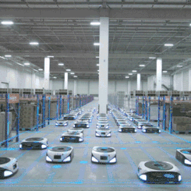
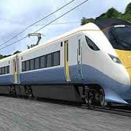
Introduction
A great development took place in various fields in the last few years, which made electricity an indispensable need for the individual.

Slide 5
Introduction
Dramatically increased development and its increasing correlation with energy consumption have had unfortunate consequences:
Negative impacts on the environment have increased .
Depletion of non-renewable energy sources.
High expenses spent on generating needed energy.

Slide 6
Energy consumption sectors
Transport
Industry
Buildings
Factors that qualified Buildings to be the third sector next to the industry and transport sector :
population growth.
high requirement of services and comfort levels in the buildings.
rise in time spent inside buildings.

Slide 7
Green building definition
green building means buildings that achieve a balance between the biosphere and the occupants of the building, as the building is designed within the local climate in which it is held on to reduce the amount of water used in building construction, reducing energy in works, reducing materials consumed upon construction and after completion, encouraging recycling and contributing to the creation of high-efficiency, healthy and sustainable buildings that are affordable and environmentally friendly.

Slide 8
Life-Cycle Cost Analysis (LCCA)
Life-cycle cost analysis (LCCA) is a method for assessing the total cost of facility ownership.
The study is conducted over a specific period of the building's life.
The picture becomes clearer and more comprehensive of the long-term cost (operating cost ).

Slide 9

eQuest simulation software
eQUEST program is an energy modeling and simulation program that gives us finally the energy consumption rate and all detailed information on building energy consumption, it indicates the rate of effect each parameter on energy performance (electric and gas consumption during the life span of a building).

Slide 10
Methodology

Slide 11
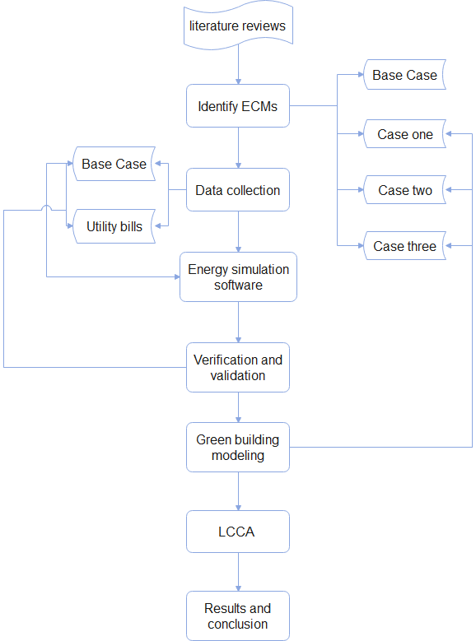

Slide 12
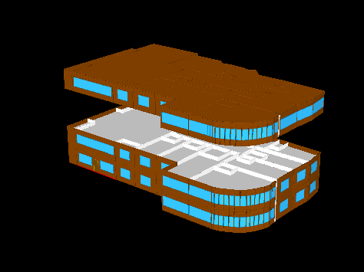
Energy conservation measures -Cases
Base Case
Case One
Replacement of the Lighting system
Case Two
Case Three
External wall Insulation
Combination of case one and two.

Slide 13
Data collection

Slide 14
Data collection
Cost data
Physical data
Construction cost
Monthly bills
Maintenance cost
Inflation rate
Building
envelope
Walls type and insulation
Windows and doors type
HVAC system
Occupancy Data
Capacity, type &EER
Activity area
Hour of use
Lighting system
Type& LPD
Water heating system
Capacity & type
Name Here
Manager

Slide 15
Model inputs

Slide 16
Inputs to eQUEST for all Cases
HVAC
External wall
HVAC
External wall
EER =8.2
U=0.401BTU/h.ft^2.F
EER =8.2
U=0.401BTU/h.ft^2
No insulation
No insulation
Fluorescent
Avg LPD =0.496 W/ft^2
Light source
Roof
construction
Light source
Base Case
Roof
construction
LED
Avg LPD =0.326
Case
One
8 in. concrete
8 in. concrete
Doors construction
Windows type
Doors construction
Windows type
Double clear
Aluminum frame
Steel Urethane foam
Double clear
Aluminum frame
Steel Urethane foam

Slide 17
HVAC
External wall
HVAC
External wall
Polystyrene insulation
Polystyrene insulation
EER =8.2
EER =8.2
U=0.401BTU/h.ft^2
No insulation
Case
Two
Roof
construction
Roof
construction
Light source
Light source
Case
Three
Fluorescent
Avg LPD =0.496
LED
Avg LPD =0.326
8 in. concrete
8 in. concrete
Doors construction
Windows type
Doors construction
Windows type
Double clear
Aluminum frame
Steel Urethane foam
Double clear
Aluminum frame
Steel Urethane foam

Slide 18
Results

Slide 19
Base Case
Space cooling & Ventilation
Equipment
Lighting
Pumps & heating
40%
1.4%
0.25%

Slide 20
Verification and Validation
Actual bills
Hotel & Restaurants
Simulation
Hotel
Month | Actual (hotel& restaurants)
Jan | 22689.31
Feb | 27639.11
Mar | 29352.64
Apr | 29697.21
May | 37695.52
Jun | 26375.98
Jul | 41793.95
Aug | 40041.01
Sep | 36667.24
Oct | 32328.55
Nov | 26286.36
Dec | 40253.47
Month | Actual (hotel)
Jan | 8086.22
Feb | 7334.82
Mar | 10184.36
Apr | 14080.08
May | 18056.72
Jun | 22125.84
Jul | 26877
Aug | 27744
Sep | 23998.56
Oct | 19744.48
Nov | 10750.8
Dec | 8265.4

Slide 21
It was noticed that the actual electric bills were higher than the simulated bills because of the consumption of the restaurants, which had been increased at a constant rate during most of the year except the period between May and June
Error factors
Due to limitations in software and Palestinian weather data.
The software cannot predict occupants’ behavior
The deference of the exchange rate of the dollar during the year.
Actual bills
Simulation bills

Slide 22
Review
Fluorescent lamps
Polystyrene insulation
Case Two
LED lamps
No insulation
Case One
Case Three
LED lamps
Polystyrene insulation
Base Case
Fluorescent lamps
No insulation

Slide 23
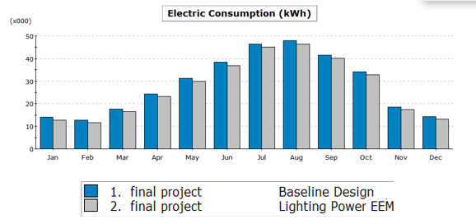
Comparison between Base Case and Case one
The total electric consumption saving was about 15470 kWh/year, which means that the annual bill dropped from 204762 NIS to 195480 NIS , about 4.5% saving.
 | Base Case (kWh *1000) | Case One (kWh *1000) | % diff from Base Case
Space Cool | 265.07 | 263.54 | -0.58%
Space heat | 0.87 | 0.88 | 1.1 %
Area lights | 30.35 | 16.40 | -46%
Total |  |  | -45.48%

Slide 24
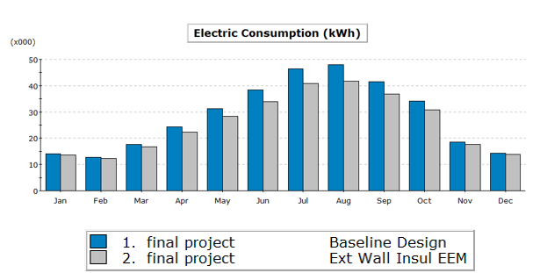
Comparison between Base Case and Case Two
The total electric consumption saving was about 32130 kWh/year, which means that the annual bill dropped from 204762 NIS to 185383 NIS , about 9.4% saving.
 | Base Case (kWh *1000) | Case Two (kWh *1000) | % diff from Base Case
Space Cool | 265.07 | 233.26 | -12%
Space heat | 0.87 | 0.55 | -36.8 %
Total |  |  | -48.8%

Slide 25
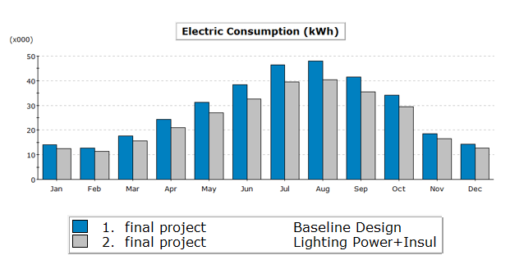
Comparison between Base Case and Case Three
The total electric consumption saving was about 47400 kWh/year, which means that the annual bill dropped from 204762 NIS to 176322 NIS , about 13.9% saving.
 | Base Case (kWh *1000) | Case Three (kWh *1000) | % diff from Base Case
Space Cool | 265.07 | 231.56 | -12.6%
Space heat | 0.87 | 0.56 | -35.6%
Area lights | 30.35 | 16.76 | -44.8
Total |  |  | -93%

Slide 26
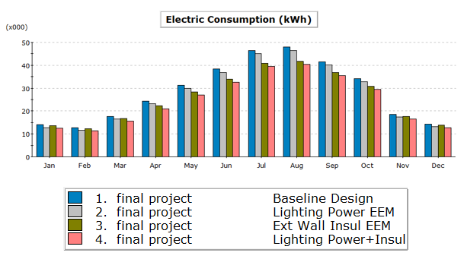
Simulation results
01
YOUR CONTENTS
Case One
Case Two
325800 kWh/year
309140 kWh/year
Base Case
Case Three
341270 kWh/year
293870 kWh/year

Slide 27
Conclusion

Slide 28
Conclusion
eQuest software was used to simulate the energy performance of the Royal wings Hotel in Nablus, Palestine. Through the process of calibrating the baseline model, the validity of the software was discussed. A comparison was made between the actual electric bills and the software resulting bills. The results of the comparison approve that the software was accurate and could be reliable for energy simulation.
Different parameters influence the energy consumption in the hotel. The first parameter discussed this semester is the lighting system. The replacement of the fluorescent lamps with led lamps made an annual bill saving 8000 NIS, which equivalent to 3.2%.

Slide 29
Future works

Slide 30
Future works
Modeling and discuss case two and three
LCCA for all cases using different funding methods
Design a solar PV system to cover the bills and study the LCCA for this case

Slide 31
THANK YOU

