Slide 1

Prepared by:
Gina Kadri
Shahd Abdulhaq
Supervised by:
Dr.Raed Al-Qadi

Slide 2
What is “Survive the Road“ Game?
A desktop/mobile (android) 2d with 3d illusion car game.
We provide multiple sub games.

Slide 3
Motivation
The dominance of smartphones.
The universal spirit of playing.
Mobile games are considered as very profitable businesses.
The huge experience one can gain while developing games.
Notes:
Wwe did reaseraches for engines…libgdx gave us the effeiceny and features we wanted

Slide 4


Libgdx Engine
Java game development framework.
Cocas2d -> IOS
AndEngine -> no ability to create the desktop
Version.
Notes:
S3obat.
Effiecent

Slide 5





LibGdx
  Desktop version
  Android version
  Open Source and free
  High-performance framework.

Slide 6
Application Layout
Our game consists of three projects :
    Core project
    Android project
    Desktop project
Notes:
Slide for each and pictures
Stress on this

Slide 7
Core Project
This Project contains all the codes of the game containing the whole functionalities.
all other projects are linked to this project.

Slide 8
Desktop Project
Contains the starter class to run the game on the desktop.
It is linked to the Android project's assets- folder as well as the core project.

Slide 9
Android Project
This Project contains the starter class to run the application on android.
The assets-folder which stores the assets of the game for all platforms.

Slide 10
Main Components
Stage : a container for all added Actors.
Actor: draw able objects rendered to the stage.
Sprite Batch: allows textures to be drawn by collecting geometry for the new texture.
Notes:
Stage: handles distributing touch events, animating Actors and asking them to render themselves

Slide 11
Main Components
Camera to project the whole scene.
Music Interface: to represent streamed audio files.

Slide 12
Key Features
Multiple Views.
Multiple Levels.
Multiple timing modes.
Multiple ways of controlling the movement.
Notes:
4ayre el 3enwan

Slide 13
Key Features
Contacting the player by showing statuses of the player’s progress, including:
    Score.
    Number of each elements the player collides with.
    Timer.

Slide 14
Challenging Factors:
  Limited time in higher levels.
  Ability to Increase the score and the speed.
  Obstacles scattered along the road to make the game more difficult and challenging .
  Ability to buy some elements from the shop to beat these obstacles.

Slide 15
The game can be partitioned into 2 main categories:
Competition
Adventure
  Top view track
  Back view track

Slide 16
Competition
This category uses AI to :
    Increase the difficulty of the game.
    Make the game more entertaining.
Notes:
AI more details

Slide 17
Artificial Intelligence Algorithms:
We built different algorithms to allow the shooting car to:
  Appear suddenly.
  keep tracking the player’s position.
  Keep shooting the player to cause his lives’ loss.

Slide 18
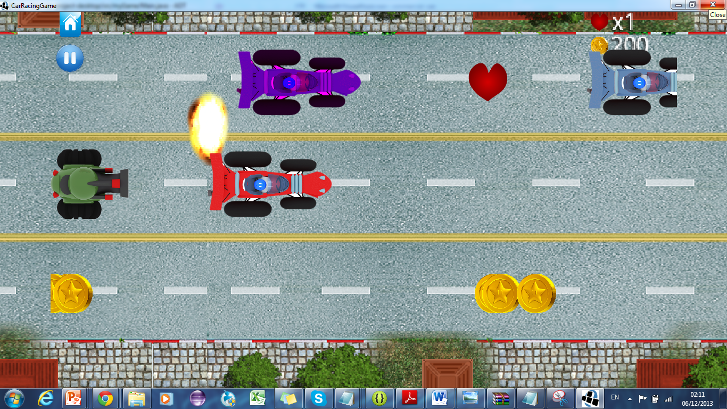
Notes:
Finite state machine

Slide 19
Back View Category
Two timing modes
    Limited time.
    Endless
Three levels of the limited time mode
    Easy
    Medium
    Hard

Slide 20
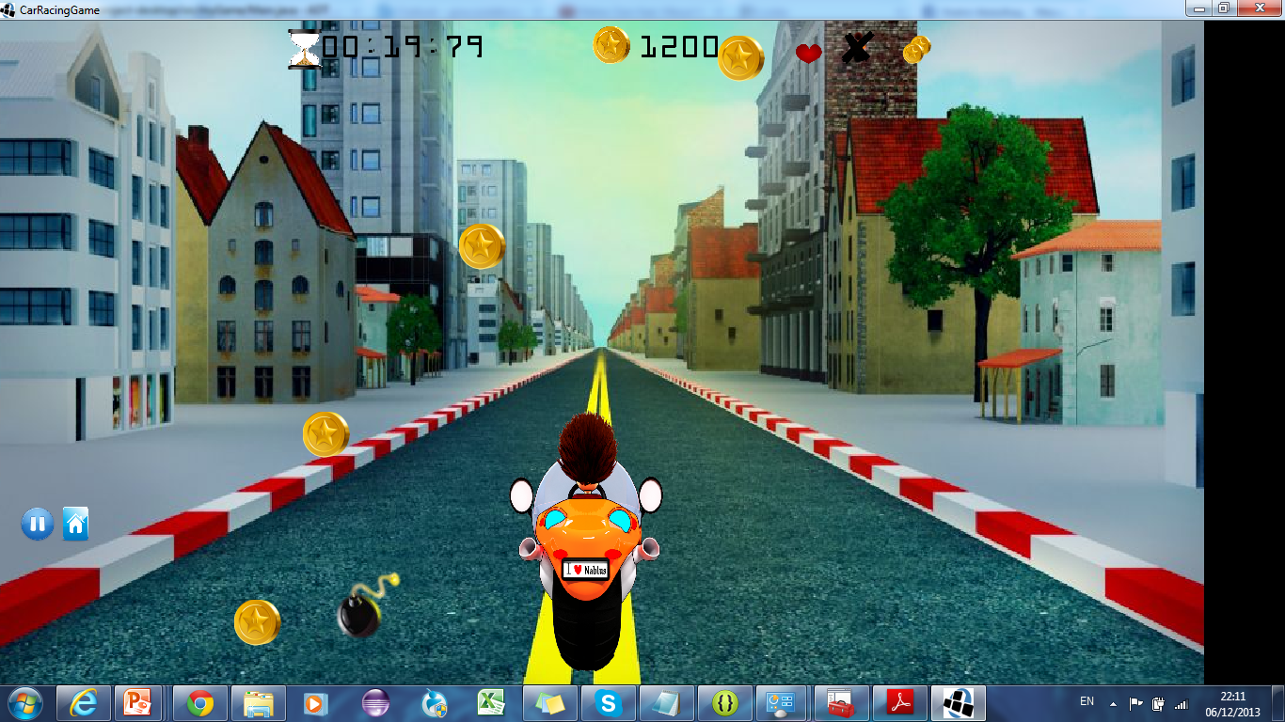

Back- view Category
We used perspective Camera.
The movement of the motor is controlled using Accelerometer.
We used animations to provide Illusion of 3d.

Slide 21
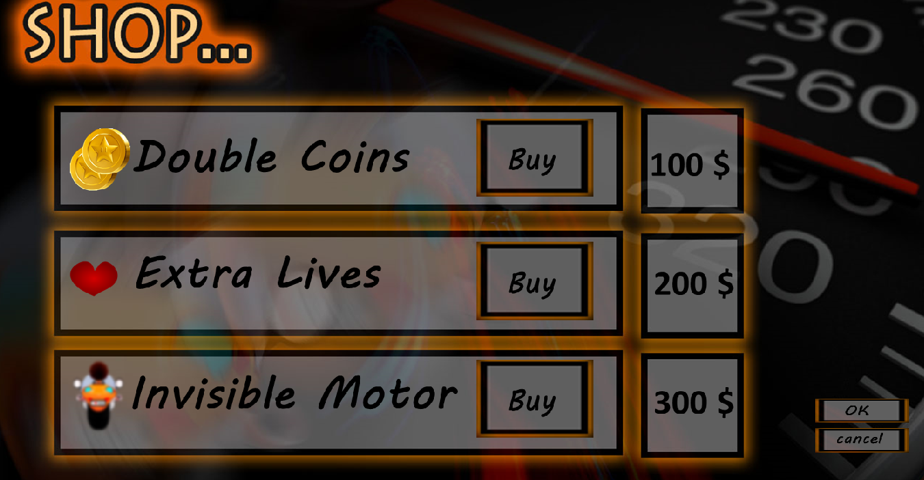
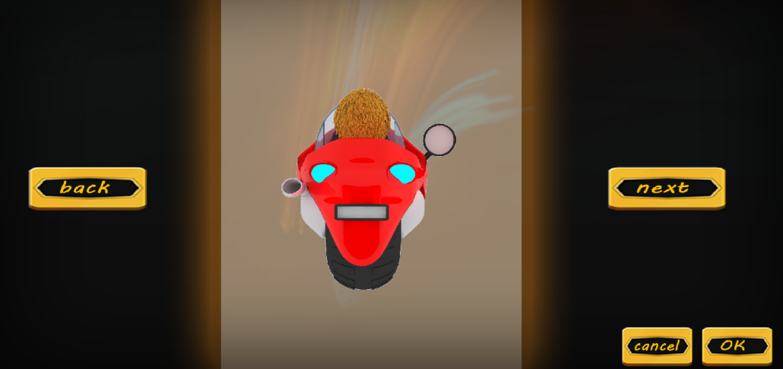
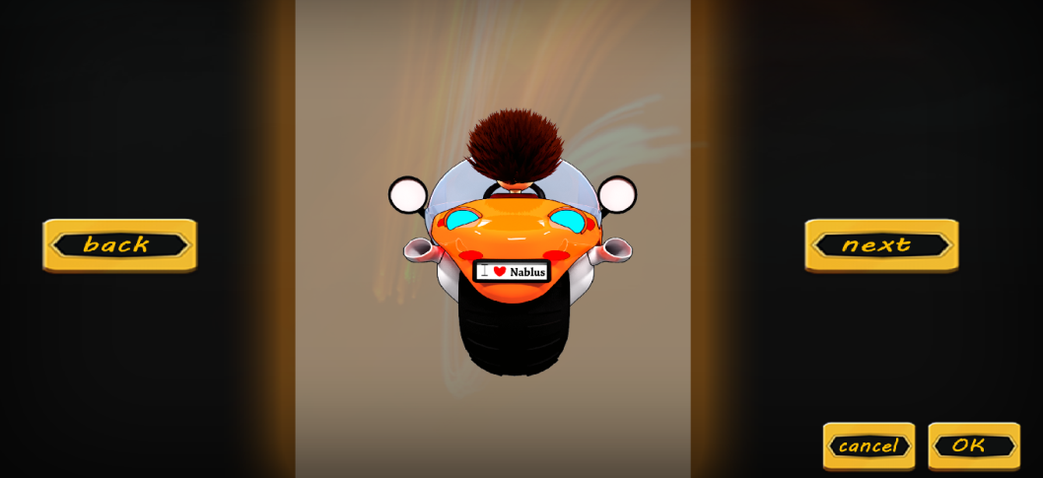
Notes:
Add showroom

Slide 22

Interacting with the player by showing the status of progress.

Slide 23
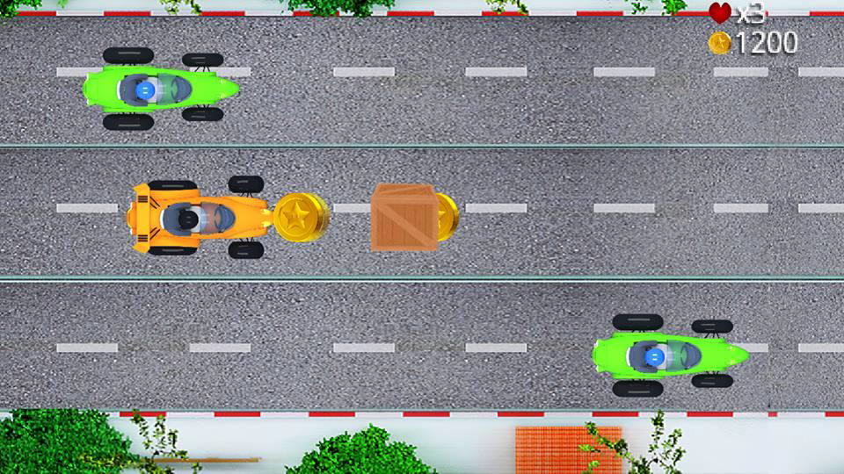
Top View Category
  We use Orthographic camera.

Slide 24
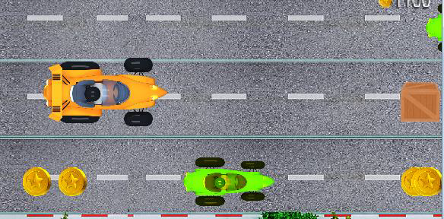
Top View Movements Techniques
Gesture Detector .
Jumping feature.
Ability to increase the speed using long press.
Notes:
describe

Slide 25
Parallax
Special scrolling technique in computer graphics.
We used it to scroll the top-view background. Infinitely.
Background images should be moved slower than all foreground images .

Slide 26
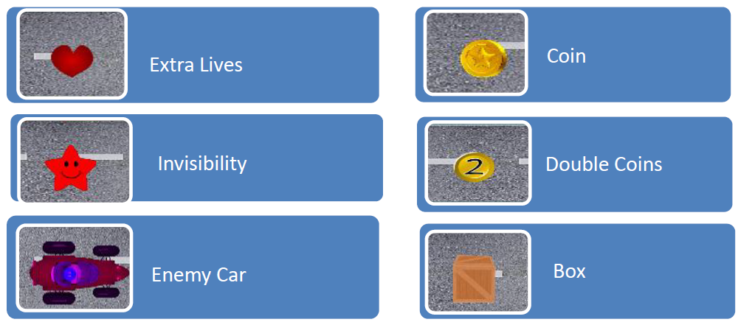
Top View Elements

Slide 27
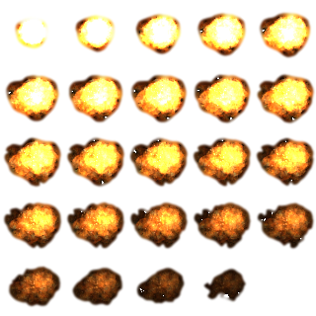
Some used Techniques
Sprite Animation:
  Sprite animation is the technique
  used to create the illusion of
  movement using static images
  (frames).
  We used this technique in :
    Explosion animation.
    Track in back view category.

Slide 28

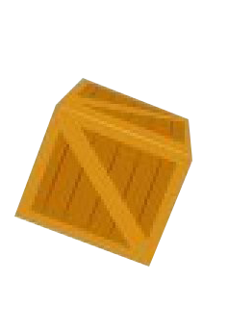



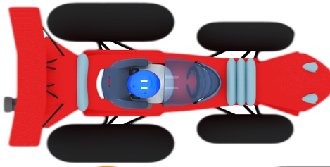
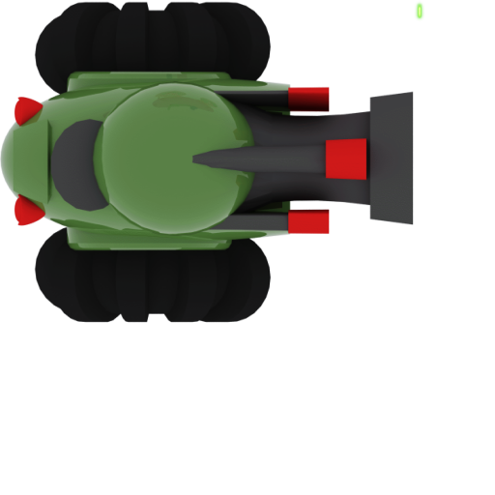


2.Collision Detection
In our game we keep detecting collisions between the player and each of the following objects:

Slide 29
We are treating these objects as rectangles that have changing bounds according to the movement.
So we track the player’s bounds and each of those objects’ bounds to detect if an overlapping between the player and any object occurred to fire the effect of that collision.
Notes:
T2lel 7ake

Slide 30
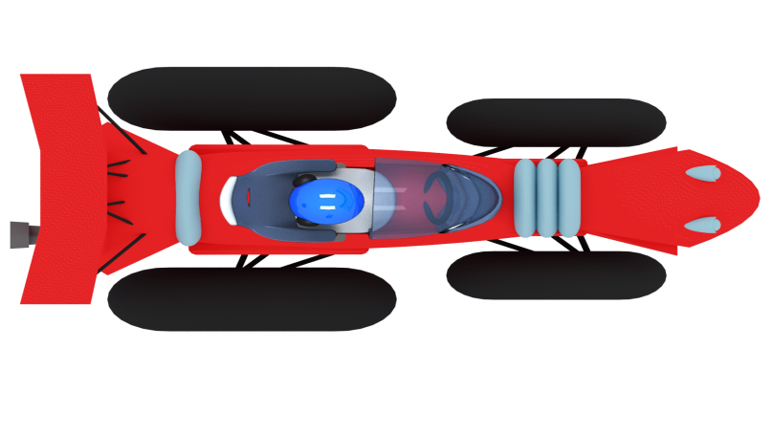
We check the collisions of the four sides of the player.
Notes:
Rasme bdl code

Slide 31






Tools used
Notes:
Add Gimp rather than painter

Slide 32
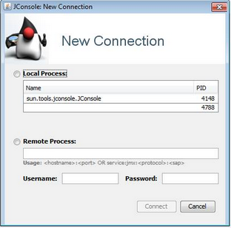
For memory optimization and leakage debugging:
    MAT Eclipse Memory Analyser
    Jconsole.jar

Slide 33

Other Online Tools:

Slide 34
Desktop Demo

Slide 35
Problems And Solutions
1. The differences between both desktop and mobile device platforms.
  Two different worlds, coordinates and sizes.
  Different ways of controlling:
    Movements.
    Events handling
      On android we needed InputMultiplexer to listen to multiple types of events using gesture or touches.

Slide 36
2.Memory Leakage
- Games are heavy resources applications, using images and sounds which consume considerable amount of RAM.
- Most of these recourses are not managed by the java garbage collector, so we need to manage the memory manually .

Slide 37
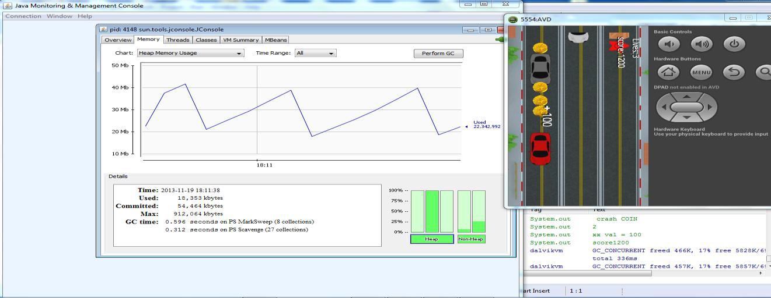
We used the JConsole , which provided us with information about the performance and resource consumption of our game.

Slide 38
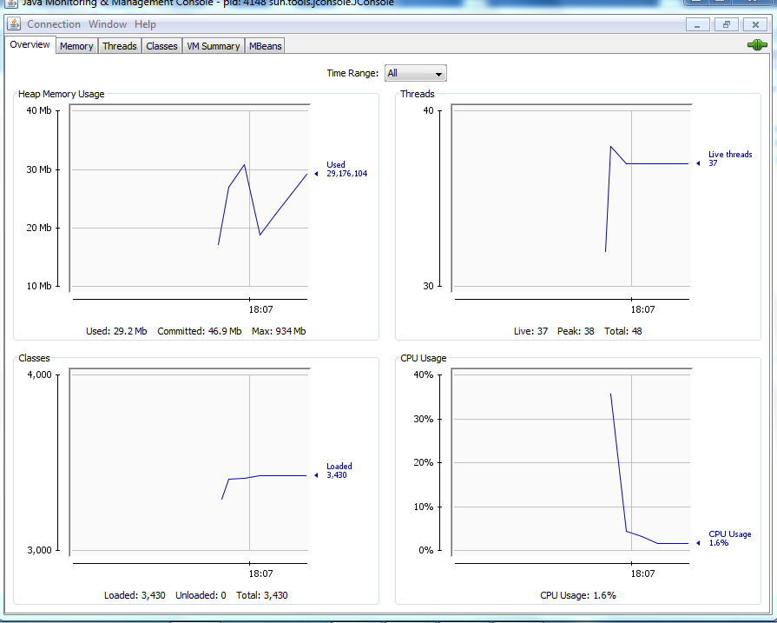
Before running the game

Slide 39
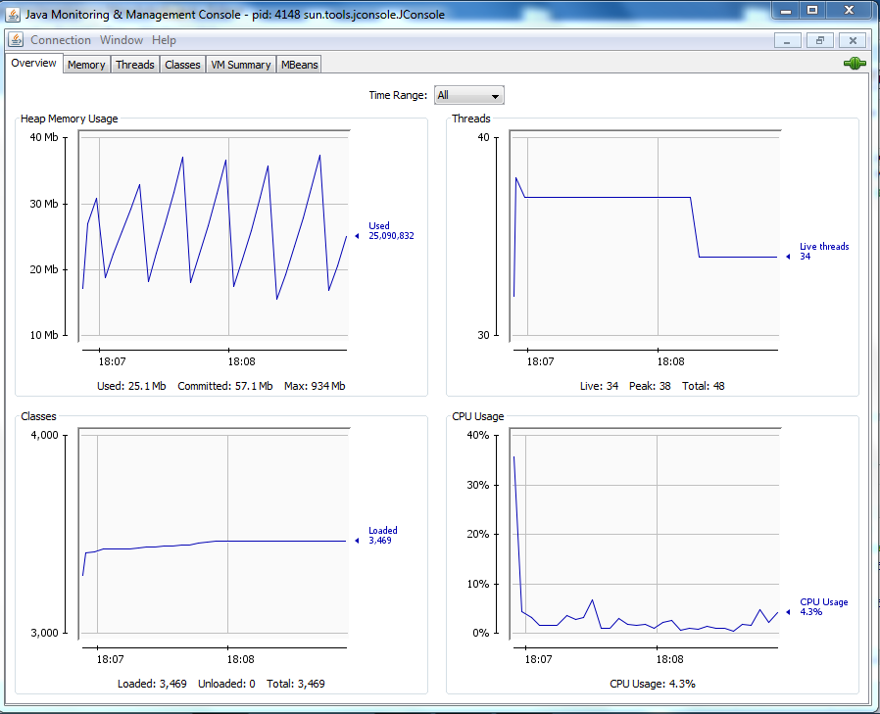
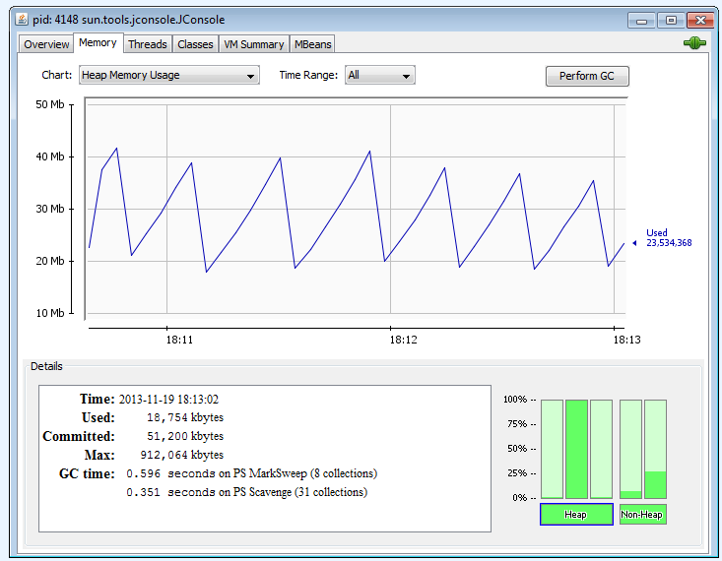
When the game was running!

Slide 40
Analyzing
We did some memory analysis using Eclipse Memory Analyzer (MAT) to identify memory leakage, and see which objects at heap cause the problem .
We used JConsole to represent the performance of the memory and CPU while the game is running .

Slide 41
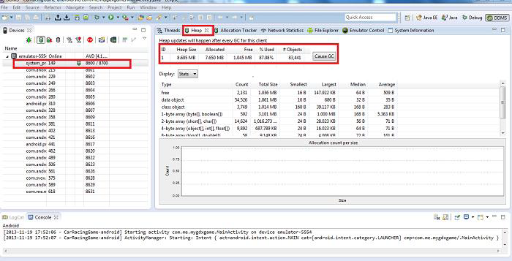
We analyzed all the processes using MAT.

Slide 42
Solution
Code optimization to make the game more efficient
Enabling and disabling the blending on batches to render the graphics only when they are needed.
We did precise optimization for the memory allocation and graphics as well.

Slide 43
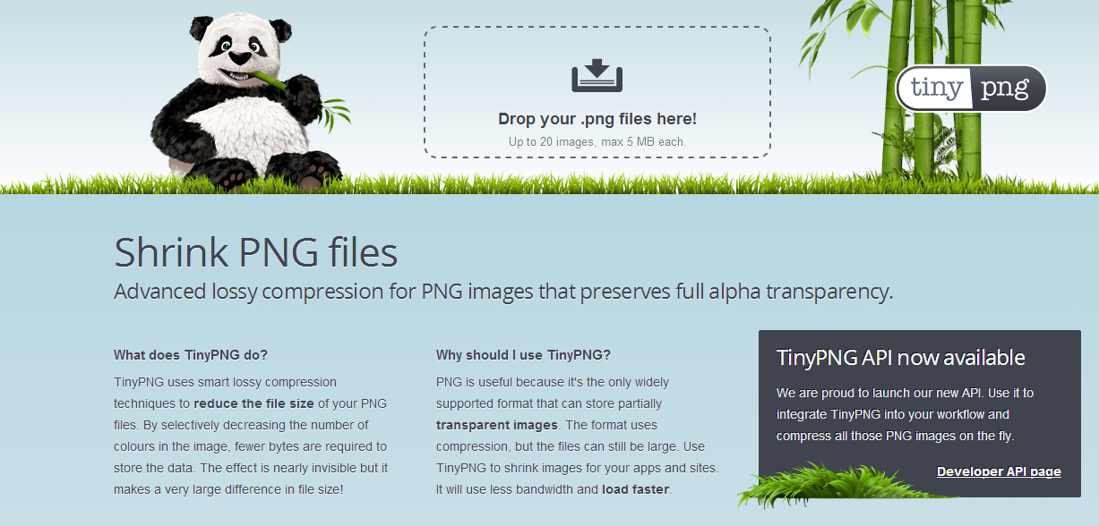
Optimizing the graphics
We used different techniques for optimizing the graphics
    1.We shrank the PNG images while preserving the resolution using tinyPNG.

Slide 44
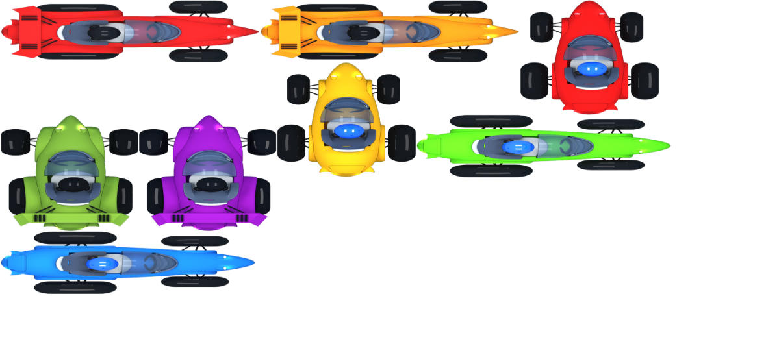
2.Texture atlases and sheets to load just one sheet rather than multiple textures to gain higher performance.
    Loading individual 8 cars → 3MB
    Loading a sheet of 8 cars → 1.8 MB

Slide 45
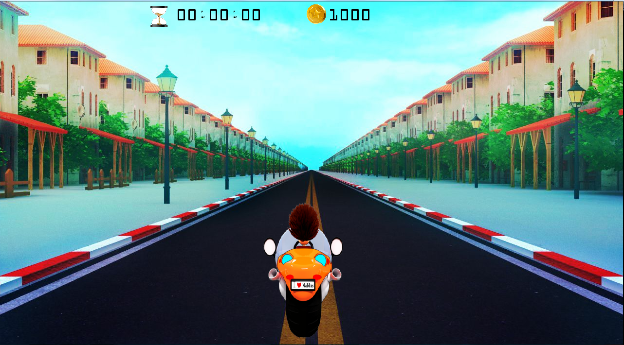
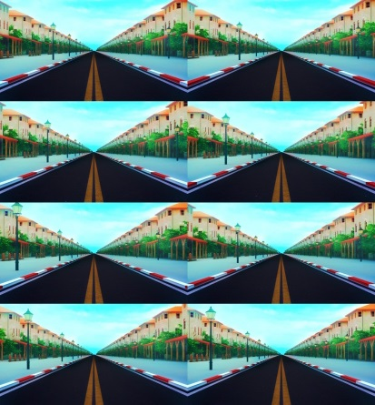
3.Creating animations
Limitations:
  Number/size of frames
  If low→ not sufficient scenes.
Notes:
Last one must be as first one

Slide 46
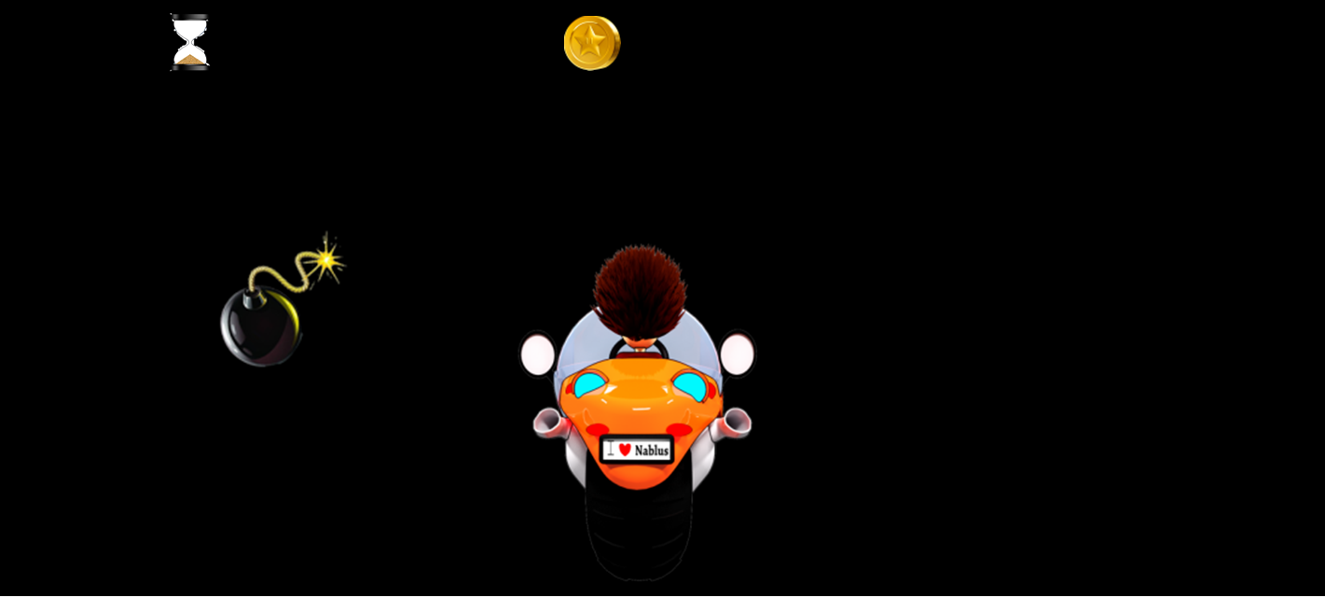
  If large number of frames
→ large sizes in one sheet may be not draw able.

Slide 47
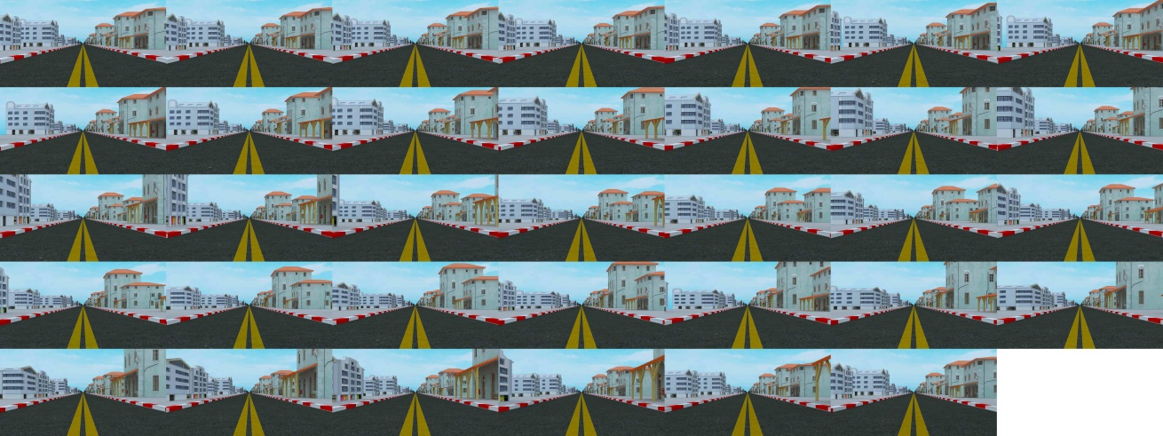
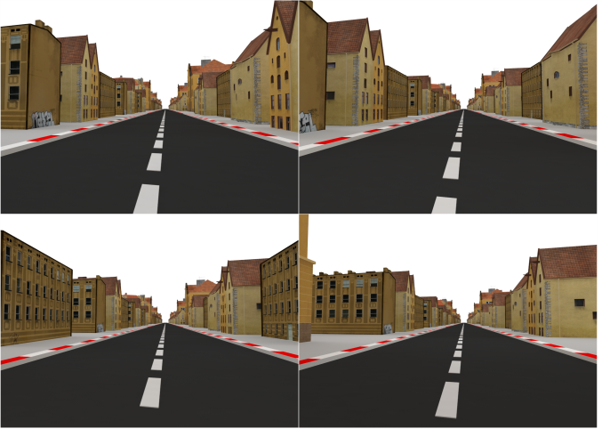
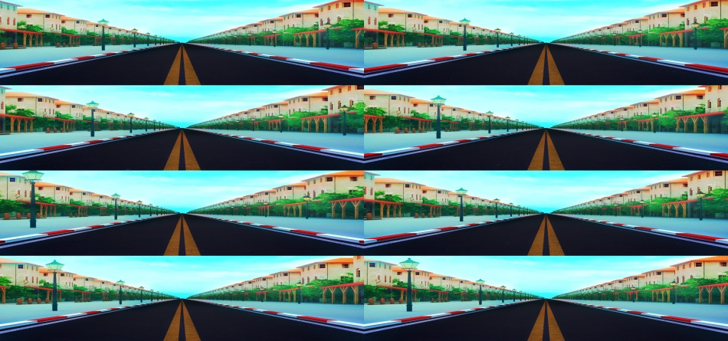

We created more than 100 sheets! until we got the view we wanted perfectly well

Slide 48
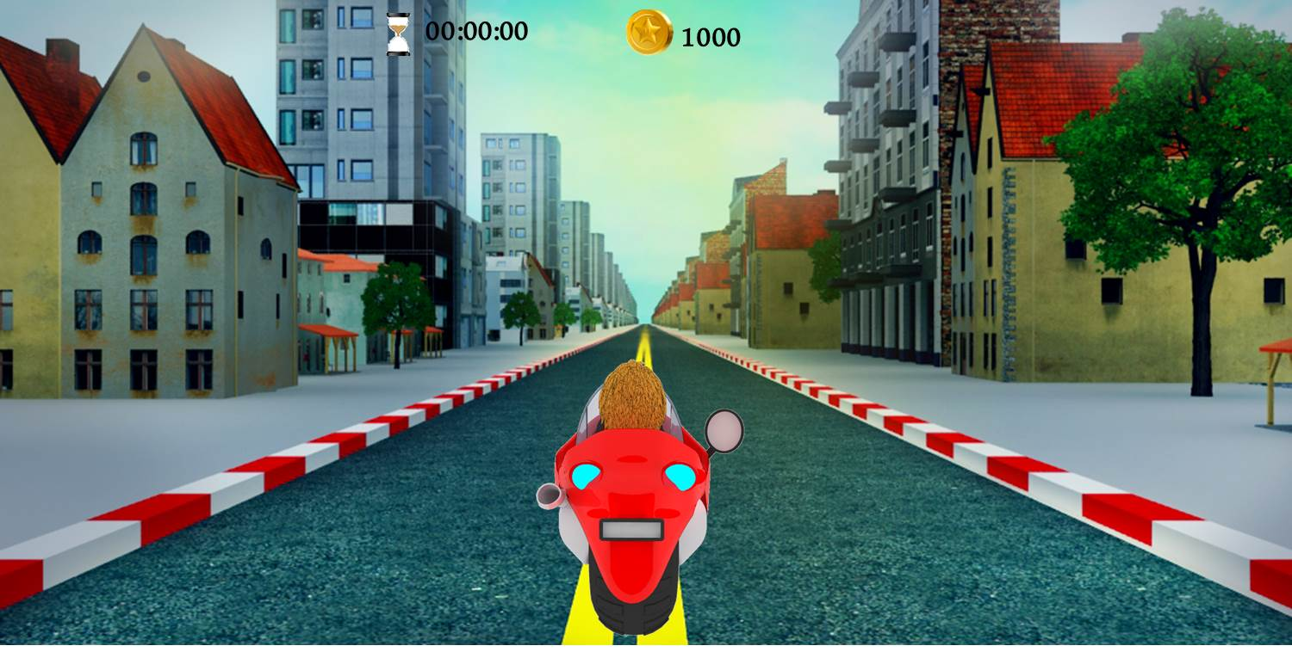
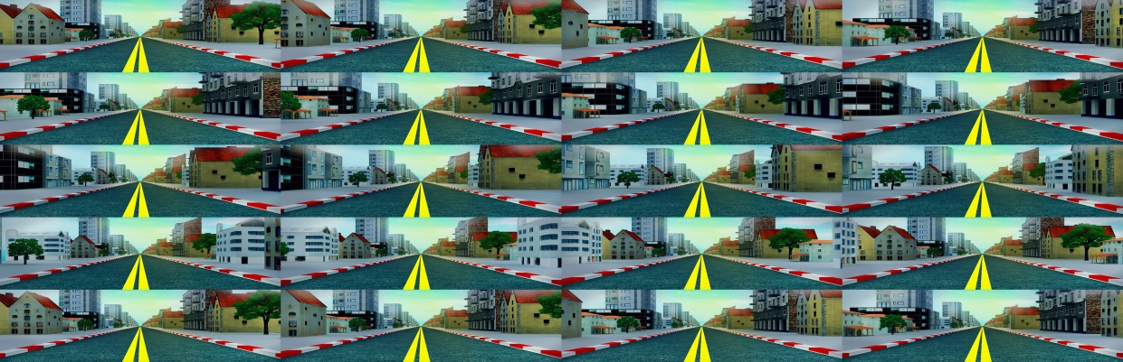
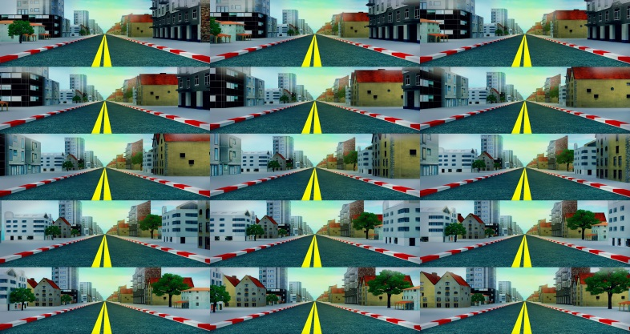
We partitioned the frames into two sprite sheets in order to render large number of frames resulting different scenes.
Notes:
Ma btt7mal aktr mn 5000 pixels

Slide 49

Future Work
Turn it into business
Providing other effects and features
  Multiplayer feature over Wi-Fi or Bluetooth
  Full 3d category
  Html/IOS versions

Slide 50
Android Demo

