Slide 1

An-Najah National University
Faculty of Engineering and Information Technology Department of Mechanical and Mechatronics Engineering
Graduation project 2
Cigarette Rolling Machine Supervisor:
Dr. Salameh Abdul Fattah.
Group members: Mohammad Nasri Abu Alrob Majdi Abed Al Hameed Kmail

Slide 2
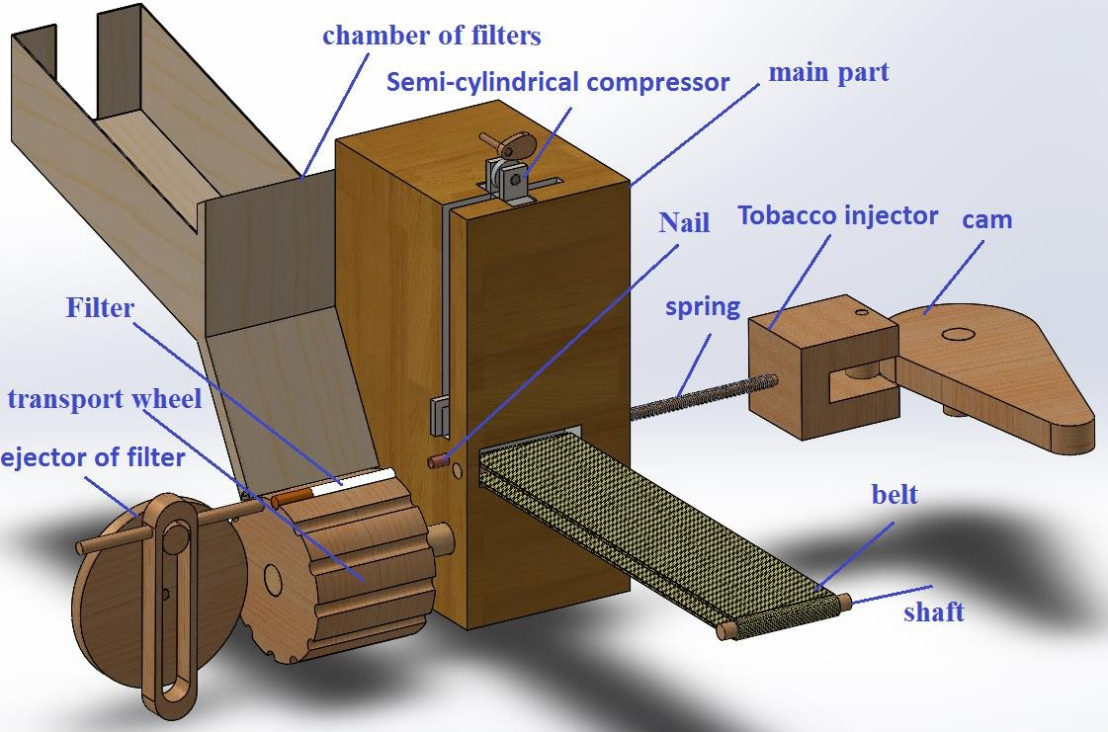

Slide 3
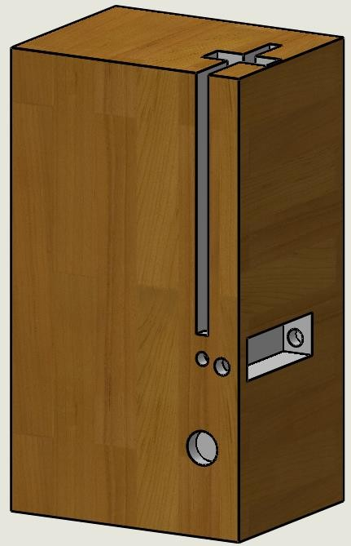
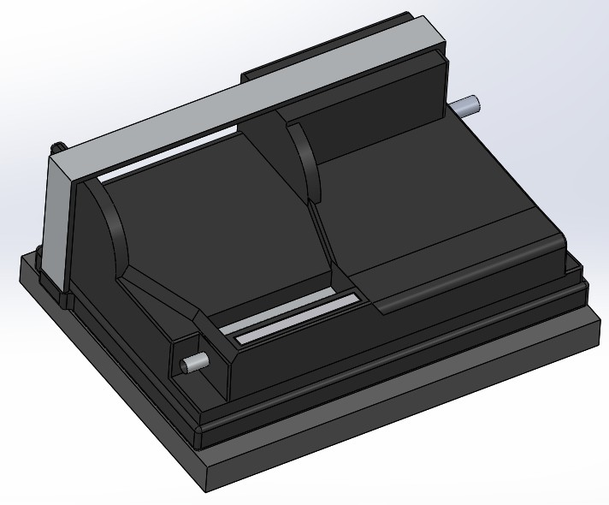
or removed, and parts remained as they were
In Project 2 new parts were added, other sections were modified
Mechanical parts
1. Main part

Slide 4
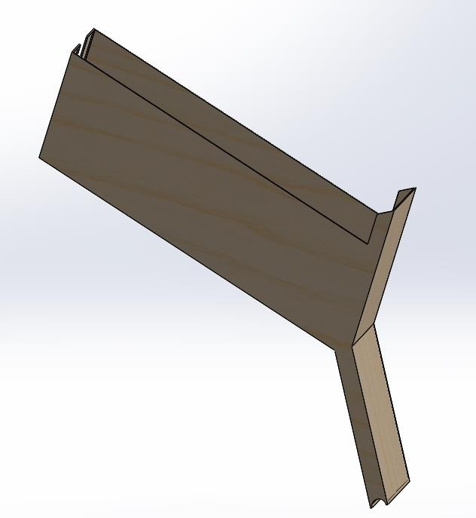
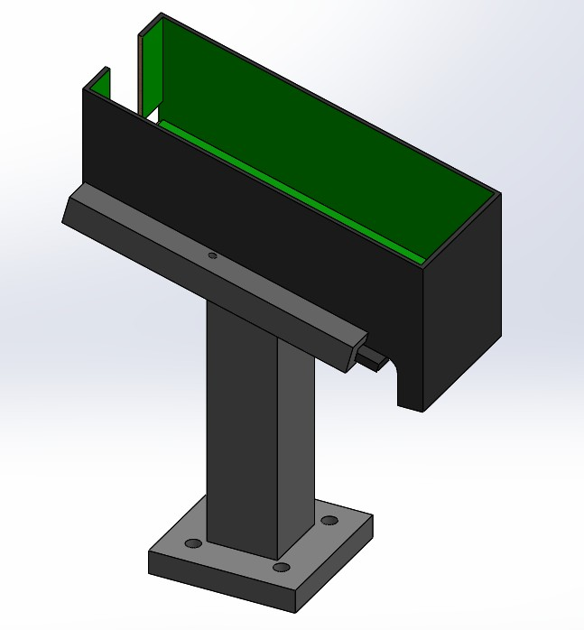
2. Chamber of filters

Slide 5
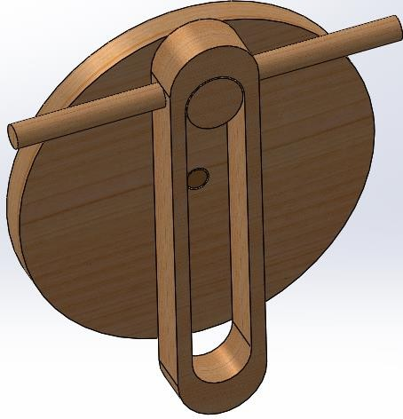
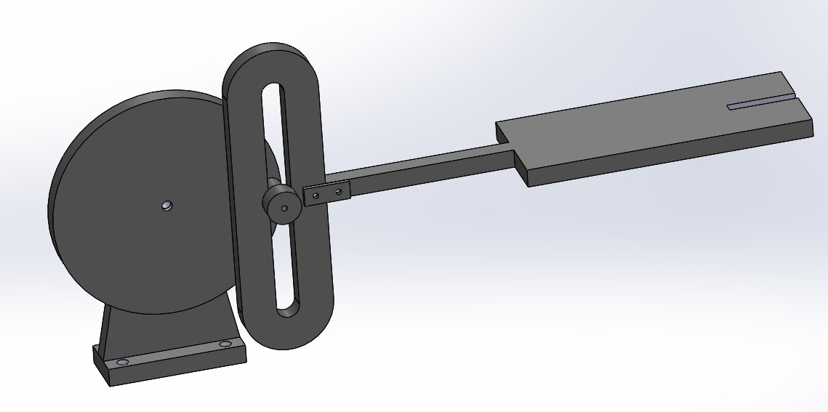
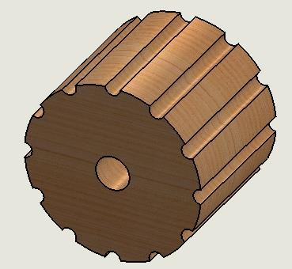
Ejector of filters

Slide 6
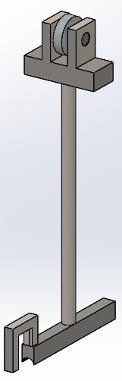
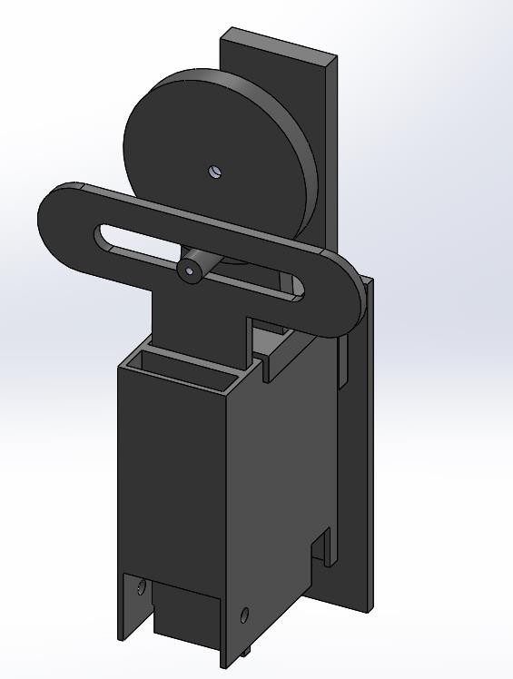
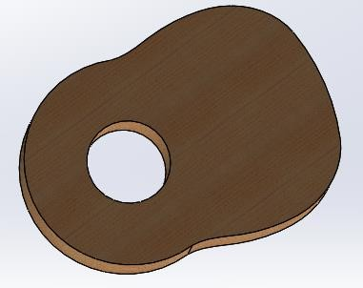
Semi-cylindrical compressor

Slide 7
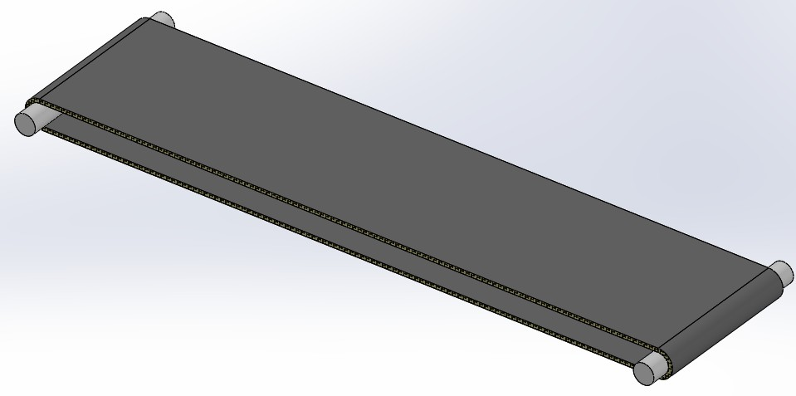
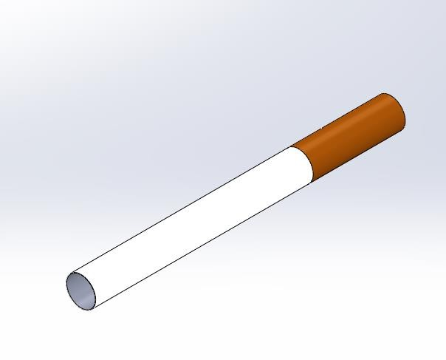
Tobacco's belt
Filter

Slide 8
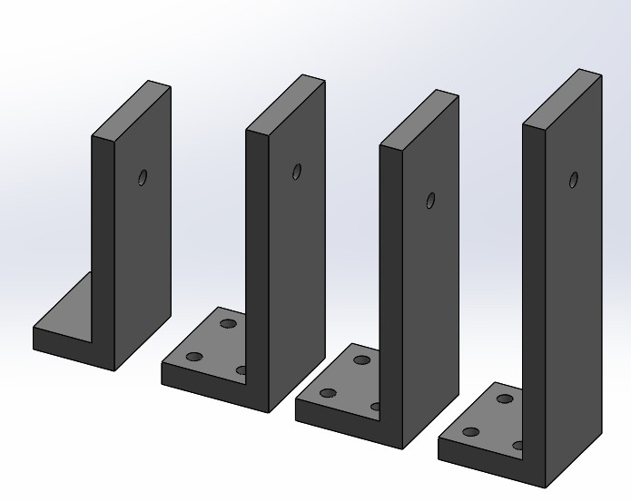
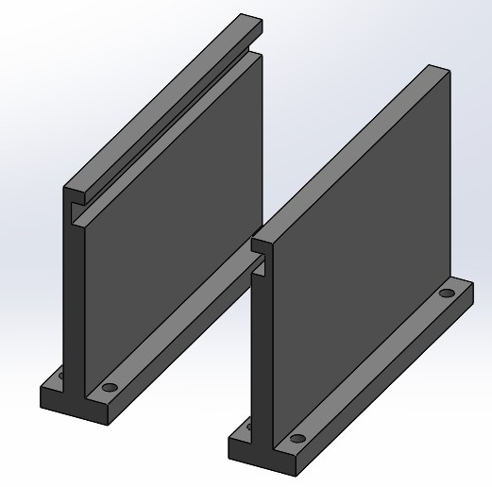
Base for stepper motor
channel for ejector of filter

Slide 9
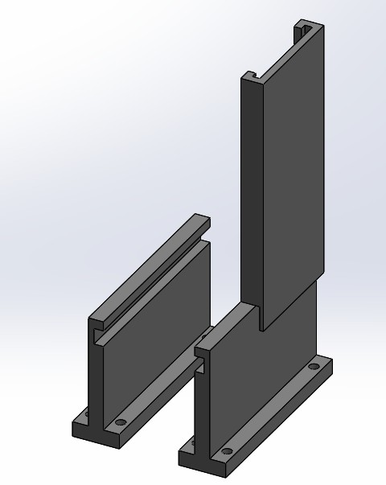
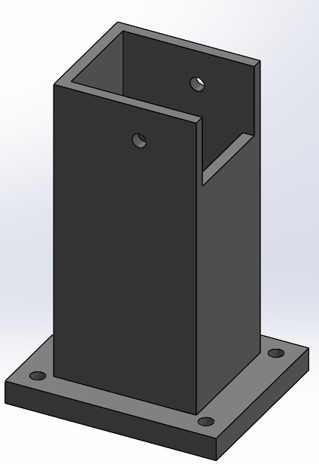
channel for main part
Base for belt

Slide 10
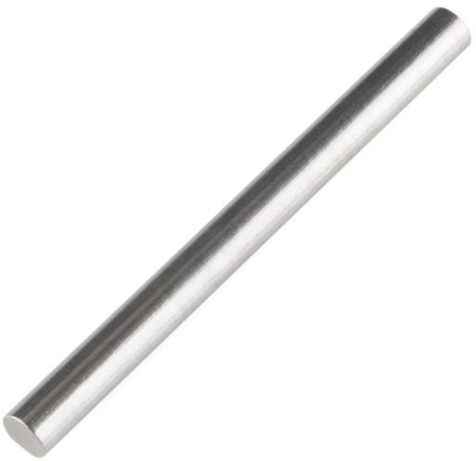
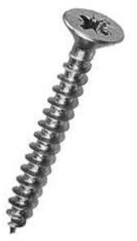
Screw
Shaft

Slide 11
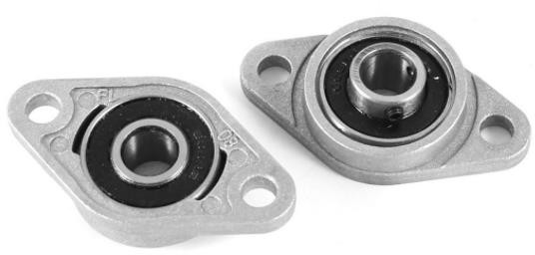
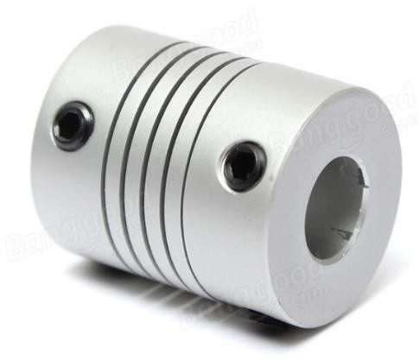
Flange bearing
Coupler

Slide 12
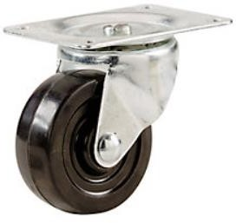
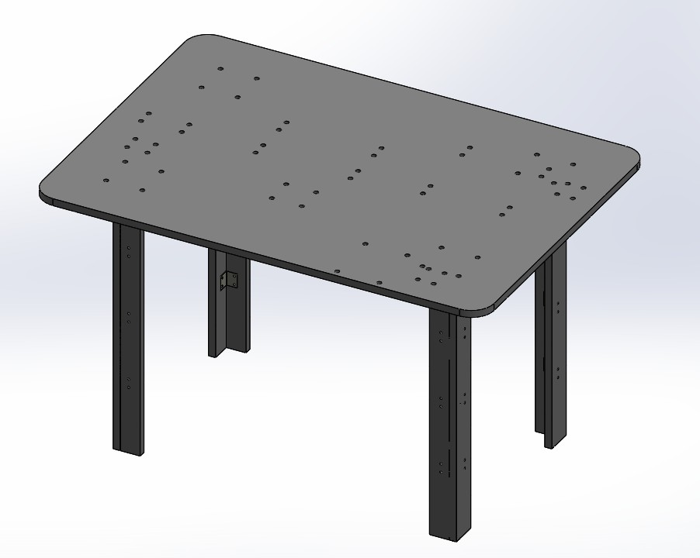
Industrial wheel
Table

Slide 13
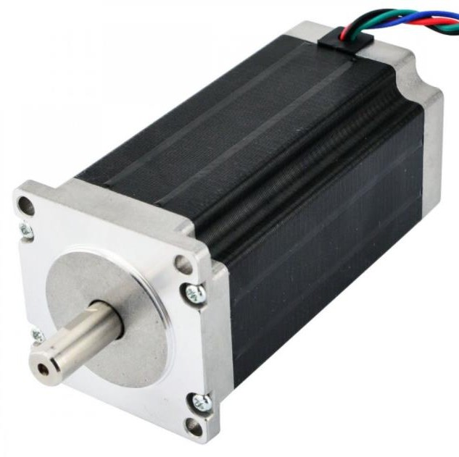
Electrical part :
Stepper motor

Slide 14
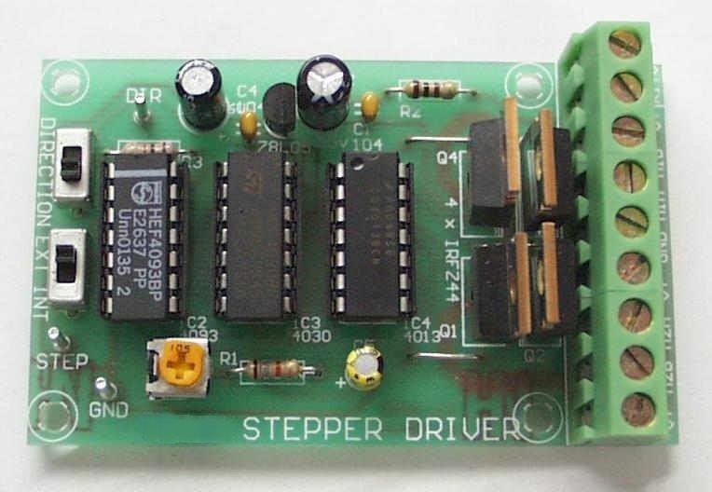
Stepper Driver
The drivers are responsible on the application's Motion Control by managing the speed and motion precision. During operation the driver receives feedback from the motor and allows the circle to close , and its connected between stepper motor and Arduino

Slide 15
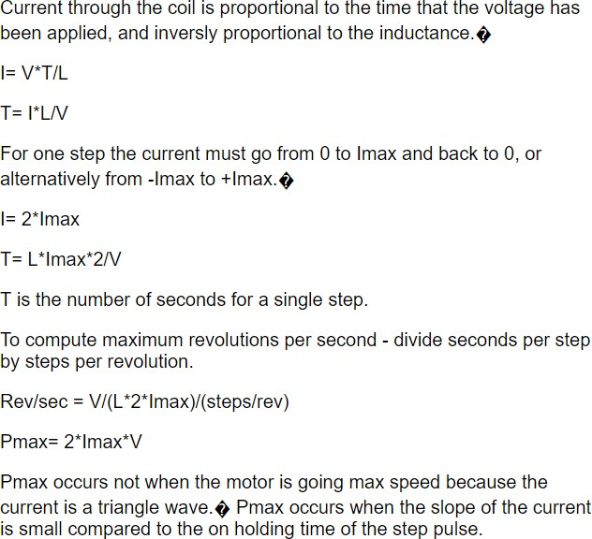

Slide 16
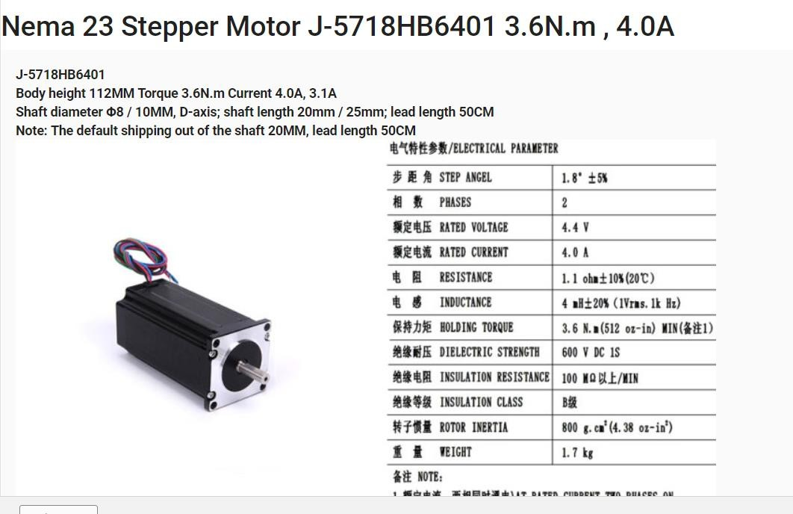

Slide 17
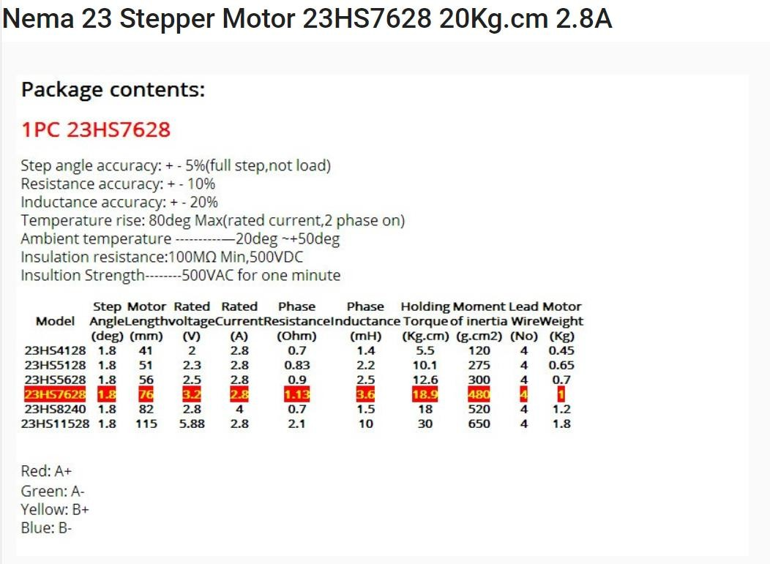

Slide 18
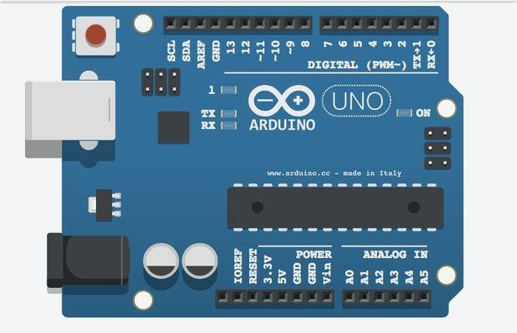
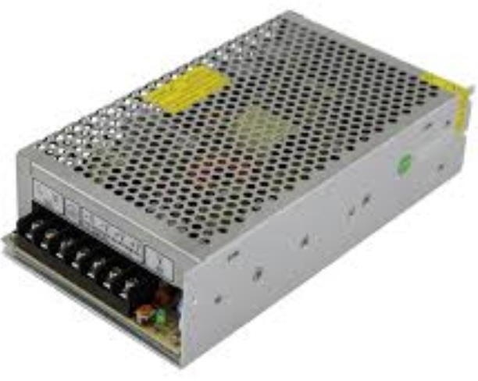
Arduino
power supply unit

Slide 19
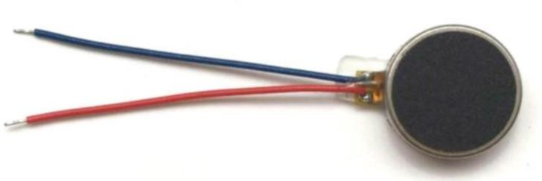
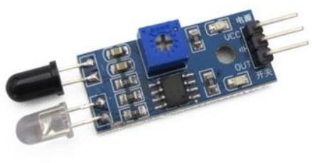
vibrating motor
Sensor IR

Slide 20
Recommendations:
We design our machine to produce a small quantities , but we can to develop it's productivity to produce a huge quantities integrated production line.
We also can add a packing part with our machine.

Slide 21
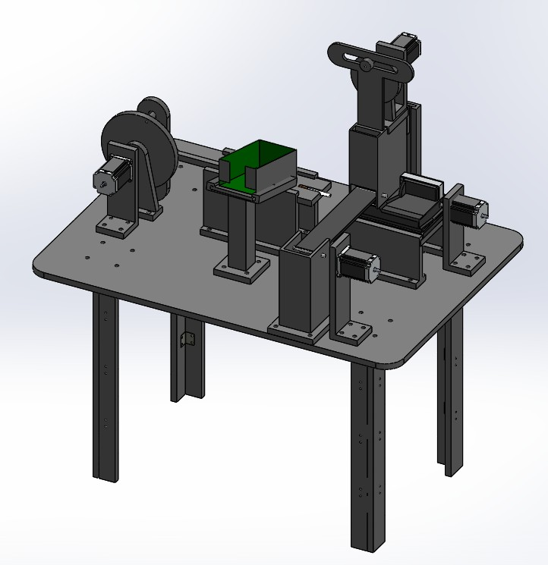

Slide 22
Thank You

