Slide 1
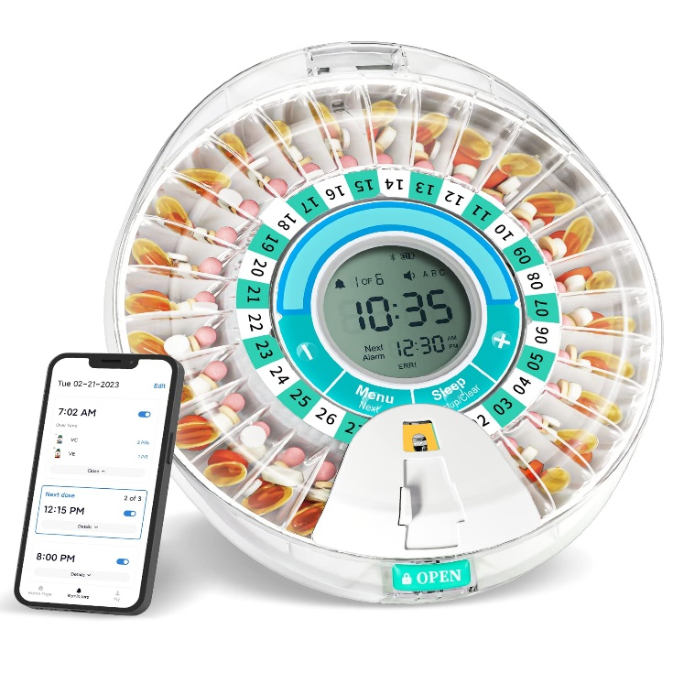
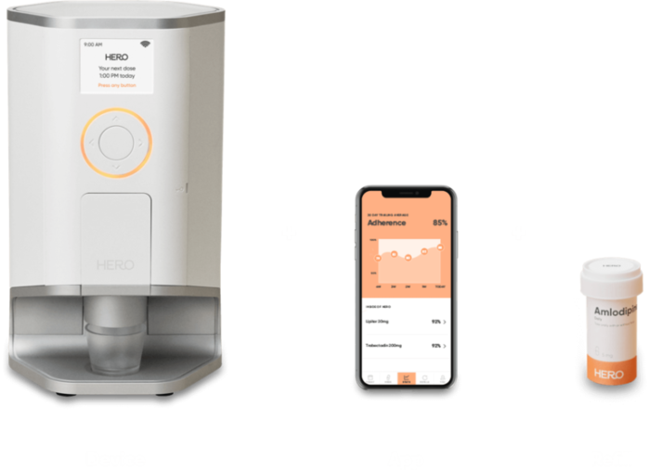
Smart Medicine Dispenser & Home Automation
MedHero

Slide 2
Introduction
Smart medicine dispensers represent a significant advancement in healthcare technology, offering improved medication adherence and patient care. These devices aim to address the challenges associated with medication management, including dosage accuracy, adherence tracking, and remote monitoring.

Slide 3
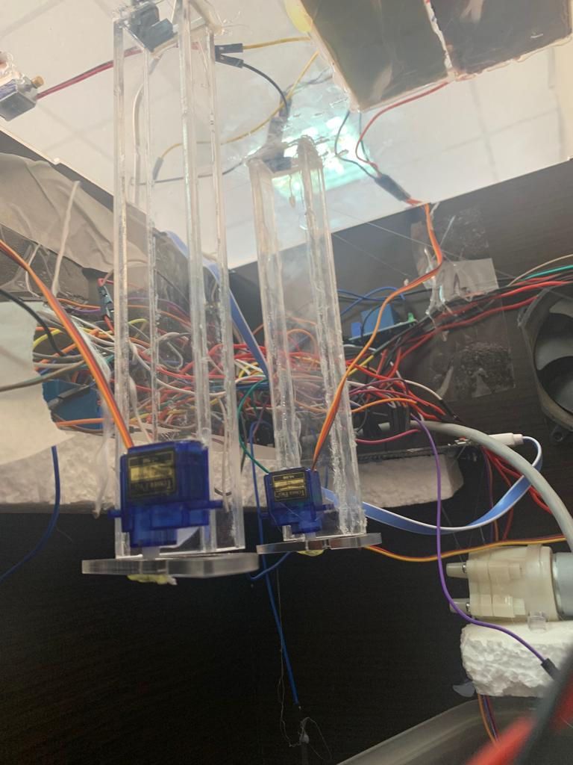
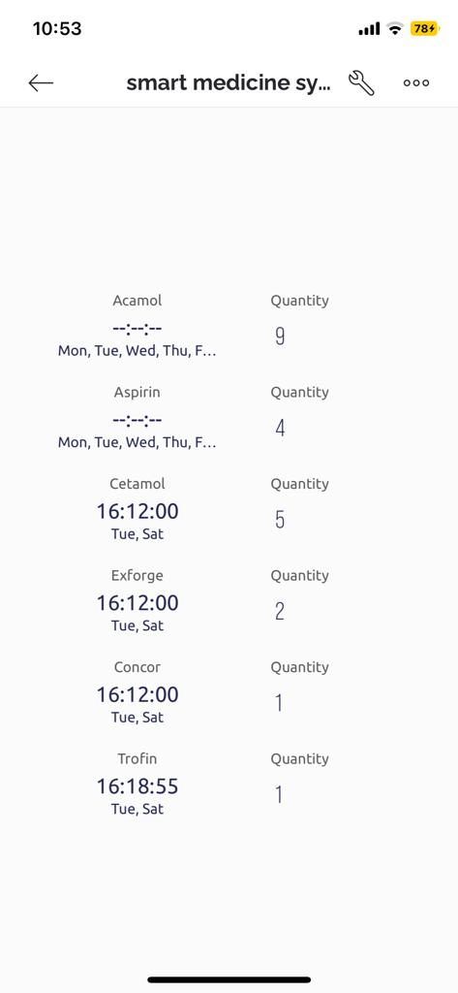
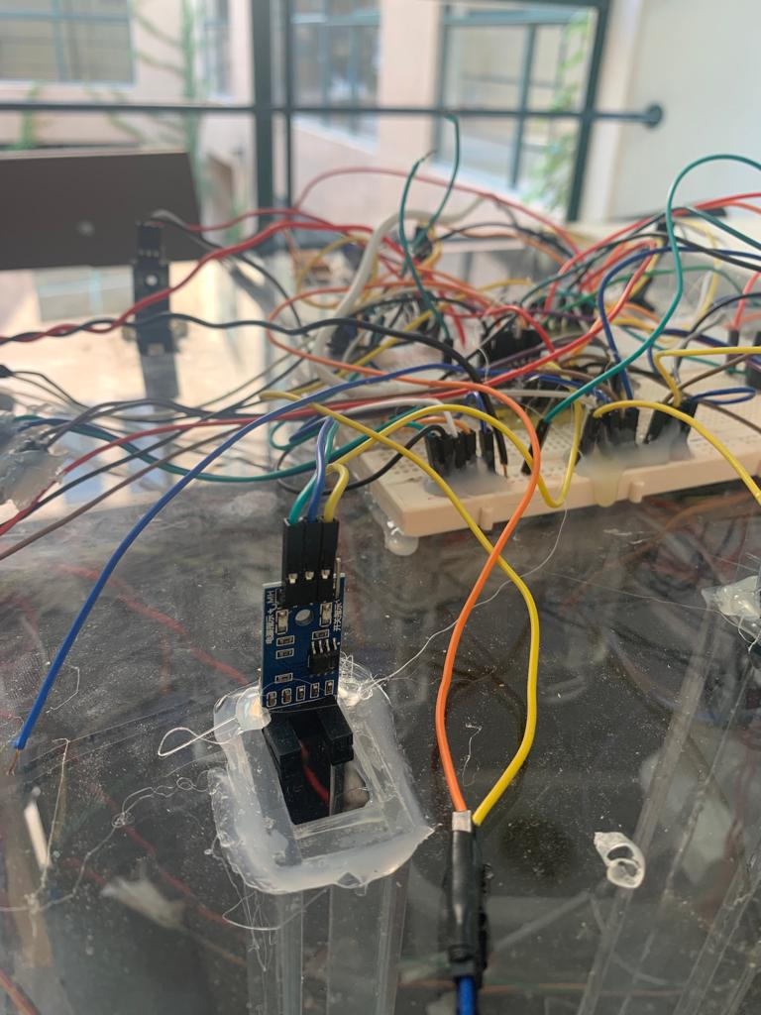
The Smart Medicine Dispenser offers the capability to store, dispense, and schedule medications effectively.

Slide 4
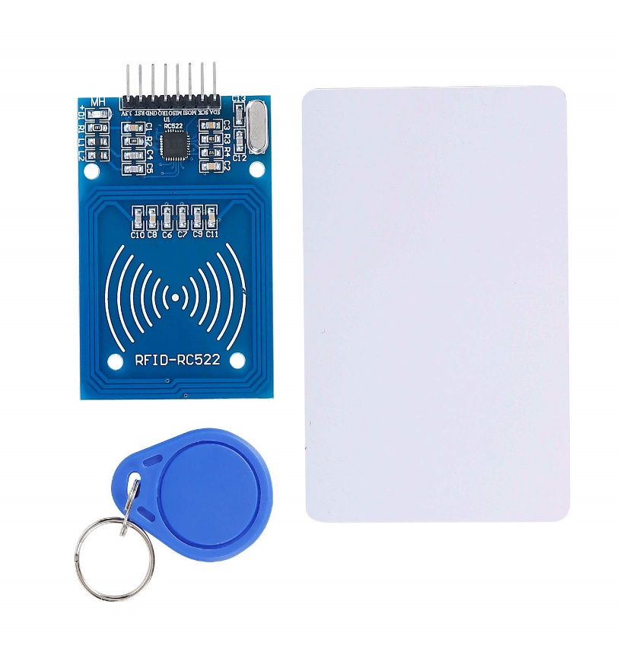
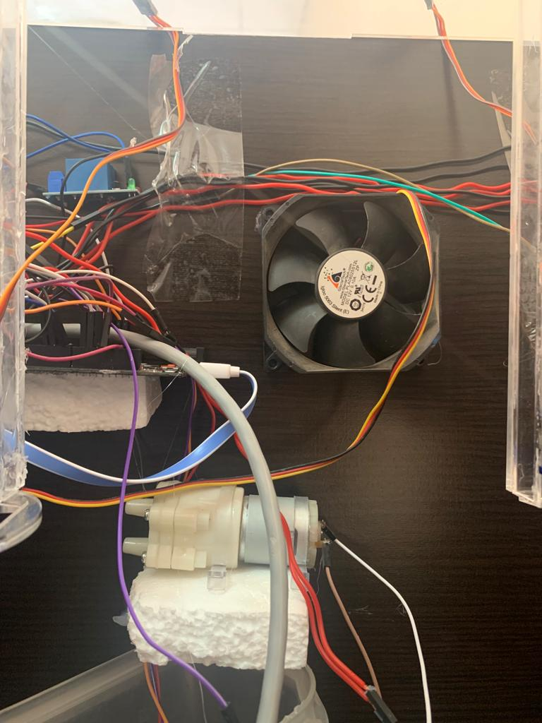
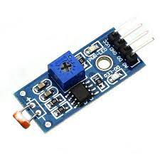
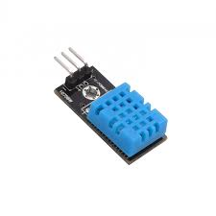
the project extends its functionality to home automation by incorporating temperature control, a water pump, fans, and an RFID-based access control system.

Slide 5
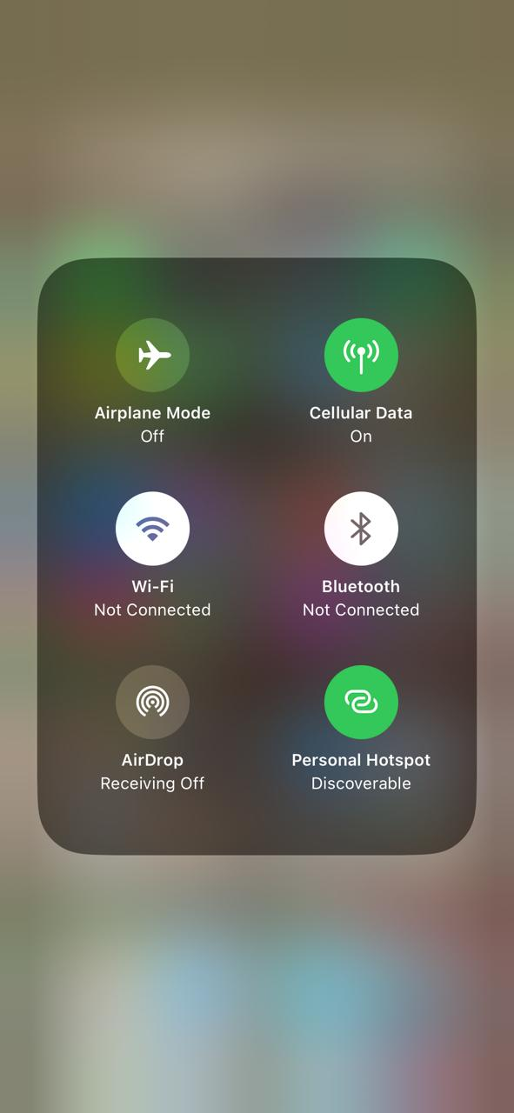
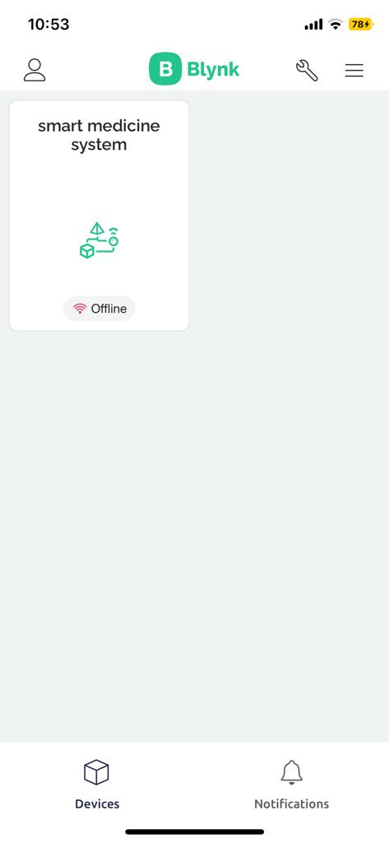
Home Automation and IoT
The Blynk mobile application acts as the user interface, allowing users to schedule medication doses, receive real-time updates, and monitor medication history.
It communicates with the ESP32 via Wi-Fi, enabling remote control.

Slide 6
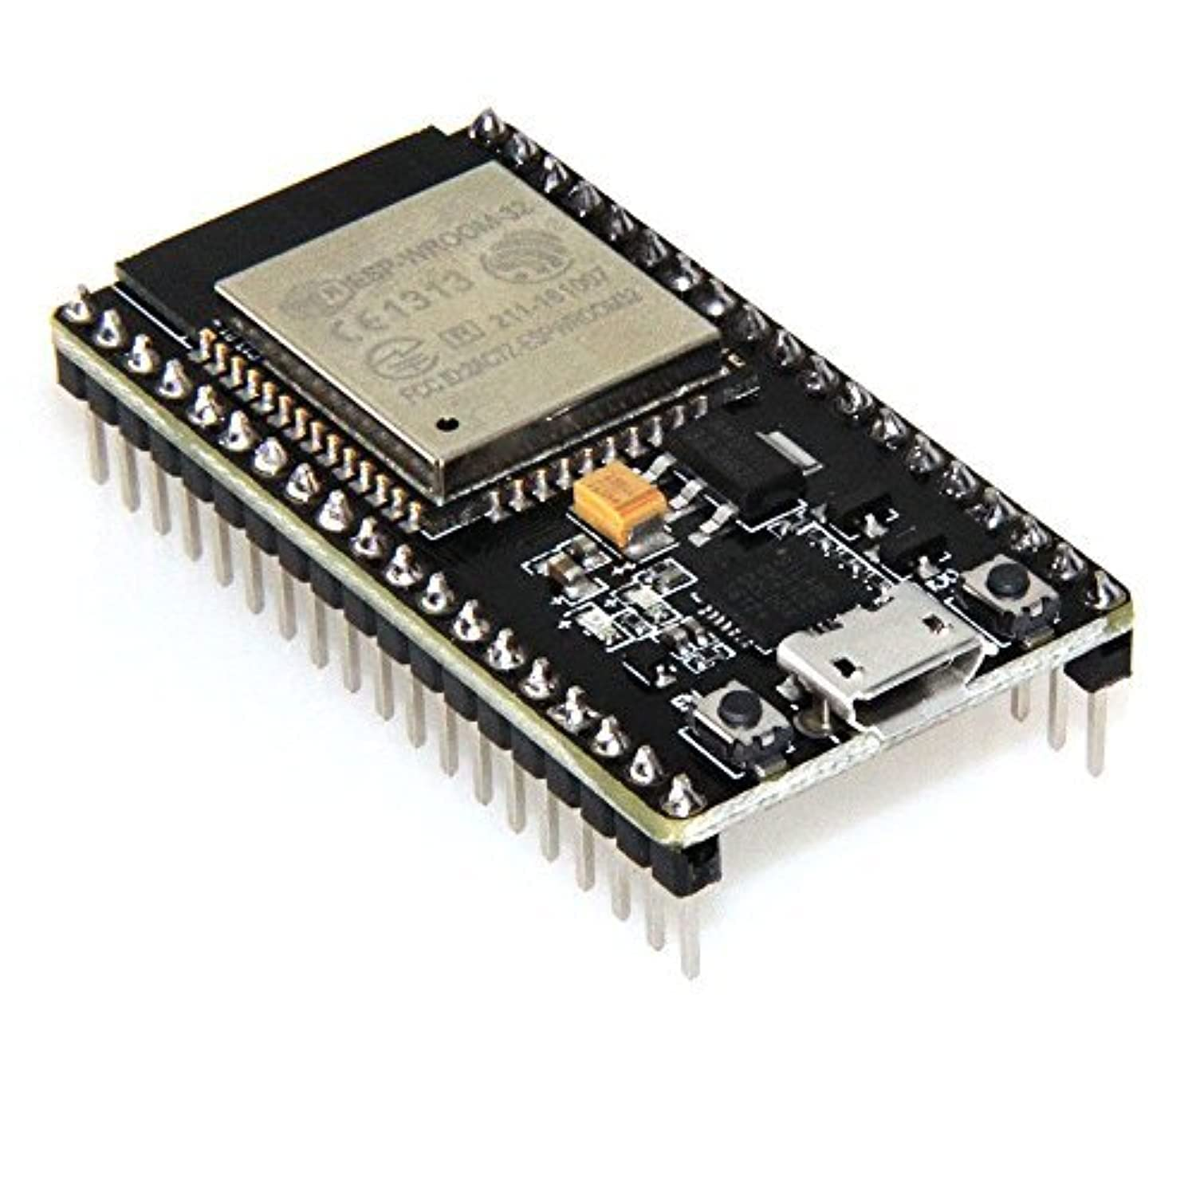
Hardware Components
ESP32 Microcontroller.
It is responsible for processing data from various sensors, managing medication dispensing, and interfacing with the Blynk mobile application.

Slide 7
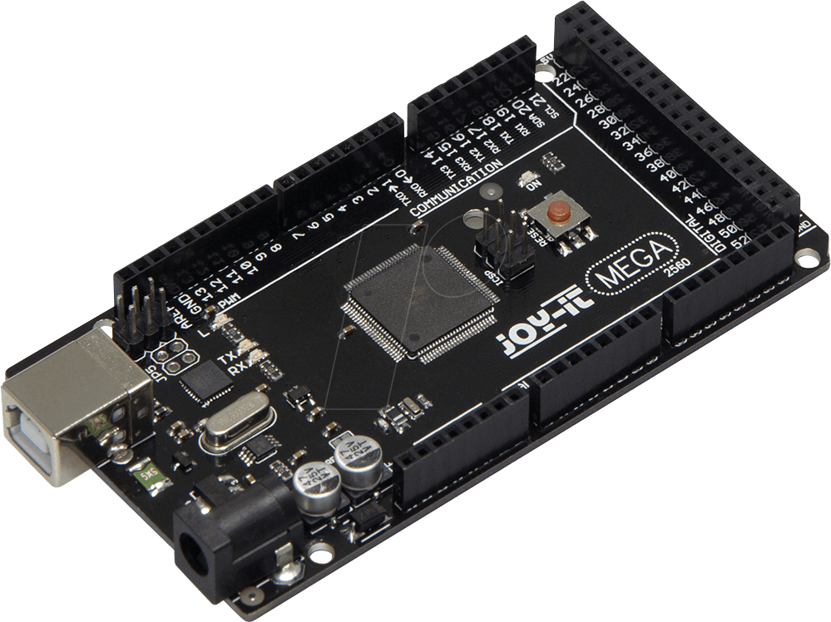
Arduino Mega 2560.
handling additional functions related to home automation. It connects to various sensors and actuators for temperature control, water pump activation, fan control, and RFID-based access.

Slide 8
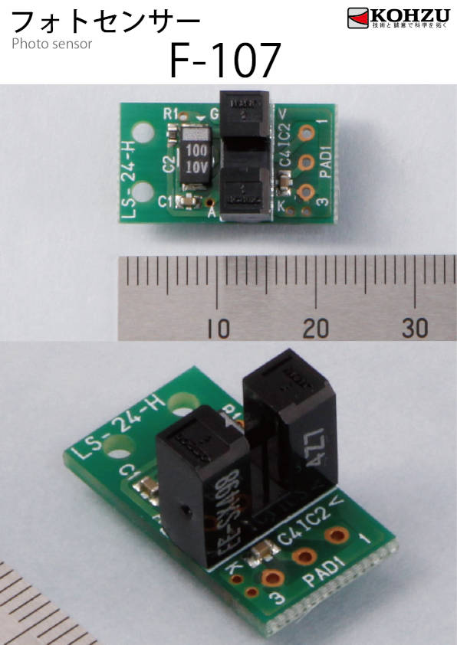
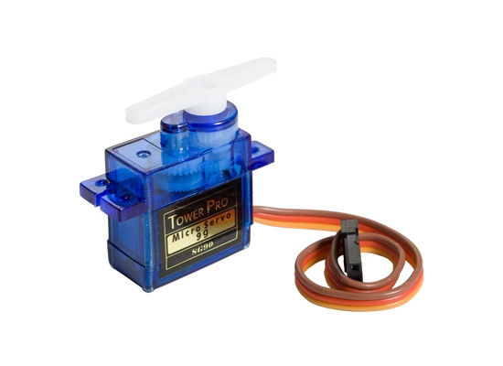
IR Sensors and Servo Motors
Six sets of IR sensors and servo motors are employed for accurate medication dispensing and monitoring. Each set consists of an IR sensor to detect the presence of medication cups and a servo motor to dispense medication.

Slide 9
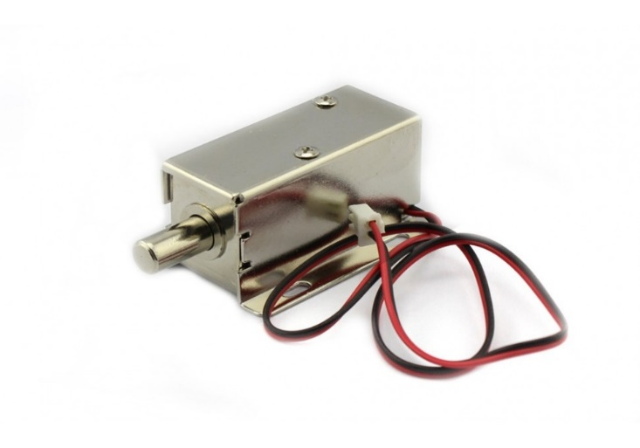

RFID System
An RFID reader is integrated into the system to enable secure access control. It reads RFID cards or tags to trigger the opening of a solenoid lock for medication access.

Slide 10
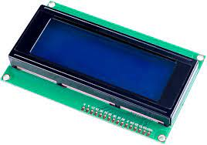
LCD2004 Display Module
The LCD2004 display module provides a user-friendly interface, displaying the current time, medication counts, and relevant information.

Slide 11

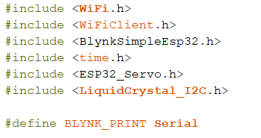
Software Components.
Library and Includes: The code includes various libraries required for the project, such as WiFi, Blynk for IoT communication, Servo for controlling servos, LiquidCrystal_I2C for controlling an LCD display, and time.h for handling time-related functions.

Slide 12
Pin definitions :Several GPIO pins are defined for controlling servos, IR sensors, a buzzer, and an I2C LCD display.
Wi-Fi and Blynk Setup: It connects to a Wi-Fi network and initializes Blynk with authentication credentials.
Servo Initialization: Servos for each type of medication are attached and briefly moved to a default position.

Slide 13
Medication Timers: There are separate Blynk virtual write functions for setting the time and days for each type of medication (acamol, aspirin, cetamol, exforge, concor, trofin). These timers are set through a mobile app using Blynk widgets.
IR Sensor and Buzzer Setup: IR sensors are set as inputs to detect when pills are taken or refilled. A buzzer is set as an output for alarms.

Slide 14
Low Medication Quantity Warnings: If the quantity of any medication drops below 4, a log event is sent to Blynk to indicate low medication quantity.
Temperature Control.
Water Pump and Laser Sensor.
    RFID-Based Access Control

Slide 15
Limitations.
It's important to note that the system's performance is subject to certain limitations. For instance, the medication dispenser's capacity is limited to six medications, and additional customization may be required to accommodate more.
Additionally, the system's Wi-Fi dependency for remote control may affect its functionality in cases of network outages.

Slide 16
Problems We Faced
Power Supply Limitations: No enough Power !!
Solution : use more than one power source , that could solve the variations in power.
Servo Noise: we encountered during the project was the noise produced by the servo motors when dispensing medication.
Solution : voltage regulators or Buck Converter for whole system , But this solution is Cost a lot.
Medications size : not all of the medications have the same size so we solution : decided to add the medications with its cover , and the non cover medications like capsuls , we try to resize this type by small tupes.

Slide 17
Future Enhancements
Expanding Medication Capacity: Increasing the number of medication slots to accommodate a wider range of medications.
Enhanced User Interface: Further improving the Blynk mobile application to offer additional features and user customization.
IoT Security: Implementing robust security measures, especially for remote access and data storage, to ensure the system's integrity.

Slide 18
Questions and Discussion

Slide 19
Thank you

