Slide 1

Industrial Engineering Department
Graduation project (I)
Implementation Of Six Sigma
DMAIC Methodology To Improve The Internship Process
Supervisor name:
Dr. Tamer Haddad
Group members:
Israa Abuihaj
Yousef Melhem
Islam Hamdan
Ahmad Bustami

Slide 2
Outline:
Introduction
Problem Statement
Objectives
Quality Gurus
Six Sigma

Slide 3
Introduction
The Practical Training Center at An-Najah National University is an applied academic center that takes a complementary role to the work of the various college departments at An-Najah University in order to achieve its objectives in training students in line with the mission and objectives of the university.
Problem Statement
The internship process at our organization is currently facing challenges with inefficiencies and inconsistencies in the selection, training, and evaluation of interns. This results in a suboptimal experience for both the interns and the organization.
The objective of this project is to implement the Six Sigma DMAIC methodology to improve the internship process, resulting in a more efficient and effective process that benefits all stakeholders.

Slide 4
Objectives
The main objective of this project is to implement the DMAIC methodology for Six Sigma in the Practical Training Center at An-Najah University to improve and develop the training process.
Achieve the best student satisfaction by aligning Six Sigma principles such as process improvement, waste reduction, and continuous improvement with the mission of the training center.
Identify major factors affecting the training center and students such as unsatisfactory training, lack of time for training, and lack of soft skills.
Evaluate students of the Faculty of Engineering and Information Technology by getting evaluations from the companies and institutions in which they trained.
Analyze evaluations using Six Sigma tools and study the students' opinions of the companies and the training process.

Slide 5
Quality Gurus
1-Walter A. Shewhart
Shewhart's work pointed out the importance of reducing variation in a manufacturing process and Shewhart created the basis for the control chart.
2-W. Edwards Deming
Deming said" organizations can increase quality and simultaneously reduce costs (by reducing waste, rework, increasing customer loyalty).
3-Joseph M. Juran
Juran—who focused on managing for quality— The training started with the top and middle management.
Juran is best known for the following contributions to the quality philosophy: The Juran Trilogy and Pareto principle.

Slide 6
Six Sigma
Six Sigma is a business management strategy that was originally developed by Motorola in 1986 .
It is a data-driven approach that aims to improve the quality of process outputs by identifying and removing the causes of defects (errors) and minimizing variability in manufacturing and business processes .
The goal of Six Sigma is to achieve a process that is 99.99966% free of defects, meaning that only 3.4 defects per million products are expected.
Six Sigma projects follow two project methodologies . These methodologies, composed of five phases each, bear the acronyms DMAIC and DMADV (Define-Measure-Analysis-Design-Verify).DMAIC (Define-Measure-Analyze-Improve-Control).

Slide 7
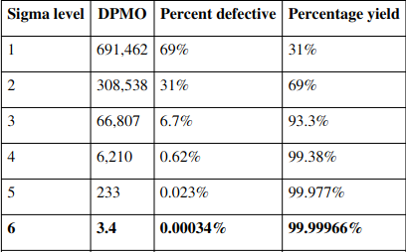
The widely accepted definition of a Six Sigma process is a process that produces 3.4 defective parts per million opportunities (DPMO). As shown in the table on the right.
This level of quality is near perfect and is the ultimate goal for Six Sigma projects. Through the use of quality management tools such as Pareto chart, cause and effect chart, and Control chart and SIPOC analysis (Suppliers, Inputs, Process, Outputs, Customers) etc. and follow the DMAIC or DMADV methodology.

Slide 8
DMAIC
The DMAIC project methodology has five phases:
Define the problem, the project goals, and customer (internal and external) requirements.
Measure key aspects of the current process and collect relevant data.
Analyze the data to investigate and verify cause-and-effect relationships.
Improve the current process based upon data analysis using techniques such as the design of experiments
Control the future state process to ensure that any deviations from target are corrected before they result in defects.

Slide 9
Methodology
The methodology used to study and evaluate the training process for the Practical Training Center at An-Najah National University is DMAIC, which is an acronym for the five phases associated with a problem-solving methodology.
it will use these 5 phases to identify the root cause of inefficiency in the training process and devise solutions to enhance the process. Each phase uses specific tools to help identify the root cause of process inefficiency as well as devise solutions that will enhance the process.

Slide 10
The Define phase will help to define the problem or opportunities related to the training process and establish the goals and objectives for the project.
The Measure phase will gather and analyze data to better understand the current process by collecting data on process performance, customer requirements, and process inputs and outputs.
The Analyze phase will use statistical tools and techniques such as process mapping, cause and effect diagrams, to identify the root cause of the problem or opportunity.
The Improve phase will develop and implement solutions to the problems or opportunities identified in the analyze phase.
The Control phase will establish a plan to monitor and maintain the improvements made in the improve phase.

Slide 11
Define phase
The Define phase is a critical step in the DMAIC methodology that sets the foundation for the rest of the project.
The Define phase also includes the use of several tools such as process map, Project Charter, SIPOC Diagram, and Voice of the Customer.
A process map is used to accurately illustrate the current state of the process.
The Project Charter serves as documentation that justifies the need for process improvement and ensures that all parties involved in the project understand the process that is being improved.
A Supplier Input Process Output Customer (SIPOC) diagram is used to determine the project’s Critical Quality factors.
The Voice of the Customer (VOC) captures the preferences, expectations, and aversions of the customer and is used to develop specifications for process improvement.

Slide 12
Voice of Customer (VOC):
In this project, the customer is the trainee students and the service provided is the practical training course. By understanding the customer's needs, the organization can improve the training process and ensure that it is meeting the customer's expectations.
In this specific project, the VOC process was used to identify the most important requirements of the students based on previous studies. The identified requirements include facilitating the process of registering for the practical training course, choosing appropriate training places, preparing a clear plan and structure for the student, choosing a supervisor familiar with the tasks of training the student, and achieving the maximum benefit from training.

Slide 13
To collect data on these requirements, questionnaires were conducted by the training center sent to the training places to evaluate the trained students, as well as questionnaires that evaluate the training places and the training process at the end of the training process.
The surveys included specific questions that correspond to the project and aim to benefit from it. These questions focused on areas such as follow-up of the supervisor, benefit from the training, clarity of the training program and its objective, quality of work and training, and the student's problem-solving skills, organization, and cooperation.
These questions raised represent the expected requirements and desires of students for successful and efficient training operations.
The questions that were taken into account (correspond with the project and benefited from) are:

Slide 14
Follow-up supervisor
The benefit of training
Was the practical training program clear and aimed at developing your practical abilities?
Would you recommend choosing a training place for your subsequent colleagues in the coming years?
Did you encounter difficulties in using Al-Zajel to send the weekly reports?
Work Quality
Collaborative skills
Problem-Solving
Organization Skills

Slide 15
Project Charter
The official plan and authorization for the project is summarized in the Six Sigma Project Charter, The Project Charter is a contract between the project team and its sponsor.
The charter documents the why, how, who, and when of a project, including the following elements:
Problem statement
Project objective or purpose
Scope
Team members
Project schedule
Other resources required

Slide 16
Process mapping:
Process mapping is the graphical representation with illustrative descriptions of how things get done. It helps the participants to visualize the details of the process closely and The major components of a process map include the inputs, outputs and the steps in the process.
The process map for the training process for students of the College of Engineering at An-Najah University was created to provide a visual representation of the current state of the training process.
This process map is a high-level map and only includes the essential information that is necessary to provide an accurate visual representation of the training process.

Slide 17
SIPOC Diagram:
SIPOC diagrams are often used as a starting point for process improvement initiatives, as they provide a clear visual representation of the process and its key components.
They are particularly useful for identifying process inputs and outputs, as well as the suppliers and customers who are involved in the process.
By identifying these key components, teams can gain a better understanding of how the process works, and where opportunities for improvement may exist.
The elements of the SIPOC diagram include:
Supplier
Input
Process
Outputs
Customers

Slide 18
Measure Phase
In the Measure Phase, the team also establishes a baseline performance of the process by collecting and analyzing data.
The Measure Phase also includes identifying the customer's requirements and expectations. This can be done by conducting customer surveys, interviews, or by analyzing customer feedback.
Tools typically used during the Measure Phase include a process map, Pareto Chart, data collection plan, and sampling.
The tools used in this phase are critical in identifying the areas of improvement and tracking progress as the process is improved.

Slide 19

Sampling
The data collection plan describes the sample size, sample selection method and measurement frequency.
In our project, the number of population "N" was about 575 students, and with random sampling, a sample size of "n" equals 231 students.
A total of 231 random samples were taken from all the different disciplines in the College of Engineering and Information Technology.
The Formula of Sample Size – Discrete Data:
$n={\left(\frac{1.96}{∆}\right)}^{2}∗P(1−P)$
where:
n: Sample Size.
P: is the proportion defective that we are estimating .
Δ: the level of uncertainty in your estimate that you are willing to accept.

Slide 20
Analyze Phase
The objective of the Analyze phase is to gather and analyze information about the project and its requirements. This includes understanding the project scope.
The goal of this phase is to develop a clear understanding of the project and its objectives, and to identify any potential issues that may arise during the project's execution.
The team initiates this phase by identifying potential root causes.the potential root causes are organized in manner that allows the team to easily prioritize and access each of them.
Following the prioritization and organization of potential root causes, the team works together to determine whether or not the potential root causes actually contribute to process inefficiency.

Slide 21
Tools commonly used during the Analyze Phase include brainstorming, Cause-and-Effect diagrams, Pareto analysis.
A Cause-and-Effect Diagram also referred to as a Fishbone Diagram graphically displays all potential causes of process inefficiency and helps the project team identify the root cause(s). The goal of a Cause-and-Effect (CE) diagram is to identify all the probable causes and then select the most likely ones for further investigation.
A Pareto Chart displays the contribution of each cause associated with process inefficiency. This chart is used to prioritize the causes associated with process efficiency and is used to further analyze the root cause of the problem during the Analyze Phase. so it can be determined which problems or opportunities should be tackled first.

Slide 22
Results And Analysis
In the Define phase, this section will provide an identification of the project and the use of various tools to gather information on the project purpose and scope included: VOC,SIPOC, Process map.
VOC: tool that is used to gather feedback and the needs from students There is mutable ways that can use to gather VOC including questions about the type of training program are interested in and specific skills want to gain,an open-ended question to share ,hold focus group with student In our project we used the open question from university survey and the literary references We noticed the diversity of students' needs and requirements leads to requirements in terms of the training center and in terms of training locations, like

Slide 23
Relevant training that aligns with the student's field of study and career goals Hands-on and experiential learning opportunities.
Mentorship and guidance from experienced professionals
Opportunities for networking and professional development
Training provided by reputable companies and organizations
Recognized and valued by potential employers
Flexible training options that allow students to balance their studies with their work experience.
Choosing a supervisor familiar with the tasks of training the student.
Facilitating the process of registering for the practical training course and facilitating communication with the training.
Achieving the maximum benefit from training and developing the various skills of students.
Preparing a clear plan and structure for the student during the training period in a way that is appropriate to his specialization and field of work.
Choosing appropriate training places for the student and taking into account the students' differences in terms of the training period and the student's interests in the field of work.

Slide 24
The survey questions covered a variety of topics, including:
Work Quality
Collaborative Skills
Problem-Solving
Organization Skills
Follow-up supervisor
The amount of benefit from training
Practical training program
Recommendation.

Slide 25
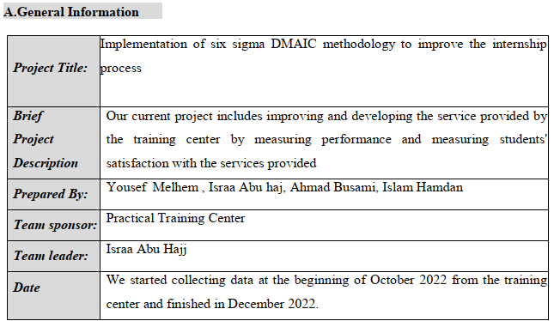
Project charter

Slide 26
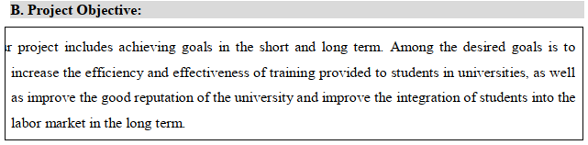
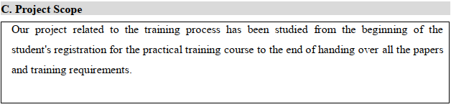

Slide 27
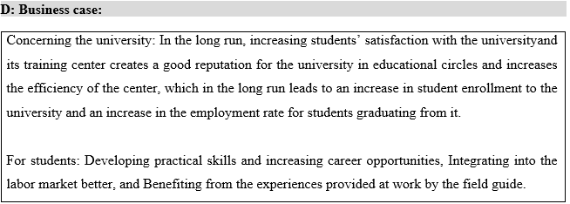
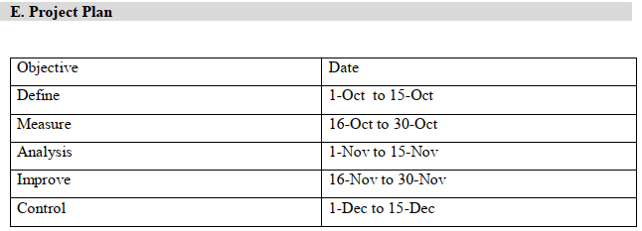

Slide 28
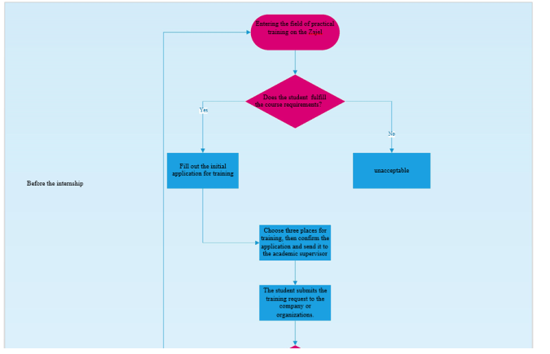
Process Map

Slide 29
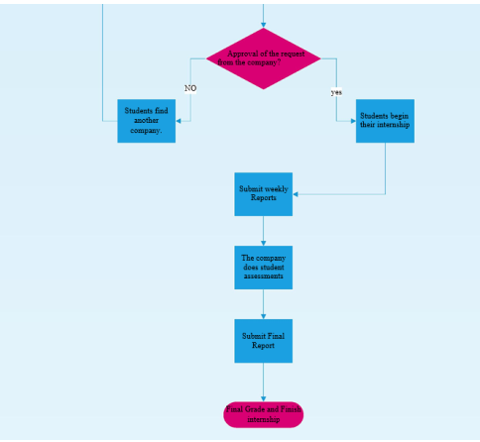

Slide 30
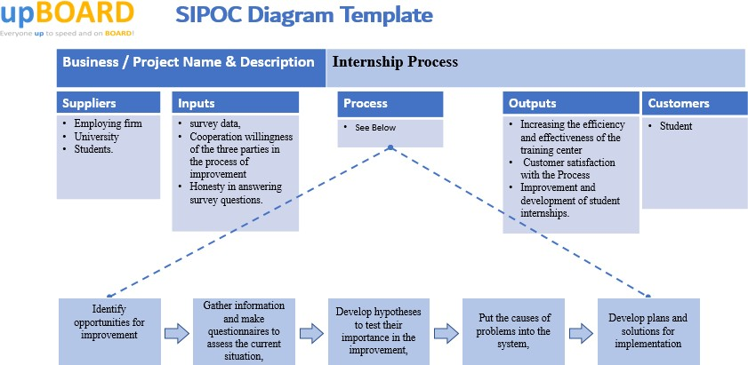
SIPOC Diagram

Slide 31
Measure phase
This phase used tools that resulted in a good understanding of the current state of the process. The tools used include
Sampling :
A survey is being conducted by the Training Center at An-Najah National University on the evaluation of companies and institutions for trainee students (Second Semester 2021- 2022) and (Summer Semester 2022). Where we focused in our project on the trainee students in the Faculty of Engineering and Information Technology.
Number of students who participated in the survey
A total of 231 random samples were taken
Semester | Number of students
2ndSemester | 334
Summer Semester | 241

Slide 32
The questionnaire contains 13 questions that related to the VOC and evaluating the vocational training. Every question has a rating system from 1 to 10
1-3= Poor
4-6=Marginal
7-8=Good
9-10=Excellent

Slide 33
Using the Mini-Tab program, we used a pie chart to obtain the analysis of the answers that we chose for the sample of trained students
12.6% of the students, had ratings less than 7 for the quality of performance.
25.2% of the students, had ratings less than 7 for social behavior
23% of the students, had ratings less than 7 for the ability to solve problems.
22.9% of the students, had ratings less than 7 for Organization Skills.

Slide 34
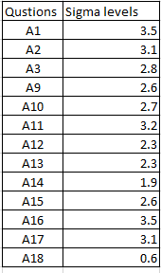
35% of the students, had ratings less than 7 for the follow-up of the supervisor
15.2% of student did not benefit greatly from the training process.
97%, believe that practical training aims to develop practical abilities.
84%, did not encounter difficulties in sending weekly reports, but there are 16% faced actual problems in sending reports.
we calculate sigma levels for some questions selected.in table below:

Slide 35
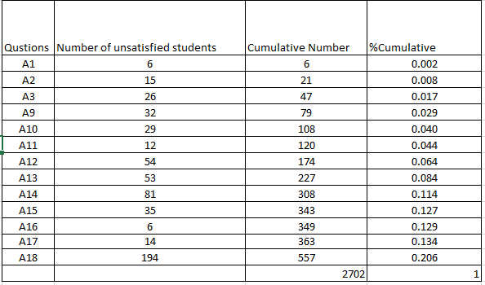
Analysis phase:
Pareto Chart

Slide 36
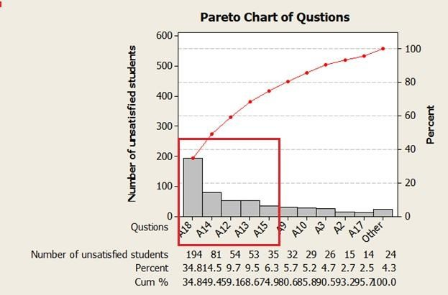

Slide 37
Question No. | Variable | Criterion
12 | A12 | Problem Solving
13 | A13 | Organizational Skills
14 | A14 | How was the field supervisor's follow-up with you
15 | A15 | What is the extent of the benefit that you have achieved from the practical training?
5 | A18 | Did you encounter difficulties in using Al-Zajel to send the weekly reports

Slide 38
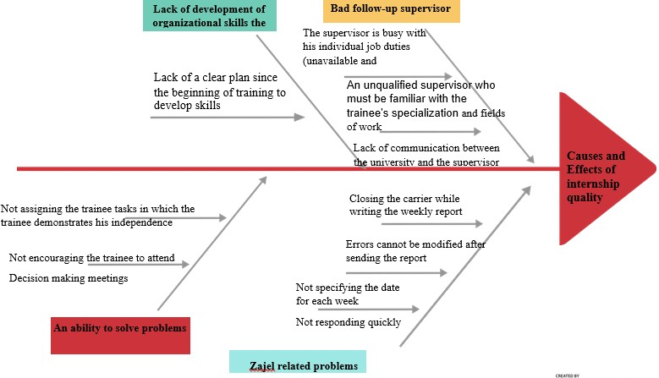

Slide 39
Discussion and Conclusion
The purpose of this graduation project is to conduct a statistical study using Six Sigma methodologies to identify the needs and concerns of students at Najah National University Training Center (NNUTC) in order to improve the training process for both the university and the employing party.
The project sought to identify the needs and concerns of students, as well as the factors affecting the training process, and to develop solutions for the same.
The project used a variety of quality control tools to identify the issues and to find solutions in a systematic way.
Major factors such as unsatisfactory training of students, lack of soft skills among students and less time allotted for training were identified.
The study population consisted of students, companies, and the training center at An-Najah National University and a sample of 231 students were taken for the study.

Slide 40
3. The project also highlighted the importance of involving both students and the employing party in the training process to ensure that the needs and concerns of both parties are taken into account.
4. The study also emphasized the need for continuous improvement and regular evaluation of the training process to ensure that it remains effective and relevant.
5. The project highlighted the importance of providing students with adequate soft skills training to help them better adapt to the demands of the workplace.
6. The study findings and recommendations can be useful for other universities and training centers to improve their training process and better meet the needs and concerns of the students.

Slide 41
Recommendations
Based on the findings of this graduation project, the following recommendations are proposed to improve the internship process at the Practical Training Center at An-Najah National University:
Increase the duration of the training program to provide students with more time to gain hands-on experience and develop the necessary skills for their future careers.
Provide more comprehensive and relevant soft skills training for students to help them better adapt to the demands of the workplace.
Regularly evaluate and update the training program to ensure that it remains relevant and effective.
Implement a continuous improvement program to regularly assess and improve the training process.
Provide the students with more information and guidance regarding the training process and the expectations of the employers.

Slide 42
Encourage the students to seek mentorship from senior students or professionals in their field of interest.
Encourage the students to participate in extracurricular activities, as it will help them to develop their soft skills and improve their employability.
Encourage the students to seek feedback from the companies and institutions where they are training to gain insight on how they can improve their performance.
It should be noted that the success of the implementation of these recommendations will depend on the commitment and involvement of all stakeholders, including the university administration, faculty members, students, and the employing party.
It is also important to note that the recommendations proposed in this project should be implemented in a phased manner, and should be accompanied by a monitoring and evaluation process to ensure their effectiveness.
It is worth noting that, while these recommendations are based on the findings of this specific study, it is important to keep in mind that every organization and training center has its unique set of challenges and circumstances.

Slide 43


