Slide 1
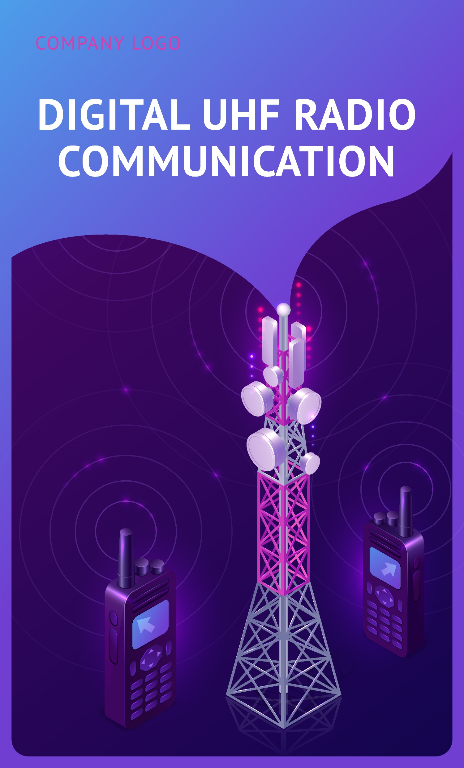
The Effect of Power Increment on Cell Breathing
and Capacity
By
Rahaf khraim
Supervised By
Dr. Yousef Dama
Eng. Ahmad Qashou

Slide 2
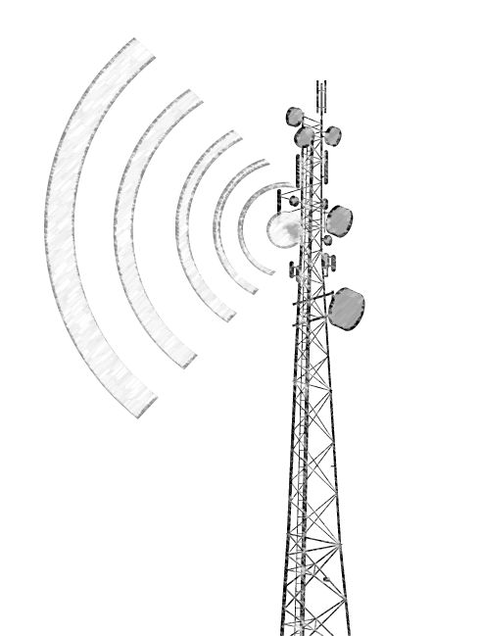

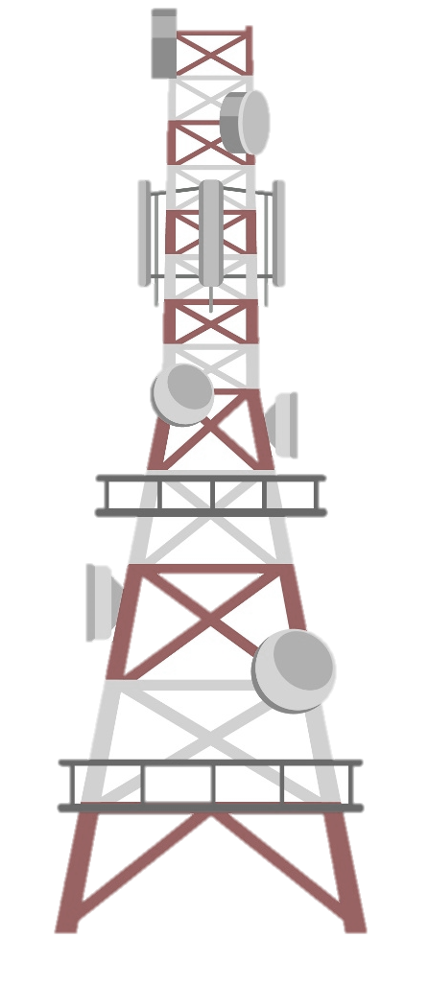

Roadmap
Introduction
Problem statement and objectives
2
1
Results
Concepts
4
3
Conclusions
Recommendations
6
5

Slide 3
Introduction
In 3G mobile networks, customers will need high-speed packet-based data access to access services. Future wireless systems must be able to provide high-quality broadband access with high network capacity and throughput at cheap cost. Coverage and cell border are affected by 3G UMTS/WCDMA standard features as cell breathing, load, capacity, and power regulation. As a result, many users are refused or experience reduced service levels and throughput.

Slide 4
Problem Statement
Based on cell breathing, load, capacity, and power control, which are considered the main concepts in the 3G UMTS/WCDMA standard, coverage and cell border are affected. Thus, many users are rejected or at least suffer from downgraded service levels and low throughput situations.
Objectives
Our objective is to reduce the problem of cell breathing and to serve subscribers who are lost in peak times due to cell breathing.

Slide 5
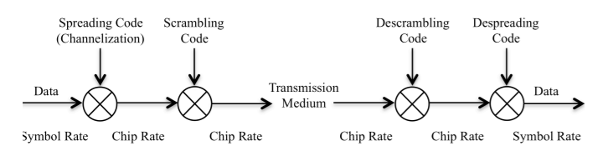
Concepts
Spreading and De-spreading
Notes:
Photo by Katerina Jerabkova on Unsplash

Slide 6
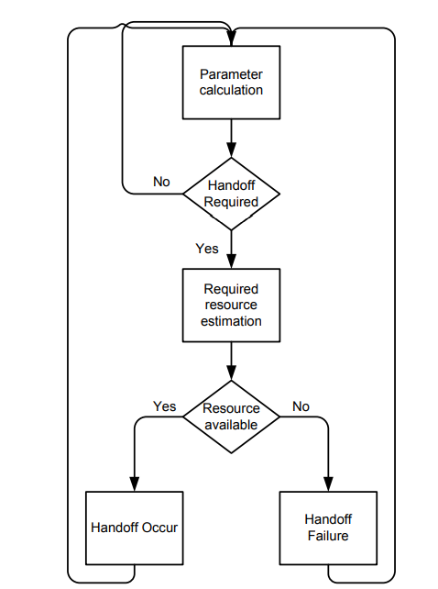
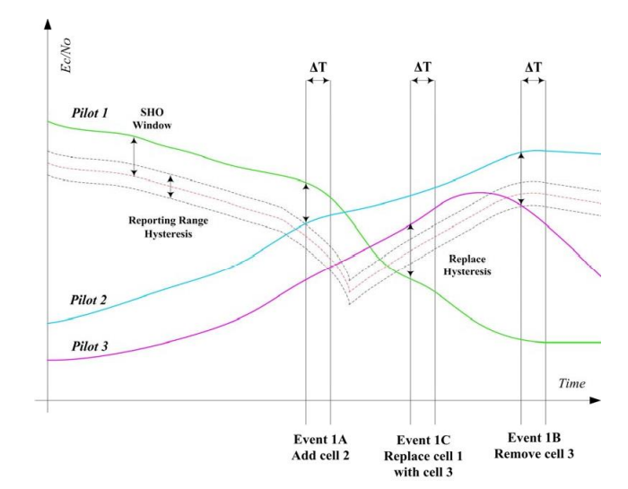
Concepts
Soft & Softer Handover
Notes:
Photo by Katerina Jerabkova on Unsplash

Slide 7
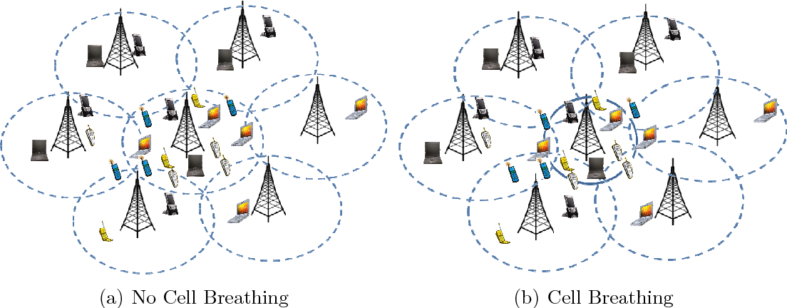
Concepts
Cell Breathing
Notes:
Photo by Katerina Jerabkova on Unsplash

Slide 8
Concepts
Cell Breathing
Notes:
Photo by Katerina Jerabkova on Unsplash

Slide 9
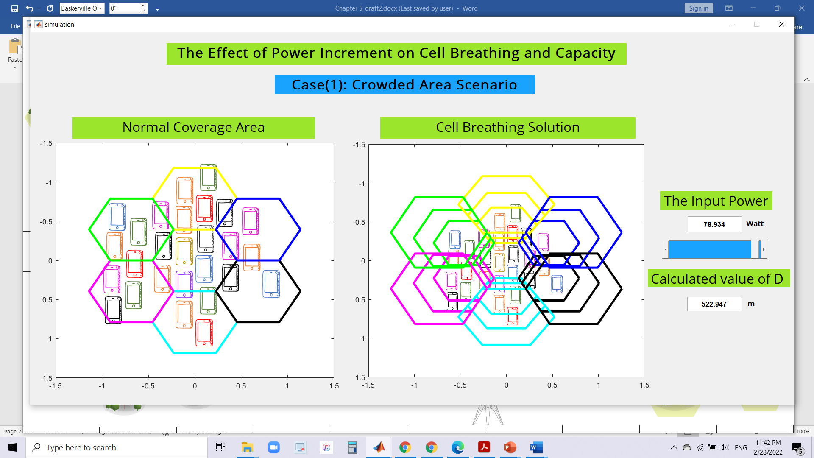
Results
MATLAB Simulation
Notes:
Photo by Katerina Jerabkova on Unsplash

Slide 10
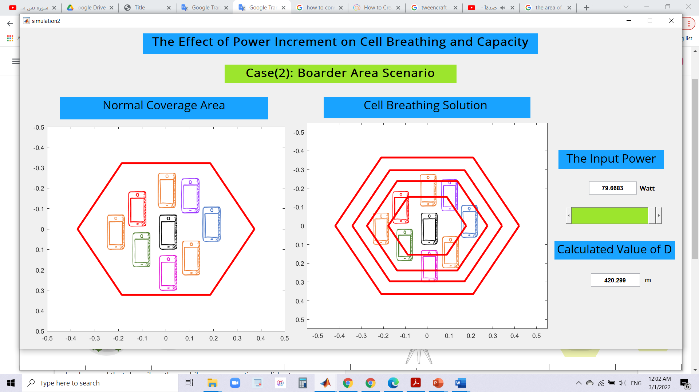
Results
MATLAB Simulation
Notes:
Photo by Katerina Jerabkova on Unsplash

Slide 11
Results
MATLAB Simulation
Notes:
Photo by Katerina Jerabkova on Unsplash

Slide 12

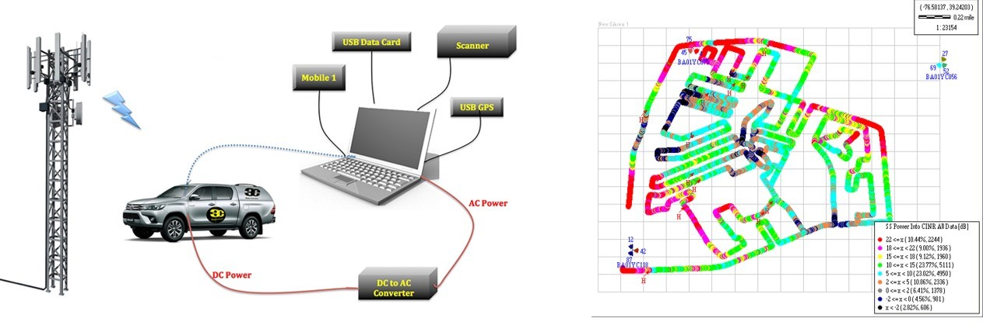
Results
Validation
JawwaL
Drive Test
Notes:
Photo by Katerina Jerabkova on Unsplash

Slide 13
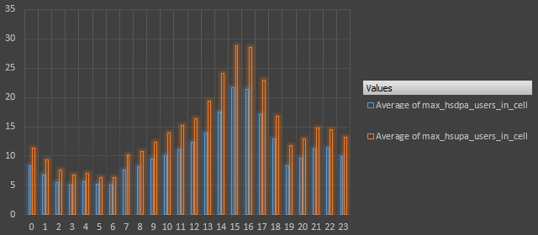
Results
Validation
JawwaL
Notes:
Photo by Katerina Jerabkova on Unsplash

Slide 14
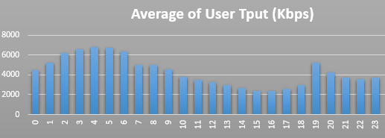
Results
Validation
JawwaL
Notes:
Photo by Katerina Jerabkova on Unsplash

Slide 15
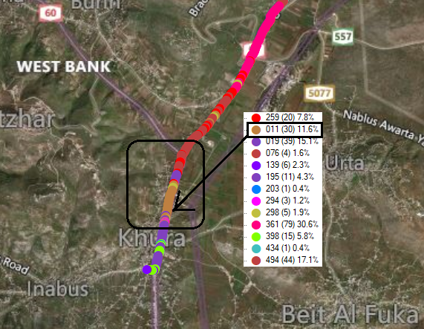
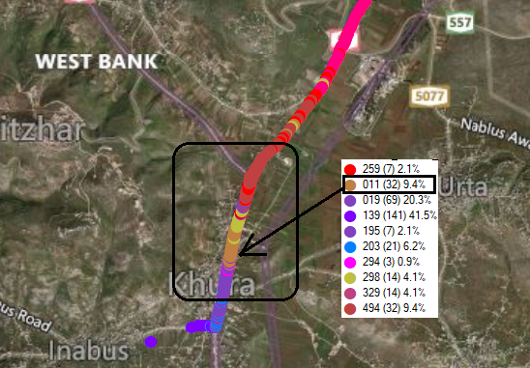
Results
Validation Coverage (SC)
JawwaL
Normal Mode [40 Watt]
Cell Breathing Mode [40 Watt]
Notes:
Photo by Katerina Jerabkova on Unsplash

Slide 16
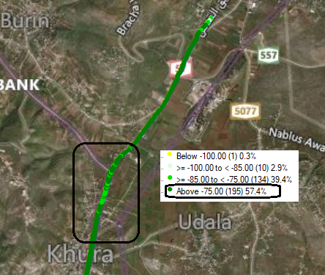
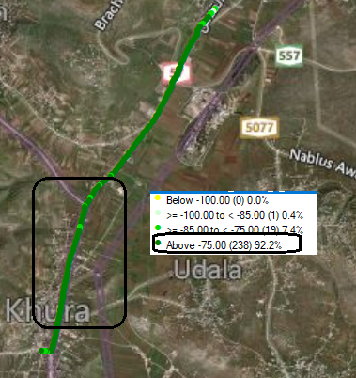
Results
Validation RSCP
JawwaL
Cell Breathing Mode [40 Watt]
Cell Breathing Mode [60 Watt]
Notes:
Photo by Katerina Jerabkova on Unsplash

Slide 17
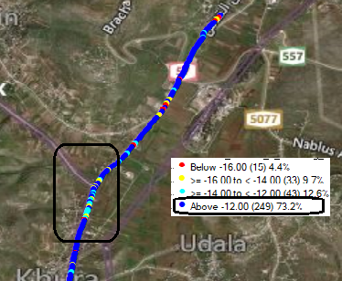
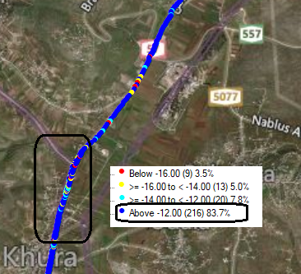
Results
Validation Ec\No
JawwaL
Cell Breathing Mode [40 Watt]
Cell Breathing Mode [60 Watt]
Notes:
Photo by Katerina Jerabkova on Unsplash

Slide 18
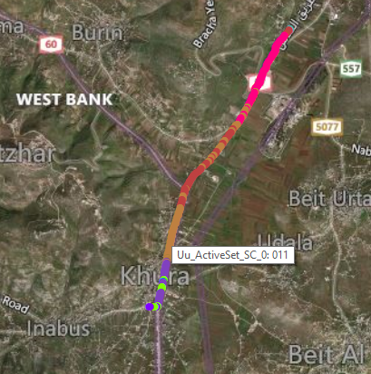
Results
Validation Coverage (SC)
JawwaL
Normal Mode [40 Watt]
Normal Mode [60 Watt]
Notes:
Photo by Katerina Jerabkova on Unsplash

Slide 19
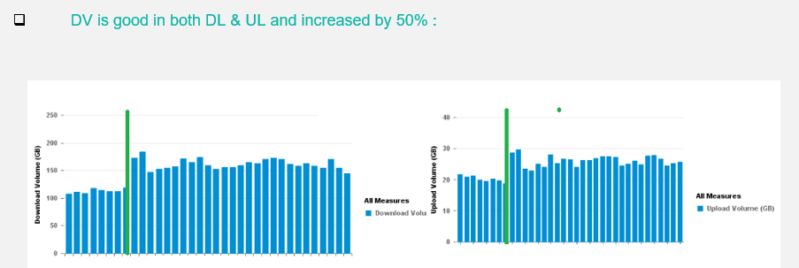
Results
Validation Data Volume
JawwaL
Notes:
Photo by Katerina Jerabkova on Unsplash

Slide 20
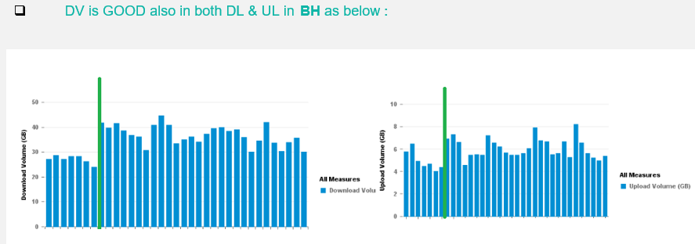
Results
Validation Data Volume
JawwaL
Notes:
Photo by Katerina Jerabkova on Unsplash

Slide 21
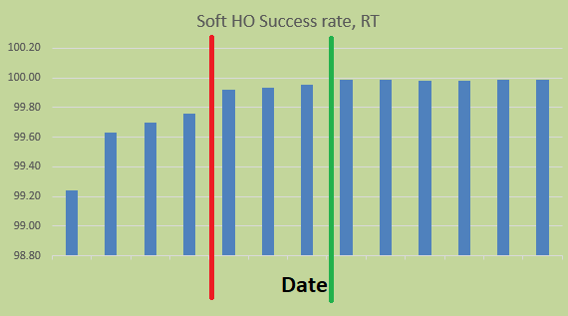
Results
Validation Handover success rate
JawwaL
Notes:
Photo by Katerina Jerabkova on Unsplash

Slide 22
Conclusion & Recommendation
Our responsibility is to develop and try the best and most suitable solution in terms of costs and in terms of quality because we certainly strive to obtain the highest quality at a reasonable cost. Thus, in order to avoid rejecting many users or suffering from downgraded service levels and low throughput situations, for that, our project and our proposal were found to solve this problem.
We can say that we have proven the effectiveness of our solution theoretically through equations and simulations and practically by taking a real case and proving that there is a real and tangible improvement through increasing the power by the user firstly, and through performance indicators that are monitored daily.
JawwaL
Notes:
Photo by Katerina Jerabkova on Unsplash

Slide 23
THANKS

