Slide 1


Submitted to:
Dr. Moien Omar
Ghadeer Deek
Orayb Abu Lawe
Ziena Yasin

Slide 2



Impacts of integrating solar PV power to an existing grid
Faculty of Engineering
Electrical Engineering Department

Slide 3
Introduction
In project 1 a ring network was investigated to analyze the effect of PV integration on it with different penetration level.
impacts of PV on parameters : voltage profile , drop voltage and losses according to the two penetration level and methods of distribution of PV.

Slide 4
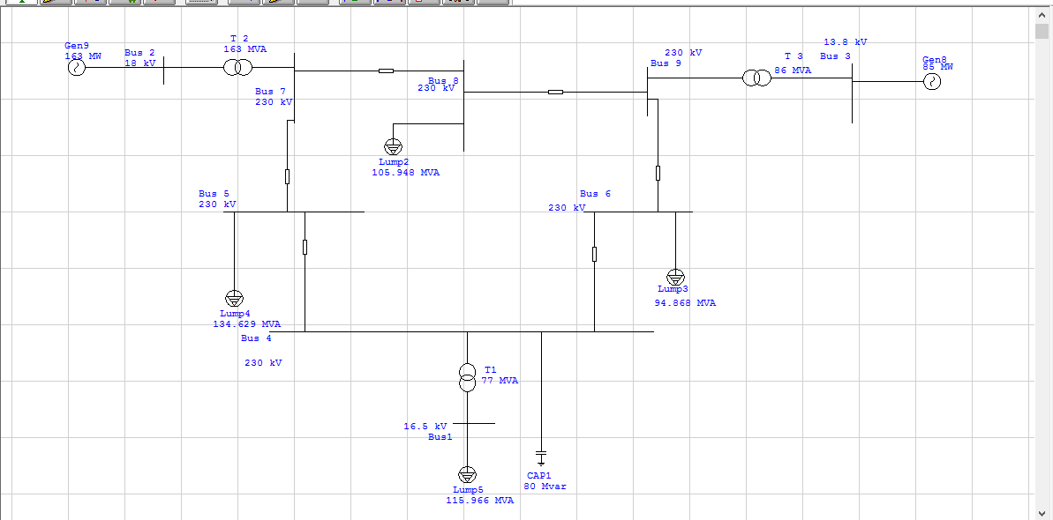
Ring network

Slide 5
The aim of the project
this research is supposed to answer these questions:
What is the effect of solar cells on radial and ring networks with different penetration level.
What is the difference in the effects between centralized and decentralized and whichever is better to be adopted in grids.
What is the difference between the radial and ring networks .
What are the proposed solutions in the event of problems of integration of cells, especially when increasing penetration level.

Slide 6
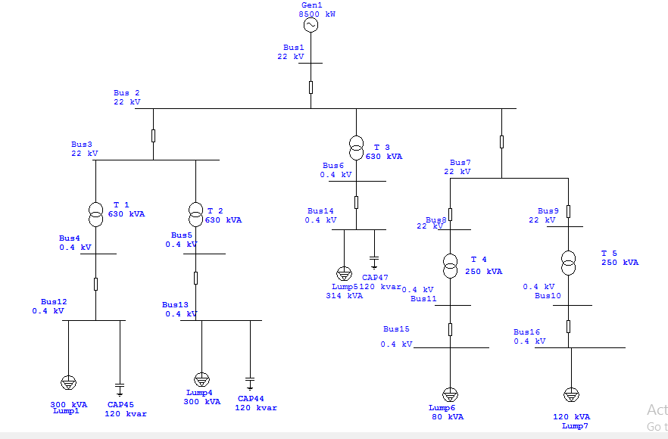
simulation Results and Discussions

Slide 7
Ideology
network
with PV
penetration level= 29%
penetration
level = 87%
without PV
PV = min
load =max
PV = max
load =min
PV = max
load = min
PV = min
load = max

Slide 8
Normal case
(with capacitor and tap changer at bus 12,14)
Voltage profile
Drop voltage
Bus number | Nominal voltage (kV) | Actual voltage (pu)
12 | 0.4 | 96.33%
14 | 0.4 | 97.84%
Line from bus to bus | Voltage drop (%)
4 to 12 | 8.05
5 to 13 | 6.84
losses
41.8 KVAR
74.2
kW

Slide 9
Scenarios of PV integration with grid
PV
300 KW
50 KW
load
410 KW
1025 KW
PV
900
150 KW
load
410 KWKW
1025 KW

Slide 10
Penetration level 29%
Centralized PV system
Decentralized PV system
300KW PV with 410 KW (40%) load
300KW PV with 410 KW (40%) load
Voltage profile
Voltage profile
Bus number | Nominal voltage (KV) | Actual voltage (pu)
12 | 0.4 | 103%
14 | 0.4 | 110.35%
Bus number | Nominal voltage (KV) | Actual voltage (pu)
12 | 0.4 | 105.15%
14 | 0.4 | 105.42%
Drop voltage
Drop voltage
Line from bus to bus | Drop voltage (%)
4 to 12 | 2.83
losses
10.7
KVAR
19.4
kW
Line from bus to bus | Drop voltage (%)
4 to 12 | 0.88
losses
3.6 KVAR
6.7
kW

Slide 11
Penetration level 87%
Centralized PV system
Decentralized PV system
900KW PV with 410 KW (40%) load
900KW PV with 410 KW (40%) load
Voltage profile
Voltage profile
Bus number | Nominal voltage (KV) | Actual voltage (pu)
12 | 0.4 | 103.08%
14 | 0.4 | 121.87%
Bus number | Nominal voltage (KV) | Actual voltage (pu)
12 | 0.4 | 110.35%
14 | 0.4 | 110.44%
Drop voltage
Drop voltage
losses
61.9
KVAR
111.2
kW
losses
11.5 KVAR
21.7
kW
Line from bus to bus | Drop voltage (%)
4 to 12 | 2.83
Line from bus to bus | Drop voltage (%)
4 to 12 | 3.78

Slide 12
Proposed solution
Reactor installation and tap changer operation
Remove the added capacitor of the grid
Flexible alternating current transmission system
Use of PV inverter and advanced additional control function
Distribution grid re–arrangement
Rainforcement
Voltage regulator

Slide 13
Tap changer
the taps is only on the primary side of transformers where the voltage is 22kv , each tap providing ±1.1% from nominal voltage.
Vp/Vs = Np/Ns

Slide 14
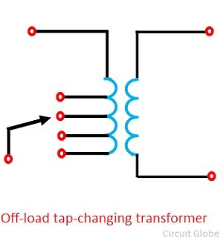
No Load Tap Changers

Slide 15
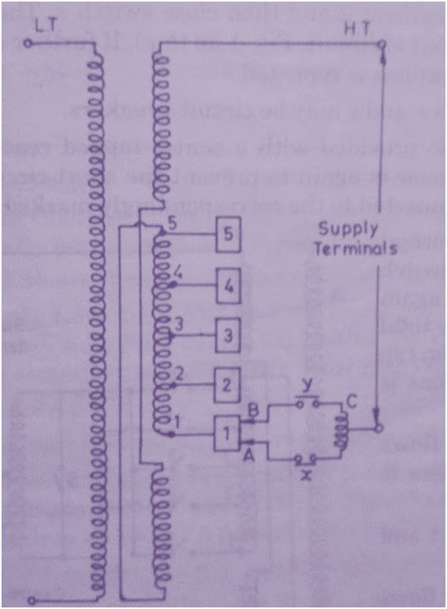
On Load Tap Changer
two essential conditions are to be fulfilled.
The main circuit shall not be opened else heavy sparking will take place.
No part of tapped winding shall be shorted.

Slide 16
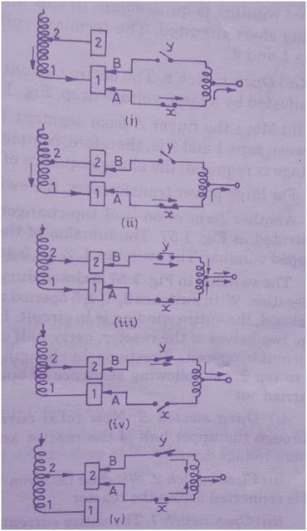
Continue…
Step1: Open Switch y
Step2: Move Finger B
Step3: Close Switch y
Step4: Open Switch x
Step5: Move Finger A

Slide 17
conclusion
In the results of integration PV with the grid. There was an increase in voltages profile and decrease in losses in general
de _concentrated PV is better in terms of decreasing of losses.
Voltage violation in ring system was limited on some cases, unlike radial system.
the voltage of all buses in ring system was close to each other in the all cases of the integration of PV, unlike radial system.
The difference in losses between centralized and de_ centralized in radial system was larger than ring system.

