Slide 1
Occupational Safety
Safety at workplace
Safety tools
Human–machine interaction and work design

Slide 2
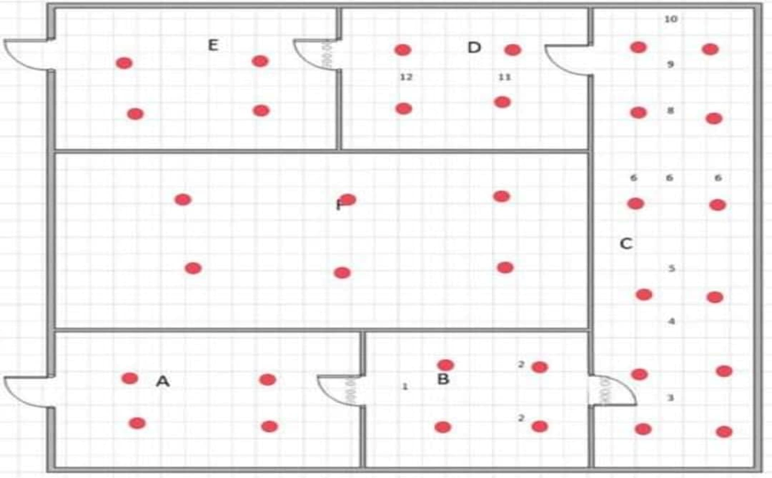
Safety at work place
Heat, cold and the design of the physical environment
Lighting
Periodic illumination level measurements by light-level meter

Slide 3
Ventilation system
 | Type | Air In cubic feet per minute
1 | workplace | 60
2 | Offices and management rooms | 20
Periodic velocity of air flow measurements and air pressure by CFM meter device.
Noise and Vibration
noise level shouldn’t exceed 80 Db.
In laboratory, noise level should be between 55-60 dB
In testing, all windows must be closed, measurement is done at a distance of at least 1 meter from walls, 1.2 meter from ground.
Regular maintenance and replacement of worn parts can prevent vibration

Slide 4
Safety tools
Helmet and Work shoes
Ear protection
Worker's dress
It is not safe to use loose clothes. Especially the wire drawing machine
  Wearing of polyester and cotton is proper
Gloves (Super fabric gloves, consists of nylon or polyester)
Dust mask(miller machine)
Safety Glasses (mixer machine, press machine)

Slide 5
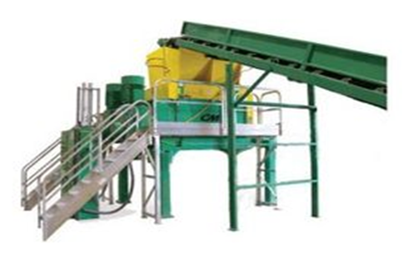
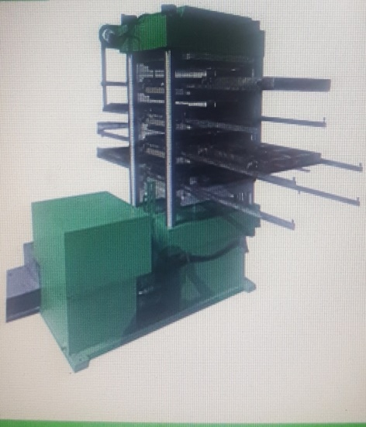
Human–machine interaction and work design
Tire debeader
Tire shredder machine(The risk should be about 2.7 m from the ground as it is high-risk).
Dryer mixer Machine
Rubber Tile Press Machine

