Slide 1
Smart Medicine Cabinet
(SMC)
Sondos Salama
Sondos Antari
Rua Samara

Slide 2

The Problem
Often a senior citizen keeps all their medications in the same place, and when it’s time to take a pill there’s a high possibility that they will take the wrong one or even mix the dose. Even if the senior citizen has a caretaker, at one point they would have to leave for an hour or maybe a day, and in this case there’s nothing to guarantee that the right medication is taken in the right time or dose.
Listen to this man describe the problem with his father’s medications.

Slide 3
The Deadly Consequences
Weaken the immune system, increasing susceptibility to infections.
Cause cardiovascular conditions ranging from abnormal heart rate to heart attacks.
Cause nausea, vomiting and abdominal pain.
Cause the liver to have to work harder, possibly causing significant damage or liver failure.
Cause seizures, stroke and widespread brain damage.
Behavioural Problems.

Slide 4
The Deadly Consequences
DEATH!

Slide 5
What is SMC?
Completely closed and safe.
Has different sections, each for different medication.
The led come off for refill.
A window on the side that opens using RFID card to access the dropped pills.
Each pill is saved in a separate box.
Only two ways of opening:
  Password: for caretaker to open the led and refill the medications.
  RFID: for patient to access only the right pills in the right time.

Slide 6
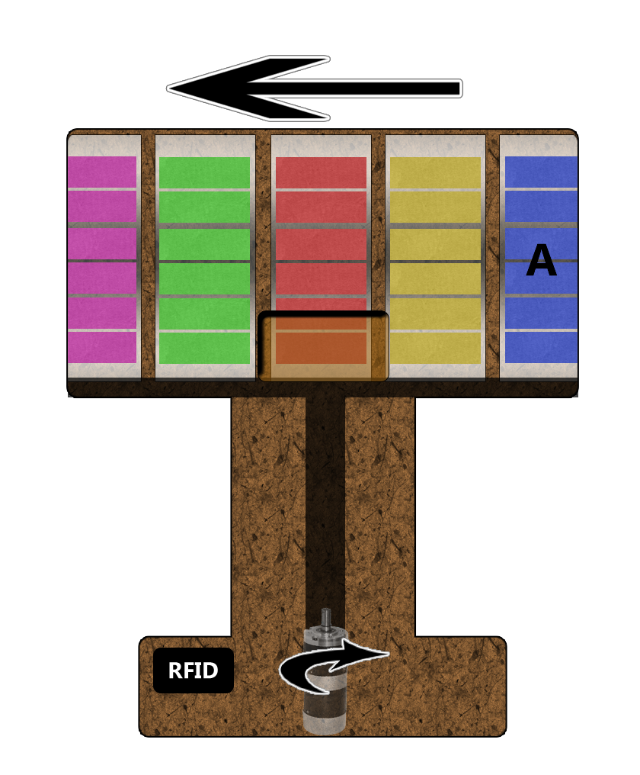
How does SMC Work?
Each section in SMC is labeled uniquely, so each section can be set for a certain medication using the Mobile App.
Using the App, the user can set the time and dose for each section (medication).
When it’s time for medication A, a sound and light alarm will go off.

Slide 7

How does SMC Work?
When the RFID card is used, the DC motor will rotate the sections until section A is at the window.
Then the Push/Pull motor will push the right amount of pills out to the window.
The app will save that medication A was taken in the right time.
If the card was not used after 10 minutes from when the alarm went off, the App will save an ‘untaken pill warning’

Slide 8
Why Using SMC?
SMC will offer the perfect solution for the problem of taking the right medication in the right time.
SMC will ease the minds of the caretaker of the senior citizen.
SMC design is simple and user friendly.
Staking the medications is easy after opening the locked top.
And when the times come for a certain medication, the alarm is very noticeable. Using the RFID card is very simple and easy even for a senior citizen.
The Mobile Application with SMC is user friendly and easy to use and understand.

Slide 9
Demo

Slide 10
Any Questions?
Thank you!

