Slide 1
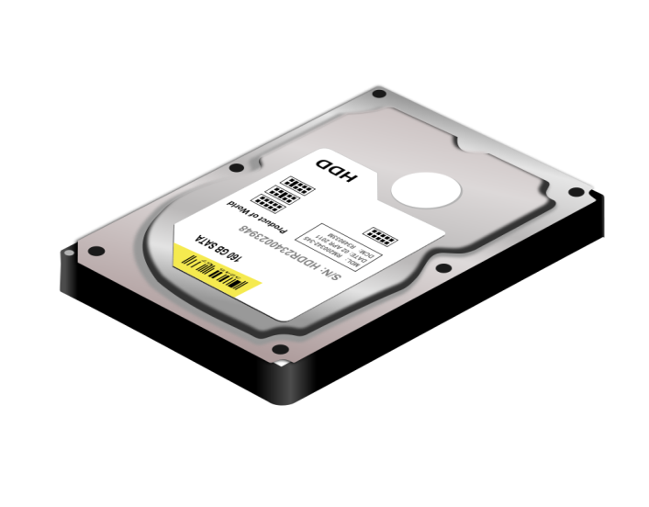
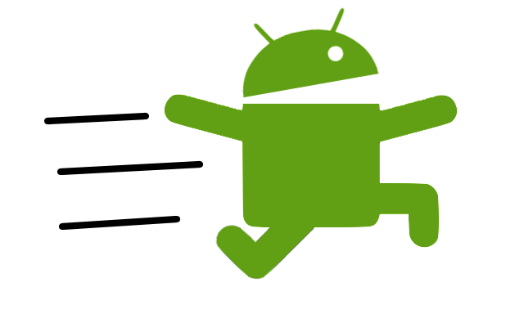
Fastdroid
Produced by :
Firas Abdalhaq
Mohammad Amour
Supervised by :
Dr. Raed Alqadi

Slide 2
Contents
Introduction
Motivation
Components of the system
Operating modes
connection
Technical problems
Features
Future work
Demo
Q & A

Slide 3
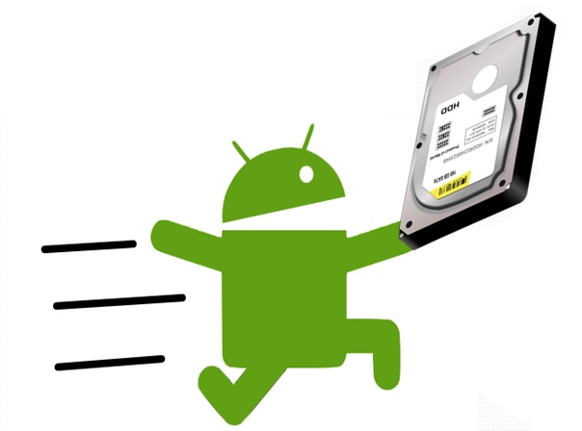
What is FastDroid?
Fastdroid is a system that offers a FAST and EASY way to make ordinary windows file system fully or partially accessible by an android device , giving the user an easy and efficient way to browse and copy data from his/her own hard drive .

Slide 4
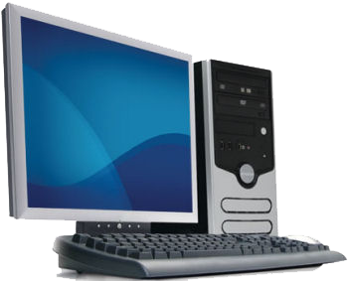
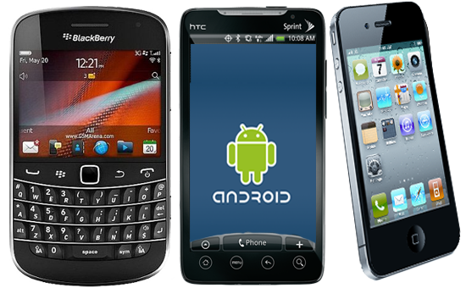
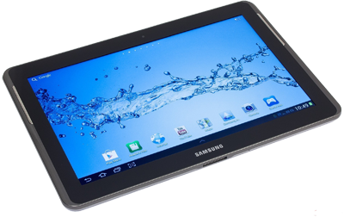
Motivation
We live in a world of technology that is full of PCs tablets mart phones etc…

Slide 5

Smart phones have a
limited storage.
Files generally and Multimedia files specially are growing Larger and larger
(movies , songs ,Pictures etc...).
WE NEED TO TRANSFER
DATA EFFICIENTLY AND EASILY !!!!!

Slide 6



Old solutions
To transfer files between those devices as:
  Mail

Slide 7

Old solutions
To transfer files between those devices as:
  Mail

Slide 8


Better solutions
Cloud based solutions
  Dropbox
  G-drive

Slide 9
Better solutions
Cloud based solutions
  Dropbox
  G-drive
BUT

Slide 10
There are limitations
  Need to upload all files that are potentially needed in the future.
  Uploading speed is usually low (1/10 download).
  Transferring speed is limited by internet bandwidth even if the android and the pc are on the same network.

Slide 11
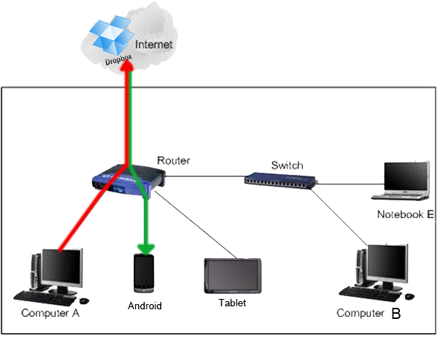
Cloud based systems
Figure 1: Uploading and downloading operationsin DropBox

Slide 12
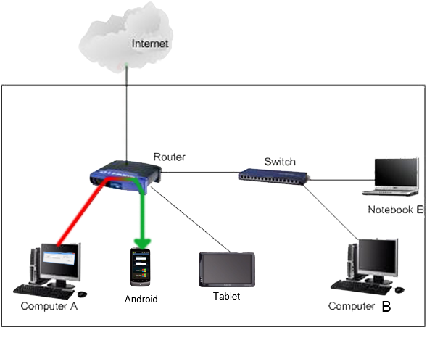
With FastDroid (local mode)
Figure 2: Uploading and downloading in Fastdroid in a local network

Slide 13
With FastDroid
NO need to upload files to be accessible.
You will have a full download speed of Wi-Fi (11 Mb/s) if you are on the same network (local mode).

Slide 14
Components of the system
Android application .
Host PC application (Microsoft .NET c#).
Server application (Microsoft .NET c#).

Slide 15
Operating modes
Fastdroid supports three different operating modes
Remote mode
Local mode
Offline mode

Slide 16
Remote transferring mode
Transfer operation is done remotely “ via internet”
Fastdroid uses the a server to act like a bridge or a switch to transfer packets between android and remote pc.

Slide 17
Flash Time

Slide 18
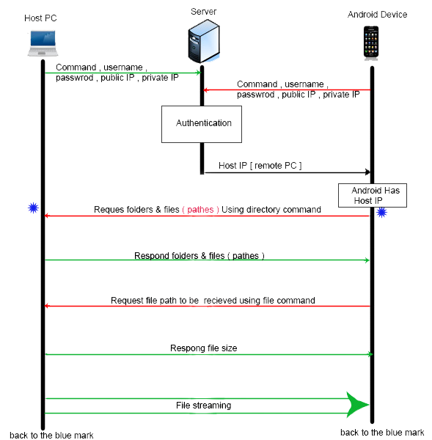
Local transfer
Server Authentication and getting host IP address.
transfer operation is done locally .
Figure 3: connection & communication steps in local network of Fastdroid

Slide 19

Offline mode
Offline mode is used when there is no internet connection.
Allows user to Host PC by entering host IP address.
No server authentication is needed.

Slide 20
Technical problems
Server Bridging technique
Android memory heap limitations (file size)
Port Forwarding (connection initialization is one way)

Slide 21
System components

Slide 22
Android application
Android application has a user friendly interface that enables an easy and simple interaction browsing and copying data
User does not need to configure the application to detect weather he is on the same network or on a remote network
User needs only to enter the username and password

Slide 23
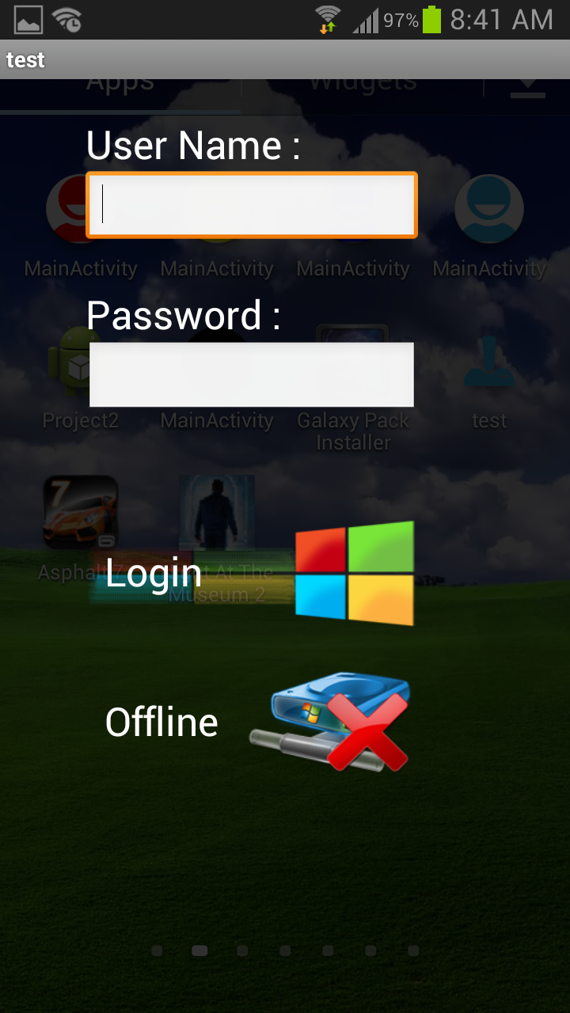
Transparent
needs only the username and password
Remote and local modes
Offline button for offline mode
Figure 4: Fastdroid main activity

Slide 24
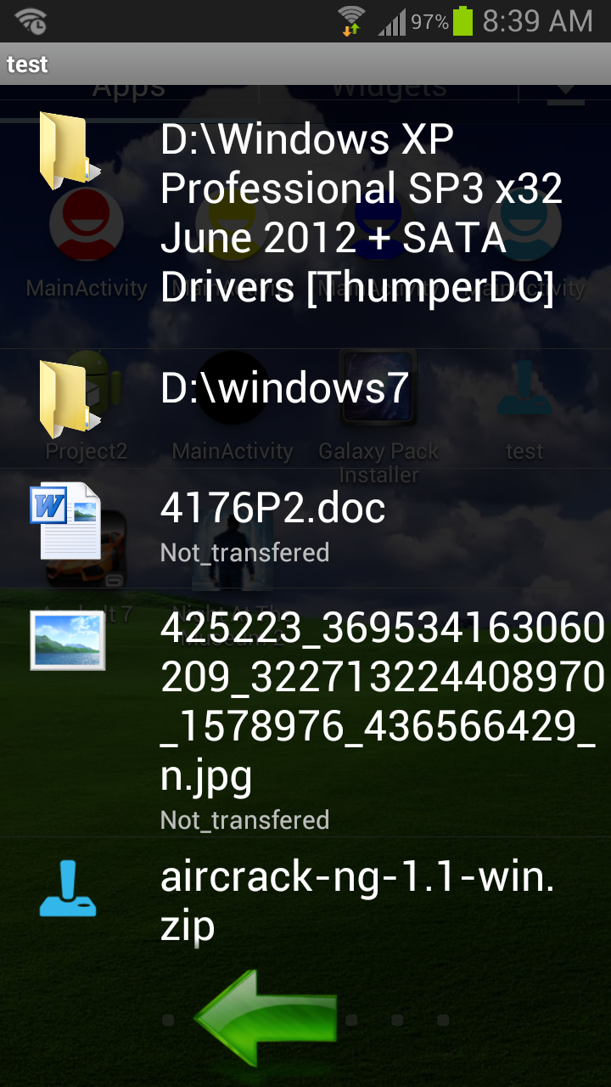
Files & directories in the accessed directory are displayed in a list view .
Back button displays the contents of the parent directory
Click item to start transfer or access sub directory .
Figure 5: Files & directories

Slide 25
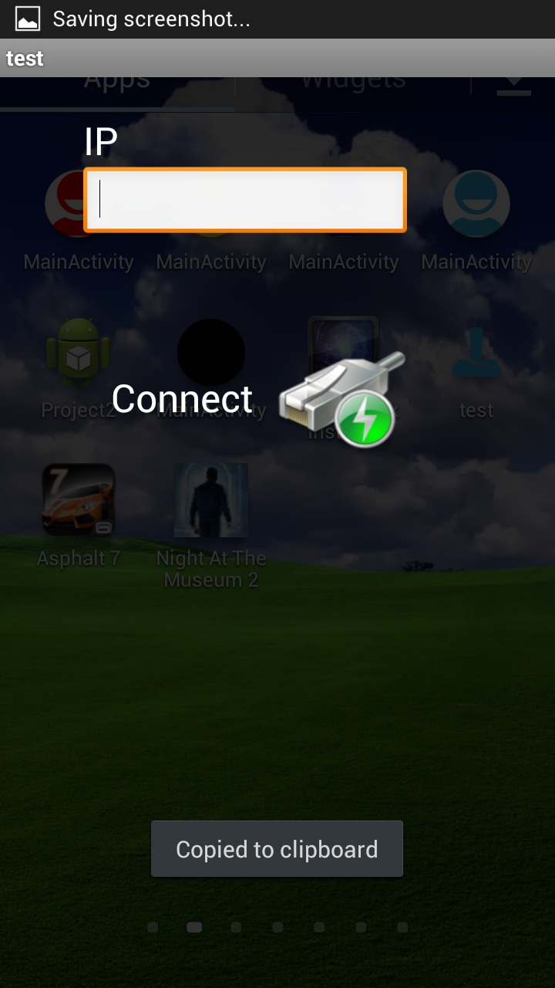
Offline mode
Only IP address of the host PC needed
Figure 5: Offline mode activity

Slide 26
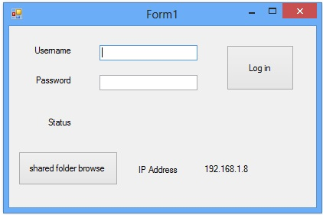
Host PC application
Browse button to selected directory to be accessible by android
Parent directory of the browsed directory is not accessible.
Figure 6: Host application interface

Slide 27
Server application
We build server application from scratch
Server authenticates connection
No user interface needed
Remote and local mode

Slide 28
Other features of Fastdroid
Threading , Multiple users , multiple file transfer simultaneously .
User friendly (username password without network knowledge).
Browse all directories and subdirectories and all files they contain.
Secure since user specifies the folder or partition to be shared.

Slide 29
Future work
Ensure data encryption
Developing in IOS operating system
Develop a PC application that will have the same functionality as the android application so that it can access another PC operating system.

Slide 30
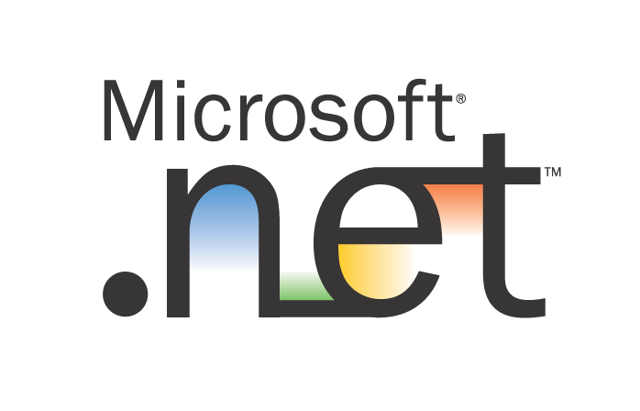

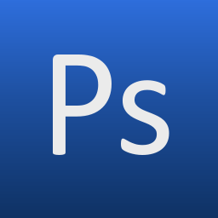
Software used

Slide 31
Demo Time

Slide 32
Questions ??!!

