Slide 1

Redesign of AL-Rahma Dispensary In Nablus.
Prepared by : Mohammad Shanaa
Mahdi Abu-Safat
Hmed Hamarsheh
Nasser Malayshi
Supervised by : Eng. Wala Omar

Slide 2
Outline
Introduction
Site description & Analysis
Architectural design
Environmental design
Structural design
Mechanical design
Electrical design
Quantity survey and cost

Slide 3
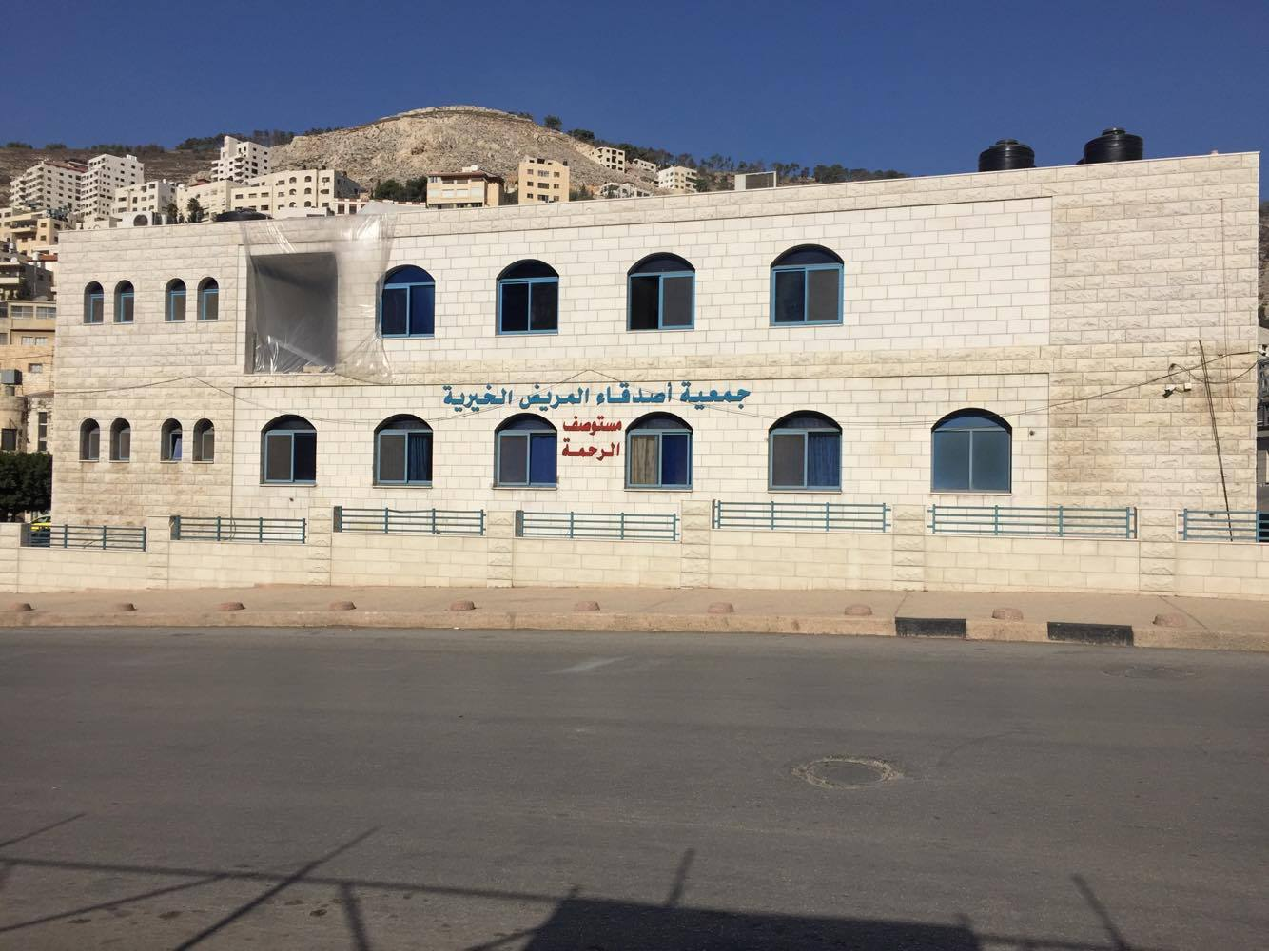
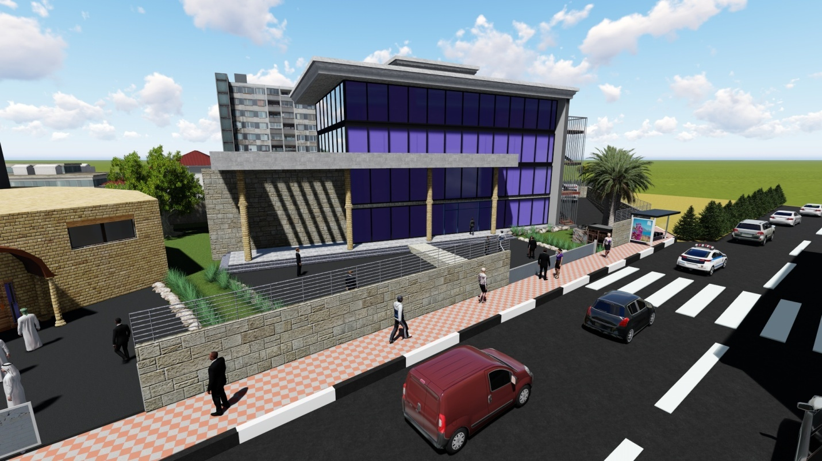
Introduction:

Slide 4
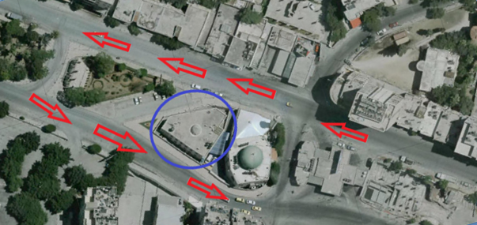
Site analysis
N

Slide 5
Site analysis
Climate condition:
Temperature = (9-32) ˚C
Humidity = 61 %

Slide 6
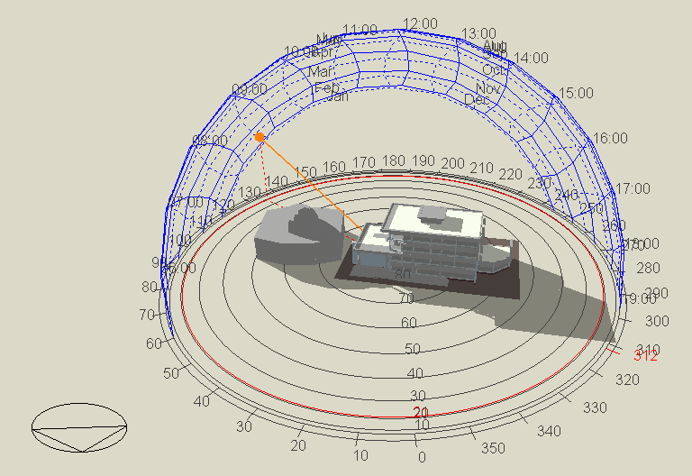
Sun path and shadows analysis
1. In Winter.
Sun path and shadows on 21/1 at 9:00 AM.

Slide 7
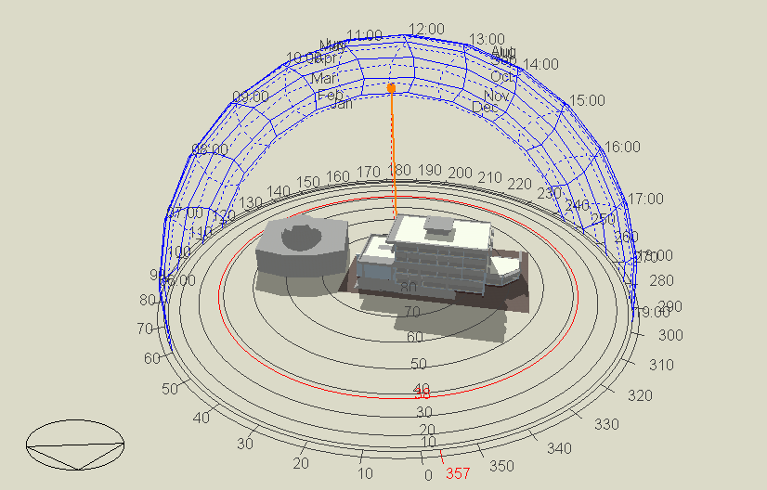
Sun path and shadows analysis
1. In Winter.
Sun path and shadows on 21/1 at 12:00 PM.

Slide 8
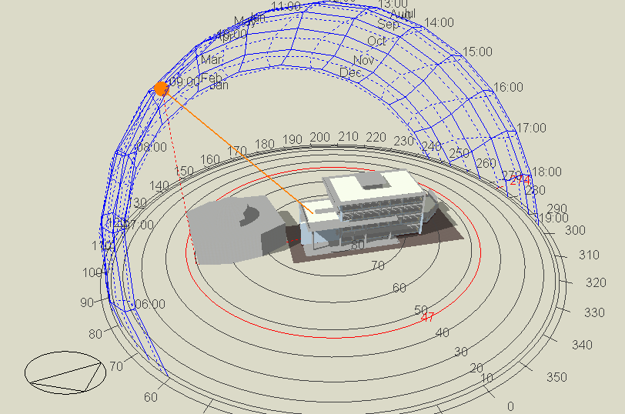
Sun path and shadows analysis
2. In Summer.
Sun path and shadows on 21/7 at 9:00 AM.

Slide 9
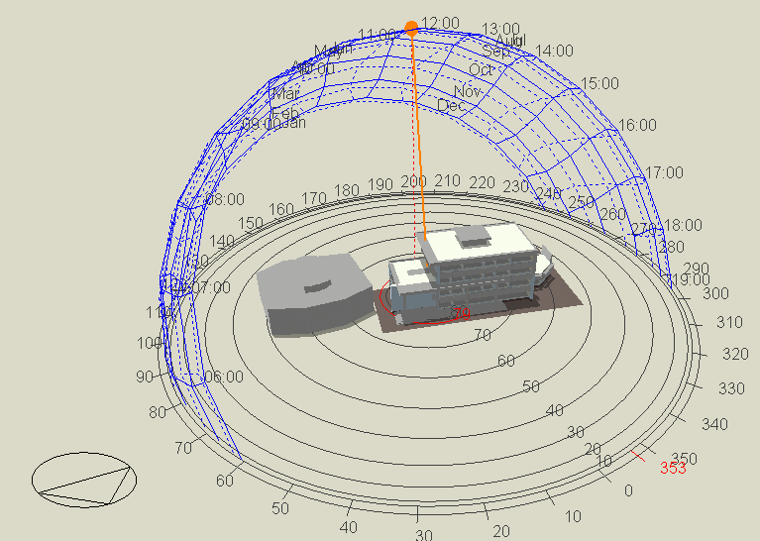
Sun path and shadows analysis
2. In Summer.
Sun path and shadows on 21/7 at 12:00 PM.

Slide 10
Architectural design
Site Plan
Parking
Ground Floor
First Floor
Second floor
Third floor

Slide 11
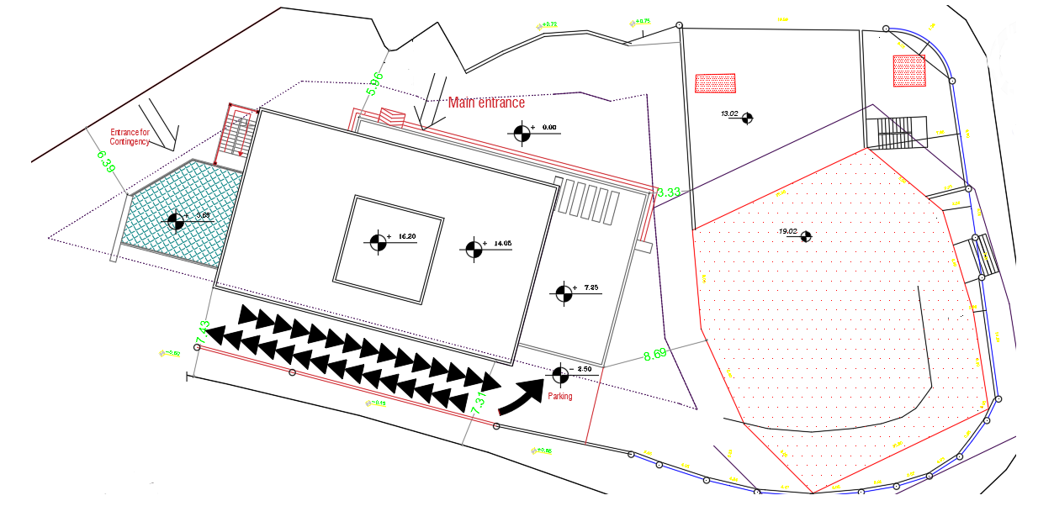
Site Plan
N

Slide 12
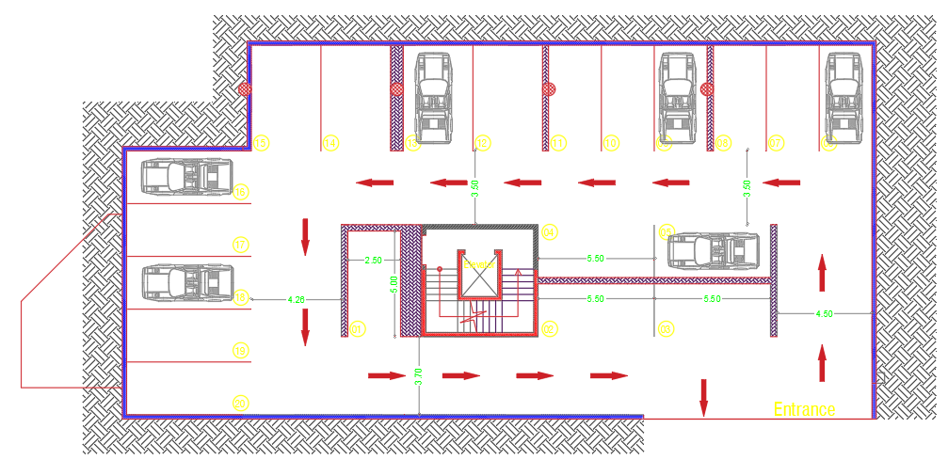
Basements
N
About 605 m2 and capacity for 19 cars

Slide 13
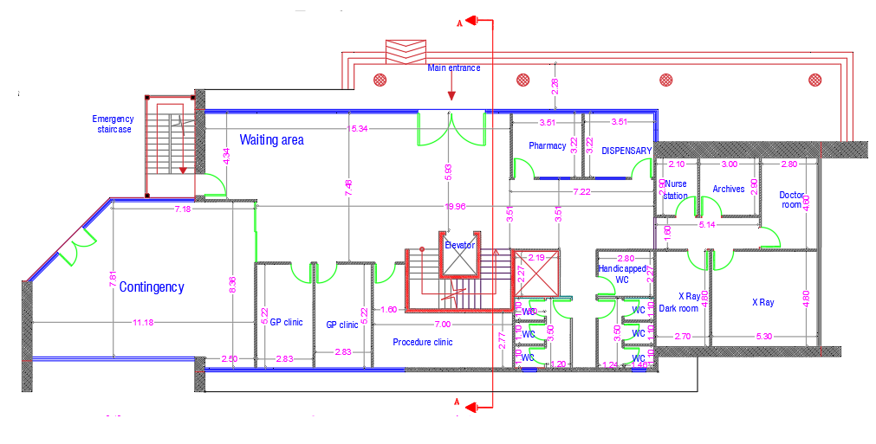
Ground Floor
N

Slide 14
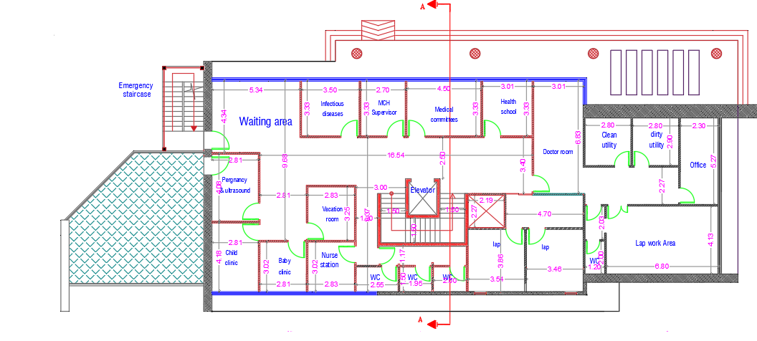
First Floor
N

Slide 15
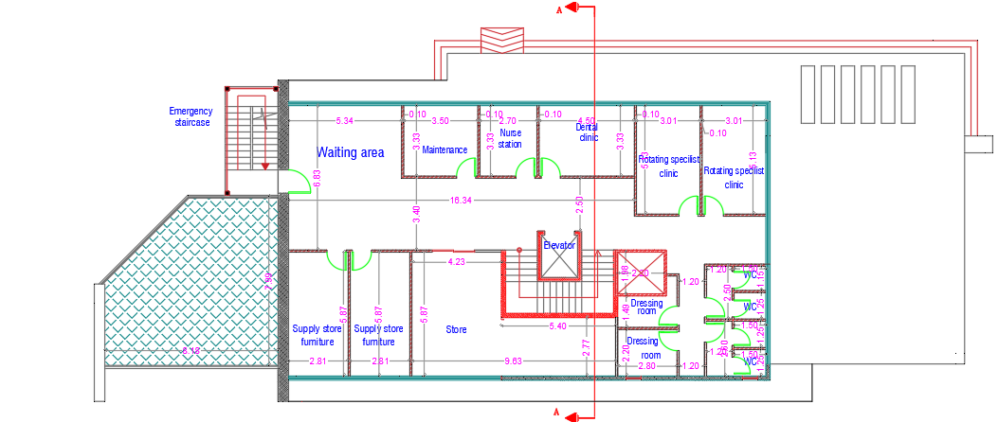
Second Floor
N

Slide 16
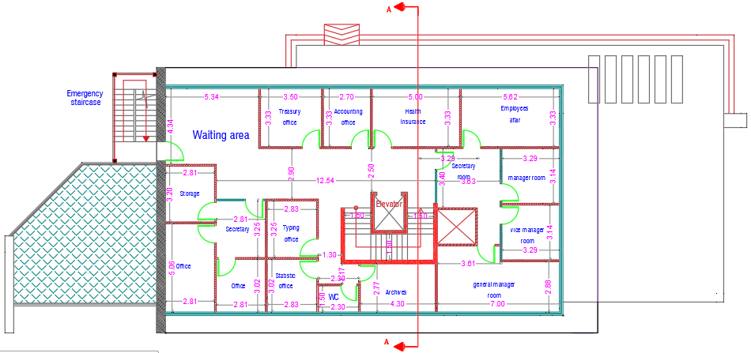
Third Floor
N

Slide 17
Environmental Design
Thermal design.
Natural Lighting.
Acoustic Design.

Slide 18
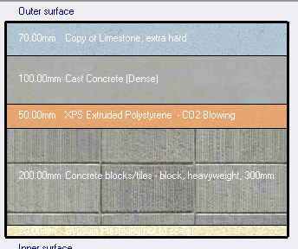

Thermal
Exterior Wall
U-Value = 0.51 W/$m^{2}$.K

Slide 19
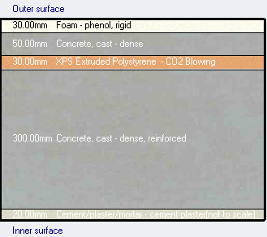


Thermal
Flat Roof
Glazing
Double grey 6mm/13mm argon LOE (low emittance glass), and SHGC= 0.568
U-Value= 1.76W/$m^{2}$.K.
U-Value= 0.466 W/$m^{2}$.K.

Slide 20
Design Builder Results
Design Builder Parameters:
HAVC System: VRF.
System is used for Heating & Cooling.
Building is used for 24 hours.

Slide 21
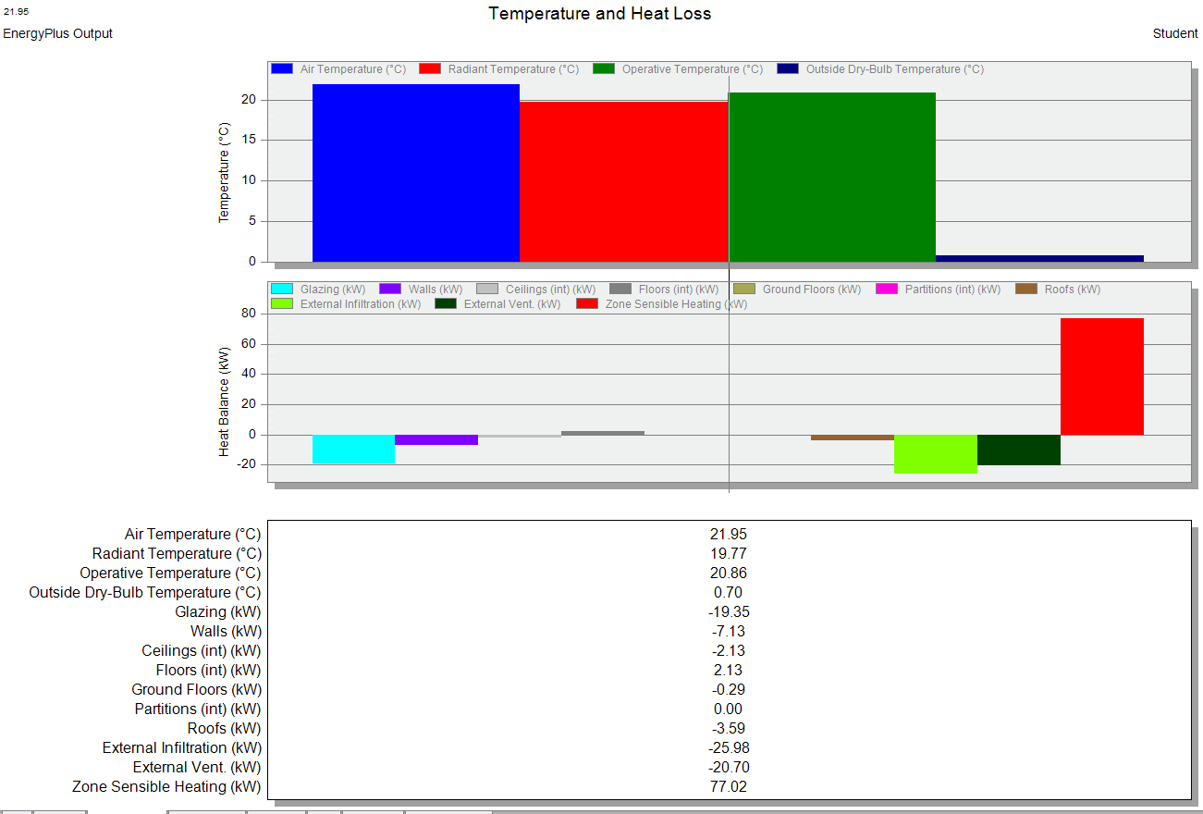
Air and operative temperature.
Air temperature equals 22.15 C
Operative temperature equals 21.08 C

Slide 22
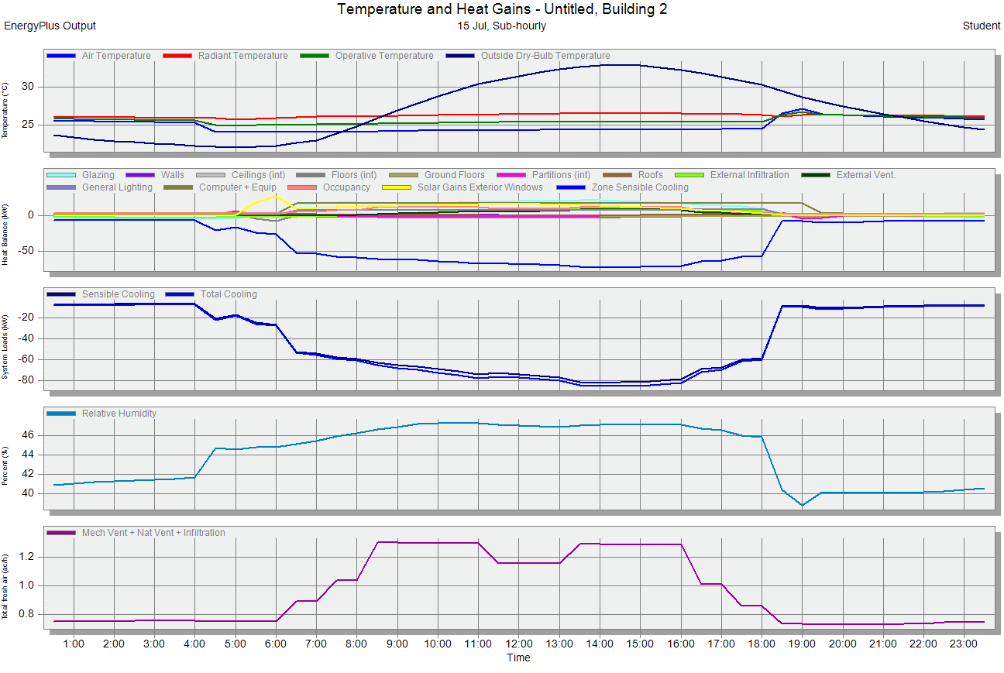
Design Builder Results
between 41-53 %

Slide 23
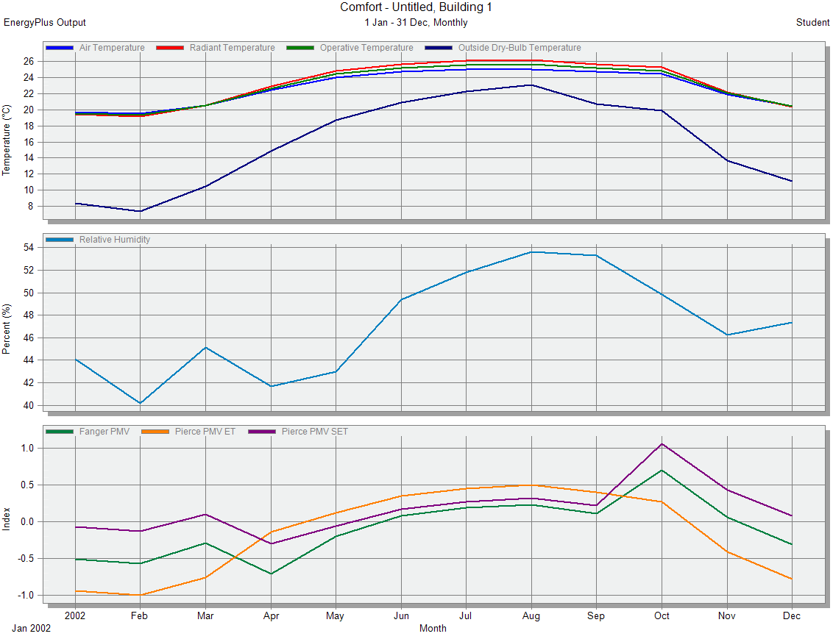
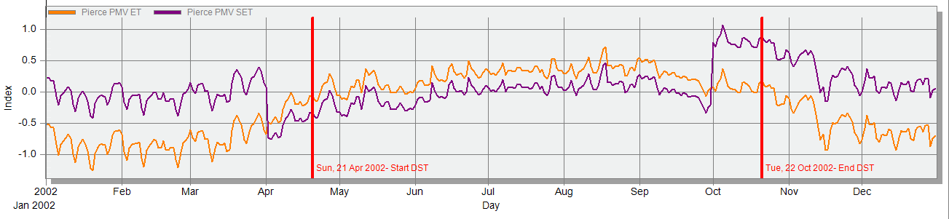
Design Builder Results.
Before.
After.

Slide 24
Site energy.
 | Old | New
Total site energy/year | 253.85 kWh/m² | 167.93 kWh/m²
The cost of 1 KWh is 0.60 ₪ so the total energy consumption is equal 161514 ₪ (0.60*269191.28).
The cost of 1 KWh is 0.60 ₪ so the total energy consumption is equal 171696 ₪ (0.60*286282.34).
Heating and cooling capacity.
Load capacity | `Old | New
Heating capacity | 224.31 kW | 112.67 kW
Cooling capacity | 305.67 kW | 210.49 kW

Slide 25
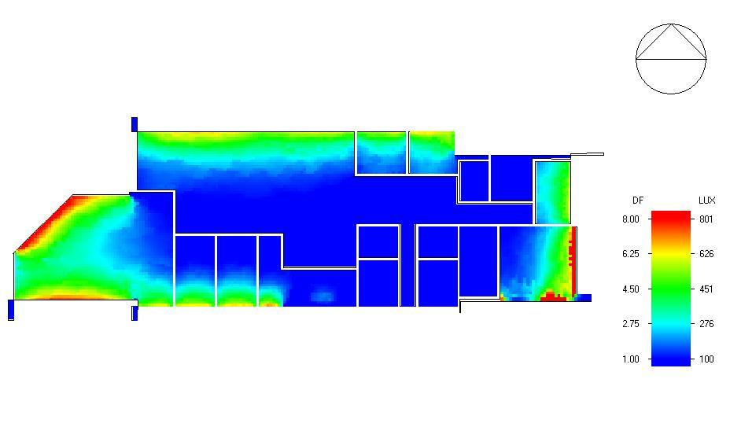
Natural Lighting
Ground Floor

Slide 26
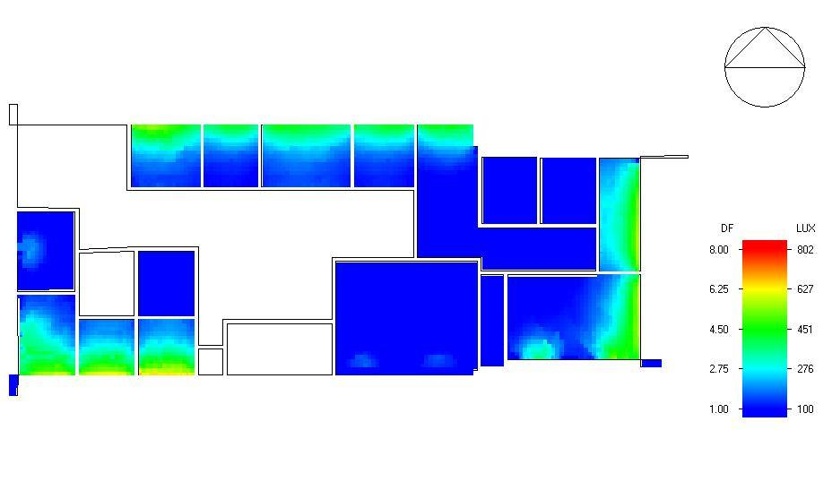
Natural Lighting
First Floor.

Slide 27
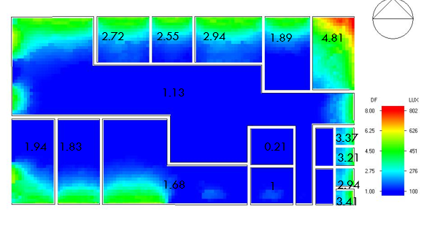
Natural Lighting
Second Floor.
The total average daylight factor for all building equals 2.39 which is acceptable.

Slide 28
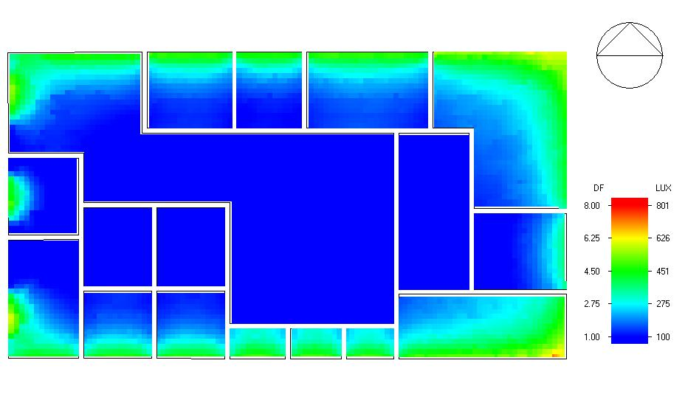
Natural Lighting
Third Floor:
The total average daylight factor for all building equals 2.14 which is acceptable.

Slide 29
HVAC system.
System used are :
VRF
This building was divided into several zones.
Main components of VRF system are :
Out door unit (for cooling and heating).
Controller.
Fan coil unit.
Ducts.
Diffusers.

Slide 30
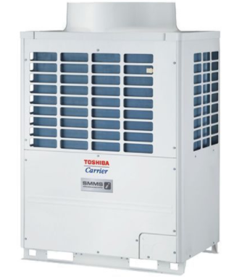
Out door unit.

Slide 31
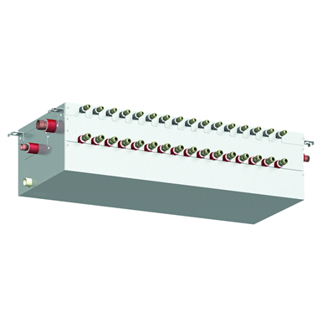
Controller.

Slide 32
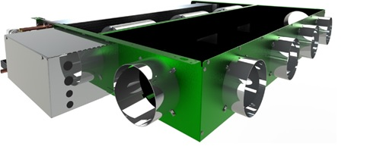
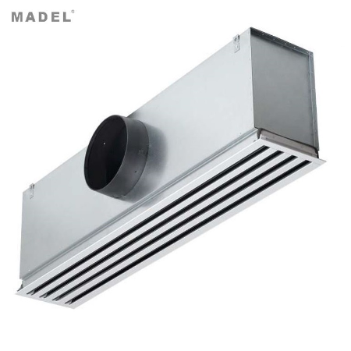
Fan coil unit.
Diffusers.

Slide 33
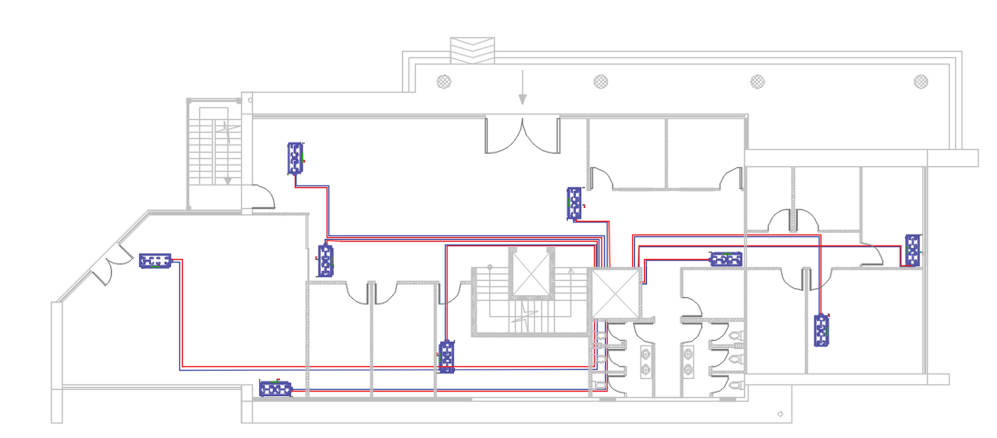
  HVAC distribution for ground floor.

Slide 34
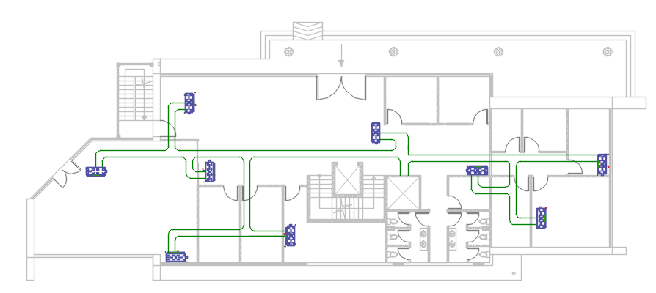
HVAC distribution for ground floor.

Slide 35
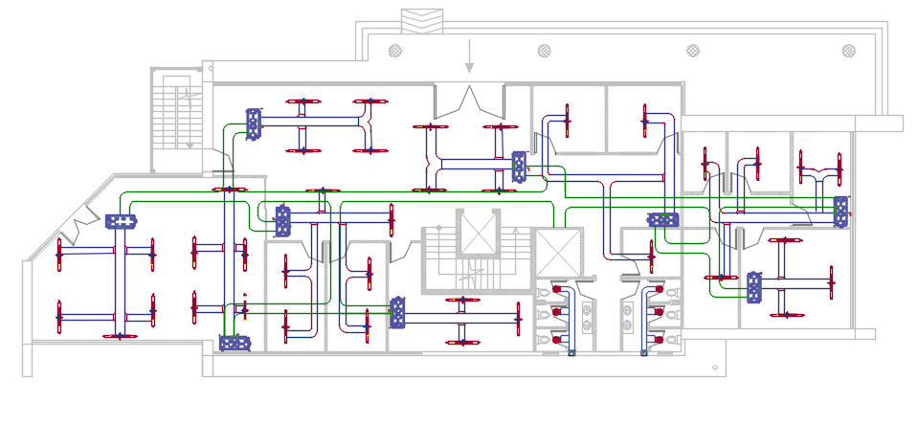
HVAC distribution for ground floor.

Slide 36
Quantity Surviving.
Total cost for the project = 5,688,085 NIS.
Unit cost for the project = 2634 NIS.

Slide 37
THANK YOU.

