Slide 1

Building engineering department
Graduation project 2
Integrated design for energy plus building municipal
Al-Najah National University
Faculty of Engineering
Under the supervision of :Eng.Moayed salhab
Prepared By: Islam Adwan, Reem Jaber & Hadeel Alakhars

Slide 2
Introduction:
This project represents an integrated design for a municipality in the West of Nablus. Its strategic location to serve all categories of the city's population and its accessibility and given the importance of the municipality to develop and improve the level was administrative, architectural, and urban planning of the country. The concept of this project is Energy plus Building.

Slide 3
Architectural- Environmental aspect:

Slide 4
Architectural
Architectural plans
Site location

Slide 5
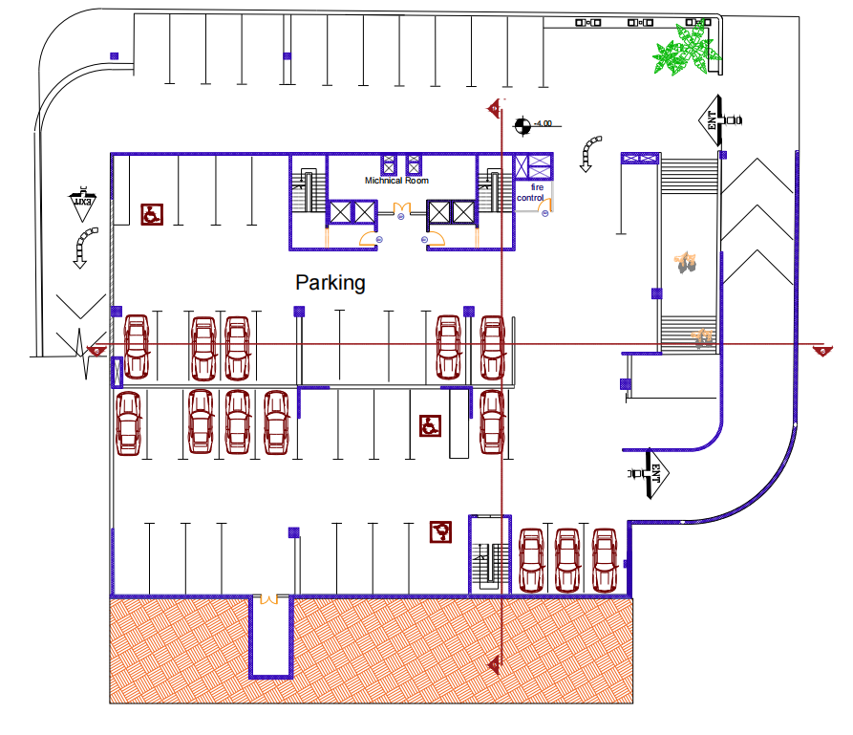
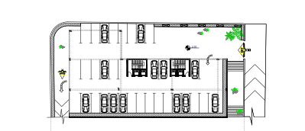
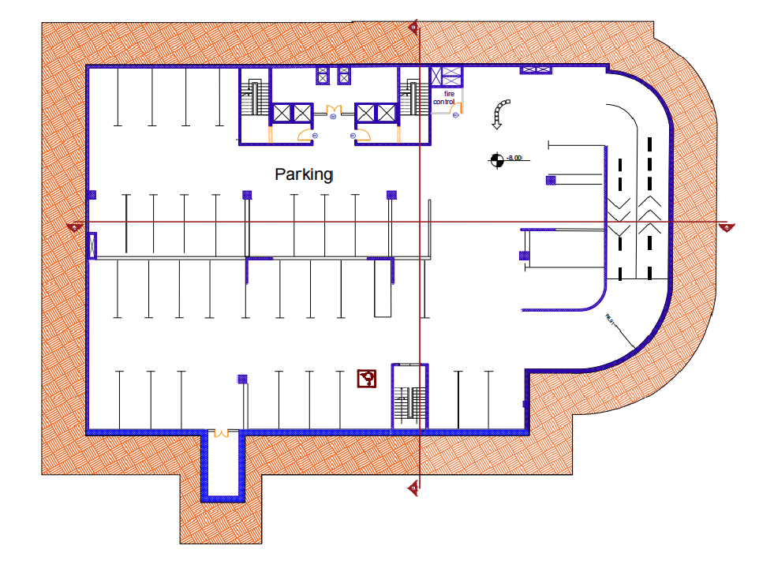
Architectural plans
Before
After

Slide 6
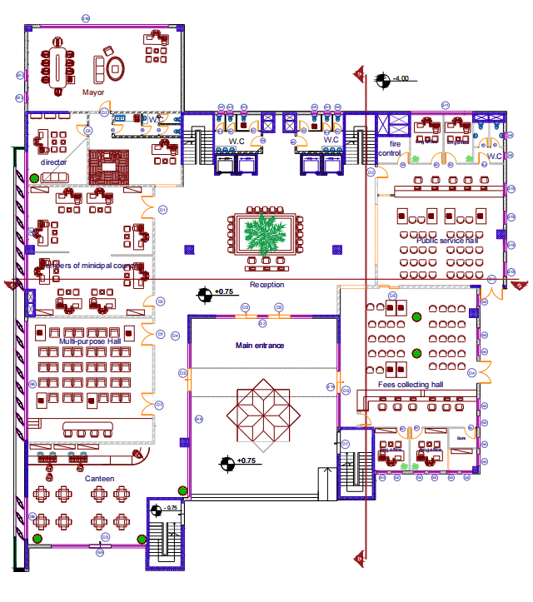
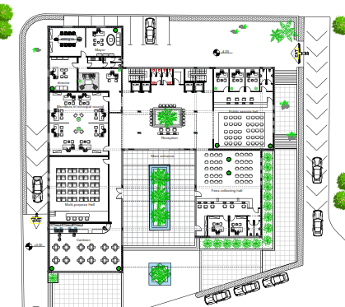
Before
After

Slide 7
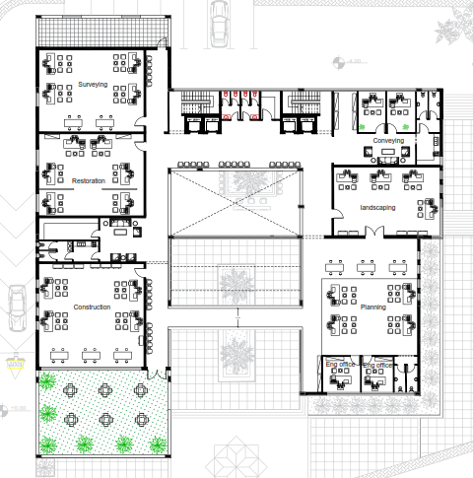
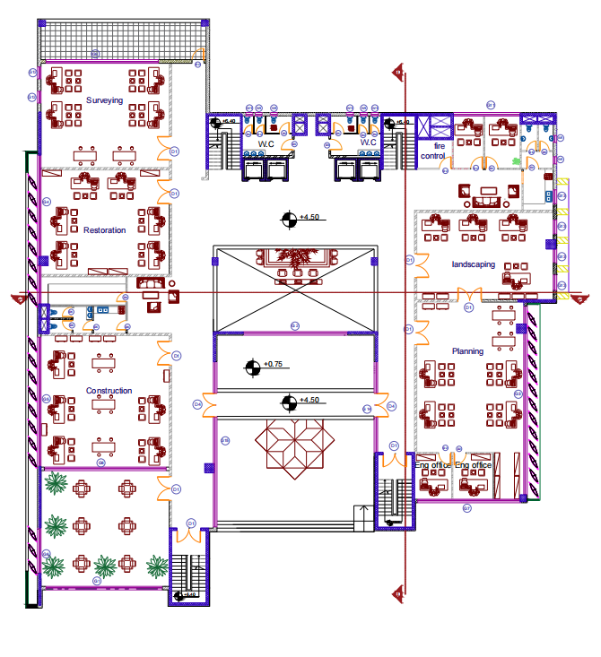
Before
After

Slide 8
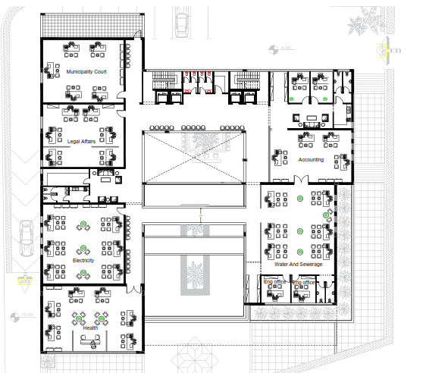
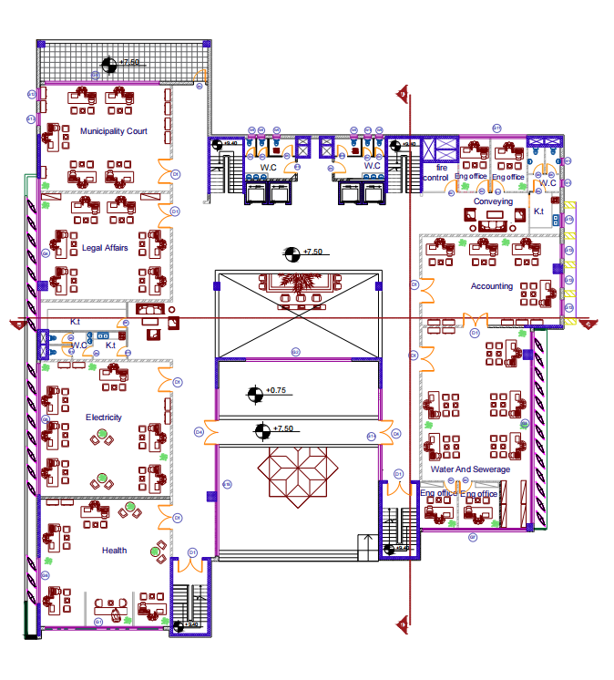
Before
After

Slide 9
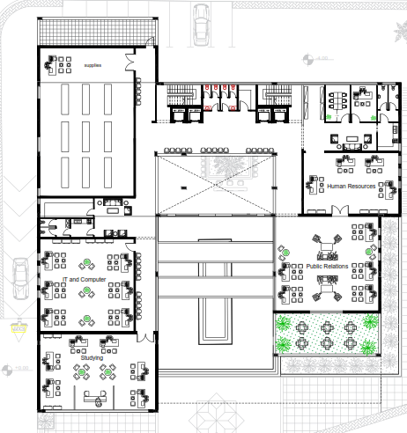
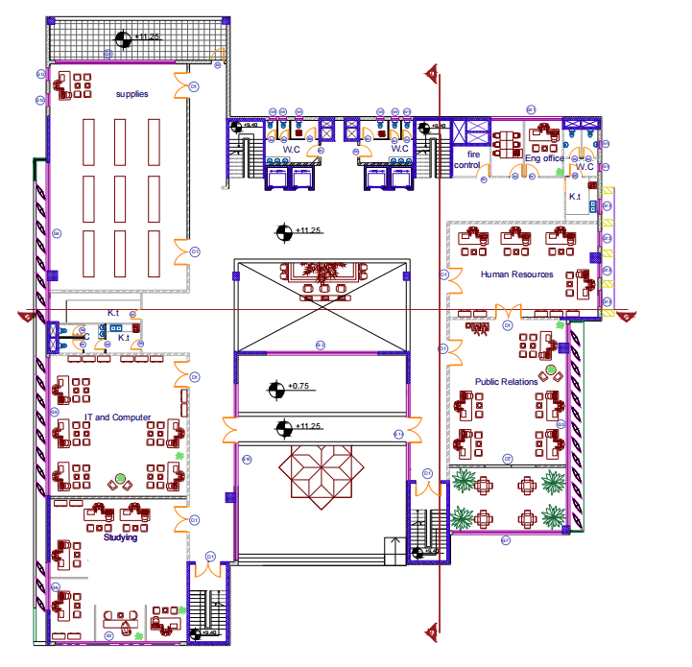
Before
After

Slide 10
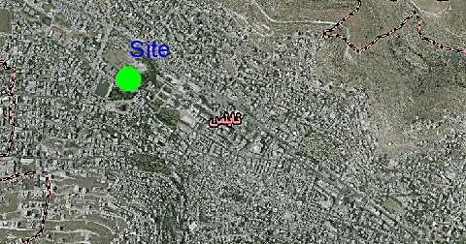
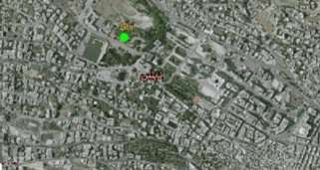
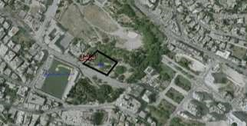
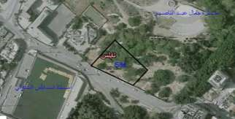
Site location

Slide 11
Environmental
Proposals
Environmental Analysis
Thermal
Analysis
Energy conservation
Photovoltaics

Slide 12
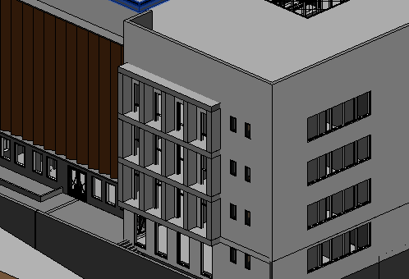
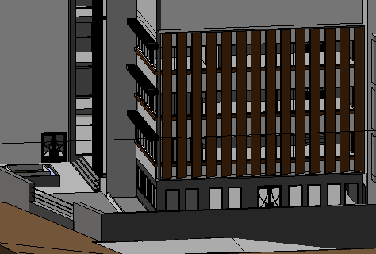
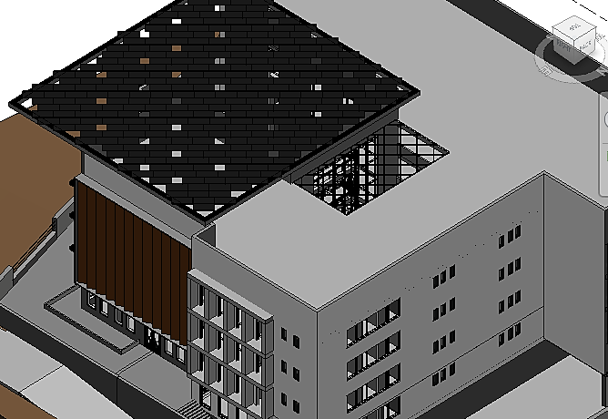
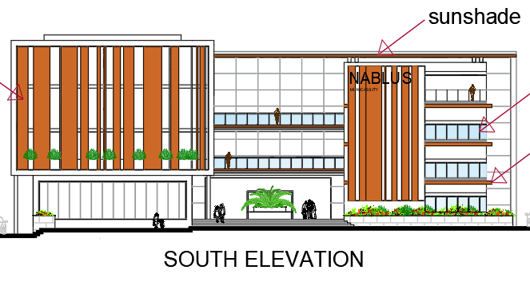
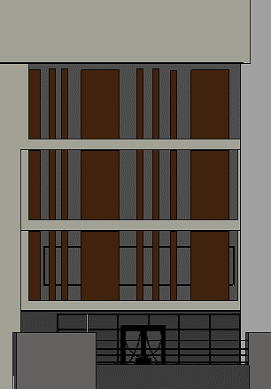
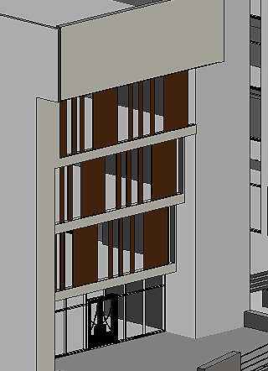
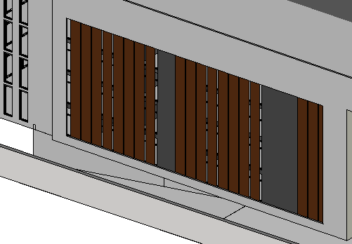
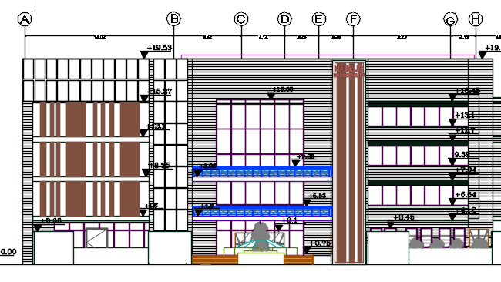
Proposals
Increase Glazing area.
Type glass(Double glass 12 mm)
Setback on the southern façade
Louvers on south wall
interior court
perforated Canopy
Vertical louvers in west and East
Mesh Cantilever

Slide 13
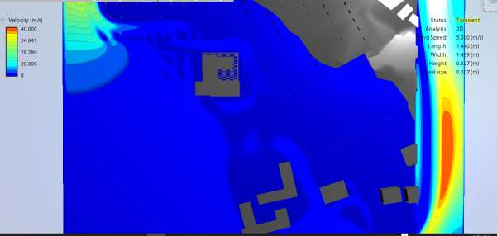
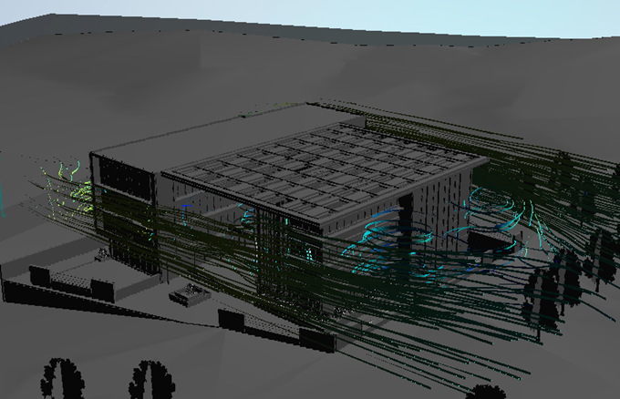
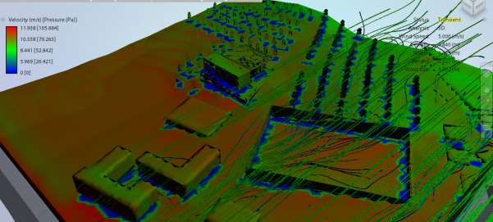
Environmental analysis
Wind movement around building:

Slide 14
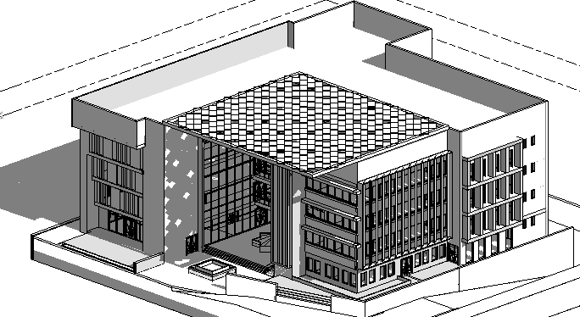
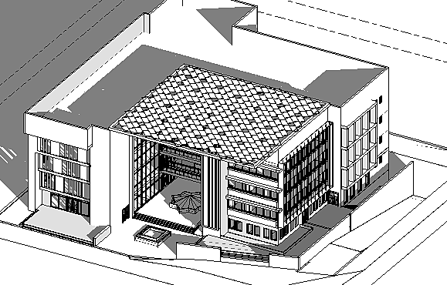
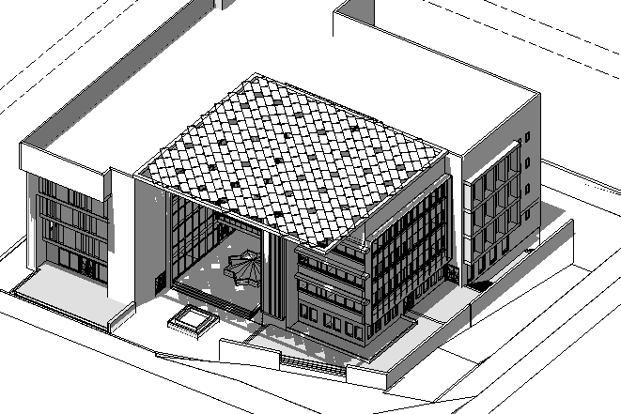
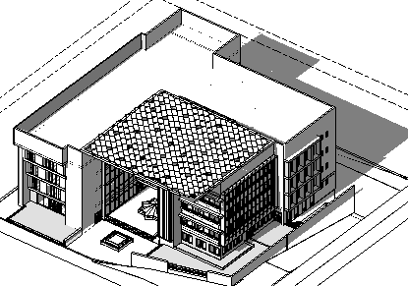
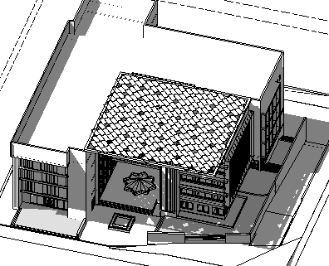
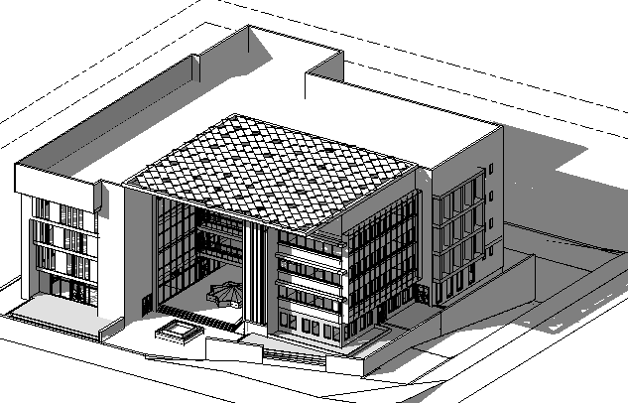
Overshadowing and shading:
Time In Summer | Image | Time In Winter | Image
8:00 AM |  | 8:00 AM
12:00 PM |  | 12:00 PM
2:00 PM |  | 2:00 PM

Slide 15
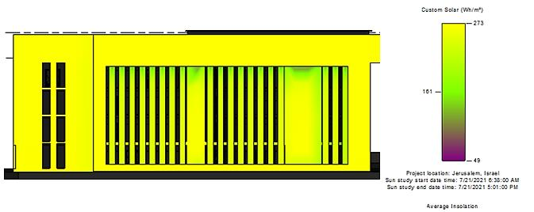
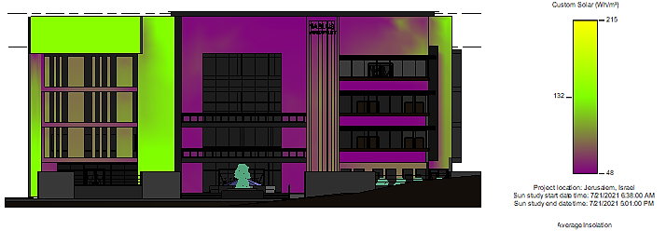
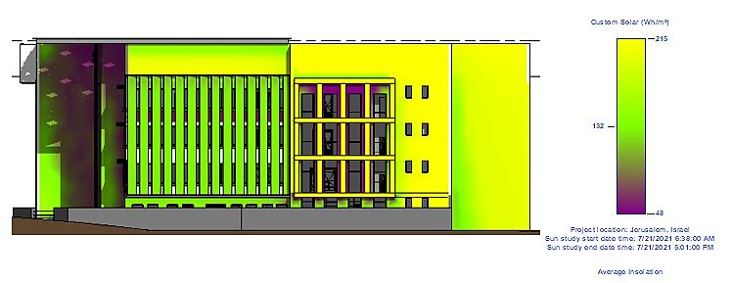
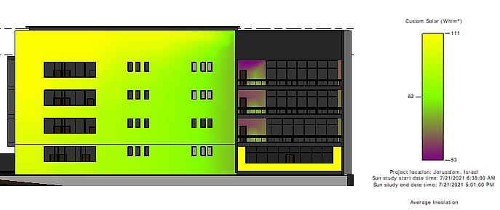
Solar radiation
Solar radiation in summer for elevation:
west elevation
south elevation
East elevation
North elevation

Slide 16
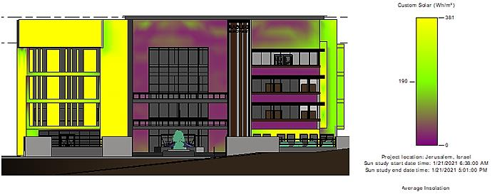
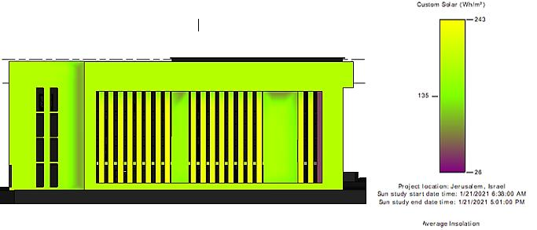
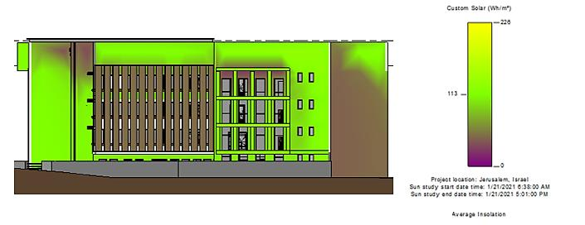
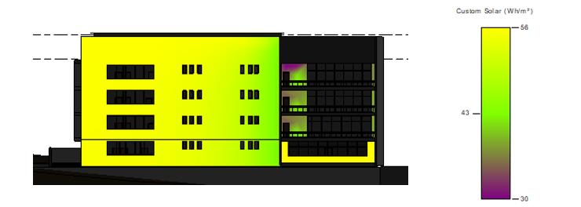
Solar radiation in winter for elevation:
south elevation
west elevation
North elevation
East elevation

Slide 17
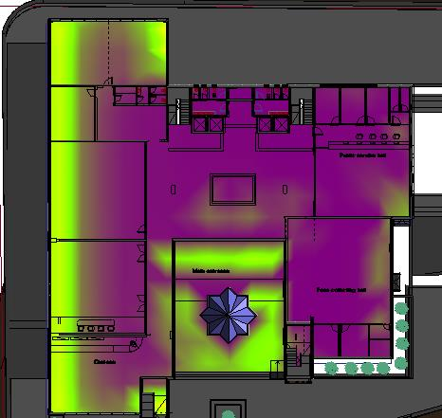
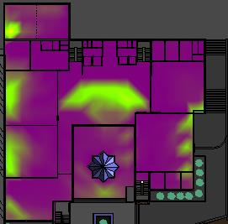
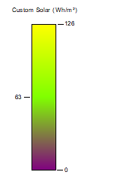
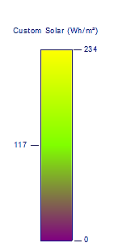
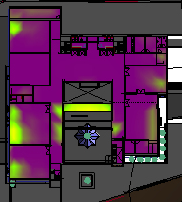
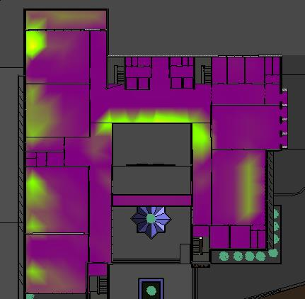
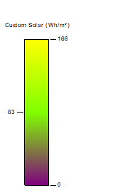
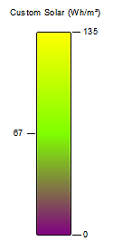
Solar radiation Inside (Summer) :
GF (before)
GF (after)
1st , 2nd and 3rd (after)
1st ,2nd and 3rd (before)

Slide 18
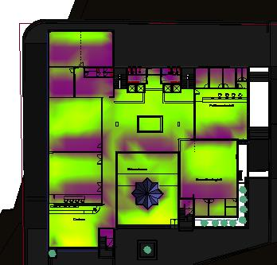
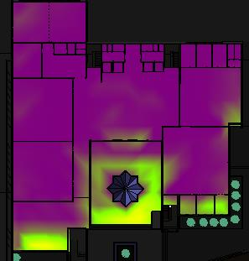






Solar radiation Inside (Winter) :
GF (before)
GF (after)
1st ,2nd and 3rd (before)
1st , 2nd and 3rd (after)

Slide 19









Daylight factor:
GF (before)
GF (after)
3rd (after)
3rd (before)
1st ,2nd (before)
1st , 2nd (after)

Slide 20






Internal ventilation:
(before) | Image | (after) | Image
Gf floor |  | Gf floor
1st ,2nd floor |  | 1st ,2nd floor
3rd floor |  | 3rd floor

Slide 21





Photovoltaics:
Package B (East wall)
Package A (South wall)
Package E
Package C (West wall)
Package D

Slide 22
Summary
Name | Max power(Kwp) | # of module | Energy(Mwh/year)
package A | 22.8 | 48 | 25.1
package B | 57 | 120 | 49.4
package C | 59.9 | 126 | 65.4
package D | 148 | 312 | 245
package E | 68.4 | 144 | 115
Total |  |  | 487.7

Slide 23

Economic analysis:
Payback period=7.45 Years
future saving for 50 years = 20675910.4 (ILS)
present saving for 50 years = 4106761.7 (ILS).
Present cash flow :

Slide 24




Energy conservation:
Proposals to convert the building to energy- plus building:
Base model
Name | U (w/m^2.k)
Wall | 2.44
Partition | 2.44
Roof | 1.78
Floor | 2.32
Window | 5.89
Use Double glass (12)mm
We use 4cm polystyrene In wall
We use 5cm polystyrene in roof
Convert to (LED with step control
Converting the building to tight infiltration

Slide 25






Energy conservation:
Proposals to convert the building to energy- plus building:
Use heat recovery in the HVAC
perforated Canopy
Setback on the southern façade
Vertical louvers in west
Vertical louvers in East
Mesh cantilever in east wall
Co2 sensor
Isolation of the floor between Gf and B1 (4cm polystyrene)

Slide 26



Rustles:

Slide 27


Energy- plus:
There is a surplus of electricity 280.9 Mwh/year.

Slide 28





Thermal analysis:
External Wall
Window
u=0.45 (w/m^2.k)
Roof
u=0.36 (w/m^2.k).

Slide 29


Heating and cooling load
Heating load: (total load =279.8 Kw) (79.55 Ton)
Cooling load: (total load =349.2 Kw)(99.28 Ton)

Slide 30


Thermal comfort:
High PMV between (0.5 to-0.5)
Number the of hours of discomfort is equivalent to 479

Slide 31








LUMION render: (Exterior render)

Slide 32










LUMION render: (Internal render)

Slide 33
Structure aspects

Slide 34
Structure
Assumption
Structure blocks
Details
Martials Properties
ETABS check
Manual calculation
Seismic checks

Slide 35
Assumption:
loads:
Seismic load:
Live load =3.84 Kn/m2
seismic zone 2B(Z=0.2),
Superimposed load =3.7 Kn/m2
Soil profile: SD
Wall load =15 Kn/m2
Ca=0.28
Wind load =-1.01(Kn/m2)
Cv=0.4
Snow load =2.5(kn/m2).
Important factor =1.25
Vv=(0.175*Dead load)
R=5.5

Slide 36


Structure blocks:
Martials characteristics:
Fy=420 MPa
Fc=40 Mpa
Manual calculation:
u-boot thickness =450mm
Dead load =7.54 Kn/m2
concentrated load=2165.48 Ton.

Slide 37


ETABS check
Compatibility check
As we can see in the analysis before us, there is nothing disconnected then Compatibility
Equilibrium check

Slide 38


Stress-strain check:
Columns:

Slide 39



Frame and beams :
First, we will check for one-way solid slab beams, which are beams 2 and 3, This analysis was done on the ultimate load 1.2dead and 1.6 Live load:
Two-way slab:(Beam1 and Frame):

Slide 40


Use ultimate load 1.2dead and 1.6 Live load: shown in the
Mo (Wall and Beam Weight)=30*(13.75^2)/8=710 Kn/m2
Mo (beam)=(710+692.3)=1402.3 (Kn/m2).

Slide 41


Deflection check
Slab deflection:
Beam deflection:
Shear check:
Max shear from ETABS=120Kn/m------> 120*0.78=93Kn/Rib.
ФVc=0.75*1.1*(1/6)*(40^0.5)*(260)*(450-30) =95Kn/rib. ----->Vu< ФVc(Ok).

Slide 42





Seismic checks:
Period check
MPMR
Base shear check
Drift Check:

Slide 43




Details
Columns:

Slide 44




Beam:

Slide 45


Shear wall:

Slide 46


Slab:
Foundation
Raft footing

Slide 47


Single footing

Slide 48

Retiling wall

Slide 49


Sheet pile
Sheet pile

Slide 50


Beam :

Slide 51


Propped :

Slide 52

Stair

Slide 53



Water tank :
Vertical section in water tank display roof and wall
Horizontal section in water tank
Vertical section in water tank display Footing and wall

Slide 54
Electro-mechanical aspects:

Slide 55
Electro-mechanical aspects
Water supply
Drainage Design
Vertical transportation
Firefighting system
Artificial lighting
HVAC design
Acoustic
Electrical design

Slide 56


Acoustic
Architectural
Sound Insulation
RW (Sound Transmutation class)
1.Rw for project component:
RW for Girtin wall
RW for External wall

Slide 57







RW for partition
RW for ceiling
2.Achieve Rooms for RW
Achieve canteen for RW
Achieve Mayor for RW
Achieve meeting room for RW
Achieve construction office for RW
Achieve multi-purpose hall for RW

Slide 58


Lnw for floor (Impact insulation class):
1.Lnw for floor
2.Achieve Rooms for Lnw

Slide 59



Reverberation Time:

Slide 60



1. Distributed Sixto 63 SP in the ceiling
Distribution ceiling materials for canteen
Distribution ceiling materials for Construction office
Distribution ceiling materials for multi-purpose hall
In Meeting for All ceiling is SIXTO 63 SP.

Slide 61




2. Achieve Rooms for RT60
Achieve RT60 for construction office
Achieve RT60 for canteen
Achieve RT60 for meeting room
Achieve RT60 for Multi-purpose hall

Slide 62





Electro-Acoustic:
PRO 3031-A catalog
Catalog for ceiling LSP (CENA812) from AUDAC Company

Slide 63






Distribution ceiling loud speaker
Ceiling sound speaker distribution in public services hall
Loud speaker distribution In Multi-purpose hall
ceiling sound speaker distribution in fees collected
Ceiling sound speaker distribution in corridor (GF)
Ceiling sound speaker distribution in corridor (1st ,2nd ,3rd )
Ceiling sound speaker distribution in canteen

Slide 64



Water supply

Slide 65




Cold water design
1.Dimeter design for pipes:
Main Branch Design
Main Horizontal Design
Main vertical Design
2.Calculation loss for each story

Slide 66




Hot water design
1.Dimeter design for pipes:
Main Branch Design
Main Horizontal Design
Main vertical Design
2.Calculation loss for each story

Slide 67


Water tank design
The amount of water consumption per person for offices (including canteen) =15 L/day
Total = 432 *15 =6.48 m3/day =25.92 m3/4days use 6 roof Tanks (each tank 5 m3)
Solar water heater design:
Then total Area = (28.42)/ (0.375*0.4*6.321) =30m2 we need to 30m2
Mirror of water heater we use 15 Mirror or 7 solar water heater
Water conservation
To create water savings, a water tank is designed to collect rainwater. This tank is designed to
collect 100% of rainwater, Area roof =1436 m2, Rain fill 660.1mm.
Total volume for water tank = (1436*0.6601)-((6.48*26*3)) =442 m3 then use rain water-----> tank (15*8*4 m)

Slide 68


Vertical and horizontal transportation
Elevator design
Elevator calculation
The end we need to (4 Elevators (capacity=2500Ib, speed=350fpm))
Elevator calculation

Slide 69
Artificial lighting design :
Indoor lighting design:
Limitation:
All lighting element luminaires is LED with step control elements.
The daylight factor should be in between this ringing (1-5) present
Light Levels (Illuminance) for indoor area as levels of offices area standard.
The reflection percentage it’s for floor its 0.2, ceiling its 0.8 and wall its 0.7.
Lighting transmission for Windows =0.69.
Ceiling void =0.85 m.

Slide 70




Offices and public halls :
The parameter for design this room is 500 lux min as standard.

Slide 71


Public service hall :

Slide 72


Reception (entrance hall) and loopy :
The parameter for design this room is 300 lux min as standard, uniformity =0.6 and UGR<22.

Slide 73



Multi-purpose Hall (Stage area).

Slide 74



Wash and bath rooms

Slide 75


Emergency stair:

Slide 76



Outer lighting design:
Elevation lighting
Focus on directed lighting on the environmental ideas to highlight the beauty and view of architectural design of the building

Slide 77


Open parking on the northern side and east Stair :

Slide 78


Middle yard and canteen Yard

Slide 79
Firefighting system:
Standard and codes
Jordanian code, 2004 Edition.
NFPA 13, 2019 Edition.
Articles 34 and 35 of the Palestinian Civil Defense Regulations for safety requirements.

Slide 80
Automatic suppression systems
Requirements:
All halls, lobbies and public kitchens are equipped with an automatic fire extinguishing system using automatic water sprinklers.
Automatic extinguishing systems must be linked to the automatic alarm system so that these systems work at the same time.

Slide 81

Design fire protection systems for all public halls, lobbies, public kitchens, reception area and rest area.

Slide 82

water agent- Pre-action Fire Sprinkler System
The concept of it is a dry pipe system in that water is not normally contained within the pipes. The difference it is that water is held from piping by an electrically operated valve, known as a pre-action valve. Valve operation is controlled by independent flame, heat, or smoke detection.”

Slide 83


Fire sprinklers network
Ground floor fire sprinklers network
1st,2nd and 3rd floor fire sprinklers network-this is 1st floor plan

Slide 84



Manual fire extinguishers
There are no less than two manual fire extinguishers on each floor.
Smoke and heat detector

Slide 85

Audible and visual fire alarm :
Audible fire alarm
1.Sound level for audible fire alarm not less than 65 dB
2.There should be at least two warning sounds in one floor.
3.All alarm sounds distributed throughout the building work together at the same time.
Visual fire alarm
Visual signal devices must be hung on walls at a height of not less than 2 m and not more than 2.4 m.

Slide 86


Fees Collecting hall
Kitchen west area-1st, 2nd and 3rd floor.

Slide 87


HVAC design
The system used for HVAC design is (VRF system)
Outdoor unit:
The LG VRF Catalog was used.

Slide 88


Indoor unit :
Fan coil:
The LG Fan Coil Catalog was used.
Diffuser:
OC waterloo catalog.

Slide 89

Return Air:
Catalog selected from ADA

Slide 90



Gf floor
1st ,2nd floor
3rd floor

Slide 91

Drainage Design
Drainage network:

Slide 92

Rain water drainage

Slide 93

Drainage manholes network:

Slide 94

Electrical design
After designing wire for the worst case each floor:
Name | Area cross section (mm2)
Lighting | 1.5
Normal load | 2.5
Special load | 2.5
Fan coil | 1.5

Slide 95


Slide 96



Slide 97


Quantity surveying & Cost Estimate:
Base Model:
1. Initial cost:
2. Life cycle cost(future ):
Initial cost 19858818.44 ILS-----> Unit cost =2142.27 ILS/m2.

Slide 98


Final Model:
1. Initial cost
2. Life cycle cost (future):
Initial cost =21413936.72 ILS-----> Unit cost =2310 ILS/m2.

