Slide 1

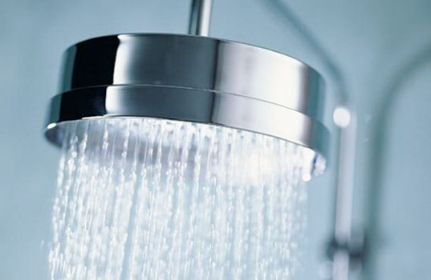
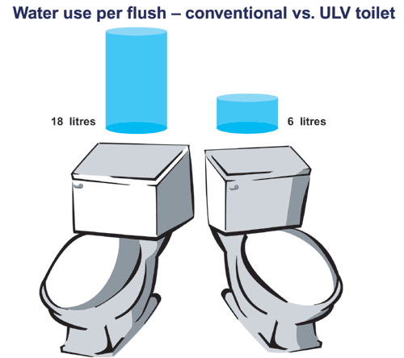
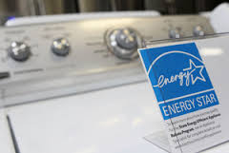
Energy and Water Use Conservation in Nablus
An-Najah National University
Engineering & IT Faculty
Civil Engineering Department
Prepared By:
Wafa’ Hasan Harb
Wa’ed Atabeh
Supervised By:
Dr. Abdulhaleem Khader

Slide 2
INTRODUCTION
General Background
Importance of the project
Problem Definition

Slide 3

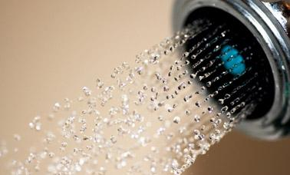
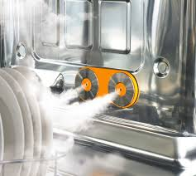
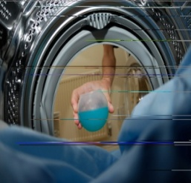
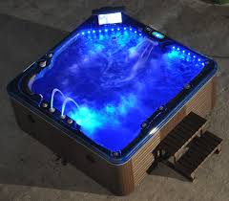
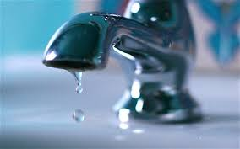
OBJECTIVES
To Reduce households water and energy use
Increase the awareness of the public
determining how water and energy can be used more efficiently

Slide 4
METHODOLOGY
Specifying Study Area
Specifying Ques. Sample
Data Collection
Data Analysis
Recommendations
Design Criteria

Slide 5
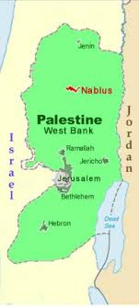
Specifying Study Area
Population: 149,772 according 2015
Water Consumption: 80 liters/c/day
“NM” consumers : 34,416
Energy Consumption:
950 kw.h per head per year.

Slide 6
Specifying Study Area
Nablus Water Production for year 2014
Water Resources | Yield
 | M3/hr | M3/ year
Sabastya | 309 | 2,706,840
Odala | 239 | 2,093,640
Farea | 225 | 1,971,000
Badan | 204 | 1,787,040
Springs | 200 | 1,752,000
Dir Sharaf | 144 | 1,261,440
Mekorot | 45 | 394,200
Total | 1366 | 11,966,160

Slide 7
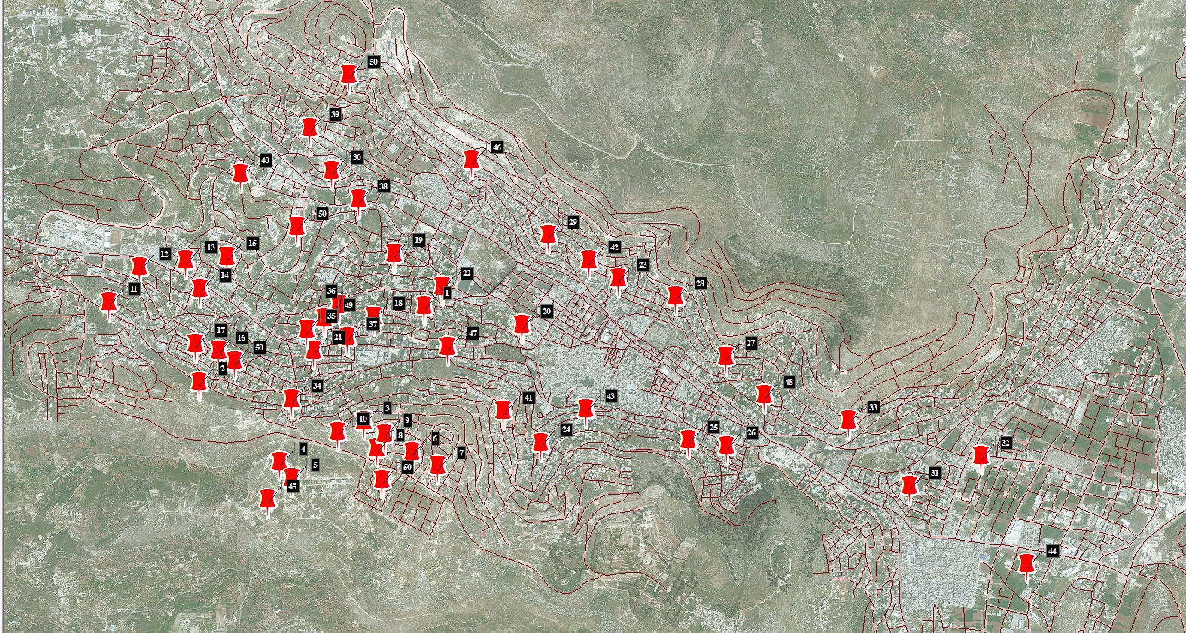
Sample Characteristics

Slide 8
Sample Characteristics
Sample # | Consumption (m³ / Year) | #of family members | L/day/Family | L/day/capita
1 | 400 | 9 | 1111 | 123
2 | 133.7 | 6 | 371 | 61
3 | 102.6 | 5 | 285 | 57
4 | 336 | 6 | 933 | 155
5 | 100 | 4 | 277 | 70
6 | 240 | 7 | 666 | 95
7 | 48 | 1 | 133 | 133
8 | 312 | 9 | 866 | 96
9 | 120 | 8 | 333 | 41
10 | 220 | 8 | 611 | 76
11 | 240 | 7 | 666 | 95
12 | 168 | 5 | 466 | 93
13 | 204 | 7 | 566 | 80
14 | 192 | 7 | 533 | 76
15 | 312 | 7 | 866 | 123
16 | 120 | 7 | 333 | 47
17 | 204 | 6 | 566 | 94
18 | 240 | 7 | 666 | 95
19 | 120 | 7 | 333 | 47
20 | 120 | 8 | 333 | 41
21 | 50 | 6 | 138 | 23
22 | 84 | 8 | 233 | 29
23 | 35 | 1 | 97 | 97

Slide 9
24 | 55 | 2 | 452 | 76
25 | 80 | 4 | 222 | 55
26 | 150 | 8 | 416 | 52
27 | 170 | 7 | 472 | 67
28 | 72 | 4 | 200 | 50
29 | 204 | 5 | 566 | 113
30 | 48 | 2 | 133 | 66
31 | 46 | 2 | 127 | 63
32 | 480 | 3 | 1333 | 444
33 | 160 | 7 | 444 | 63
34 | 150 | 7 | 416 | 59
35 | 144 | 5 | 400 | 80
36 | 144 | 3 | 400 | 133
37 | 48 | 8 | 133 | 16
38 | 96 | 7 | 266 | 38
39 | 240 | 5 | 666 | 133
40 | 96 | 5 | 266 | 53
41 | 120 | 6 | 333 | 55
42 | 300 | 7 | 833 | 119
43 | 280 | 10 | 777 | 77
44 | 84 | 10 | 233 | 23
45 | 480 | 10 | 1333 | 133.3
46 | 48 | 5 | 133 | 26.6
47 | 40 | 6 | 111 | 18.5
48 | 72 | 6 | 200 | 33
49 | 342 | 5 | 950 | 190
50 | 60 | 5 | 166 | 33.3
The average consumption 82.33 Liter/Capita/Day

Slide 10
Sample Characteristics
The Energy Consumption Rates for the Study Sample
Sample # | Consumption (KW.H/ month) | Consumption (KW.H/ Year) | #of family members | Consumption (KW.H/day/capita)
1 | 750 | 9000 | 9 | 2.73
2 | 485 | 5820 | 6 | 2.65
3 | 485 | 5820 | 5 | 3.1
4 | 485 | 5820 | 6 | 2.65
5 | 270 | 3240 | 4 | 2.2
6 | 620 | 7440 | 7 | 2.9
7 | 65 | 780 | 1 | 2.1
8 | 750 | 9000 | 9 | 2.74
9 | 685 | 8220 | 8 | 2.8
10 | 620 | 7440 | 8 | 2.55
11 | 485 | 5820 | 7 | 2.3
12 | 343 | 4116 | 5 | 2.25
13 | 685 | 8220 | 7 | 3.2
14 | 485 | 5820 | 7 | 2.3
15 | 620 | 7440 | 7 | 2.9
16 | 685 | 8220 | 7 | 3.2
17 | 620 | 7440 | 6 | 3.4
18 | 685 | 8220 | 7 | 3.2
19 | 620 | 7440 | 7 | 3
20 | 750 | 9000 | 8 | 3.08
21 | 685 | 8220 | 6 | 3.75
22 | 750 | 9000 | 8 | 3.08
23 | 65 | 780 | 1 | 2.1
24 | 145 | 1740 | 2 | 2.4
25 | 270 | 3240 | 4 | 2.2

Slide 11
26 | 685 | 8220 | 8 | 2.8
27 | 685 | 8220 | 7 | 3.2
28 | 220 | 2640 | 4 | 1.8
29 | 343 | 4116 | 5 | 2.25
30 | 185 | 2220 | 2 | 3
31 | 145 | 1740 | 2 | 2.38
32 | 220 | 2640 | 3 | 2.4
33 | 485 | 5820 | 7 | 2.27
34 | 750 | 9000 | 7 | 3.5
35 | 485 | 5820 | 5 | 3.2
36 | 343 | 4116 | 3 | 3.75
37 | 685 | 8220 | 8 | 2.8
38 | 485 | 5820 | 7 | 2.27
39 | 415 | 4980 | 5 | 2.7
40 | 343 | 4116 | 5 | 2.25
41 | 483 | 5796 | 6 | 2.65
42 | 685 | 8220 | 7 | 3.2
43 | 750 | 9000 | 10 | 2.5
44 | 750 | 9000 | 10 | 2.5
45 | 685 | 8220 | 10 | 2.25
46 | 343 | 4116 | 5 | 2.25
47 | 415 | 4980 | 6 | 2.3
48 | 483 | 5796 | 6 | 2.6
49 | 483 | 5796 | 5 | 3.2
50 | 415 | 4980 | 5 | 2.7
The Average Consumption 2.69 KW.H/day/capita

Slide 12

Specifying Questionnaire Sample

Slide 13
Specifying Questionnaire Sample
رقم العائلة | عدد أفراد الأسرة | 0 - 15 / الفئات العمرية | 15 - 30 / عام | 30 - 50 / عام | > 50 / عام | معدل دخل الأسرة | نوع المسكن | مساحة المنزل
1 | 9 | 3 | 4 | 1 | 1 | > 10000 | فيلا | 400
2 | 6 | 0 | 4 | 1 | 1 | 4001 - 8000 | شقة سكنية | 180
3 | 5 | 0 | 3 | 2 | 0 | 4001 - 8000 | شقة سكنية | 300
4 | 6 | 1 | 3 | 1 | 1 | 8000 - 10000 | شقة سكنية | 250
5 | 4 | 0 | 2 | 0 | 2 | 8000 - 10000 | شقة سكنية | 132 m
6 | 7 | 1 | 4 | 1 | 1 | 4001 - 8000 | منزل مستقل | 132 متر مربع
7 | 1 | 0 | 0 | 0 | 1 | 2001 - 4000 | شقة سكنية | 150
8 | 9 | 2 | 3 | 3 | 1 | 4001 - 8000 | منزل مستقل | 150
9 | 8 | 0 | 2 | 4 | 2 | 2001 - 4000 | شقة سكنية | 144متر
10 | 8 | 2 | 4 | 1 | 1 | 4001 - 8000 | منزل مستقل | 450 متر مربع
11 | 7 | 2 | 3 | 1 | 1 | 8000 - 10000 | شقة سكنية | ١٥٠ م
12 | 5 | 0 | 3 | 0 | 2 | 4001 - 8000 | منزل مستقل | 130
13 | 7 | 2 | 3 | 2 | 0 | 2001 - 4000 | شقة سكنية | 175
14 | 7 | 2 | 3 | 2 | 0 | 2001 - 4000 | شقة سكنية | 175
15 | 7 | 2 | 3 | 2 | 0 | 2001 - 4000 | شقة سكنية | 250m
16 | 7 | 2 | 3 | 2 | 0 | 0 - 2000 | شقة سكنية | 130
17 | 6 | 1 | 3 | 1 | 1 | 4001 - 8000 | شقة سكنية | 170
عدد مرات استخدام الغسالة اسبوعيا | عدد الحنفيات في المنزل | معدل استخدام الحنفية الواحدة في اليوم الواحد
5 | 8 | 3
7 | 6 | 11
2 | 3 | 10
6 | 7 | 20
5 | 6 | 20
4 | 4 | 15 مرة
مرتين في الشهر | 3 | من 7 إلى 10 مرات
2 | 6 | 100
5 | 3 | 50
4 | 4 | 6
يوميا | 4 | 55
3 | 3 | 25
3 | 5 | 20
3 | 5 | 20
7 | 7 | 60 مرة
14 | 3 | 40
4 | 5 | 30
45 | 10 | 2 | 4 | 2 | 2 | > 10000 | فيلا | 5 dunom
46 | 5 | 0 | 3 | 0 | 2 | 4001 - 8000 | شقة سكنية | 152
47 | 6 | 1 | 3 |  | 2 | 4001 - 8000 | شقة سكنية | 100
48 | 6 | 0 | 4 | 1 | 1 | 0 - 2000 | شقة سكنية | 110 متر مربع
49 | 5 | 1 | 2 | 2 | 0 | 2001 - 4000 | منزل مستقل | 200 m
50 | 5 | 1 | 2 | 2 | 0 | 8000 - 10000 | فيلا | 350
2 | 3 | 25
2 | 5 | 6
7 | 6 | 2
2 | 5 | 50
5 | 3 | 9
3 | 4 | 15
2 | 4 | 5-8
4 | 11 | 5

Slide 14

DATA COLLECTION
Questioner Data
Households Devices
Households collected data
Devices available in the market

Slide 15
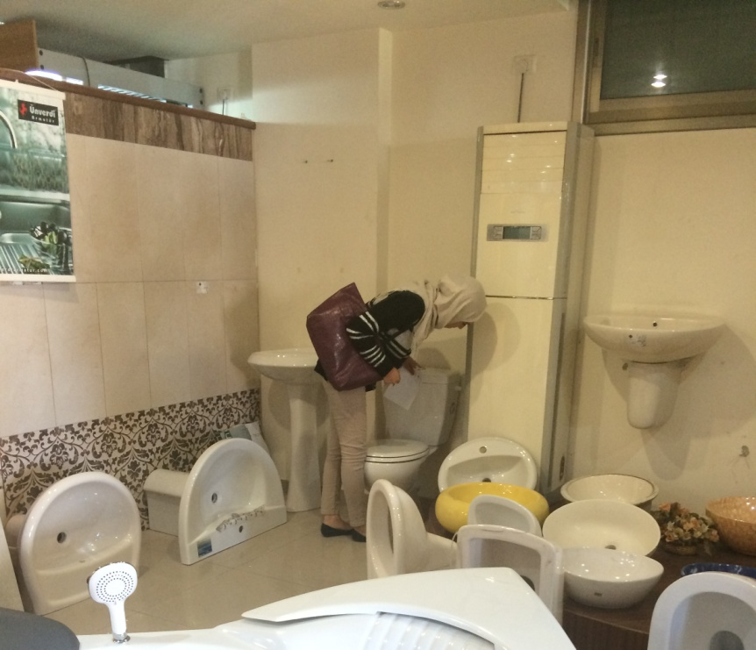
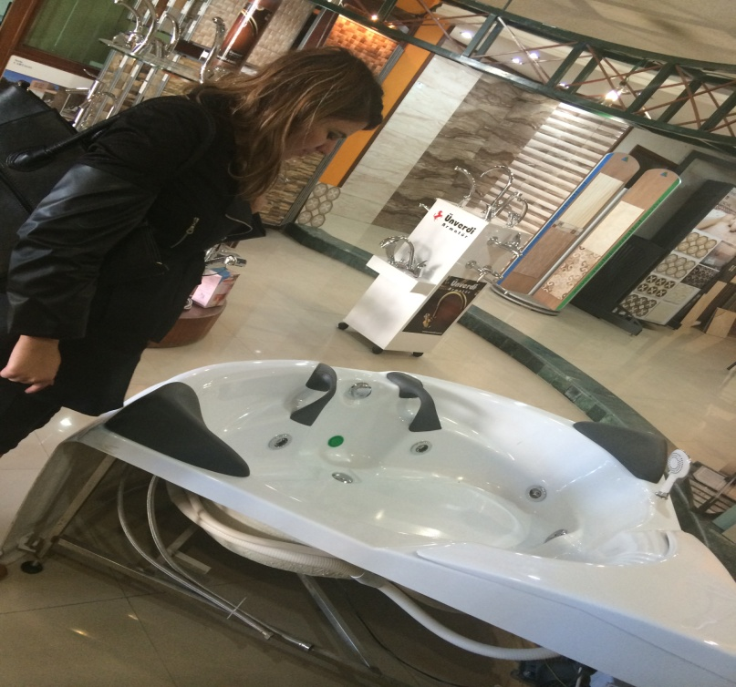
Devices Available In The Market
Sbitany Co. ltd.
Al-Susa Company.
Shamout Co.
Dolphen
Awadeh com.
Alternative energy sources Co.

Slide 16
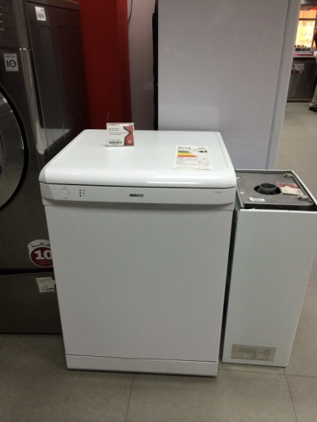
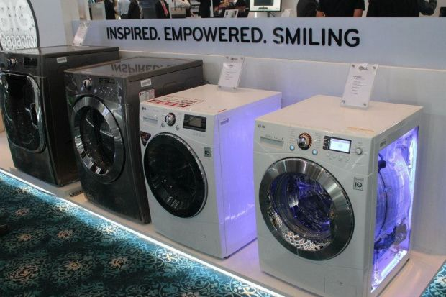
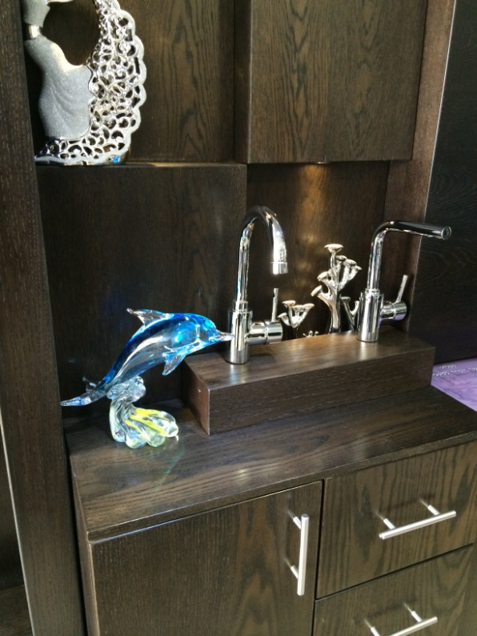
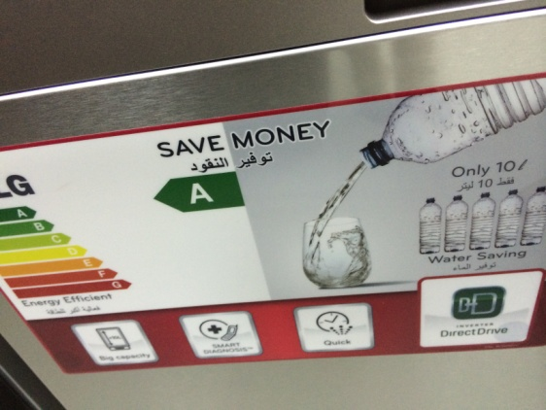
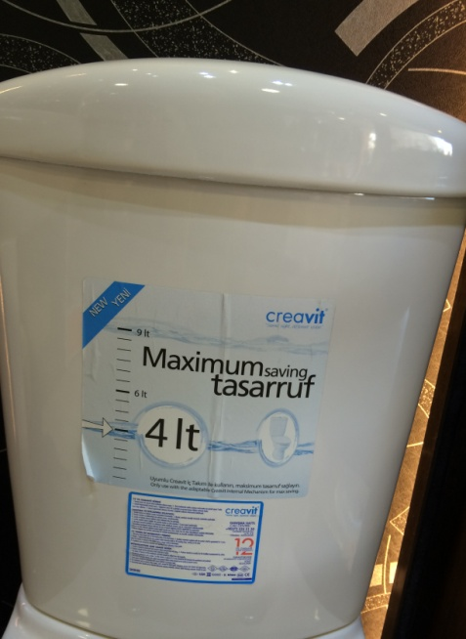
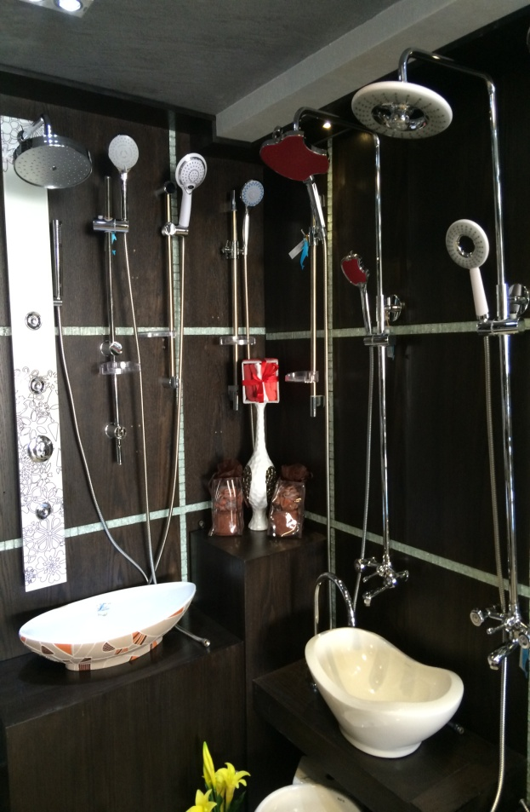
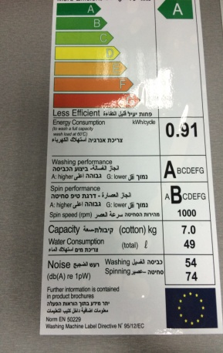
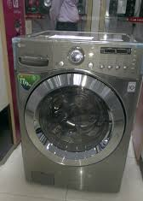
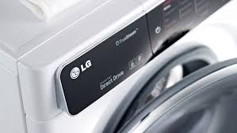
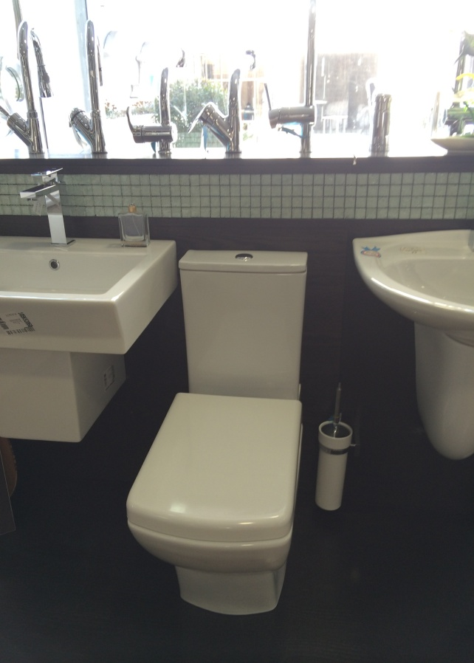
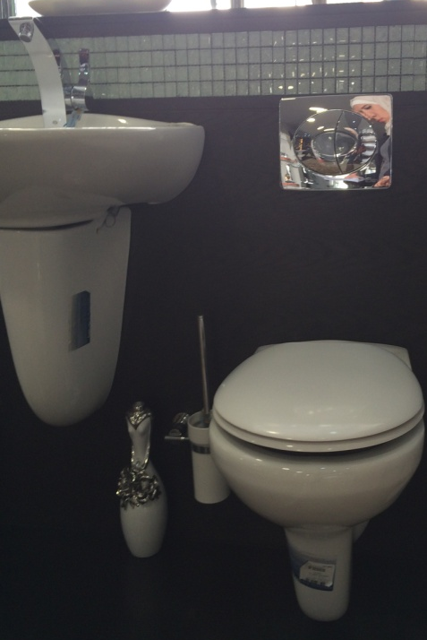
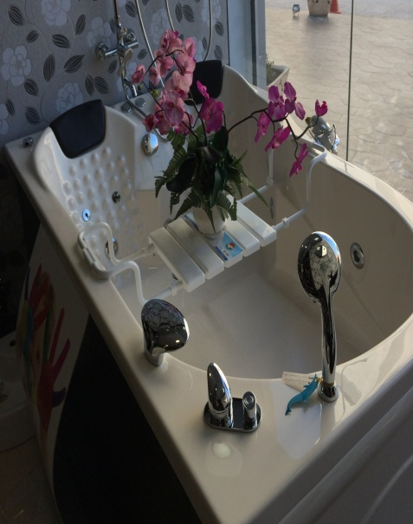

Slide 17

DATA ANALYSIS
DEVICES
QUES.
Avg. Consumption
Per Capita consumption
Characteristics
Avg. monthly use

Slide 18

Questionnaire Analysis
Characteristics of the householders
hh type | Avg. # of rooms | No. of Families | Income | Av. hh size/m²
A | 5.3 | 8 | High | 841.5
B | 4.2 | 35 | Medium | 206.3
C | 3.2 | 7 | Low | 134.2
Overall | 4.2 | 50 |  | 394

Slide 19
Devices Analysis

Slide 20
Devices Analysis

Slide 21
Devices Analysis

Slide 22
Devices Analysis

Slide 23

DESIGN and MODIFICATIONS
Devices for a typical design
Devises | Typical Device | Water consumption | Energy consumption
Dishwasher | LG -True Steam LDF8072ST | 8 liters/ cycle | 900 W / Full Cycle
Faucet | agua flux ( M24) | 3.5 l/min | -
Shower | High efficiency showerhead | 2.5 galloon/min | -
Washing Machine | LG-WM3875HVCA | 45 Liter/ cycle | 91 KW.H/Cycle
Toilet | NEW Creavite | 4 Liters/ Flush | -
Jacuzzi | Apoloo | 400 L/use | -

Slide 24
Amounts of Water and Energy Conservation

Slide 25
Amounts of Water and Energy Conservation
Average monthly domestic energy consumption using typical design values
kw.h/month

Slide 26
Amounts of Water Conservation
Type A
Toilets can an amount equal = 28.11 – 18.7 = 9.41 m³/month.
Which means that devices can save about = 112920 L/year.
The amount of saved water of all appliances= 136560 L/year ≈ 136,500 L/year
Type B
Total monthly domestic water consumption using house appliances =33.54 m³/month.
Total monthly domestic water consumption using typical devices= 24.04 m³/month.
The amount of saved water = 33.54- 24.04 = 9.5 m³/month.
Which means that devices can save about = 114000 L/year.
Type C
Total monthly domestic water consumption using house appliances =35.97 m³/month.
Total Monthly domestic water consumption using typical devices= 18.64 m³/month.
The amount of saved water = 35.97- 18.64 = 17.33 m³/month.
Which means that devices can save about = 207960 L/year ≈208,000 L/year

Slide 27
Amounts of Energy Conservation
Type A:
The amount of saved energy = 26.7_25.32 =1.38 kw.h/month
Which means that devices can save about = 16.56 kw.h/year≈ 16.6 Kw.h/year
Type B
The amount of saved energy = 29.4_26.8= 2.6 kw.h/month.
Which means that devices can save about = 31.2 kw.h/year ≈ 31 Kw.h/year
Type C
The amount of saved energy = 28.56_26.3 = 2.26 kw.h /month.
Which means that devices can save about = 27.12 kw.h/year ≈ 27 Kw.h/year

Slide 28
Amounts of Water and Energy Conservation
B: 50% A: 25% C: 25%
Weighted avg. of consumption using house appliances(each family in Nablus) X No. of consumer in NM =50,637 X 34,416
Weighted avg. of consumption using typical appliances(each family in Nablus) X No. of consumer in NM =50,637 X 34,416
The total amount of water saved in Nablus ≈ 500,000 M³/Year

Slide 29

Recommendation
Toilet Water Saving Tips
Save water consumption through every day behaviors of individuals
Palestine has the possibility of the use of solar energy.

Slide 30
Recommendation
Check faucets and pipes for leaks
Check your toilets for leaks Install water-saving shower heads and low-flow faucet aerators
Use your dishwasher and clothes washer for only full loads

Slide 31


