Slide 1

An-Najah National University Faculty of Engineering
Industrial Engineering Department.
Graduation Project (2)
Feasibility study for a pvc production line at Nablus company for Nylon and plastic

Slide 2
Prepared by :
Saed Sader
Baraah Haj Mohammad
Haya Abdullah
Taha Amer
Supervisor:
Eng. Suleiman Daifi

Slide 3
Outline:
Introduction
Technical study
Financial analysis
Conclusion and Recommendation

Slide 4
Introduction:
Our problem is represented in the possibility of establishing a new PVC Pipes production line in Nablus Company for the manufacture of nylon and plastic, which focused on the production of the agricultural nylon industry, so this line will open a greater opportunity for them to develop their production and support their ability to compete in the market.
PVC pipes are made out of a material known as polyvinyl chloride, a durable, strong plastic , also plastic pipe network is low cost and has a life span of more than 50 years.

Slide 5
In The previous work:
We study the current situation in the Nablus Co. for Nylon and plastic
We made a market study In order to understand the market share and explore the demand for our product, So we start studying the market and analyze it to identify the market demand for the pvc pipes in its different diameters.
A technical study need to be conducted to determine the project's founding costs and then to estimate the operational costs size.

Slide 6
Continued…..
In order to know if the project is feasible or not a financial study must be conducted.
So we make some calculations on the number of squared meter in the north (13,451,843) and we have that:
3901035 m for 4 in
807111 m for 6 in
269037 m for 8 in

Slide 7
Technical Study:
The objective of the technical study is to know the Capital Investment , Running cost and Income.
The following is a general description of the project from the technical point of view, and accordingly the investment requirements are explained in the PVC Pipe production line.
Our project will be about 3 measurements: 4 inch, 6 inch and 8 inch which are the most dimensions used.

Slide 8
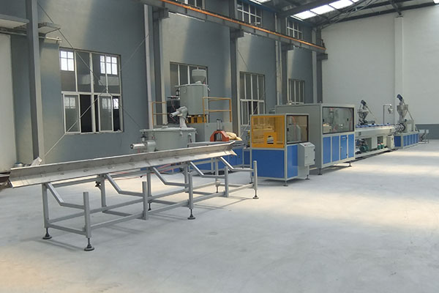
Suggested Production line Design

Slide 9
Capital investment:
Land and Infrastructure
Water network
Electricity and electrical energy needed to run the facility
Machinery, equipment and production lines
Furniture and IT equipment.
Vehicles
Pre-operating expenses
Working capital
Contingencies

Slide 10
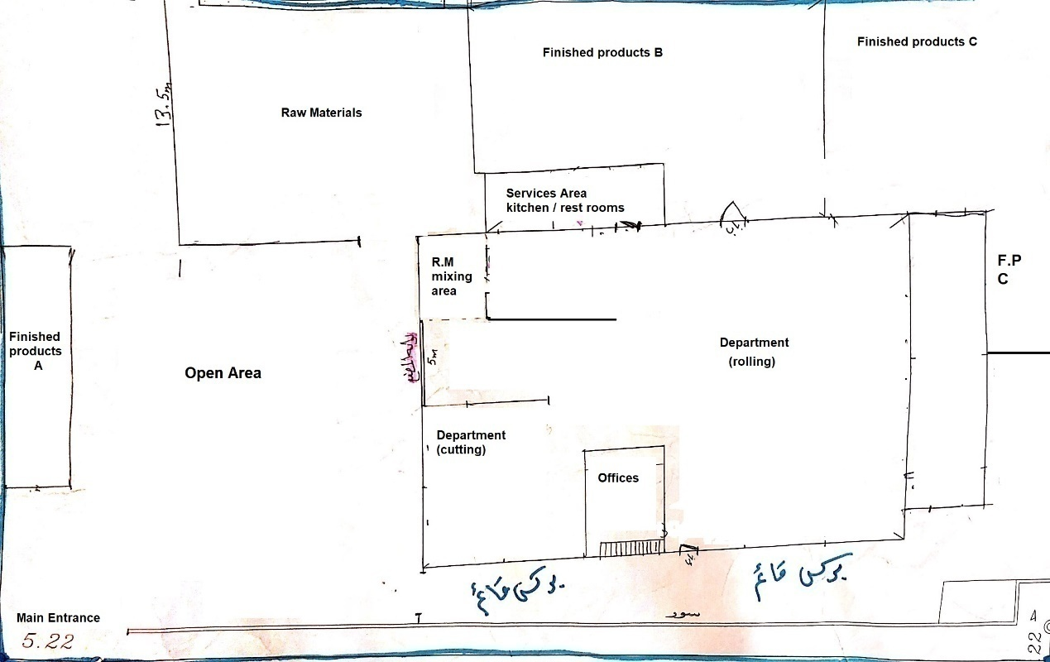
The existing layout of the factory
Land and Infrastructure

Slide 11
the new layout after transfer the 3 warhouses and opining the new production line instead of them.
New Production Line

Slide 12
Water network:
Production of PVC pipe is a manufacturing processes that do not require water dramatically, water system are available in Nablus For Nylon and Plastic factory therefore there is no need for a new water network connection, two water tanks only needed to supply the water to the machine for cooling purposes which is cost 1000 JD for both tanks.

Slide 13
Electricity and electrical energy needed to run the facility
Item | Cost/Ampere (Jd) | Needed (Ampers) | Cost(Jd)
Amperes | 20 | 150 | 3000
Joint 1 A with the supply ele. Co. | 30 | 150 | 4500
قواطع ,اسلاك ,امانات وغيرها | 4000
Total |  |  | 11500

Slide 14
Machinery, equipment and production lines
We asked two companies which manufacture the wanted machines for PVC Pipes:
The first offer from a chines Co. need a delivery time about 45 days, 30% of the total price payed when we order the machines and 70% when receiving the machine. The company guarantee with production lines for 6 months and with machines for 1 year. The total machines price is about $57000.
The second offer is from Taiwan, delivery time needed to receive is about 90 days, Total price must be payed when order the machines, the guarantee for the machines is 6 months and the total price is $60000. This prices not include shipping cost.
According to the previous offers we decide to order the first machines the main reason is the longer time of guarantee ,cheaper and the payment method is more facilitate.

Slide 15
Furniture and IT equipment:
The factory already have furniture and IT equipment, so no need to buy a new equipment but they will using this equipment for the new production line.
Vehicles
Vehicles needed to transfer finish product to the customers the factory outsource this by dealing with Vehicles Company which take care of transportation, pay for them monthly about 1600 JD.

Slide 16
Pre-operating expenses:
It includes the cost of technical, legal and engineering consultations, laboratory testing of the final product, experimental production, training of workers, licensing fees and negotiation with the parties involved in the project, it about 3000 Jd.
Working capital:
Working capital is estimated at 18000Jd if the plant is fully operational, 72-day account receivable.
Contingencies:
The reserve required to cover unforeseen costs, fluctuations in asset prices and other establishment expenses is estimated at 5560 Jd.

Slide 17
Summary of Initial Foundational Costs
No. | Item | Cost(Jd)
1 | Water network | 1000
2 | Electricity network | 11500
3 | Machinery, equipment and production lines | 34000
4 | Vehicles | 1600
5 | Pre-operating expenses | 3000
6 | Land | 840
7 | Constriction | 1700
8 | Re layout | 2000
Total |  | 55540
9 | Contingencies (0.1* Total) | 5560
10 | Working Capital | 18000
Total summation |  | 80000

Slide 18
Operational costs:
Expected annual production size.
Manpower required to manage and operate the production line.
Raw materials and quantities required for production.
Electricity consumption and costs.
Water consumption and costs
General operating expenses

Slide 19
Market share of the plant during the next 6 years
Expected market share | Year
10% | 2019
10% | 2020
10% | 2021
10% | 2022
10% | 2023
10% | 2024

Slide 20
Expected annual production size
PVC Pipe diameter | Market share | Demand | Production size
4 in | 10% | 780807 | 78080
6 in | 10% | 161422 | 16142
8 in | 10% | 53807 | 5380

Slide 21
Manpower required to manage and operate the production line
Number | Job Description | Required Number | Monthly Salary Per Capita(Jd) | Total Monthly Salary Per Employee | Total Annual Salary (Jd)
1 | Manager | 1 | 1600 | 1600 | 5760
2 | Worker | 4 | 300 | 1200 | 14400
3 | Accouter | 1 | 400 | 400 | 1440
4 | Engineer | 1 | 600 | 600 | 2160
Total annual salary (30% of total salaries for the new production line except the workers) |  |  |  |  | 23,760
(3.25 % of total salaries for Insurance expenses) |  |  |  |  | 770
Total |  |  |  |  | 24,530

Slide 22
Raw materials and quantities required for production
Pvc pipe | Annual production(m) | Weight of 1 m(kg) | Total Raw material weight(ton) | Cost (Jd)
4 in | 78080 | 1.14 | 90 | 94500
6 in | 16142 | 1.85 | 30 | 31500
8 in | 5380 | 2.56 | 13 | 13650
Total |  |  |  |  | 139650

Slide 23
Electricity consumption and costs:
The machine consume 67kw/h the factory will operate for 8 h the total electricity cost 2000 Jd monthly which means 24000 annually.
Water consumption and costs:
Monthly water cost is estimated at about 1000Jd. 12000 JD Annually

Slide 24
General operating expenses total cost
Cost | Item | No.
2000 | Annual Administrative Expenses | 1
2700 | Annual maintenance | 2
600 | Insurance | 3
1600 | advertising expenses | 4
2500 | Stationery, communications and services | 5
4000 | Depreciation expenses | 6
13,400 | Total

Slide 25
Summary of total operational cost:
Cost(Jd) | Item | No.
24,530 | Manpower required to manage and operate the production line | 1
139650 | Raw materials and quantities required for production | 2
24000 | Electricity consumption and costs | 3
12000 | Water consumption and costs | 4
13,400 | General operating expenses | 5
213580 | Total

Slide 26
Total annual revenue
PVC Pipe diameter | Production Size | Avg. Price | Income
4 in | 78080 | 8 | 624640
6 in | 16142 | 18 | 290556
8 in | 5381 | 35 | 188300
Total |  |  | 1103496

Slide 27
Financial Analysis
In order to study and implement the project's material returns, the Advisory Group carried out financial analysis from the numbers they had in the previous chapter and the analysis had three scenarios as follows:
Cash flow with fixed sales and fixed Running cost.
Cash flow with geometric increasing sales with 2.5%
Sensitivity analysis has four scenarios ( two good, two bad)

Slide 28
Cash flow with fixed sales and fixed Running cost:
invstment | 80000 | Year 1 | Year 2 | Year 3 | Year 4 | Year 5 | Year 6 | Year 7
Running cost | 209580 | 209580 | 209580 | 209580 | 209580 | 209580 | 209580 | 209580
Dep | 4000 | 4000 | 4000 | 4000 | 4000 | 4000 | 4000 | 4000
Income | 1.1 m | 1.1 m | 1.1 m | 1.1 m | 1.1 m | 1.1 m | 1.1 m | 1.1 m
Net income before tax | 889916 | 889916 | 889916 | 889916 | 889916 | 889916 | 889916 | 889916
Tax | 177983 | 177983 | 177983 | 177983 | 177983 | 177983 | 177983 | 177983
Net income after tax | 711932 | 711932 | 711932 | 711932 | 711932 | 711932 | 711932 | 711932

Slide 29
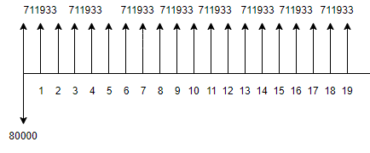
Cash flow diagram for the first scenario, fixed sales and fixed Running cost

Slide 30
Indicators:
1 .Net present value: 6000000
2. Rate of Return : 890%
3. pay pack period is less than 1 year
4. Break even point there is less than 1 year of work

Slide 31
Cash flow with geometric increasing sales with 2.5%:
invstment | 80000 | Year 1 | Year 2 | Year 3 | Year 4 | Year 5 | Year 6 | Year 7
Running cost | 209580 | 217780 | 221455 | 225130 | 228805 | 232480 | 236155 | 239830
Dep | 4000 | 4000 | 4000 | 4000 | 4000 | 4000 | 4000 | 4000
Income | 1.1m | 1.13 m | 1.15 m | 1.18 m | 1.21 m | 1.24 m | 1.27 m | 1.31 m
Net income before tax | 889916 | 909303 | 933899 | 959210 | 985248 | 1.01 m | 1.03 m | 1.06 m
Tax | 177983 | 181861 | 186779 | 191842 | 197050 | 202405 | 207912 | 213576
Net income after tax | 711933 | 727443 | 747119 | 767368 | 788199 | 809620 | 831650 | 854304

Slide 32
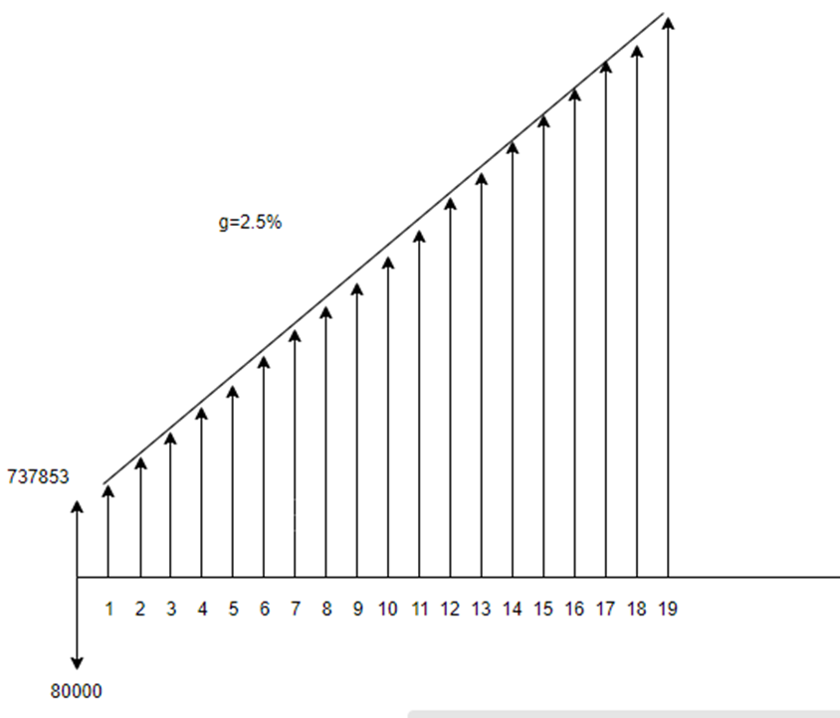
Cash flow for the cumulative increasing.

Slide 33
Indicators:
Net present value: 795000 JD
Rate of Return: 892%
Payback period is less than 1 year
Break even point is less than 1 year

Slide 34
Sensitivity analysis:
we made four scenarios (two good , two bad) and we can make more but we enough with these scenarios also these scenarios helps the company to face the market volatility especially that we live in Palestinian territory and there are so many regulations from the outside and the inside that can affect the company suddenly.

Slide 35
Good scenarios
• Increasing in sales 10 %
• Decreasing in the raw material prices 10%
Bad scenarios:
• Decreasing in sales with 10%
• Increasing in raw material prices with in 10%

Slide 36
Good scenarios
1. Increasing in sales 10%:
Investment | 80000 | Year 1 | Year 2 | Year 3 | Year 4 | Year 5 | Year 6 | Year 7
Running cost | 209580 | 209580 | 209580 | 209580 | 209580 | 209580 | 209580 | 209580
Dep | 4000 | 4000 | 4000 | 4000 | 4000 | 4000 | 4000 | 4000
Income | 1.1m | 1.21 m | 1.21 m | 1.21 m | 1.21 m | 1.21 m | 1.21 m | 1.21 m
Net income before tax | 889916 | 988716 | 988716 | 988716 | 988716 | 988716 | 988716 | 988716
Tax | 177983 | 197743 | 197743 | 197743 | 197743 | 197743 | 197743 | 197743
Net income after tax | 711933 | 790972 | 790972 | 790972 | 790972 | 790972 | 790972 | 790972

Slide 37
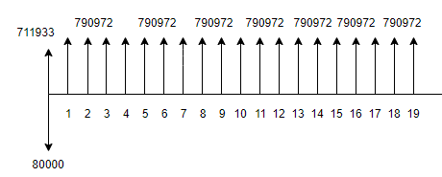
Cash flow of Increasing in sales 10 %

Slide 38
Indicators:
Net present value:7000000 JD
Rate of return:900%
Payback period less than 1 year
Break event point is less than 1 year

Slide 39
2. Decreasing in raw material prices 10%:
invstment | 80000 | Year 1 | Year 2 | Year 3 | Year 4 | Year 5 | Year 6 | Year 7
Running cost | 209580 | 195405 | 195405 | 195405 | 195405 | 195405 | 195405 | 195405
Dep | 4000 | 4000 | 4000 | 4000 | 4000 | 4000 | 4000 | 4000
Income | 1.1 m | 1.1 m | 1.1 m | 1.1 m | 1.1 m | 1.1 m | 1.1 m | 1.1 m
Net income before tax | 889916 | 904091 | 904091 | 904091 | 904091 | 904091 | 904091 | 904091
Tax | 177983 | 155913 | 155913 | 155913 | 155913 | 155913 | 155913 | 155913
Net income after tax | 711933 | 723273 | 723273 | 723273 | 723273 | 723273 | 723273 | 723273

Slide 40
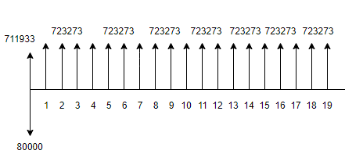
cash flow diagram for decreasing prices of raw materials 10%

Slide 41
Indicators:
Net present value:6400000 JD
Rate of Return:891%
Payback period less than 1 year
Break event point is less than 1 year.

Slide 42
Bad scenarios
1. Decreasing in sales with 10%:
invstment | 80000 | Year 1 | Year 2 | Year 3 | Year 4 | Year 5 | Year 6 | Year 7
Running cost | 209580 | 209580 | 209580 | 209580 | 209580 | 209580 | 209580 | 209580
Dep | 4000 | 4000 | 4000 | 4000 | 4000 | 4000 | 4000 | 4000
Income | 1.1 m | 993146 | 993146 | 993146 | 993146 | 993146 | 993146 | 993146
Net income before tax | 889916 | 875741 | 875741 | 875741 | 875741 | 875741 | 875741 | 875741
Tax | 177983 | 155913 | 155913 | 155913 | 155913 | 155913 | 155913 | 155913
Net income after tax | 711933 | 623653 | 623653 | 623653 | 623653 | 623653 | 623653 | 623653

Slide 43
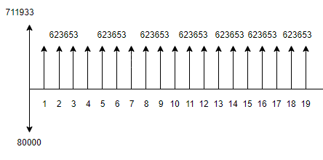
Cash flow diagram of decreasing the sales 10%

Slide 44
Indicators:
Net present value:560000 JD
Rate of Return:879%
Payback period less than 1 year
Break event point is less than 1 year.

Slide 45
2.increasing in raw material prices 10% :
invstment | 80000 | Year 1 | Year 2 | Year 3 | Year 4 | Year 5 | Year 6 | Year 7
Running cost | 209580 | 223755 | 223755 | 223755 | 223755 | 223755 | 223755 | 223755
Dep | 4000 | 4000 | 4000 | 4000 | 4000 | 4000 | 4000 | 4000
Income | 1103496 | 993146 | 993146 | 993146 | 993146 | 993146 | 993146 | 993146
Net income before tax | 889916 | 875741 | 875741 | 875741 | 875741 | 875741 | 875741 | 875741
Tax | 177983 | 175148 | 175148 | 175148 | 175148 | 175148 | 175148 | 175148
Net income after tax | 711933 | 700593 | 700593 | 700593 | 700593 | 700593 | 700593 | 700593

Slide 46
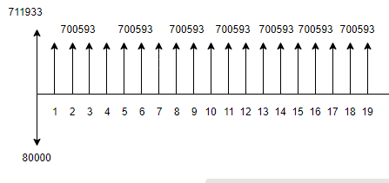
cash flow diagram of increasing raw material prices 10%

Slide 47
Indicators:
Net present value: 6185300 JD
Rate of Return:888%
Payback period less than 1 year
Break event point is less than 1 year.

Slide 48
Conclusion
From the primary market study we can conclude that:
The level of competition in the northern areas is weak.
The demand for the PVC pipes is high.
There is good chance for Nablus Company to invest in this important production line.
The project is visible and the advisory group recommend to execute it as the financial outcome is very good.

Slide 49
Recommendations:
The market share should be estimated carefully.
The technical study should be conducted carefully to identify the capital investment Running cost and income especially the raw material and its prices.
The financial, economical analysis should be conducted and make sure of it more than one time to support Nablus Company owners in their decision to invest in this new production line.
Coordinate with governmental institutions and agencies to develop a comprehensive vision of how to support the Palestinian factory and give them strength to face imported and Israeli products and reduce the risk of it.

