Slide 1

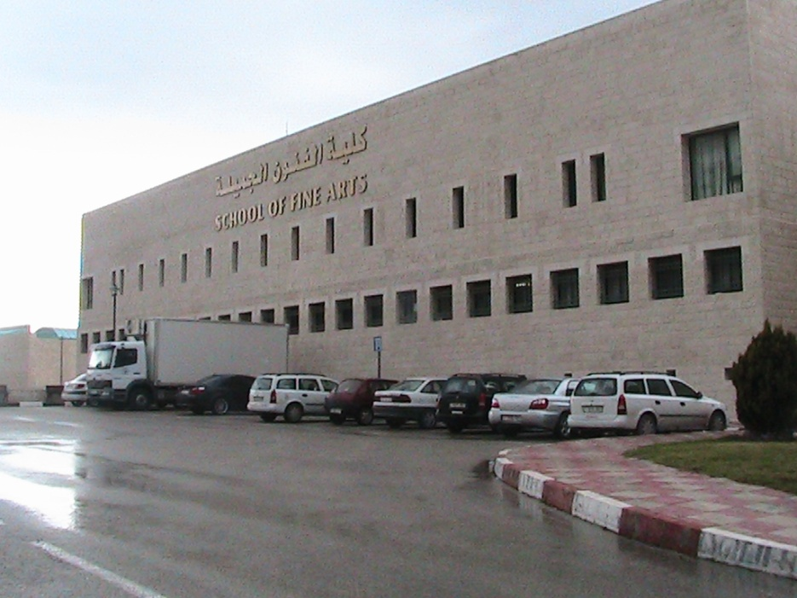
بسم الله الرحمن الرحيم
Towards Green Building
Case study: Fine Arts Building( at An Najah national University)

Slide 2
Prepared by:
Ayah Hassan
Ghadeer O’tear
Saja Sweidan
Supervisor:
Dr. Mutasem Ba’ba

Slide 3
The Project Idea:
Modify Certain aspects to make the Building more environmentally friendly (green).

Slide 4
Chapter One
Architectural and Environmental design system

Slide 5
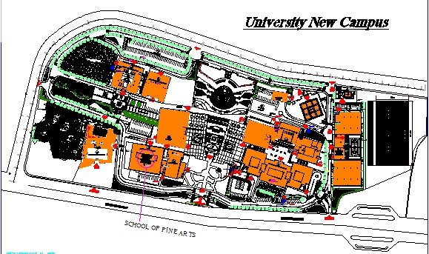
  Building site
School of fine arts located in the new campus of AN-Najah National University, in Nablus.
N

Slide 6
Architectural Design:
A (48x41) m building consist of a basement with an area of (1003.5 m²),(1668.9m²) for the ground floor, (139.89m²) for the roof and (1571m²) for the rest floors.
The Faculty was designed in the latest specifications and standards, and provide 19 classroom and 28 studios designed specifically to meet the purpose for which it was designed for.

Slide 7
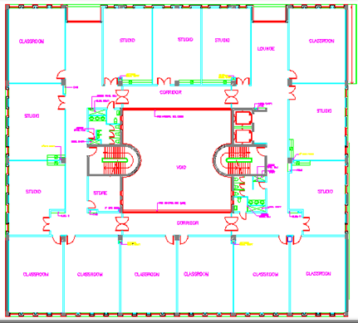
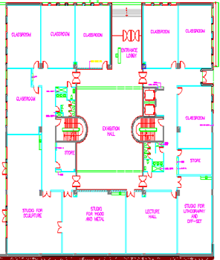
Architectural plan:

Slide 8
Element for green design:
Thermal.
Acoustic.
Handicap.
Safety.
Lighting.
Water management.
Also, Structural design.

Slide 9
1-How to increase Thermal efficiency of a building::
Thermal problem solved by:
Insulation.
Shading.
Skylight.

Slide 10
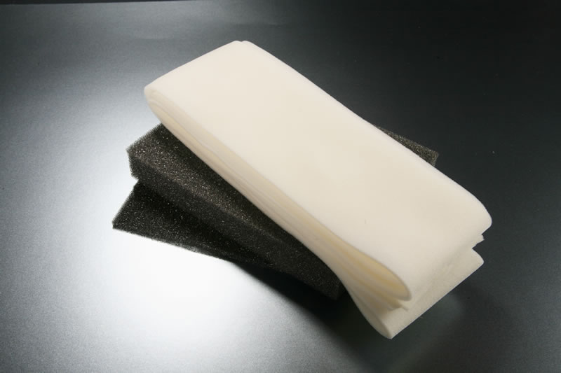
Insulation:
Type of Insulation used:
Polyurethane foam and panel:

Slide 11
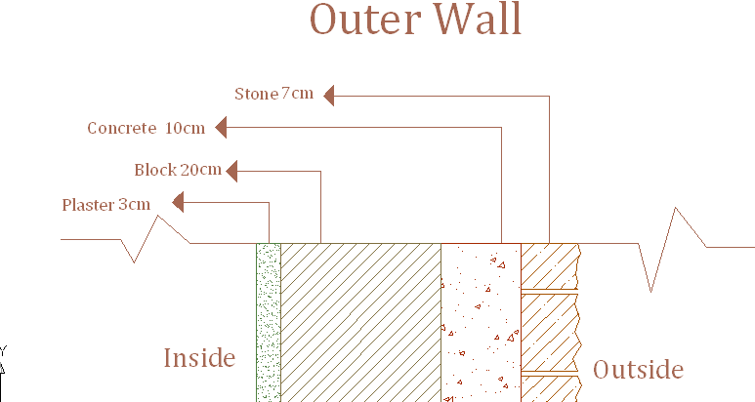
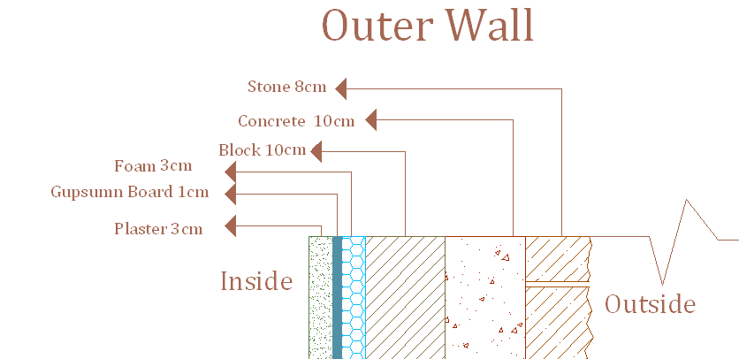
For Example, Outside Wall:
Before insulation.
After insulation.
U1= 1.64 W/m².cº
U2=0.66 W/m².cº
U2/U1=40.2%
STC1= 52
STC2=60

Slide 12
Before insulation:
Type of material | Thickness (m) | K(w/m.k) | R
Out side | _ |  | 0.04
Stone | 0.07 | 2.6 | 0.026
Concrete | 0.1 | 1.85 | 0.054
Cement brick | 0.2 | 0.6 | 0.333
Plaster | 0.03 | 1.2 | 0.025
Inside | _ | _ | 0.13
 |  | total R | 0.609
 |  |  | R | 0.60
 |  |  | U = | 1.641

Slide 13
After insulation:
 | Type of material | Thickness (m) | K(w/m.k) | R
1 | Out side | _ |  | 0.040
2 | Stone | 0.08 | 2.6 | 0.030
3 | Concrete | 0.1 | 1.85 | 0.054
4 | Cement brick | 0.1 | 0.6 | 0.167
5 | Foam | 0.03 | 0.03 | 1
6 | Gypsum board | 0.01 | 0.179 | 0.055
7 | Plaster | 0.03 | 1.2 | 0.025
8 | Inside | _ | _ | 0.13
 |  |  | total R | 1.502
 |  |  |  | R total | 1.502
 |  |  |  | U | 0.667

Slide 14
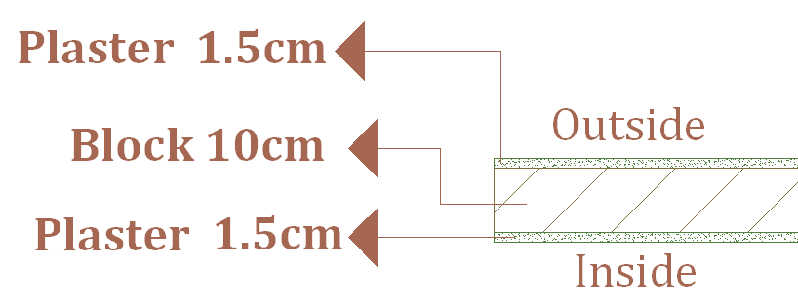
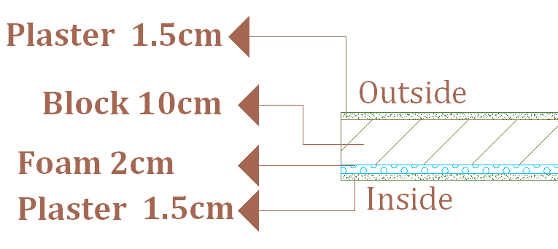
Inside wall Insulations
Before insulation:
After insulation:
U1= 2.214 W/m².cº
U2=0.894 W/m².cº
U2/U1=40.4%
STC1= 42
STC2=53

Slide 15
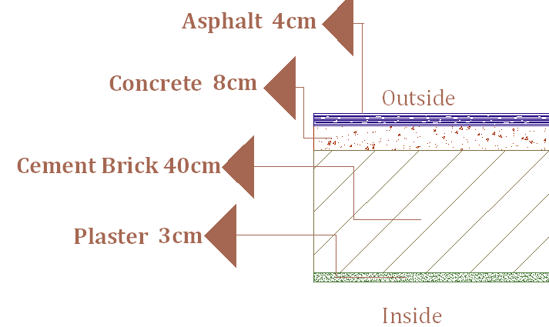
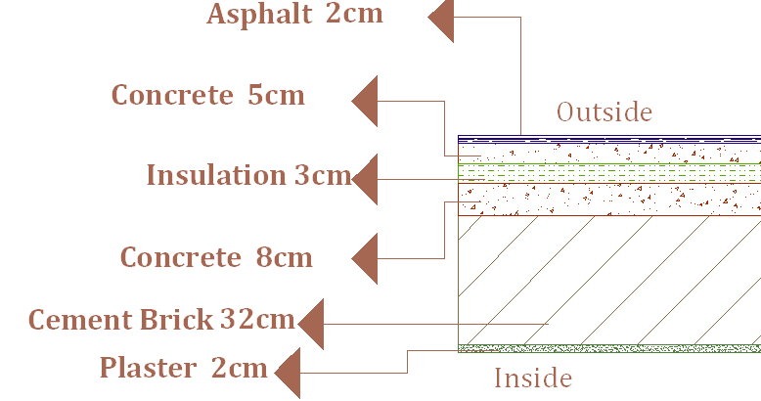
Ceiling insulation:
Before insulation: After insulation:
U1= 2.066 W/m².cº
U2=1.1 W/m².cº
U2/U1=92.2%
STC1= 52
STC2=63

Slide 16
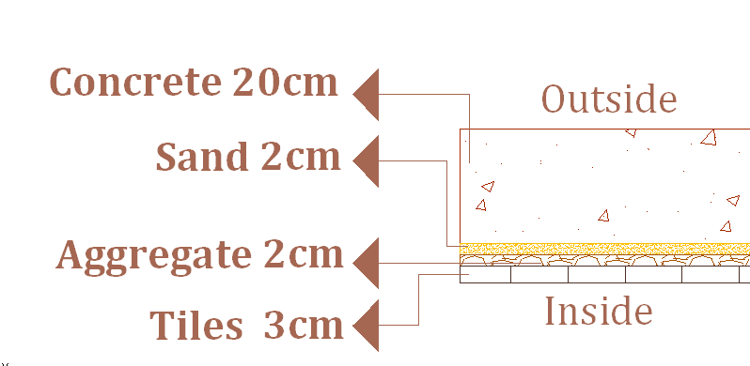
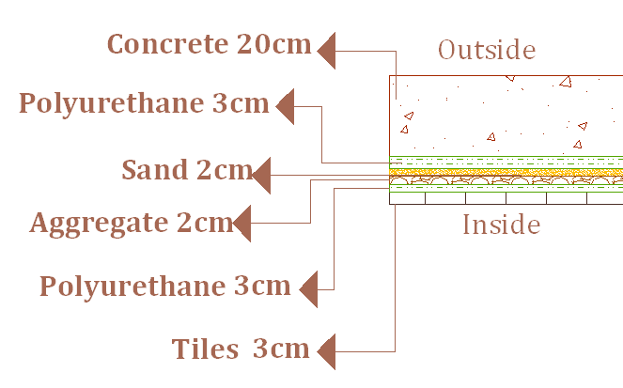
Basement floor.
Before insulation:
After insulation:
U1=3.452W/m².cº
U2=0.442 W/m².cº
U2/U1=13%

Slide 17
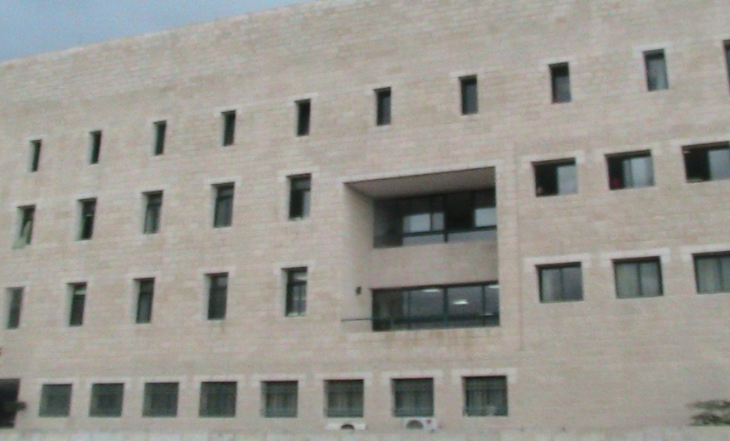

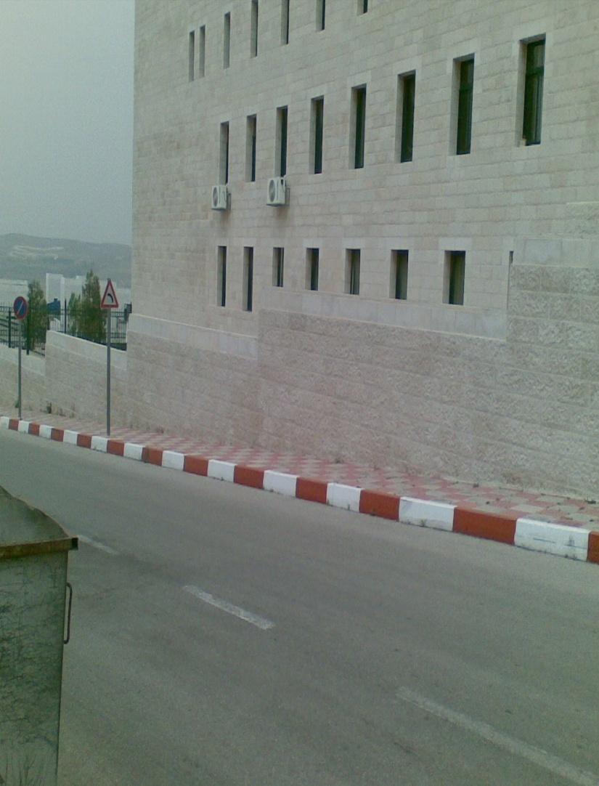
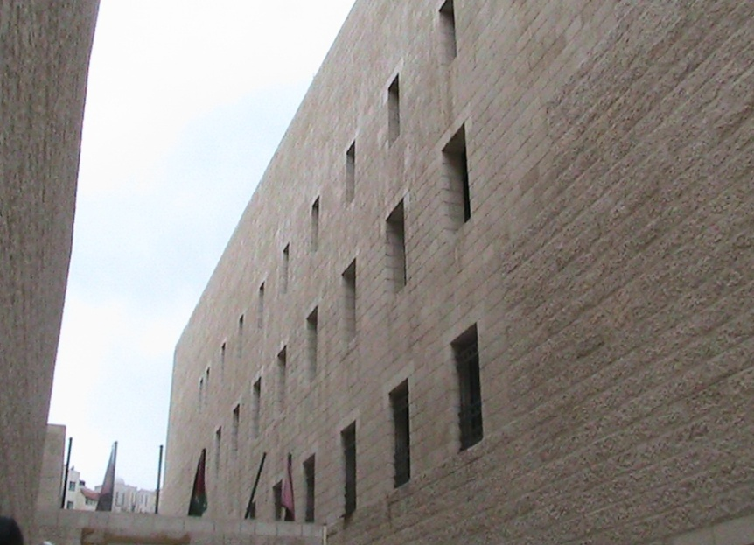
Shading
Building Elevation
North Elevation
South Elevation
East Elevation
West Elevation

Slide 18

Second Elevation: South Elevation.

Slide 19
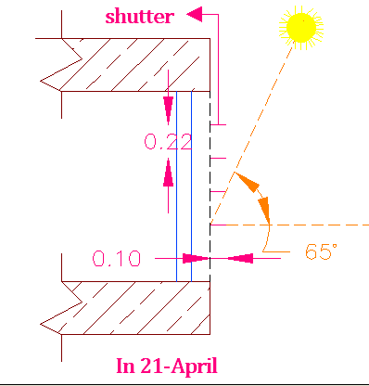
Drawing of shutter.
Dimension of window =
(1.25*1.25)m.
Assume length of shutter = 10cm
Tan(Ø)=height of shutter/ length of shutter
→ h= tna(Ø)*L
h = 22cm.

Slide 20

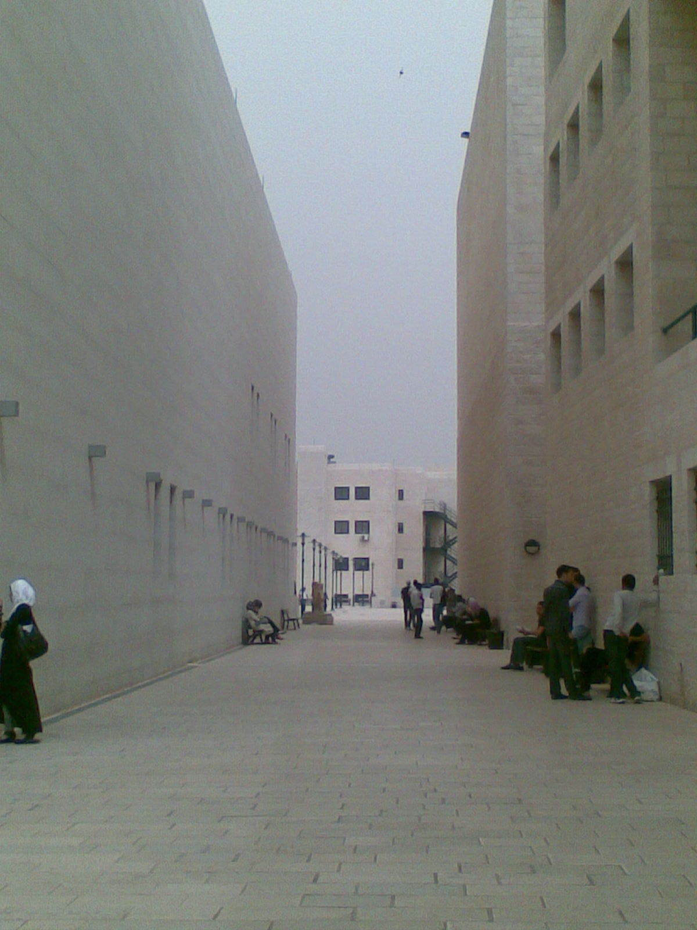
Second Elevation: North Elevation.
Library.

Slide 21
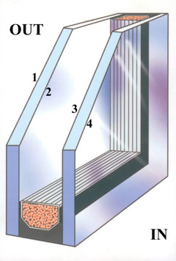
Solution :In this project we use the double glazing.
Benefits of this
Method :
**Reduce Energy Transfer.
**Day lighting

Slide 22
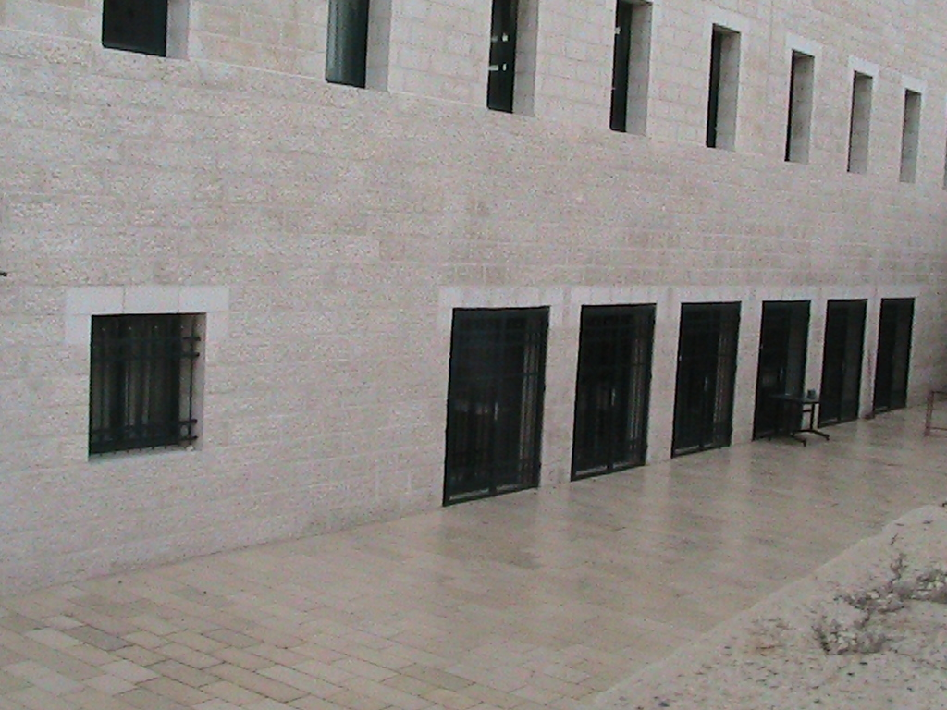
Third Elevation: West Elevation.

Slide 23
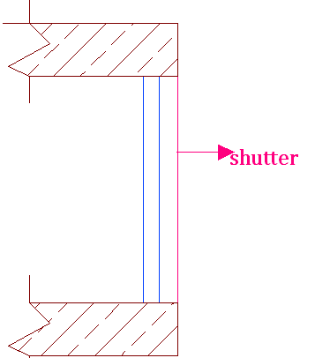
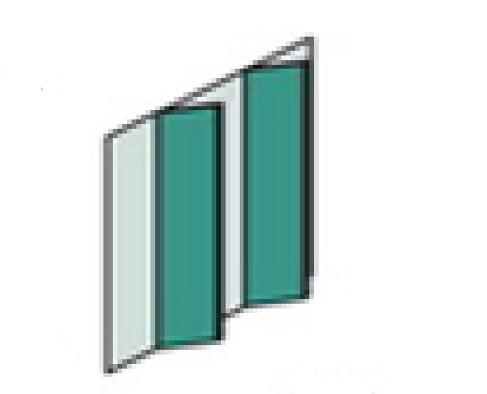
Solution One: Use shutter.

Slide 24
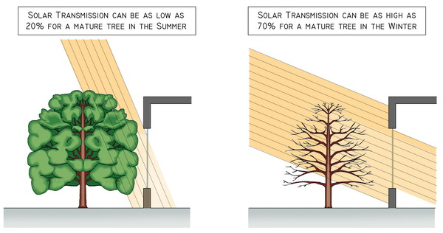
Another Solution :In this project We Use Vegetative Shading
Kind of trees can be use:
Walnut tree
Eucalyptus tree

Slide 25
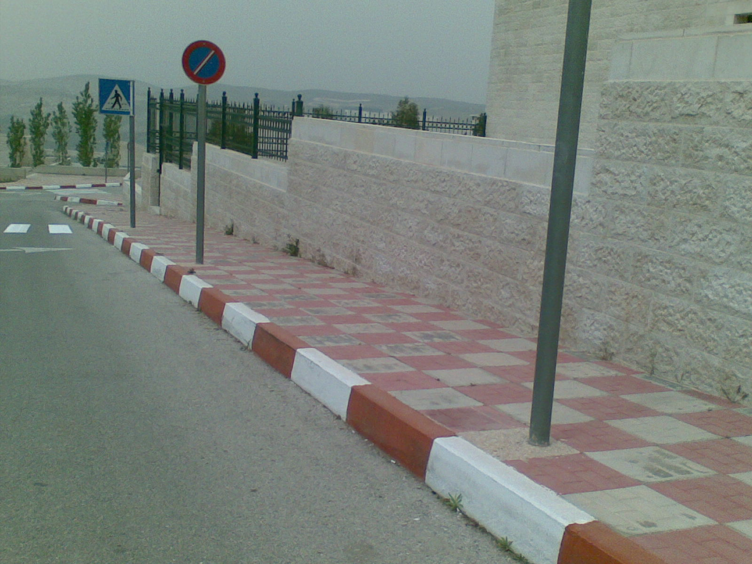
Possible place for Trees.

Slide 26
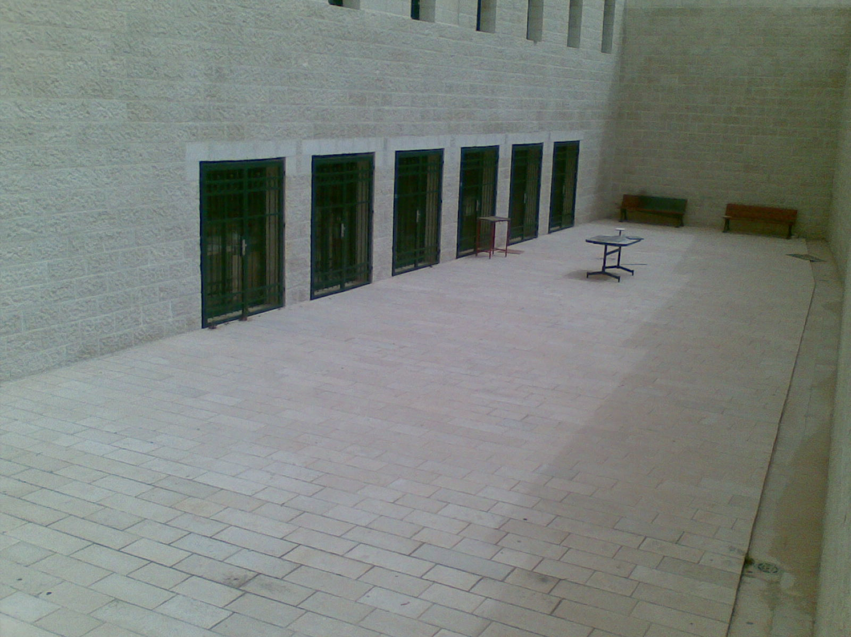
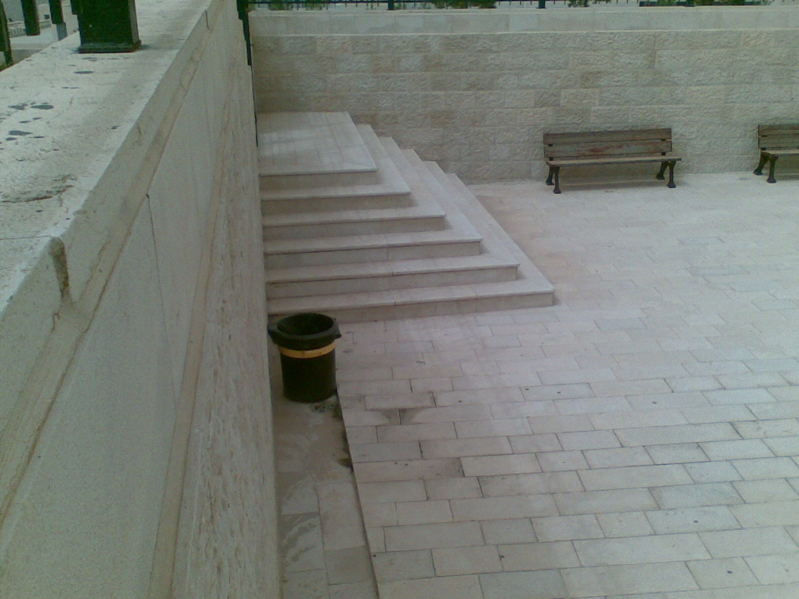

Slide 27
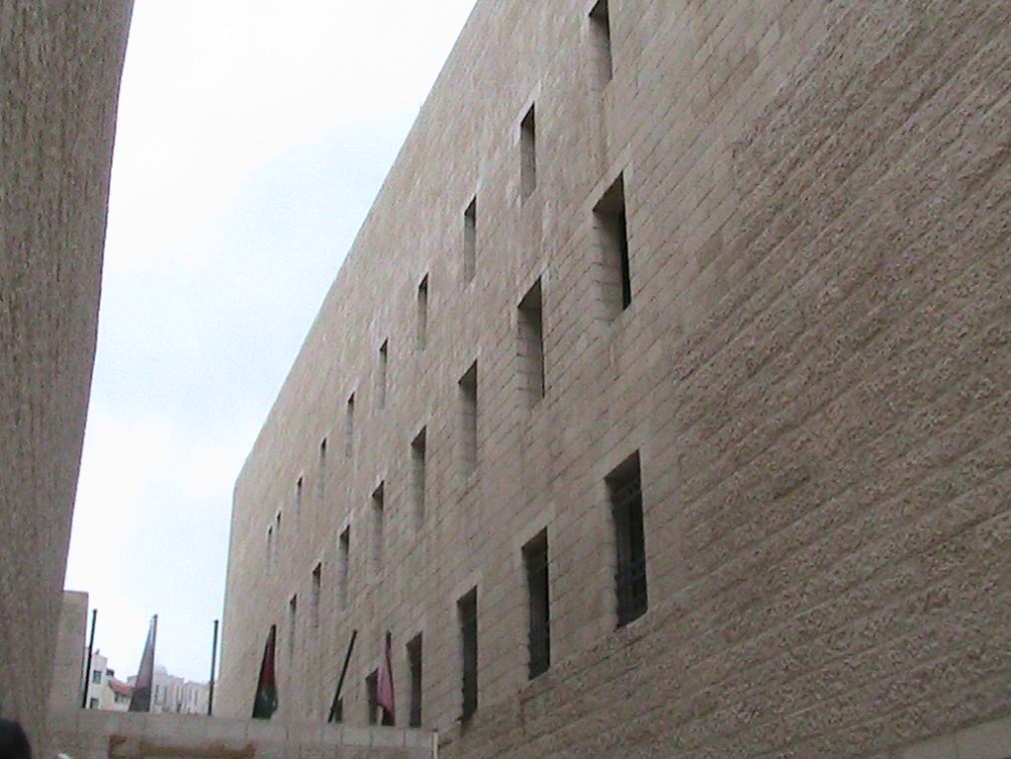
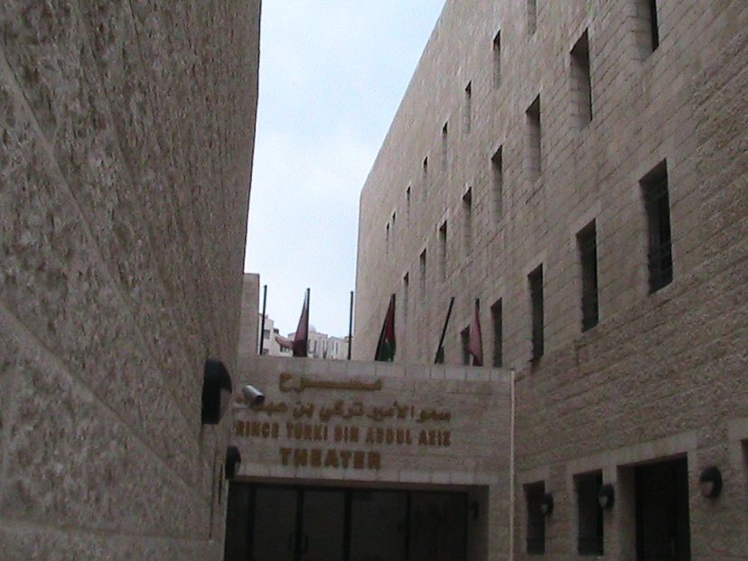
Fourth Elevation: East Elevation.

Slide 28
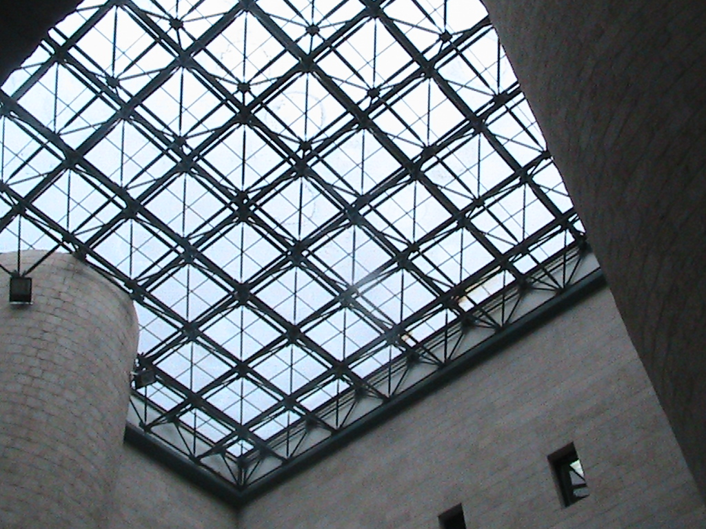
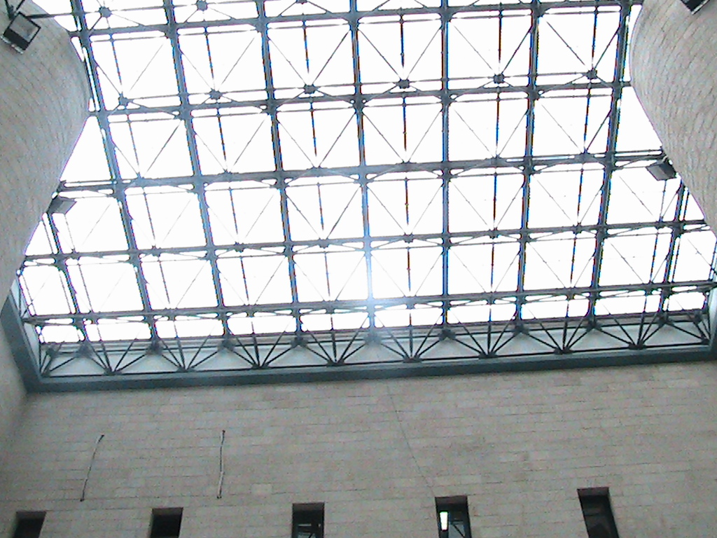
Skylight:

Slide 29

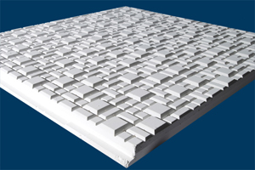
Black sheet
Acoustic Tiles

Slide 30
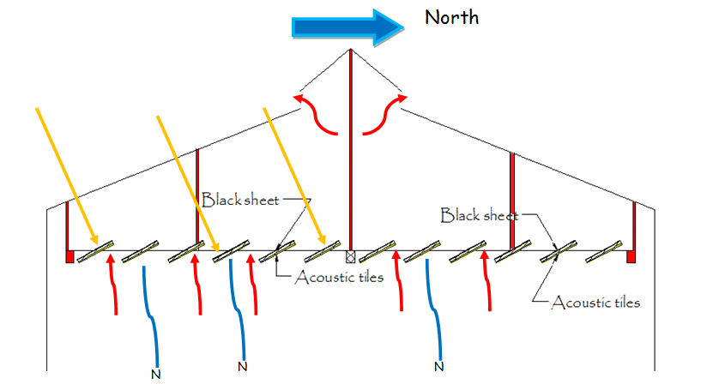
In Summer:

Slide 31
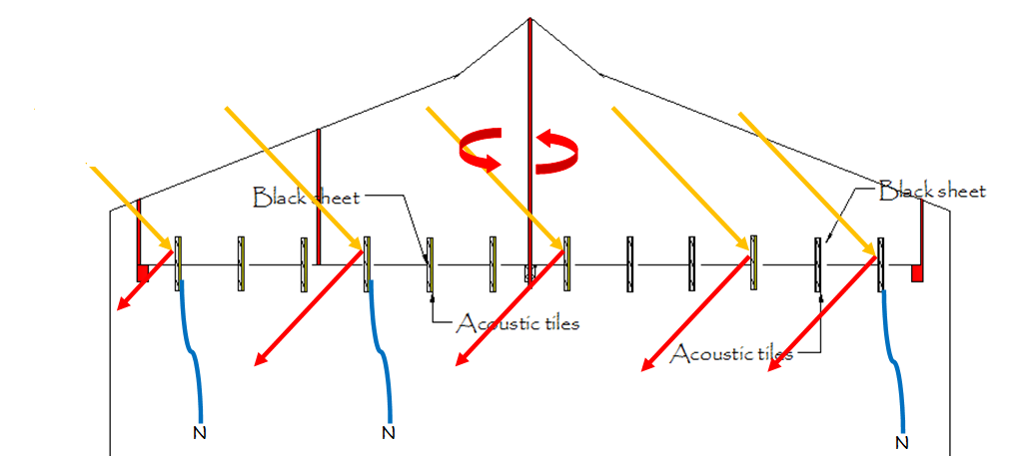
In Winter:

Slide 32
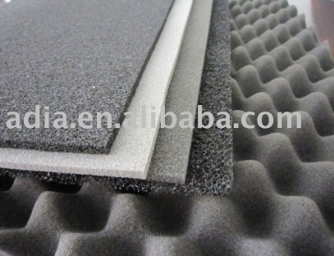
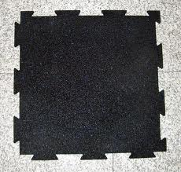
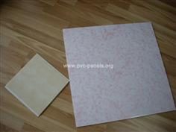
2-Noise Reduction:
Noise Reduction from outside:
Using polyurethane in outside wall.
For Noise room in First floor:
Using egg craft insulation in walls, and acoustical tiles.
in structural Borne (Drums room) use PVC or rubber Tiles.

Slide 33
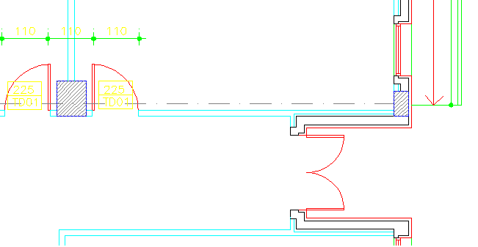
3- Safety:
Emergency Exit in Ground Floor:

Slide 34
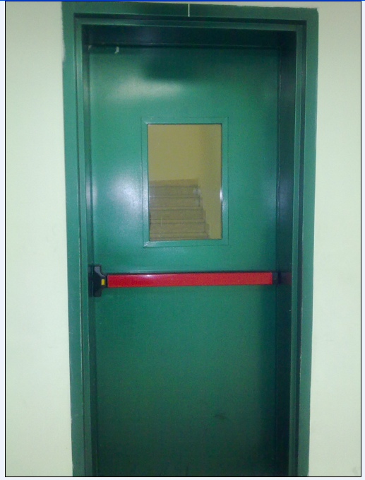
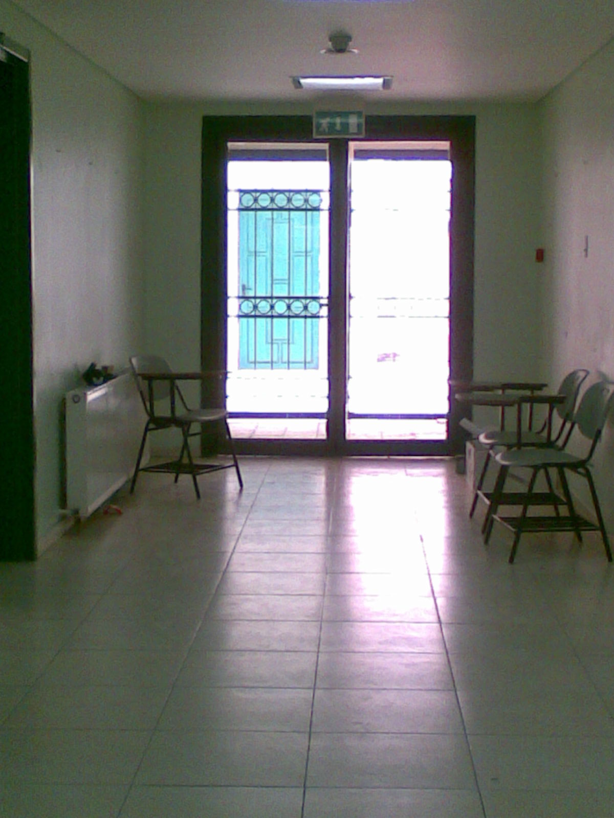
The door inside the building.
The new door can use in the building.

Slide 35
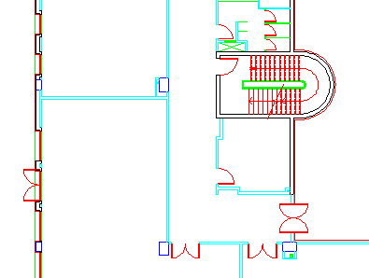
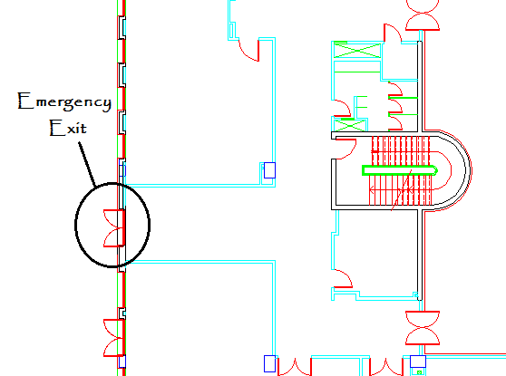
3- Safety:
Adding another Emergency Exit in Ground Floor:

Slide 37
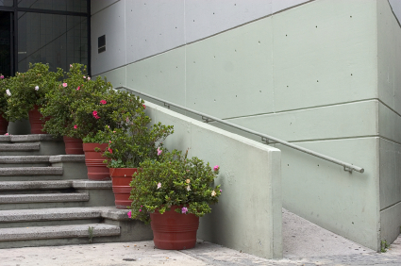

4-Handicap ramps design:

Slide 38
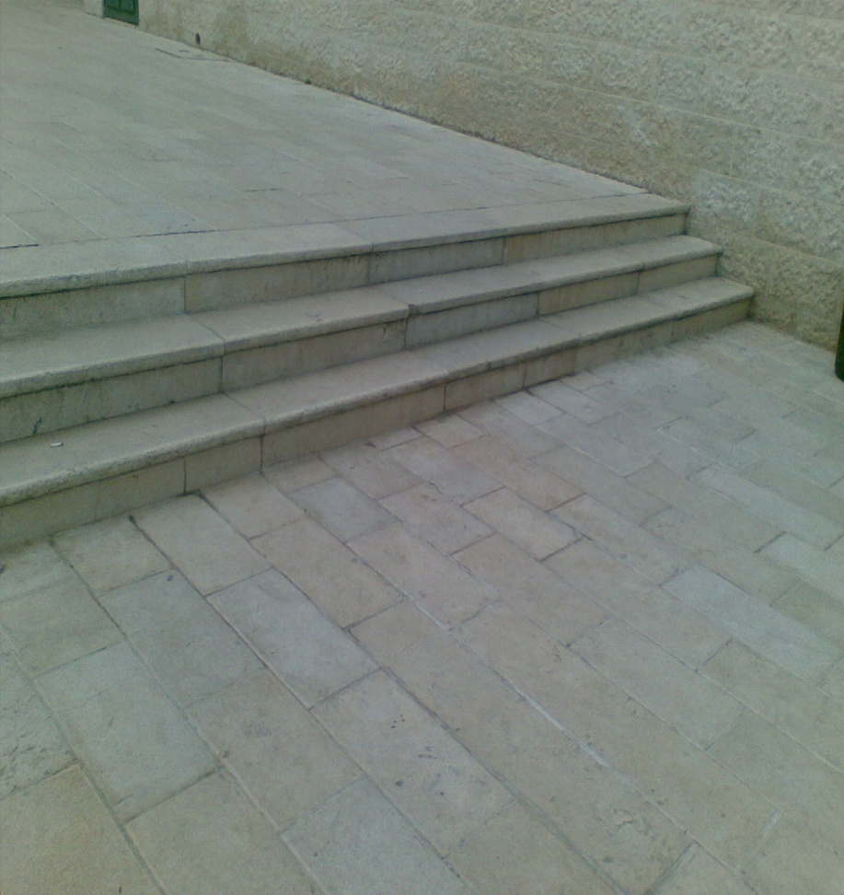
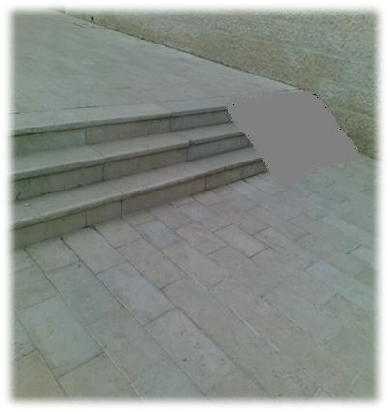
First Ramps In The Colleges.

Slide 39
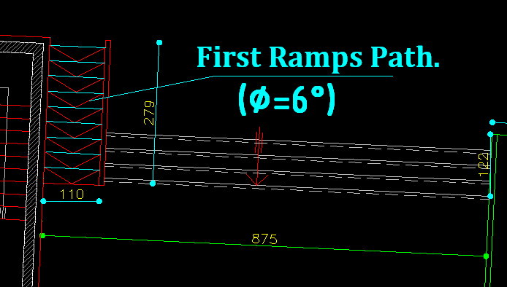
The Solution Of This
Problem.
Slope 1:10

Slide 40
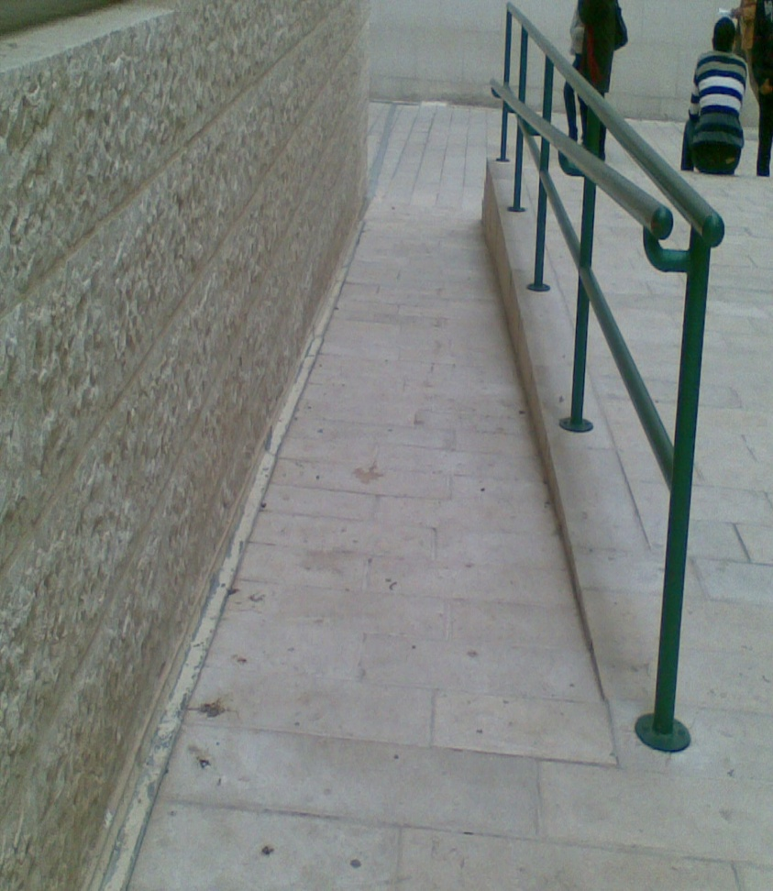
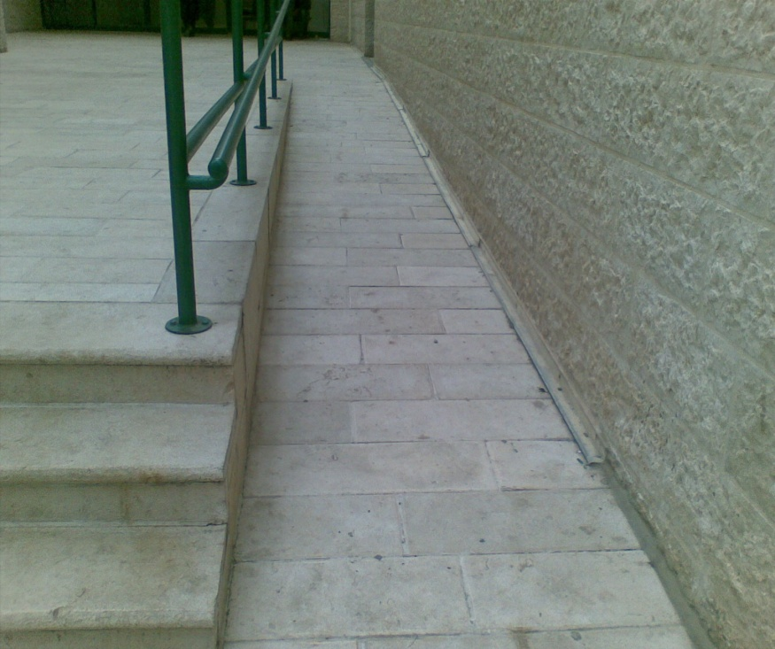
Second Ramps In The Colleges.

Slide 41
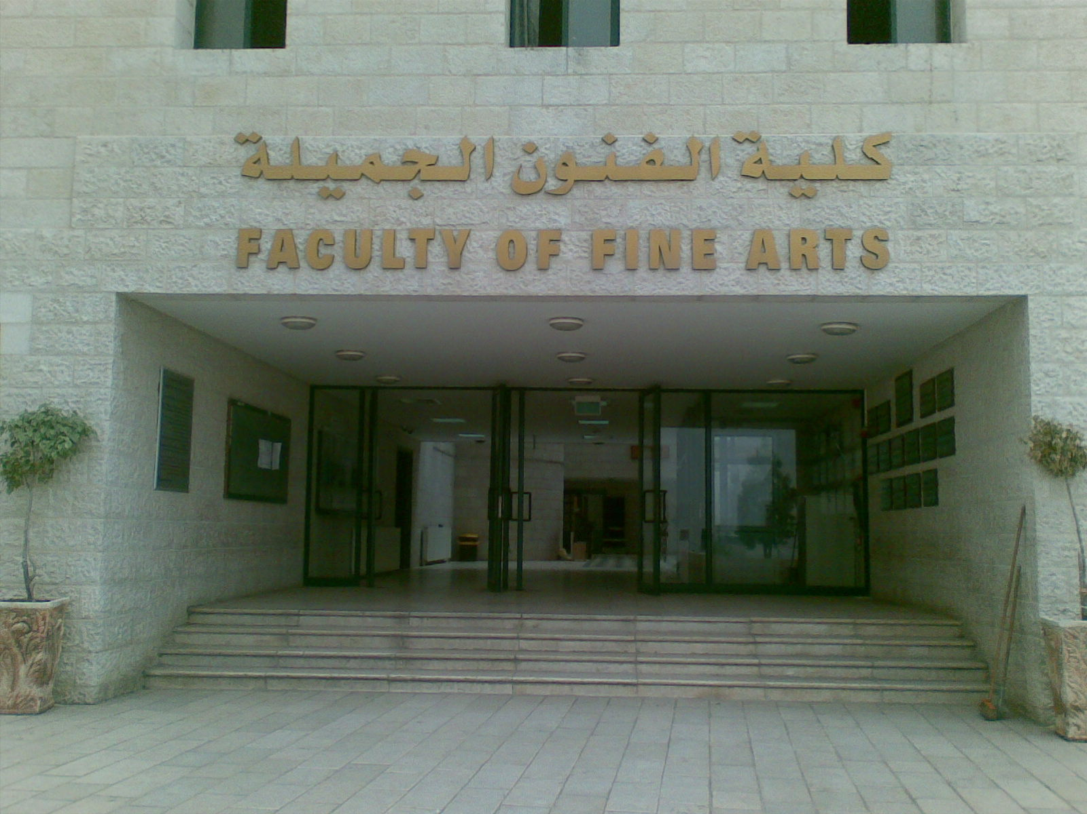
Third Ramps In The Colleges.
The main entrance to the College

Slide 42
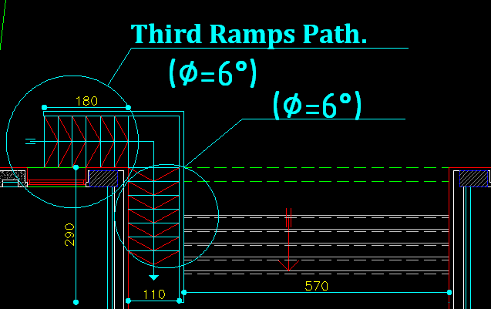
The Solution Of This
Problem.

Slide 43
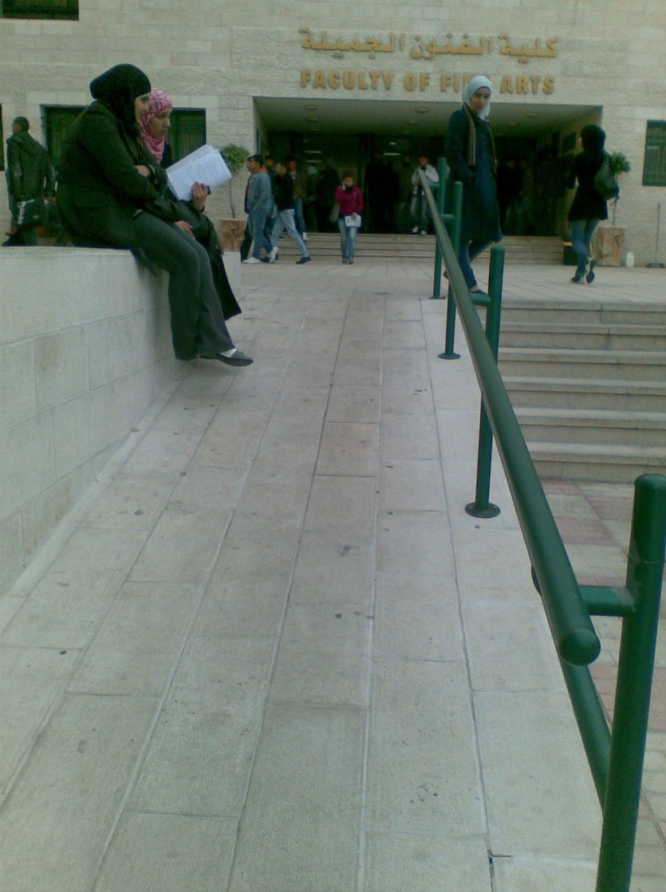


Slide 44

Another Solution For Handicap Ramps.

Slide 45
Architectural and Environmental Modification:
Adding Handicaps Ramp.
Adding another Emergency Exit.
Adding Shutters for the north and south Windows.
Adding a Shutters(Solar chimney)for the void.
Using Polyurethane and egg craft.
Using Rubber Tiles in music room.
Using acoustical Tiles.

Slide 46
Chapter Two
Structural
Design
Structural Design

Slide 47




Project description :
South elevation
North elevation
West elevation
East elevation

Slide 48

The 41*48 building is considered as one block

Slide 49
Project design data
The American Concrete Institute code ACI 318-05 .
The seismic design according to UBC-97.
Then the analysis and design are done using 3D model using SAP2000 program.
Material used:
B350 concrete is used→f'c=300Kg/cm²
Unit weights of materials:
Reinforced concrete = 2500 kg/m³.
Hollow block = 1000 kg/m³.
Eaton blocks =470 kg/m³.
The yield strength of steel for flexure equal fy = 4200 kg/cm² and for shear reinforcement equal fys = 4200 kg/cm².
bearing capacity of soil = 4 Kg/cm².
Soil density 19.2 KN/m³

Slide 50

Structural system:
In this block we use two way ribbed slab with 40 cm depth.
LL=0.5 ton/m².
SID=.35t/m²
Wu= 1.85ton/m².
Main beams is assumes
to be 70*60cm (drop beam)
Secondary beams (above shear walls) assumes to be 40*30

Slide 51


Column dimension calculation

Slide 52

  Model design on sap
Equivalent solid slab thickness = .3089 m
Set modifiers factors
Roof steel truss loads were
interred on the shear walls
carrying the truss
D.L= .8 KN/m²
S.L =1.5 KN/m²
L.L = .5 KN/m² (booth L.L and S.L is assumed to be live on the sap )
Since the angle of the truss <45 then W.l is upward and was not included in the calculation.

Slide 53
Sap model checks

Slide 54

compatibility checks
Mode one:
period =.53second
Type of movement :twisting

Slide 55


Mode two:
period =.46 second
Type of movement :
twisting
Mode three:
period =. 34 second
Type of movement : twisting

Slide 56

Equilibrium checks:

Slide 57

Comparing the annual forces and stresses values with sap values

Slide 58



Second : beams

Slide 59


Third : column

Slide 60

Earthquake check
Cv=.2 Za= .2 Ct= .03 g=9.8
Ca=.2 I=1 R=5.6
Spectrum data :
manually calculated period =.7sec
mode one period = .52sec
error =25%
V = 1535.54 t
Vmin= 498 t
V max =2021.3 t

Slide 61
Structural details

Slide 62

Slabs details:

Slide 63

N-S corner

Slide 64



Slide 65

Beams details:
The two way slabs construction contains 10 type of main beam and one type of secondary beam (above shear walls).

Slide 66

Beam one details

Slide 67


Slide 68

Columns details
column were divided into four groups

Slide 69

Group four details

Slide 70

footing design and details:
single footing were divided into four groups :

Slide 71

Group two:

Slide 72


Slide 73


retaining wall design and details
Maximum loads were taken from the main model :
Gravity retaining wall were used and the dimension were assumed to be as shown in the near drawing :

Slide 74


Sap model

Slide 75

Sap results

Slide 76

Retaining wall details

Slide 77

shear wall design and details
Shear walls were divided into two types :
Type A: (stairs house Shear wall)
Maximum loads were taken from the main model :

Slide 78

shear wall details- type A

Slide 79

Stairs details
Stairs model was done separately on sap :
L.L =.5 t/m²
S.I.D: .5 t/m²

Slide 80

Moments values were taken from the previous model :

Slide 81

Stairs details :

Slide 82
Chapter Three
Mechanical System Design

Slide 83


Water Management:
Separate grey water from
black water.
Recycling grey water and reuse
it in supplying W.c’s or in irrigation.
Use of storm water in
irrigation or in W.c

Slide 84

Recycling Gray Water:
Ultraviolet germicidal irradiation (UVGI).

Slide 85
And that include:
Water Supply System.
Drainage System
Design of Fire Protection.
Heating System Design.
Fire alarm System.
Elevators Design.

Slide 86

3.1 Water supply systems
System used in our project:
water pressure system with storage tank.

Slide 87
Demand weights of fixtures in Fixture Units: (For Flush Valve)
fixture | Weight in fixture unit
Water closet | 10
Wall urinal | 5
Service sink | 3
Lavatories | 2
Bidet | 2
Shower head | 4

Slide 88
Number of fixture unit in the building:
Floors | Number of Fixture units
Basement floor | 29
Ground floor | 115
First floor | 127
Second floor | 127
Third floor | 196
Fourth floor | 166
Total Fixture Unit for the faculty= 760 F.U
Total Fixture Unit for the faculty
( for grey water) =505F.U

Slide 89

Water Supply plan:

Slide 90
3.2 Drainage system:
Drainage fixture values for plumbing fixture:
Plumbing fixture | Drainage fixture unit
Water closet | 6
Wall urinal | 4
Lavatories | 1
Service sink | 2
Floor drain | 3
Bidet | 1
Shower head | 2

Slide 91
Number of Drainage fixture unit in the building:
Floors | Number of Drainage Fixture units
Basement floor | 24
Ground floor | 91
First floor | 135
Second floor | 114
Third floor | 175
Fourth floor | 152

Slide 92

Drainage plan:

Slide 93

Stack plan:

Slide 94
3.6 Heating System Design.
Water to water heat transfer system
two pipe system.
Q= AU ΔT
Design condition:
T | Winter | Summer
Tin | 22 | 24
Tout | 6 | 31
Ø in | 50% | 50%
Ø out | 73% | 61%
W in | 8.2 | 8.9
W out | 4.8 | 20.5

Slide 95

Heat Calculation:
Computer room:
A(m2) | Q total (watt) | No. of radiator | Q/rad | no, of section | flow rate (kg/s)
58.188 | 7998 | 4 | 1600 | 7 | 0.889

Slide 96

Heating plan:

Slide 97


3.3 Design of Fire Protection
Using manual system such fire hose and fire extinguisher to protect from fire.

Slide 98


3.4 Fire alarm and Smoke Fire System:

Slide 99


3.5 elevator design
Two elevators with 2500 Ib car capacity , and 350 fpm speed.

Slide 100
Chapter Four
Electrical System Design

Slide 101
Electrical System :
Using DIALux program for lighting and for calculate the intensity and the distribution for Regular light units.
The company that was dealing with,
Thorn global company, to provide dramatically and spread in most countries of the world .
15 % saving in lighting.

Slide 102


Lamps and luminaries used in lighting:-
POPPACK BATTEN 2x58w T26

Slide 103


SPECALPH 3x18 W T26 :

Slide 104


SOUL DIRECT SURF 1X55W T16:

Slide 105


CHALICE MV FIXED 1X50W :

Slide 106

Lighting Calculation:
For Computer room: (E =500 lux)

Slide 107

Picture from DIALux program:
Head of Department Office
(300 Lux)

Slide 108

DEPARTMENT COUNCIL MEETING & SEMINAR ROOM:
(750 Lux)

Slide 109

Classroom (300 lux):

Slide 110

Studio(500 Lux):

Slide 111

Lighting plan:

Slide 112


Emergency Lighting:

Slide 113
Green building
Thermal
lighting
Safety
Acoustic
Water management
Handicap

Slide 114
Thank you

