Slide 1
Auto Parallel Parking Car

Slide 2
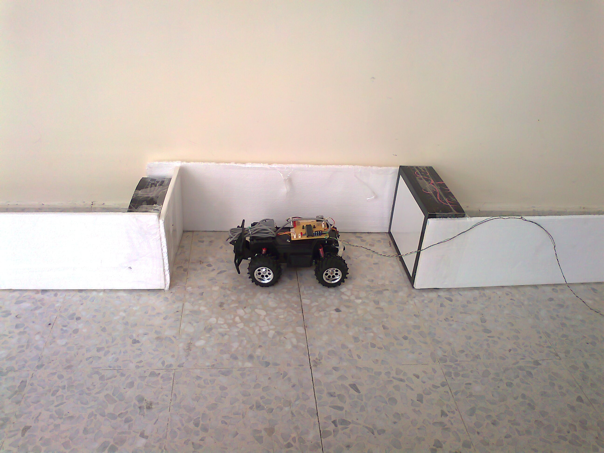

Slide 3
We created a Car that can identify a parking space and parallel park by itself. The Car drives down a street searching for a parking space to its right using a distance sensor. When the car has identified a space, the car checks to see whether that space is large enough to park in

Slide 4
If it determines that there is sufficient space, the car will begin parallel parking into that space. It uses information from sensors placed on front, right, and rear of the car to direct the car into the parking space. Once the car has parked, it will remain in that position until it is reset.

Slide 5
Logical Structure
Move Car
Detect Parking
Park Car
Sensor Data

Slide 6
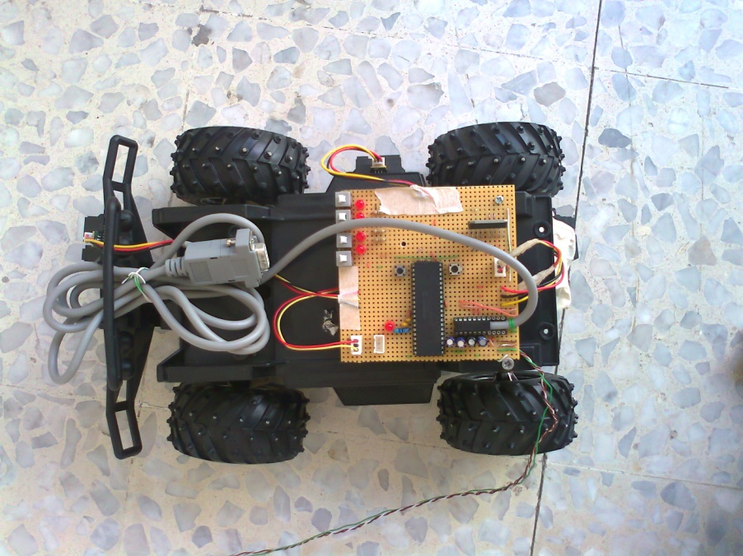
Hardware
Car.
Motors of the Car.
Microcontroller.
H-bridge L298HN .
Distance Sensors .

Slide 7
Distance Sensors
We used three infrared distance sensors to determine the distance between our car and nearby objects. We placed a sensor on the front, the right side, and the rear of the car. For the front and rear, we used 4-50cm sensors. For the right side, we used we used a 7-80cm sensor. We decided to use a sensor with a larger range for the side so that we could more easily detect a parking space.

Slide 8
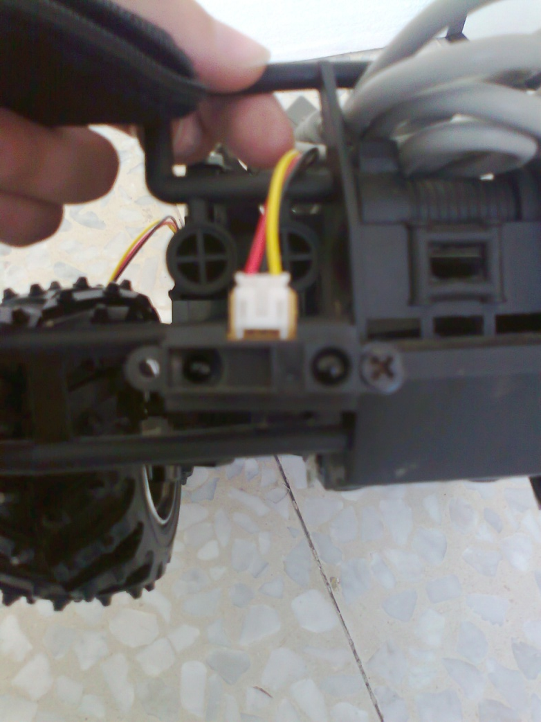

Slide 9
we measured the output of each sensor at various distance values, linearized the plot, curve fit the line, and implemented an analog to digital conversion so that we had reliable distance values.

Slide 13
How we take the data from sensors ?
X=Digital value from sensor.
X0<X <X1.
(X0,Y0) ,(X1,Y1).
Interpolate function:
value = ((y0 - y1) * (X -x0))/(x1 -x0)
value = y0 – value // distance in cm.

Slide 14
How to Park the CaR
Forward until Detect Park
Go back until bigginning of Gap
Turn wheel left
Go forward /stop
turn wheel right go back inside space
turn right close to rear wall
Turn left go back to side wall/ sensor
ReSet
Go Forward /sensor

Slide 15


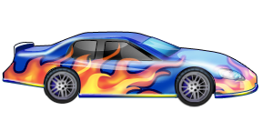

Slide 16
Thank You

