Slide 1


10 Way
graduation project
College of Engineering and Information Technology
Department of MIS

Slide 2

Digital Marketing & More..
Teamwork Project:-
Asal Hamarsheh
Aya Hawah
Haya Bshara

Slide 3

Introduction:-
Marketing is one of the most important factors for the success of enterprises and businesses, to continuity and spread. With the development of technology and communication has led to the emergence of a new direction of marketing is digital marketing
Any company seek to achieve the biggest profit at the lowest costs, seeking to search for digital marketing companies that provide services with high quality and cost is a bit of a start here the idea of creating a website 10 way for digital marketing

Slide 4

Why Digital Marketing :-
Reaches People Where They Spend Their Time & Money
More Targeted
Segmentation, Automation & Personalization
Advanced Analytics
Easy to Scale & Adapt

Slide 5
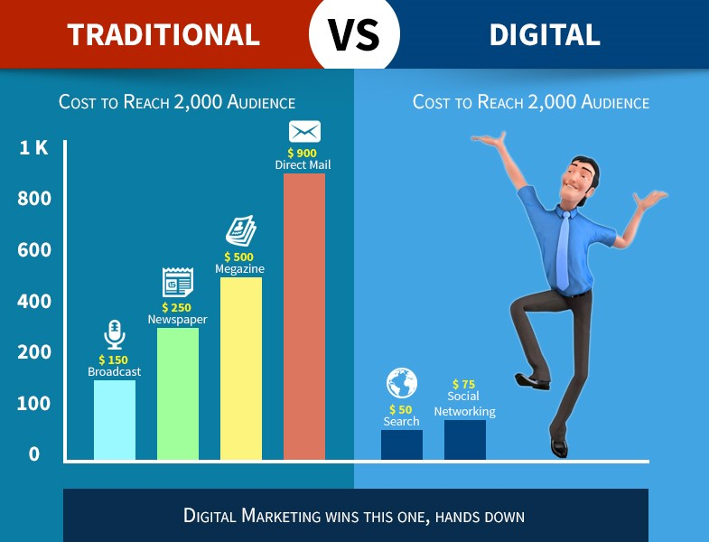
Why Digital Marketing Con. :-

Slide 6
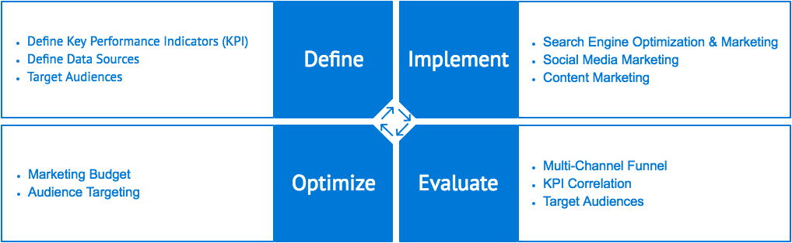
10 Way idea:-
10 way for digital marketing is website that provides services to customers through the marketing of services, products and commercial activities through access all segments through advertising on social media, Google ads and Search engine marketing

Slide 7

10 Way Do:-
Raising awareness about the importance of digital marketing to develop the business environment and achieve commercial goals
Reach as many customers as possible to expand their online businesses
Facilitate communication between entrepreneurs and advertisers
Achieving the client's goals of increasing their business activity; such as consolidating customer relationships through social networks, attracting and retaining existing customers

Slide 8
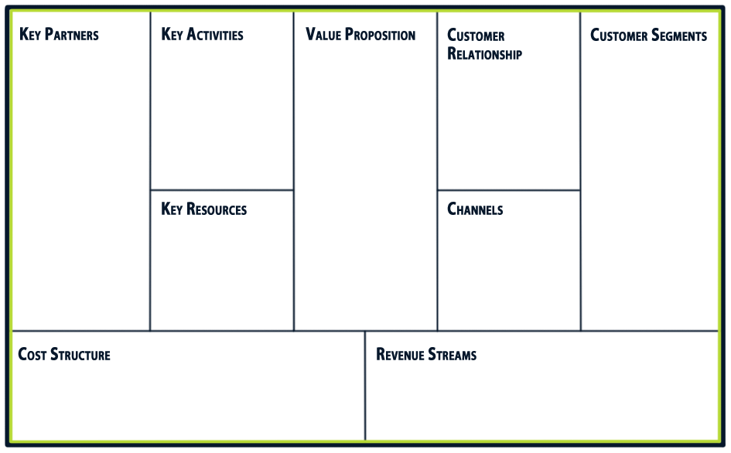
10 Way Business Model:-
Advertising
SEO
SEM
SMM
Achieving the client's goals of increasing their business activity; such as consolidating customer relationships through social networks, attracting and retaining existing customers
Network
Social Media
Facebook
Google Tools
Website
Content
Internet User
Business owners
Developers
Business Manger
Google Ads
Website
Facebook page
General and administrative
Marketing
Development
Free
Payment and ads Revenue

Slide 9
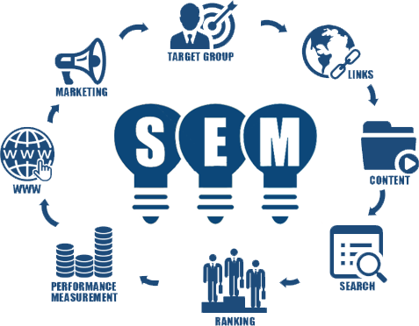

10 Way Example “Facebook & SEM”:-
We make some activities in Palshow like SMM & SEM
Palshow owners care about traffic

