Slide 1
A Model Driven Engineering through Architecture Description in e-Health Systems

Slide 2
Outline
CAPS
Meta-Model
Models
Simulator for Diabetes Model
Diabetes Mobile Application
CupCarbon for Diabetes Mobile Application
BMC

Slide 3
Video Caps

Slide 4
CAPS: Situational Aware (SiA) Cyber-physical systems (CPS).
Evaluate the systems early in the design process before the system or prototypes are built.
Avoiding costly redesign/redevelopment cycles.

Slide 5
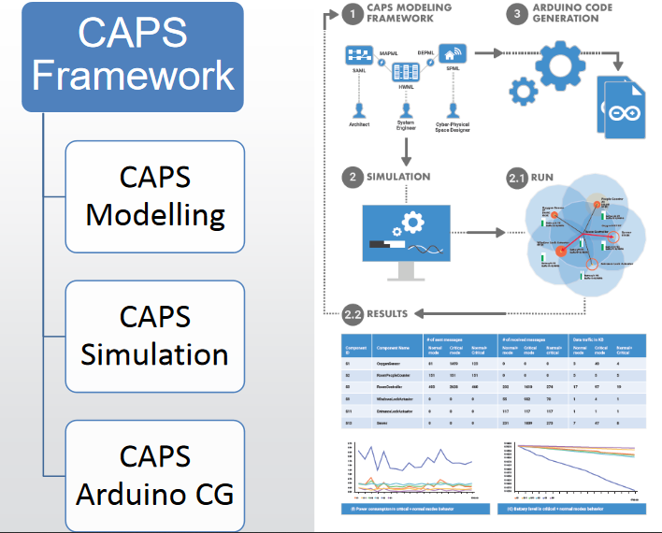
CAPS Framework

Slide 6
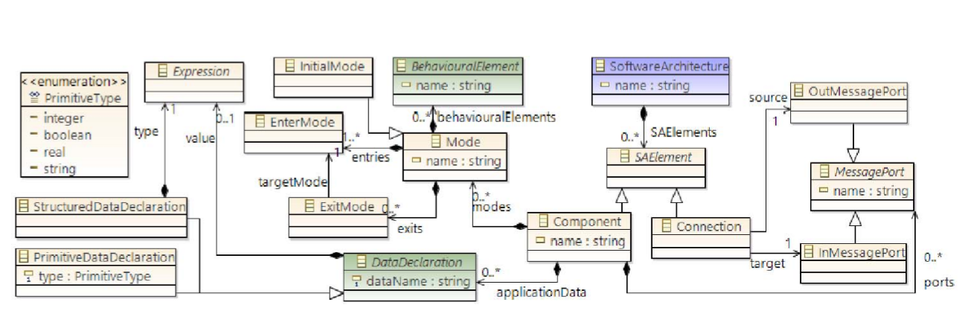
Meta-model

Slide 7
Models
Smart Hospital Gown Model
Smart Eyeglasses Model
Diabetes Mellitus Model
Diabetes Mellitus mobile Application Model

Slide 8
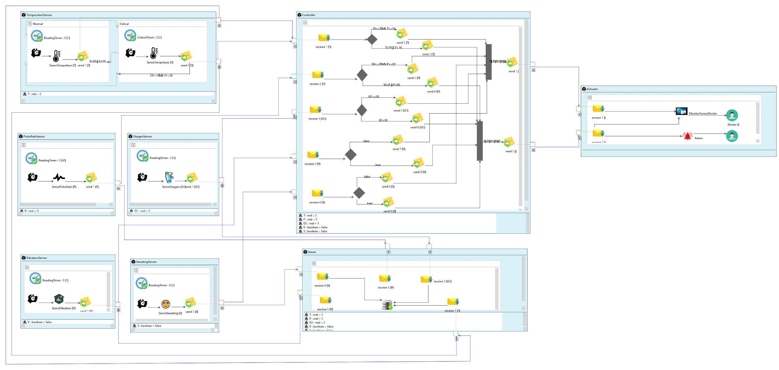
Smart Hospital Gown Model

Slide 9
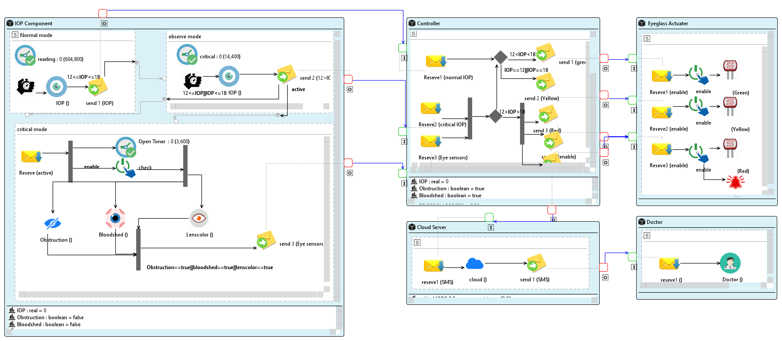
Smart Eyeglasses Model

Slide 10
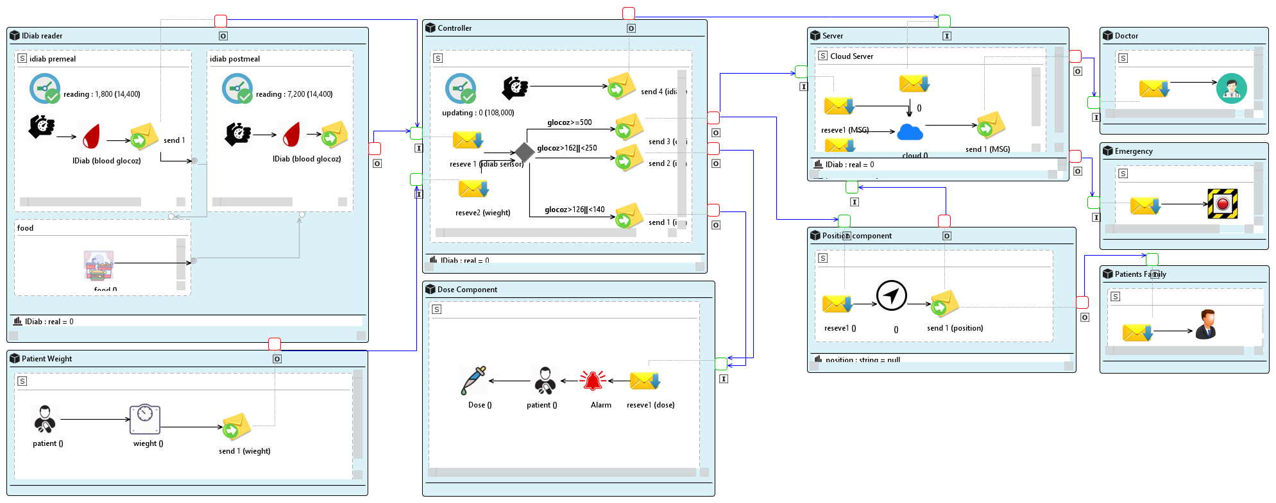
Diabetes Mellitus Model

Slide 11
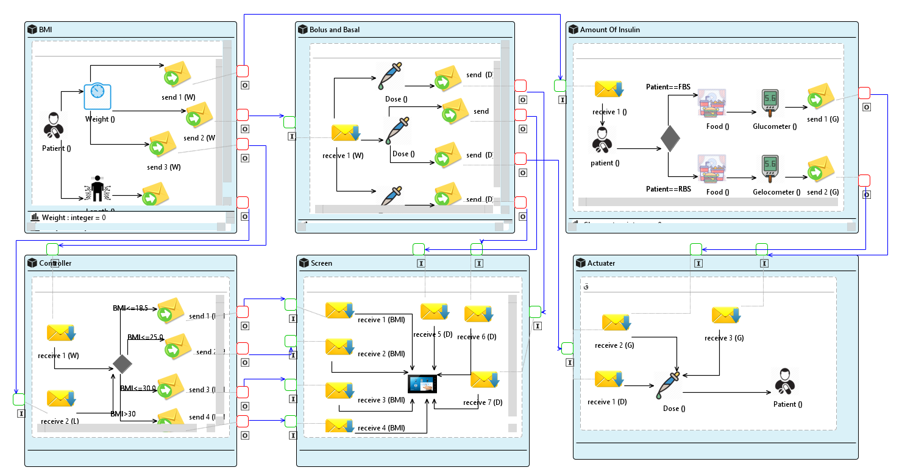
Diabetes Mellitus Mobile application Model

Slide 12
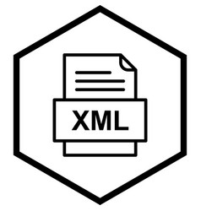



Slide 13
Simulator Diabetes mellitus
Case one:
Benefits of case one:
*Diat
If some patient needs to follow specific carbohydrate or within range of the pump.
*Know the type of food that caused high sugar Check if food is within the possible range of pumps or not
1 unit of Insulin utilizing 10-12 grams in CHO
1 unit of inslulin decrease 50ml/dl of blood
sugarNormal blood =100mg/dl
Include 4 cases as follow:

Slide 14
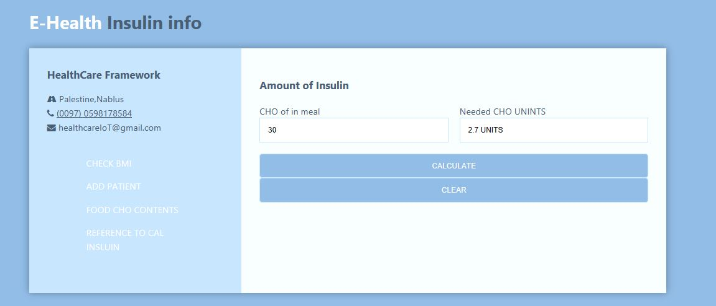
Case one

Slide 15
Case Two
Then IDiab produces values(pre-meal,post-meal) Into simulator to evaluate numbers of doses insulin to decrease Sugar in blood, But if the value of post-meal is higher then 500,Which

Slide 16
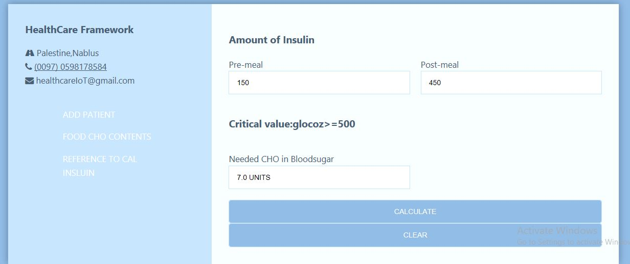
Case Two

Slide 17
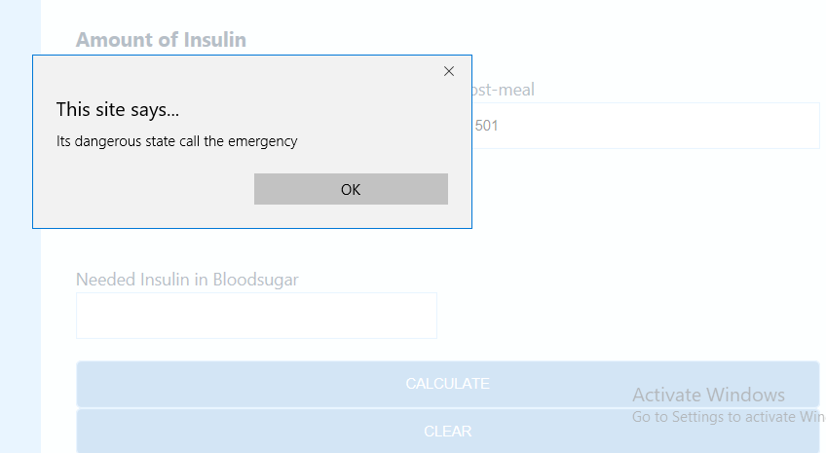
Case Two

Slide 18
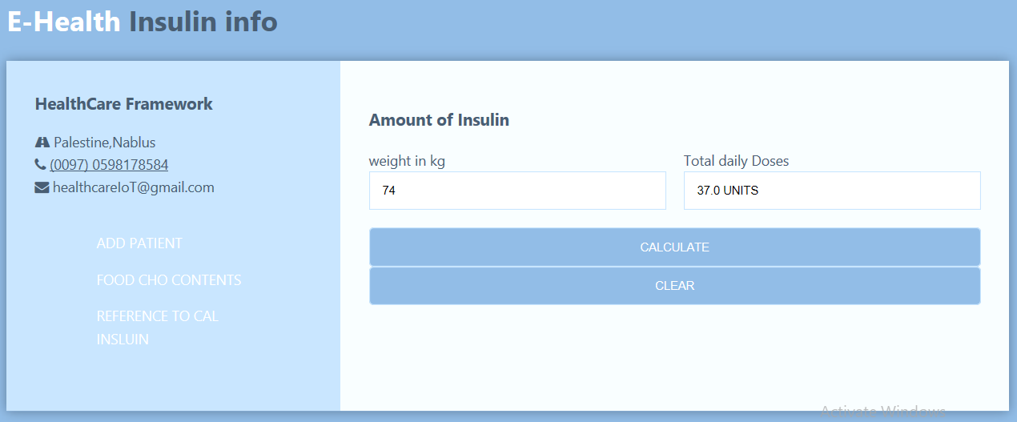
Case Three

Slide 19
Case Four : External
Case Four:Evaluate numbers of doses insulin to decrease Sugarin blood, Between meals,

Slide 20
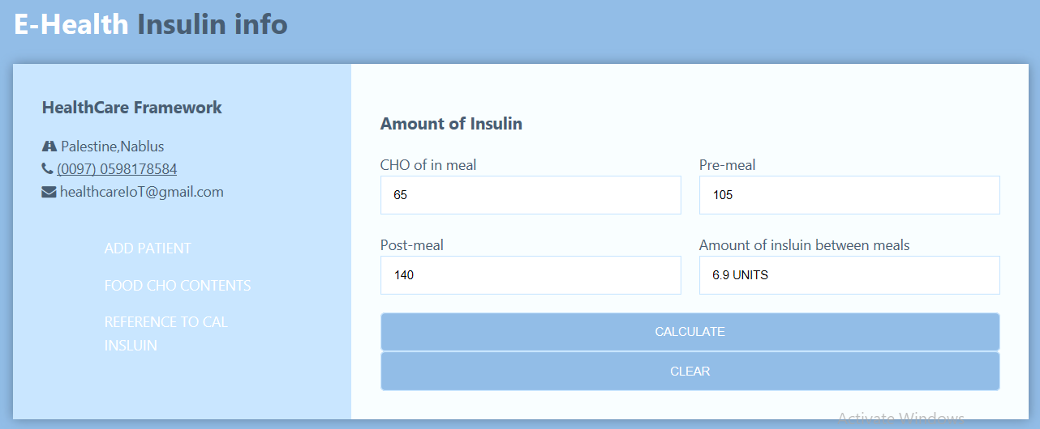
Case Four

Slide 21
Generate Randomly
Generate randomly part:We bring diabetes data thru call patients and ask some questions as requested about Diabetes or conduct tests. Which were questions as follow:*age,*sex,*weight,*The average amount of Carbohydrate,*The average amount of blood in sugar directly after wake up,*The average amount of blood in sugar after meals,The goal of these data to make simulator randomly generate a results.

Slide 22
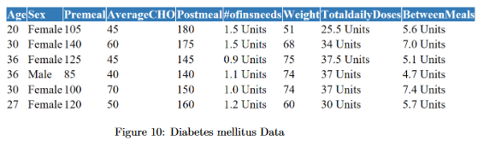
Generate Randomly

Slide 23
Mobile Application Diabetes mellitus type 1

Slide 24
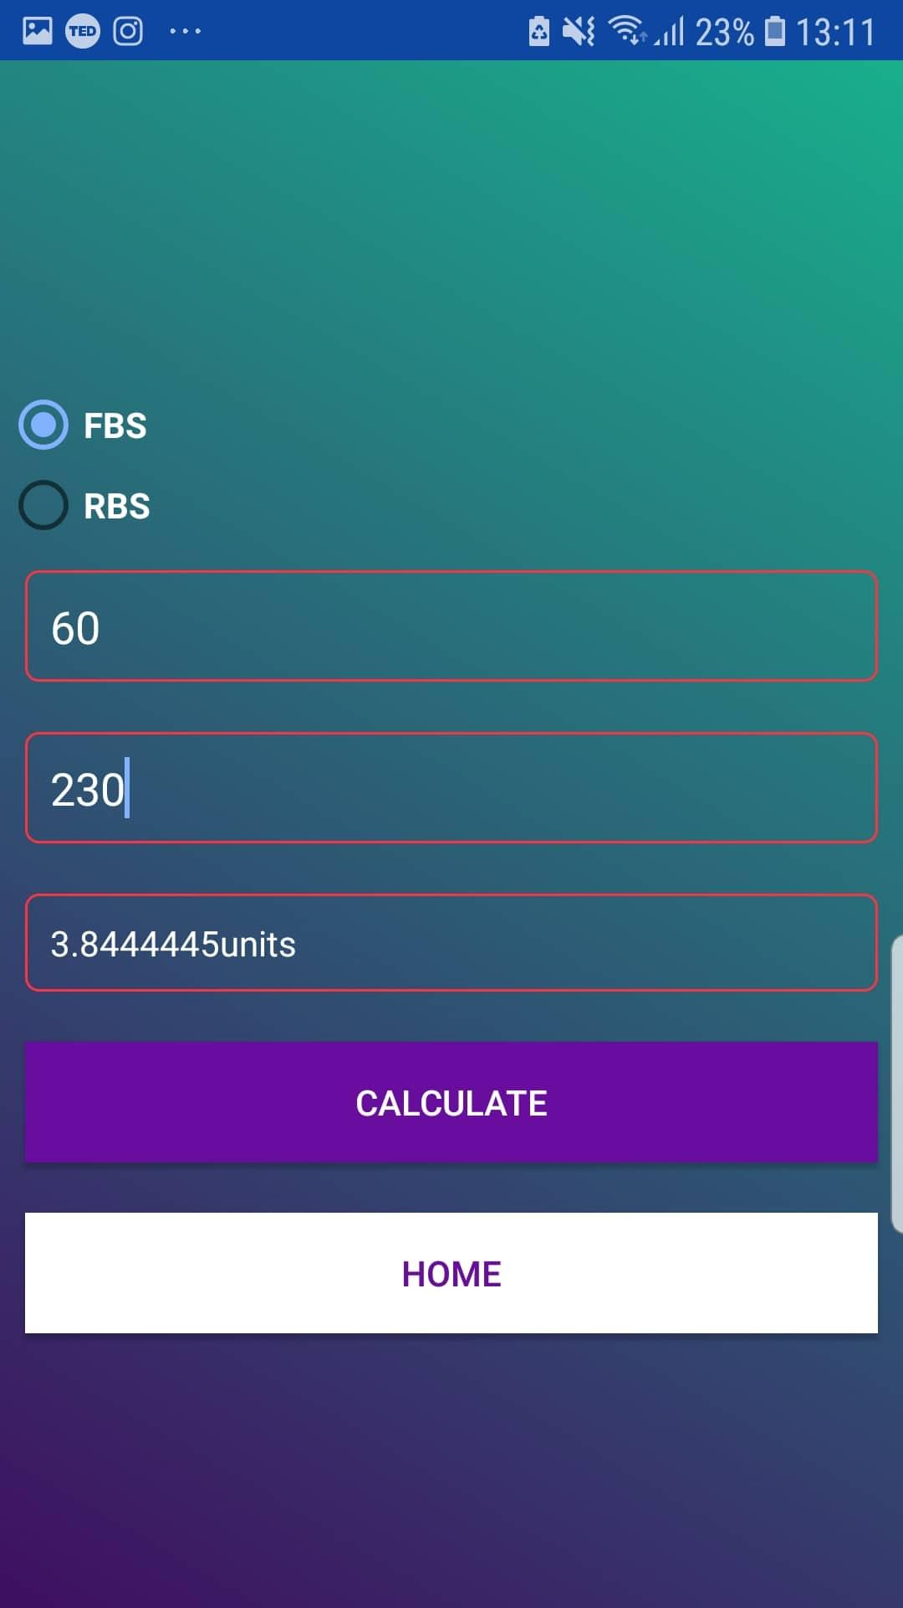
Mobile Application Diabetes mellitus type 1

Slide 25
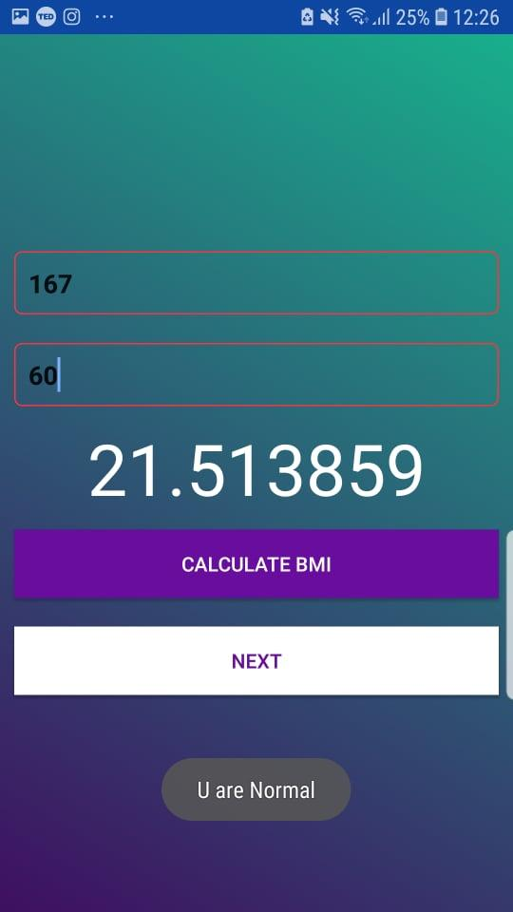
Mobile Application Diabetes mellitus type 1
The first stage: calculate BMI(Body mass index) when pt.
entering weight and height, and the app told you if, Underweight,
Normal, Overweight, Obese.

Slide 26
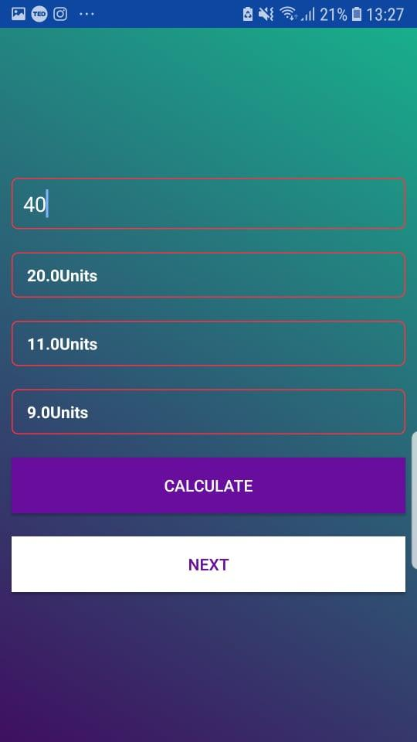
Mobile Application Diabetes mellitus type 1
Second stage: calculate total daily insulin & Bolus & Basel of insulin depending on your weight

Slide 27
Mobile Application Diabetes mellitus type 1
Calculate the amount of insulin you need for this meal depends on blood glucose, U should determine first your stats fasting blood sugar or random blood sugar. And the amount of carb. The result will be a fraction number and let patient determine if wants round it or not so the result means needs of insulin u should take for a given meal. Usually an injection of insulin before the meal in a quarter of an hour ago.

Slide 28
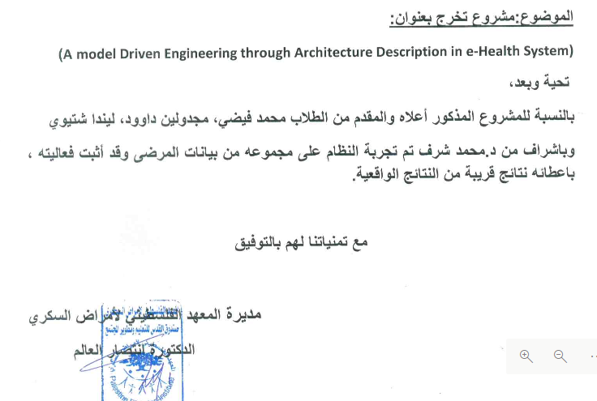
Certificate Mobile Application Diabetes mellitus

Slide 29
Cupcarbon
In this section, we will describe the results of power consumption SAML Diabetes mellitus Mobile Application running our project in CupCarbon simulator. We applied six different components behaviours and three sensors.

Slide 30
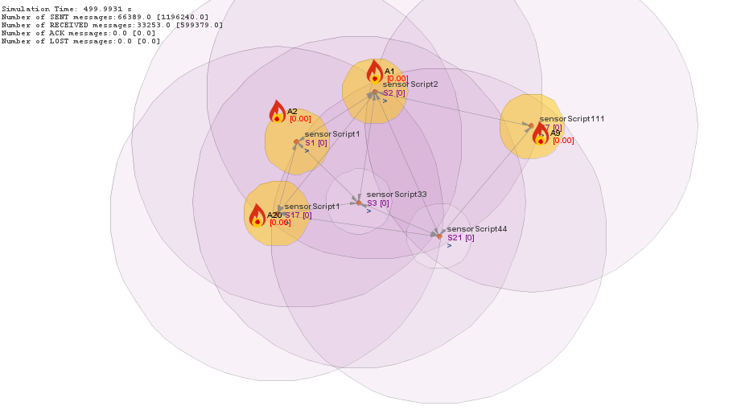
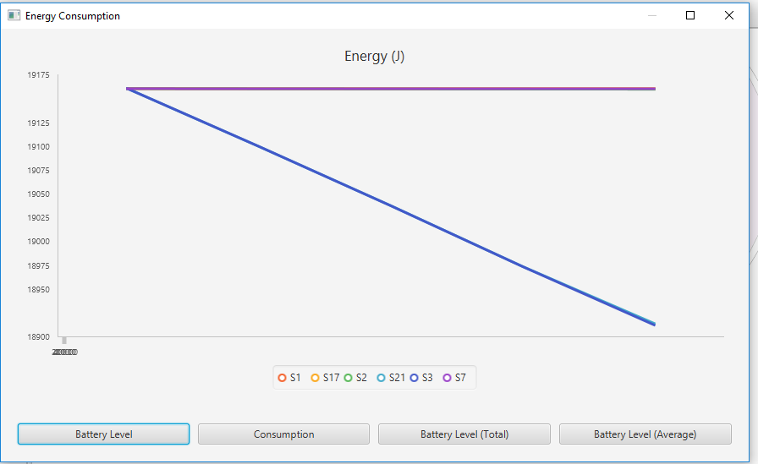
Cupcarbon

Slide 31
conclusion
Healthcare organizations can take advantage of include the following:
Improved Disease Management
Decreased Costs
Improved Outcomes of Treatment
Reduced Errors
*** In short, more connection means more accessible data and better healthcare for patients by lets doctors carry information with them anywhere they go through apps on their smartphones.

Slide 32
Future work
The application will be used by 3000 patients from the Diabetes Center infected with Type1.
Our next plan to gain values of SAML Diabetes mellitus Mobile Application rather than manual using model transformation(Acceleo). In addition, if we bring sensors in real-life to generate them testable with Arduino code.
It’s can modelling or used e-health system to build any related health system .Also, allow stakeholders to perform analysis for eﬀective architectural,it can be used the system academic or for research to the students.
Care management system. Used AES security

Slide 33
Thanks

