Slide 1

An-Najah National University
Engineering Collage
Civil Engineering Department
Graduation Project 2
3D Dynamic Analysis And design of
Ministry of Transportation Building
Supervised by: Dr. Munther Diyab
2013

Slide 2
Outline
Introduction
Preliminary Design
3D Modeling analysis and design using SAP2000

Slide 3
Chapter One
Introduction

Slide 4
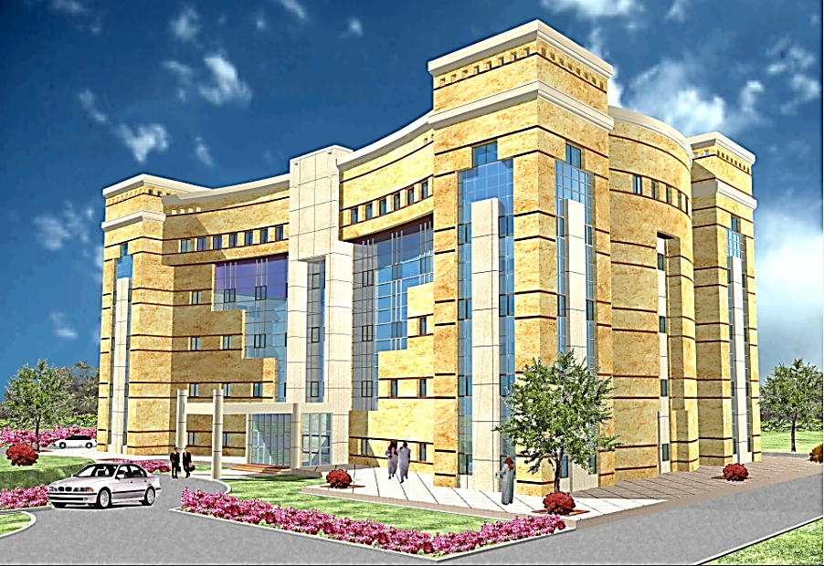
(1) Project Description
Five stories.
Story area of 1500
Story elevation 4.6 m.
Notes:
The building consists of two parts separated by an expansion joint.

Slide 5
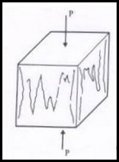
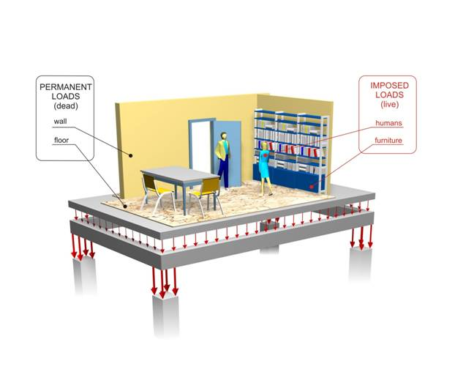

(2) Materials and loads
${\grave{\text{f}}}_{\text{c}} \text{= }\text{28} \text{MPa}$
E for concrete 24.9 GPa
f_{Y} = 420 MPa
Unit weight is 25 KN/m³
SDL = 4 KN/m².
(LL) = 4 KN/m².

Slide 6



(3) Design Codes

Slide 7
Chapter Two
Preliminary Design

Slide 8
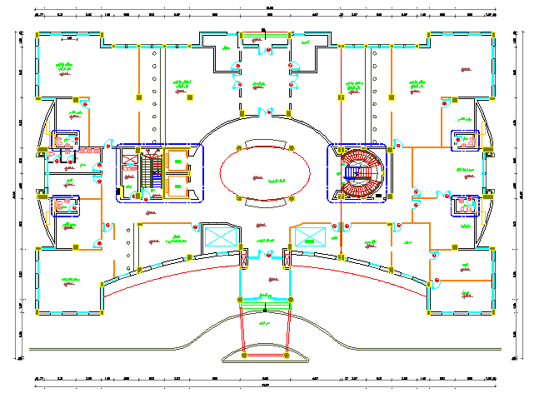
Architectural Plan

Slide 9
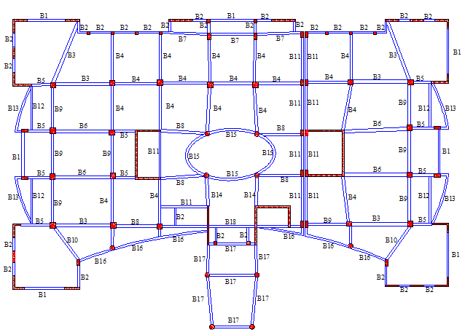
Structural Plan

Slide 10
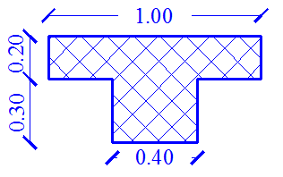
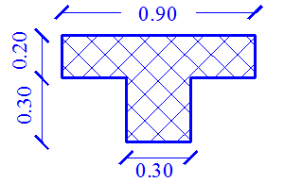
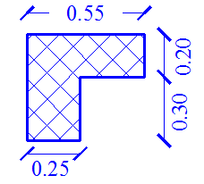
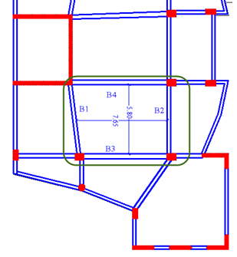
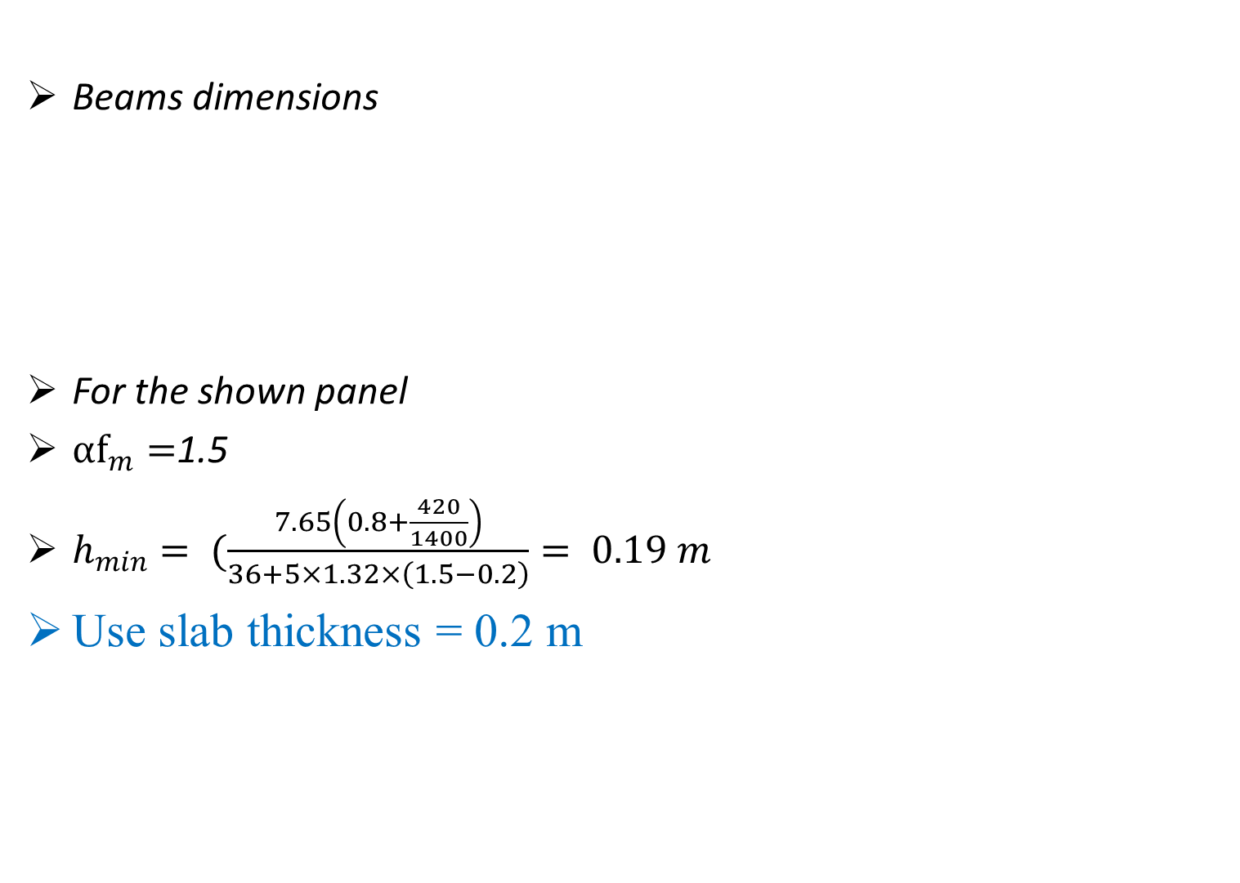
Dimensions For Beams and Slab
Beams dimensions
For the shown panel
${αf}_{m}=$1.5
$h_{min}= (\frac{7.65\left(0.8+\frac{420}{1400}\right)}{36+5×1.32×\left(1.5−0.2\right)}= 0.19 m$
Use slab thickness = 0.2 m

Slide 11
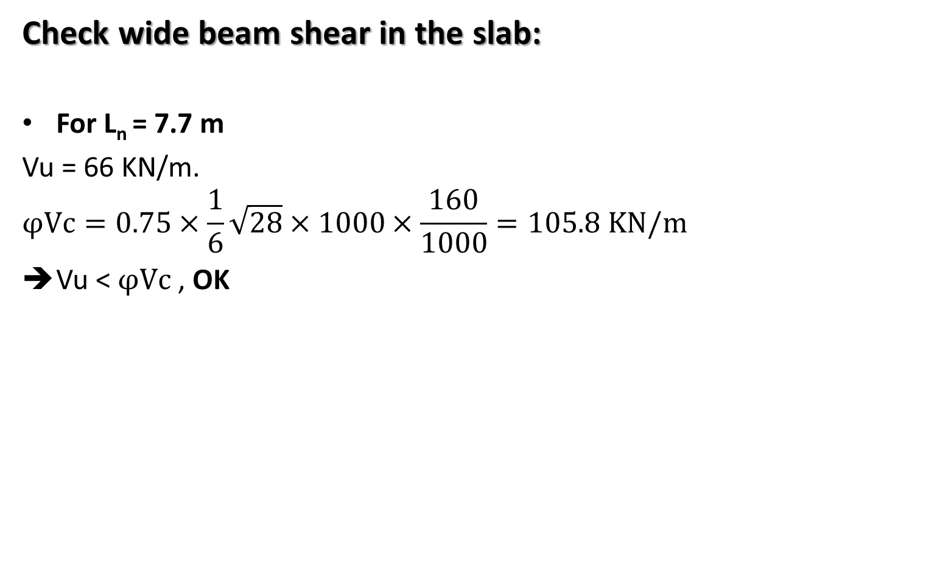
Manual Checks for Dimensions
Check wide beam shear in the slab:
For L_{n} = 7.7 m
Vu = 66 KN/m.
$$φVc=0.75×\frac{1}{6}\sqrt{28}×1000×\frac{160}{1000}=105.8 KN/m$$
Vu < $φVc$ , OK

Slide 12
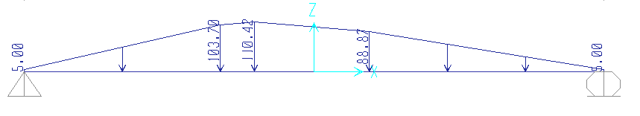
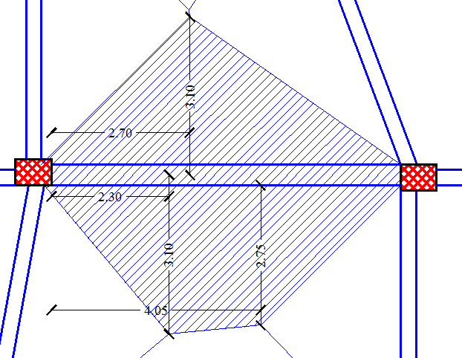
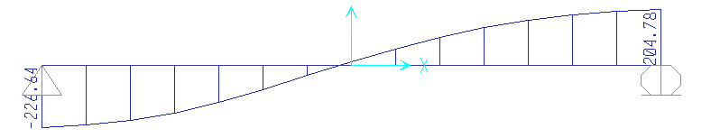
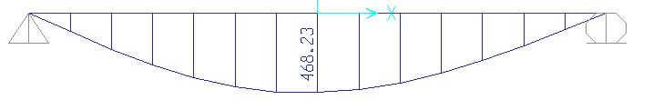
Manual Checks for Dimensions
Check beam dimensions
Load distribution from tributary area
Shear force from tributary area
Moment diagram from tributary area

Slide 13
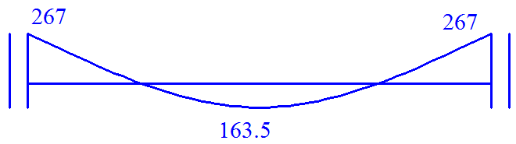
Manual Checks for Dimensions
Check beam dimensions
Moment diagram from tributary area
Moment diagram from direct design method
Total moment = 267+163.5 = 430.5
Difference percentage = 8%

Slide 14
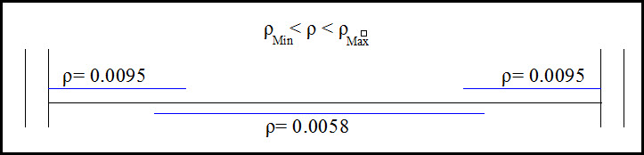
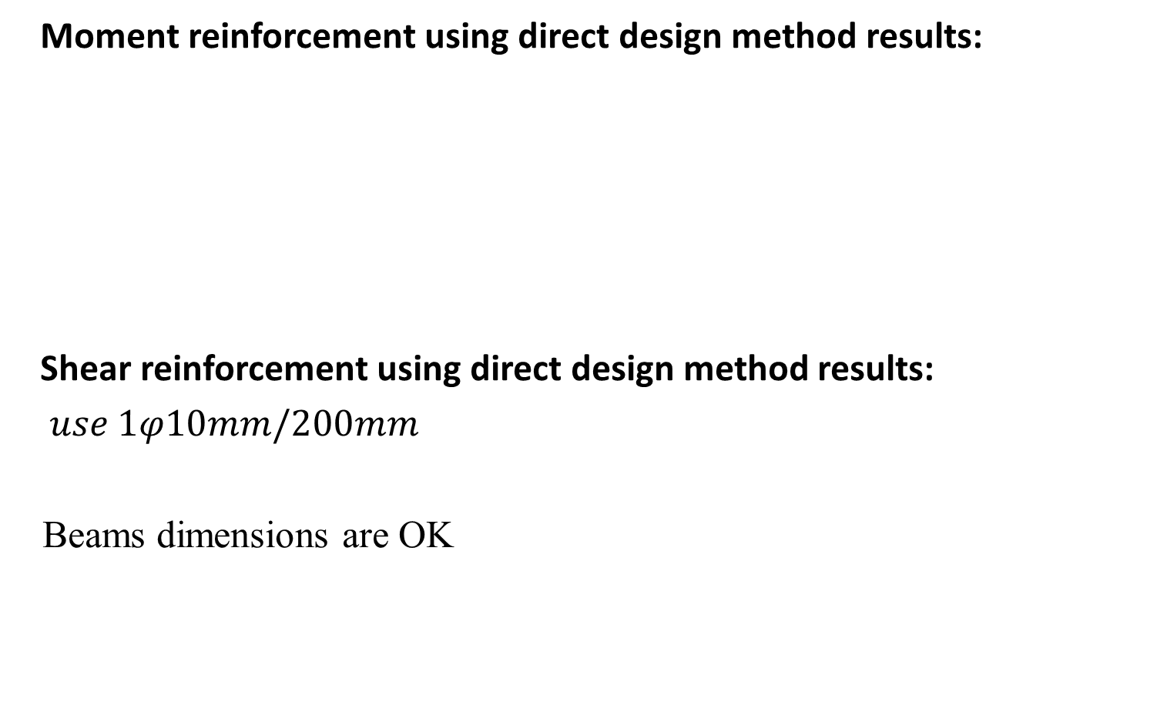
Manual Checks for Dimensions
Moment reinforcement using direct design method results:
Shear reinforcement using direct design method results:
$use 1φ10mm/200mm$
Beams dimensions are OK

Slide 15
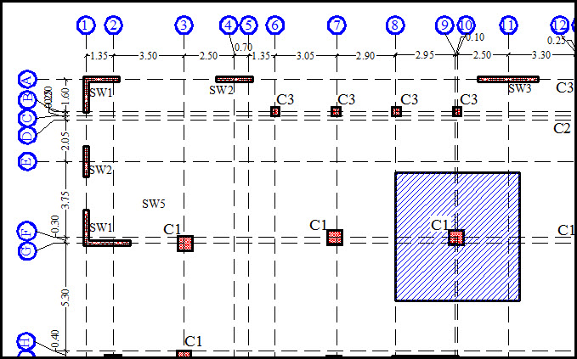

Dimensions For columns
Axial Force in column C1 at grid 10-F
$$Total ultimate load on the column=3906 KN$$
Using ρ = 1%
Dimensions are 60X60 cm

Slide 16
Chapter Three
3D Model & Checks

Slide 17
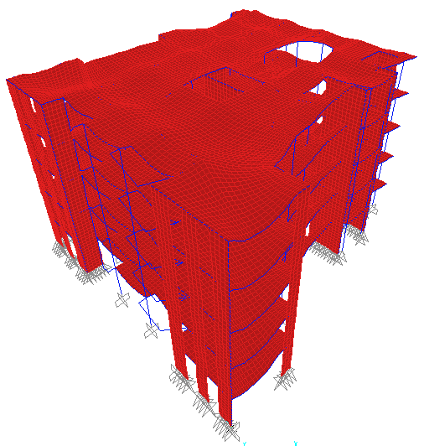
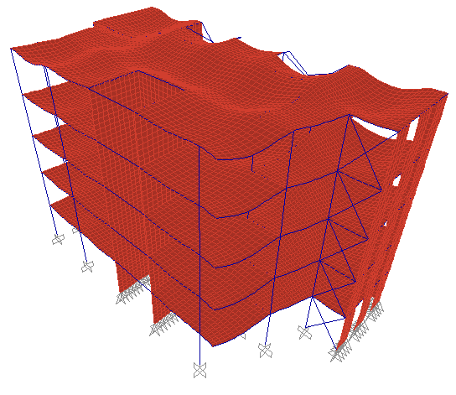
Compatibility Check
→ The model is compatible.

Slide 18

Equilibrium Check
Manual result SAP results
Total live load = 9720 KN
Difference percentage = 0.02%
Member | Weight, KN
Shear walls | 4904
Columns | 2898
Beams | 4415
Slab | 12150
external wall | 11325
Superimposed | 9720
Total | 45412

Slide 19
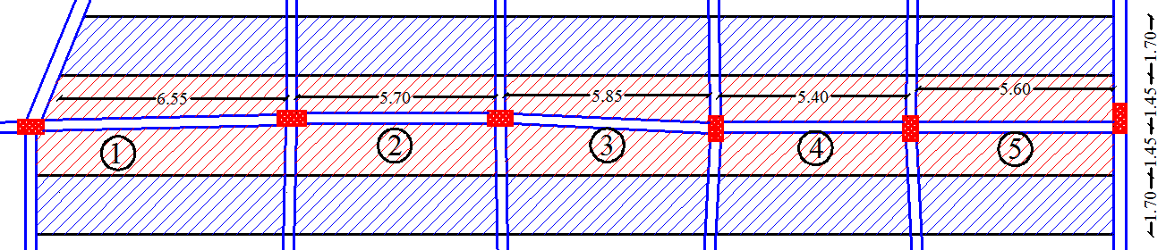
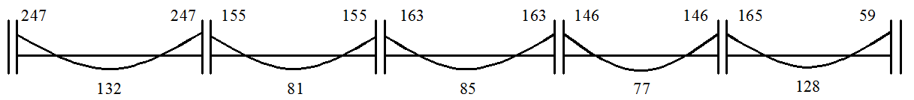

Internal Forces Check
Moment check in beams:
Moment diagram from direct design method:
Moment diagram from SAP results:
Difference is acceptable

Slide 20
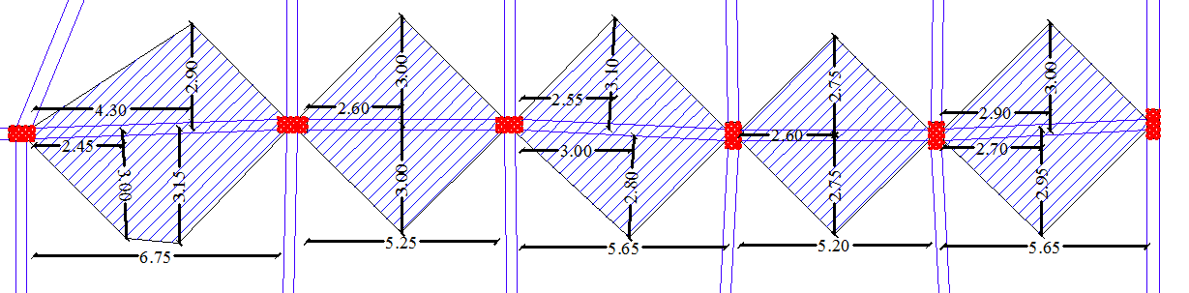
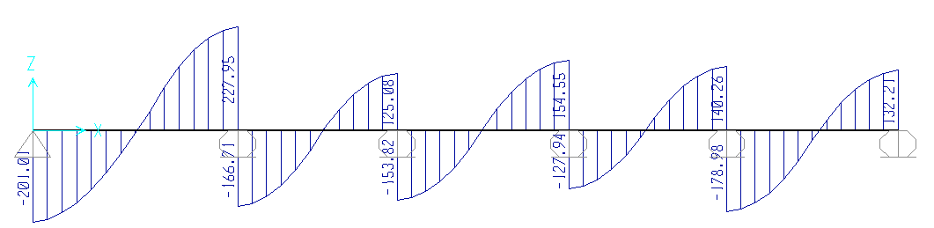
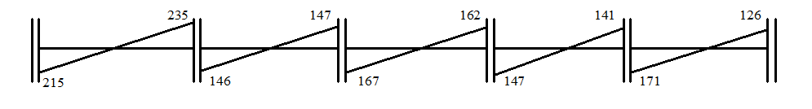
Internal Forces Check
Shear check in beams:
Shear diagram from direct design method:
Shear diagram from SAP results:
Difference is acceptable

Slide 21
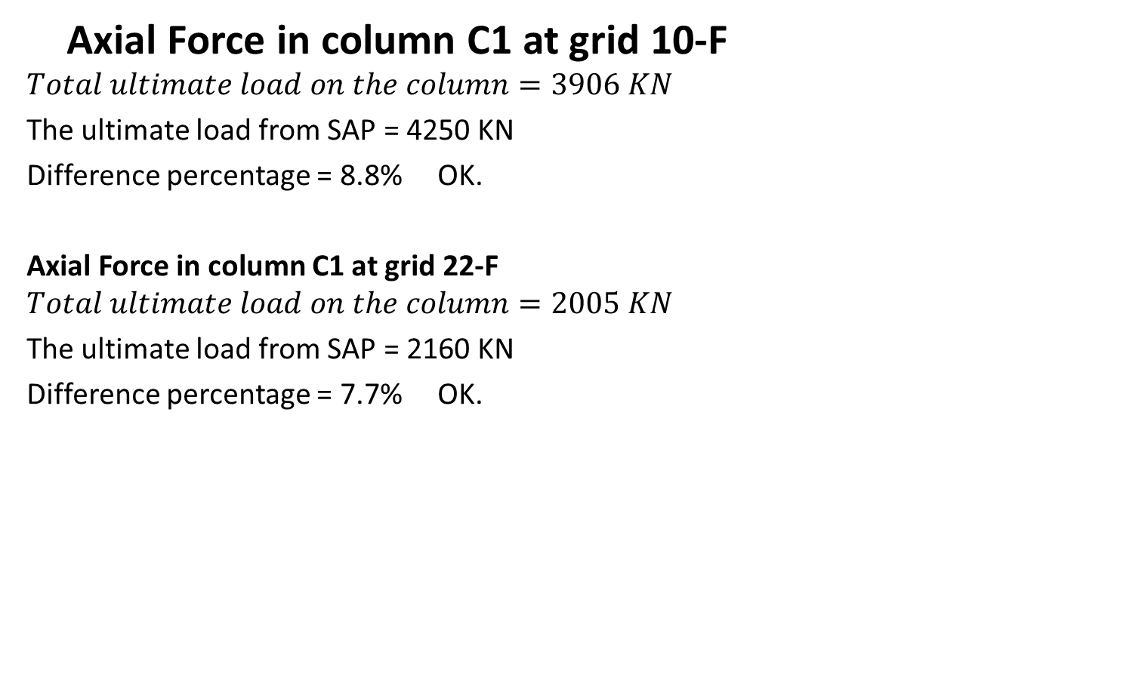
Internal Forces Check
Axial Force in column C1 at grid 10-F
$$Total ultimate load on the column=3906 KN$$
The ultimate load from SAP = 4250 KN
Difference percentage = 8.8% OK.
Axial Force in column C1 at grid 22-F
$$Total ultimate load on the column=2005 KN$$
The ultimate load from SAP = 2160 KN
Difference percentage = 7.7% OK.

Slide 22
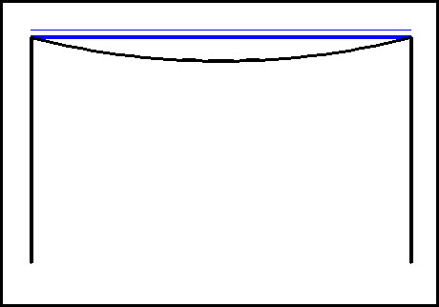
Deflection Check
Comments on Deflection Check:
Actual beams deflection = total beam deflection - average axial deformation of columns that support the beam.
Actual floor deflection = total deflection - the average axial deformation of the four surrounding columns.
Actual slab deflection = Actual floor deflection - the average actual beams deflection.

Slide 23
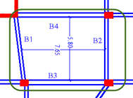
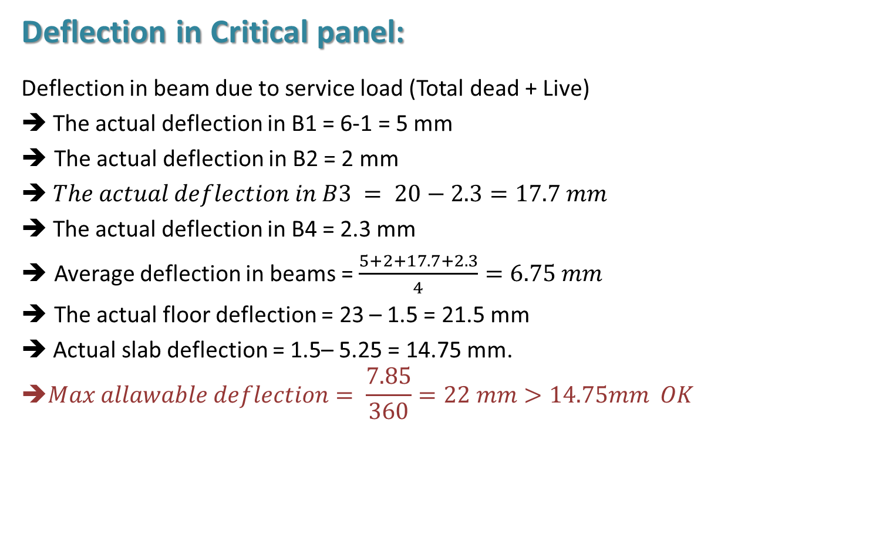
Deflection Check
Deflection in Critical panel:
Deflection in beam due to service load (Total dead + Live)
➔ The actual deflection in B1 = 6-1 = 5 mm
The actual deflection in B2 = 2 mm
➔ $The actual deflection in B3 = 20−2.3=17.7 mm$
➔ The actual deflection in B4 = 2.3 mm
Average deflection in beams = $\frac{5+2+17.7+2.3}{4}=6.75 mm$
The actual floor deflection = 23 – 1.5 = 21.5 mm
➔ Actual slab deflection = 1.5– 5.25 = 14.75 mm.
$$\text{➔}Max allawable deflection= \frac{7.85}{360}=22 mm>14.75mm OK$$

Slide 24

Deflection Check
Deflection in Critical panel:
Deflection from live load:
-Deflection in B2:
➔ The actual deflection in B2 from live load
$$∆ (L) = ∆ (D + L) − ∆ (D) = 5−4.2 = 0.8 mm.$$
➔ Actual slab deflection =
$$∆ (L) = ∆ (D + L) − ∆ (D) = 14.75 – 9.75 = 5 mm.$$

Slide 25
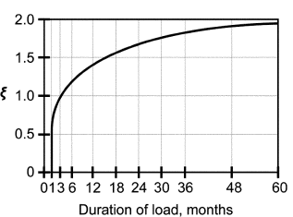
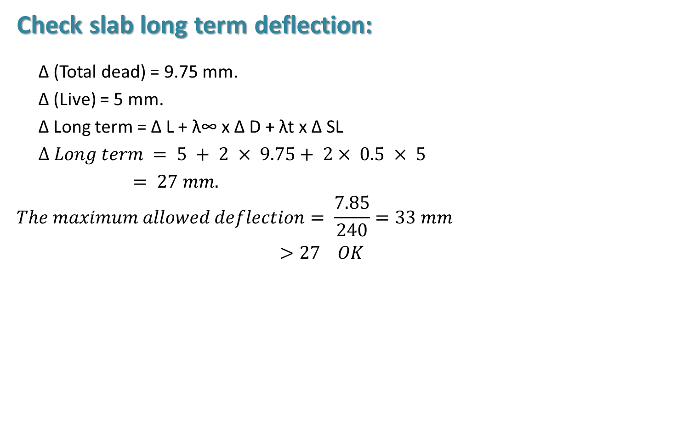
Deflection Check
Check slab long term deflection:
∆ (Total dead) = 9.75 mm.
∆ (Live) = 5 mm.
∆ Long term = ∆ L + λ∞ x ∆ D + λt x ∆ SL
$∆ Long term = 5 + 2 × 9.75+ 2× 0.5 × 5$
$= 27 mm.$
$$The maximum allowed deflection= \frac{7.85}{240}=33 mm$$
$>27 OK$

Slide 26
Chapter Four
3D Dynamic Analysis

Slide 27
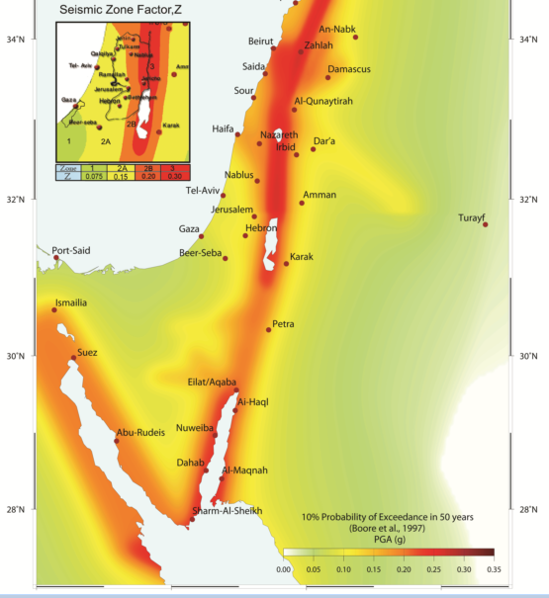

    Design Input Data
Nablus is zone 2B, site soil is Sc
Ca = 0.24, CV = 0.32
Importance factor = 1.25
R=4.5
Scale factor = $\frac{I∗g}{R}$ = $\frac{1.25∗9.81}{4.5}$ = 2.725
The structure will be designed as "Intermediate Sway".

Slide 28


    Preliminary Design(Equivalent Static)
Total mass = dead + 0.25*Live = 8422.3 ton
T$=2π \sqrt{\frac{(\sum_{i=1}^{n}{Mi Δi^{2})}}{(\sum_{i=1}^{n}{Fi Δi)}}}$ = 0.766 sec. in Y-direction
$T = Ct∗{\left(hn\right)}^{3/4}$ = $0.0731∗{\left(5∗4.6\right)}^{\frac{3}{4}}=0.77 sec$
The difference is 3.03% which is acceptable.

Slide 29

    Preliminary Design(Equivalent Static)
Base shear V = 9592.41 KN between maximum and minimum
$V=F top+ \sum_{i=1}^{n}{Fi}$
The following formula to distribute the base shear on stories:
$$Fi= \frac{(V−Ft)(Wi∗hx)}{\sum_{i=1}^{n}{Wi∗hi}}$$
Floor # | Height | Elevation(h) | Floor Mass | M*(h) | Force | shear
5 | 4.6 | 23 | 1684.457 | 38742.51 | 3540.281 | 3540.281
4 | 4.6 | 18.4 | 1684.457 | 30994.01 | 2420.76 | 5961.041
3 | 4.6 | 13.8 | 1684.457 | 23245.51 | 1815.57 | 7776.612
2 | 4.6 | 9.2 | 1684.457 | 15497 | 1210.38 | 8986.992
1 | 4.6 | 4.6 | 1684.457 | 7748.502 | 605.1901 | 9592.182
 |  |  | ∑ | 116227.5

Slide 30
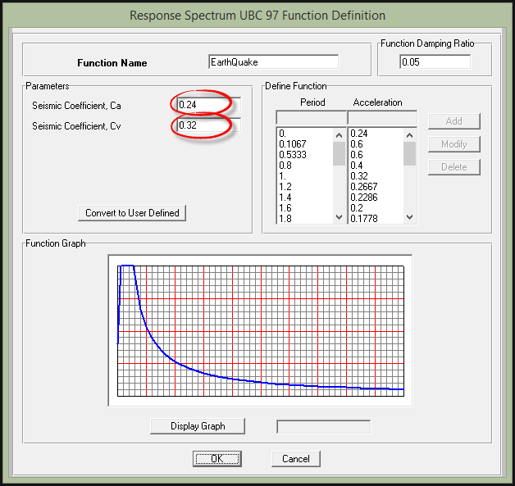
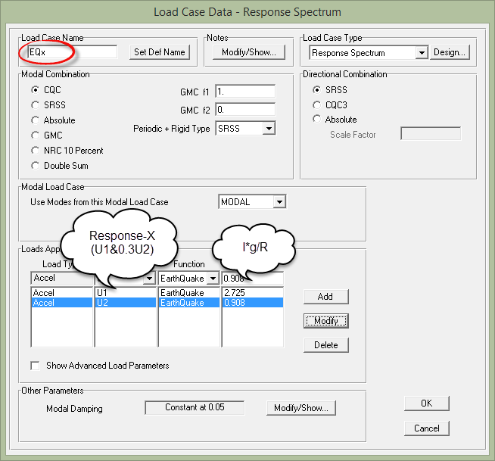
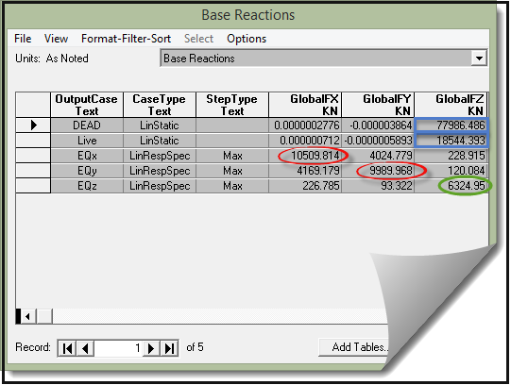
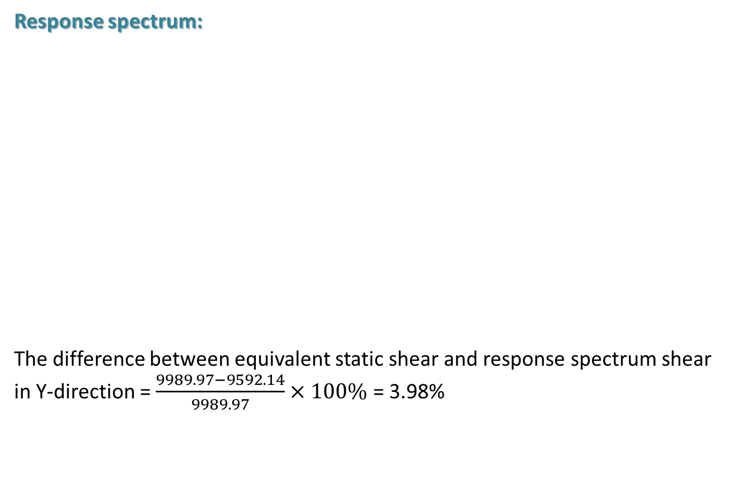
    Modal Analysis
Response spectrum:
The difference between equivalent static shear and response spectrum shear in Y-direction = $\frac{9989.97−9592.14}{9989.97}×100\%$ = 3.98%

Slide 31
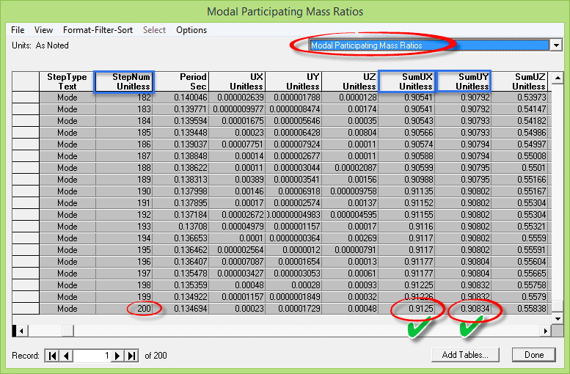
    Modal Analysis
Response spectrum:

Slide 32
Chapter Five
Slab, Beams and Columns Design

Slide 33
Chapter Six
Footings, Shear walls and Stairs Design

Slide 34
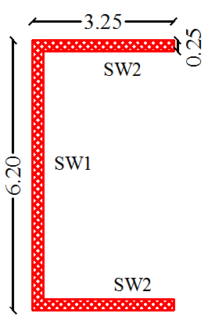
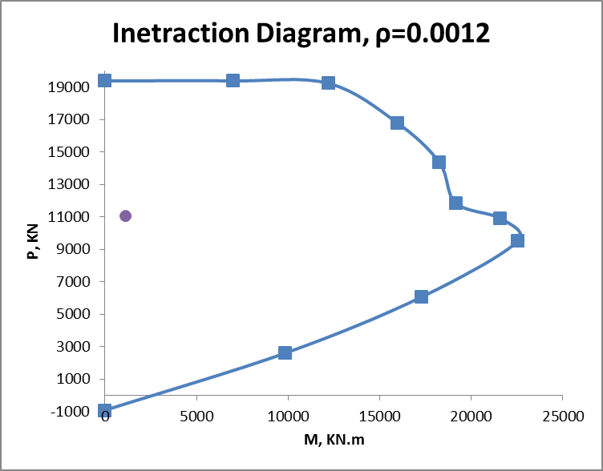
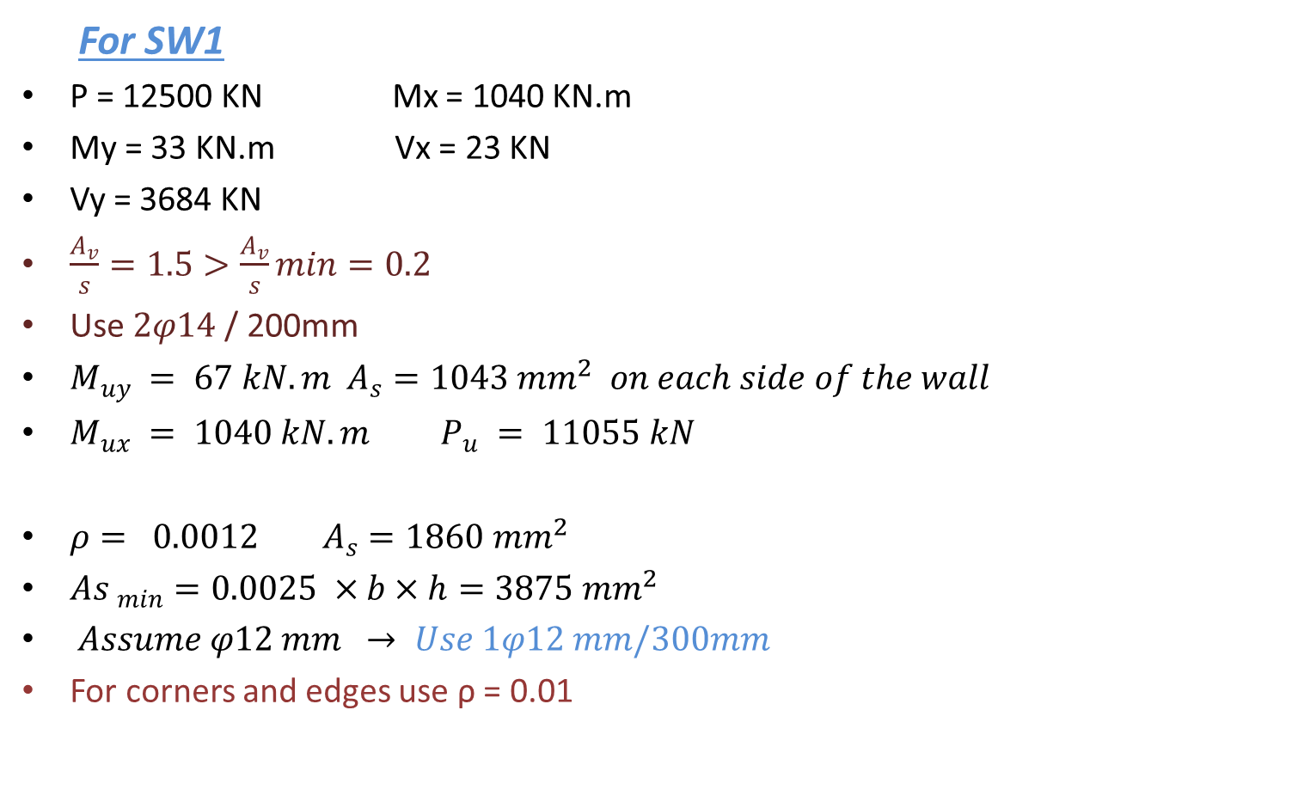
    Shear Walls Design
For SW1
P = 12500 KN Mx = 1040 KN.m
My = 33 KN.m Vx = 23 KN
Vy = 3684 KN
$\frac{A_{v}}{s}=1.5>\frac{A_{v}}{s}min=0.2$
Use $2φ14$/ 200mm
$M_{uy} = 67 kN.m$ $A_{s}=1043 mm^{2} on each side of the wall$
$M_{ux} = 1040 kN.m P_{u} = 11055 kN$
$ρ= 0.0012 A_{s}=1860 mm^{2}$
${As }_{min}=0.0025 ×b×h=3875 mm^{2}$
$Assume φ12 mm → Use 1φ12 mm/300mm$
For corners and edges use ρ = 0.01

Slide 35
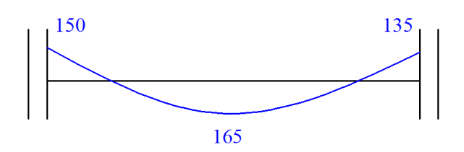
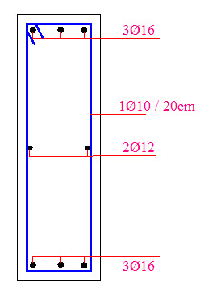

    Design of Tie Beams
All tie beams $80cm depth×25cm width$ moment diagram
Critical tie beam
$ρ < ρ_{min}=0.0033$
$As =610 mm^{2}$
$Use 3φ16 for both top and bottom steel$
$Use 2φ12 mm in the middle$

Slide 36




    Design of Footings
Site soil is classify Sc with $q all=400 Kn/m2$
Area is Max from
$A1= \frac{Survice reaction}{q all}$
$A2= \frac{envelop from [\left(1DL+1LL+Ex\right),\left(1DL+1LL+Ey\right),\left(1DL+1LL+Ez\right)] }{1.3∗ q all}$
Wide beam check.
Punching check.
Settlement check.

Slide 37


    Design of Footings
Design of footing F3
Area = 53m2, thickness h= 1.5 m, d=1.35m,
Total ultimate load is 27372 KN
Wide beam check $Vu=591 KN/m<∅Vc=983 KN/m$
$Vu punching=7342 KN$ < $∅Vcp=9884 Kn$
Max settlement is 0.9 cm
As_{MIN} = 0.0018 * b * h is used in each direction
For top steel As_{MIN} = 0.0009 * b * h in each direction
Ld < available length, so hock used.

Slide 38

    Design of Footings

Slide 39

    Design of Footings

Slide 40


    Stairs Analysis and Design
use 0.15 m slab thickness
Vu = 24 KN/m < $∅Vc=105$ KN/m
$ρ=0.006$
$$As=\frac{708mm^{2}}{m}$$
$$Use 8∅12mm longitudinal bottom steel$$
For top steel $use 6∅12$
$$For transverse steel use 1∅12mm/250mm$$

Slide 41


    Stairs Analysis and Design
Stair Detailing :

Slide 42



    Expansion Joint Design
spacing between the two blocks = $∆_{\max{ A}}+∆_{\max{ B}}+2.5 cm$
$=4.5+3+2.5=10 cm$
  External Walls
  Will not make bracing

Slide 43

    Expansion Joint Design
Moment diagram with out earthquake:
Moment diagram with earth quake:

Slide 44
THANK YOU

Slide 45
Questions
??

