Slide 1
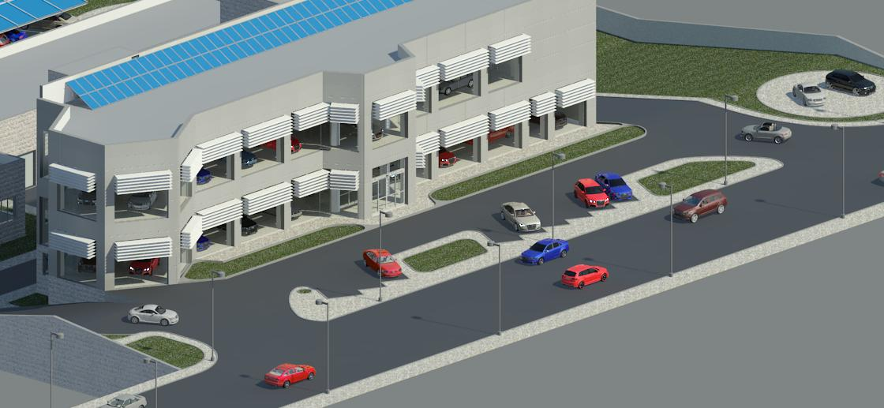

An-Najah National University
Faculty of Engineering and Information Technology
Building Engineering Department
Final Project II – 68591
Cars Showroom
Supervisor:
Dr. Mutasim Baba’
Prepared By:
Mustafa Qassem
Nidal Tuqan
Hisham Al-Karmi

Slide 2
Outlines
Site Analysis
Architectural Design
Environmental Design
Structural Design
Mechanical Design
Electrical Design
Safety Design
Quantity Survey and Cost Estimate

Slide 3
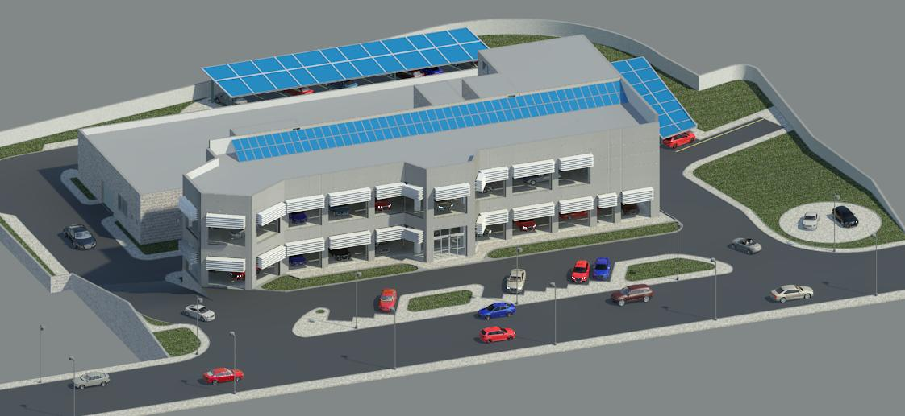
Site Analysis

Slide 4
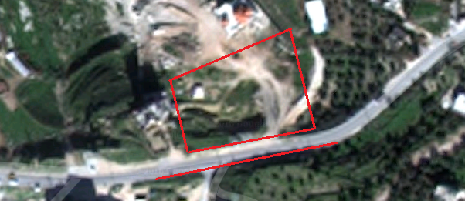
Site Analysis
Our site is located in bet wazzan
village, west of An-Najah National
University ( New Campus ) by 2 km.

Slide 5
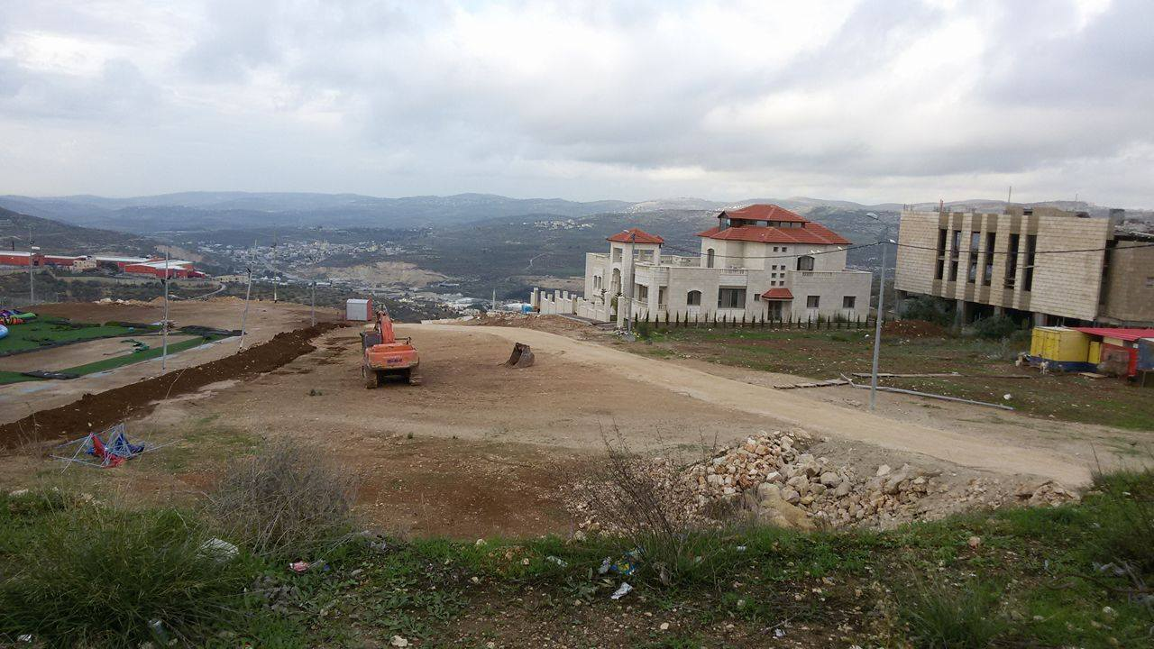
Site Analysis
The site has an area of 7000 m²
The land is excavated along its area.
it’s below of the street by 4 meters.
In south direction there is the
bet wazzan main street which is
the main access to the land.

Slide 6
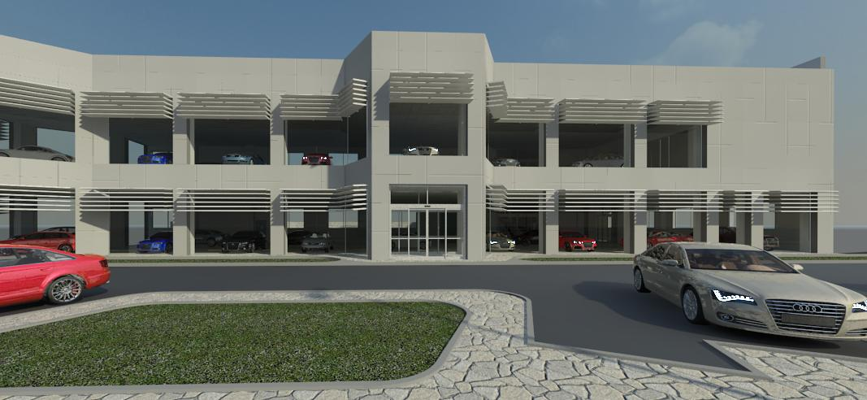
Architectural Design

Slide 7
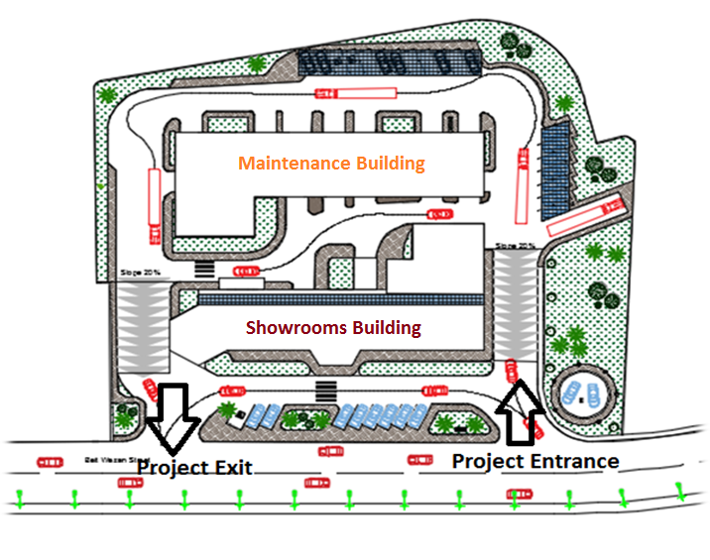
Site Plan

Slide 8
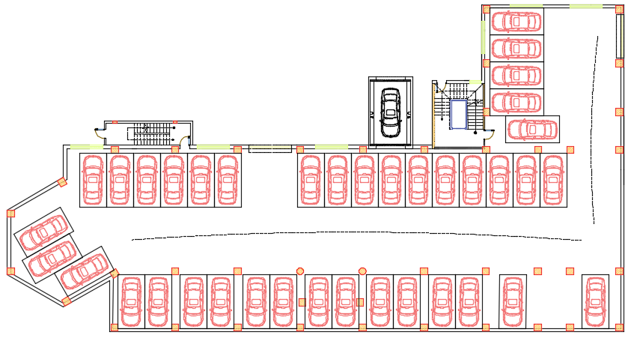
Basement Floor Plan
Car Storage Plan
# of Stored Cars = 38

Slide 9
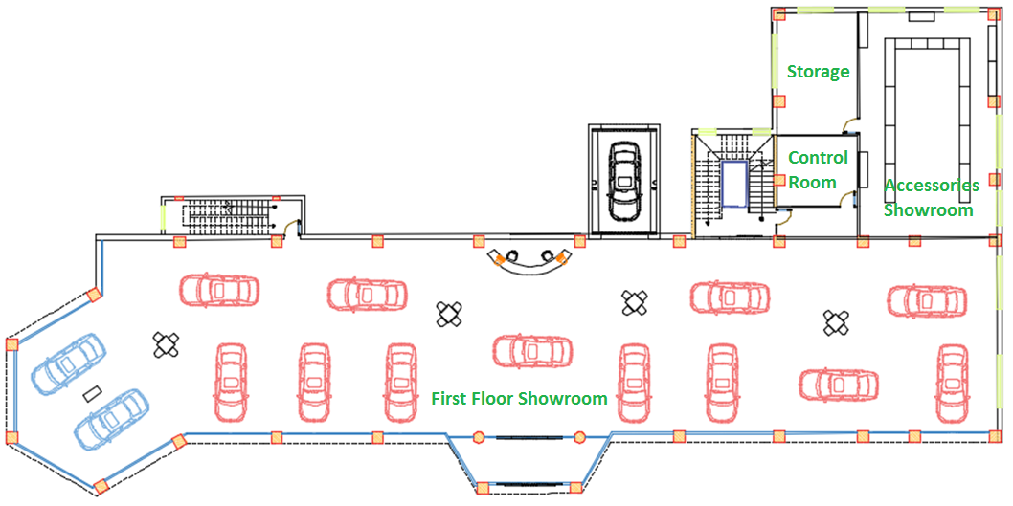
First Floor Plan
# of displayed Cars = 14

Slide 10
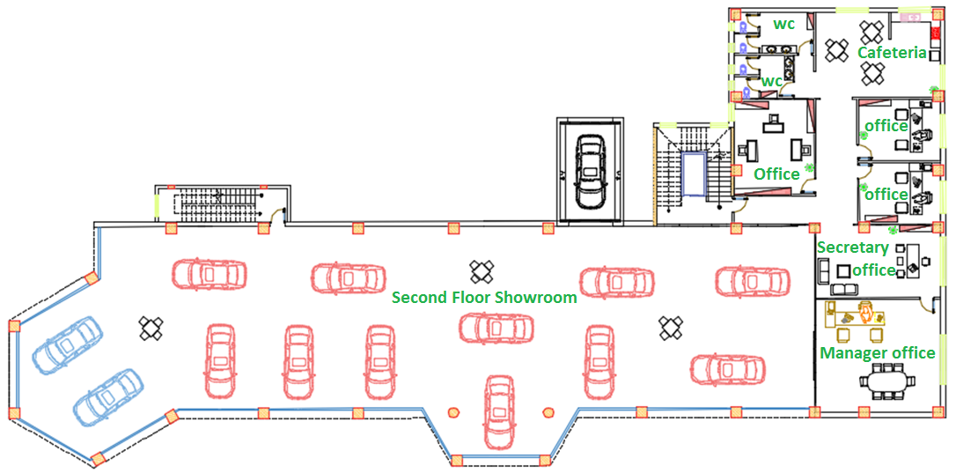
Second Floor Plan
# of displayed Cars = 13

Slide 11
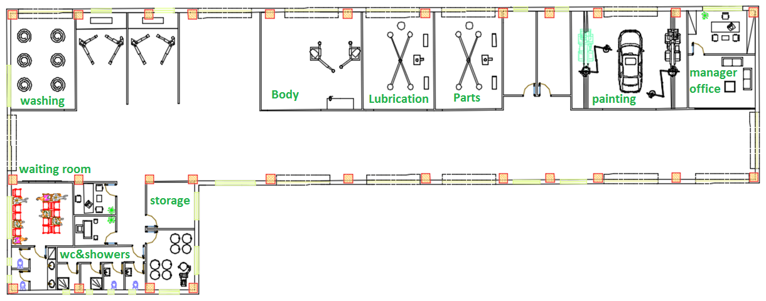
Maintenance Floor Plan

Slide 12
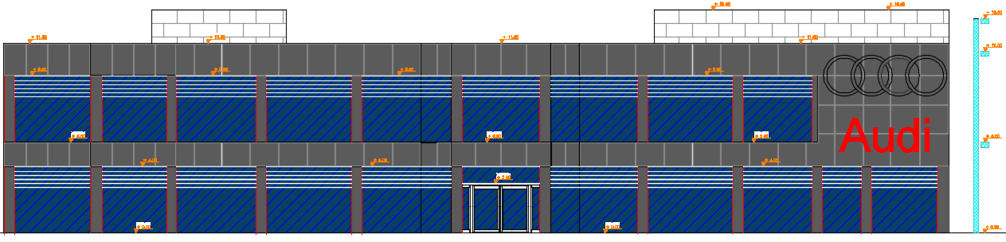
Elevations
South (Main) Elevation

Slide 13
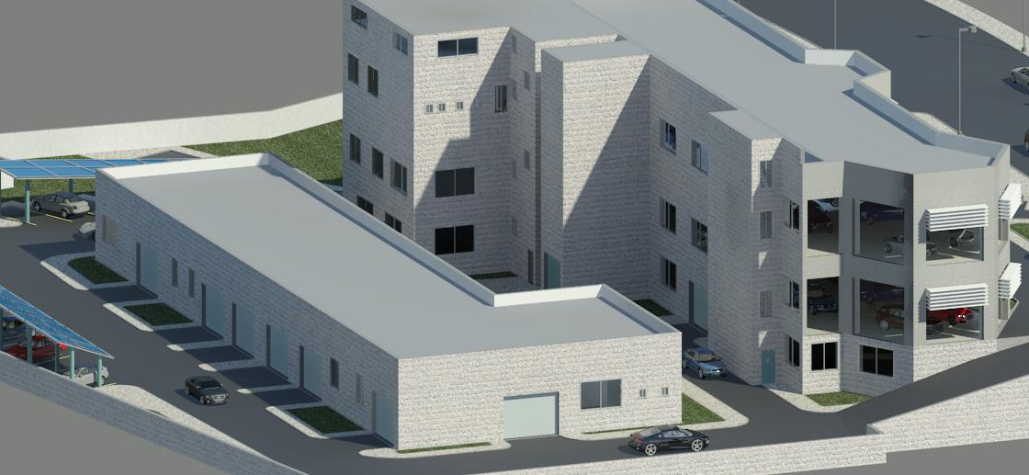
Environmental Design

Slide 14
Environmental Design
Our Strategy to obtain Energy Efficiency building is Based on:
1- Envelope Insulation
2- Glass Selection
3- Effective Shading

Slide 15
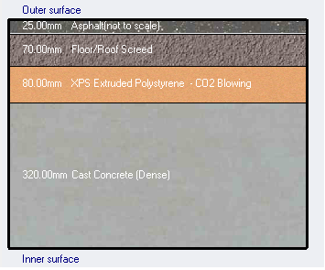
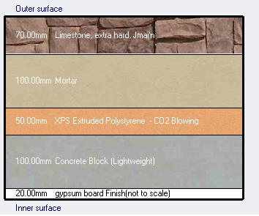
Envelope Insulation
Construction of Envelope Elements
Flat roof
(U-value = 0.289 W/m².K)
Stone wall
(U-value = 0.411 W/m².K)

Slide 16
Glass Selection
For glazing façades we used SGG PLANISTAR SUN Glass type with 16mm argon which is a product of Saint-Gobain Company.
Product | LT% | g-value | Shading Coefficient SC | Selectivity LT/g | LRe% | LRi% | U-Value (W/m².K)
 |  |  |  |  |  |  | 12mm air | 16mm argon
SGG PLANISTAR SUN | 71 | 0.36 | 0.41 | 1.97 | 14 | 15 | 1.5 | 1

Slide 17
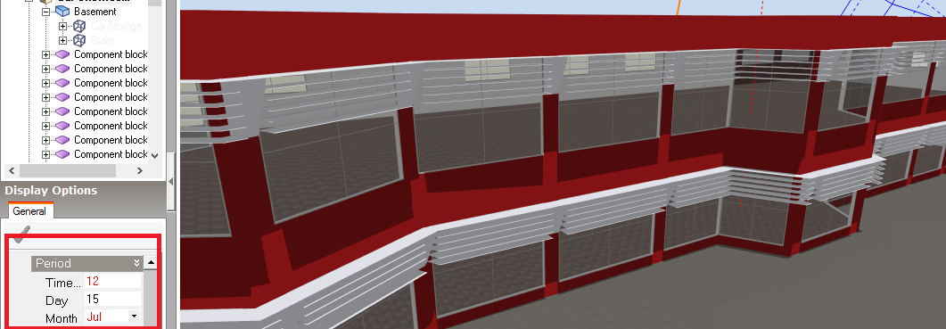
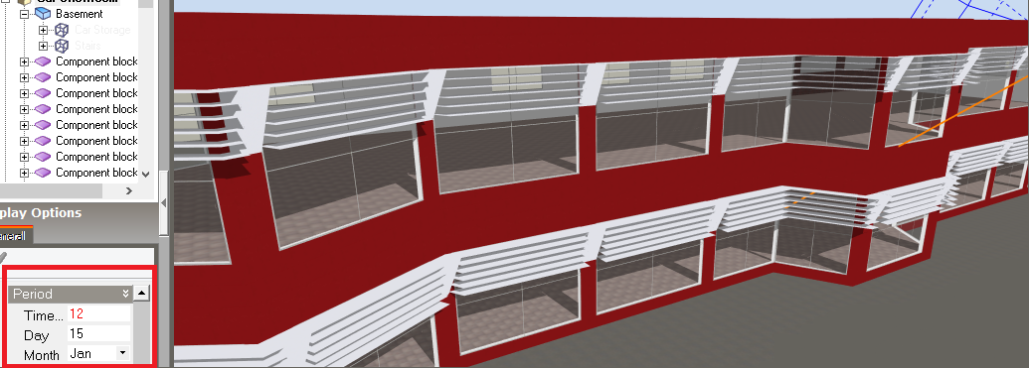
Effective Shading
For effective shading we used
lovers On the top part of the
glazing area
Shading effect on 15 July at 12:00 pm
Shading effect on 15 Jan at 12:00 pm

Slide 18
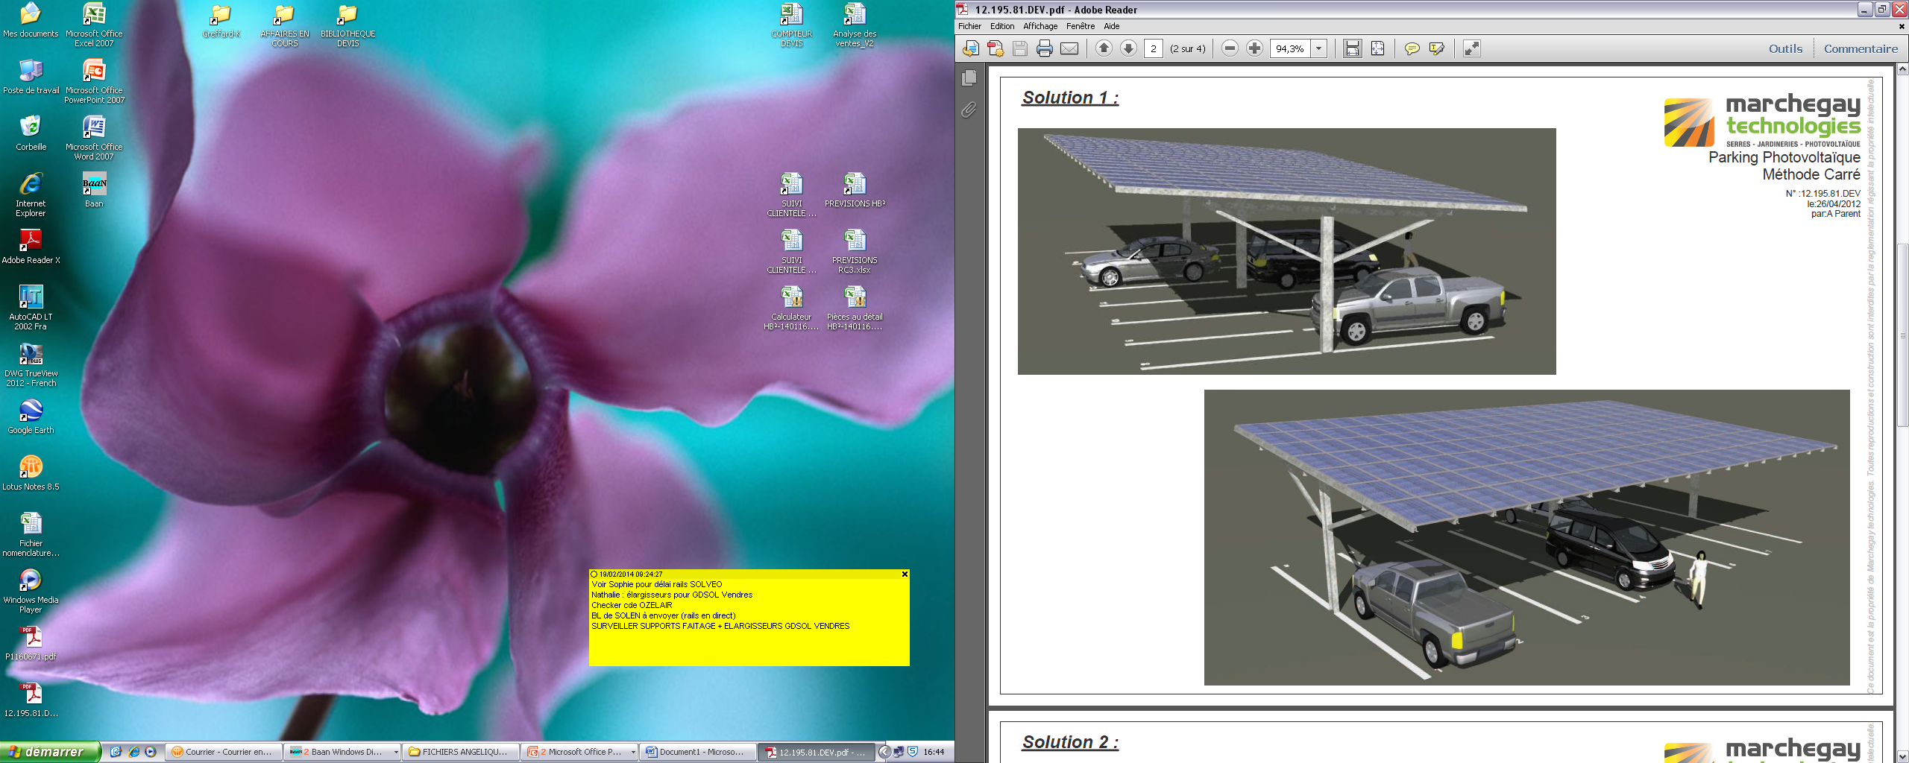
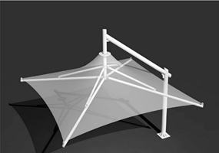
Effective Shading
Outdoor Shading
Photovoltaic shading canopy for car parking
Umbrella for external car display

Slide 19
Thermal Analysis
Cooling Load
Heating Load
Block | Zone | Design Capacity (kW) | Design Flow Rate (m3/s) | Total Cooling Load (kW) | Sensible (kW) | Latent (kW) | Humidity (%) | Design Cooling Load Per Floor Area(W/m2)
First Floor | Showroom | 34.11 | 1.9568 | 29.66 | 22.59 | 7.07 | 54.3 | 51.3
 | Accessories | 5.11 | 0.2964 | 4.44 | 3.42 | 1.02 | 54.1 | 51.1
 | Security Office | 0.89 | 0.0624 | 0.77 | 0.72 | 0.05 | 48.7 | 52.6
Second Floor | Showroom | 33.52 | 1.9867 | 29.15 | 22.93 | 6.22 | 53.3 | 58.4
 | Office3 | 1.33 | 0.1001 | 1.16 | 1.16 | 0 | 46.5 | 72.7
 | Secretary | 2.08 | 0.1563 | 1.81 | 1.8 | 0 | 46.6 | 66
 | Office1 | 1.74 | 0.1237 | 1.51 | 1.43 | 0.08 | 48.4 | 65.5
 | Office2 | 1.43 | 0.1079 | 1.25 | 1.25 | 0 | 46.4 | 78.5
 | Manager Office | 3.11 | 0.2337 | 2.7 | 2.7 | 0 | 46.7 | 58.8
 | Total | 83.32 | 5.024 | 72.45 | 57.99 | 14.46 | 47.6 | 49.7
Block | Zone | Comfort Temperature (°C) | Steady-State Heat Loss (kW) | Design Capacity (kW) | Design Capacity (W/m²)
Car showroom total design heating capacity = 45.470 kw
First floor total design heating capacity = 21.020 kw
First Floor | Showroom | 19.31 | 13.81 | 17.26 | 25.97
 | Accessories | 19.26 | 2.14 | 2.67 | 26.71
 | Security Office | 21.32 | 0.44 | 0.55 | 32.40
Second floor total design heating capacity = 24.450 kw
Second Floor | Showroom | 18.93 | 14.5 | 18.13 | 31.55
 | Office 3 | 21.21 | 0.58 | 0.73 | 39.97
 | Secretary | 21.23 | 0.88 | 1.09 | 34.79
 | Office 1 | 21.03 | 0.87 | 1.08 | 40.75
 | Office 2 | 21.21 | 0.58 | 0.73 | 39.90
 | Manager Office | 20.88 | 1.69 | 2.12 | 40.03

Slide 20
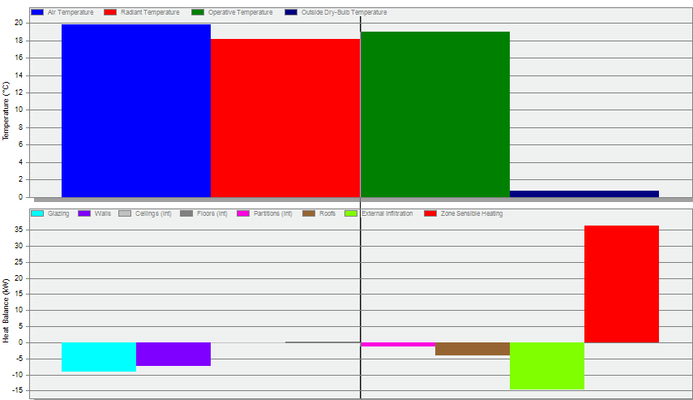
Thermal Analysis
Temperature and heat loss charts

Slide 21
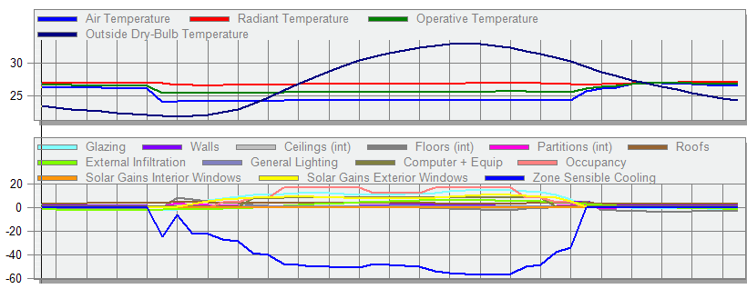
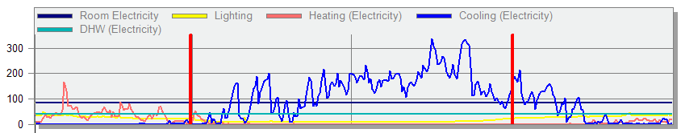
Thermal Analysis
Temperature and
heat gain charts
Energy consumption chart

Slide 22
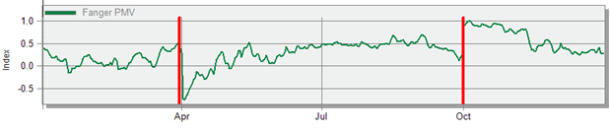
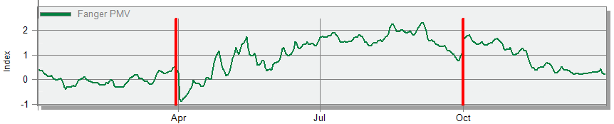
Thermal Comfort
Fanger PMV chart with mixed mode system
Fanger PMV values with mixed mode system
Fanger PMV chart without HVAC system
Fanger PMV values without HVAC system

Slide 23

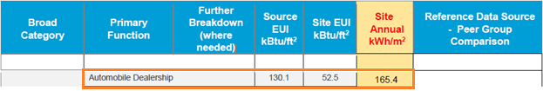
Thermal Analysis
HVAC system performance
Benchmark Intensity = 165.4 kWh/m²
Our Building Energy Intensity = 89.9 kWh/m²
Reduction = 46%
That’s mean our building is very energy efficient building
Site and Source Energy
Benchmark Intensity energy consumption per total building area

Slide 24
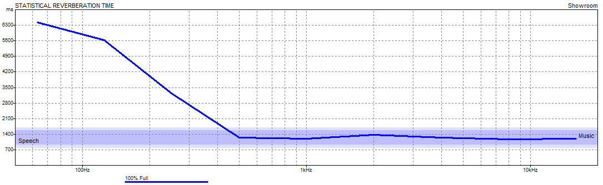
Acoustical Analysis
Recommended RT60 Rating For Showrooms 1 - 1.4 s
FREQ. | TOTAL ABSPT. | SABINE RT(60)
63Hz: | 59.784 | 6.35
125Hz: | 67.166 | 5.57
250Hz: | 119.063 | 3.19
500Hz: | 316.783 | 1.25
1kHz: | 328.265 | 1.2
2kHz: | 278.65 | 1.37
4kHz: | 299.528 | 1.24
8kHz: | 280.096 | 1.18
16kHz: | 267.249 | 1.21

Slide 25
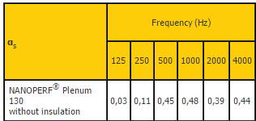
Acoustical Analysis
To get these results we used “NANOPERF Plenum 130” false ceiling without insulation which is a product of BARRISOL Company

Slide 26
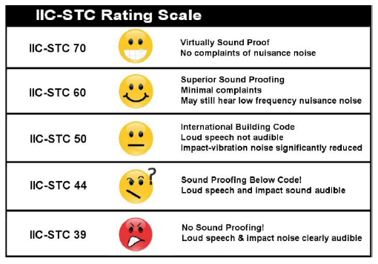
Acoustical Analysis
Sound Transmission Class (STC) & Impact Insulation Class (IIC)
STC For Internal Walls = 51 dB
STC For External Walls = 53 dB
STC For Ribbed Slab = 60 dB
IIC For Ribbed Slab = 67 dB

Slide 27
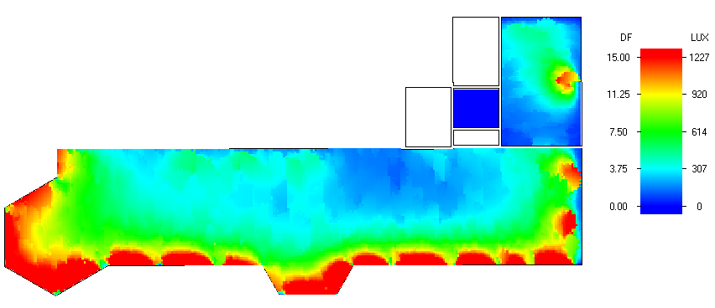
Daylight Factor (DF%)
Block | Zone | Floor Area (m2) | Floor Area above Threshold (m2) | Floor Area above Threshold (%) | Average Daylight Factor (%) | Minimum Daylight Factor (%) | Maximum Daylight Factor (%) | Uniformity ratio (Min / Avg)
Showroom | First Floor | 664.674 | 664.251 | 99.94 | 3.7 | 0.207 | 35.15 | 0.056
Accessories | First Floor | 100.101 | 91.166 | 91.07 | 3.82 | 0.5 | 15.1 | 0.13
DF% In First Floor Showroom

Slide 28
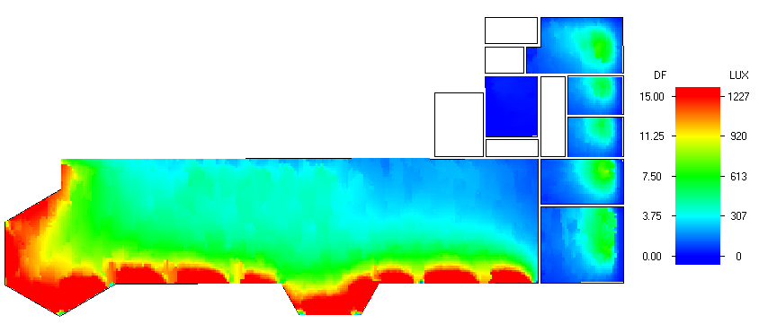
Daylight Factor (DF%)
Block | Zone | Floor Area (m2) | Average Daylight Factor (%) | Minimum Daylight Factor (%) | Maximum Daylight Factor (%) | Uniformity ratio (Min / Avg) | Uniformity ratio (Min / Max)
Showroom | Second Floor | 574.504 | 3.8 | 0.24 | 35.77 | 0.063 | 0.0067
Office 3 |  | 18.291 | 2.84 | 0.24 | 7.1 | 0.08 | 0.03
Secretary |  | 31.47 | 3.11 | 0.33 | 9.66 | 0.1 | 0.03
Office 1 |  | 26.555 | 0.17 | 0.02 | 0.5 | 0.11 | 0.04
Office 2 |  | 18.245 | 2.9 | 0.24 | 7.19 | 0.08 | 0.03
Kitchen |  | 41.896 | 3.02 | 0.32 | 8.3 | 0.11 | 0.04
Manager Office |  | 52.86 | 3.02 | 0.24 | 8.26 | 0.08 | 0.03
DF% In Second Floor
Showroom

Slide 29
Daylight Factor (DF%)
LEED V3 NC 2009 IEQ 8.1 Test
Summary Results, average values for 9:00 and 15:00
Total area (m2) | 781.670
Total area above threshold (m2) | 749.571
% Area within illuminance threshold limits | 95.9
LEED v3 NC 2009 IEQ 8.1 Status | PASS
LEED v3 test summary results for first floor
Summary Results, average values for 9:00 and 15:00
Total area (m2) | 763.821
Total area above threshold (m2) | 669.874
% Area within illuminance threshold limits | 87.7
LEED v3 NC 2009 IEQ 8.1 Status | PASS
LEED v3 test summary results for second floor

Slide 30
Structural Design

Slide 31
Structural Design
The project consists of two block separated by 3.5 cm structural joint.

Slide 32
Design Codes
ACI -318-09 for reinforced concrete structural design.
UBC -97 for earthquake load computations.
ASCE for load computations.
The analysis and design were done using Etabs program

Slide 33
Block A Design
Design Data:
Concrete F`c For slab, Beams, Columns, Shear walls and Footing = 28 MPa
Reinforcement steel
The yield strength of steel Fy= 420MPa.
Bearing Capacity For Soil 350 kN/m².

Slide 34
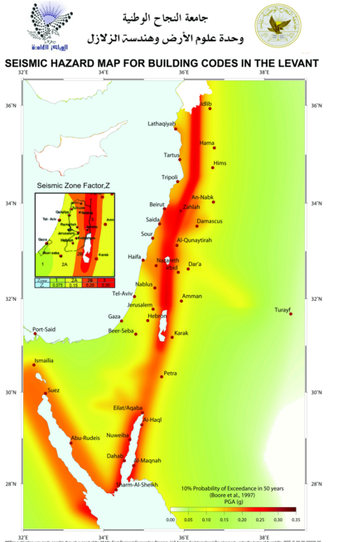
Seismic Design Data
- Soil Type Sc
Location:
Nablus → Zone: 2B
→ Z = 0.2
Cv = 0.32
Ca =0.24
I =1
R = 5.5
In order to reach 90 % of mass participation we
need 30 modes for UX and 19 mods for UY

Slide 35
Loads Used for Concrete blocks
Loads
Load type | Basement slab | First floor slab | second floor slab
Live | 5 KN/m² | 5 KN/m² | 1 KN/m²
SID | 4 KN/m² | 4 KN/m² | 3 KN/m²
Snow | 0 | 0 | 2 KN/m²

Slide 36
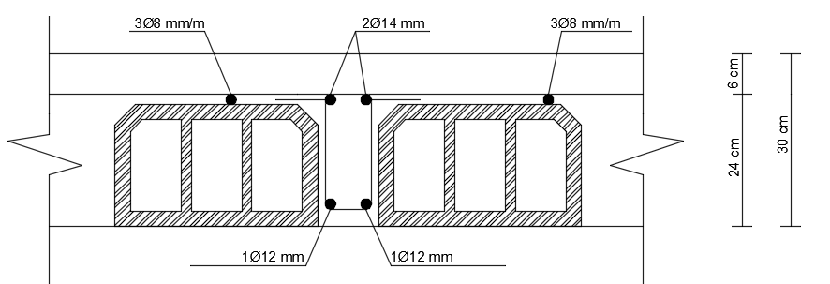
Structural Design For Block A
Structural Design
Slabs
Structural system: One way ribbed slab with drop beams.
Thickness = 30 cm .

Slide 37
Structural Design
Beams
Main beam 90*50
Secondary beam 50*30
Edge beam 30*30
Columns
Two types of column diminutions were used
Column 80x80
Column 70x40

Slide 38
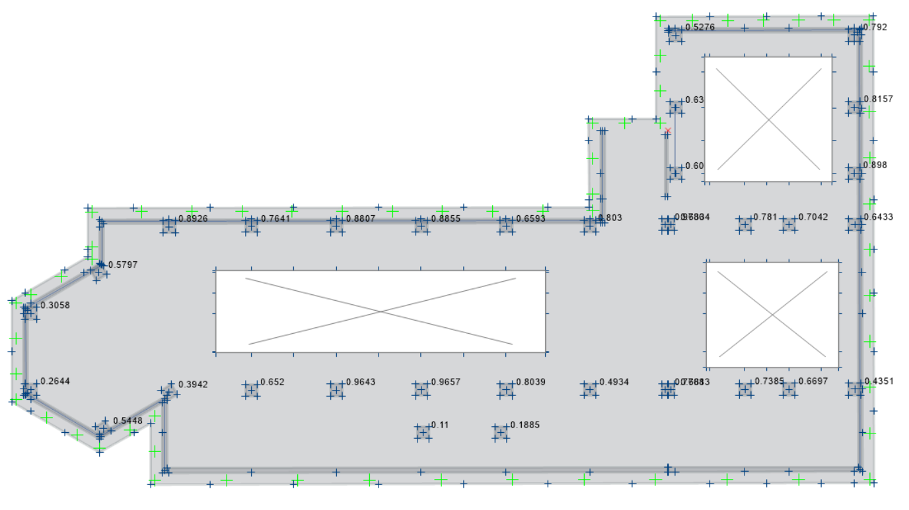
Foundation Design for the buildings
Footing Design
Using Safe 2014 program we designed MAT foundation for the building
The thickness of the mat will be 950 mm, because the
distance between columns is large.
Check of punching shear is ok.

Slide 39
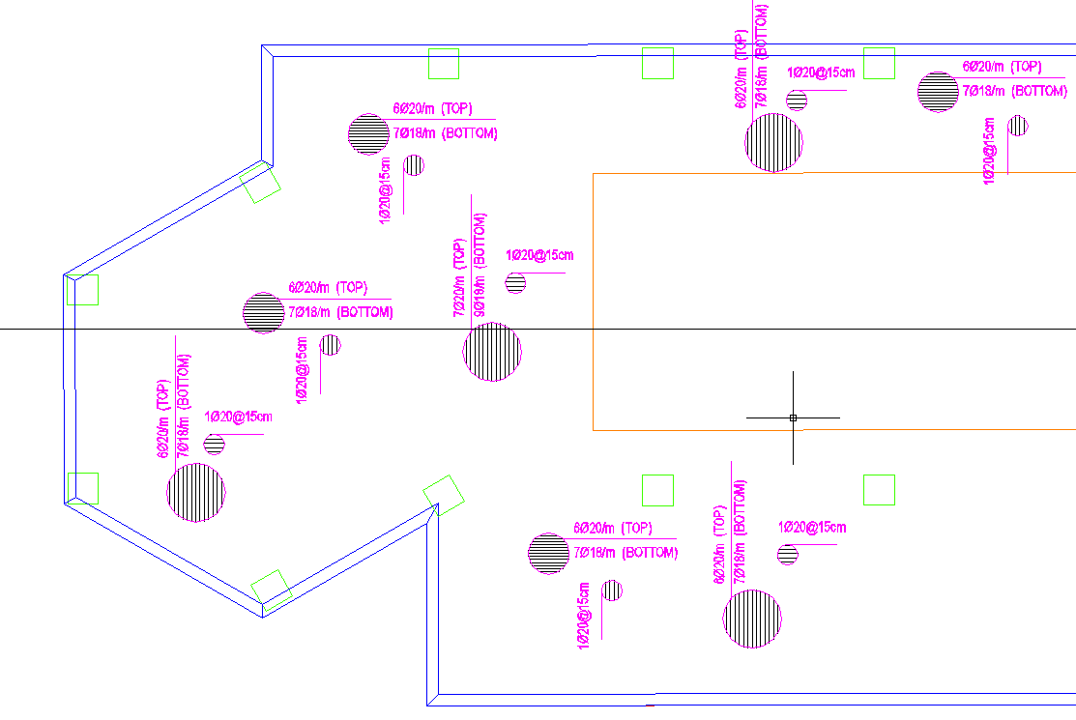
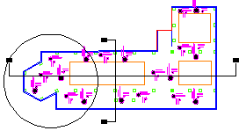
Footing Design
Footing Reinforcement

Slide 40
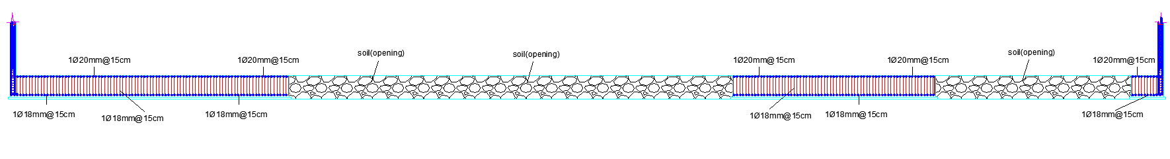
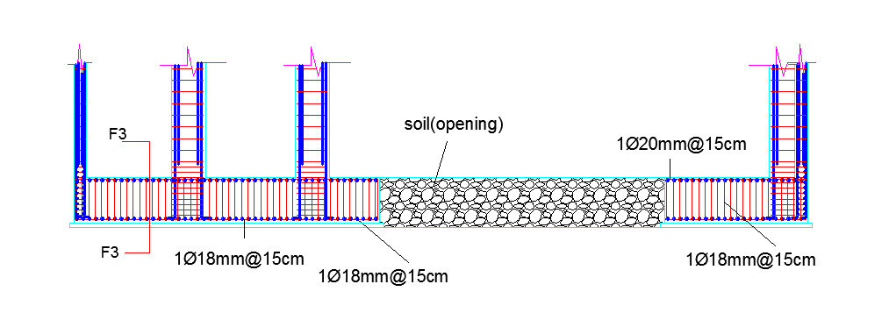
Footing Design
Sections in footing

Slide 41
Structural Design
3D Modeling for Block A

Slide 42
Structural Design Checks
Compatibility Check
Max deflection in the model = 14.5 mm
Max allowable deflection in slab = L / 240
Max allowable deflection = 5.8 / 240 = 24 mm

Slide 43
Equilibrium Check
Structural Design Checks
Loads | ETABS- Results | Manual Results
Dead Load | 22430KN | 21436 KN
Live load | 7916.9KN | 7910.84 KN
SID load | 6662.3KN | 6662.26 KN
Error = ( ( Manual – ETABS Load ) / Manual Load ) X 100%

Slide 44
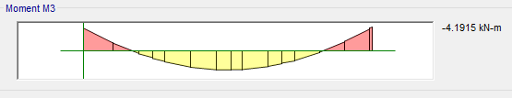

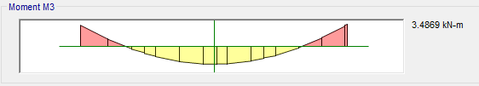
Structural Design Checks
Internal Forces Check
From Etab M = (M1+M2)/2 + M3
(4.2+4.4)/2+3.5 = 7.8
By hand M = W L² / 8 = 3 * 5 ² / 8 = 9.375 ……………ok

Slide 45
Structural Design Checks
Base shear (V) for seismic design
Manual calculation for ( V ) = 4267 KN.
From Etabs :

Slide 46
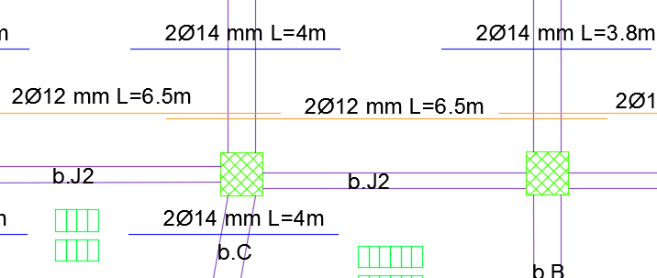
Design Stage
Structural Design
Ribbed Slab Reinforcements in X – Direction For Block A:

Slide 47
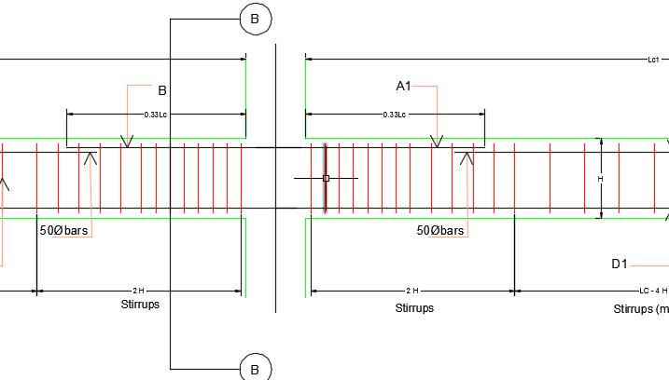
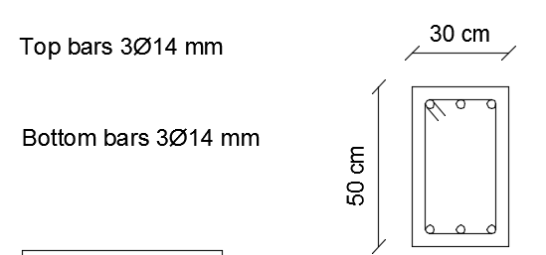
Structural Design
Beams Reinforcements

Slide 48
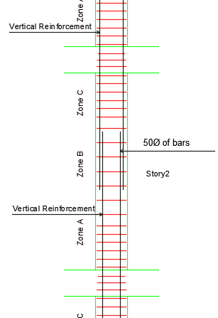
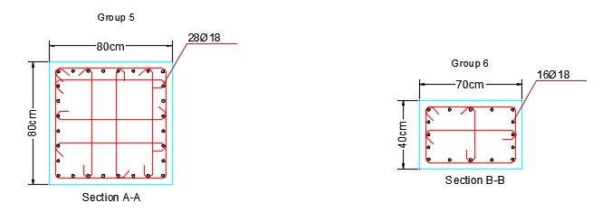
Structural Design
Columns Reinforcements

Slide 49
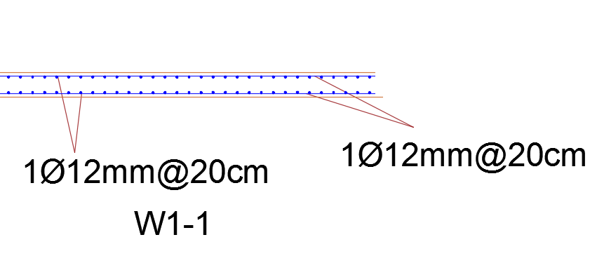
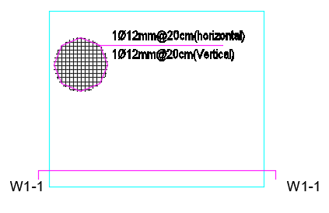
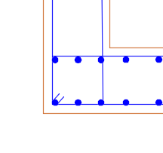
Structural Design
Shear walls Reinforcements

Slide 50
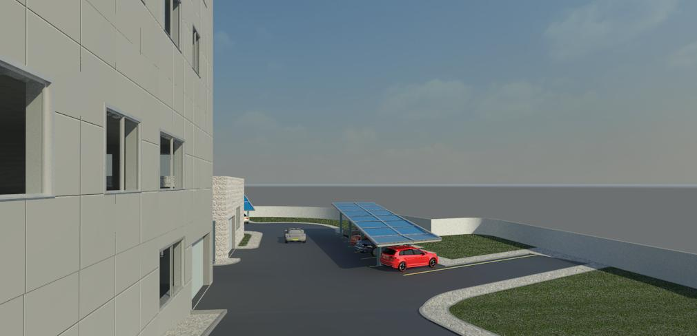
Mechanical Design

Slide 51
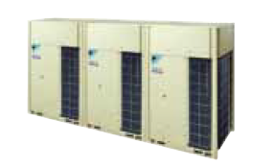
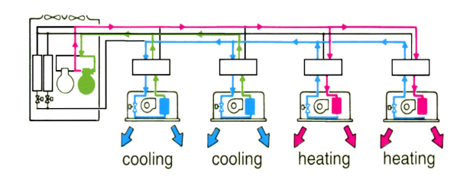
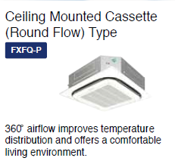
Mechanical Design
HVAC System (VRF)
Outdoor unit : Daikin Company model REYQ30THY1 (E)
Indoor unit : Daikin Company model FXFQ25PVE

Slide 52

Selection of indoor units
Block | Zone | Design Capacity (kW) | # of indoor units
First Floor | Showroom | 34.11 | 13
 | Accessories | 5.11 | 2
 | Security Office | 0.89 | 1
Second Floor | Showroom | 33.52 | 12
 | Office3 | 1.33 | 1
 | Secretary | 2.08 | 1
 | Office1 | 1.74 | 1
 | Office2 | 1.43 | 1
 | Manager Office | 3.11 | 2
 | Total | 83.32 | 34
The number of needed units according to our selection is 34 unit for the whole building

Slide 53
Selection of indoor units
MODEL |  | REYQ30THY1(E)
Power supply |  | 3-phase 4-wire system, 380–415 V, 50 Hz
Cooling capacity KW | kcal/h | 72,200
 | Btu/h | 286,000
 | kW | 83.9
Heating capacity KW | kcal/h | 80,800
 | Btu/h | 321,000
 | kW | 94
Power consumption | Cooling (kW) | 20.9
 | Heating (kW) | 22.2
MODEL |  | FXFQ25PVE
Power supply |  | 1-phase, 220-240 V/220 V, 50/60 Hz
Cooling capacity KW | kcal/h | 2,400
 | Btu/h | 9,600
 | kW | 2.8
Heating capacity KW | kcal/h | 2,800
 | Btu/h | 10,900
 | kW | 3.2
Power consumption | Cooling | 0.033
 | Heating | 0.027
Outdoor unit specifications
Indoor unit specifications

Slide 54


Indoor Units Distribution
Indoor units distribution in first floor
Indoor units distribution in second floor

Slide 55


Water Supply System
Tank Sizes
Our main storage tank is located underground
with capacity of 84 m³ which supplies two
small roof tank for both blocks
3 m³ water roof tank for showrooms building
7 m³ water roof tank for maintenance building
Daily Consumption
For Showroom Building: 0.5 m³/day
For Maintenance Building: 3.5 m³/day

Slide 56

Drainage System
Fixture | # of DFU's | Line Diameter
WC | 4 | 4"
Lavatory | 1 | 2"
Kitchen sink | 2 | 2"
Shower | 2 | 2"
Septic tank is used to collect sewer, then we pump waste to the main sewerage network

Slide 57

Drainage System
Vertical Distance = 6 m
Horizontal Distance = 31 m
According to our calculations we need a Submersible pump with minimum power = 8 HP

Slide 58



Mechanical Design
Drainage system for second floor
HVAC drain pipe distribution
Drainage system for maintenance building

Slide 59

Mechanical Design
For storm water, we designed a water tank to collect storm water with volume = 75 m³.
Then we used this storm water for cars washing after filtering.

Slide 60

Electrical Design

Slide 61

Artificial Lighting Design
Results of Dialux simulation
Function | Target Lux(Avg) | Recom. Lux | # of Luminaires | Uniformity (Uo) | Reflection Factor % |  |  | Total Load (KW) | Light power density (W/m²)
 |  |  |  |  | Ceiling | Wall | Floor
Showroom (F.F) | 530 | 500 | 159 | 0.64 | 70 | 84.4 | 20 | 6.46 | 11.74
Showroom (S.F) | 545 | 500 | 143 | 0.68 | 70 | 84.4 | 20 | 5.82 | 11.76
Entrance | 634 | 500 | 9 | 0.71 | 70 | 84.4 | 20 | 0.38 | 18.86
Accessories | 670 | 500 | 25 | 0.77 | 70 | 84.4 | 20 | 1.45 | 18.13
Manager office | 392 | 300 | 6 | 0.71 | 70 | 84.4 | 20 | 0.32 | 8.33
Secretary office | 366 | 300 | 4 | 0.71 | 70 | 84.4 | 20 | 0.21 | 9.91
Maintenance | 435 | 300 | 37 | 0.52 | 42.9 | 57.3 | 42.9 | 6.58 | 22.38
Painting room | 1094 | 1000 | 12 | 0.75 | 42.9 | 57.3 | 42.9 | 1.35 | 30.54
Cars Storage | 339 | 300 | 44 | 0.3 | 70 | 57.3 | 57.3 | 7.83 | 8.28

Slide 62







Artificial Lighting Design
Artificial lighting for first floor showroom

Slide 63





Artificial Lighting Design
Artificial lighting for Second floor showroom
Artificial lighting for Entrance

Slide 64




Artificial Lighting Design
Artificial lighting for Accessories showroom

Slide 65



Artificial Lighting Design
Artificial lighting for Manager office

Slide 66



Electrical Design
Artificial lighting for Painting booth

Slide 67


Sound Reinforcement System
JBL Control 16C/T loudspeaker
Function | # of speakers
First floor showroom | 17
Second floor showroom | 15
Accessories showroom | 3
Total | 35
Distribution of loudspeakers in the showroom- first floor

Slide 68


Electricity Calculations
Sockets distribution in the second floor showroom
Lighting distribution in first floor showroom

Slide 69

Electricity Calculations
Zone | Lighting C.B | Sockets C.B | HVAC C.B | Total C.B for each zone
First Floor: Showroom | 14 | 3 | 6 | 23
Accessories Showroom | 2 | 1 | 1 | 4
Security Office | 1 | 1 | 1 | 3
Second Floor: Showroom | 12 | 2 | 5 | 19
Manager Office | 2 | 1 | 1 | 4
Secretary Office | 1 | 1 | 1 | 3
Office 1 | 1 | 1 | 1 | 3
Office 2 | 1 | 1 | 1 | 3
Office 3 | 1 | 1 | 1 | 3
Kitchen | 1 | 1 | 0 | 2
Total | 36 | 13 | 18 | 67
Electrical control panel system

Slide 70

Photovoltaic Panels (PV)
In order to obtain effective energy efficient building, we used the PV to reduce energy consumption
We installed PV panels on three areas.

Slide 71


Photovoltaic Panels (PV)
Our Building Energy Consumption
So by using PV’s we can reduce 54 % of consumed energy
Produced Energy by using PV panels

Slide 72

Safety Design

Slide 73



Safety Design
Separating the entrance and exit of the project so as to prevent accidents
We designed an emergency exit
In maintenance building Entrances and exits are designed opposite

Slide 74

Fire Alarm Systems
      Fire alarm system - smoke detectors design
Distribution of smoke detectors in second floor
Function | Area m² | # of Detectors
First Floor Showroom | 620 | 32
Second Floor showroom | 550 | 26
Accessories Showroom | 101 | 6
Manager Office | 52.5 | 2
Secretary Office | 33.5 | 2
Office 1 | 18.5 | 1
Office 2 | 18.5 | 1
Office 3 | 28.5 | 2
Total | - | 72
Number of smoke detectors in the building

Slide 75

Firefighting Systems
      Firefighting system - sprinklers design
First floor showroom sprinklers distribution
Function | Area m² | # of sprinklers
First Floor Showroom | 620 | 63
Second Floor showroom | 550 | 51
Accessories Showroom | 101 | 9
Total | - | 123
Number of sprinklers in the building

Slide 76


Firefighting Systems
Distribution of fire extinguishers in second floor
We used dry powder extinguishers

Slide 77

Quantity Survey &
Cost Estimate

Slide 78
Quantity Survey & Cost Estimate
Work | Quantity | Unit | Unit Cost | Cost (nis)
Excavation | 859 | m³ | 50 | 42,950.0
Filling | 2056 | m³ | 15 | 30,840.0
Reinf. Concrete work | 2664.52 | m³ | 1000 | 2,664,520.0
Stone | 2057.2 | m² | 250 | 514,300.0
Plastering | 3646.3 | m² | 25 | 91,157.5
Painting | 3646.3 | m² | 25 | 91,157.5
Gypsum Board Walls | 2516.9 | m² | 100 | 251,690.0
Gypsum Board Ceiling | 429.9 | m² | 100 | 42,990.0
Alucobond | 576.7 | m² | 150 | 86,505.0
Curtain wall | 522.28 | m² | 750 | 391,710.0
Windows | 266.1 | m² | 500 | 133,050.0
False Ceiling | 1677.2 | m² | 150 | 251,580.0
Tiling | 1677.2 | m² | 100 | 167,720.0
Sliding Doors | 8 | - | 7500 | 60,000.0
Timber Doors | 37 | - | 1500 | 55,500.0
Metal Gates | 20 | - | 5500 | 110,000.0
PV Panels | 47110 | w | 7.5 | 353325
HVAC units | 34 | - | 6000 | 204000
Elevator | 1 | - | 66000 | 66000
Cars Elevator | 1 | - | 220000 | 220000
Total | - | - | - | 5,608,995.0
Total Project Cost = 5,608,995 Nis
Total Cost per m² = 1430 Nis/m²

Slide 79

Thank You

