Slide 1

An-Najah National University
Faculty Of Engineering
Civil Engineering Department
Wastewater Collection and Treatment Plant
For some villages of the south and southeast of Nablus
Prepared By :
Nahawand A. Ismail
Majd M. Hamayel
Bara’a A. Sweedan
Supervision of:
        Eng. Hamees Tubeileh

Slide 2
Outline:
Objectives of the project.
Significance of the work.
Methodology.
Study area.
Data Collection
Modeling (Sewer Network and WWTP)

Slide 3
Objectives
Study the flow direction of south and south-east villages of Nablus to connect it with a near wastewater plant
Design the main sewer network.
Design wastewater treatment plant in the best location

Slide 4
Significance of the work
In the villages of south and southeast of Nablus, there is no public sewage network, and the population is now disposing of sewage according to the old system or method using septic tanks or cesspits.
The current method of disposal of sewage is unhealthy and polluting the environment, this requires finding suitable solutions for safe disposal of wastewater in order to provide a better life for the population.

Slide 5
Methodology
Study the flow direction
Select study area
Select suitable location of WWTP
Design the sewer network
Design Flow of each village
Collect data
Design WWTP

Slide 6
Study Area
Our study area is south and southeast villages of Nablus that can’t be connected with Nablus Eastern Plant due to high cost, topography and political constrains.

Slide 7
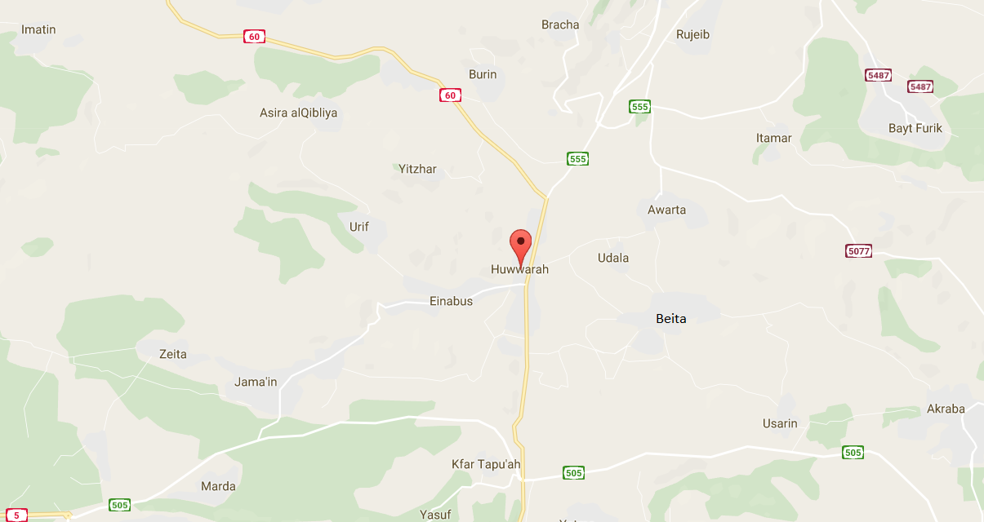

Slide 8
Data Collection
Communities
Land Boundaries
Built Up Area
Contour Maps
Arial Photo
Roads
Parcels Maps -available ones
Water supply and Consumption
Population of villages

Slide 9
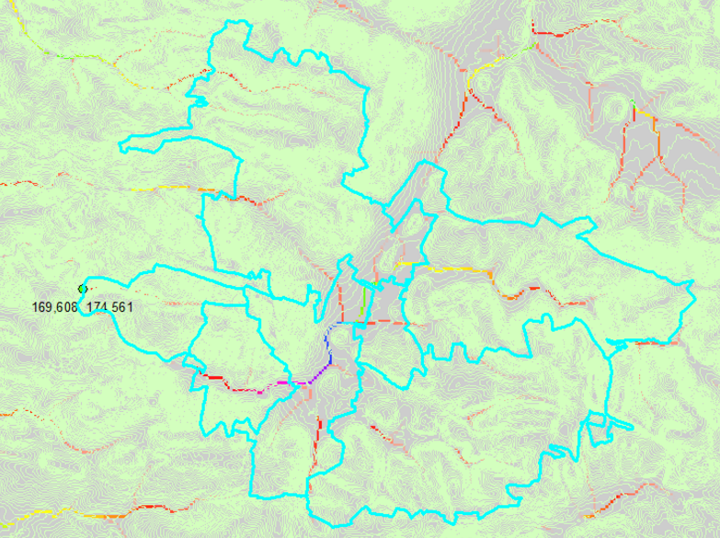
Study the Flow Direction
Using ArcHydro
From the direction of natural flow, we have identified the villages that flow into the same valley

Slide 10
Selecting Study Area
Beita
Burin
25%
Za’tara
Einabus
Urif
Awarta
Huwwara
Odala

Slide 11
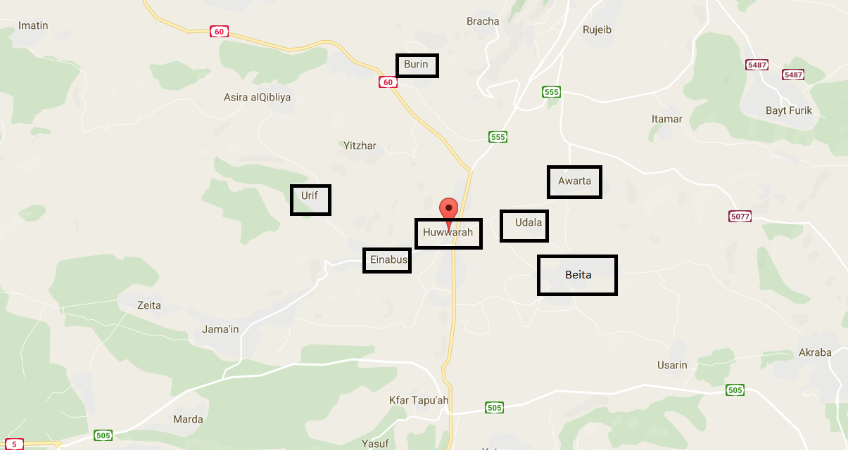

Slide 12
Selecting Suitable Location of WWTP
Criteria for the plant site selection:
Topography
Located near the served zones
Access to the existing roads
Presence of housing
Geotechnical stability of the site

Slide 13
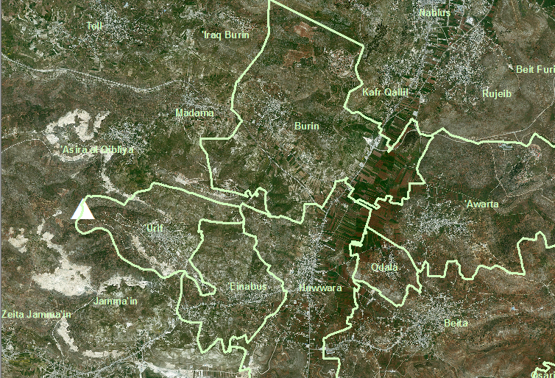
Suggested Location
The best location to establish WWTP is located Southwest of the village of Urif.
Positives of that location:
1. The station will serve seven neighboring villages.
2. The town of Jamma'in can benefit from this station .
3. 400 m far away from the populated areas.
4. There is no space for expansion in the residential areas .
5. Its an area with 50 dunums space and can be extended to 95 dunums.
6. There are no villages located below or near the valley

Slide 14
Collect Data
Water Supply
source | Existing of water network | Community Name
West Bank Water Department | exist (1996) | Beita
Nablus Municipality | exist (2014) | Awarta
West Bank Water Department | exist (1987) | Huwwara
West Bank Water Department | exist (1985) | Odala
West Bank Water Department | exist (1989) | Einabus
West Bank Water Department | exist (2015) | Urif
Nablus Municipality | exist (2010) | Burin

Slide 15
Collect Data
Future Population
We take Design period as 30 years from now
Population (2047) | Population (2016) | Community Name
18029 | 11017 | Beita
11167 | 6824 | Awarta
11054 | 6759 | Huwwara
2253 | 1377 | Odala
4668 | 2840 | Einabus
5802 | 3545 | Urif
4586 | 2808 | Burin

Slide 16
Design Flow
We need the following information:
Future population
Water consumption per capita per day
% of produced wastewater from consumed water: 80%
% of infiltration: 20%
Peak hourly factor

Slide 17
Design Flow
Design Flow of each Village as follow
Design Flow (m³/day) | Infiltration (m³/day) | Qavg (m³/day) | water consumption Lw/c.d | PHF | Population in 2037 | Community Name
5538.5 | 346.2 | 1730.8 | 120 | 3 | 18029 | Beita
3430.5 | 214.4 | 1072.0 | 120 | 3 | 11167 | Awarta
3395.8 | 212.2 | 1061.2 | 120 | 3 | 11054 | Huwwara
908.4 | 43.3 | 216.3 | 120 | 4 | 2253 | Odala
1874.1 | 89.2 | 446.2 | 120 | 4 | 4648 | Einabus
2339.4 | 111.4 | 557.0 | 120 | 4 | 5802 | Urif
1849.1 | 88.1 | 440.3 | 120 | 4 | 4586 | Burin
19335.7 | 1104.7 | 5523.7 |  |  | 57539 | Sum

Slide 18
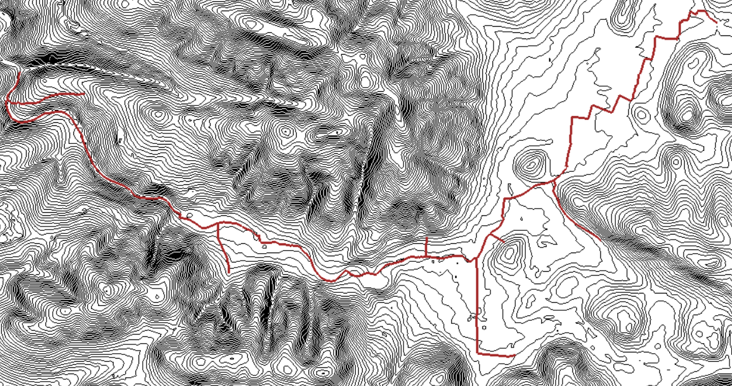
MODELING
1. Design the Sewer Network using SewerCAD

Slide 19
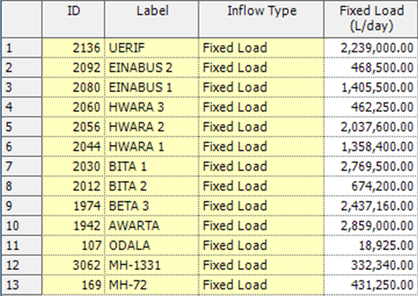
Enter the inputs
Enter the load as a fixed load at each manhole at the outfall of each town .
Design the conduits choosing PVC conduits and circular shape , exclude pipes with 4,6 and 18 in diameter.

Slide 20
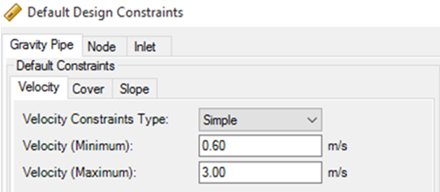
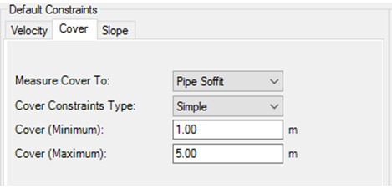
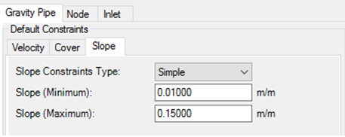
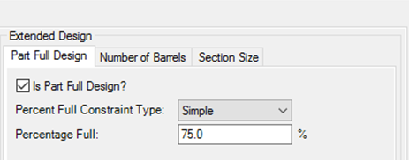
Enter the design constrains

Slide 21
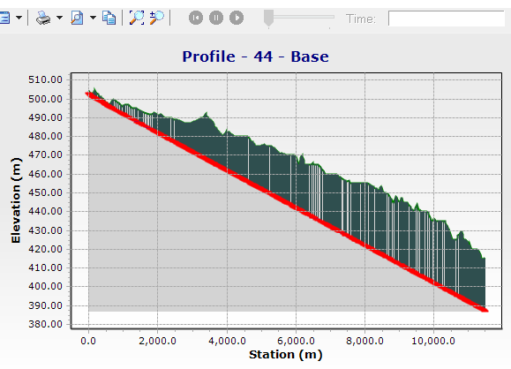
Run the model and get the results
Soo many errors shined !!!!!!!!!!!
555 manholes of 740 have a cover of 6 to 36 m

Slide 22
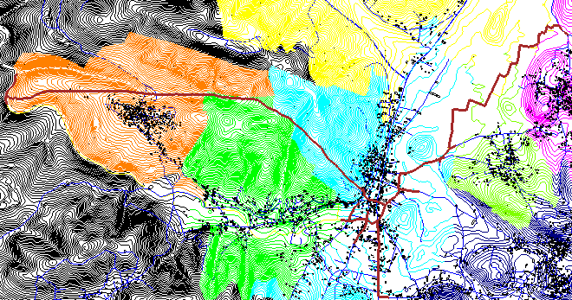
Rebuild the model

Slide 23
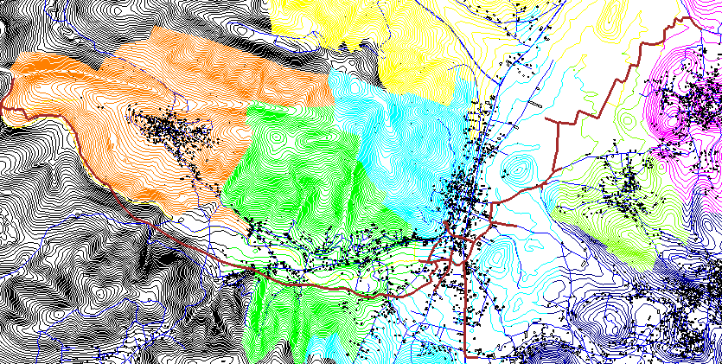
Rebuild the model

Slide 24
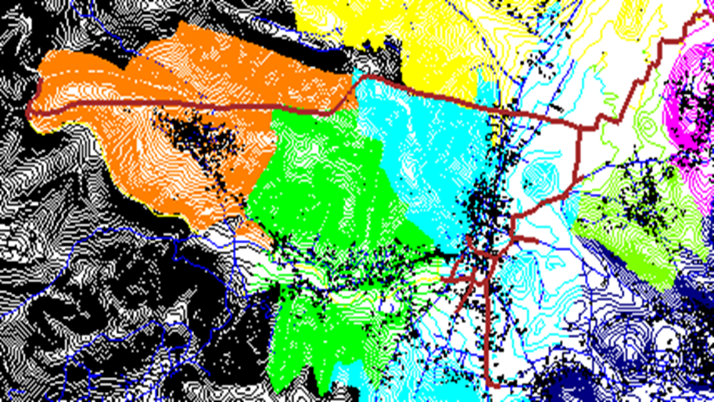
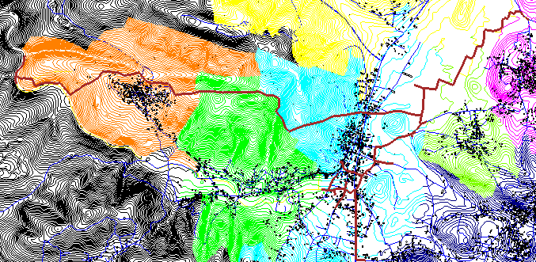
We tried so many layouts but the cover depth unfortunately keep to arise and arise and arise..

Slide 25
Choose the best system and redesign
Pump station and vacuum valve.
Small diameters.
Low slopes .
Costly.
Small diameters system
Very small diameters.
Septic tanks
Low slopes.
Costly.
Presser and vacuum system
Conventional system
By gravity.
Large diameters.
High slopes and large excavation.
Less cost.
Conventional system is less Expensive , Expandable , Adaptable
And simple .
According to the Authority of water’s code , use conventional system with low slopes and automatic screw screen .

Slide 26
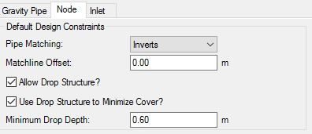
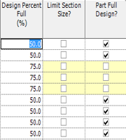
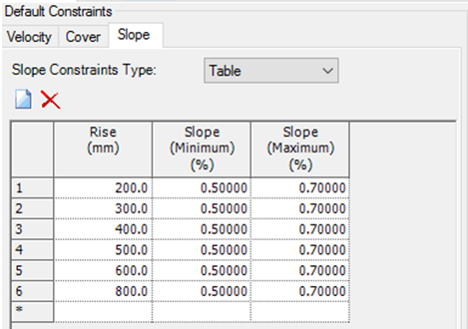
New model with new constrains !

Slide 27
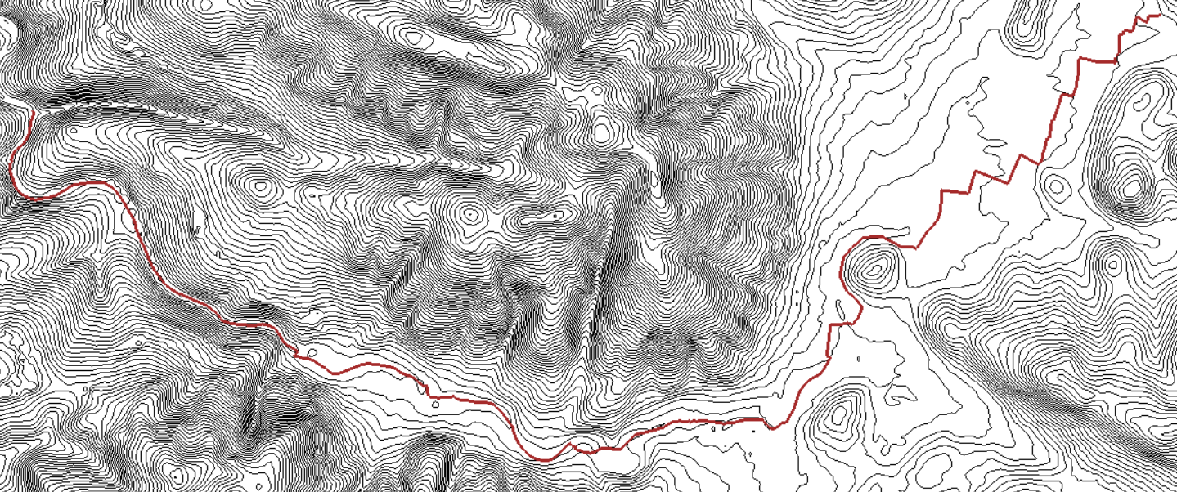
Our new model has 973 manholes and 973 conduits have diameters ranges from 8 in to 24 in.

Slide 28
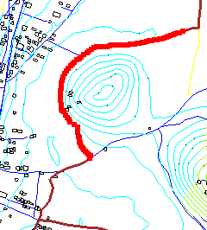
Results
The total flow in outfall = 17,493,625.39 (L/d) and the ground elevation 415.01 m.
also the distance between manholes doesn’t exceed 30m and not less than 3 m.
The flow of manholes differs between 462,250.01 (L/d) such as MH (524) and 17,493,625.39 (L/d) such as MH (1042).

Slide 29
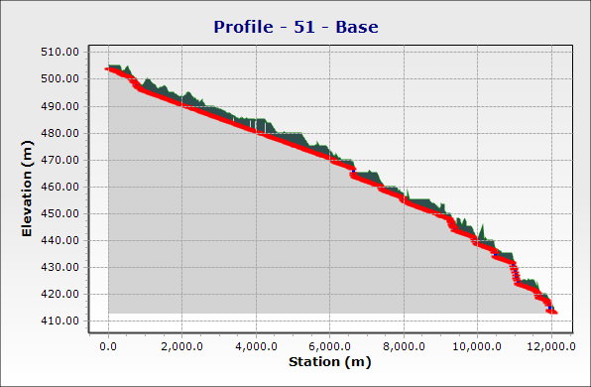
The whole network profile

Slide 30
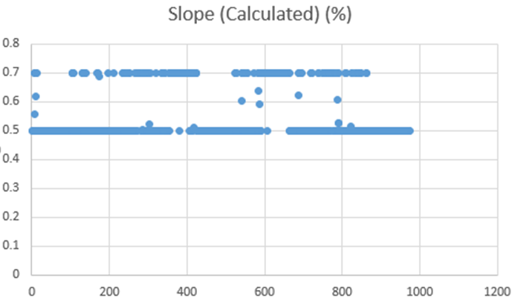
Conduit’s slope

Slide 31
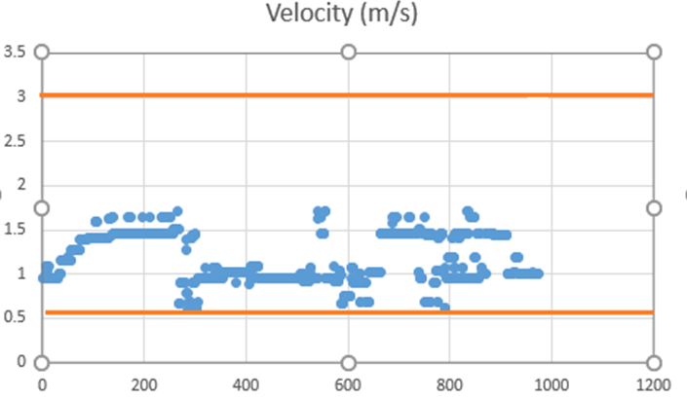
Conduit’s velocity

Slide 32
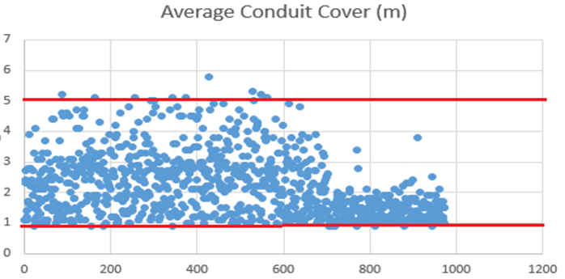
Conduit’s cover
(.9 % from the manholes have a values of 5.1 m and 5.8 m)

Slide 33
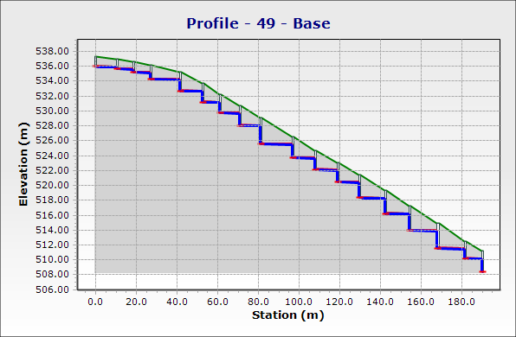
Line with drop manholes

Slide 34
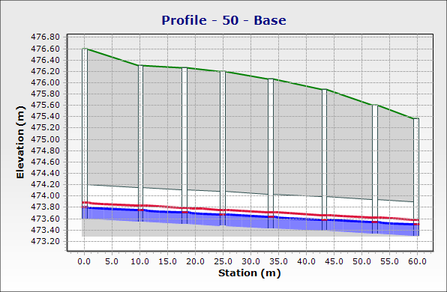
Line without drop manholes

Slide 35
2. Wastewater Treatment Plant Design
Introduction
    Wastewater treatment is a process used to convert wastewater – which is water no longer needed or suitable for its most recent use – into an effluent that can be either returned to the water cycle with minimal environmental issues or reused. During the treatment process, pollutants are removed or broken down.

Slide 36
Modeling
Checking
Simulation
To develop a model of WWTP required according to the concentrations in the study area.
To find out the effect of different pollution loads on the performance of WWTP.
To check if the process of WWTP can produce effluent that meets the Palestinian Guidelines for wastewater reuse.

Slide 37

Modeling
GPS-X is the most advanced tool available for the mathematical modeling, simulation, optimization and management of wastewater treatment plants.

Slide 38
Modeling
Treatment Process Required
parameter | unit | Exp. value | Standard value | Comment Need or not treatment | Treatment process
N as NH4 | mg/L | 90 | 15 | Need | Aeration
T.S.S | mg/L | 470 | 90 | Need | Coagulation & flocculation,
BOD₅ | mg O₂/L | 490 | 60 | Need | Biodegradation
COD | mg O₂/L | 900 | 150 | Need | Biodegradation
TKN | mg/L | 105 | 60 | Need | Plug Flow Reactor
P as PO₄⁻³ | mg/L | 18 | 30 | No need | -

Slide 39
Modeling
Design Flow
Future Population in 2047 = 57539
Average Daily Flow Rate (Qavg) = population in future * 120 * 0.8
Qavg = 5523.744 m³/day
Maximum Daily Factor = 1.8 (1.5 – 1.8)
Design Flow = Qavg * PDF + %Infiltration * Qavg
= 11000 m³/d

Slide 40
Preliminary Treatment :
To remove the material that may cause damage to the plant such as debris and grease.. etc.
Primary Treatment :
To remove settleable, floatable solids and organic mater form the Wastewater
Secondary Treatment:
To remove dissolve solids, colloidal solids and BOD by biological process.

Slide 41
Entering Data
Unit’s dimensions
The connectivity between process.
Calibration
Based on the treatment plant lab Results.
Simulation
Plant Designer Data case.
Pollution Loads.
Normal operation case
Influent characteristics.
Operational condition.

Slide 42
Par shall flume design
W (m) | A (m) | B (m) | C (m) | D (m) | E (m) | F (m) | G (mm) | N (mm) | X (mm)
0.23 | 0.88 | 0.86 | 0.38 | 0.57 | 0.3 | 0.46 | 76 | 114 | 51

Slide 43
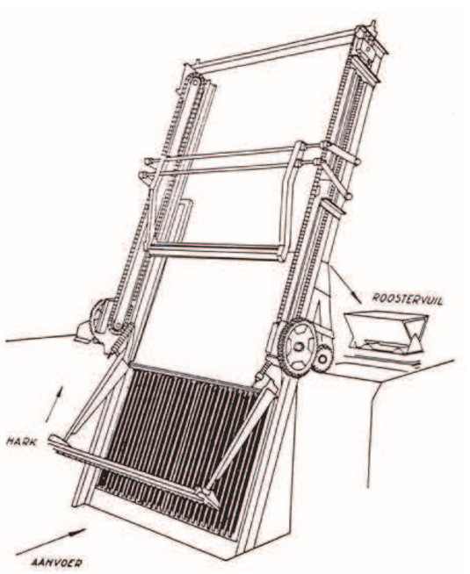
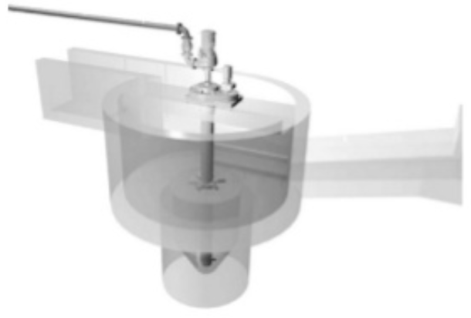
1. Preliminary Treatment
Preliminary treatment typically serves 3 important functions:
    1. Removal of untreatable solid materials
    2. Protection of subsequent treatment units
    3. Improvement of the performance of subsequent treatment units

Slide 44
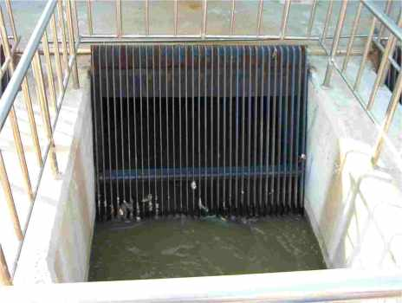
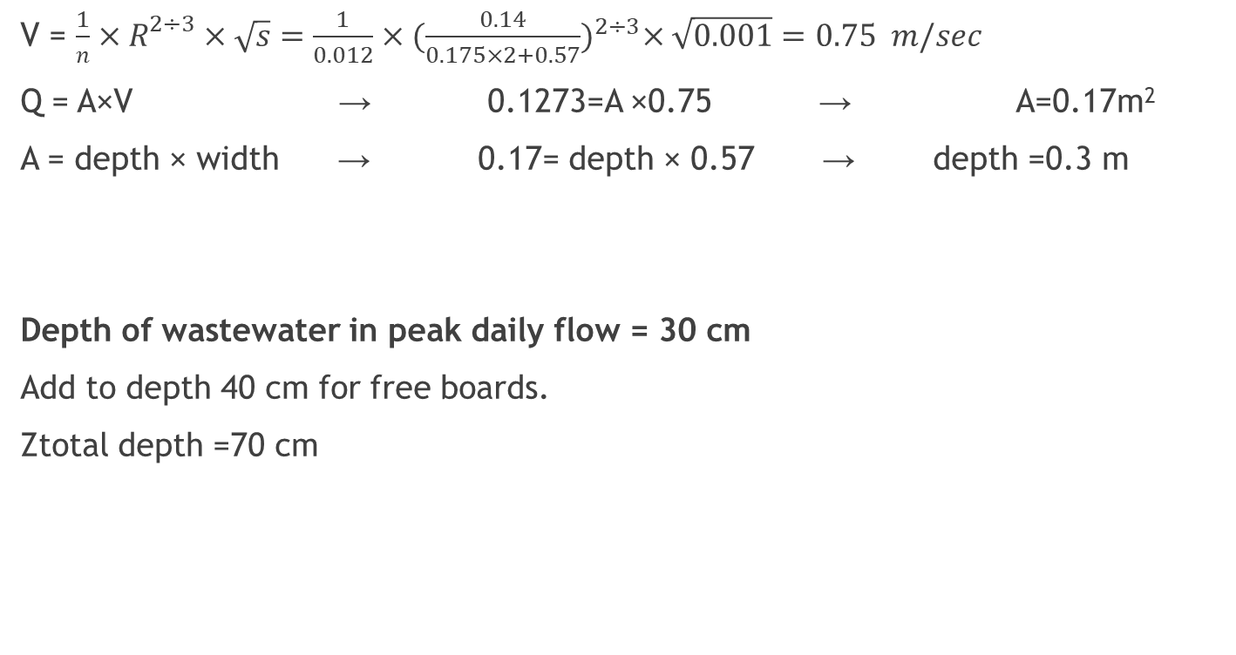
Bar Racks Design
V = $\frac{1}{n}×R^{2÷3}×\sqrt{s}=\frac{1}{0.012}×{(\frac{0.14}{0.175×2+0.57})}^{2÷3}×\sqrt{0.001}=0.75 m/sec$
Q = A×V → 0.1273=A ×0.75 → A=0.17m²
A = depth × width → 0.17= depth × 0.57 → depth =0.3 m
Depth of wastewater in peak daily flow = 30 cm
Add to depth 40 cm for free boards.
Ztotal depth =70 cm

Slide 45
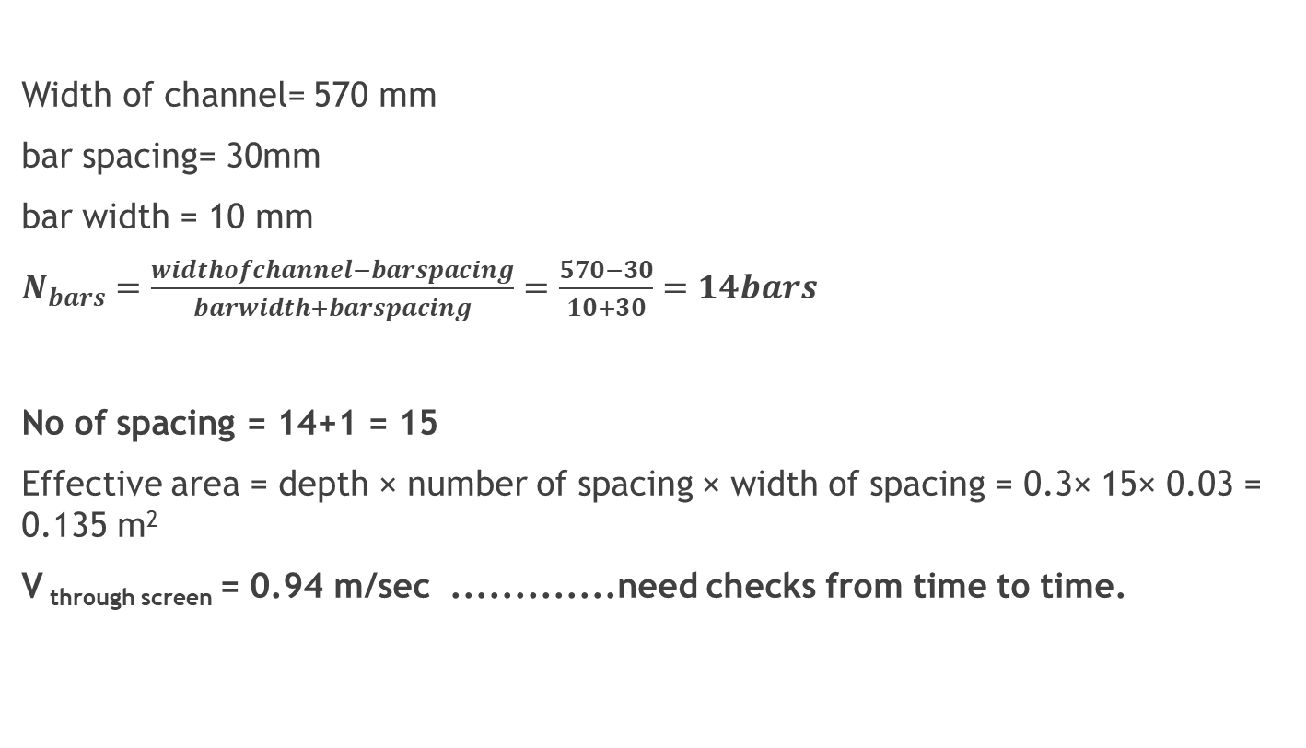
Coarse Screen Design
Width of channel= 570 mm
bar spacing= 30mm
bar width = 10 mm
$N_{bars}=\frac{widthofchannel−barspacing}{barwidth+barspacing}=\frac{570−30}{10+30}=14bars$
No of spacing = 14+1 = 15
Effective area = depth × number of spacing × width of spacing = 0.3× 15× 0.03 = 0.135 m²
V _{through screen} = 0.94 m/sec .............need checks from time to time.

Slide 46
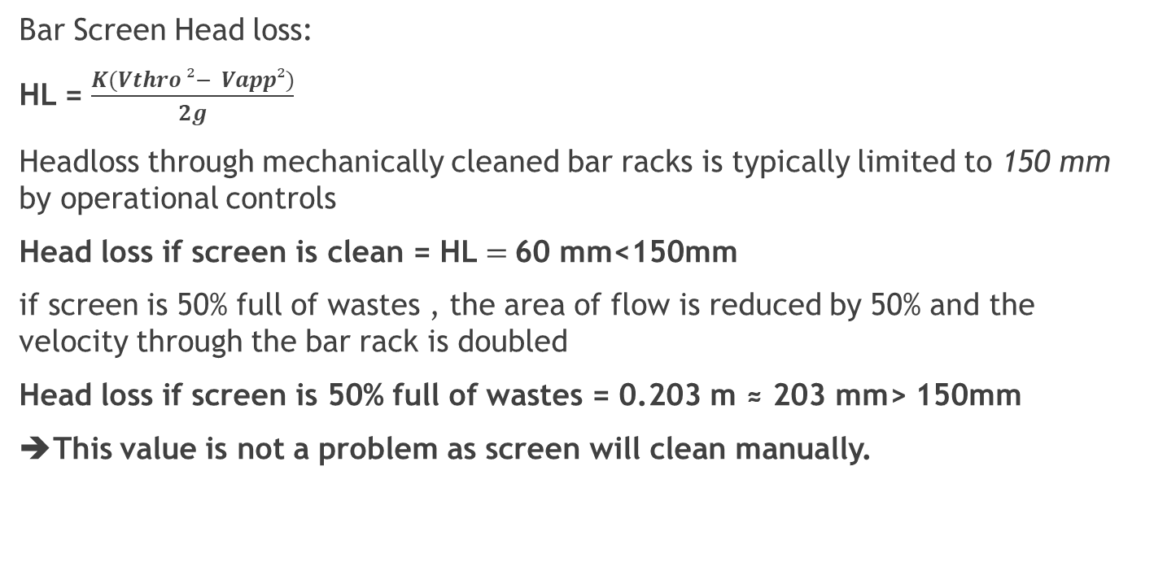
Coarse Screen Design
Bar Screen Head loss:
HL = $\frac{K(Vthro ²− Vapp²)}{2g}$
Headloss through mechanically cleaned bar racks is typically limited to 150 mm by operational controls
Head loss if screen is clean = HL $=$60 mm<150mm
if screen is 50% full of wastes , the area of flow is reduced by 50% and the velocity through the bar rack is doubled
Head loss if screen is 50% full of wastes = 0.203 m ≈ 203 mm> 150mm
➔This value is not a problem as screen will clean manually.

Slide 47
Grit Chamber Design
Objectives:
• To extend the lifespan of the mechanical components, especially pumps.
• To prevent sand and grit from getting into the pipelines and machinery, this can cause blockages.
• To avoid depositing a sand package at the bottom of the digestion tank, the presence of which would minimize the effective volume and hence the efﬁciency of the tank.

Slide 48
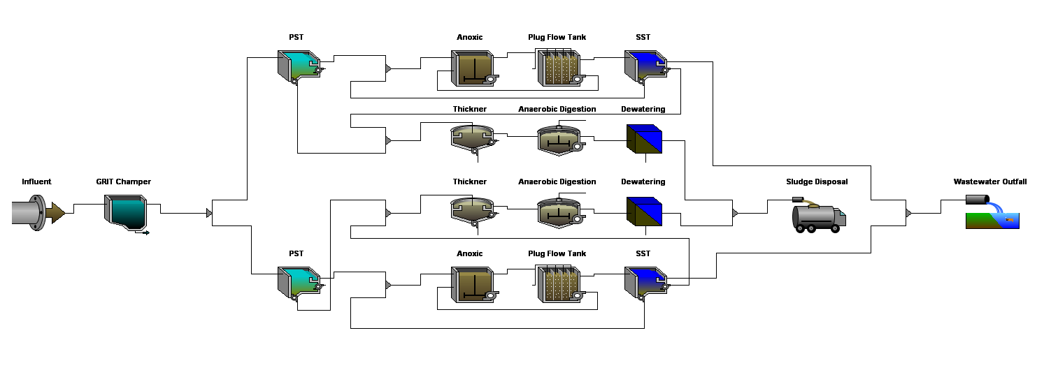

Slide 49
Calibration the model based on the lab data
Influent Composition
cod | total COD | gCOD/m3 | 900
tkn | total TKN | gN/m3 | 105
snh | free and ionized ammonia | gN/m3 | 90
Influent Fractions
icv | XCOD/VSS ratio | gCOD/gVSS | 1.8
fbod | BOD5/BODultimate ratio | - | 0.6
ivt | VSS/TSS ratio | gVSS/gTSS | 0.85
Organic Fractions
frsi | soluble inert fraction of total COD | - | 0.001
frss | readily biodegradable fraction of total COD | - | 0.18
frxi | particulate inert fraction of total COD | - | 0.001
Volatile Fraction
ivt | VSS/TSS ratio | gVSS/gTSS | 0.85
Composite Variables
x | total suspended solids | g/m3 | 481.76
vss | volatile suspended solids | g/m3 | 409.5
xiss | total inorganic suspended solids | g/m3 | 72.26
bod | total carbonaceous BOD5 | gO2/m3 | 538.92
cod | total COD | gCOD/m3 | 900
tkn | total TKN | gN/m3 | 105
Organic Variables
si | soluble inert organic material | gCOD/m3 | 0.9
ss | readily biodegradable substrate | gCOD/m3 | 162
xi | particulate inert organic material | gCOD/m3 | 0.9
xs | slowly biodegradable substrate | gCOD/m3 | 736.2

Slide 50
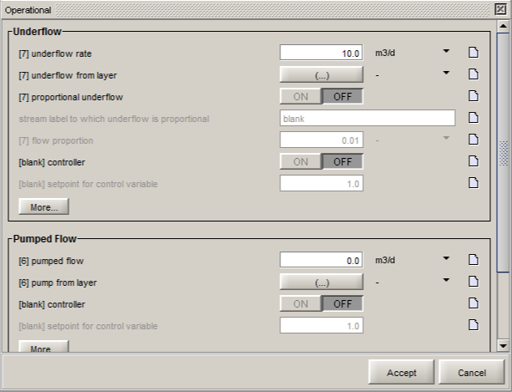
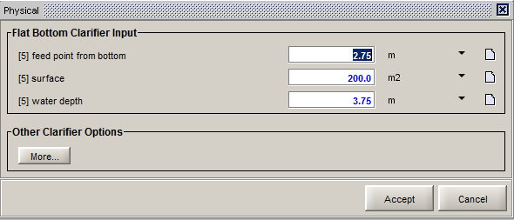
2. Primary Treatment

Slide 51
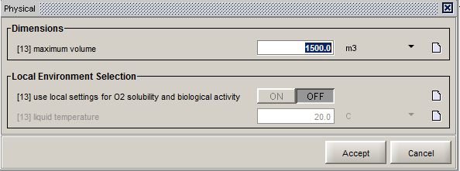
3. Secondary Treatment – Anoxic Tank

Slide 52
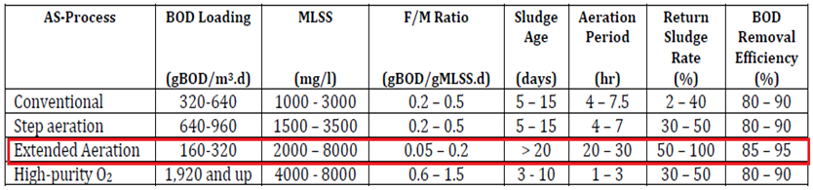
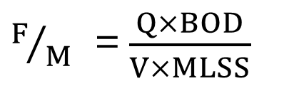
3. Secondary Treatment – Aeration Tank
$F/M$ =$\frac{Q×BOD}{V×MLSS}$

Slide 53
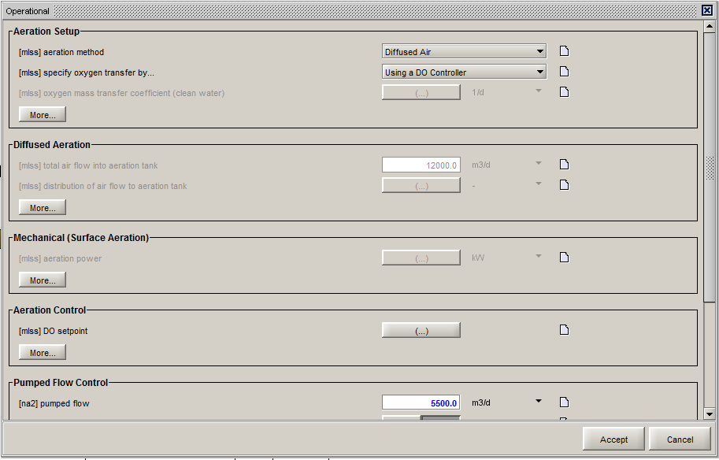
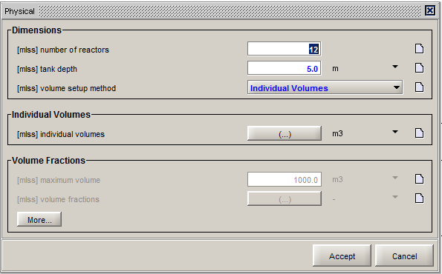
3. Secondary Treatment – Aeration Tank

Slide 54
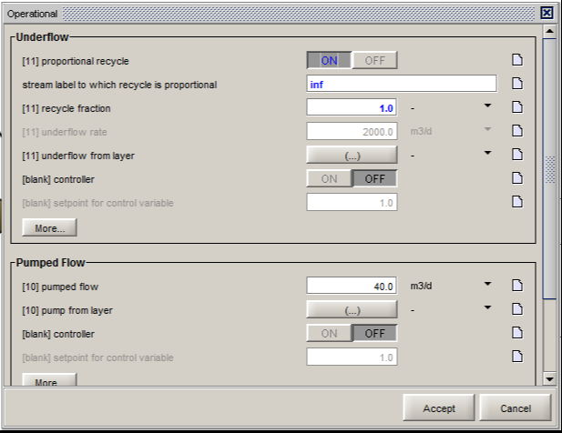
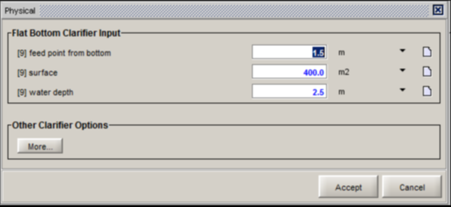
3. Secondary Treatment - SST

Slide 55
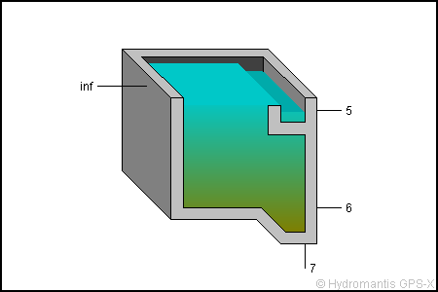
Simulation Results-PST
 |  | In | Out
Flow | m3/d | 5500 | 5490
TSS | mg/L | 481.76 | 378.15
VSS | mg/L | 409.5 | 321.43
cBOD5 | mg/L | 538.92 | 443.92
COD | mg/L | 900 | 741.47
TKN | mgN/L | 105 | 103.92
HRT | h | - | 3.27

Slide 56
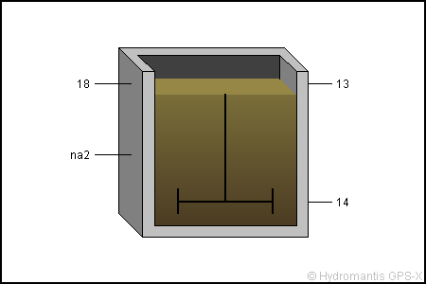
Simulation Results-Anoxic Tank
 |  | Simulation Results
 |  | In | Internal | Out
MLSS | mg/L | 7105.69 | 7092.55 | 7092.55
Soluble COD | mg/L | 85.95 | 13.09 | 13.09
Ammonia N | mgN/L | 53.55 | 40.49 | 40.49
Nitrite/Nitrate N | mgN/L | 12.22 | 1.38 | 1.38
Alkalinity | mgCaCO3/L | 175.49 | 167.28 | 167.28
HRT | h | - | 1.45 | -
 |  | Mass Flows
 |  | 18 | na2 | 13
TSS | kg/d | 78091.63 | 38437.76 | 116956.17
COD | kg/d | 72274.33 | 34512.49 | 106074.7
TN | kg/d | 5436.36 | 2574.89 | 7764.7375
 | Operational Variables
 |  | Out
F to M Ratio | kgBOD5/(kgMLVSS.d) | 2.97

Slide 57
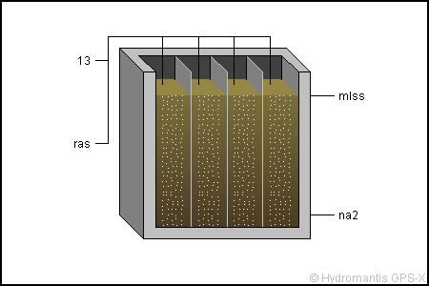
Simulation Results-Aeration Tank
 |  | Simulation Results
 |  | 13 | mlss(1)
MLSS | mg/L | 7092.55 | 7081.68
Soluble COD | mg/L | 13.09 | 4
Ammonia N | mgN/L | 40.49 | 32.59
Nitrite/Nitrate N | mgN/L | 1.38 | 7.42
Alkalinity | mgCaCO3/L | 167.28 | 117.48
HRT | h | - | 1.95

Slide 58
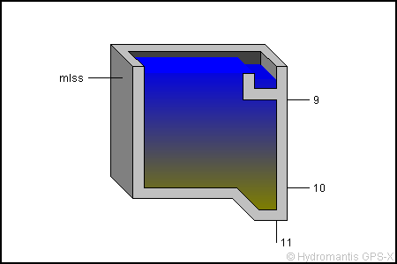
Simulation Results-SST
 | Simulation Results
 |  | In | Out
Flow | m3/d | 10990 | 5450
TSS | mg/L | 6988.6844 | 43.527852
VSS | mg/L | 4233.6798 | 26.368766
cBOD5 | mg/L | 965.92559 | 11.428845
COD | mg/L | 6274.9986 | 48.178294
TKN | mgN/L | 443.73872 | 20.330304
TN | mgN/L | 468.16362 | 44.755197
HRT | h | - | 2.18

Slide 59
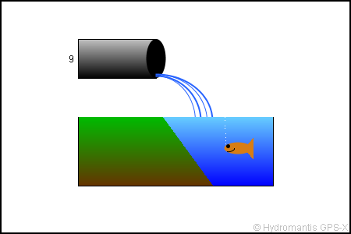
Simulation Results-Outfall
 | Simulation Results
 |  | Out
Flow | m3/d | 5450
TSS | mg/L | 41.145491
VSS | mg/L | 24.890117
cBOD5 | mg/L | 11.010545
COD | mg/L | 46.009014
Ammonia N | mgN/L | 9.573801
Nitrite/Nitrate N | mgN/L | 24.425399
TKN | mgN/L | 20.18208
TN | mgN/L | 44.607478
Alkalinity | mgCaCO3/L | 1.3071328

Slide 60
Results
Physical and chemical properties (mg/l) | Simulation Results(mg/l) | Palestinian standard (mg/l) |  |  |  | Meet standard or not?
 |  | A | B | C | D
TSS | 41.145 | 30 | 30 | 50 | 90 | Yes
BOD | 11.015 | 20 | 20 | 40 | 60 | Yes
COD | 46.01 | 50 | 50 | 100 | 150 | Yes
Ammonia N | 9.57 | 5 | 5 | 10 | 15 | Yes
Nitrate N | 24.42 | 20 | 20 | 30 | 40 | Yes
TN | 44.6 | 30 | 30 | 45 | 60 | Yes

Slide 61
Results

Slide 62
Results

Slide 63
Conclusion
After studying the topography of east and southeast of Nablus Governorate, seven villages were selected to be connected in a Trunk sewer line starts from Awarta passing through Huwwara and ends at the wastewater treatment plant in Urif with a peak hourly flow 19000 m³/day, the following have been conclude:
The final model has 974 manholes and 974 conduits.
The length of pipes didn’t exceed 30 meters and more than 3 meters.
The material of conduits is circular PVC with diameters 8, 10, 12, 15 and 24 inches.

Slide 64
Conclusion
The location of WWTP near the outlet of Urif away 400 meters from the buildup areas with a peak daily flow reaches 11000 m³/day, the following have been conclude:
Two units were used because the flow is huge and two units kept in reserve.
The Treatment process used is Activated Sludge; this is the most common method in Palestine as the concentrations are very high due to water scarcity.
The concentrations at the outfall satisfy the Palestinian Standards (TR34-2012) under type C – Medium Quality.

Slide 65
Recommendations
1- Achieving such a project needs technical workers with high skills and accuracy.
2- Put Automatic Screw Screens at the outfall of each village in order to remove large particles.
3- To get a better quality in wastewater treatment plant, we can exceed the maximum used parameters as hydraulic retention time (HRT).
4- Conduct further studies to find out the required budget for such projects.

Slide 66


