Slide 1

An- Najah National University
Rehabilitation of qalqiliaya Electrical Network by adding a new connection point
Submitted To :
Dr. Maher Khammash
Prepared By :
Ammar Eid .
Mahmoud farraj .
2016-2017

Slide 2
Introduction
The project aims to study the performance of Qalqiliya Electrical network and to add a new connection point in the south region of the city of Qalqiliya with a maximum capacity of 7MW from the electrical Israel Company
Analyzing and make a load flow study using ETAP software and trying to achieve the optimum performance for Network .
Compare the two conditions (with a new connection point and without connection point

Slide 3
Objectives
Collecting data for the new connection point including all parameters and their specifications ( location, transmission lines , …load ).
Designing the one line diagram in ETAP program for new condition by adding the new connection point .
Improving the voltage level and reducing the losses and correcting of power factor in the network .
Making the system more protected by increasing reliability and stability .
Analyzing the network under maximum load condition using load flow analyses.
To get economical benefit when improving the performance of network.

Slide 4
Why new connection point ?
The main problem which faces Qalqilya Network is that the power supplied by IEC (الشركة القطرية الاسرائيلية ) ) is not enough for the demand in the city, especially in the summer season . And because the old connection point has a capacity up to 13 MW which is not sufficient for the network .
To solve this problem , we add a new connection point with IEC in the south region of the city of Qalqilya through an over head transmission line of 22 kV. The max demand is reached approximately to (7 MW) to cover the total demand .

Slide 5
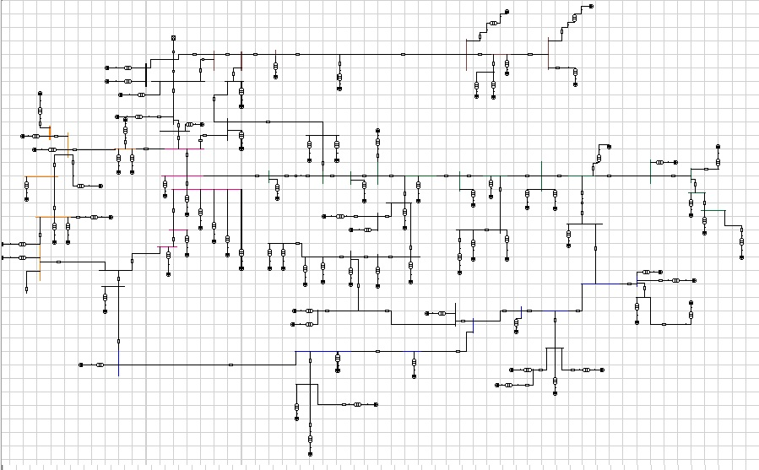
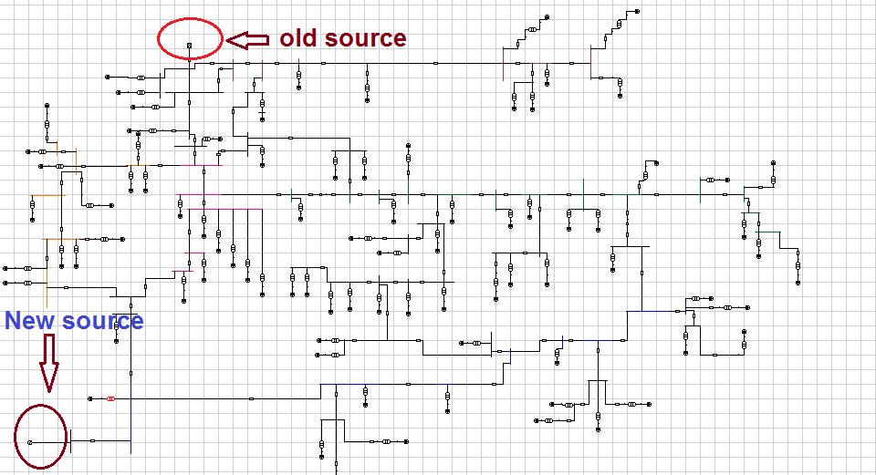
south Region Network
Before & After

Slide 6
Methodology
Collecting data for new C.P and elements
Plotting one line diagram for new network
Improve p.f to avoid penalties
Making Economical study for our project
Analyzing the network under max. load case

Slide 7
Plotting one-line diagram using ETAP software for new Network
We make a load flow study and analysis Network using ETAP software .
Components of the network :
Two sources (22 kV) .
(201 ) bus in this network .
(87) loads( residential, industrial, commercial).
( 85 ) Distribution transformers .

Slide 8
The results of load flow in original case
Operating Voltage(kV) | Rated Voltage(kV) | Bus
21.4 | 22 | Bus1
21.381 | 22 | Bus2
0.383 | 0.4 | Bus11
0.386 | 0.4 | Bus16
0.385 | 0.4 | Bus30
0.382 | 0.4 | Bus89
0.384 | 0.4 | Bus96
0.384 | 0.4 | Bus110
0.385 | 0.4 | Bus111
0.386 | 0.4 | Bus113
0.38 | 0.4 | Bus114

Slide 9
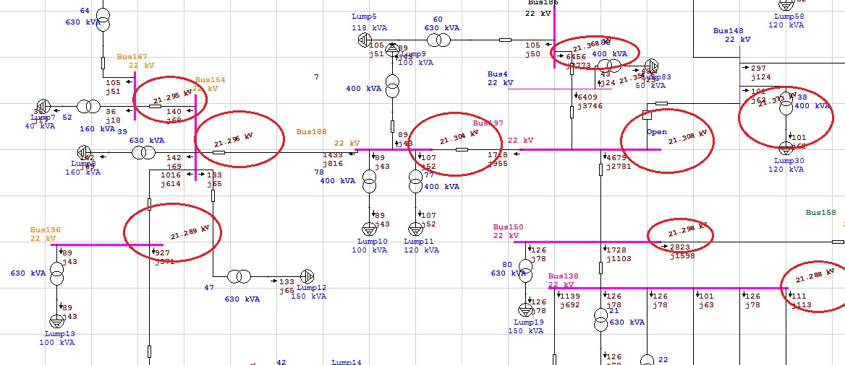
Some of voltage buses :

Slide 10
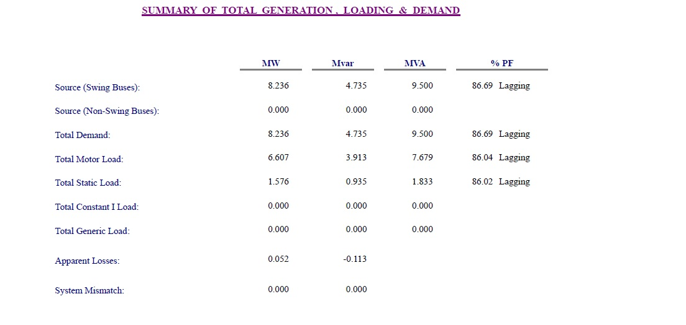
Summary of results in original case
From the above results , there are many problems in the network .The P.F of the swing bus = 86.69 Lagging , which causes high penalties and losses . So, we try to increase the power factor of the busses and the voltage of the buses which is not included in the acceptable range .

Slide 11
Maximum load case
The voltage should be within this range :
1.05 V nominal < V < 1.1 V nominal
In first stage of the analysis of the network we have to take the maximum load in daily load curve ,then applied it on ETAB .
We started the study of this case after we applied the data needed Like load factor and other data.

Slide 12
Load factor
We have the average value of loads by using the load factor of each load which we got from the real data of
The average demand load factor in our network is 75% that means the average load to the maximum load ratio is 75% which considered as a very good operating load factor .

Slide 13
Our goal is to improve the voltages within the range by using the following steps :
Tab changing in the transformers.
Adding capacitors to produce reactive power.
Add another connection point .
The tap changer of the secondary side tap change in all distribution transformers by 5% .

Slide 14
maximum load case
Voltage with change tap changer (kV) | Voltage without change tap changer (kV) | Bus
21.4 | 21.4 | Bus1
21.386 | 21386 | Bus2
0.383 | 0.383 | Bus11
0.402 | 0.401 | Bus16
0.390 | 0383 | Bus30
0.389 | 038 | Bus89
0.372 | 0370 | Bus96
0.4 | 0380 | Bus110
0.38 | 0379 | Bus111
0.405 | 0386 | Bus113
0.372 | 038 | Bus114
0.390 | 038 | Bus115

Slide 15
Summary of results in maximum load case
%PF | MVar | MW | MAX CASE(Voltage without change tap changer )
86.15lag | 10.056 | 17.059 | Source (swing bus)
- | 0.135 | 0.238 | Apparent losses
For more improvement we add capacitor banks at the low voltage level and this is a temporary solution but we need a major solution to cover the total demand in the city. So , we choose to add a new connection point .

Slide 16
Add a new connection point
Comparing the voltages before and after adding the new connection point.
Voltage with two connection point (kV) | Voltage with one connection point (kV) | Bus
21.4 | 21.4 | Bus1
21.392 | 21.381 | Bus2
0.391 | 0.383 | Bus11
0.390 | 0.386 | Bus16
0.390 | 0.385 | Bus30
0.388 | 0.382 | Bus89
0.388 | 0.384 | Bus96
0.388 | 0.384 | Bus110
0.395 | 0385 | Bus111
0.390 | 0386 | Bus113
0.395 | 038 | Bus114

Slide 17
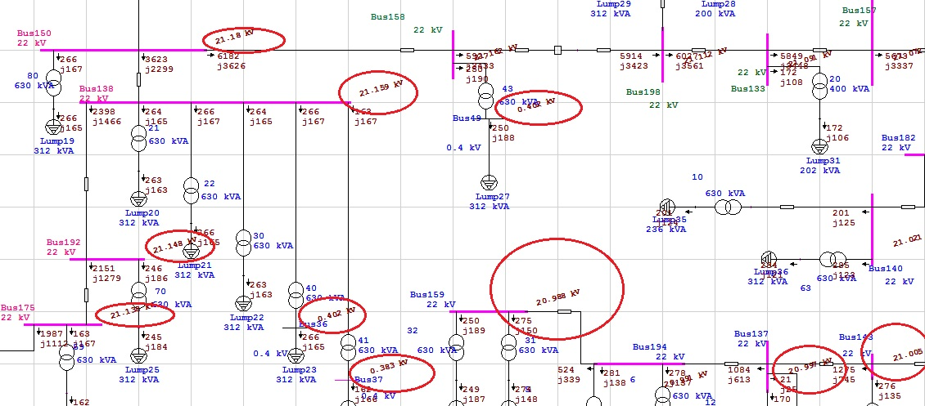
Some of under voltage buses :

Slide 18
Summary of results for new network
%PF | MVAR | MW
93.44 | 2.983 | 10.034 | Source (swing bus)
70.54 | 7.034 | 7.00 | SOURCE(NEW)
- | - | 0.162 | Apparent losses
The P.F of the NEW bus = 70.54 lag , which is low and causes a lot of penalties on both the company and consumers. So, we have to try to increase the power factor of the busses .

Slide 19
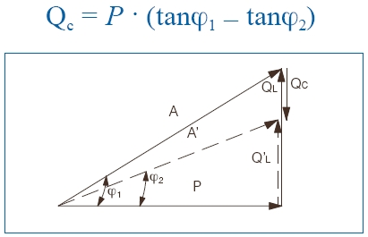
Power Factor Improvement
It is important to keep the P.F above 0.92 on the distribution transformer so as to minimize the electrical losses and do not paying penalties.
How to improve the P.F ??

Slide 20
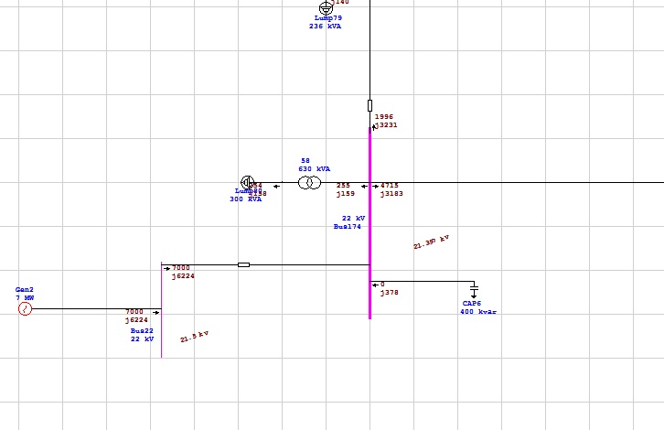
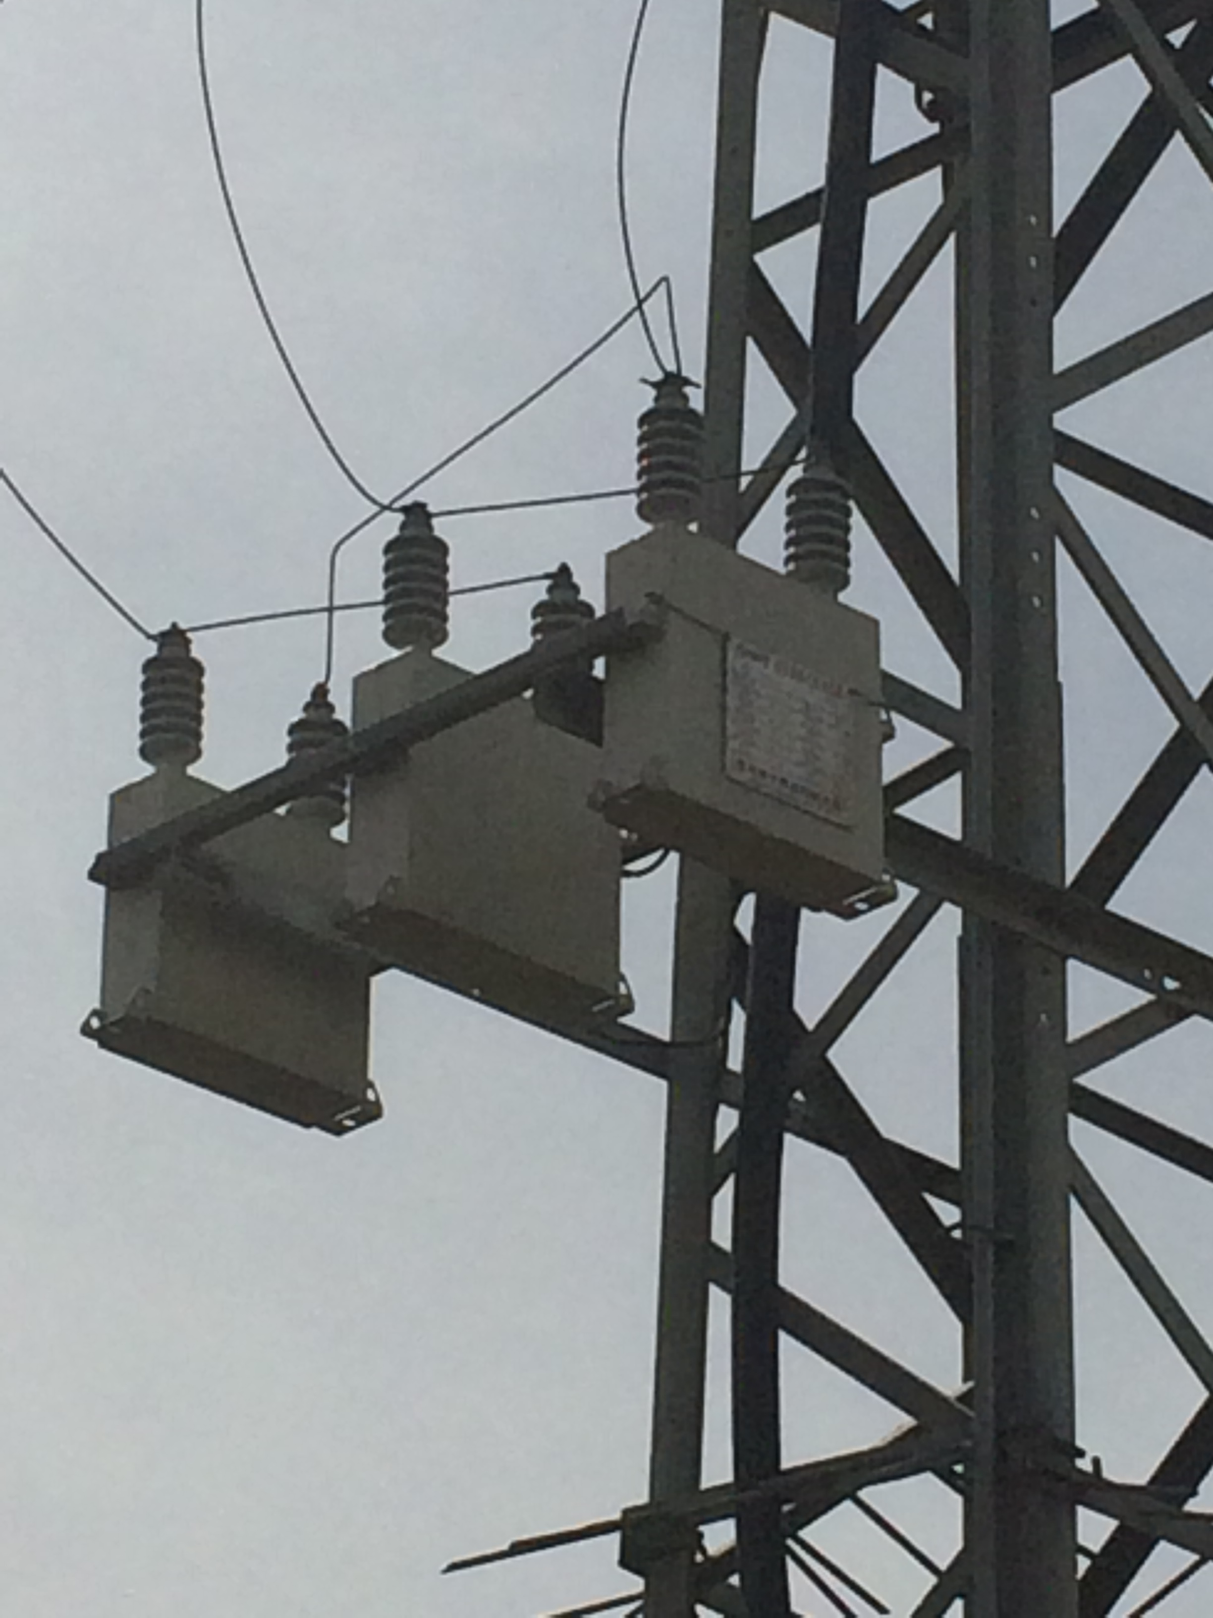
We added shunt capacitor banks at the buses at both transmission and distribution levels and loads with value : ( 300 , 400 , 1000 ) kVAR .

Slide 21
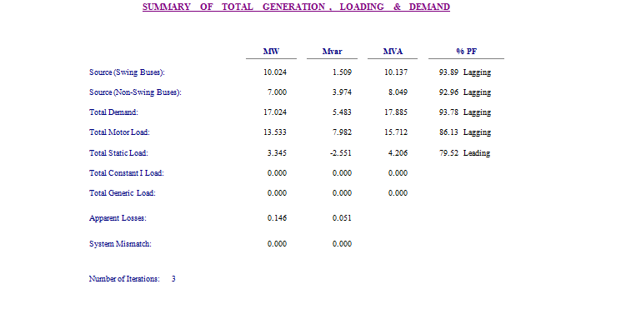
Summary of results after improvement the network
After adding the capacitor banks the losses in the network decrease to 0.146MW
The P.F = 92.96% which it was achieved .

Slide 22
Elements Of The Network
1- Sources :
There are two sources
The old source (13MW –Swing)
The new source (7MW-controal)
by Israel Electrical Company (IEC), at 22KV.
2- Transformers :
Distribution transformers :
85 distribution transformers (22/0.4)KV
Number of Transformers | Transformer Ratings (KVA)
1 | 1000
50 | 630
23 | 400
2 | 250
4 | 160
5 | 100
85 | total

Slide 23
Elements Of The Network
3- Transmission Line & cable :
Over Head Line:
The conductors used in the network are ACSR (Aluminum Conductor Steel Reinforced)
Under Ground Cable :
The underground cable used in the network are XLPE Cu .

Slide 24
Economical Study
In this project it is important to study the economical calculation to find if our work is suitable or not .
Saving in penalties :
P.F before imp. = 0.8620
P.F after imp. = 0.9376
Pav =12.794
Total energy per year = Pav * 8760= 112077.06MWH.
Total cost per year = Total energy * cost (NIS/KWH) = 67246578NIS/year.
Saving in penalties of P.F = 50972.906NIS/year.
Saving in losses :
Saving in losses = cost of losses before – cost of losses after
= 638604 – 575532
= 63072NIS/year..
Power Factor | P.F Penalties
P.F ≥ 0.92 | No Penalties.
0.92 > P.F ≥ 0.8 | 1% of total bill for each one under 0.92
0.8 > P.F ≥ 0.7 | 1.25% of total bill for each one under 0.92
P.F < 0.7 | 1.5% of total bill for each one under 0.92

Slide 25
Economical Study
Simple Pay Back Period :
Total fixed capacitor banks using = 3.2 MVAR.
Cost of fixed capacitor = 18000 NIS / MVAR .
Total cost of capacitor banks = 3.2 * 18000 = 57600NIS.
The cost of under ground cable XLPE (1*240 mm²) = 100 NIS / 1 meter
Total cost = 100 * 200= 20000 NIS .
The cost of Infrastructure (such as: excavations, power source, accessories) = 100 NIS/1meter
Total cost = 100 *600=60000NIS .
The cost of (Links, wages of workers, equipment , Towers , installation cost and maintenance ) = 10000 NIS .
Total capital cost = 57600 + 20000+ 60000 + 10000
= 147600 NIS
Total saving = saving in losses + saving in penalties
= 63072+ 50972.906= 114044.906 NIS
S.P.B.P = Investment / Saving = 147600/ 114044.906 =1.3 years

Slide 26
Conclusions
After the analysis and adding a new connection point , drop voltage was decreased , apparent losses was reduced too .
The power factor was improved to over and above 92% which will reduce any penalties paid to "IEC" on both "NEDCO" Company and consumers as will, and this is duo to adding a new connection point .
The network at full load need to 17 MW , but the availability of current two connection point is 20 MW . So, now we in the save side .
The time needed to recover the cost for the project is about 1.3year . And the new network will be feed the new growth of load for the period from now to 2025 , depending on the annual increase of the loads to cover the demand in the city.

Slide 27
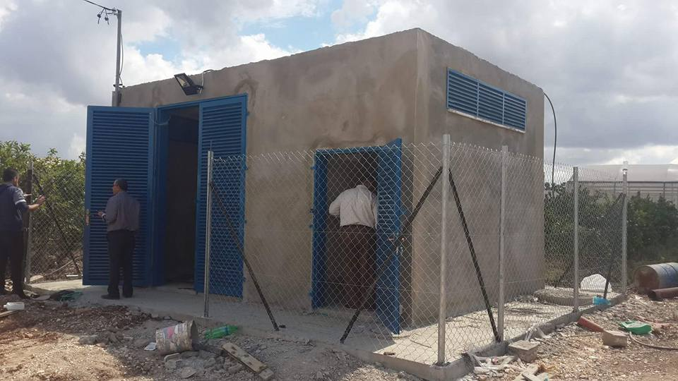
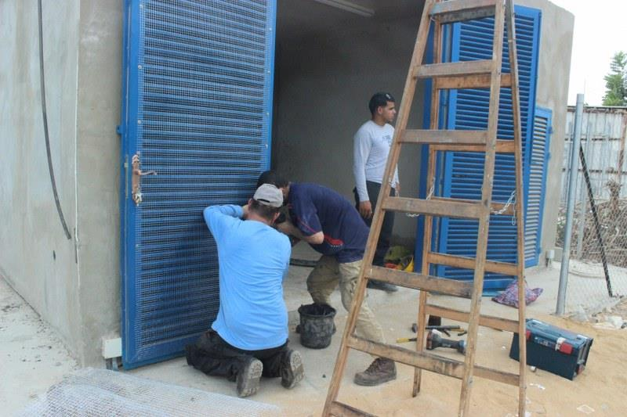
new connection point

Slide 28
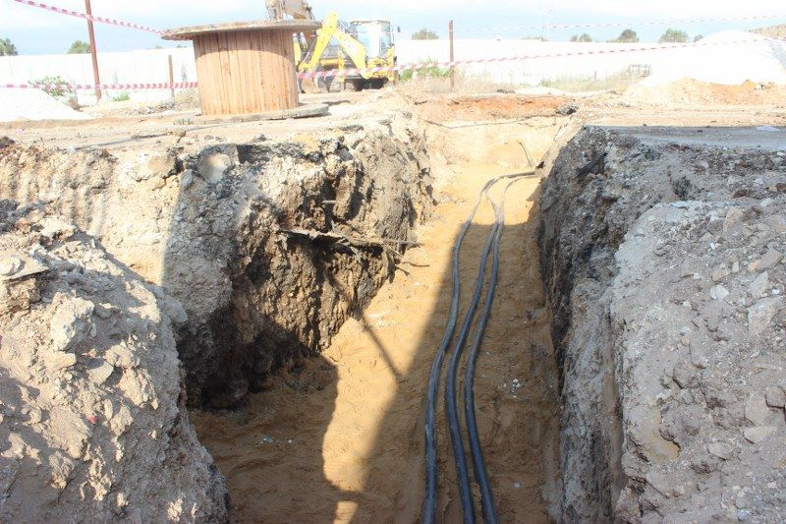
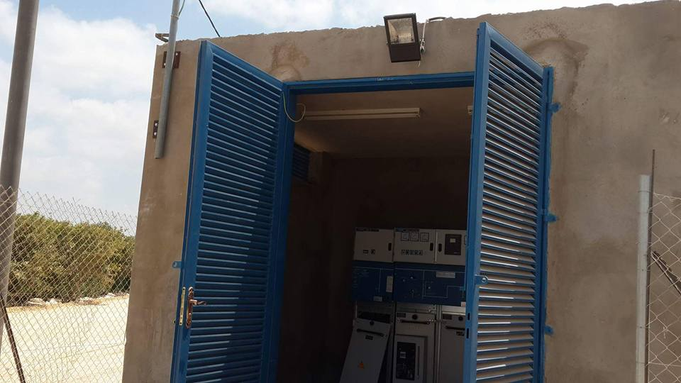

Slide 29
Recommendation
We hope that Qalqilya Municipality take our study and achieve it in the ground .
THANKS FOR YOUR ATTENTION

Slide 30


