Slide 1

An-Najah National University
Faculty of Engineering and Information Technology
Building Engineering Department
Graduation Project (II)
Nablus Municipality
Prepared by:
Manar Shorbaji
Amneh Badawie
Ola Taha
Supervisor Name:
Eng. Nermeen Albarq

Slide 2
Content :
Introduction
Site Analysis
Architectural Aspect
Environmental Aspect
Structural Aspect
Mechanical work
Electrical work
Quantity & Estimate Serving
1

Slide 3
Introduction
In this project, an integrated municipality design was created that keeps pace with the development of the times and meets basic needs.
New integrated design is introduced taking all strengths into consideration and demolishing all weaknesses.
2

Slide 4
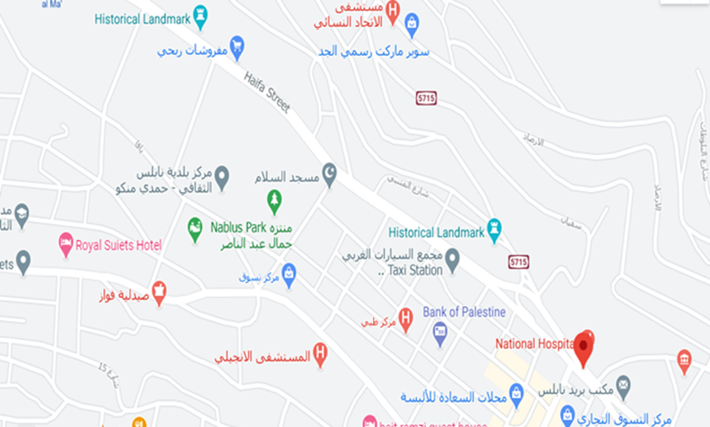
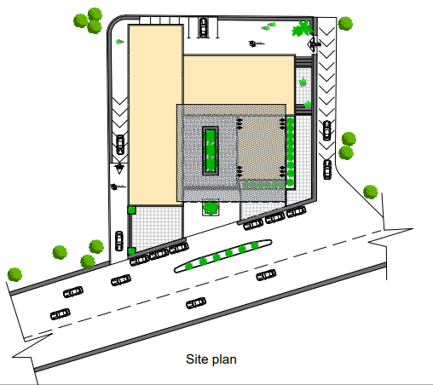
Site Analysis
The land on which the municipality will be built is located on Haifa Street, located in the Rafidia district in Nablus.
Areas and slope
Area of land which municipality is built on equals to (3380) m² with slope less than 6 % approximately.
3

Slide 5
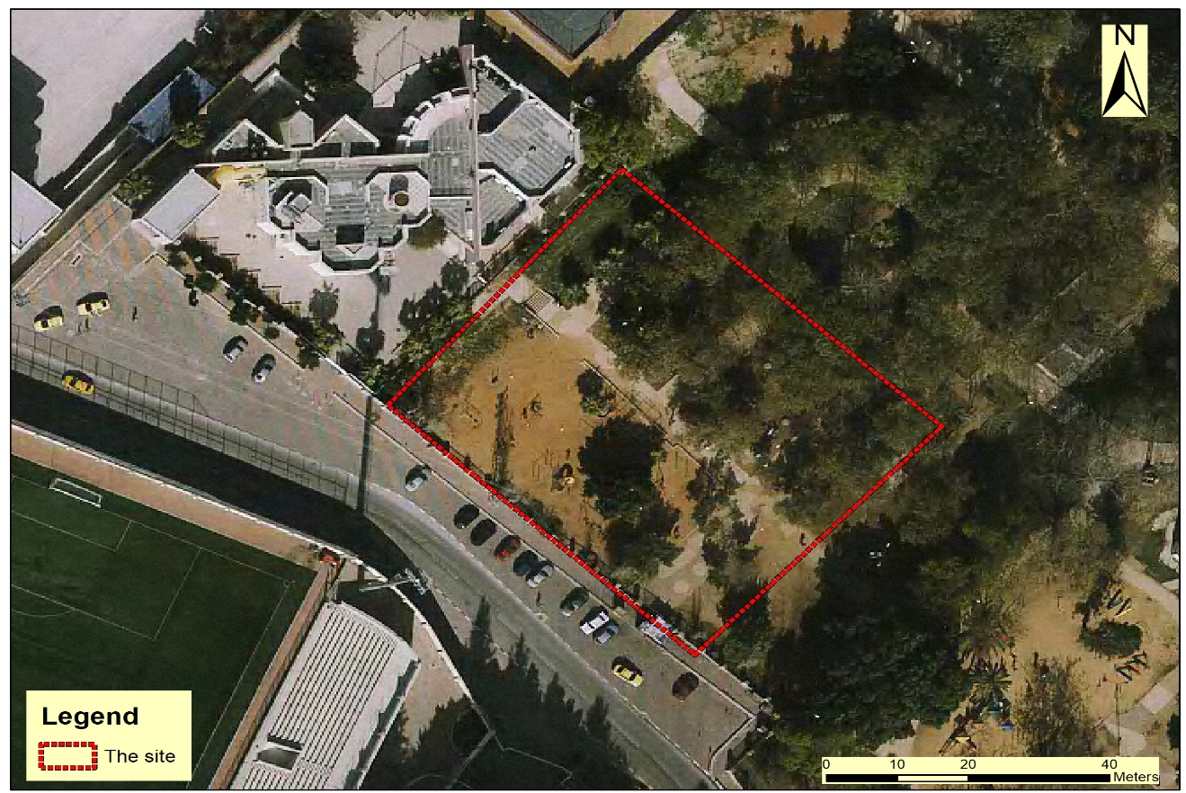
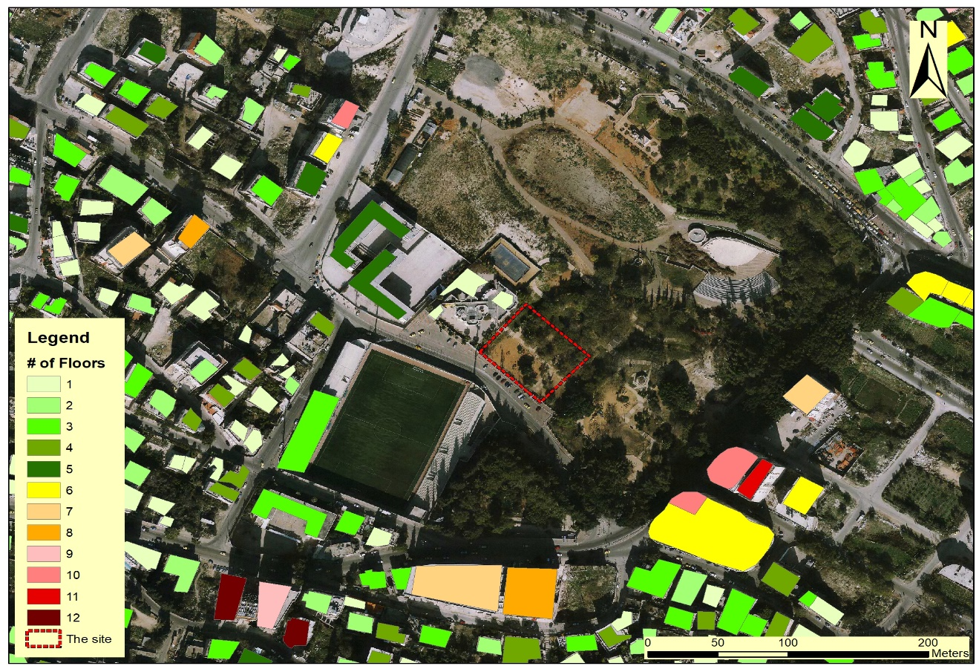
Site Analysis
5

Slide 6
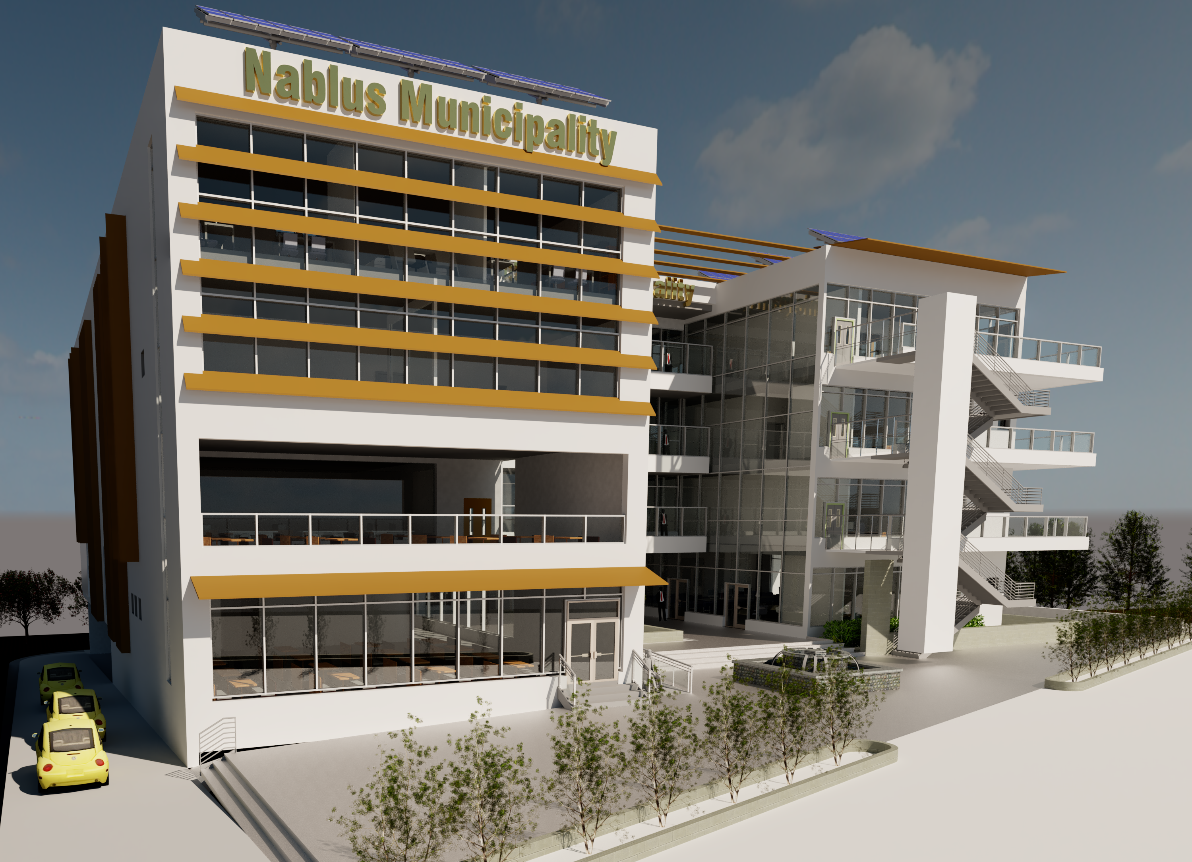
Architectural Aspect
General Information
Floors , Elevations and Sections
7

Slide 7
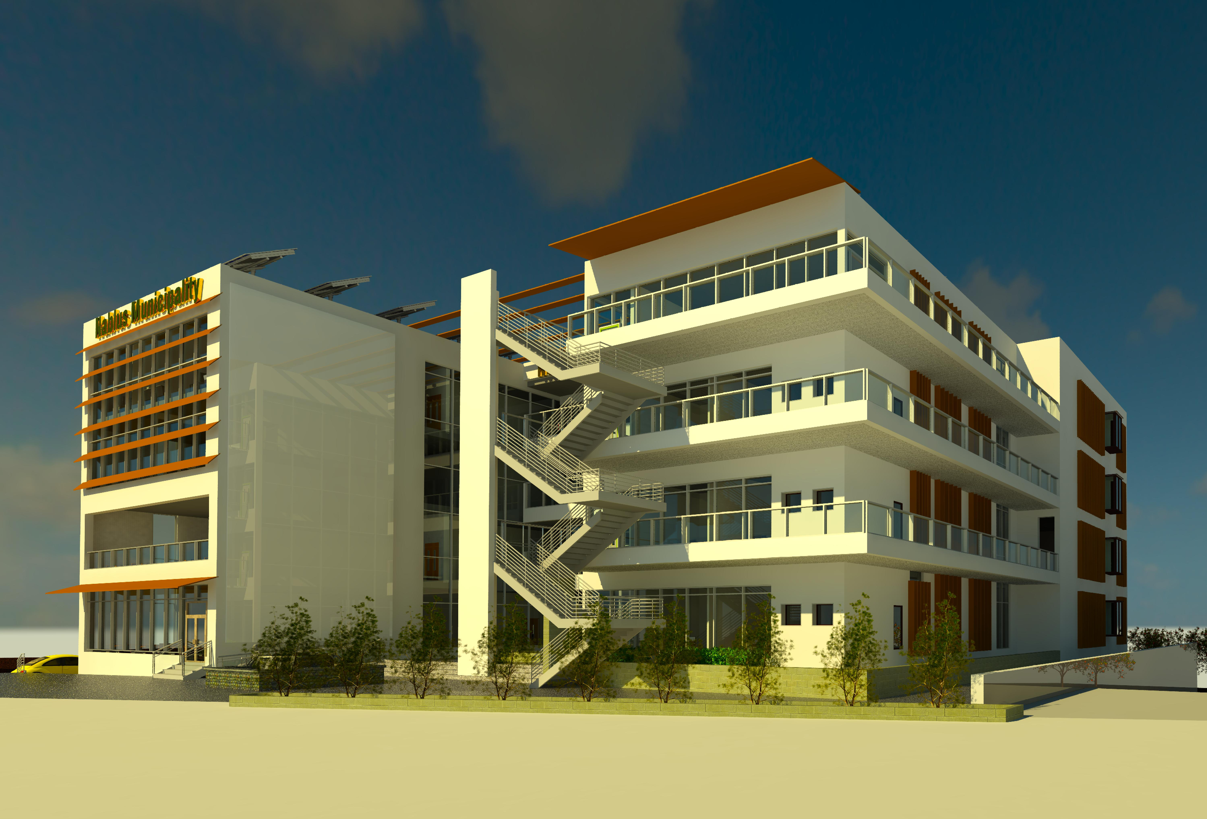
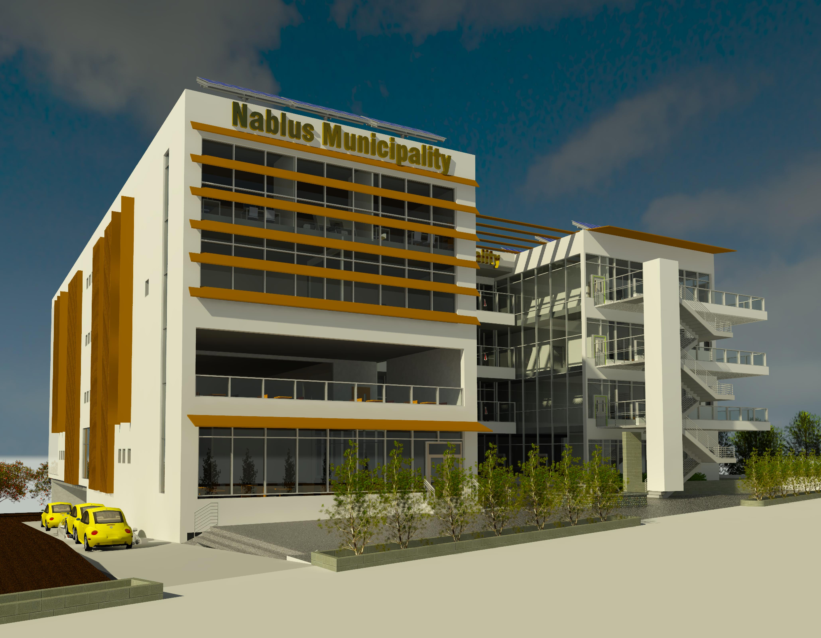
General Information
The Nablus Municipality includes Five story.
Total area equals to 6770 m2.
8

Slide 8
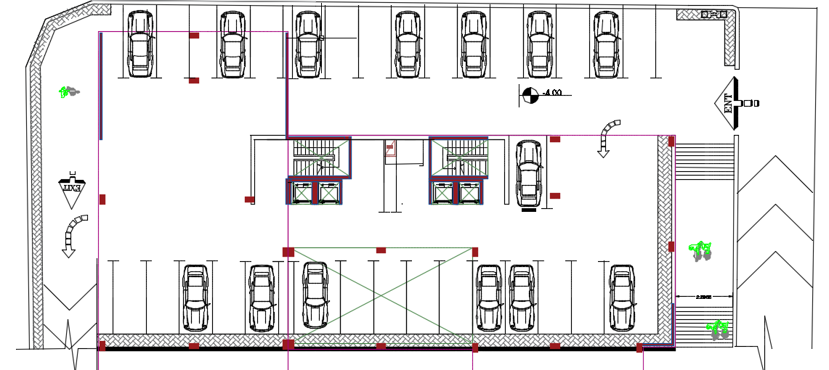
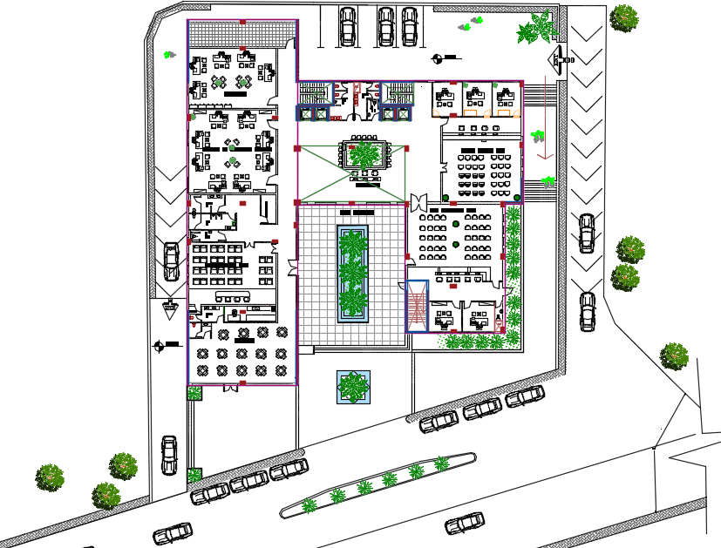
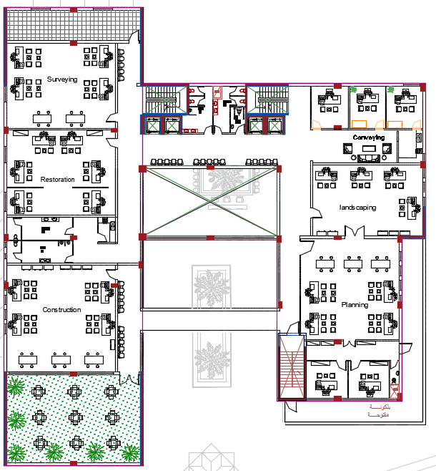
Architectural Aspect
Area 6670. m2
Floor Height 4 m
9

Slide 9
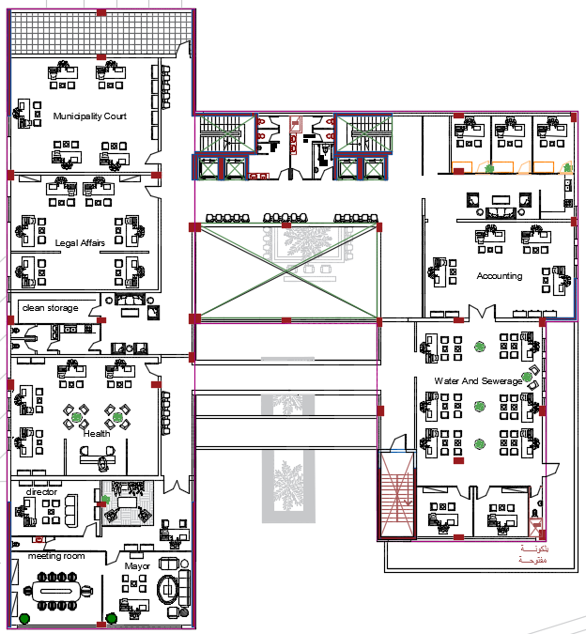
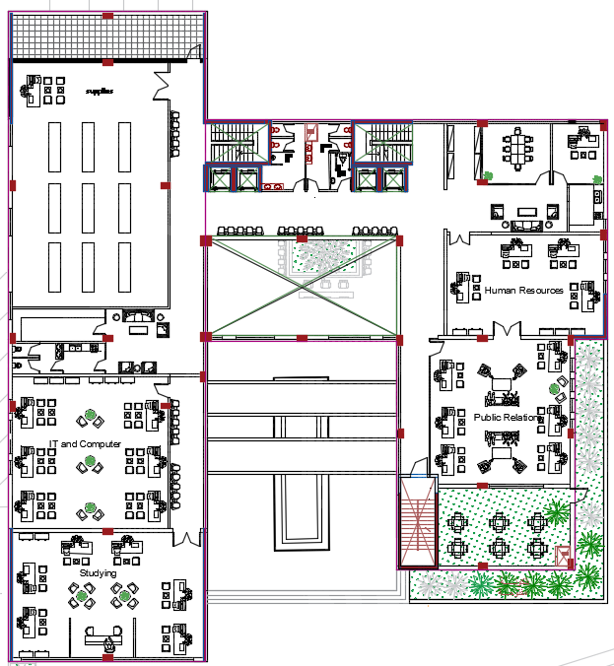
Architectural Aspect
10

Slide 10
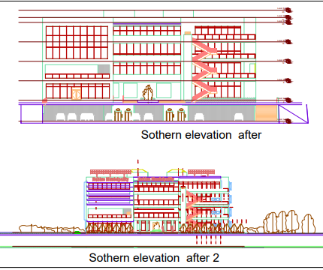
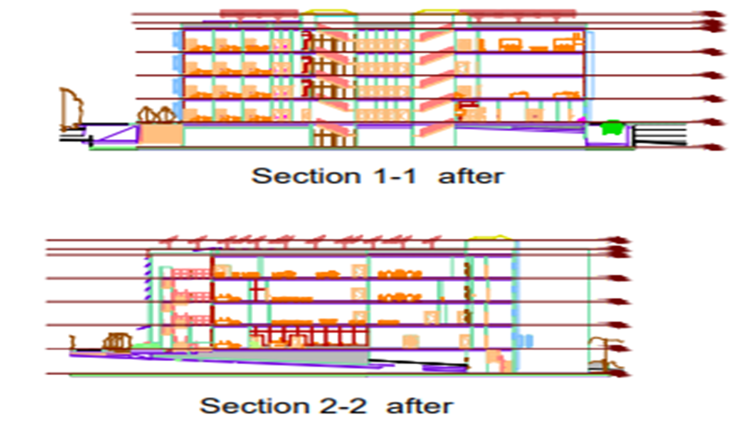
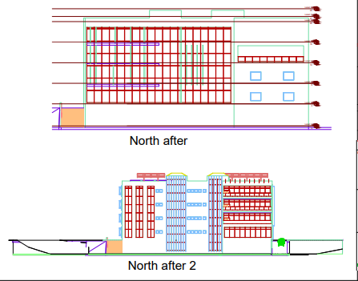
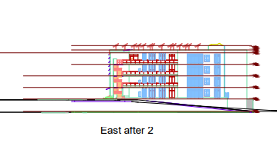
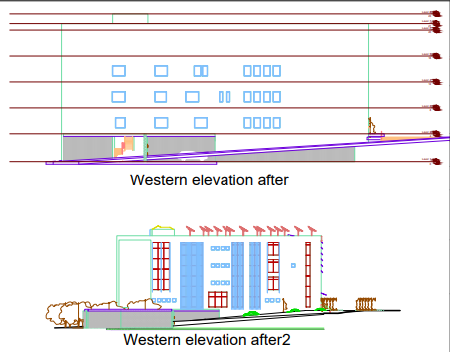
Architectural Aspect
14

Slide 11
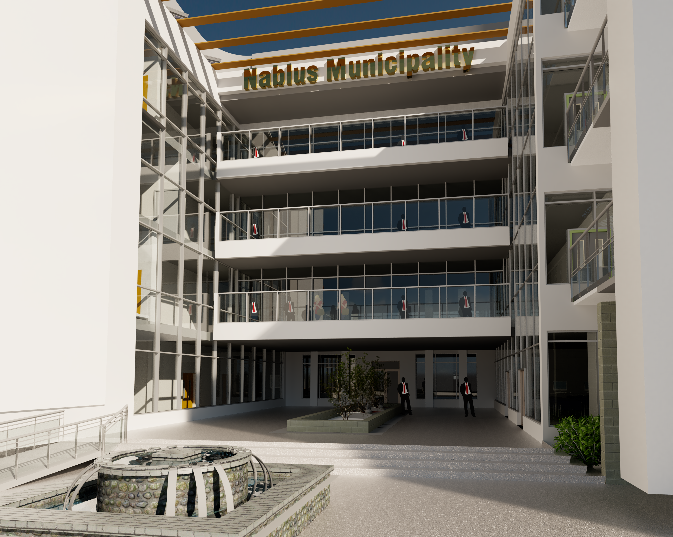
Architectural Aspect
20

Slide 12
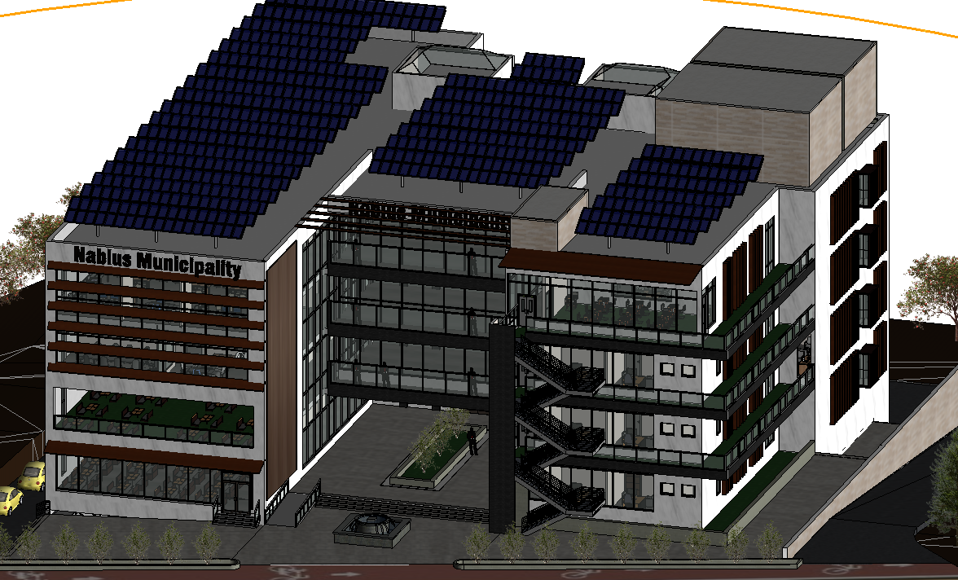
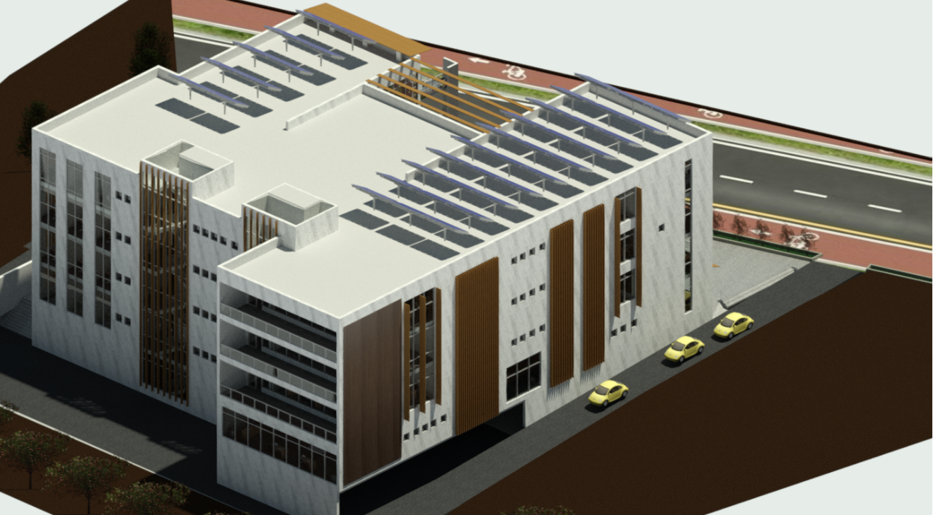
20

Slide 13
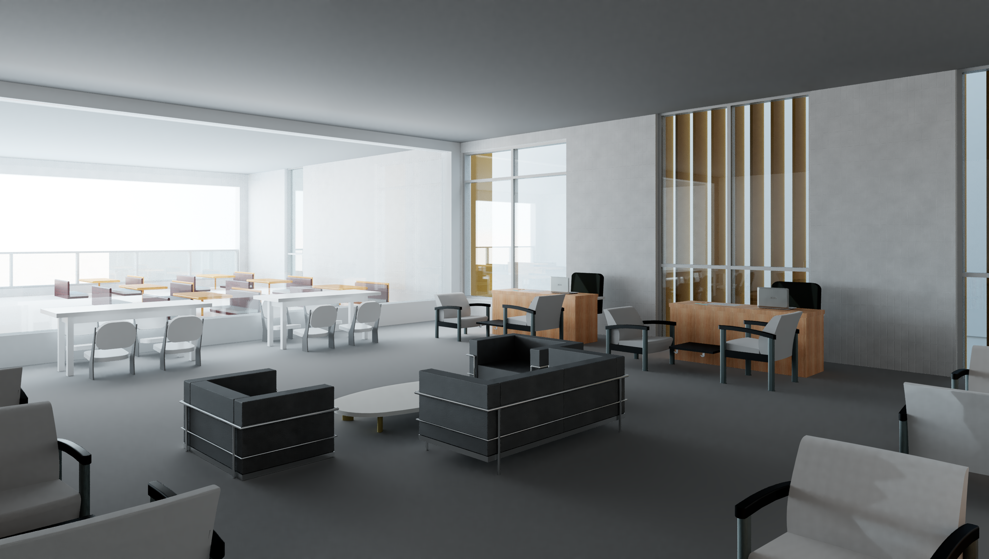
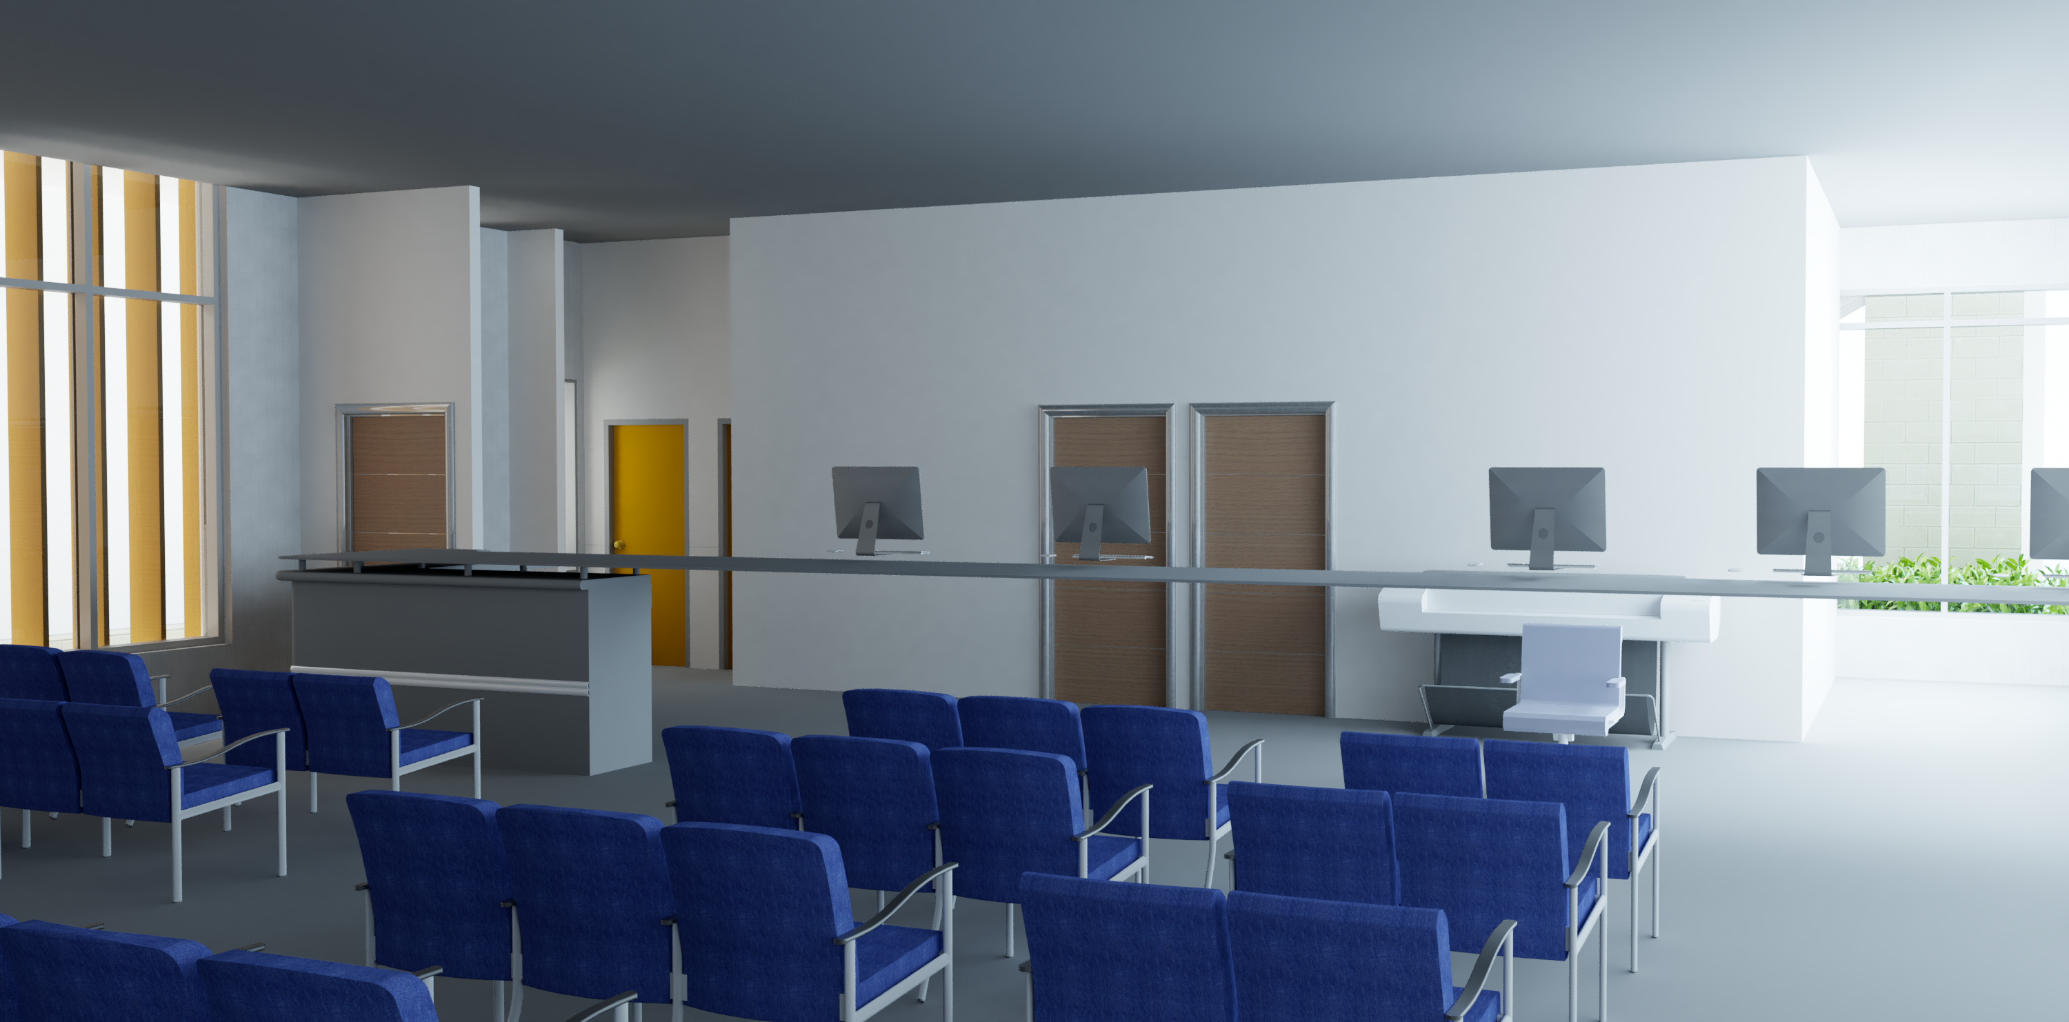
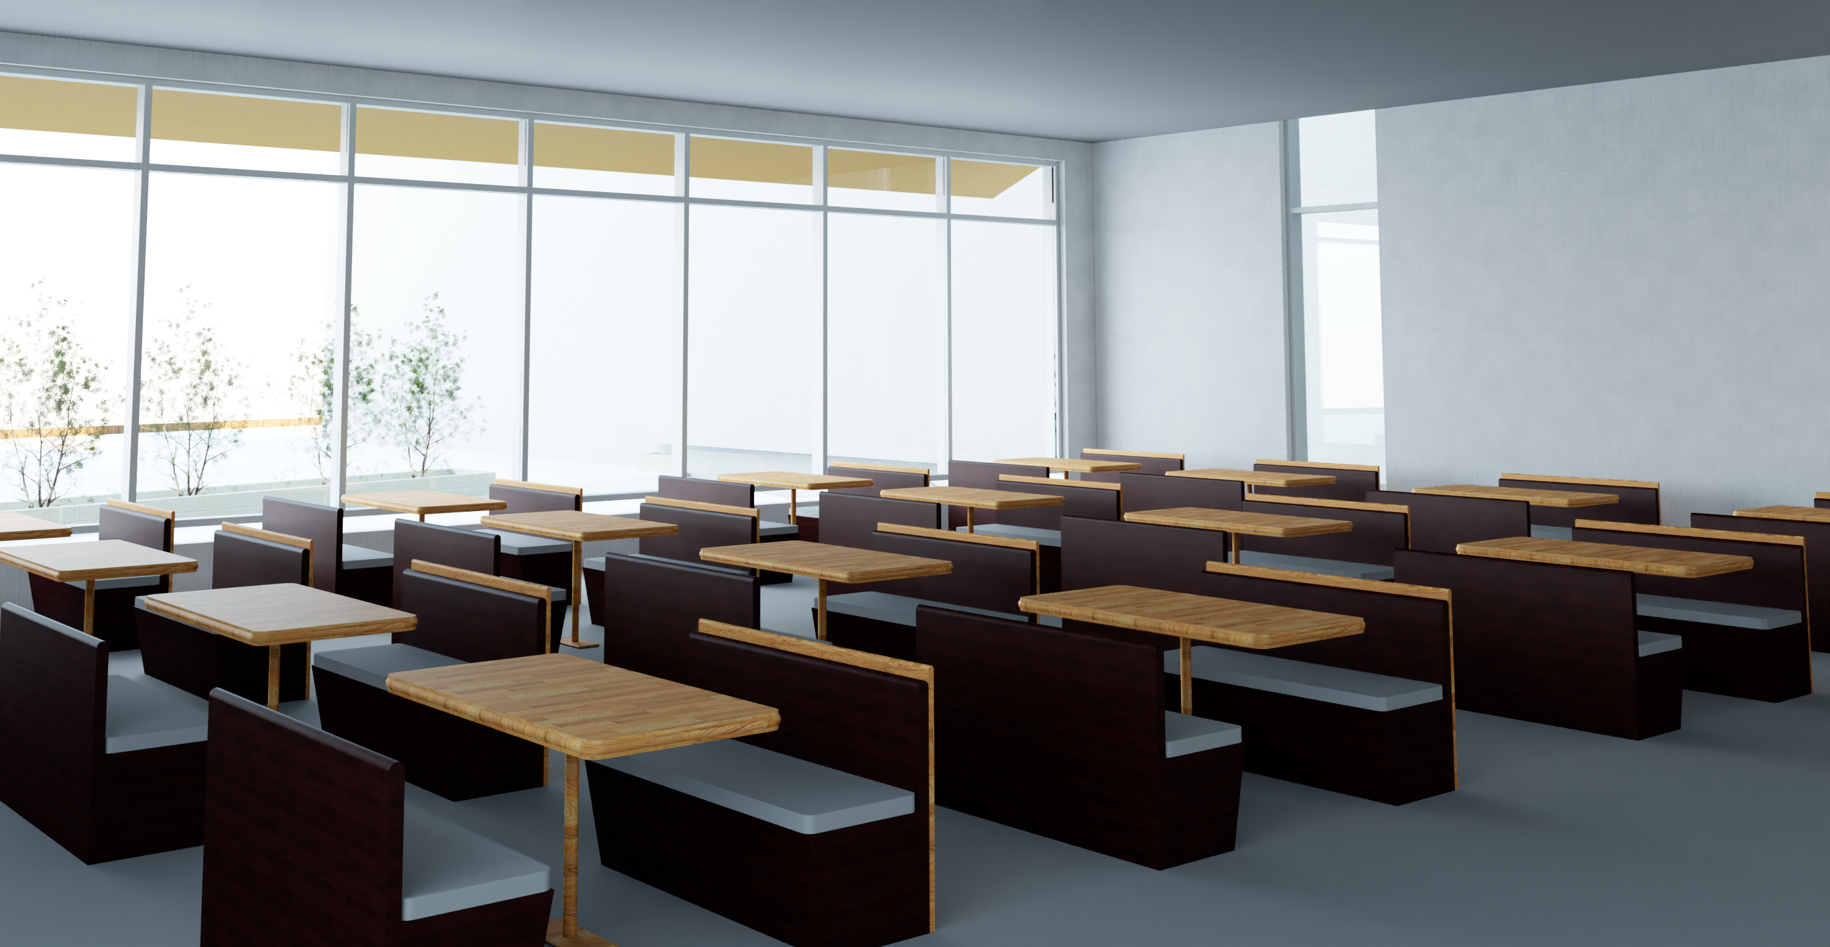
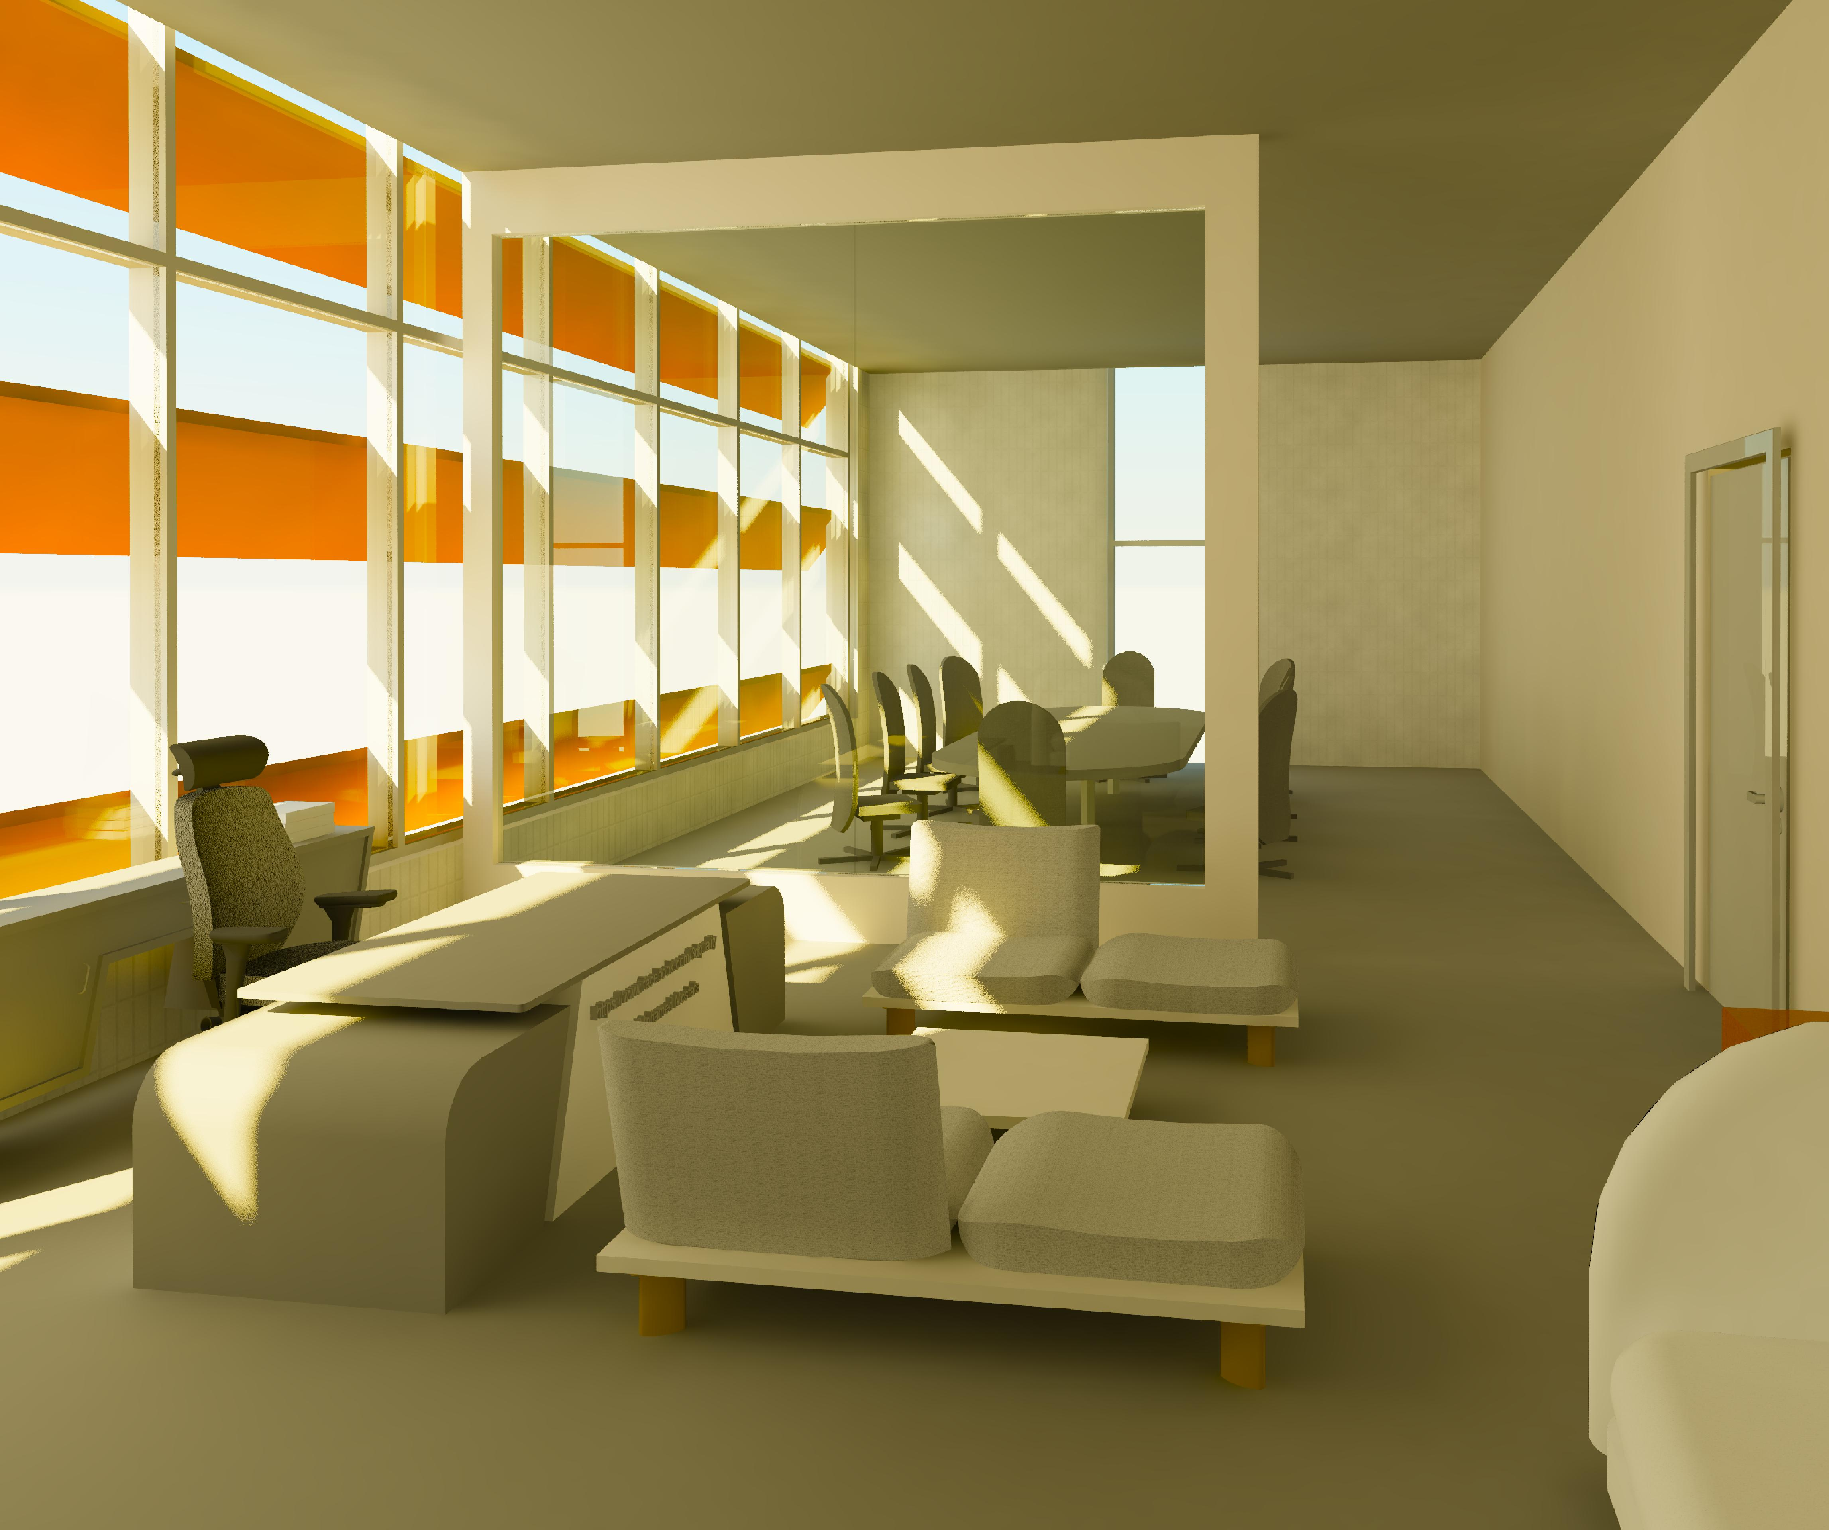
Architectural Aspect
23

Slide 14
Environmental Aspects
As any aspect , environmental design is very important and it should be taken into consideration
Solar radiation
Daylight factor (DF)
Sun path diagram
Shadow
DesignBuilder
Acoustics
48

Slide 15
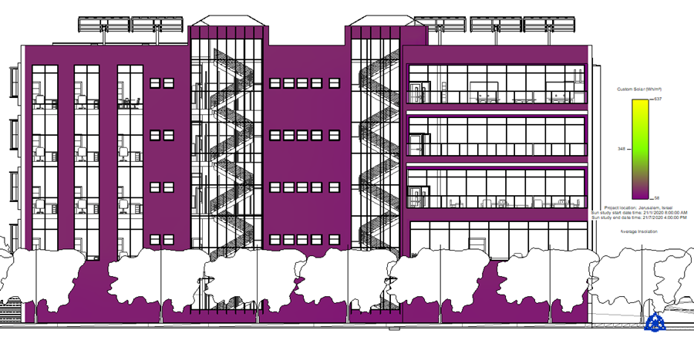
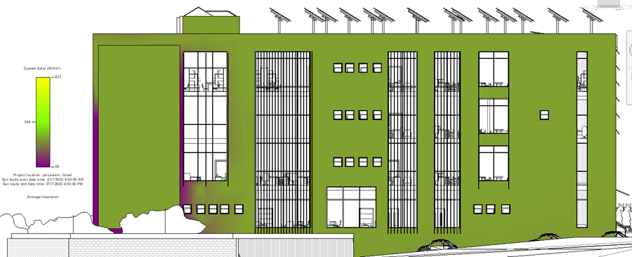
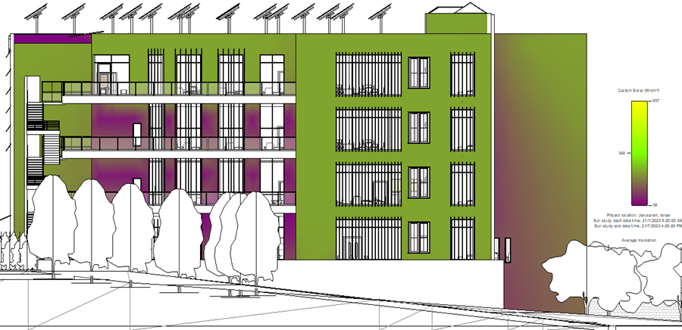
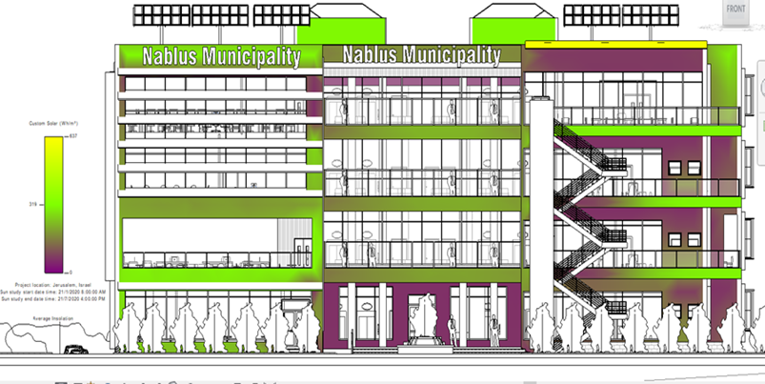
Solar radiation
North elevation solar radiation (after)
Western elevation solar radiation (after)
Eastern elevation solar radiation(after)
South elevation (after )
54

Slide 16
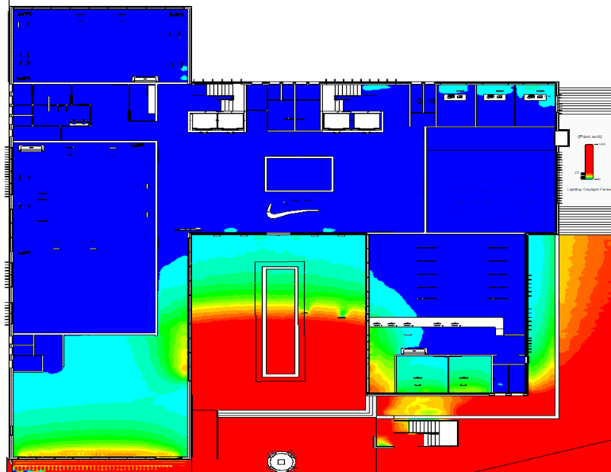
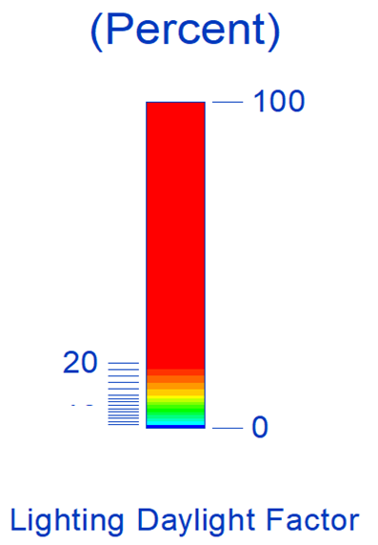
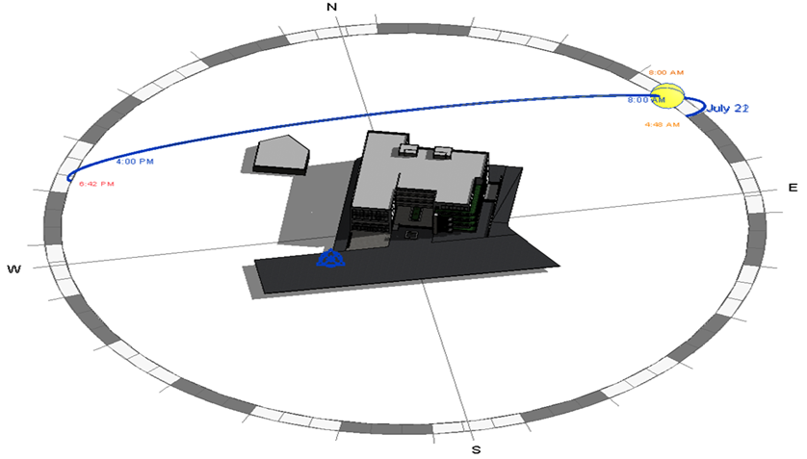
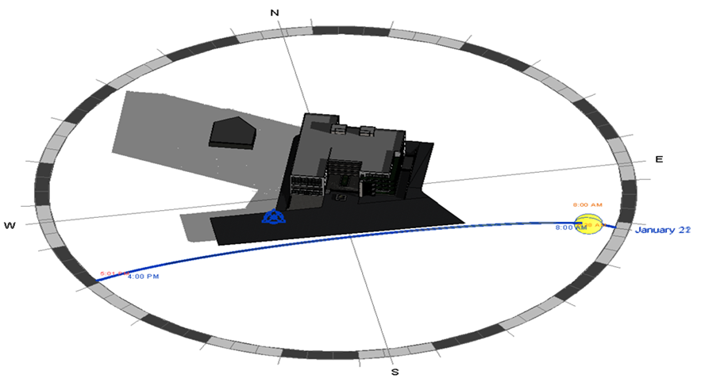
Daylight factor (DF)
Ground floor
Sun path diagram in winter from 8:00 am to 4:00 pm
Sun path
Sun path diagram in summer from 8:00 am to 4:00 pm
59

Slide 17
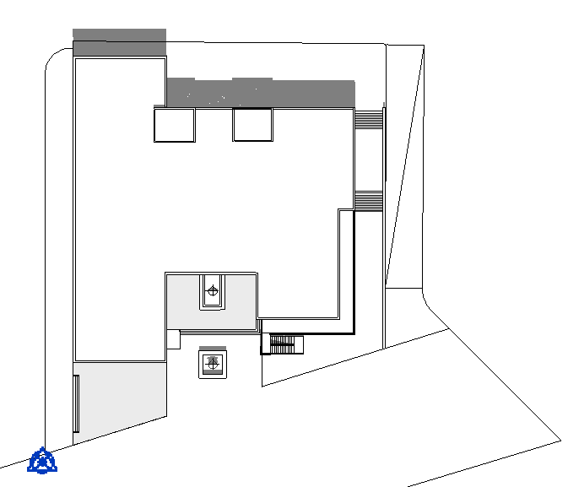
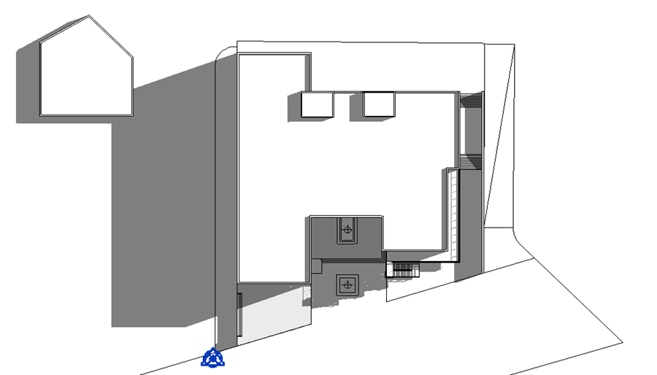
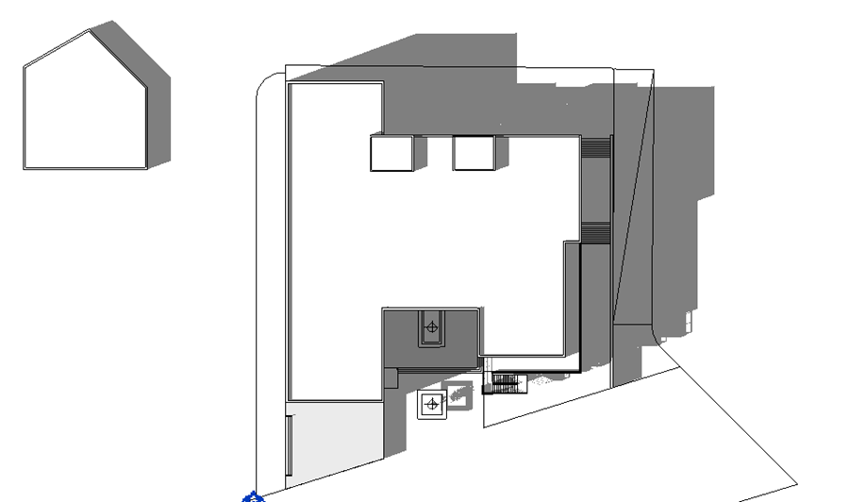
Shadow
shadow at 8:00 am
Shadow at 12:00 pm
Shadow at 3:00 pm
61

Slide 18
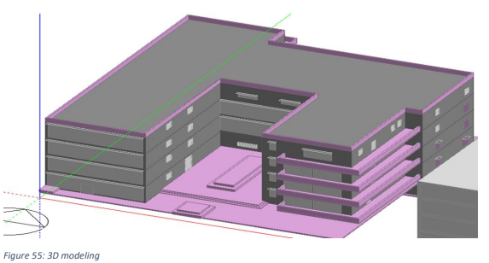
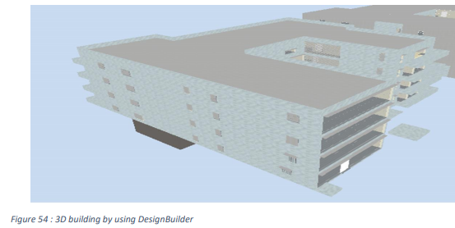
DesignBuilder
we will analyze the municipality building from a thermal point of view, and add insulators in the ceilings, floors, roofs, partitions, external and internal walls. To become an isolated Palestinian building.

Slide 19
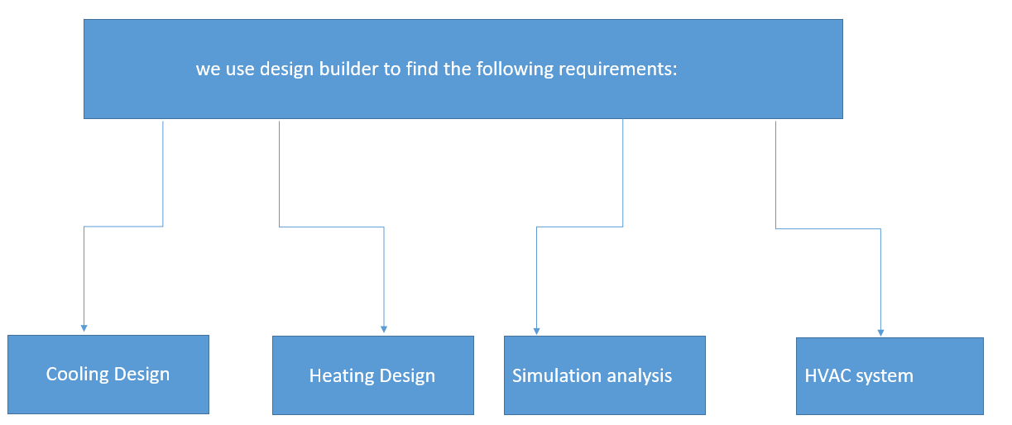

Slide 20
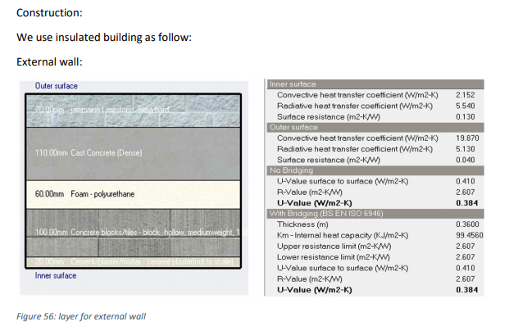
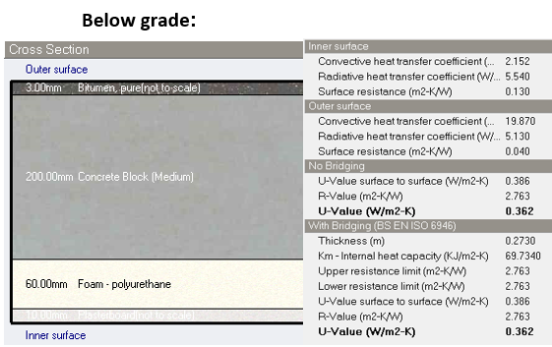
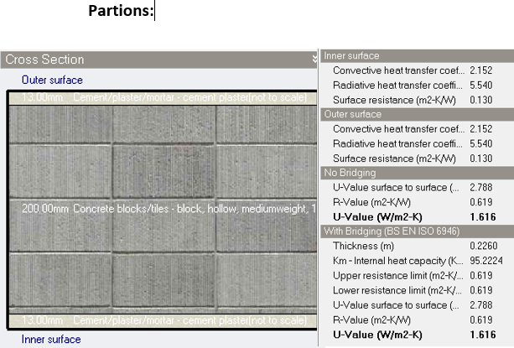
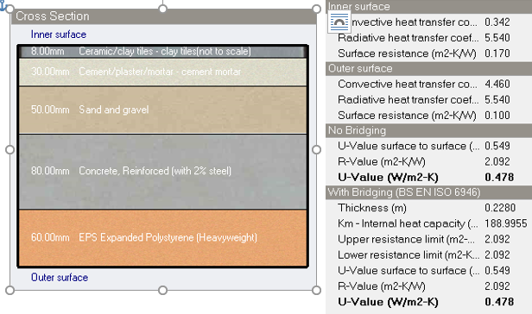

Slide 21
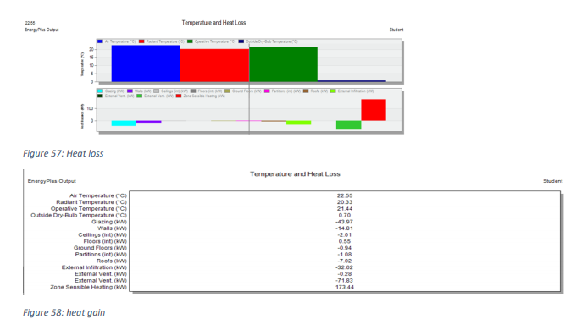
Heating design:

Slide 22
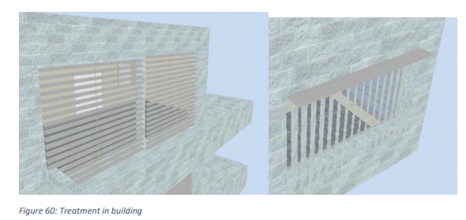
Cooling design:
The Cooling Load consists of the envelop transmission (U-value), solar gain, internal gains including (humans, lighting and equipment).
We put vertical louver in east and west elevation:

Slide 23
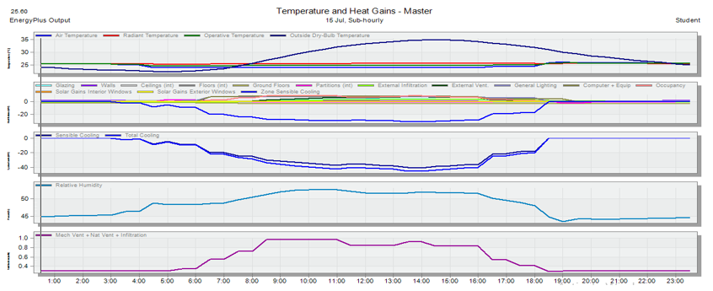
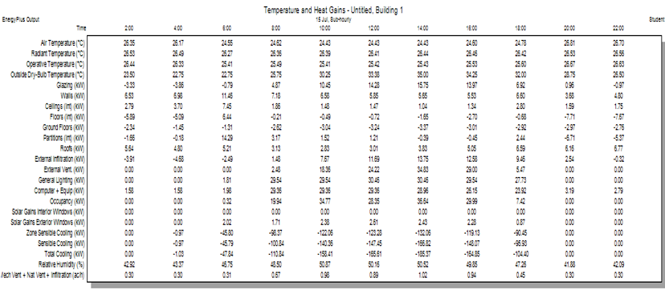
Cooling design:

Slide 24
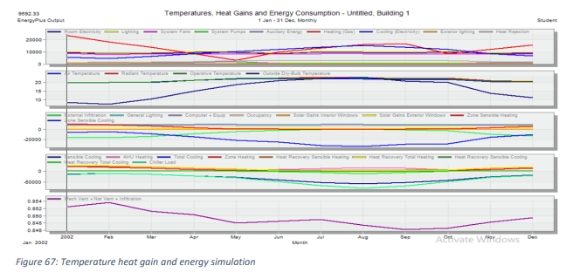
Simulation
The simulation analysis It is a simulation of reality. It takes the whole building in all its details
These sum result according to Air temperature:

Slide 25
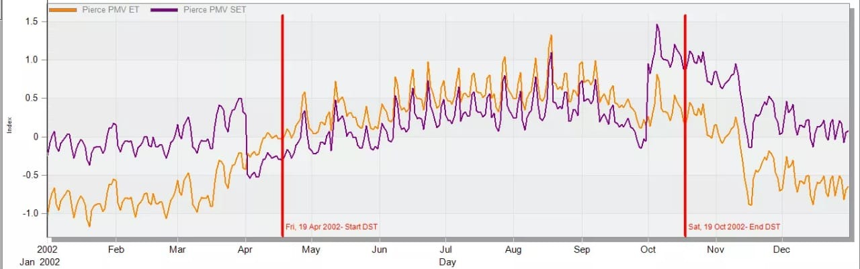
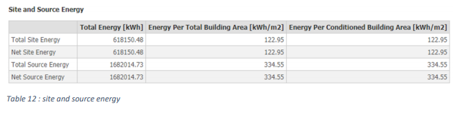
U-value of wall equal = 0.369 which is good less than recommended value 0.5
Energy per conditioned area =122 less than base line =150 KWh/m2 (standard for office building) so the building is energy efficient

Slide 26
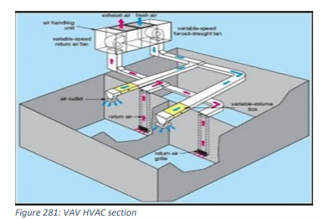
HVAC design
The system used here is VAV (variable air volume) HVAC system.

Slide 27



Slide 28



Slide 29

Acoustic analysis

Slide 30



Sound pressure level:
The intensity level can be expressed as the sound pressure level (SPL):
Effect of distance on sound level :
Sound level decreases when moving away from a sound source.

Slide 31




Engineering office:
Engineering office plan
Noise in room
Room RT60
Direct SPL

Slide 32



Total SPL
ALC
STI Eng. room

Slide 33

INSUL

Slide 34



STC value
Total STC

Slide 35


Internal wall
Partition Sound Transmission Class (STC) standard

Slide 36


Ceiling

Slide 37


Structural Aspect

Slide 38

Structural Aspects
This chapter explains the structural design of the building.
At the beginning, the building was divided into two blocks
as shown in the figure, and then by using ETABS program,
each block was modelled and analysed, also the preliminary
design of the structural elements such as columns, walls,
beams and slabs was determined and checks.
Preliminary design
Two-way ribbed slab with drop beams,
Slab thickness (h)=400 mm ribbed slab pattern
Beam 1: 800 mm in depth and 800 mm in width
Beam 2: 400 mm in depth and 800 mm in width
700 x 400 mm cross sectional for column
Thickness of shear wall 1 = 200 mm
Thickness of shear wall 2 (basement wall) = 300 mm
Thickness of shear wall 3 = 400 mm

Slide 39




Column design
Basement
Ground
First
Second

Slide 40


Modeling and analysis
By using ETABS we need to modeling and analysis first & second block check
Compatibility check

Slide 41
Equilibrium check
Load pattern |  | Load (KN) |  | Error %
 |  | Manual | ETABS
Live |  | 15419.5 | 15419.8 | 0.002
SID | on slab | 16961.45 | 28624.75 | 0.029
 | walls | 11655
 | Total SID | 28616.45
Dead | Columns | 1680 | 34943.92 | 2.825
 | Beams | 12848
 | Slab | 17855.78
 | Walls | 3576
 | Total Dead | 35959.78
Load pattern |  | load |  | Error %
 |  | Manual | ETABS
Live |  | 14035 | 14039.42 | 0.031
SID | on slab | 15438.5 | 27816.06 | 0.031
 | walls | 12369
 | Total SID | 27807.5
Dead | Columns | 2492 | 38709.8 | 2.87
 | Beams | 12384
 | Slab | 16252.53
 | Walls | 8724.8
 | Total Dead | 39853.33
Equilibrium check model for first block
Equilibrium check model for secondary block

Slide 42

Structural Models
Internal forces check :
column | Axial load (KN) |  |  | Error%
C1 | Manual- load due to |  | ETABS
 | beams | 1155 | 3358 | 1.82
 | slab | 2152
 | Self- weight | 112
 | Total | 3419
C2 | beams | 682 | 4910 | 2.08
 | slab | 4217.92
 | Self- weight | 112
 | Total | 5011.92
Beam | manual |  |  | ETABS | Error %
B1 | moment (KN.m) | M(-) | 96.04 | 121 | 20.63
 |  | M(+) | 104.00 | 95 | 8.65
 |  | M(-) | 185.41 | 136.7 | 26.27
 | shear (KN) |  | 201.5 | 175.14 | 13.08
B2 | moment (KN.m) | M(-) | 684.03 | 560.7 | 18.03
 |  | M(+) | 368.32 | 542.13 | 32.06
 |  | M(-) | 684.03 | 885.64 | 22.76
 | shear (KN) |  | 569.91 | 532.44 | 6.57
Internal forces in first block
internal force checked for columns
Internal force check for beams in block 1
Span | manual |  |  | ETABS | Error %
S1 | M22 (KN.m) | M(-) | 13.54 | 12.06 | 10.93
 |  | M(+) | 48.24 | 45.7 | 5.26
 |  | M(-) | 59.24 | 55.6 | 6.14
 | M11 (KN.m) | M(-) | 24.13 | 22.6 | 6.33
 |  | M(+) | 25.98 | 30.07 | 15.73
 |  | M(-) | 28.95 | 26.32 | 9.10
Explains internal force for slab in block 1

Slide 43


Structural Models
ETABS Checks
Deflection check for block 1: Live load deflection:
Limit = (11.30*1000)/360 = 31.40 mm Displacement from (D+L) load which equals 29.03 mm shows in Figure
Δlive = ΔD+L - ΔD
= 29.03 – 11.90
= 17.13 mm
17.13 < 31.40 ok
45.87 < 47.10
Thus, long-term deflection was acceptable

Slide 44



Seismic Checks
Load combination
Seismic effect on Block 1
Seismic effect on Block 2

Slide 45


Mass participation check:
Sum x =96% and Sum y =94%, and both are more than 90%.
Drift check
Drift check for Block 1
Sum x =91% and Sum y =98%, and both are more than 90%. (Block 2)
Drift check for Block 2

Slide 46






Base shear check
Check Period:
Values of time Period in Block 1
T method (A) =$0.426s$
T from Etabs = 0.57s
1.4*0.426 = 0.59 > T from ETABs = 0.57 → Check is OK
Manual and ETABs calculation for (V)s Value on block 1
Values of time period in Block 2
T method (A) =$0.426s$
T from Etabs = 0.502s
1.4*0.426 = 0.59 > T from ETABs = 0.5 → Check is OK
Manual and ETABs calculation for (V)s Value on block 2

Slide 47


Design element
Design of column
The reinforcement of columns in block 1

Slide 48




Design of beam
Distributions of the Beams
Check for doubly reinforcement for the beams in block 1
beam to calculate the shear in block 1

Slide 49




Design of slab

Slide 50


Design shear wall
shear wall in block 1
Stair shear wall

Slide 51


Design of footing
Isolated footing
detailing of columns and footing in Block 1
detailing of columns and footing in Block 2

Slide 52

Design of Retaining wall
The project involves a basement floor, which results in various levels in the property, necessitating the construction of a retaining wall.

Slide 53

Stair design:
The loads will use to design the stair:
Live load = 5 KN/m² ,,,, SID load = 5.5 KN/m²
Dead load = 0.2 * 25 = 5 KN/m² (assume the slab thickness = 20 cm).
Ultimate loads on stair equal (1.2D + 1.6L) = (1.2 × (5.5+ 5)) + (1.6 ×5) = 20.6 KN/m2

Slide 54

Water tank
Detailing of water tank

Slide 55
Electro-Mechanical Aspect
1- Mechanical work
Water supply system
Drainage system
Fire system
2- Electrical work
Power design
Low voltage design
Photovoltaic system design
PV Sys
RET screen
Earthling system
Main circuit breakers
Elevator
Lighting design (DILUX)

Slide 56

Mechanical work
Water supply
This building contains hot & cold water. The cold water comes from tanks situated on the rooftop, and heated water comes from boilers. In this building water put away in-ground tank water.
Consumption | fresh water | Flushing water | Raining water
Daily | 21.09 | 2.96 | (-)
Yearly | 4850.7 | 680.8 | 926.27
annual consumption water in building CM
weight of fixture units

Slide 57
Water Supply System
Use two tanks of (10*7*5m), So two tanks for flushing = 700 m³
Fresh water tank = (6*5*4m) = 120 m³
Types of pipes:
Stainless Steel for Vertical pipes
PVC for horizontal and branch pipes
Pipe selection
Pipe selection
Type | water |  | Gray water
 | diameter(inch) | Losses (psi) | diameter(inch) | Losses (psi)
Vertical | 2.5 | 7.67 | 2 | 16.51
Horizontal 1 | 2.5 | 0.39 | 1.5 | 1.57
Horizontal 2 | 2.5 | 0.15 | 1 | 0.94
Horizontal 3 | 2 | 0.24 | 1 | 6.24
Horizontal 4 | 2 | 0.22 | 1 | 1.6
Branch | 1 | 0.701 | 0.75 | 2.19
Total |  | 9.371 |  | 29.05

Slide 58


Water supply plan by AutoCad

Slide 59
Drainage system
Water Drainage System
Three types of drainage water systems:
Black water
We use 4 inch stakes with slope 1% for all WC's.
Grey water
We use 2 inch with slope 2% for lavatories.
Rain water
We use 4 inch with slope 1%
We use 6 inch with slope 1% between manholes.

Slide 60


Drainage plan

Slide 61
Firefighting system
Designing the building to protect against fire has become an important necessity for the engineer
Firefighting system
Introduction
Facilities Classification
In your building the category is category C
Fire detecting and alarm system
-Smoke detector
- Heat detector
Requirements for prevention and self-protection (Jordanian code)
Emergency fire escape (Jordanian code)

Slide 62



Firefighting system
Design of fire system:
Sprinkler
Hazard classification | High hazard | Medium hazard | Low hazard
coverage area(m² ) | 9 | 12 | 18-20
Maximum distance(m) | 3.6 | 3.9 | 4.6
Sprinkler to sprinkler maximum distance = 4.6 m by NFPA 13 CODE (National Fire Protection Association)
Fire detector alarm
Heat detector symbol
Smoke detector symbol

Slide 63


Fire fighting
Hose station
FM200 classes

Slide 64




Sprinkler plan
Basement
First
Second
Ground

Slide 65


Fire system distribution
First floor fire system
SD
Basement fire system

Slide 66


Electrical work
1- PV sys
Calculated the number of panel that we have distribution direction by landscape design and got 270 panels, height of module = 1.5 m to ignore shadow and to allow passage man maintenance.
The capacity of system = 270*400 Wp = 108000 Wp = 108 KWp.
Active Area = 270 x (2.031x 1.011) = 554.5 m²

Slide 67

1- PV sys
Energy Cost
NIS/KWh = 0.7
Convert NIS/KWh to $/KWh = 0.7/3.5 =0.2 $
So 1 MWh = 200$
Energy cost =51774 $/year from RET screen Program
PV system Cost:
Power system consist of:
1) Cost of modules
=No. of module x watt x price/watt
=270 x 400 x 0.1$/watt= 10800 $
Custom fees: assume an interest of 1.3 to delivered to Palestine so &
The cost of modules = 1.3 x 10800 = 14040 $
2) cost of inverter
Inverter cost=Price x # of inverter
= 1140 $ x 30 = 34200 $
Pvsys program simulation result

Slide 68

Earthling system
The earthing system for buildings is not designed in the Nablus Municipality building because it is provided by the Electricity Company.
In municipality Nablus building we can use TN-S earthling system

Slide 69


Low voltage drop

Slide 70

Power design
In this building, the electrical design is intended to provide adequate power for all sockets and luminaires, and every system requires electricity, so these are the results obtained after performing all calculations and applying the equation of electric.in this section we provide the power design, Electrical sockets, circuit breaker boards and earthling system.
DF: diversity factor for lighting = 0.90
DF: for socket =0.30.
SF: safety factor = 1.20.
220: electrical voltage for 1 phase.
380: electrical voltage for 3 phase.
Calculation power design
HVAV system need 240.62 kW.
Elevator calculation
Power of elevator = mass in kg x acceleration x (h _{final} – h _{initial})/ speed (m/sec)
Power of one elevator = [(1200 x 9.81 x (20.3 – 0)] / 2 = 119486 watt
Total power for ground floor = 23185.7 W
Total power for first floor = 21806 W
Total power for second floor = 26304.3 W
Total power for third floor = 19809 W
current load

Slide 71


Power design
Ground floor

Slide 72

Main circuit breaker for building
Main Circuit Breaker
Floor | Circuit board name | Total Power (W) | Iload (A) | I C.B (A) | I cable (A) | Circuit Breaker (A) | Cable Cross- secton area | Phase
Master | DB.0 | 23185.7 | 94.85 | 109.08 | 125.44 | 125 | 50 mm^2 | 3 Phase
First | DB.1 | 21806 | 89.21 | 102.59 | 117.98 | 125 | 50 mm^2 | 3 Phase
Second | DB.2 | 26304.3 | 107.61 | 123.75 | 142.31 | 125 | 50 mm^2 | 3 Phase
Basement | DB.3 | 3300 | 13.50 | 15.53 | 17.85 | 15 | 4 mm^2 | 1 Phase
Third | DB.4 | 19809 | 81.04 | 93.19 | 107.17 | 125 | 50 mm^2 | 3 Phase
HVAC | M.C.B | 240620 | 290.00 | 333.50 | 383.53 | 400 | 240 mm^2 | 3 Phase
Elevator | M.C.B | 35316 | 144.47 | 166.15 | 191.07 | 66 | 25 mm^2 | 3 Phase
M.C,B |  | 370341 | 506.41 | 582.37 | 669.72 | 723 | 550 mm^2 | 3 Phase

Slide 73

Vertical transportation (Elevator)
options | 2500/350 | 2500/400 | 3000/350 | 3000/400 | 3500/350 | 3500/400
p | 13 | 13 | 16 | 16 | 19 | 19
RT | 90 | 83 | 106 | 99 | 109 | 105
Hc=(300 x p)/RT | 46 | 43 | 45.28302 | 48.48485 | 52.29358 | 54.28571
N | 2.354343 | 2.5186 | 2.391625 | 2.233688 | 2.071 | 1.995
N* | 3 | 3 | 3 | 2 | 3 | 2
PHC | 20.79% | 14.49% | 20.35% | 10.90% | 17.63% | 24.06%
I | 22.5 | 27.66667 | 26.5 | 49.5 | 36.33333 | 35
So we need three elevators with car capacity 2500 Ib and speed 400 fpm needed.

Slide 74


Lighting System
DIALux program was used to design lighting system in Municipality
Lighting System
Public hall
Isoline chart for the Perpendicular illuminance in public hall.

Slide 75


Result for public hall
Type and specification of used luminaire in public hall
The result of simulation in public hall.

Slide 76



First floor
Basement
Ground floor

Slide 77
Quantity surveying & cost estimate
After calculating the quantities and costs of materials and workers for all works in the building, the total cost is equal (14043896.93 NIS)
Cost per m2 = 2204.693391 NIS/ m2
62

Slide 78

END OF PRESENTATION

