Slide 1
PIPE DETECTIVE
DONE BY:
Marah Sha'bello Raghad Dabbous
SUPERVISED BY:
Dr. Mahmoud Asa'ad

Slide 2
PROBLEM STATEMENT
Workers in industries that deal with pipes and narrow spaces face numerous challenges in their daily work, particularly when it comes to detecting cracks in pipes.
The limited accessibility of these confined areas often makes it difficult to inspect pipes thoroughly and efficiently.

Slide 3
01
02
03
04
05
06
07
THE IDEA
DESIGN
CONSTRAINTS
LIST OF CONTENTS
FEATURES
HARDWARE COMPONENTS
SOFTWARE
FUTURE WORK

Slide 4

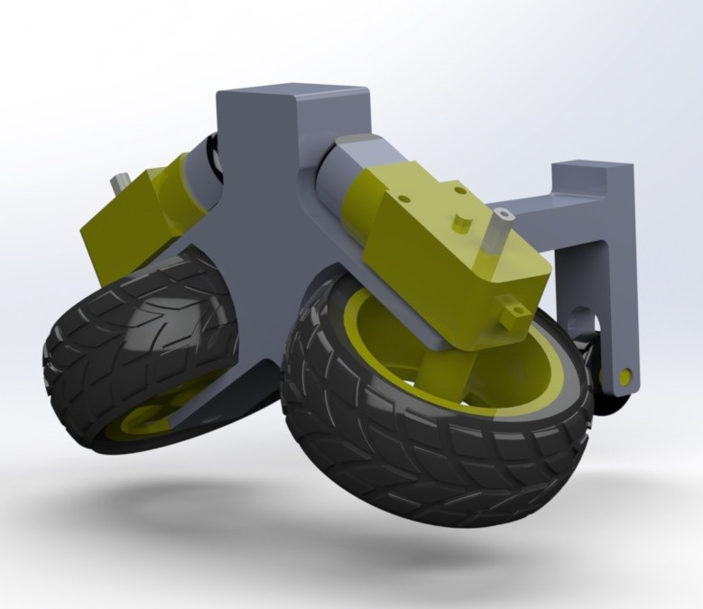
THE IDEA

Slide 5
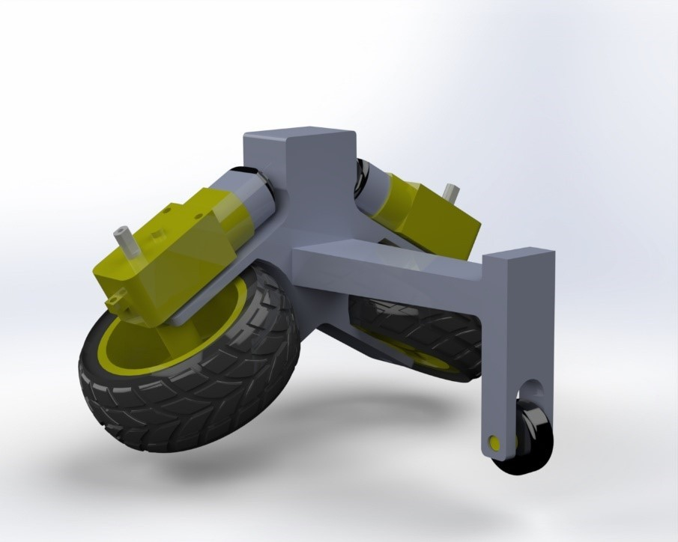
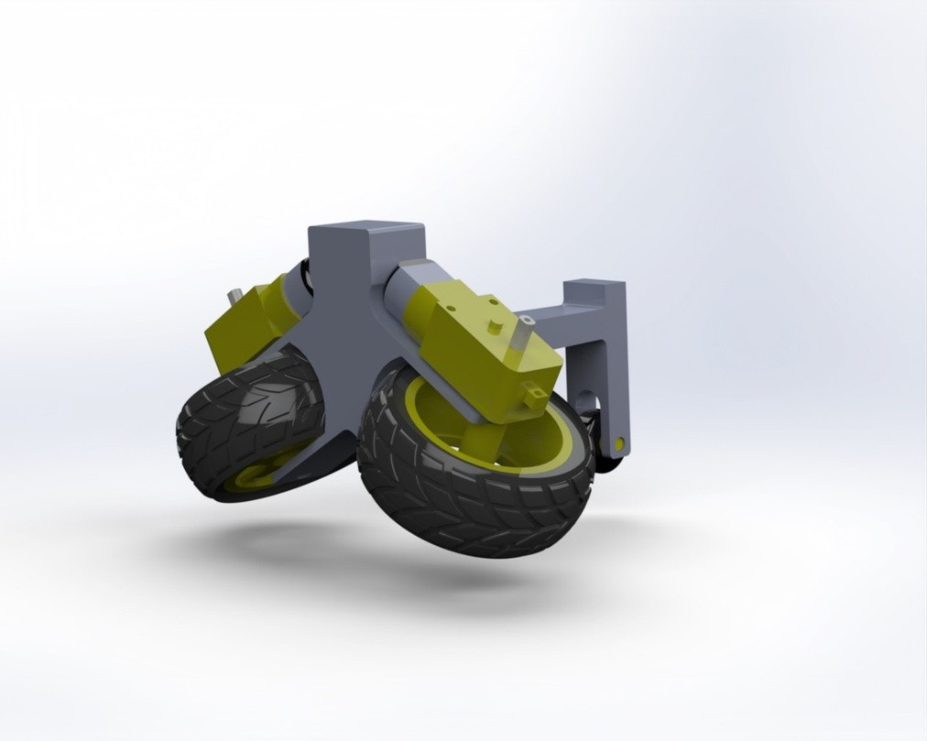
DESIGN
ROBOT’S FRONT DESIGN
ROBOT’S BACK DESIGN

Slide 6
01
Design Difficulty
02
Electrical components sensitivity
CONSTRAINTS
03
Batteries
04
Camera
05
Time Limit

Slide 7
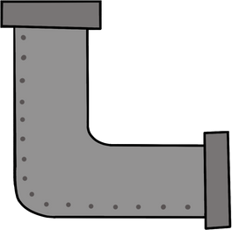
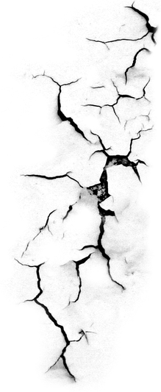

FEATURES
Carck Detection
Manual
Auto
path-Saving

Slide 8
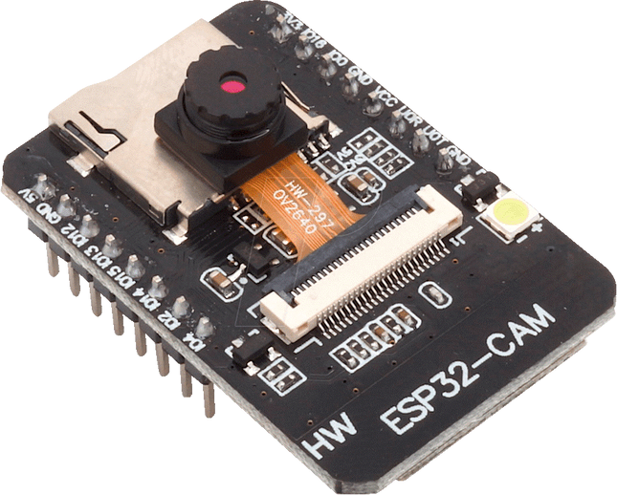
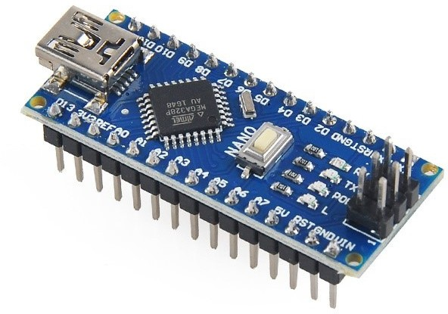
HARDWARE COMPONENTS
ESP32-CAM
ARDUINO NANO

Slide 9
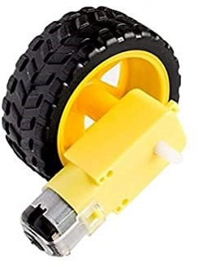
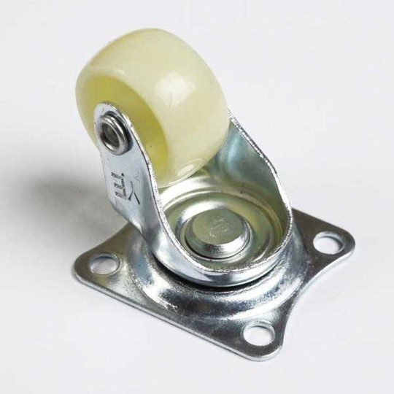
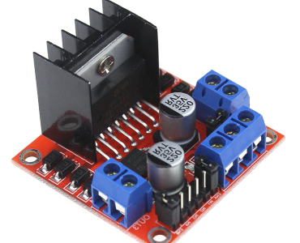
HARDWARE COMPONENTS
L298N MOTOR DRIVER (H-BRIDGE)
DC MOTORS AND WHEELS
CASTER WHEEL

Slide 10
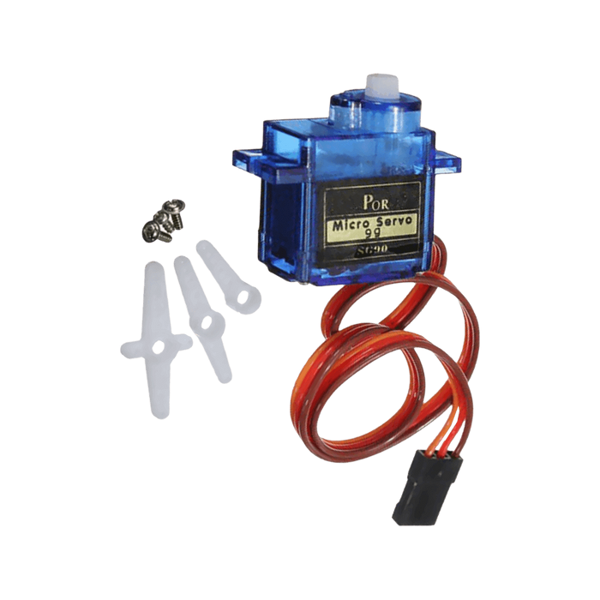
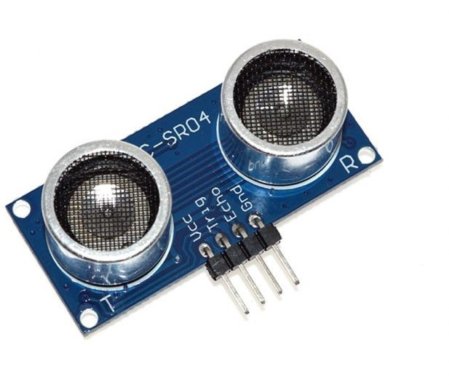
HARDWARE COMPONENTS
ULTRASONIC SENSOR
SERVO MOTOR

Slide 11
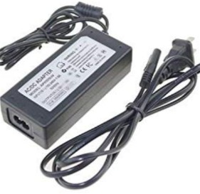
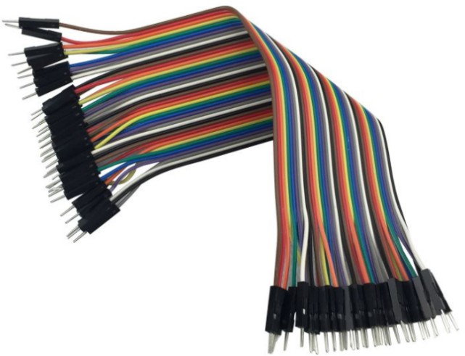
HARDWARE COMPONENTS
WIRES
AC/DC ADAPTER

Slide 12
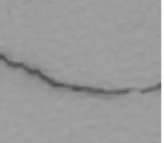
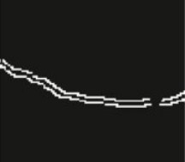
SOFTWARE
CANNY EDGE DETECTION ALGORITHM
INPUT IMAGE
OUTPUT IMAGE

Slide 13
01
Fix pipes' crack
02
03
Vertical and horizontal movement
FUTURE WORK
Suitable for pipes of various sizes.

Slide 14
DEMO

Slide 15
THANKS FOR LISTENING

