Slide 1

An-Najah National University
Faculty of Engineering & Information Technology
Graduation Project - II
Nablus Public Library
Group Members
Ahmad Asfour
AlGhalee Shihab
Islam Bishawi
Yasmeen Najjar
Supervisor
Dr. Ahmad Haj Saleh

Slide 2
TABLE OF CONTENTS
01
02
03
Introduction
Architectural Aspects
Enviromental Aspects
04
05
06
Structural Aspects
Eloctro-Mechanical Aspects
Quantity Survaying and Cost Estimation

Slide 3

Introduction
Project Description
Methodology
Project Location
Nablus Public Library

Slide 4
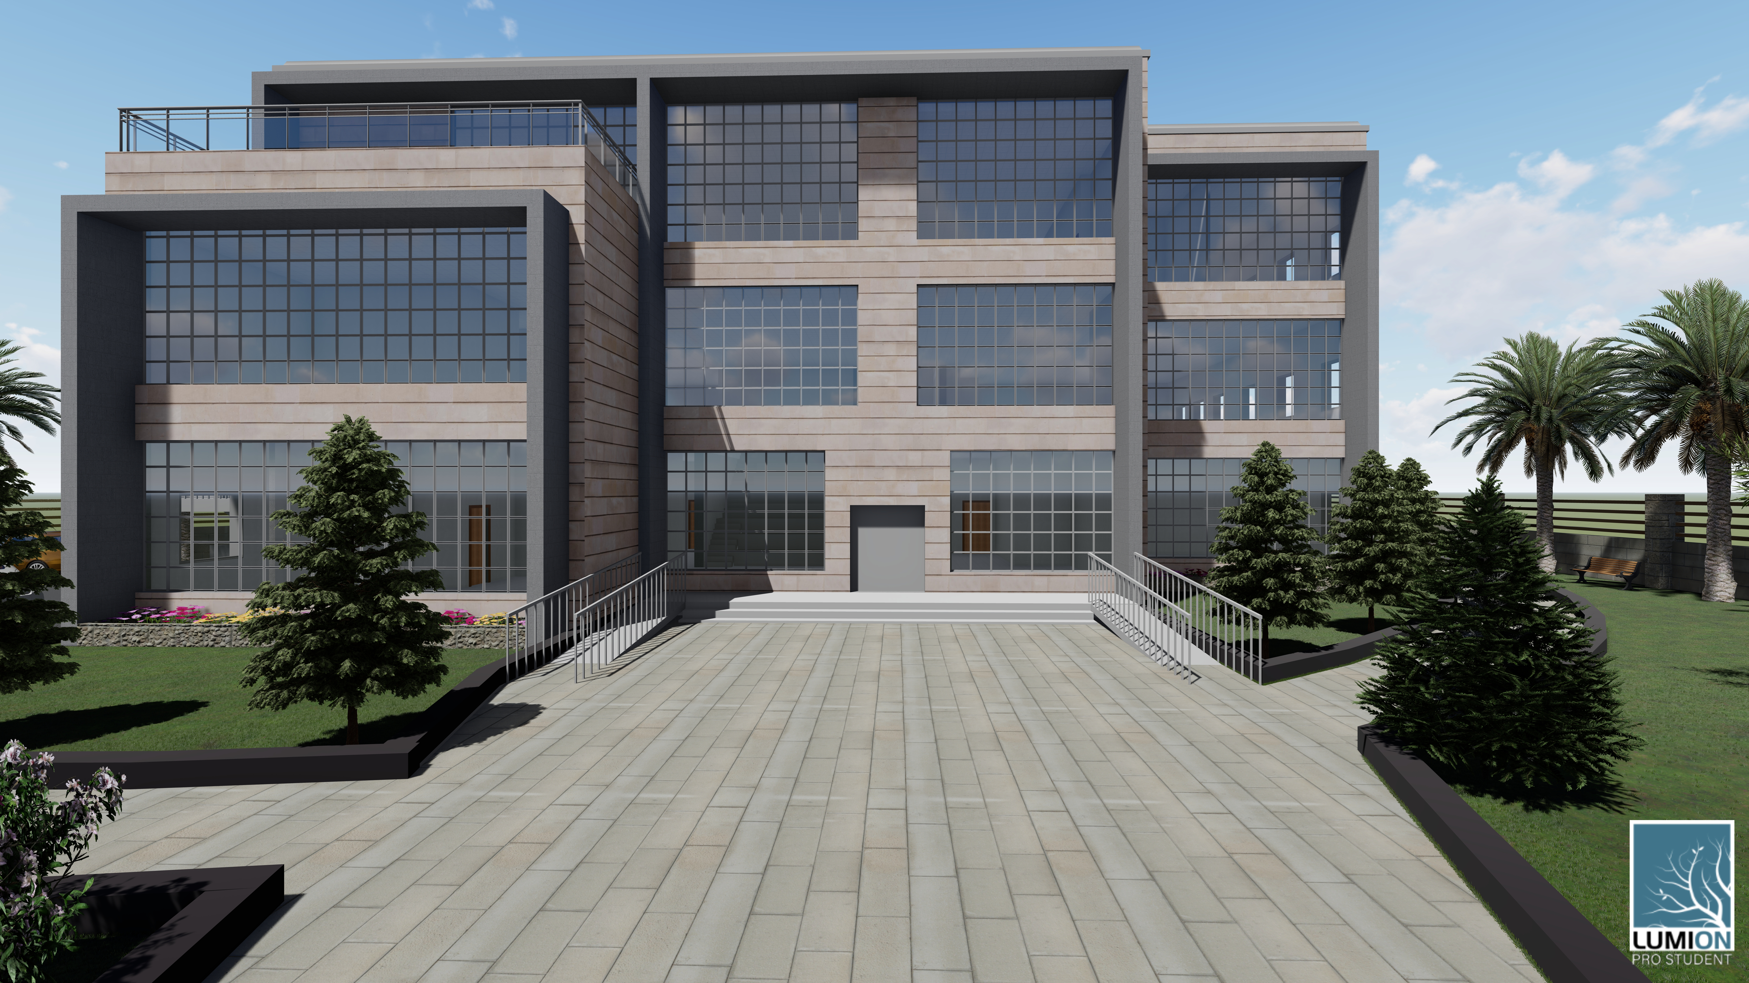
Introduction – Project Description
In this graduation project, a public library consisting of Four floors with a total area of 1424 square meters was analyzed and re-designed.

Slide 5
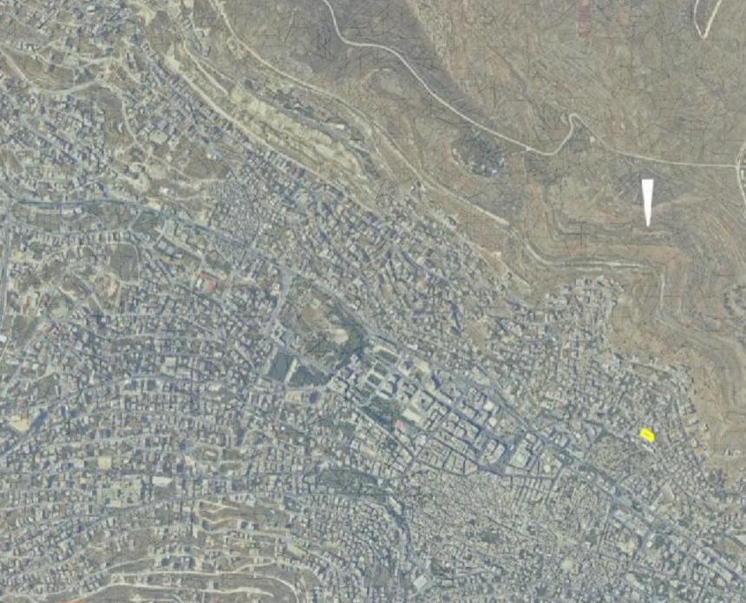


Introduction – Site Location
The proposed architectural site for the project has been changed from Al-Basateen Street to Al-Maajin area, so that it is farther from the Nablus Municipal Library with a total distance of 1.85 km distance from the city center.

Slide 6
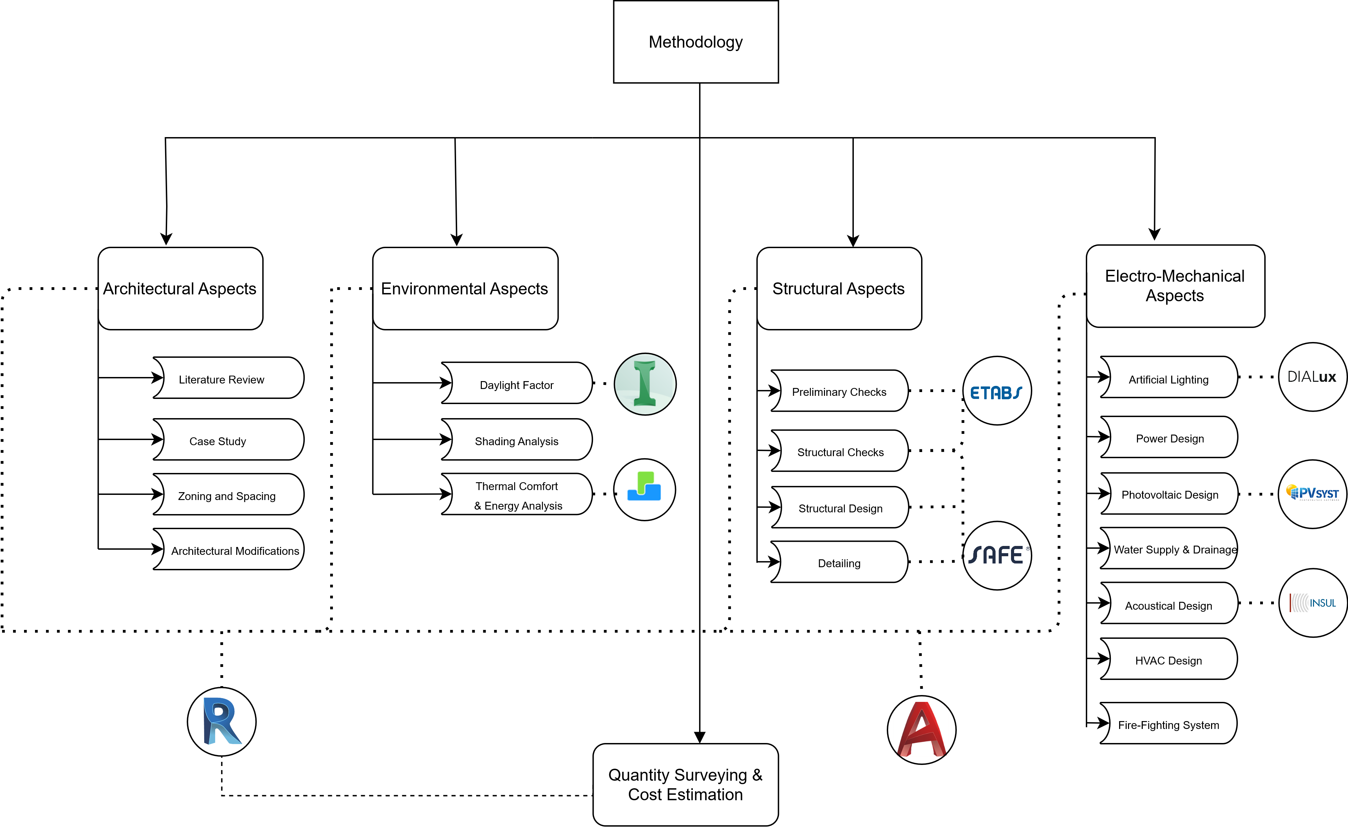
Introduction - Methodology

Slide 7
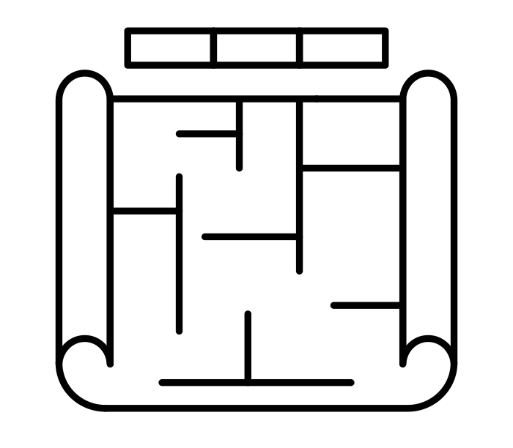
Architectural Aspects
Site Analysis
Architectural Plans
Rendered Shots

Slide 8
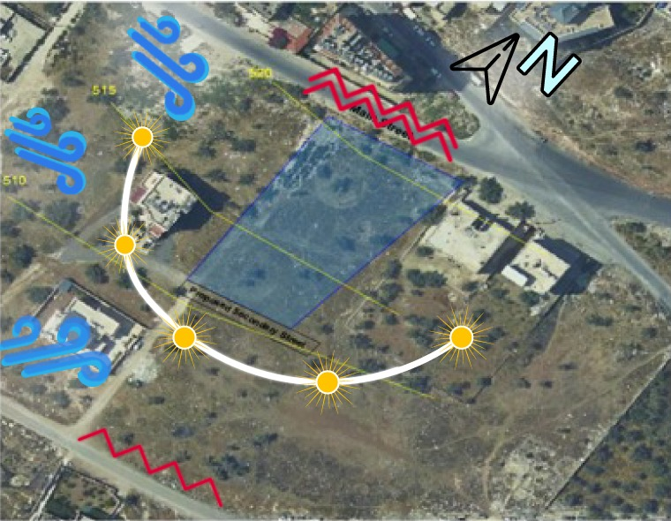
Site Analysis – Environmental Effect
Wind Direction
Noise Sources
Sun Path

Slide 9
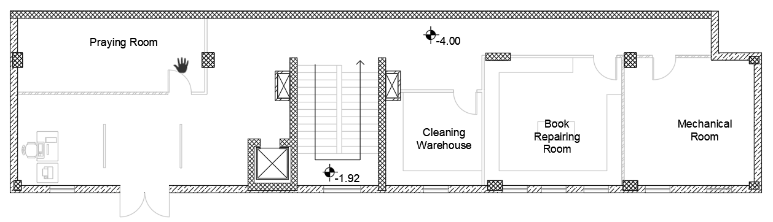
Architectural Aspects – Architectural Modifications
Adding Basement:
Mechanical Room.
Book Repairing Room.
Praying Room.
Cleaning Room.

Slide 10
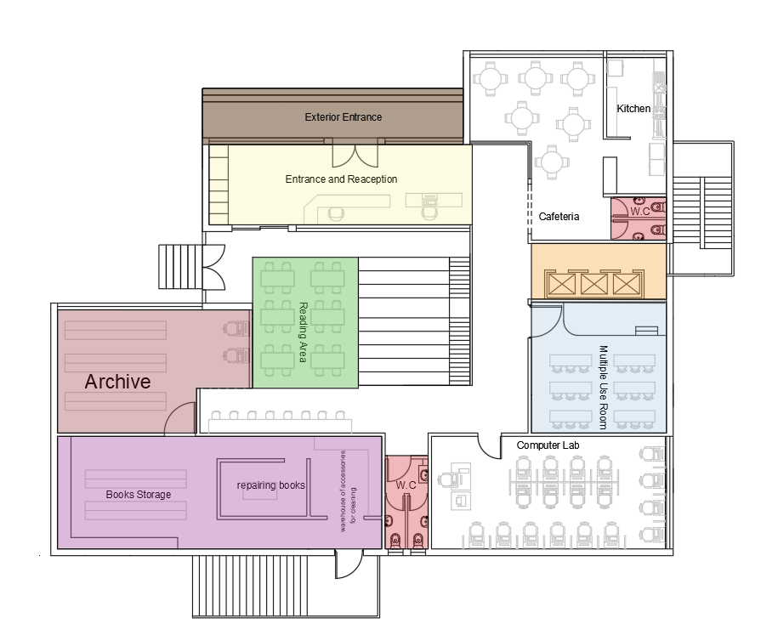
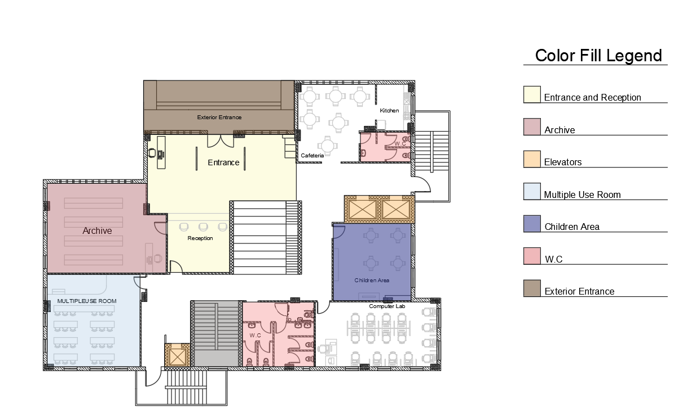
Architectural Aspects – Architectural Modifications (Cont’d)
2. Ground Floor Modifications
Before Modifications
After Modifications

Slide 11
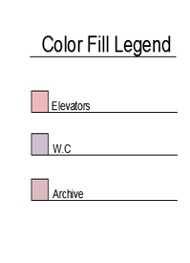
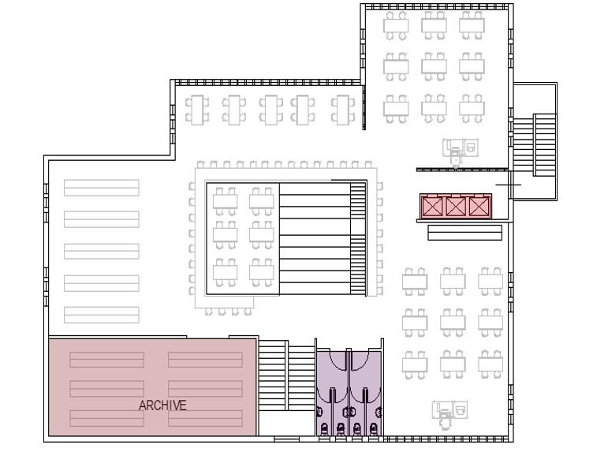
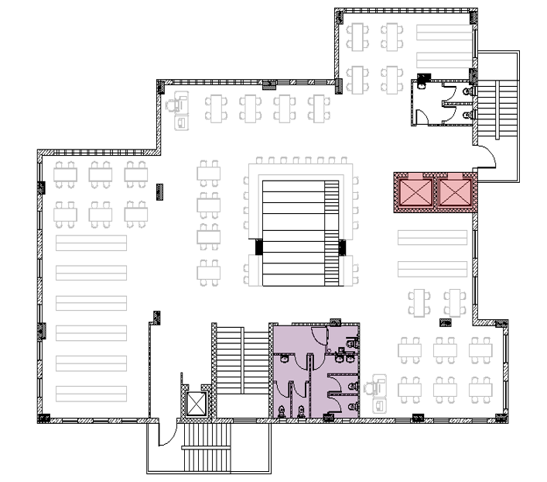
Architectural Aspects – Architectural Modifications (Cont’d)
2. First Floor Modifications
Before Modifications
After Modifications

Slide 12
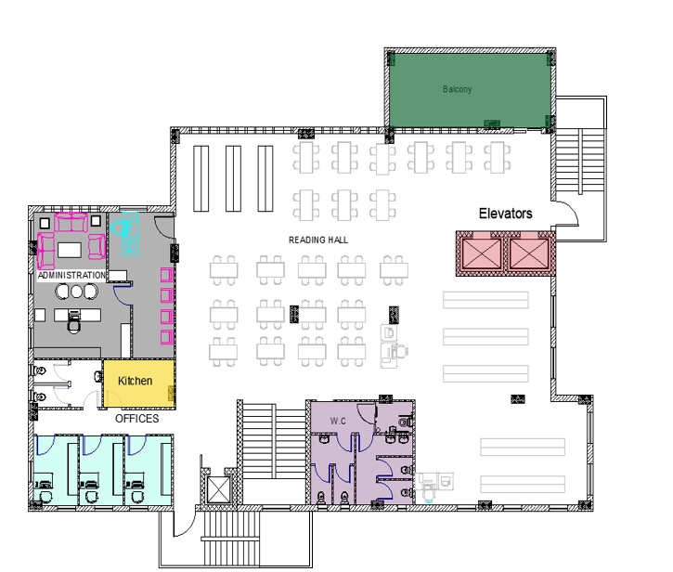
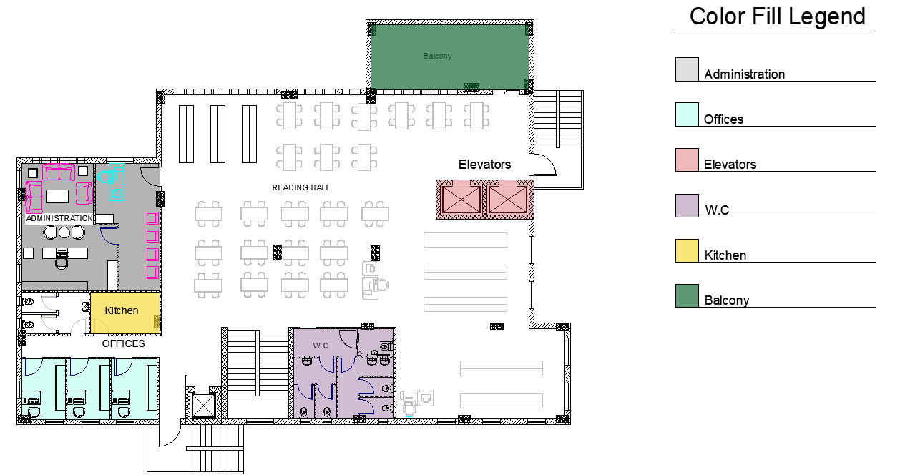
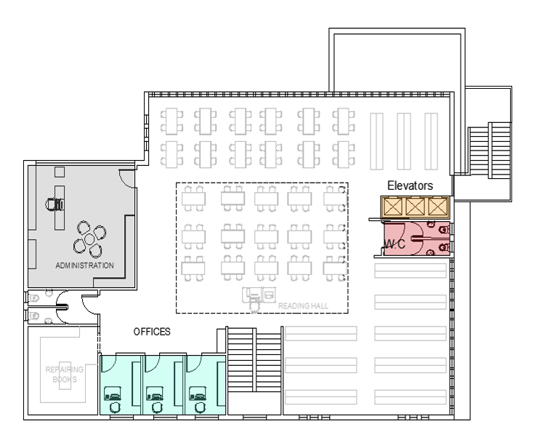
Architectural Aspects – Architectural Modifications (Cont’d)
3. Second Floor Modifications
Before Modifications
After Modifications

Slide 13
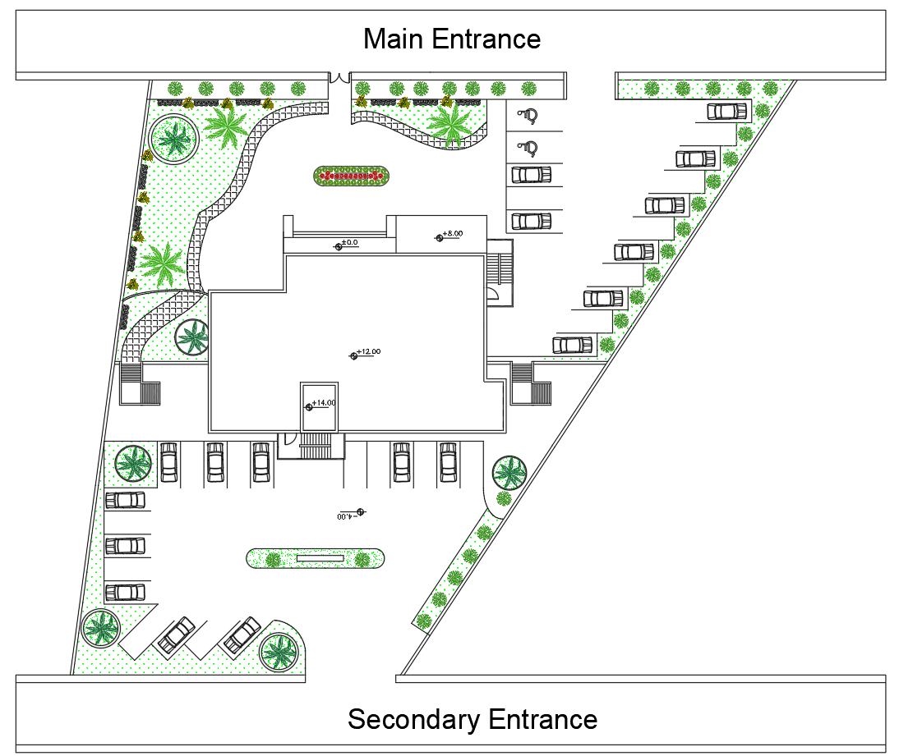

Architectural Aspects – Architectural Modifications (Cont’d)
4. Site Plan

Slide 14
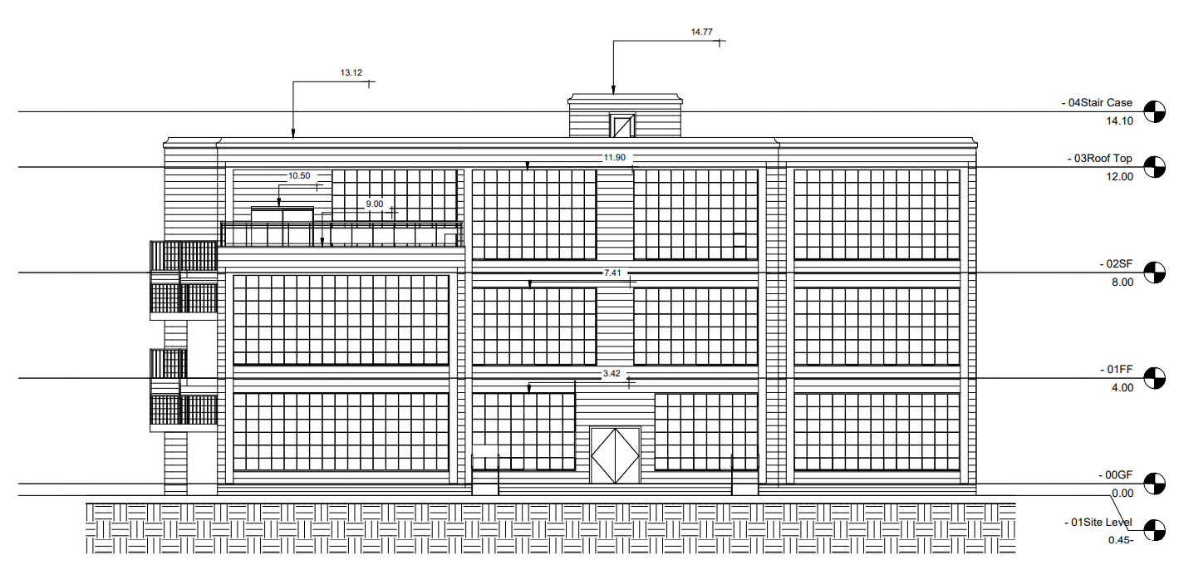
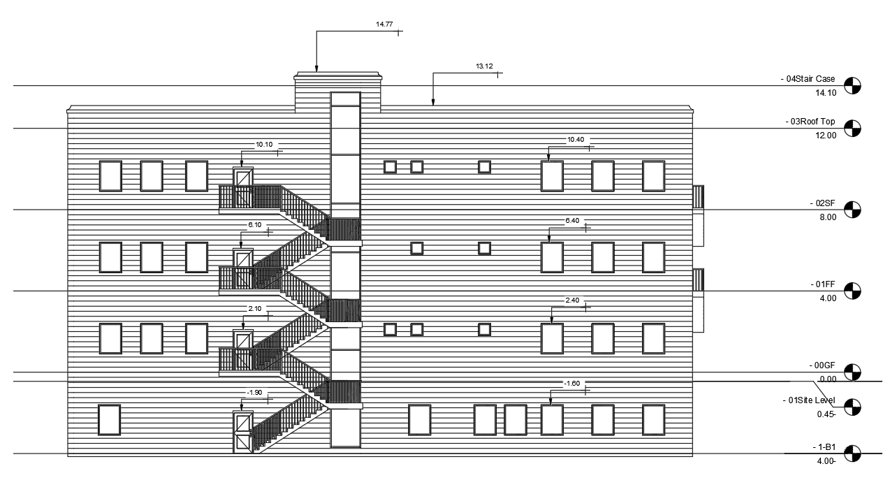
Architectural Aspects – Elevations
North Elevation
South Elevation

Slide 15
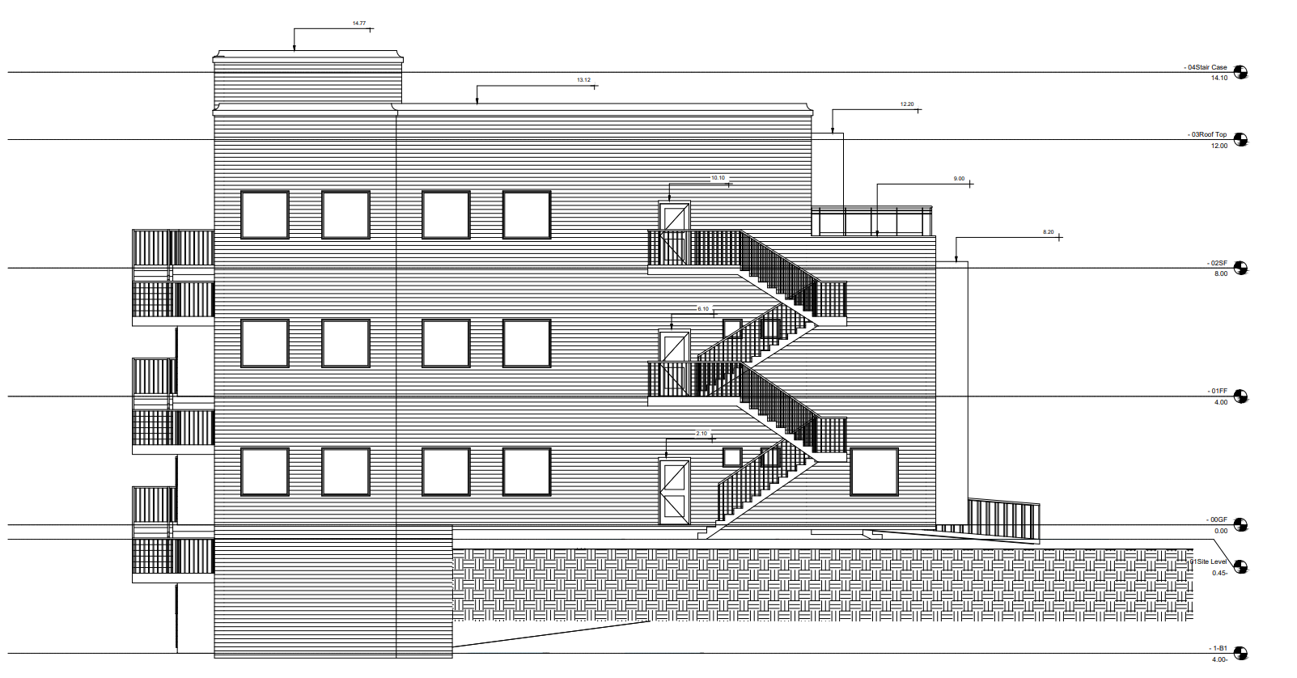
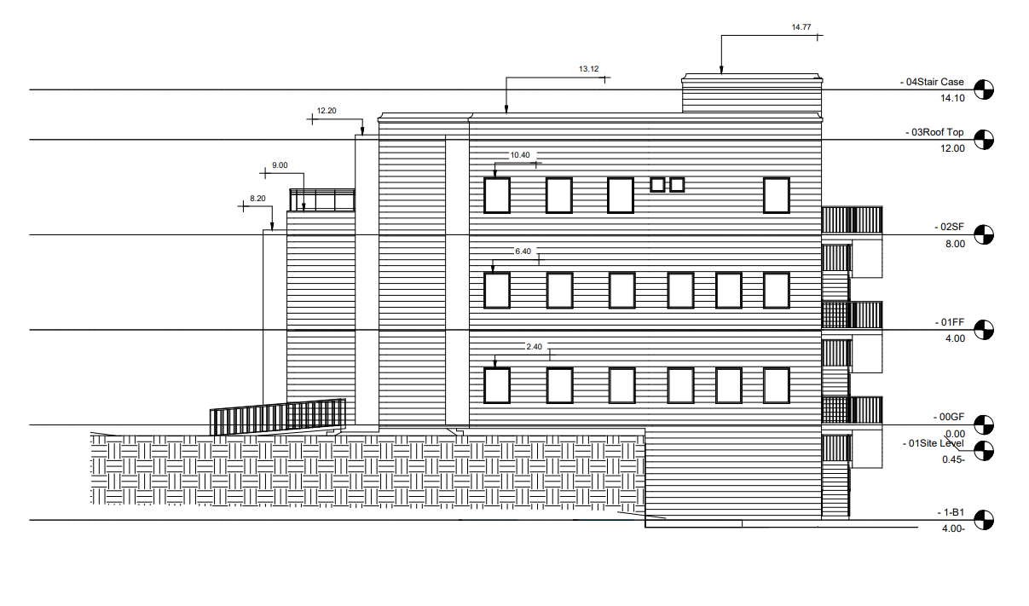
Architectural Aspects – Elevations
South Elevation
East Elevation
West Elevation

Slide 16
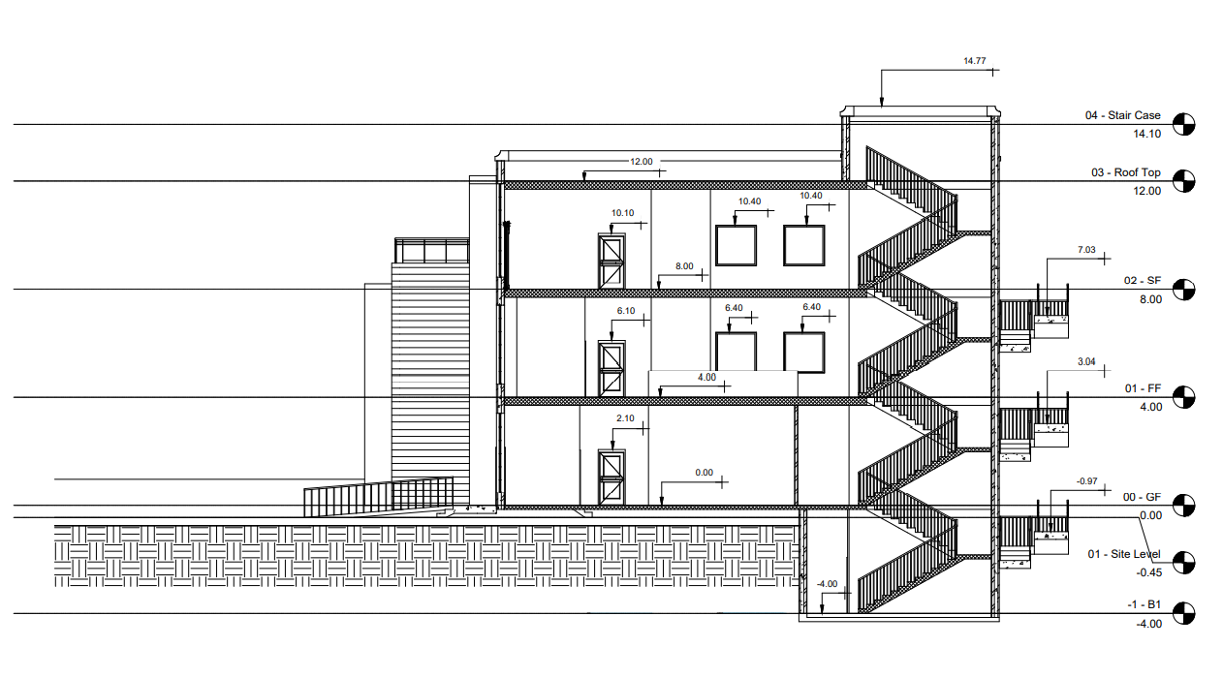
Architectural Aspects – Sections

Slide 17
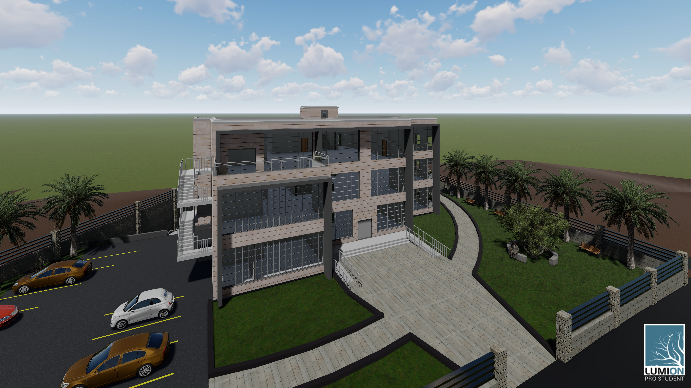
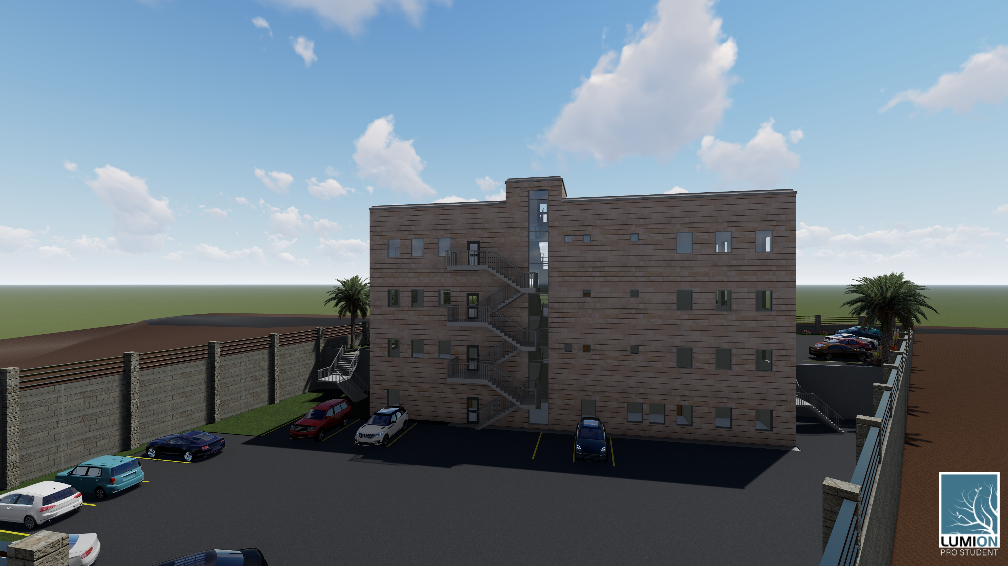
Architectural Aspects – Rendered Views

Slide 18

Environmental Aspects
Design Builder Simulation and Results
Daylight Factor Analysis
Shading System

Slide 19
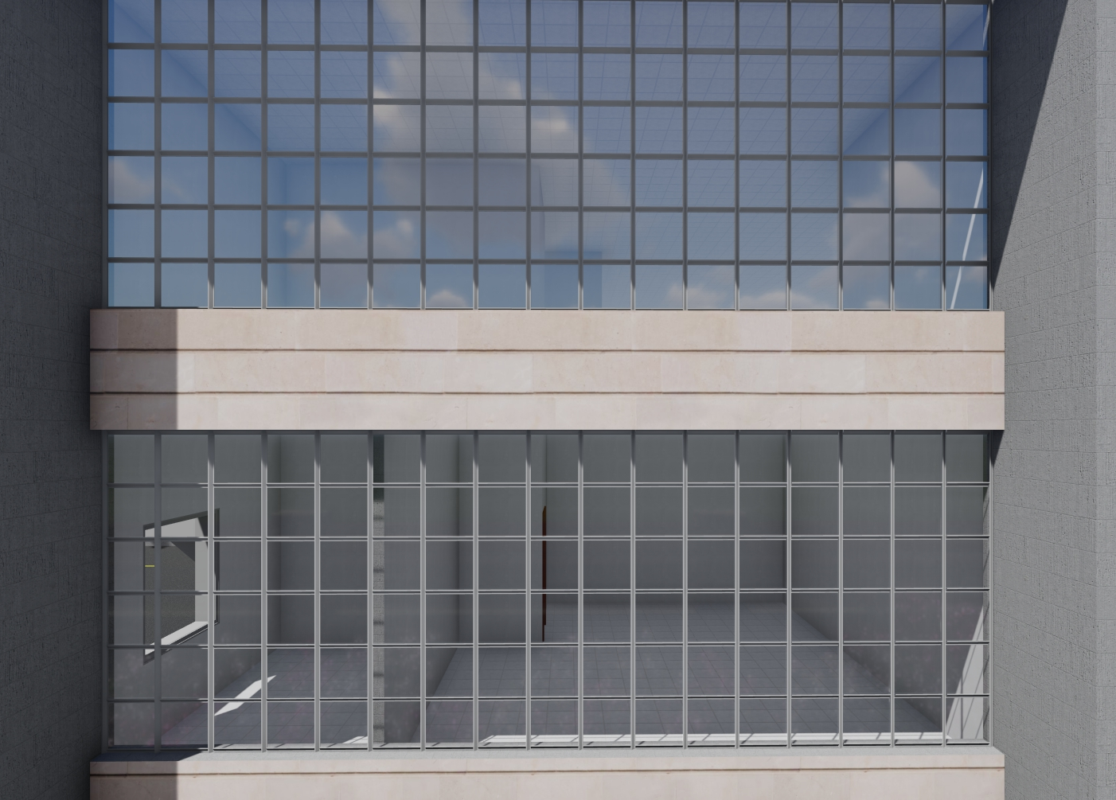
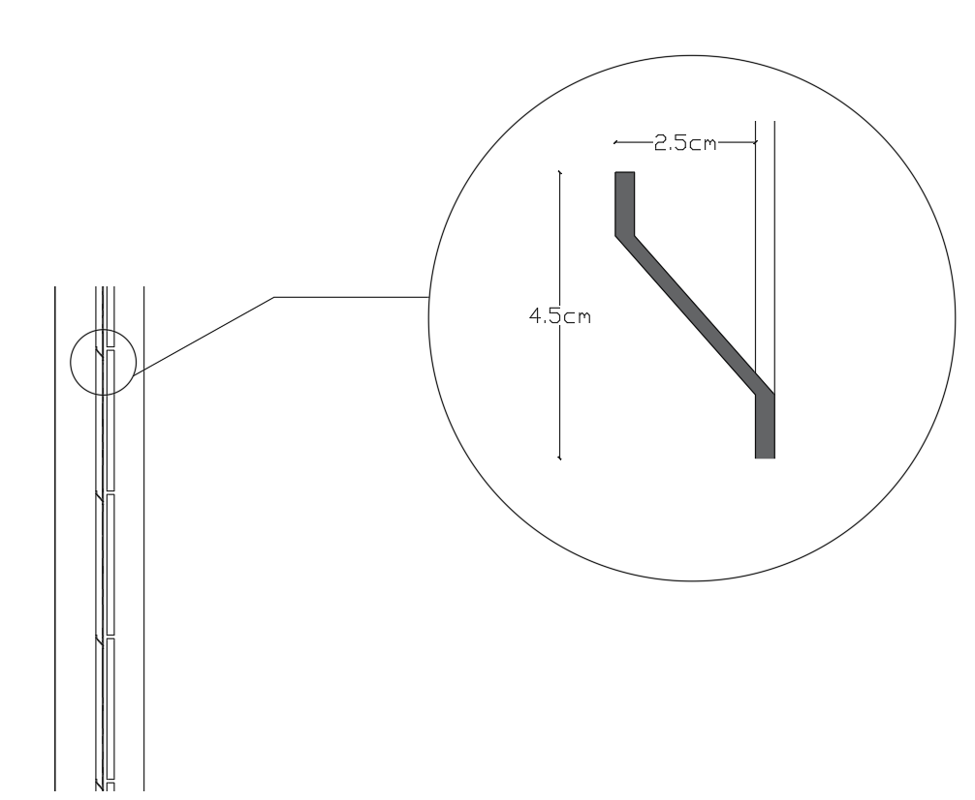
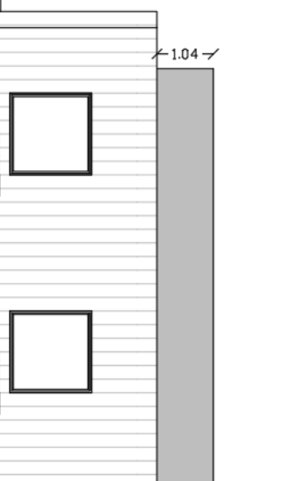
Environmental Aspects– Daylight Factor
Modifications
Opening was added to the stair case in the southern elevation.
Louvers were added each 50cm horizontally and vertically on the northern elevation because it has the largest area of glazing.
Stone frames acting as a cantilever to prevent glare.

Slide 20
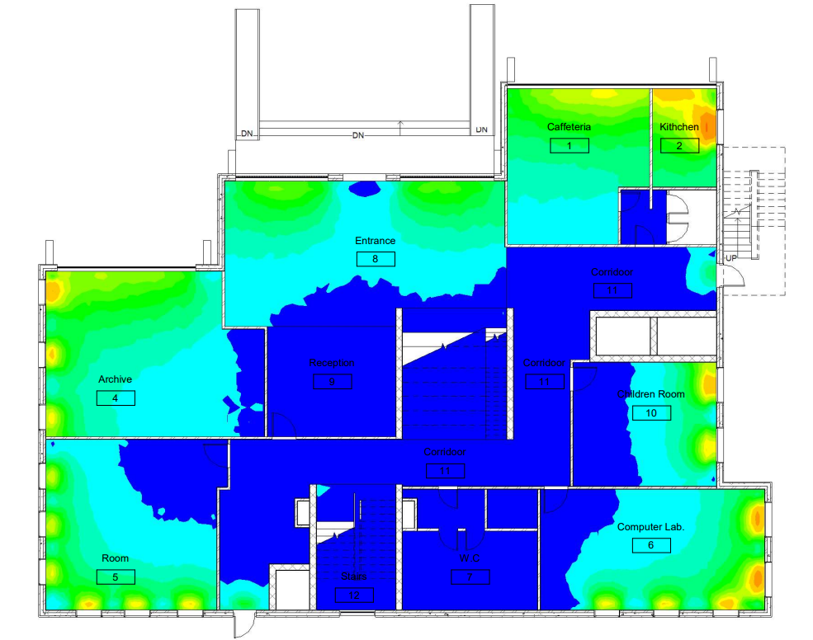
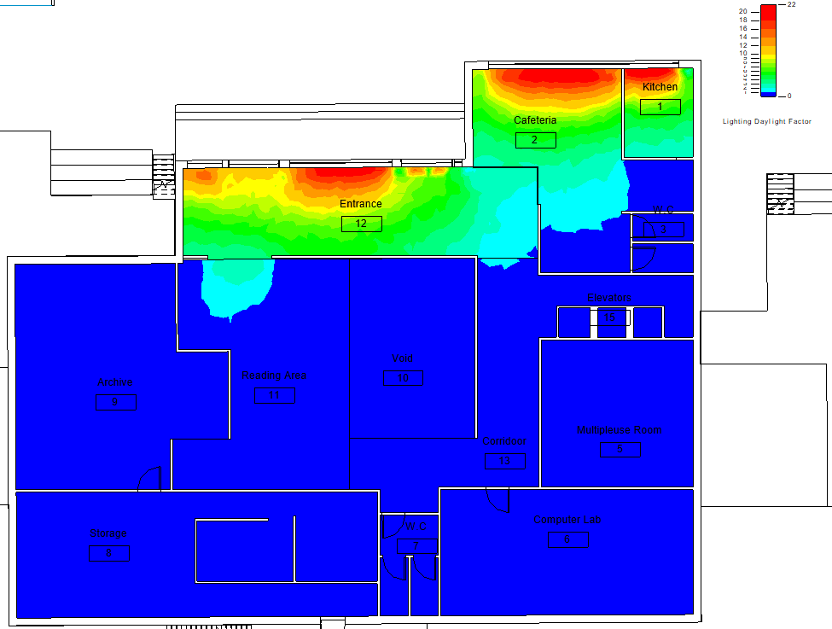
Environmental Aspects– Daylight Factor
Daylight Factor Analysis Ground Floor Plans
Before Modifications
After Modifications

Slide 21
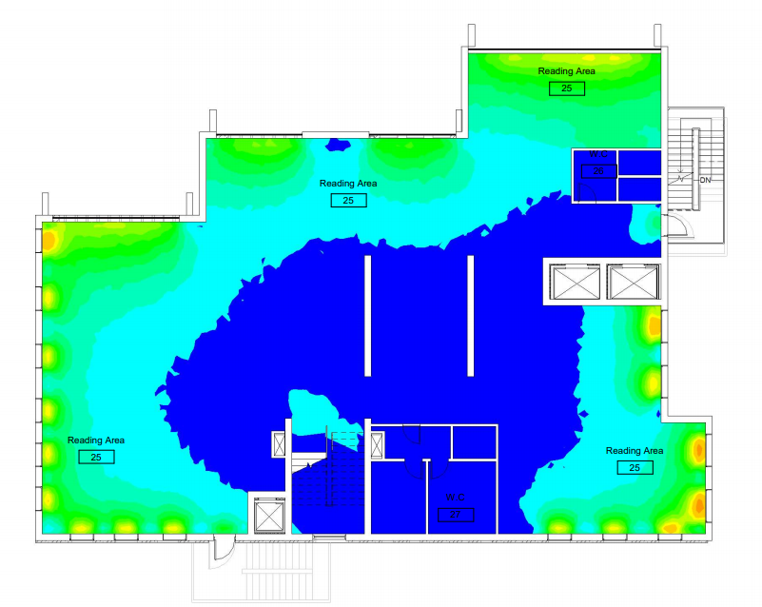
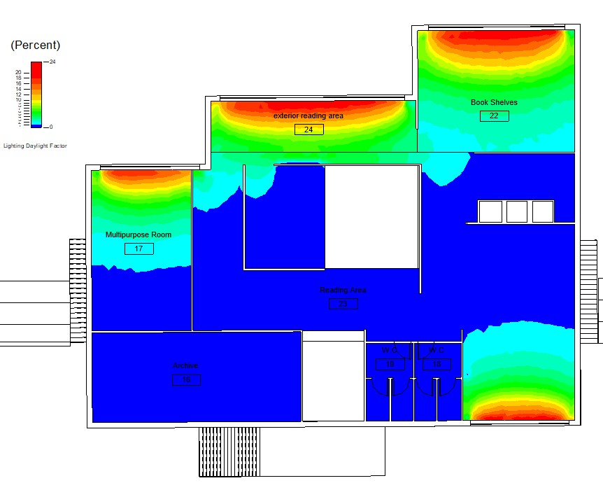
Environmental Aspects– Daylight Factor
Daylight Factor Analysis First Floor Plans
Before Modifications
After Modifications

Slide 22
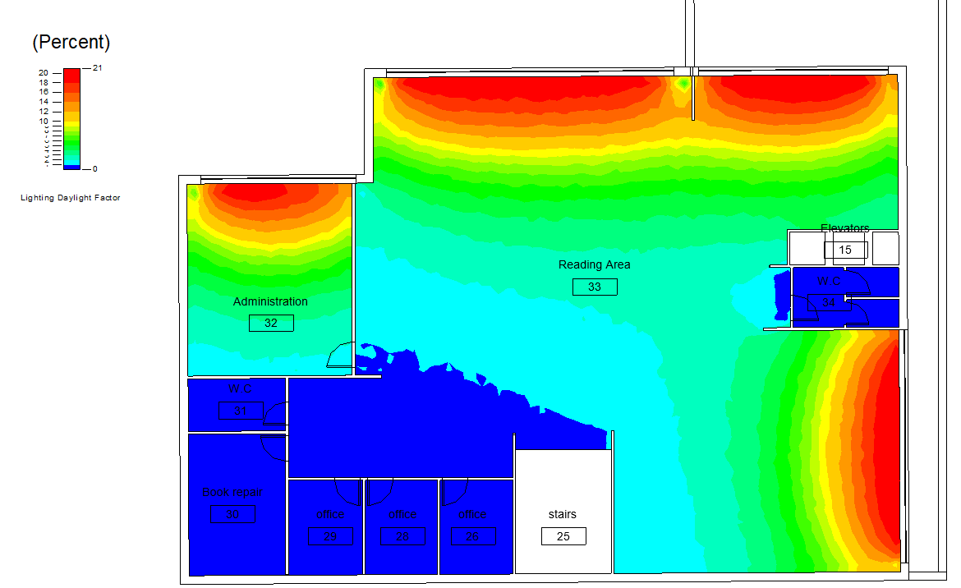
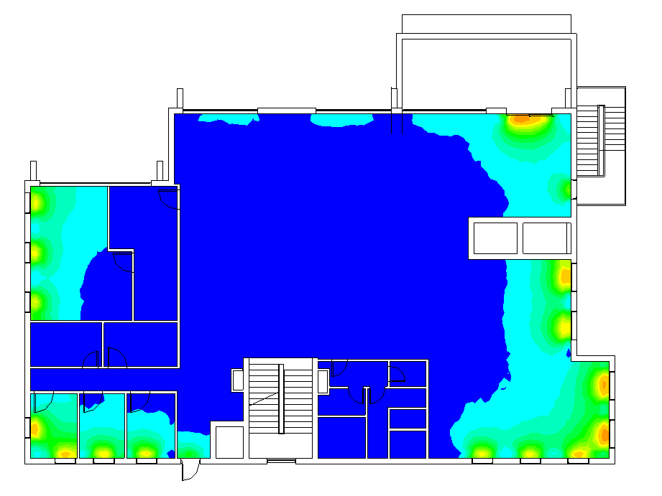
Environmental Aspects– Daylight Factor
Daylight Factor Analysis Second Floor Plans
Before Modifications
After Modifications

Slide 23
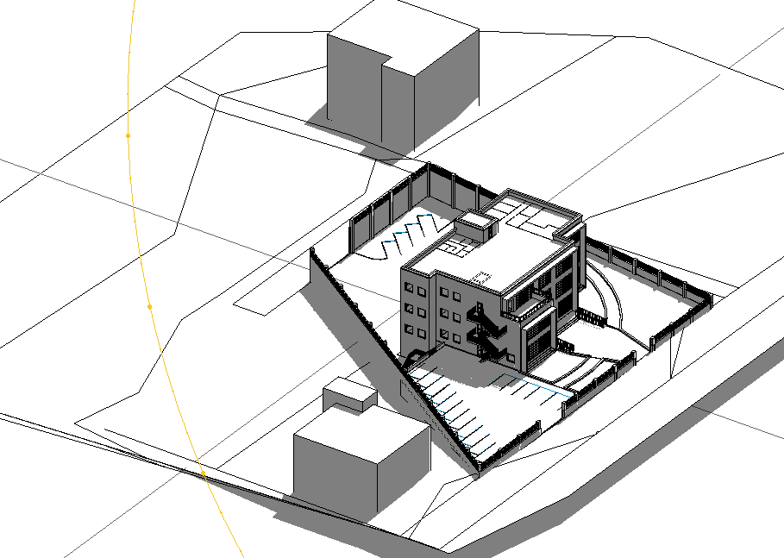
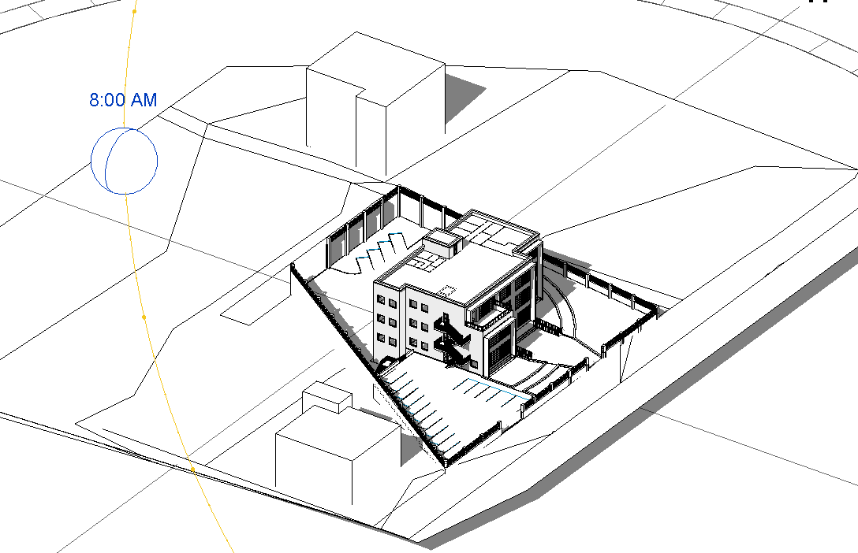
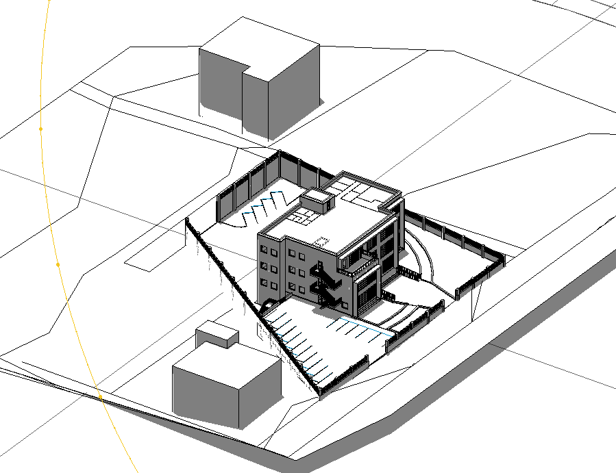
Environmental Aspects – Shading Analysis
Shading in summer
At 8:00 am
At 12:00 pm
At 2:00 pm

Slide 24
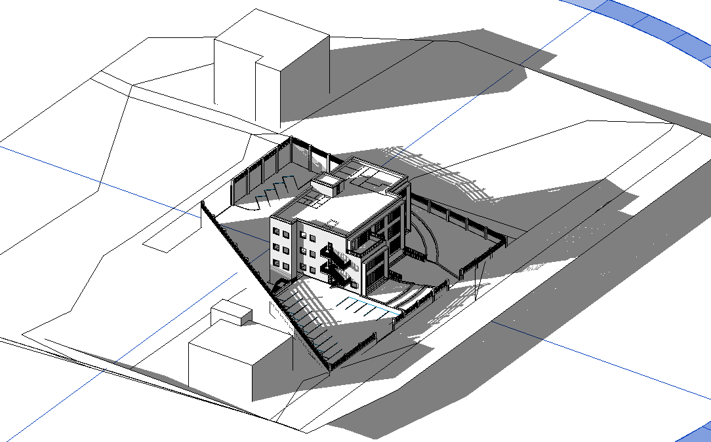
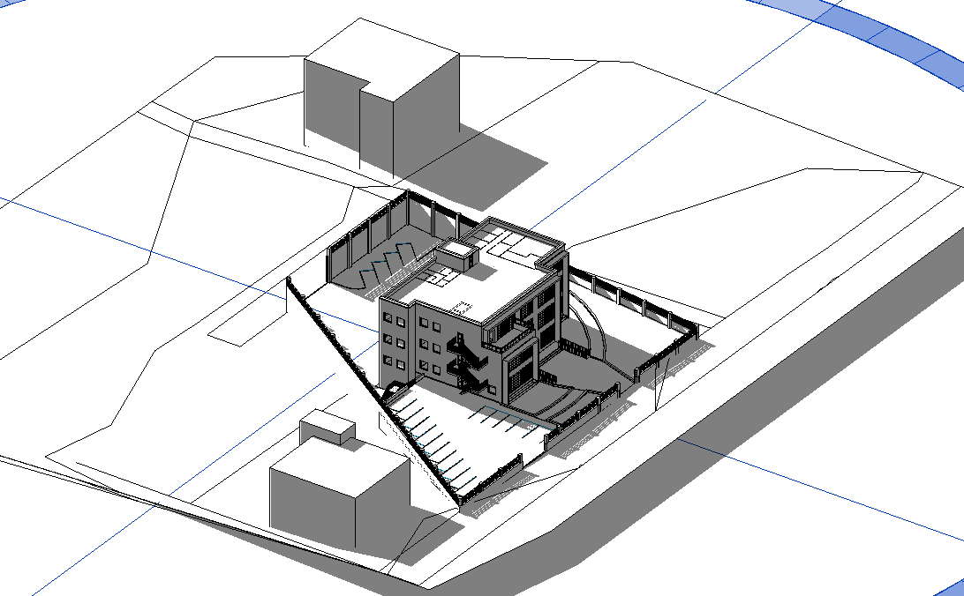
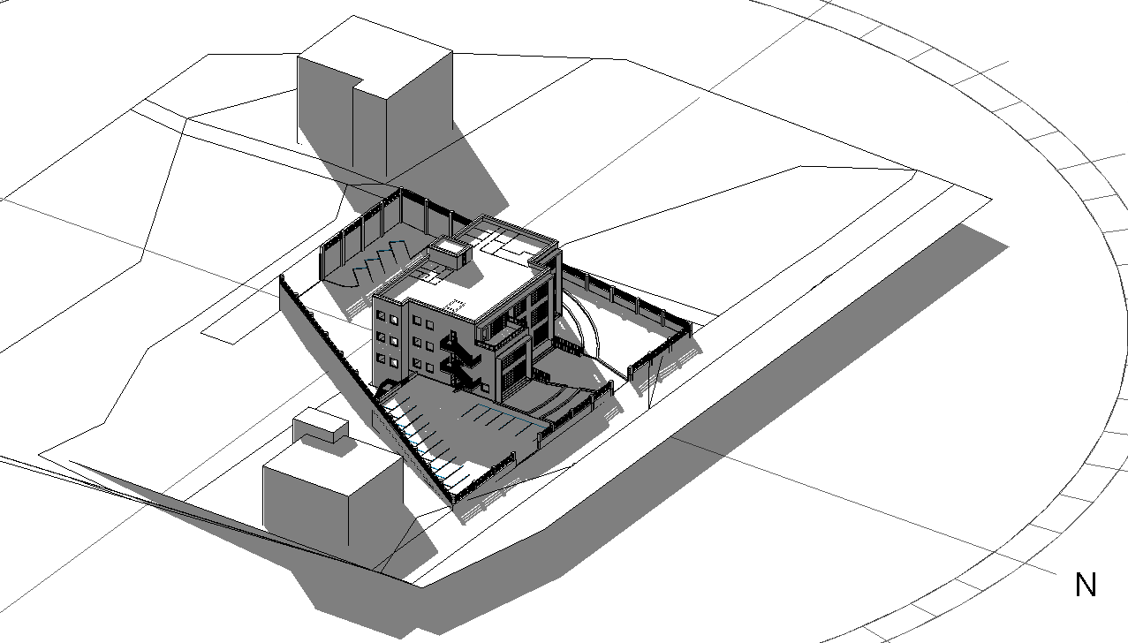
Environmental Aspects – Shading Analysis
Shading in Winter
At 8:00 am
At 12:00 pm
At 3:00 pm

Slide 25
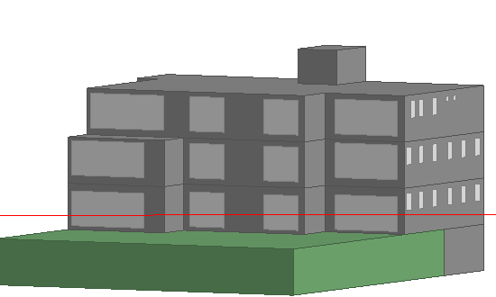
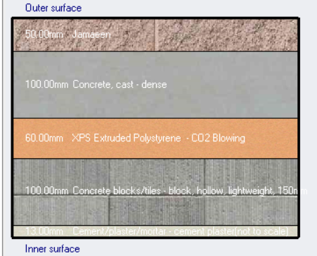
Environmental Aspects– Design Builder Analysis and Results
Design Builder Simulation Analysis
Wall Section
Wall U-Value

Slide 26
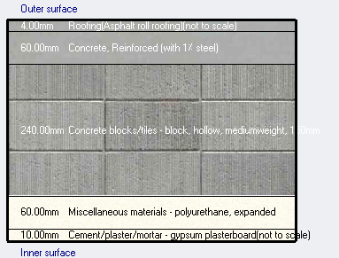
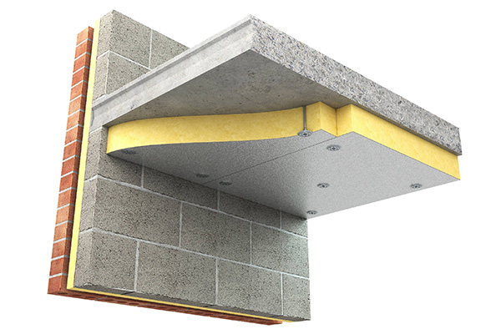
Environmental Aspects– Design Builder Analysis and Results
Roof Section
Roof U-Value

Slide 27
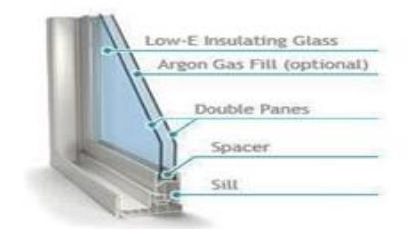
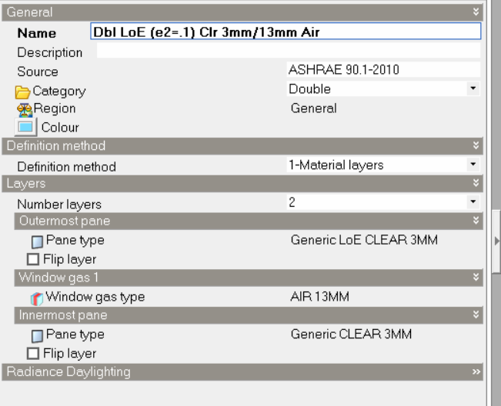
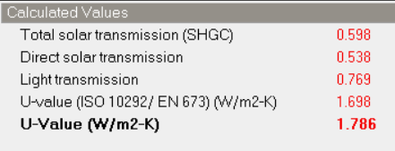
Environmental Aspects– Design Builder Analysis and Results
Window Section
Window Definition
Glass U-Value

Slide 28
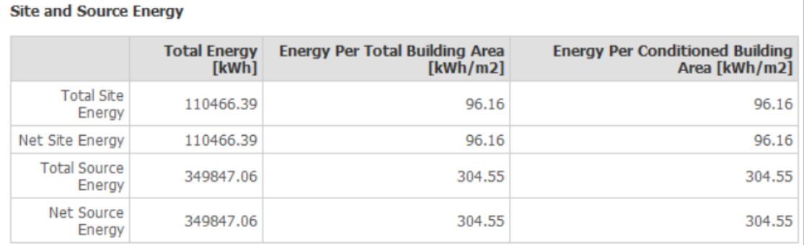
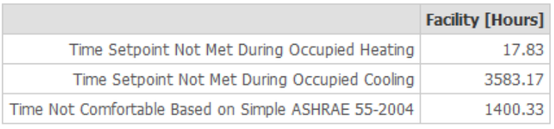
Environmental Aspects– Design Builder Analysis and Results
Design Builder Simulation Results

Slide 29
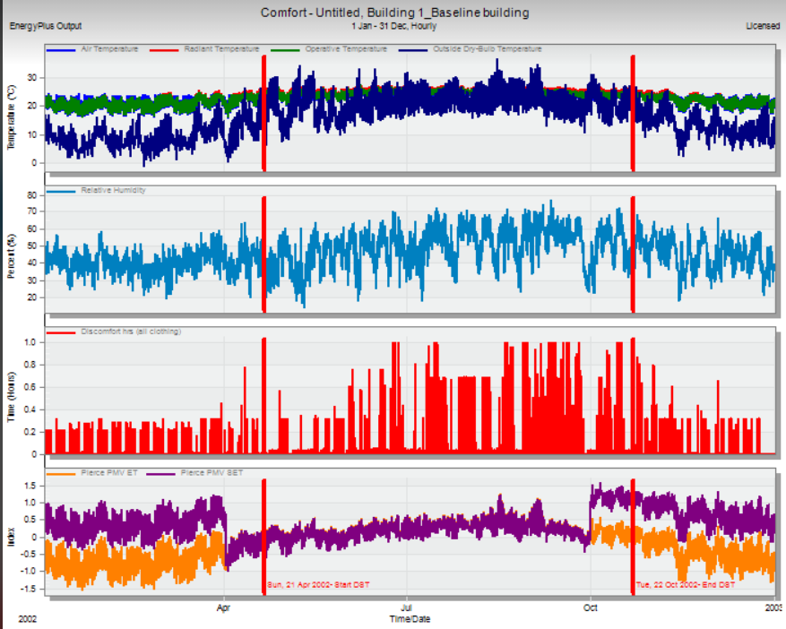
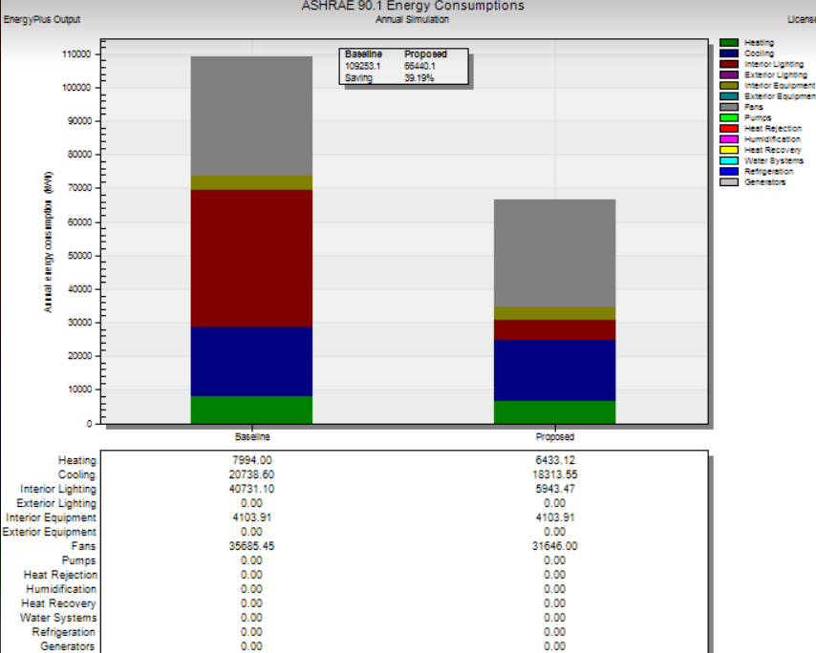
Environmental Aspects– Design Builder Analysis and Results
Predicted Mean Value
Energy Baseline Comparison

Slide 30
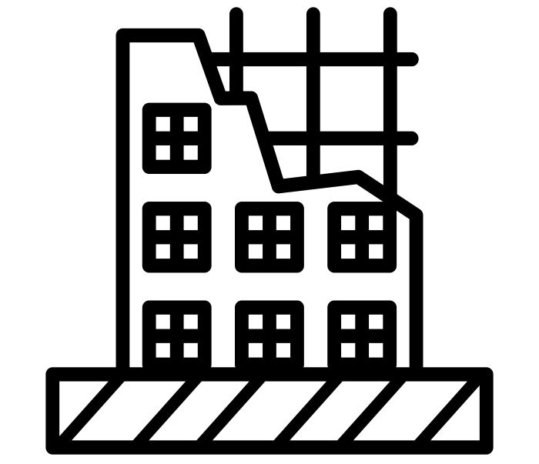
Structural Aspects
Preliminary Checks
Seismic Checks
Design Details

Slide 31
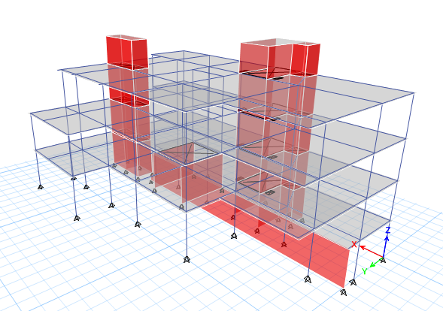

Structural Aspects – Structural System
The following codes were used in the structural design:
ACI-318R-14 for reinforced concrete structural design
ASCE 7 2010 for load combinations
IBC – 2016 for seismic design.

Slide 32
Structural Aspects – Design Data
Design Data
Loads
Materials
Dead load (From ETABS)
Superimposed Loads = 2.5 KN/m²
Live Loads = 4 KN/m²
Concrete - (f_{c}) = 28 MPa.
Steel - (f_{y}) = 420 Mpa
Soil Bearing Capacity=250kn/m2

Slide 33

Structural Aspects – Structural Checks
Compatibility Check

Slide 34

Structural Aspects – Structural Checks
Equilibrium Check
 | Etabs | Manual | Error(%) | < 5 %
Dead | 18096.79 | 17855.65 | 1.35
Live | 6580 | 6593.36 | 0.203
SID | 15916.26 | 16129.52 | 1.32

Slide 35

Structural Aspects – Structural Checks
Stress-Strain Check – Columns
C 30*40m
Structure elements | Manual
one way | 0
two way | 547.0164
main beams | 185.8442
column | 43.2
Total | 776.0606
ETABS | 715.6039
Difference | 8.4 %

Slide 36

Structural Aspects – Structural Checks
Stress-Strain Check – Beams
Edge Beam (B45*30)
 | Manual (KN) |  | ETABS (KN) |  | Difference (%)
One way | 0 | 0 | M1- | -295.43
Two way | 64.8 | 242.44 | M2- | -327.56
Weight (kN/m) | 9.45 | 53.11 | M+ | 168.69
Total(KN) | 518.098 |  | 480.189 |  | 7.89

Slide 37


Structural Aspects – Structural Checks
Stress-Strain Check – Slab
Slab
ETABS | M1(-ve) | -14
 | M2 (-ve) | -30
 | M (+ve) | 28
 |  | 50
Manual | 48.30
Difference | 3.3953 %
< 10 %
$$\frac{M1\left(−ve\right)+M2 \left(−ve\right)}{2}+M (+ve)$$

Slide 38


Structural Aspects – Structural Checks
Deflection Checks
$$Δ_{all.}= \frac{L}{240}= \frac{8.1}{240}∗\left(1000\right)=33.75mm$$

Slide 39
Structural Aspects – Structural Checks
Seismic Checks
City of Structure | Nablus
Site Class | C- very dense soil and hard rock
Risk Category | II
Over strength factor | 2.5
Deflection Amplification factor | 4.5
Seismic Importance Factor | I=1
Structural Design Type | Building Frame System-Ordinary reinforced concrete shear walls
Response Modification factor ( R) | R=5

Slide 40


Structural Aspects – Structural Checks
Seismic Checks

Slide 41

Structural Aspects – Structural Checks
Period Check
T Etabs (x direction) = 0.97 sec.
T Etabs (y direction) = 0.276 sec
$$Ta = 0.0488∗\left({16}^{0.75}\right)= 0.3904 sec$$
$$T_{limit}=\min\left\{\begin{aligned}T from ETABS=0.276 sec. \\ C_{U}∗T_{a}=0.6304 sec.\end{aligned}\right.$$

Slide 42
Structural Aspects – Structural Checks
Base shear check
Axis | T | Tlimit | T final | Cs1 | Cs2 | Cs3 | Cs final | V | V_{ETABS} | Error %
X | 0.097 | 0.54656 | 0.097 | 0.103111 | 0.3592 | 0.0204 | 0.1031 | 2944.647 | 2898.1034 | 1.5806
Y | 0.276 | 0.54656 | 0.276 | 0.1031 | 0.1262 | 0.0204 | 0.1031 | 2944.647 | 2898.1034 | 1.5806

Slide 43

Structural Aspects – Structural Checks
Drift Check
The allowable drift = 0.02
$$δ_{m }= \frac{C_{d}∗δ_{max } }{I_{c}}= \frac{0.0007∗4}{1}=0.0028$$
Where:
C_{d}: the floor height in meters.
Δ_{max}: the story drift value from ETABS.
I_{c}: the importance factor which equals 1 in this project.
So $δ_{m }$=0.00028 < 0.02

Slide 44
Structural Aspects – Structural Checks
P-Delta Check
Θ < 0.1
If the previous equation is true, then the building is safe.
.
θ= PS*h
Where:
P: the story force in kN.
S: story stiffness.
h: story height in meters.
Axis | P | S | h | theta
X | 38863.378 | 2.77*10⁵ | 4 | 3.51*10⁻²
Y | 38863.378 | 5.35E*10⁵ | 4 | 3.51*10⁻²

Slide 45


Structural Aspects – Structural Elements Design
Slab Design
Basement Slab Design
Ground Floor Slab Design

Slide 46


Structural Aspects – Structural Elements Design
Slab Design
First Floor Slab Design
Second Floor Slab Design

Slide 47


Structural Aspects – Structural Elements Design
Slab Design
Two Way Ribbed Slab
One Way Ribbed Slab

Slide 48


Structural Aspects – Structural Elements Design
Columns Design
Basement Column Distribution
Ground Floor Column Distribution

Slide 49


Structural Aspects – Structural Elements Design
Columns Design
First Floor Column Distribution
Second Floor Column Distribution

Slide 50
Structural Aspects – Structural Elements Design
Columns Design
Column | B (cm) | H (cm) | Rebar Percentage (%) | Longitudinal Reinforcement (cm2) | Bar diameter (mm) | Bar area (cm2) | # of Bars | Stirrups at the Middle | Stirrups at Supports
C1 (Corner Column) | 30 | 40 | 1% | 12 | 16 | 2.031 | 6 | 1 fi 10/150 mm | 1 fi 10/150 mm
C2 (Edge Column) | 40 | 60 | 1% | 24 | 20 | 2.54 | 10 | 1 fi 10/120 mm | 1 fi 10/120 mm
C3 (Middle Column) | 50 | 60 | 1% | 30 | 20 | 3.14 | 10 | 1 fi 10/120 mm | 1 fi 10/120 mm

Slide 51

Structural Aspects – Columns Design
Columns Design

Slide 52


Structural Aspects – Structural Elements Design
Beams Design
Basement Beams
Ground Floor Beams

Slide 53


Structural Aspects – Structural Elements Design
Beams Design
First Floor Beams
Second Floor Beams

Slide 54
Structural Aspects – Structural Elements Design
Beams Design
Beam Label | Width | Depth | Bottom | Top
B1 | 70 | 45 | 7 Ø 18 | 9 Ø 20
B2 | 70 | 45 | 4 Ø 14 | 5 Ø 16
B3 | 70 | 45 | 5 Ø 16 | 6 Ø 16
B4 | 70 | 45 | 3 Ø 12 | 4 Ø 16
B5 | 50 | 30 | 3 Ø 14 | 4 Ø 14
B6 | 70 | 45 | 10 Ø 18 | 7 Ø 25

Slide 55






Structural Aspects – Structural Elements Design
Beams Design

Slide 56

Structural Aspects – Structural Elements Design
Beams Design
Frame Section

Slide 57

Structural Aspects – Structural Elements Design
Foundations Design
Mat Foundation
Single Footings
Wall Footings

Slide 58

Structural Aspects – Structural Elements Design
Foundations Design – Mat Foundation

Slide 59

Structural Aspects – Structural Elements Design
Foundations Design – Mat Foundation

Slide 60
Structural Aspects – Structural Elements Design
Foundations Design – Single Footings
Type | Label | d (mm) | b (m) | L (m) | h (mm)
FT1 | 1,2,5 | 250 | 1.6 | 1.5 | 310
FT2 | 6,7 | 350 | 2 | 2.3 | 410
FT3 | 3,4 | 450 | 2.5 | 2.5 | 510
FT4 | 8,9 | 600 | 4 | 3.5 | 660

Slide 61

Structural Aspects – Structural Elements Design
Foundations Design – Single Footings

Slide 62




Structural Aspects – Structural Elements Design
Foundations Design – Single Footings

Slide 63




Structural Aspects – Structural Elements Design
Foundations Design – Single Footings

Slide 64


Structural Aspects – Structural Elements Design
Foundations Design – wall Footing
Wall Footing Detailing
Footing Type 4 – 3D Detailing

Slide 65





Electro-Mechanical Aspects
Artificial Lighting
Power Design
HVAC System
Water Supply and Drainage
Acoustical Design

Slide 66



Electro-Mechanical Aspects – Artificial Lighting
DIALux has been used for this Analysis and Design.
Designed Spaces:
Reading Area
Office
Children Room
Multiple Use Room
Achieve
Computer Lab

Slide 67

Electro-Mechanical Aspects – Artificial Lighting
Reading Area

Slide 68


Electro-Mechanical Aspects – Artificial Lighting
Reading Area

Slide 69


Electro-Mechanical Aspects – Artificial Lighting
Computer Lab.

Slide 70


Electro-Mechanical Aspects – Artificial Lighting
Lighting Plans
Ground Floor
First Floor

Slide 71

Electro-Mechanical Aspects – Power Design
Socket and Distribution Boards Plans
Basement

Slide 72


Electro-Mechanical Aspects – Power Design
Socket and Distribution Boards Plans
Ground Floor
First Floor

Slide 73
Electro-Mechanical Aspects – Power Design
Summary Tables
 | DB-1 B | DB-2 GF | DB-3 GF (computer lab) | DB-4 FF | DB-5 SF
Lighting power (watt) | 554 | 1935.6 | - | 2154.2 | 2018.5
Lighting current (Amp) | 2.5 | 8.7 | - | 9.7 | 9.1
Number of lighting branches | 3 | 10 | - | 11 | 10
Number of sockets branches | 2 | 6 | 9 | 8 | 8
Number of special load branches | - | 1 | - | - | 1
Circuit breaker current (Amp) | 33.8 | 35.8 | 38.4 | 36.8 | 35.9
Cable rated current (Amp) | 37 | 37 | 50 | 37 | 37
Cable cross sectional area (mm2) | 6 | 6 | 10 | 6 | 6
Floor | Number of luminaires | Number of sockets | Number of switches | Number of DB
Basement | 26 | 6 | 8 | 3
Ground floor | 79 | 54 | 25 | 1
First floor | 89 | 26 | 22 | 1
Second floor | 82 | 29 | 26 | 1
Distribution Boards
switches, sockets, luminaires and Distribution Boards

Slide 74


Electro-Mechanical Aspects – Water Supply and Drainage
Water Tanks
Electrical Boiler
 | Volume per Circulation (m3) | Tank Capacity (m3) | Number of Tanks
Cold Water | 12000 | 2 | 7
Hot Water | 2400 | 2.5 | 1
Solar Boiler
Two Electrical Boilers were needed for the Ground Floor and Second Floor
Number of Solar Boilers = 11

Slide 75
Electro-Mechanical Aspects – Water Supply and Drainage
 | Ground floor |  | First floor |  | Second Floor
Feeder pipe | Diameter (Inch) | Pressure loss (Psi) | Diameter (Inch) | Pressure loss (Psi) | Diameter (Inch) | Pressure loss (Psi)
Vertical Feeder (1) | 2.5’’ | 1.29 | 2.5’’ | 1.29 | 2.5’’ | 1.29
Horizontal | 2’’ | 0.01 | 2’’ | 0.01 | 2’’ | 0.01
Main Branch | 1.5’’ | 0.39 | - | - | 1.5’’ | 0.39
Sub Branch | 1 | 0.59 | 1 | 0.59 | 1 | 0.59
Total losses | 2.28 |  | 1.89 |  | 2.28
Max. losses | 9.19 |  | 3.5 |  | -2.1
 | Ground floor |  | First floor |  | Second Floor
Feeder pipe | Diameter (Inch) | Pressure loss (Psi) | Diameter (Inch) | Pressure loss (Psi) | Diameter (Inch) | Pressure loss (Psi)
Vertical Feeder (2) | 2’’ | 0.36 | 2’’ | 0.36 | 2’’ | 0.36
Horizontal | 1.25’’ | 0.011 | 1.25’’ | 0.011 | 1.25’’ | 0.011
Main Branch | 0.75’’ | 1.5 | - | - | 0.75’’ | 1.5
Sub Branch | 0.5’’ | 0.73 | 0.5’’ | 0.73 | 0.5’’ | 0.73
Total losses | 2.6 |  | 1.1 |  | 2.6
Max. losses | 9.19 |  | 3.5 |  | -2.1
Cold Water Summary Table
Hot Water Summary Table

Slide 76



Electro-Mechanical Aspects – Water Supply and Drainage
Water Supply Plans
Ground Floor
First Floor
Second Floor

Slide 77
Electro-Mechanical Aspects – Water Supply and Drainage
Drainage System
Used Diameters
W.C Horizantal Pipe = 4″ at slope of 1%
Lavatory Horizantal Pipe = 2″ at slope of 2%
Kitchen Sink Horizantal Pipe = 2″ at slope of 2%
Main Manhole’s Pipe = 6″ at slope of 1%
Branch Manhole’s Pipe = 4″ at slope of 1%
Rainwater Vertical Pipe = 4″

Slide 78


Electro-Mechanical Aspects – Water Supply and Drainage
Drainage System Sample Plans

Slide 79

Electro-Mechanical Aspects – Water Supply and Drainage
Rainwater System and Manholes Plan

Slide 80


Electro-Mechanical Aspects – Photovoltaic System Design
Module Specifications

Slide 81


Electro-Mechanical Aspects – Photovoltaic System Design
Module Distribution Cases
Case 1
Case 2

Slide 82


Electro-Mechanical Aspects – Photovoltaic System Design
Module Distribution Cases
Case No. | Number of Modules | Azimuth Angle | Tilt Angle | System Capacity (kWp) | Performance Ratio | Total yearly production (MWh/year)
Case 1 | 109 | 15 | 30 | 27.25 | 75.59% | 32.14
Case2 | 141 | 15 | 0 | 35.3 | 74.60% | 47.9
Summary Table
Performance Ratio
Payback Period

Slide 83

Electro-Mechanical Aspects – HVAC Design
VRF System has been considered.
HVAC System Used Components:
Air handling Unit
Cassette Unit
Ducts
Diffusers

Slide 84


Electro-Mechanical Aspects – HVAC Design
Design Capacity = 155.72 kW
Total Design Flowrate = 15.443 m³/sec.
Air Handling Unit Catalogue
Air Handling Unit Location

Slide 85


Electro-Mechanical Aspects – HVAC Design
HVAC Plans
Basement
Ground Floor

Slide 86


Electro-Mechanical Aspects – HVAC Design
HVAC Plans
Second Floor
First Floor

Slide 87
Electro-Mechanical Aspects – Acoustical Design
Insul has been used for the STC values
Ease has been used for RT60 analysis
Designed Spaces:
Offices
Children Room
Computer Lab
Multiple Use Room

Slide 88
Electro-Mechanical Aspects – Acoustical Design
Used Acoustical Materials
Material | 125HZ | 250HZ | 500HZ | 1000HZ | 2000HZ | 4000HZ
Tiles | 0.01 | 0.01 | 0.01 | 0.02 | 0.02 | 0.02
Paint (Walls) | 0.01 | 0.02 | 0.03 | 0.03 | 0.04 | 0.05
Glass | 0.03 | 0.02 | 0.03 | 0.03 | 0.02 | 0.02
Gyptone Line (Ceiling) | 0.61 | 0.77 | 0.68 | 0.61 | 0.50 | 0.45
Plywood | 0.03 | 0.02 | 0.02 | 0.01 | 0.02 | 0.01
Parquet sur lambourdes (Floor) | 0.20 | 0.15 | 0.12 | 0.10 | 0.08 | 0.07
Seats | 0.25 | 0.27 | 0.30 | 0.30 | 0.30 | 0.30
Moquette sur thibaude | 0.10 | 0.20 | 0.50 | 0.60 | 0.80 | 0.80
Carpet | 0.20 | 0.25 | 0.30 | 0.30 | 0.30 | 0.30
Rubber | 0.02 | 0.03 | 0.03 | 0.03 | 0.03 | 0.02

Slide 89




Electro-Mechanical Aspects – Acoustical Design
Office Allowed RT60
0.4-0.70 Sec
Children Room Allowed RT60
0.4-0.80 Sec

Slide 90


Electro-Mechanical Aspects – Acoustical Design
Partition Between Offices
Min. STC Required = 40DB
Partition Between W.Cs and adjacent
Min. STC Required = 50DB

Slide 91

Electro-Mechanical Aspects – Acoustical Design
Allowed Articulation Loss = 7.1%
Maximum Articulation Loss ≈ 7%
Ground Floor Fire-Fighting Plan

Slide 92





Electro-Mechanical Aspects – Fire Fighting System
Used Fire-fighting System
Dry Sprinkler System
Fire Hose Stations
Fire alarm System
Dry Stand Pipe
Fire-fighting Signs

Slide 93


Electro-Mechanical Aspects – Fire Fighting System
Second Floor Fire-Fighting Plan
Fire-fighting Symbols

Slide 94

Electro-Mechanical Aspects – Fire Fighting System
Ground Floor Fire-Fighting Plan
Fire-fighting Symbols

Slide 95


Electro-Mechanical Aspects – Fire Fighting System
Ground Floor Excavation Plans
First Floor Excavation Plans

Slide 96

Quantity Surveying & Cost Estimations
Preliminary Cost Estimation of the Library has been conducted based on the Unit base method.

Slide 97

Cost Estimation
Work Category | Cost (NIS)
Earthwork | 86,305
Structural Work | 813,839
Electrical Work | 669,980
Mechanical Work | 177953
Finishing Work | 765,360
Total Cost of the Project (NIS) | $$2,513,437$$
Unit Cost (NIS/m²) | $$1,766$$

Slide 98
THANKS
Does anyone have any questions?

