Slide 1

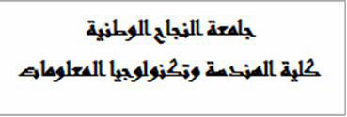



Graduation Project 2
Comparison between prefabricated and traditional buildings in terms of cost, time and insulation
An-Najah National University
Faculty of Engineering and Information Technology Department of Civil Engineering.
Prepared By:
Ameen Mohammad Jabareen – Reg. No: 11743606 Adel Ibrahim Awartani – Reg. No: 11716536 Osama Nabil Khaldy – Reg. No: 11716408 Amjad KhalidAl-Masri – Reg. No: 11642291
Supervised By:
Dr. Riyad Abdel-Karim
I

Slide 2
Abstract
Since prefab buildings come pre-designed, pre-fabricated and ready to build, the time required to prepare and build a project is faster than any other method of construction. The prefab also eliminates the need for a project engineer or engineer because all the layouts and plans have already been taken care of.
This simplified approach to the construction process makes this method of construction faster, less expensive and simpler. Prefab buildings are also constructed using modules, which are designed and manufactured in the factory and assembled on the construction site using certain connections.

Slide 3
Chapter one Introduction
1.1 Background
Prefab buildings are traditional steel structures constructed with individually designed rolled steel sections and assembled on site with bolts.
Comparison between prefabricated buildings and traditional buildings is tabulated with respect to several characteristics such as cost and time.
Prefabricated houses are considered one of the most famous examples of prefabricated structures and the most widespread, due to the beauty of their shape, speed of implementation and durability.

Slide 4
1.2 Objectives
The objectives of this graduation project are the following:
To study the comparison between prefabricated buildings and traditional buildings in terms of time.
To estimate the cost between the two types of buildings.
Comparison of the advantages and disadvantages of both types.

Slide 5
1.3 Methodology
1.3.1 Determination of the project idea :
Recently, prefabricated buildings have proven successful in some areas due to the speed of their construction and low cost. This idea is important in Palestine because of the difficult living conditions, and in the first place we aspire to spread the idea of using this type of construction in Palestine and to convince people of its idea. We hope to use it in different areas of life, such as schools, hospitals, shops, factories, etc.
1.3.2 Section of the study area :
After choosing the project idea, we contacted Diyarna, a company located in Nablus, which is the agent of Karmod Prefabricated Houses Company, based in Turkey, which is a known company in producing prefabricated houses.

Slide 6
1.3.3 Data collection :
The data in this projected was collected by the help of:
Diyarna Company, where we were given the basic ideas of this method of construction.
Contractors, where we distributed a questionnaire to a number of contractors in different governorates of the country.
A field visit was made to the suburb of Lemon, where we met some residents of the suburb and the people in charge of the suburb there.

Slide 7
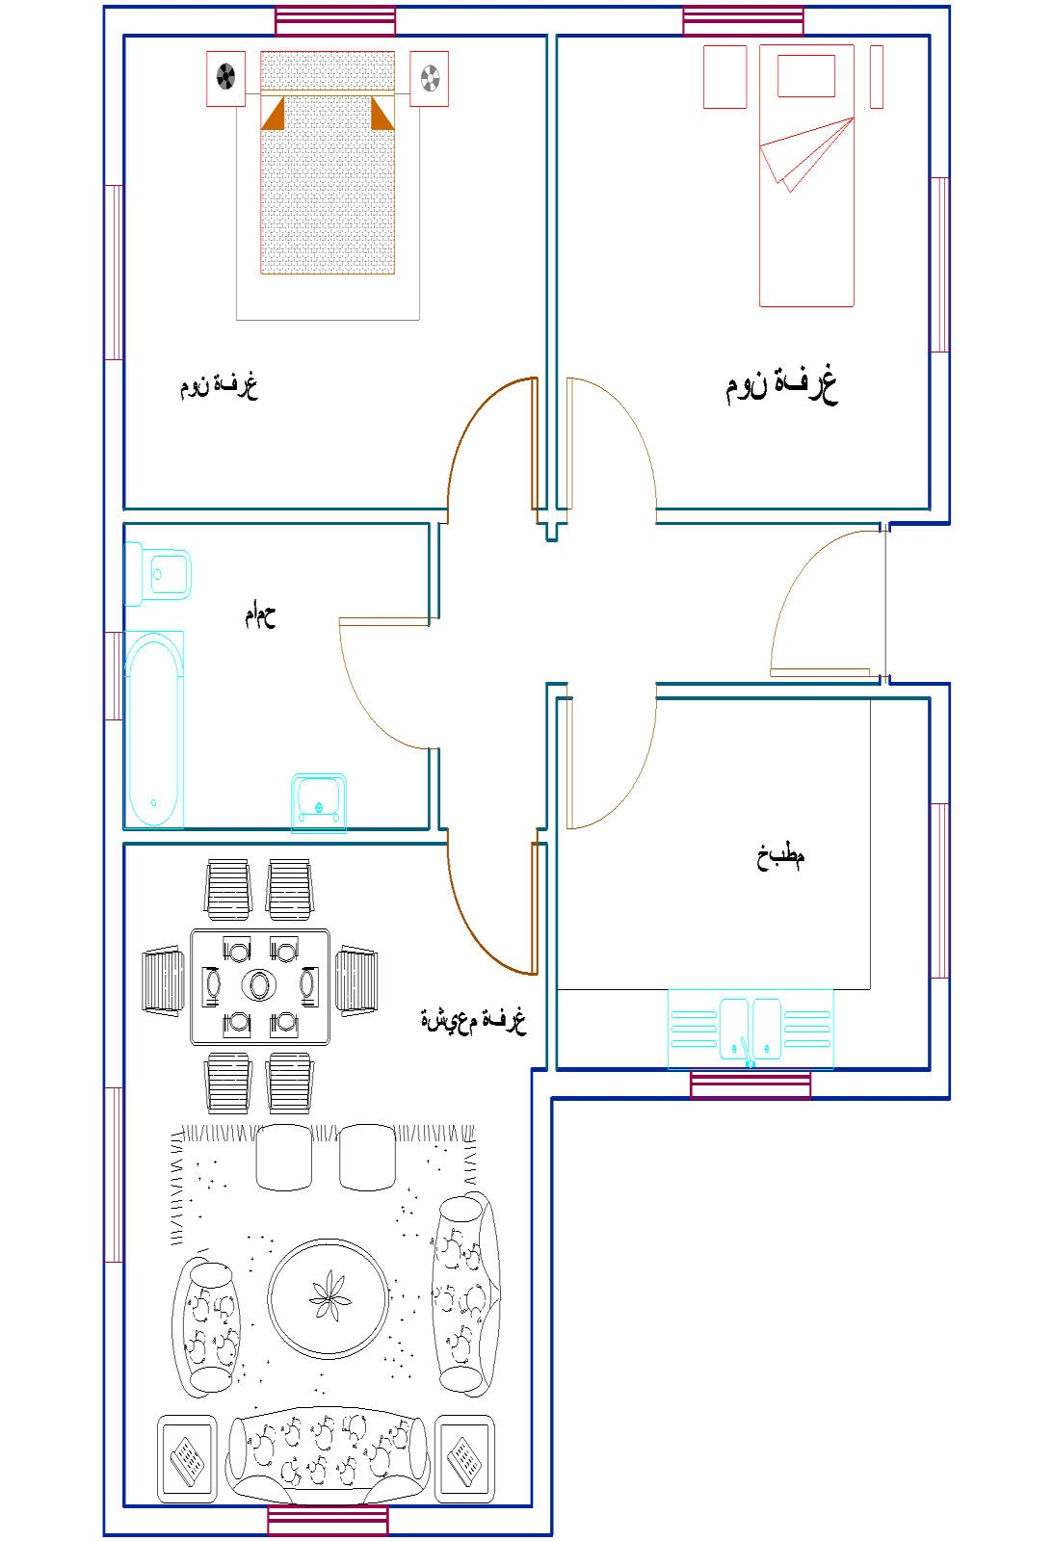
1.3.4 A typical design plan for a prefabricated house :
Using AutoCAD, we drew a plan for a typical house in El- Lemon residential complex with an area of 75m² .
Figure 1.1 Plan for a typical housing unit in El-Lemon housing complex

Slide 8
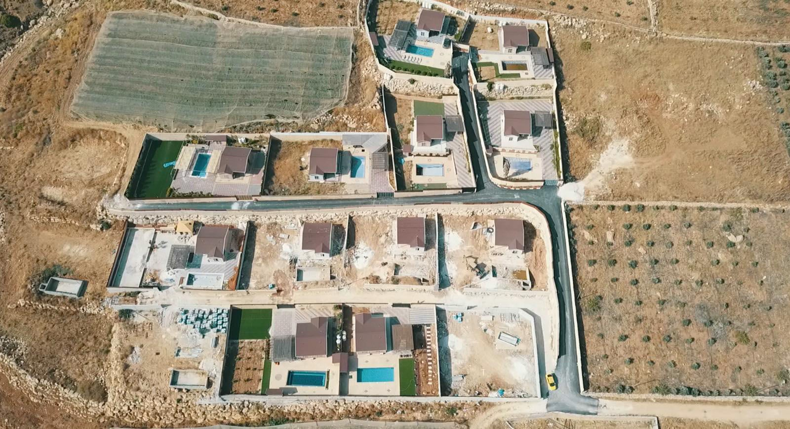
Chapter Two Description of study area
2.1 Location
Al-Nasariah village (Dahiyat Al-Lemon). Al- Nasaria village is located at an altitude of 24 meters above sea level. An-Nasariah lands cover an area of about 8,203 dunums.
Figure 2.1 some residential units under construction

Slide 9
2.2 General Framework for prefabricated buildings.
The structural components are standardized and produced in plants in a location away from the building site, then transported to the site for assembly.
The components are manufactured by industrial methods based on mass production in order to build a large number of buildings in a short time at low cost.
Prefabricated houses are produced using advanced technology that uses bolting instead of welding.
The areas of prefabricated houses range from 50 square meters to 150 square meters.
The house can consist of one or two floors.
9

Slide 10
2.3 Design and analysis for the slab of a prefabricated House
Foundation | Work | Material | Unit | Amount | Unit cost($) | Total ($)
Ground slab | Excavation | Soil (Bank) | _{m}3 | 75 | 7 | 525
 | Backfilling | Selected (Loose) | _{m}3 | 97.5 | 8 | 780
 | Formwork | Wood | _{m}2 | 11.3 | 50 | 565
 | Concrete casting | Concrete | _{m}3 | 22.5 | 90 | 2025
 | Steel reinforcement | Steel | Ton | 1.36 | 1200 | 1632
Table 2.1 Excavations and ground slab cost

Slide 11
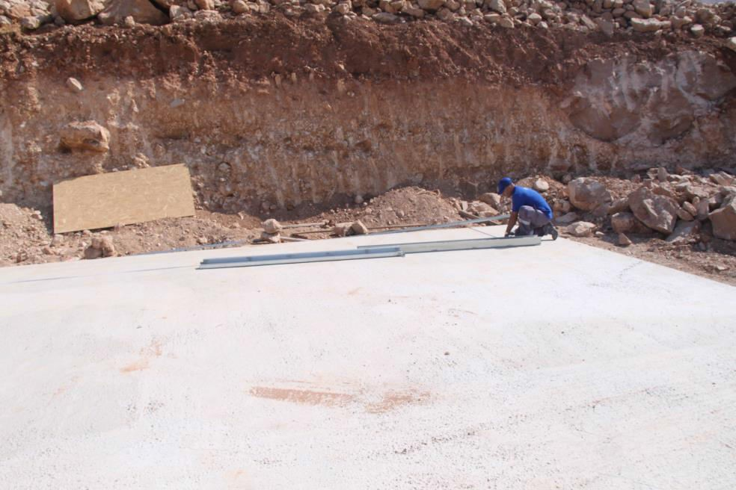
2.4 Implement steps for prefabricated houses
2.4.1 The floor
A reinforced concrete slab is prepared in certain dimensions according to the scheme provided by the manufacturer, and the construction is fixed on it by means of steel pegs and anchors.
Figure 2.2 Prepared ground slab for the housing unit

Slide 12
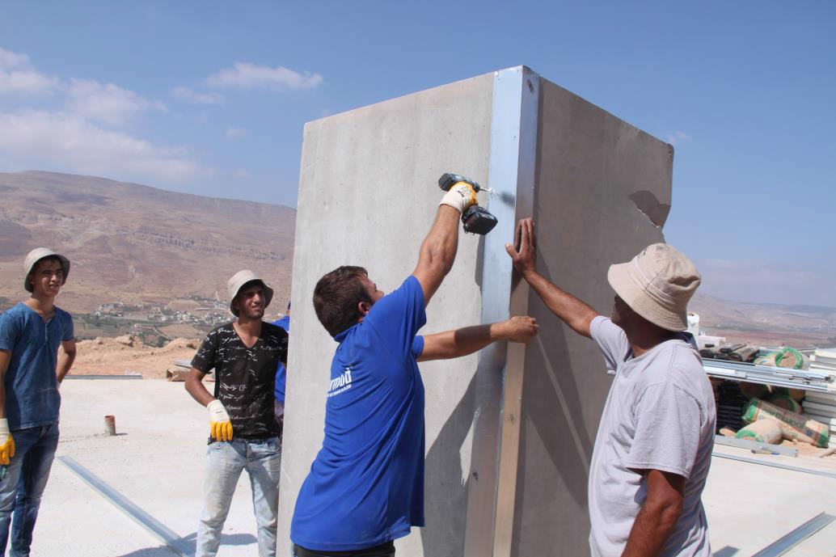
2.4.2 The interfaces
The used concrete facade system is a sandwich panel system filled with insulating material of polystyrene (foam) 2.5 m high and 10 cm thick and its width varies according to the design.
The facades are fixed to the ground slab by steel sides and
corners using screws. The sandwich panels are joined together by I-shaped steel profiles and fixed with screws. Galvanized iron frames for windows and doors are installed during the installation phase of the facades.
Figure 2.3 Assembling of facades of housing unit

Slide 13
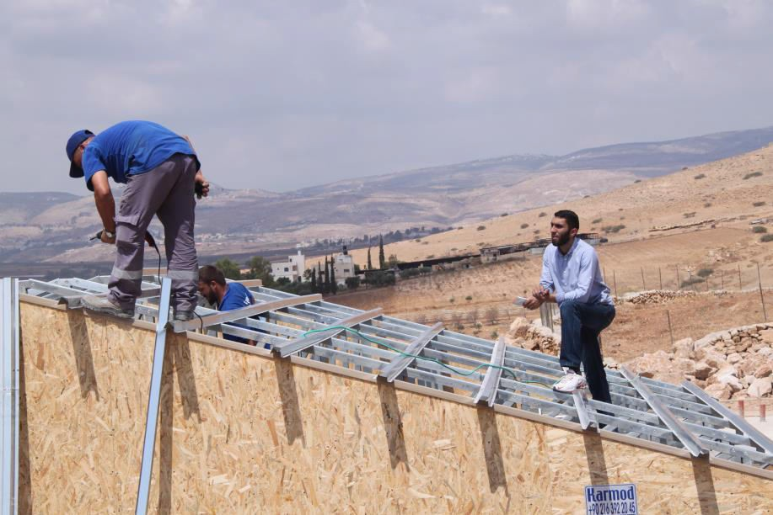
2.4.3 The roof
The roofing system is 3 mm thick galvanized metal trusses that are installed at equal spacing. After that, (steel pieces called omega) are installed above the trusses and intersecting with them. The sides of the truss are closed with steel plates on all sides. Then, the rainwater ducts are installed to the sides of the truss to drain the water according to the directions of inclination. After all-steel truss processing is completed; the treated wooden boards are placed with a name thickness. At this stage, the necessary electrical installations are made and passed from designated sleeves in the walls.
Figure 2.4 preparations for the roof cover

Slide 14
2.4.4 Roof insulation
Rolls of black pitch are spread directly on the wooden boards and fixed by melting with flame. Additional insulation rolls of red color are fixed above the black insulation rolls, using nails, to form the latter in the shape of the final surface. In addition to the electrical installations, rolls of insulating rock wool are laid inside the roof over the gypsum boards. After that, start closing the ceiling from the inside using sheets of gypsum boards treated against heat and fire with a thickness of 1 cm. After closing the ceiling completely, the interior walls are covered with the same type of gypsum boards, noting that an air space is left between the sandwich panel and the panels.

Slide 15
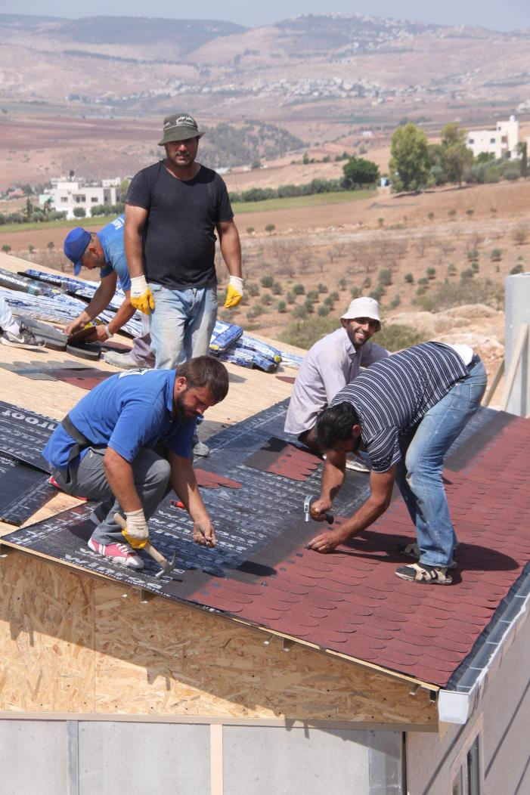
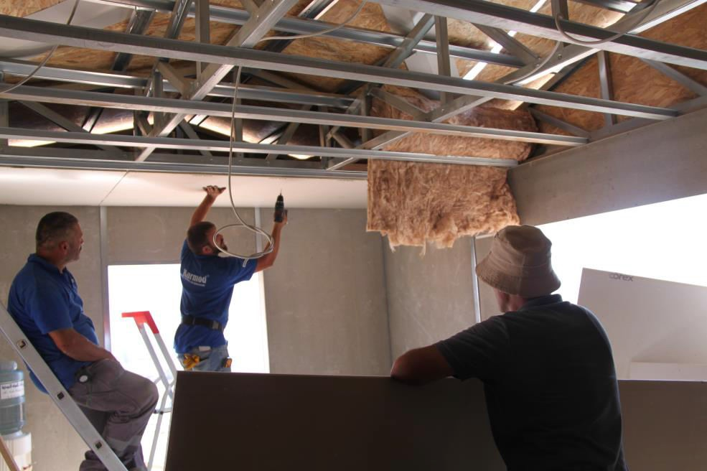
Figure 2.5 Covering of the roof panel
Figure 2.6 Electrical installations in the roof

Slide 16
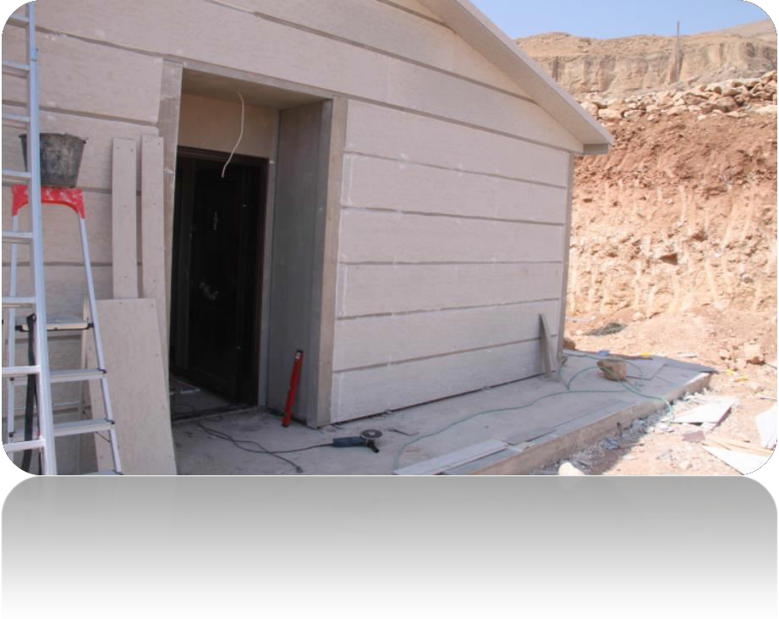
2.4.5 The outside view of the house
To finish the external facades, compressed and cured concrete slabs with a thickness of 1.5 cm and dimensions of 38 cm * 300 cm are covered, leaving 1-2 cm gaps between them, then the spaces between them are filled using a special silicone material that is resistant to moisture, mold and weather factors.
Figure 2.7 External facades for the housing unit

Slide 17
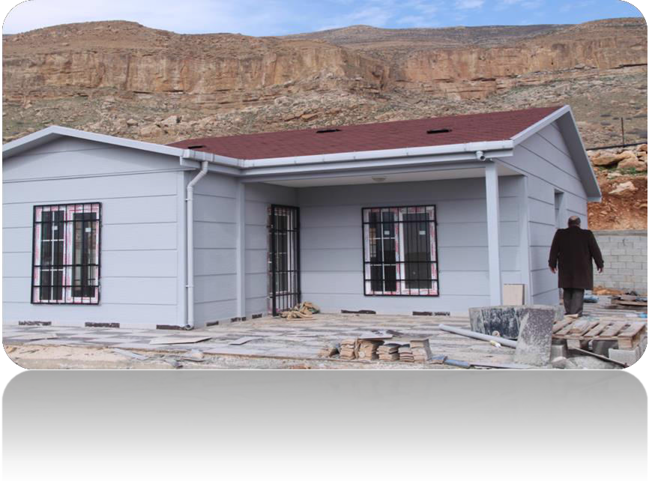
2.4.6 Finishing Works
The external concrete slabs are painted with acrylic paint and can be painted with any color.
Internal doors and the main door are installed in addition to the windows.
The inner face of the wall panels and the underside of the plaster board ceiling panels are painted with plastic paint.
The tiling process is carried out after the lentils are spread with an appropriate thickness above the ground.
Water pipes are laid under the tiles.
Figure 2.8 the residential housing unit in its final shape

Slide 18
Additional Notes
The gypsum boards used to cover the bathroom and kitchen walls and ceilings are special green gypsum boards treated against moisture.
Drainage system shall be installed during the implementation of the earth works and shall be delivered to the nearest manhole or cesspit.

Slide 19
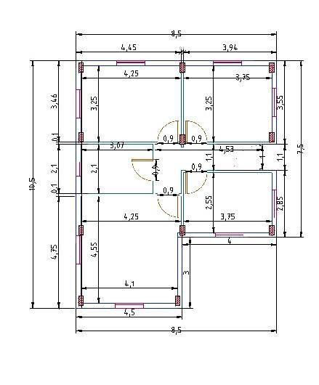
Chapter Three Discussion of Results
3.1 A typical design plan for a traditional house
After we relied on this scheme that we drew through AutoCAD, which shows all the internal and external dimensions on it, we found all the spaces and calculated the required quantities.
Figure 3.1 Plan for a typical housing unit for a traditional house
19

Slide 20
3.2 Questionnaire
We have conducted a questionnaire to study a comparison between prefabricated and traditional construction systems. The construction activities in prefabricated houses system will be compared with the related activities in traditional construction in terms of cost and time.
It also included questions comparing the characteristics of the two compared systems.
It was distributed to several contractors from different governorates in Palestine. The following table compares the valuation of 10 contractors for different building activities:

Slide 21
Company | No.1 | No.2 | No.3 | No.4 | No.5 | No.6 | No.7 | No.8 | No.9 | No.10 | Avg.
Excavation | 1000 | 1520 | 1555 | 1500 | 900 | 800 | 1350 | 750 | 850 | 900 | 1112
Backfilling | 1100 | 1250 | 1200 | 1250 | 1150 | 950 | 850 | 950 | 900 | 1000 | 1060
Reinforced concrete | 3800 | 3300 | 2800 | 2500 | 2000 | 2300 | 2200 | 2400 | 2400 | 2550 | 2625
Steel | 1800 | 1900 | 1950 | 1500 | 1600 | 2200 | 2050 | 2850 | 2500 | 2050 | 2040
Formwork | 7000 | 6400 | 5500 | 7900 | 8800 | 6500 | 8300 | 6500 | 8900 | 7200 | 7300
Block | 3200 | 3000 | 2900 | 2800 | 3000 | 2300 | 1950 | 2200 | 2900 | 2500 | 2675
Stone | 6000 | 6500 | 6000 | 7000 | 5000 | 6500 | 6650 | 6150 | 5950 | 6200 | 6195
Plastering | 3500 | 4500 | 2700 | 2900 | 4000 | 3600 | 3800 | 3800 | 3550 | 3600 | 3594
Tiles | 1850 | 1950 | 2500 | 3000 | 2000 | 1800 | 1600 | 2100 | 2000 | 2150 | 2090
Windows | 3000 | 4000 | 5000 | 2000 | 5200 | 2500 | 3000 | 2500 | 6500 | 3800 | 3750
Doors | 1500 | 2000 | 1800 | 2500 | 1300 | 1900 | 2000 | 1500 | 1000 | 1750 | 1722
Painting | 400 | 1000 | 400 | 600 | 800 | 900 | 800 | 750 | 1200 | 730 | 758
Brick | 4500 | 5000 | 9600 | 3600 | 7800 | 8600 | 6300 | 7200 | 9300 | 10000 | 7190
Table 3.1 Evaluation of building activities by different contractors

Slide 22
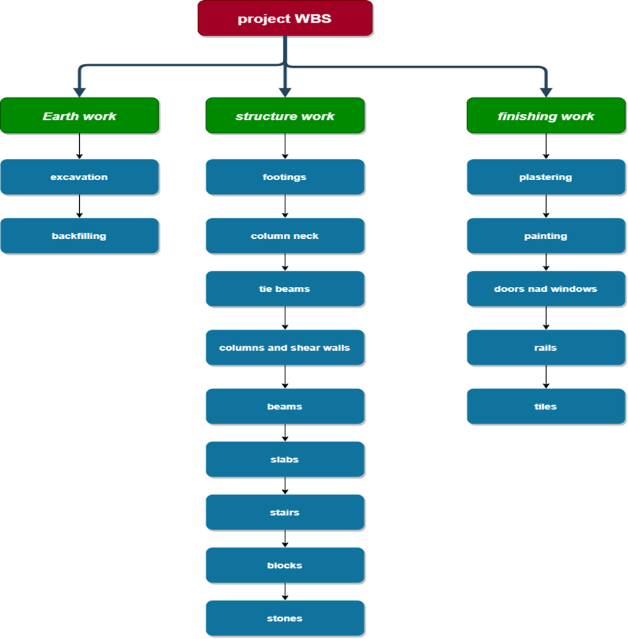
3.3 Analysis and Design for a traditional house
Work breakdown structure for the project:

Slide 23
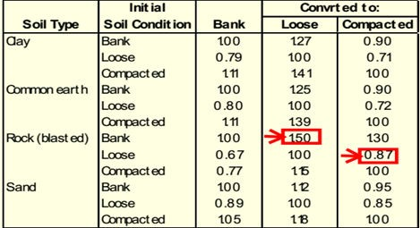
3.3.3 Excavation and backfilling
volume of the soil is usually changed from phase to another. So, in this stage we will calculate the total quantities of the excavation of our housing unit.
Using average area method, we find the areas portions that need to be excavated.
.
Table 3.2 Excavation modifying factor for different types of soil

Slide 24
Sample Calculations:
Excavation for the ground = 111.25 m³
Excavation for footings = 15.89 m³
Transportation = 127.14 * 1.25 = 158.9 m³
Foundation | Work | Material | Unit | Amount
Excavation | Excavation | Soil (Bank) | _{m}3 | 127.14
 | Transportation | Soil (Loose) | _{m}3 | 158.9
Table 3.3 Quantities of excavation works

Slide 25
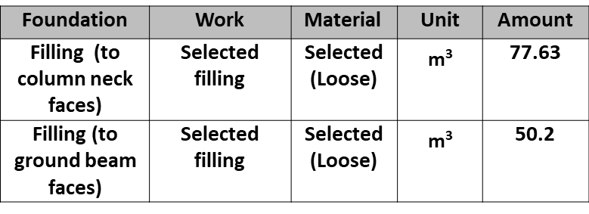

Backfilling
Backfilling for footings = 7.39 m³
Backfilling for column neck = 52.3m³
Total filling (to column neck faces)= 59.7 * 1.3 = 77.63 m³ (loose).
Lengths of ground beams = 53.34 m
Surface area of ground beams = 10.66 m²
Area of plan = 75 m²
75 – 10.66 = 64.33 m²* 0.6 = 38.6 m³(compacted) * 1.3 = 50.2 m³ (loose).

Slide 26
3.3.4 Footing Formwork, Concrete Volume & Steel
Foundation | Work | Material | Unit | Amount
Footings | Formwork | Wood | _{m}2 | 21.12
 | Blinding | Concrete | _{m}3 | 2.156
 | Concrete casting | Concrete | _{m}3 | 6.33
 | Steel fixing | Steel | Ton | 0.24
Table 3.5 Quantities for footings
3.3.5 Column Neck Formwork, Concrete Volume & Steel
No. of stirrups = 0.5 / 0.1 = 5
Foundation | Work | Material | Unit | Amount
Column neck | Formwork | Wood | _{m}2 | 6.6
 | Concrete casting | Concrete | _{m}3 | 0.44
 | Steel fixing | Steel | Ton | 0.213
 | Stirrups | Steel | Ton | 0.047
Table 3.6 Quantities for column necks

Slide 27
3.3.6 Ground Beam Formwork, Concrete Volume & Steel
No. of stirrups = 53.34 / 0.1 = 534
Foundation | Work | Material | Unit | Amount
Ground beam | Formwork | Wood | _{m}2 | 64
 | Concrete casting | Concrete | _{m}3 | 6.4
 | Steel fixing | Steel | Ton | 0.52
 | Stirrups | Steel | Ton | 0.59
Table 3.7 Quantities for ground beams
3.3.7 Ground slab Formwork, Concrete Volume & Steel reinforcement
Ground slab
Thickness of ground slab = 10 cm
Foundation | Work | Material | Unit | Amount
Ground slab | Formwork | Wood | _{m}2 | 3.77
 | Concrete casting | Concrete | _{m}3 | 7.5
 | Steel fixing | Steel | Ton | 0.3
Table 3.8 Quantities for ground slab
27

Slide 28
3.3.8 Columns Formwork, Concrete Volume & Steel
No. of stirrups = 3.10 / 0.1 = 31
Foundation | Work | Material | Unit | Amount
Columns | Formwork | Wood | _{m}2 | 40.92
 | Concrete casting | Concrete | _{m}3 | 2.7
 | Steel fixing | Steel | Ton | 0.33
 | Stirrups | Steel | Ton | 0.294
Table 3.9 Quantities for columns

Slide 29
3.3.9 Beams in walls Formwork, Concrete Volume
& Steel
Lengths of internal walls = 22.5 m Formwork for internal beams = 9m² Lengths of external walls = 37.7 m Formwork for external beams = 15.08 m²
Concrete for internal beams = 0.45 m³
Concrete for external beams = 1.5 m³
No. of stirrups = 37.7 / 0.1 = 377
Foundation | Work | Material | Unit | Amount
Beams | Formwork | Wood | _{m}2 | 24.08
 | Concrete casting | Concrete | _{m}3 | 1.95
 | Steel fixing | Steel | Ton | 0.23
 | Stirrups (External beams) | Steel | Ton | 0.232
Table 3.10 Quantities for beams

Slide 30
3.4 FINISHING WORKS
3.4.1 Plastering
Area of internal walls without internal doors = 91.72 m²
Area of internal beams = 13.6 m²
Area of windows = 11.88 m²
Area of external door = 2.4 m²
ACTIVITY | MATERIAL | UNIT | Amount
Plastering | Mortar | _{m}2 | 208.5
Table 3.11 Quantities of plastering
3.4.2 Tiling
ACTIVITY | MATERIAL | UNIT | Amount
Tiling | Normal | _{m}2 | 70.82
Tiling - Walls | Cramica | _{m}2 | 10.96
Tiling - Bathroom | Cramica | _{m}2 | 35.1
Table 3.12 Quantities for tiling

Slide 31
3.4.3 Painting
The same area of plastering without area of walls of bath rooms and without interface of kitchen.
ACTIVITY | MATERIAL | UNIT | Amount
Painting – Walls | Paint | _{m}2 | 168.88
Table 3.13 Quantities for painting

Slide 32
3.4.4 Doors and Windows
Doors:
ACTIVITY | MATERIAL | UNIT | Amount
Doors - In | Wood | _{m}2 | 8.8
Doors – In – Bathroom | Wood | _{m}2 | 2.2
Doors - Out | Steel | _{m}2 | 2.4
Table 3.14 Quantities for doors
Windows:
ACTIVITY | MATERIAL | UNIT | Amount
Windows | Aluminum | _{m}2 | 11.88
Window Sills | Stone | _{m}2 | 3.57
Table 3.15 Quantities for windows

Slide 33
3.4.5 Stone Cladding
Area of windows = 11.88 m²
Area of external door = 2.4 m²
Area of external walls = 117.5 m²
ACTIVITY | MATERIAL | UNIT | Amount
Exterior Works | Stone | _{m}2 | 103.19
Table 3.16 Quantities of stone
3.4.6 Block Works
ACTIVITY | MATERIAL | UNIT | Amount
Block | Block 10 | _{m}2 | 193.62
Table 3.17 Quantities of Concrete Blocks Works

Slide 34
3.4.7 Brick Works
Horizontal area of brick = 94 m²
Inclined area of brick = 113 m²
ACTIVITY | MATERIAL | UNIT | Amount
Brick | Brick | _{m}2 | 113
Table 3.18 Quantities for brick works

Slide 35
3.4.8 Water and drainage installations
Water installations, including drains, toilets, water pool, showers, etc., cost approximately 1290 $.
3.4.9 Electrical Installations
Electrical wiring, including safety boards, fenders, neon, boiler point, TV and telephone outlets, etc., costs approximately 1592 $.

Slide 36
3.5 BOQ:
Item | Description | Unit | Quantity | Unit cost ($) | Total ($)
A-1 | Earthwork excavation in rock soil and this include transport ,material and tools | _{m}3 | 158.9 | 7 | 1112.3
A-2 | Backfilling | _{m}3 | 132.2 | 8 | 1057.6
A-3 | importing and laying out of reinforced concrete for foundation , column ,elevator, slab , Ground slabs, stairs and beam, including labor , material and tools , excluding formwork and steel reinforcement strength for concrete 300 Kg/cm² | _{m}3 | 27.47 | 90 | 2472.84
A-4 | Reinforcement steel and stirrups in beam , column, slab and foundation this including transporting , material , tools , labor, binding wire , bending and cutting with different diameter With strength = 4200 Kg/cm² | ton | 3 | 1200 | 3600
A-5 | Formwork in all structure contact with concrete , labor for Installation and for removing , material wood , and tools | _{m}2 | 160.5 | 10 | 1605

Slide 37
A-6 | External Wall of Stone with thickness 0.03 m , and type of stone Tobzzeh | _{m}2 | 103.19 | 50 | 5159.5
A-7 | Internal block with External block Block 10 | _{m}2 | 193.62 | 20 | 3872.5
A-8 | Insulation (Foam) | _{m}2 | 73.88 | 6.5 | 480
A-9 | Doors Wooden sawid Steel doors | _{m}2 | 13.2 2.4 | 225 260 | 2970 624
A-10 | Tile porslan | _{m}2 | 116.88 | 32 | 3740
A-11 | Painting | _{m}2 | 168.88 | 4.5 | 760
A-12 | Plastering | _{m}2 | 208.5 | 10 | 2085
A-13 | Shayish | _{m}2 | 3.57 | 65 | 232.05
A-14 | Windows aluminum | _{m}2 | 11.88 | 145 | 1722.6
A-15 | Brick | _{m}2 | 113 | 74 | 8362
A-16 | Water and sewage extensions | - | - | - | 1290
A-17 | Electrical extensions | - | - | - | 1594
Table 3.19 BOQ for the housing unit cost using traditional method
37

Slide 38
Total direct cost of the housing unit = 42,739.4 $ Ratio of wastage = 5%
Total direct cost of the housing unit + Ratio of wastage = 44,876.4 $
As for the prefabricated housing unit as stated by Diyarna company the price per square meter is about 300 - 350 dollars, and since the area is 75 m², so the total price is 350 * 75 = 26,250 $.
Total price of prefabricated housing unit with ground slab = 26,250 + 5527 = 31,777 $.

Slide 39
3.6 Comparison between prefabricated housing system and traditional construction system regarding the period of construction
As a result of the questionnaire analysis, the estimated time for each construction activity is shown in the following table :
Company | No.1 | No.2 | No.3 | No.4 | No.5 | No.6 | No.7 | No.8 | No.9 | No.10 | Avg.
Excavation | 3 | 3 | 3 | 5 | 3 | 2 | 2 | 6 | 7 | 3 | 4
Backfilling | 1 | 2 | 1 | 2 | 2 | 3 | 2 | 4 | 3 | 2 | 2
Reinforced concrete | 20 | 25 | 30 | 35 | 33 | 28 | 15 | 30 | 26 | 25 | 27
Block | 22 | 26 | 26 | 25 | 19 | 20 | 16 | 15 | 12 | 20 | 20
Stone | 7 | 11 | 10 | 9 | 8 | 11 | 7 | 10 | 7 | 8 | 9
Plastering | 10 | 8 | 7 | 12 | 8 | 13 | 10 | 10 | 7 | 9 | 10
Tiles | 7 | 8 | 7 | 8 | 5 | 10 | 10 | 6 | 5 | 7 | 8
Windows | 1 | 4 | 5 | 6 | 2 | 4 | 6 | 2 | 2 | 3 | 4
Doors | 1 | 3 | 4 | 2 | 1 | 2 | 2 | 2 | 2 | 2 | 2
Painting | 5 | 4 | 5 | 7 | 8 | 5 | 6 | 4 | 5 | 6 | 6
Brick | 13 | 8 | 7 | 10 | 2 | 11 | 12 | 12 | 14 | 7 | 10
Table 3.20 Estimated time for each construction activity

Slide 40
Through the results of the questionnaire, it was found that the average total time for building a housing unit using traditional construction is 102 days.
After we contacted with Diyarn acompany, we were provided with the following information:
The expected period for the arrival of all necessary walls, aluminum, sanitary ware, doors, etc. is about 30-40 days. The expected period of delivery of the project to its owner is 30-40 working days

Slide 41
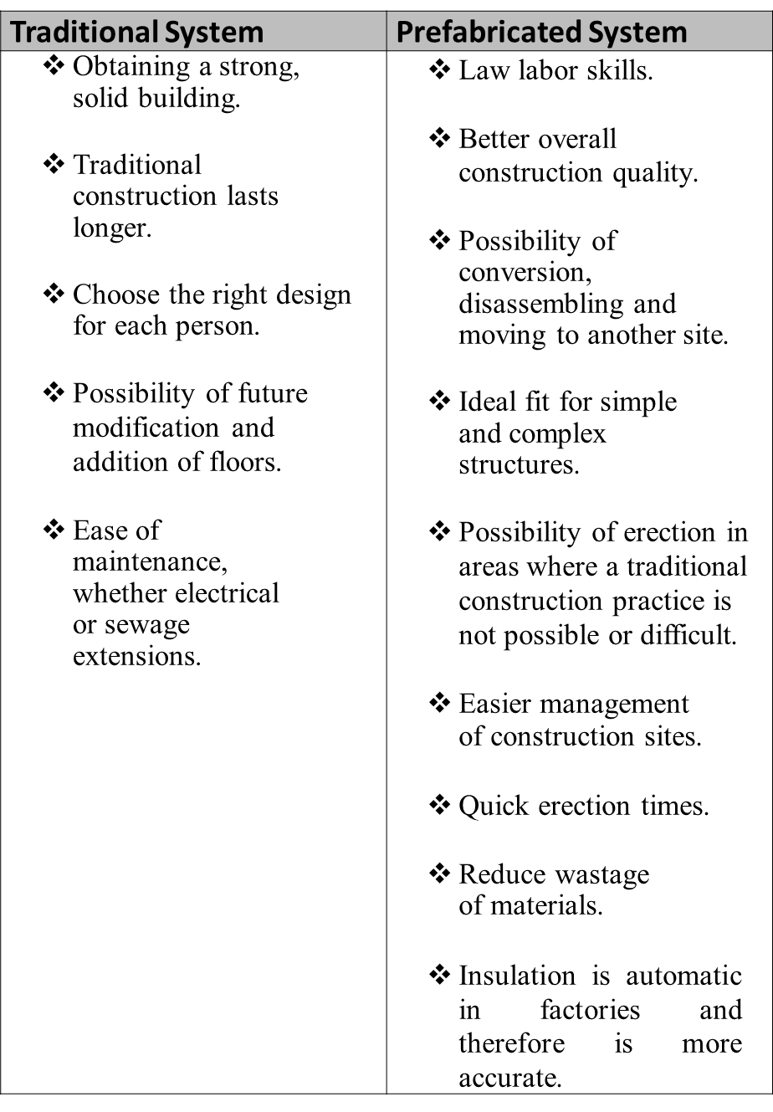
3.7 Features
Table 3.21 Features of prefabricated housing units

Slide 42
3.8 Defects
Traditional Buildings | Prefab. Buildings
It takes time, effort and labor. Lots of structural errors. High prices. Wastage of materials. For insulation, the cost and time increases. | The inability to control many architectural forms and adhere to certain forms. Few floors. Difficult maintenance. The lack of popularity of these buildings and the lack of companies specialized in this.
Table 3.22 Defects in the two systems

Slide 43
Chapter Four Conclusion and Recommendations
It is estimated that the use of prefabricated buildings has nearly doubled in the last 15 years (an increase of 86% worldwide overall). And through the studies that we carried out during this project, we found that prefabricated houses are better than traditional houses in terms of cost, time, environmental effects on sites, and general safety for workers.
We hope that in the near future the phenomenon of prefabricated houses will spread more in our country.

Slide 44


