Slide 1
Smart Grader
Supervisor:
Hussam A.Halim
Students:
Saja Abu-Baker
Suha Awartani
Shahad Abo-Romoh

Slide 2
Content
Introduction
What is smart grader?
What does smart grader do?
How smart grader is built?
Android studio
OpenCV Library
Advantages and disadvantages of OpenCV.
SQLite
GreenDAO
OpenCV Algorithm
System Diagrams
Demo.

Slide 3
Introduction
  With the technological development in different fields in life, it’s necessary to employ this technology in education.
  We propose “Smart Grader”.

Slide 4
What is “Smart Grader”?
It is an Android application that is used by teachers to help them grade and store multiple-choice questions using their phone’s camera in an efficient and simple way, instead of using old fashion ways.

Slide 5
What does “Smart Grader” do?
Create Classes and quizzes.
Add students and questions.
Correct students’ papers by camera.
Save students’ grades in database.
Give statistics graphically by charts for each quiz and for each question.

Slide 6
How “Smart grader” is built?
We used:
Android Studio for interface.
OpenCV for image processing.
SQLite for database.
Green DAO for enhancing the performance of database operations.

Slide 7
Android Studio
We used tabbed activity instead of buttons to reduce moving between screens.
Tabbed interfaces are more user-friendly than any other interfaces.
Each tab shows all related information from other tabs so that the user does not keep moving back and forth between tabs.
Main tabs are : classes, quizzes and students.

Slide 8
OpenCV Library
OpenCV exposes almost all of its functionality to Java (including camera).
It has C++, C, Python, Java and MATLAB interfaces.
You simply add a reference to the OpenCV, import its classes and move forward.
Notes:
The NDK (Native Development Kit) is a tool that allows you to program in C/C++ for Android devices. It's intended to integrate with the SDK (it's described as a "companion tool") and used only for performance-critical portions of a project.
-----
All the computations are performed on the native level, hence the overhead is equal to a cost of one or several JNI calls.
-----
The Java Native Interface (JNI) is a programming framework that enables Java code running in a Java Virtual Machine (JVM) to call and be called by native applications (programs specific to a hardware and operating system platform) and libraries written in other languages such as C, C++ and assembly.

Slide 9
Advantages and disadvantages of OpenCV
Advantages:
Fast ramp-up, the simplest way to develop for Android with OpenCV.
Easy development in a language with garbage collection.
Disadvantages:
Complex CV logic (with many calls to OpenCV) will work slowly because of additional cost of JNI calls.

Slide 10
SQLite
SQLite is an Open Source database.
SQLite supports standard relational database .
SQLite has a small footprint of about < 500 kb with all its features.
Does not need a separate server.
Disadvantage : not secure.

Slide 11

Green DAO
greenDAO is an open source Android ORM(object relational mapping).
It makes development for SQLite databases easy and fast.
No need to deal with low-level database.
It maps Java objects to database tables.

Slide 12
Green DAO (cont.)
Uses SqlCipher that provides transparent 256-bit AES encryption of database files.
Small library size ( <1000 kb ).

Slide 13
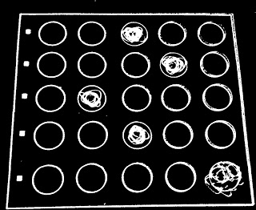
OpenCV Algorithm
Step 1: Perform image preprocessing to make the image black & white (binarization).

Slide 14
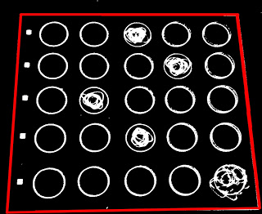
OpenCV Algorithm (Cont.)
Step 2: Use hough transform to find the lines in the image.

Slide 15

OpenCV Algorithm (Cont.)
Step 3: Find point of intersection of lines to form the quadrilateral.

Slide 16
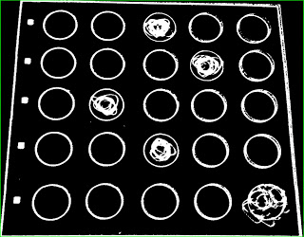
OpenCV Algorithm (Cont.)
Step 4: Apply a minimum area rectangle for extracting the region and cropping it

Slide 17
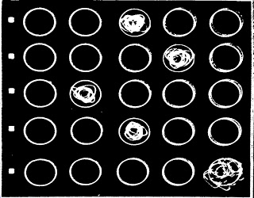
OpenCV Algorithm (Cont.)
Step 4(cont.) :Apply perspective transform.

Slide 18
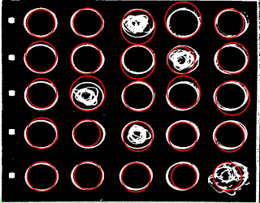
OpenCV Algorithm (Cont.)
Step 5: Use hough transform to find the circles in the image.

Slide 19
OpenCV Algorithm (Cont.)
Step 6: Sort circles into rows and columns.
Step 7: Find circles with area 30% or denser and designate these as “filled in”.

Slide 20
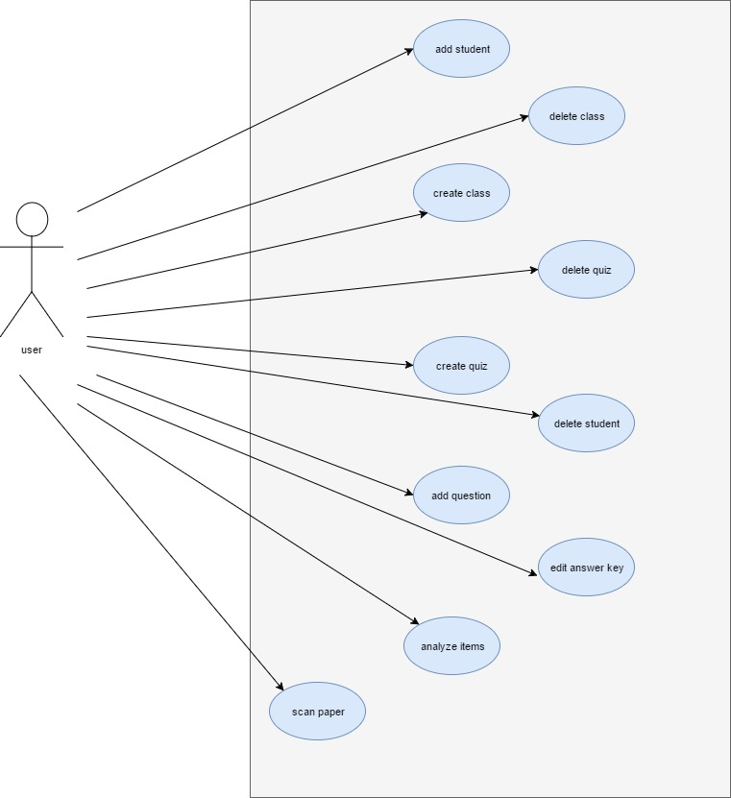
Use Case Diagram

Slide 21
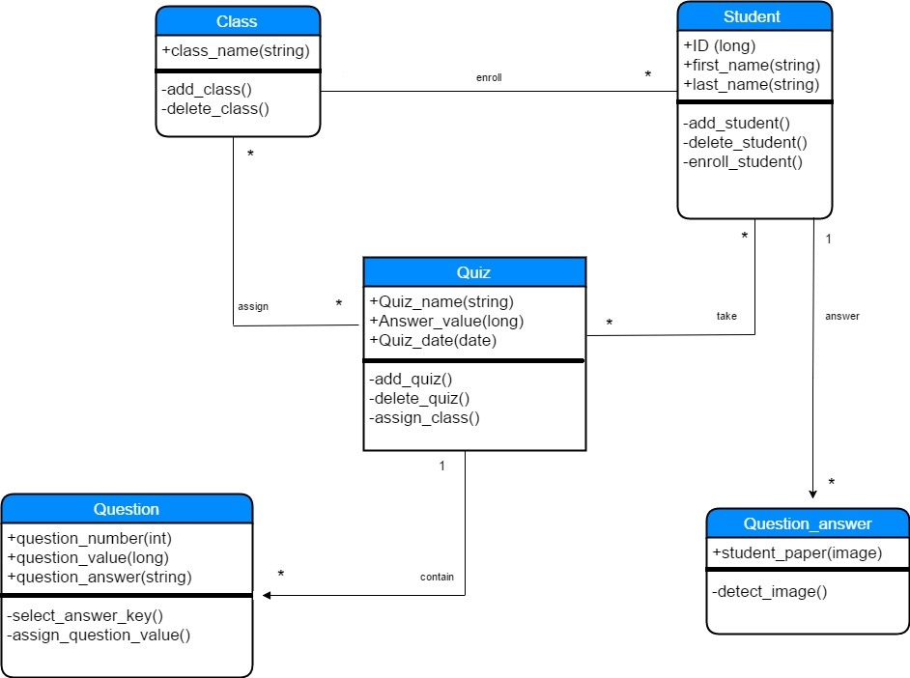
Class Diagram

Slide 22
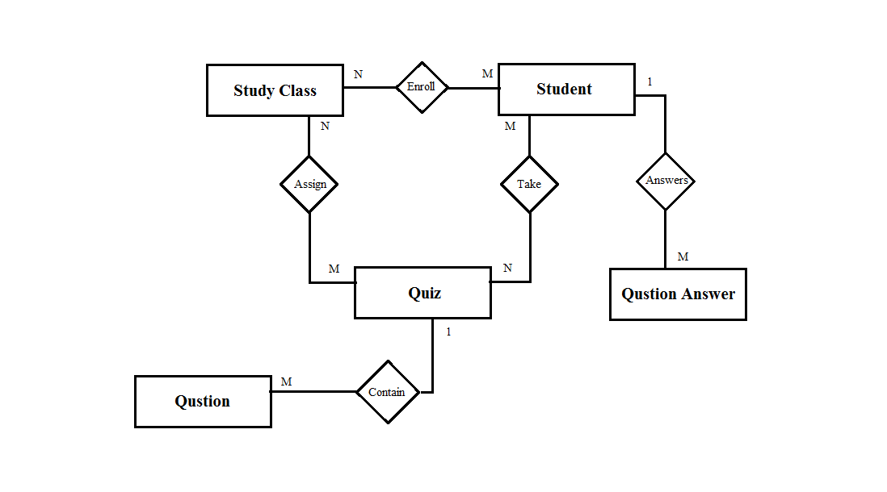
ER Diagram

Slide 23
DEMO.
Now, we will demonstrate the program.

Slide 24
Smart Grader
Supervisor:
Hussam A.Halim
Students:
Saja Abu-Baker
Suha Awartani
Shahad Abo-Romoh

