Slide 1


Graduation project
Improving and automation of
Al-armoush store processes Using odoo ERP
By: Rand Sabha, Zaina Abubaker,Tala Armoush
supervisor: Mr.Maher Abu Baker

Slide 2

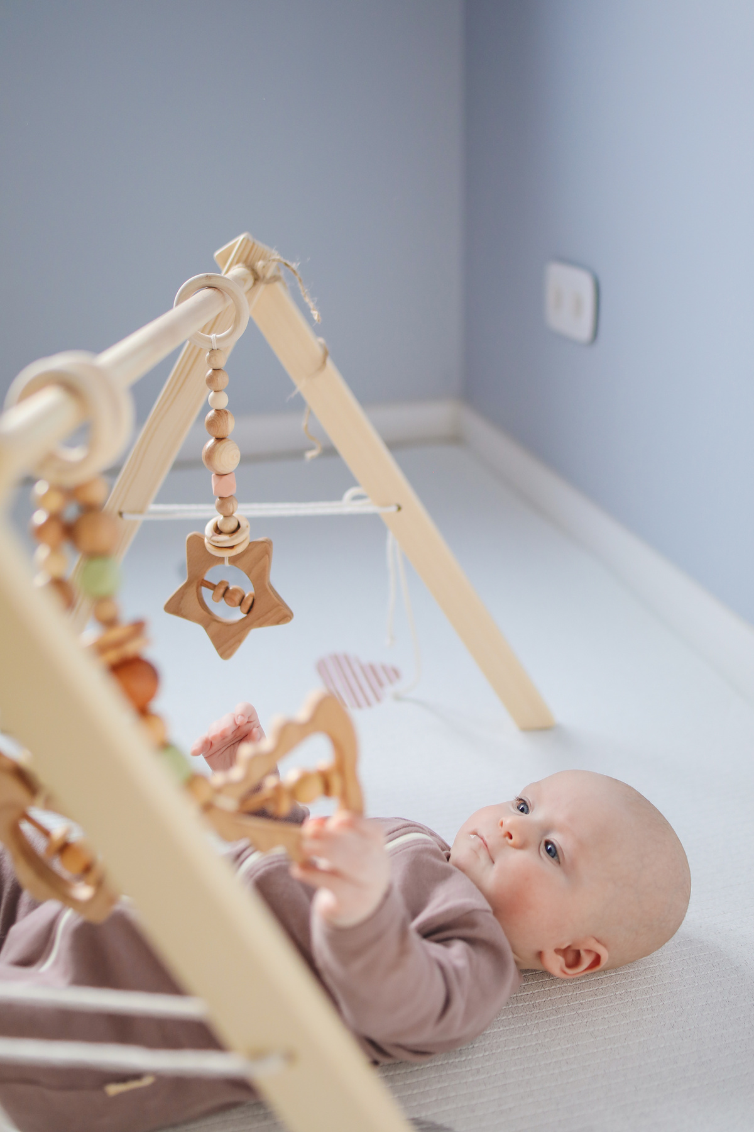
Project Content
1- Historical overview of the store
2- Mechanism of Action
3- Summary of weaknesses for the store

Slide 3

Historical overview of the store
Armoush store, established in 2020 in Nablus, offers direct and online sales of toys and children's supplies, including strollers, cribs, and bicycles. The store focuses on providing comfort for
children with beautiful goods from international brands.

Slide 4

Mechanism of Action
  selling products online or from the store
  The purchase is recorded in the sales book
by the sales employee
  Verification of accounting transactions
recorded on paper by the accounting manager
  Bringing products from warehouses and recording products on paper

Slide 5

Summary of weaknesses for the store
  Perform all operations manually .
  Errors in statistics related to inventory and sales, the lack of a reference to refer to and seeing coordinates and short movements.
  Difficulty of making decisions in the store due to the lack of accurate visual indicators .
  Difficult to conduct an audit of financial operations.

Slide 6
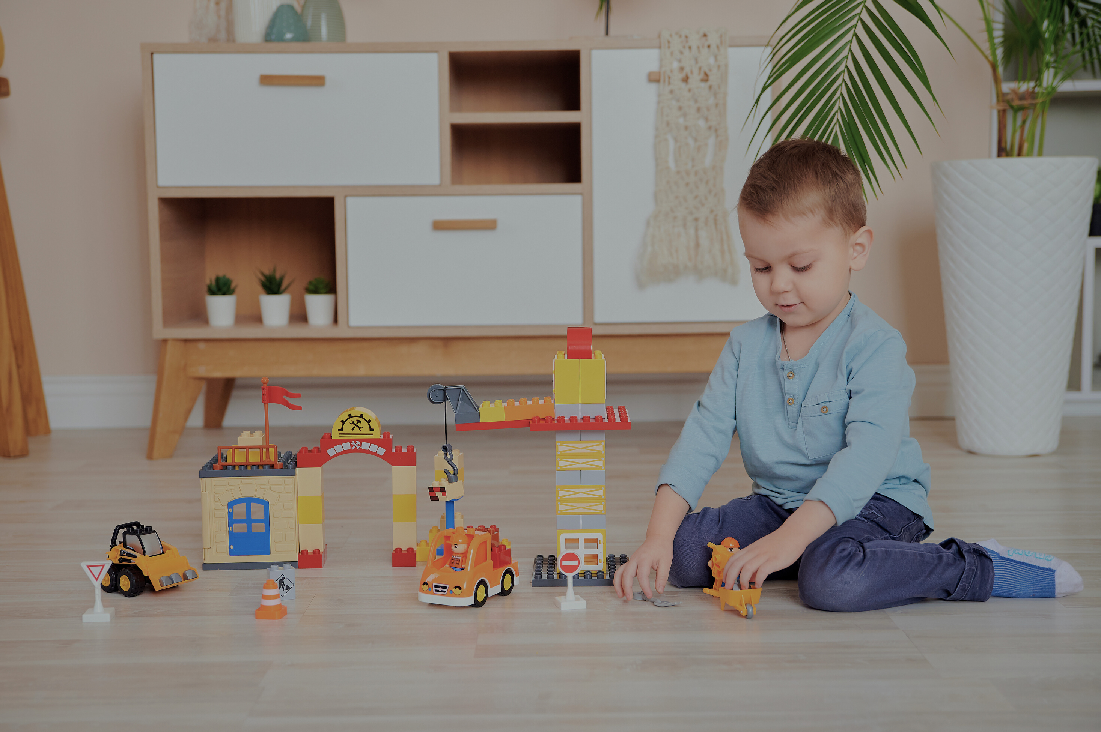
Thank You

