Slide 1
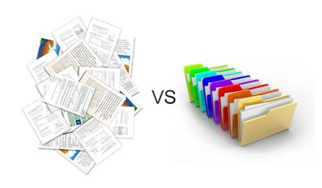
Documents Classification System
Prepared By :
Razan Abdulhaq
Shuruoq Adawi
Rasha Deriyieh

Slide 2
Main Point’s And Objectives :
Introduction .
What Is Documents Classification ?
Types Of Documents Classification .
Machine Learning Techniques .
Supervised Documents Classification Techniques .
The Main Process Of Text Mining.
RapidMiner Problems and Recommandations .

Slide 3
INTRODUCTION :
The exponential growth of the Internet has led to a great deal of Interest especially by Companies in developing useful and efficient Tools or Software’s to assist employees for doing their job and users for searching the Web.

Slide 4
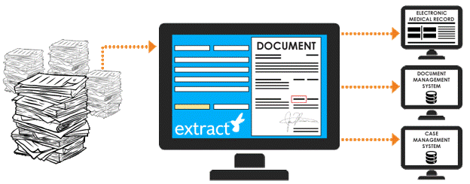
Documents Classification Definition:
Is a task of assigning a document to one or more classes or categories making it easier to manage and sort that may be done manually or algorithmically using different Text Mining Tool .

Slide 5
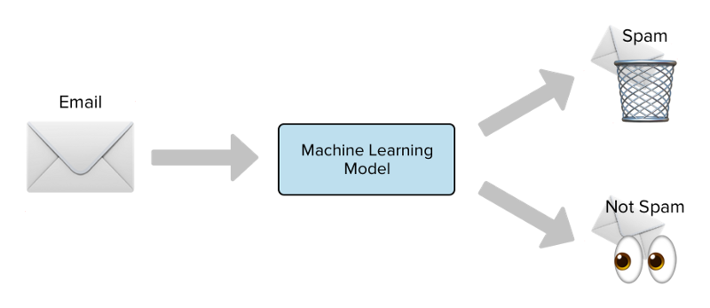
Types of Documents Classification:
Binary Classification : is the task of classifying the elements of a given set into two groups (predicting which group each one belongs to) on the basis of a
Classification rule such as Sentiment Analysis , Spam
Detection and Medical Diagnosis .

Slide 6
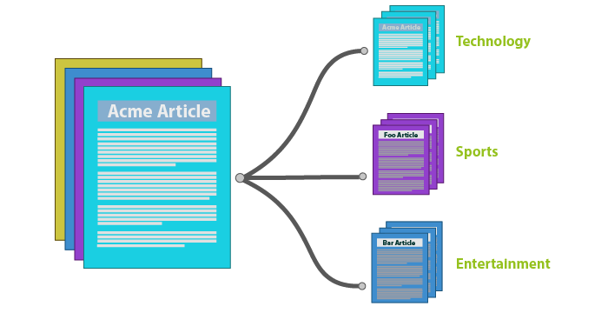
Multi Class Classification : is the problem of classifying instances into one of three or more Classes such as News Article's , Consumer Complaints , Bank Data and more .

Slide 7

What is Machine Learning :
Is a method of data analysis that automates analytical model building. It is a branch of an artificial intelligence based on the idea that systems can learn from data , identify patterns and make decisions with minimal human intervention. Importance. Today's World.

Slide 8
Document Classification Techniques (ML Algorithmes) :
Supervised Document Classification.
Unsupervised Document Classification.

Slide 9
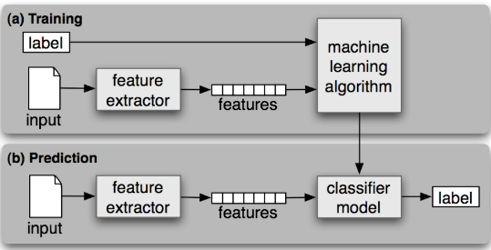
Supervised Machine Learning Algorithm :

Slide 10
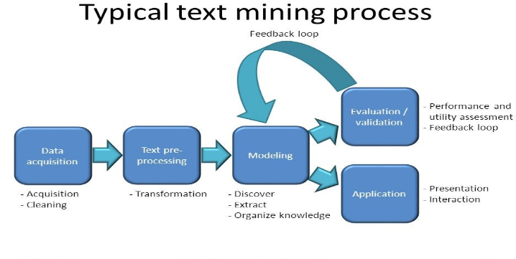

Slide 11
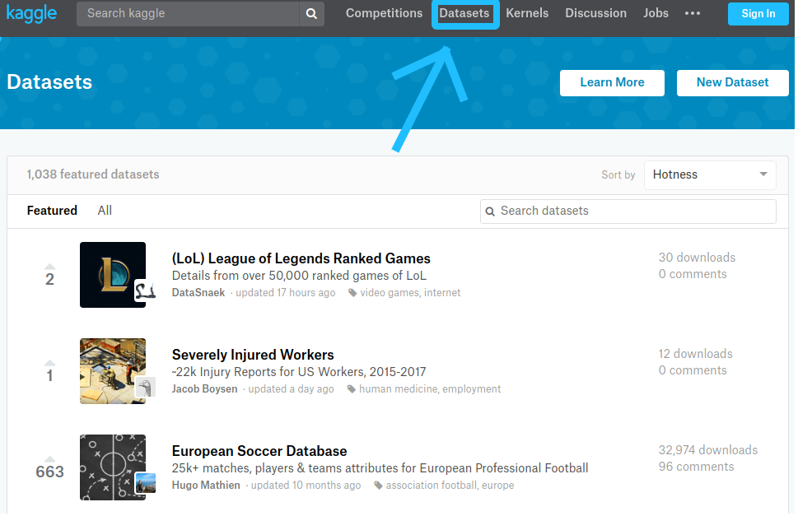

1- Data Acquisitions :
A first step in Text Mining Process and it’s responsible for :
Collecting Data from many different Resources

Slide 12
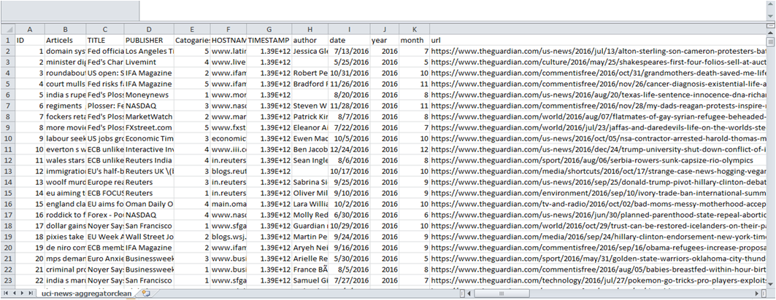
Data Cleaning : Cleaning Data that we collected using Kutools for Excel and RapidMiner .
Data Before Cleaning :

Slide 13
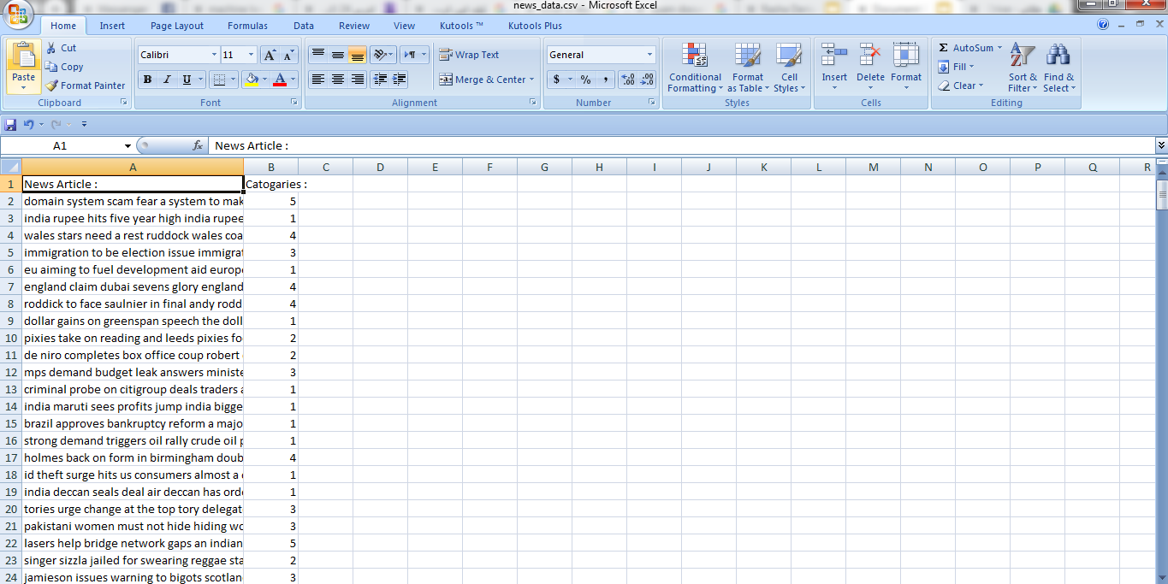
Data after Cleaning :

Slide 14
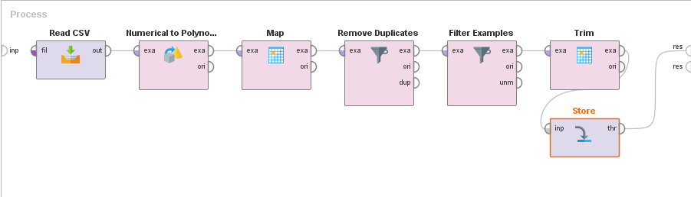
Rapid Miner Cleaning Process :

Slide 15
2- Text Preprocessing : is an important task and critical step in Text mining, In the area of Text Mining, data preprocessing used for extracting interesting and non-trivial and knowledge from unstructured text data.
Steps of Preprocessing :
Tokenization
Filtering Stop words (WorldNet)
Transformation
Stem

Slide 16
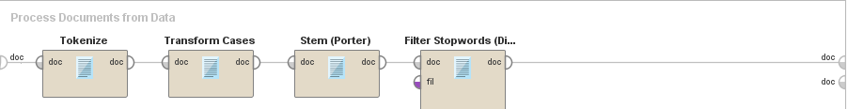
The full pre processing Process in RapidMiner :

Slide 17
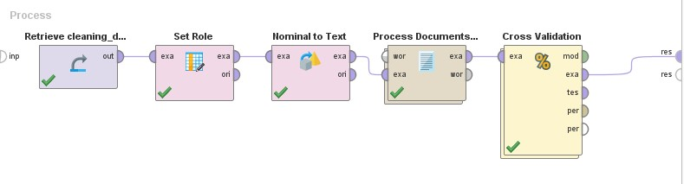
3- Modeling :
The process of selecting the model that we will use to learn the algorithm from training data .
This will be after Text transformation , features extraction and selection

Slide 18
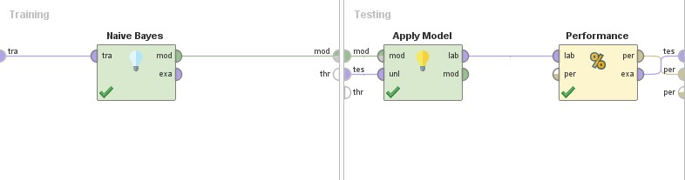
4- Evaluation :
The process of evaluate the success of our prediction

Slide 19
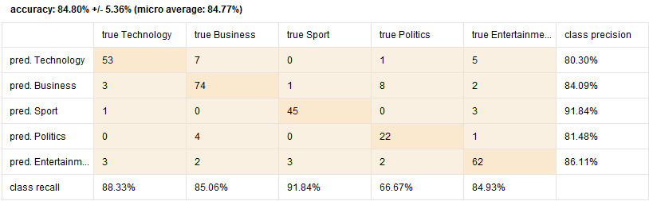
Confusion Matrix :

Slide 20
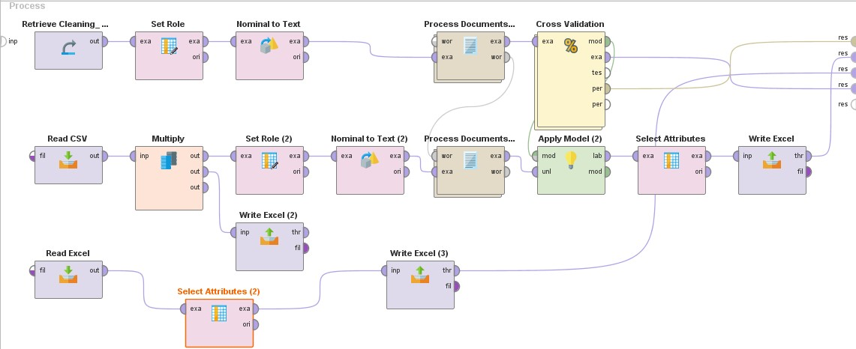
Our Project Final Process :

Slide 21
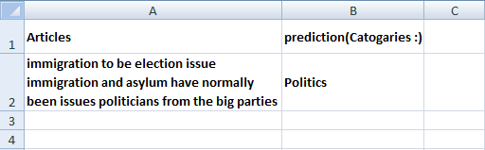

Extract , load and Transform (ETL) Process :
we extract the Result of Data using Write excel .
Then we load the Data on a new Excel files .

Slide 22
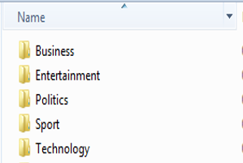
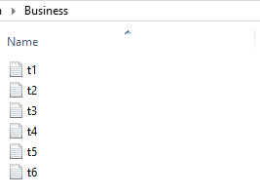
Transform The excel Data to many text files using a Kutools for Excel tool and each of These text has a defined Categories .

Slide 23
5- Application :
Text Mining applies in a variety of areas such as
Web Mining Medical and Resume Filtering .

Slide 24
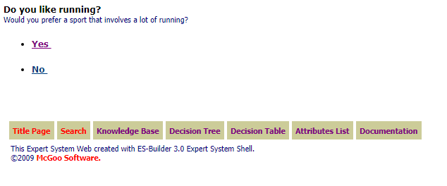
Corvid System :

Slide 25
Problems that faces us with we use RapidMiner:
Tool not fully support some languages such as Arabic.
Tool does not support the huge number of data.
Tool must be paid to give better results in pulling data.
Lack of sufficient resources to learn through.
Tool takes a lot of time to process the documents and because our computers as a students does not have a high processer so we face this problem when we dealing with a huge number of Data.
Tool can’t predict to more than one column (Hierarchical classification) .

Slide 26
Recommendation :
According to the Result that we obtained we recommend the companies to use our system with a RapidMiner Tool to classify their Documents instead of Manual Classification and use a Naïve Base algorithm for Doing that , because this will help to reduce the Employees time and efforts and make their work done more effectively and efficiency .

Slide 27


