Slide 1


Development of a Facility Master Plan for Nablus City with Emphasis on Khalit Alamod Water Distribution Zone
Prepared By :
Amjad Abdullatef Abuzant.
Ahmad Ayman Jury.
Sajed Aladden Shakhsher.
Under Supervision of:
Dr. Anan F. Jayyousi

Slide 2
Outline
Main characteristics of Nablus city.
Analysis of the city’s water situation.
Deep analysis of the critical zone (Khalit Alamod).
Expected future network for Khalit Alamod.
Generalizing the solution for the whole city of Nablus.
Conclusion.

Slide 3
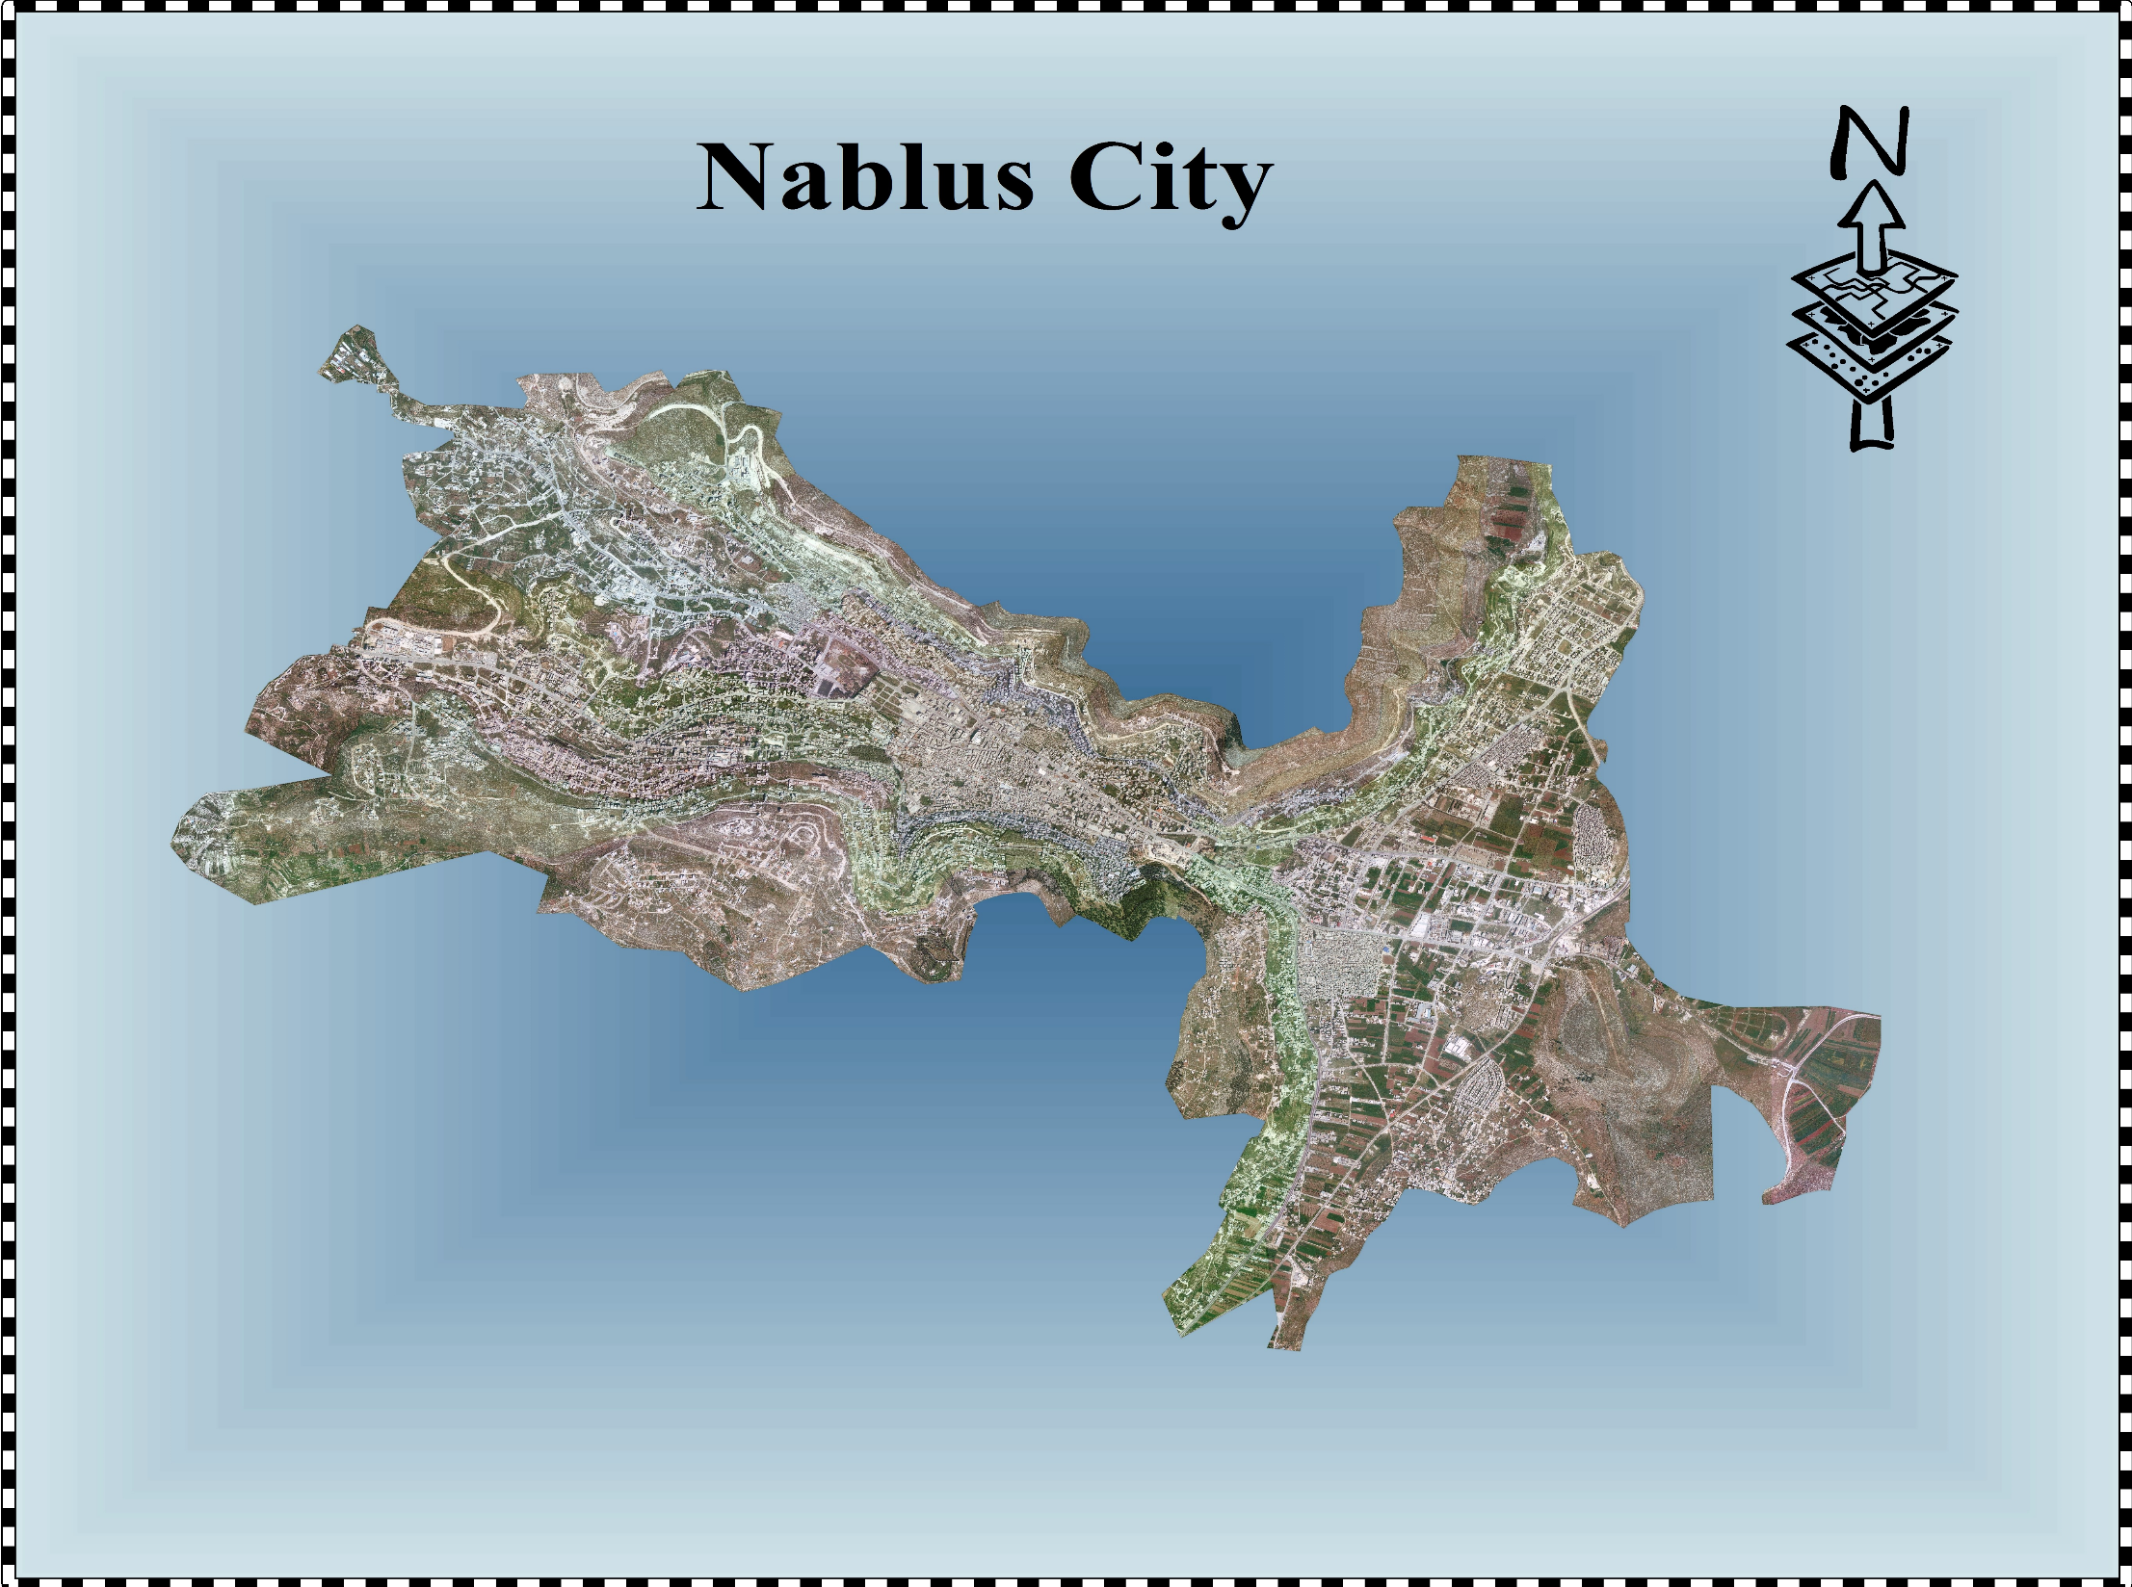

Slide 4
Main Characteristics About Nablus City
Location: 69 km. North of Jerusalem and 42 km. East of the Mediterranean sea.
Area: 29 Km².
Pop_{.2014}: 182,300 capita.
Elevation: 600m AMSL.
Climate: mild climate.

Slide 5
Nablus Water Resources
Resource | Water Production₂₀₁₄ (m³/year)
Wells | 6,336,000
Springs | 1,031,400
Total | 7,367,400
Considering water loss in conveyance lines | 6,697,200

Slide 6
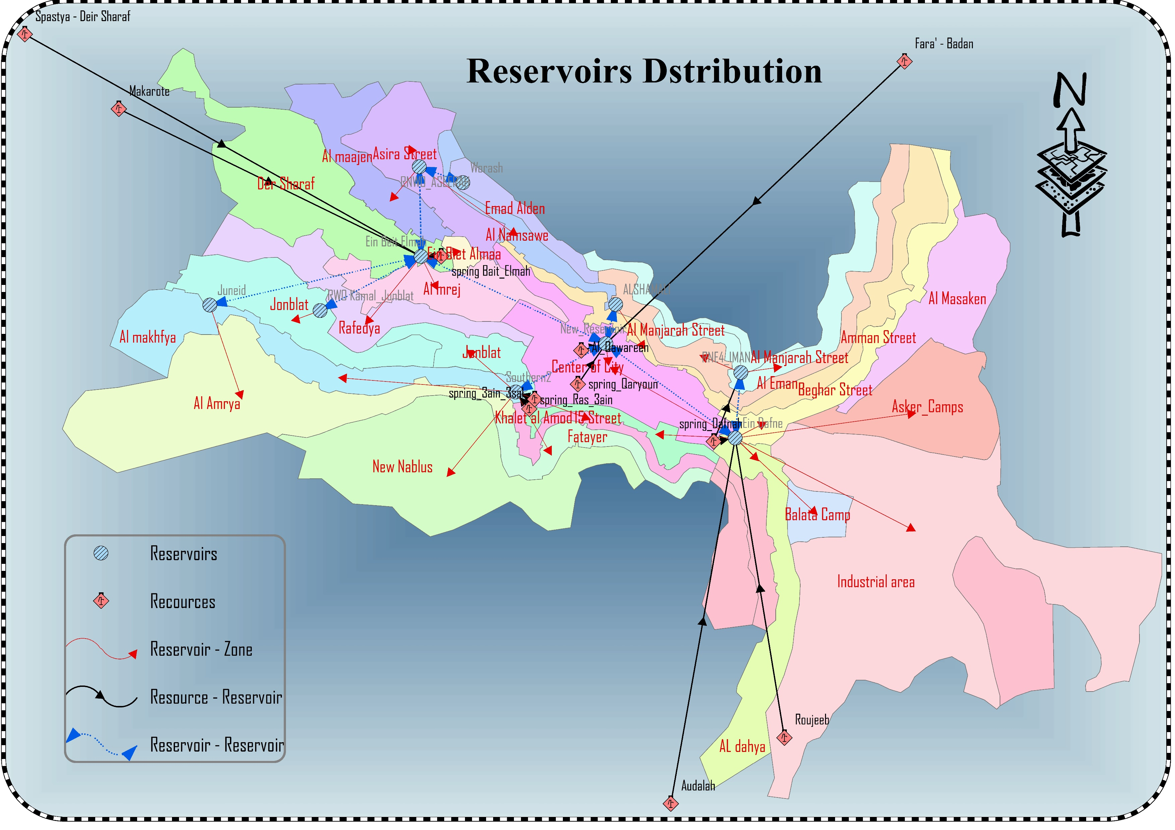
Reservoirs Distribution
Existing Reservoirs Distribution

Slide 7
Information About The Existing Main Network
Length: 68,600 m
Diameter: 2”-12”
Materials: HDPE, Steel And Ductile Iron.

Slide 8
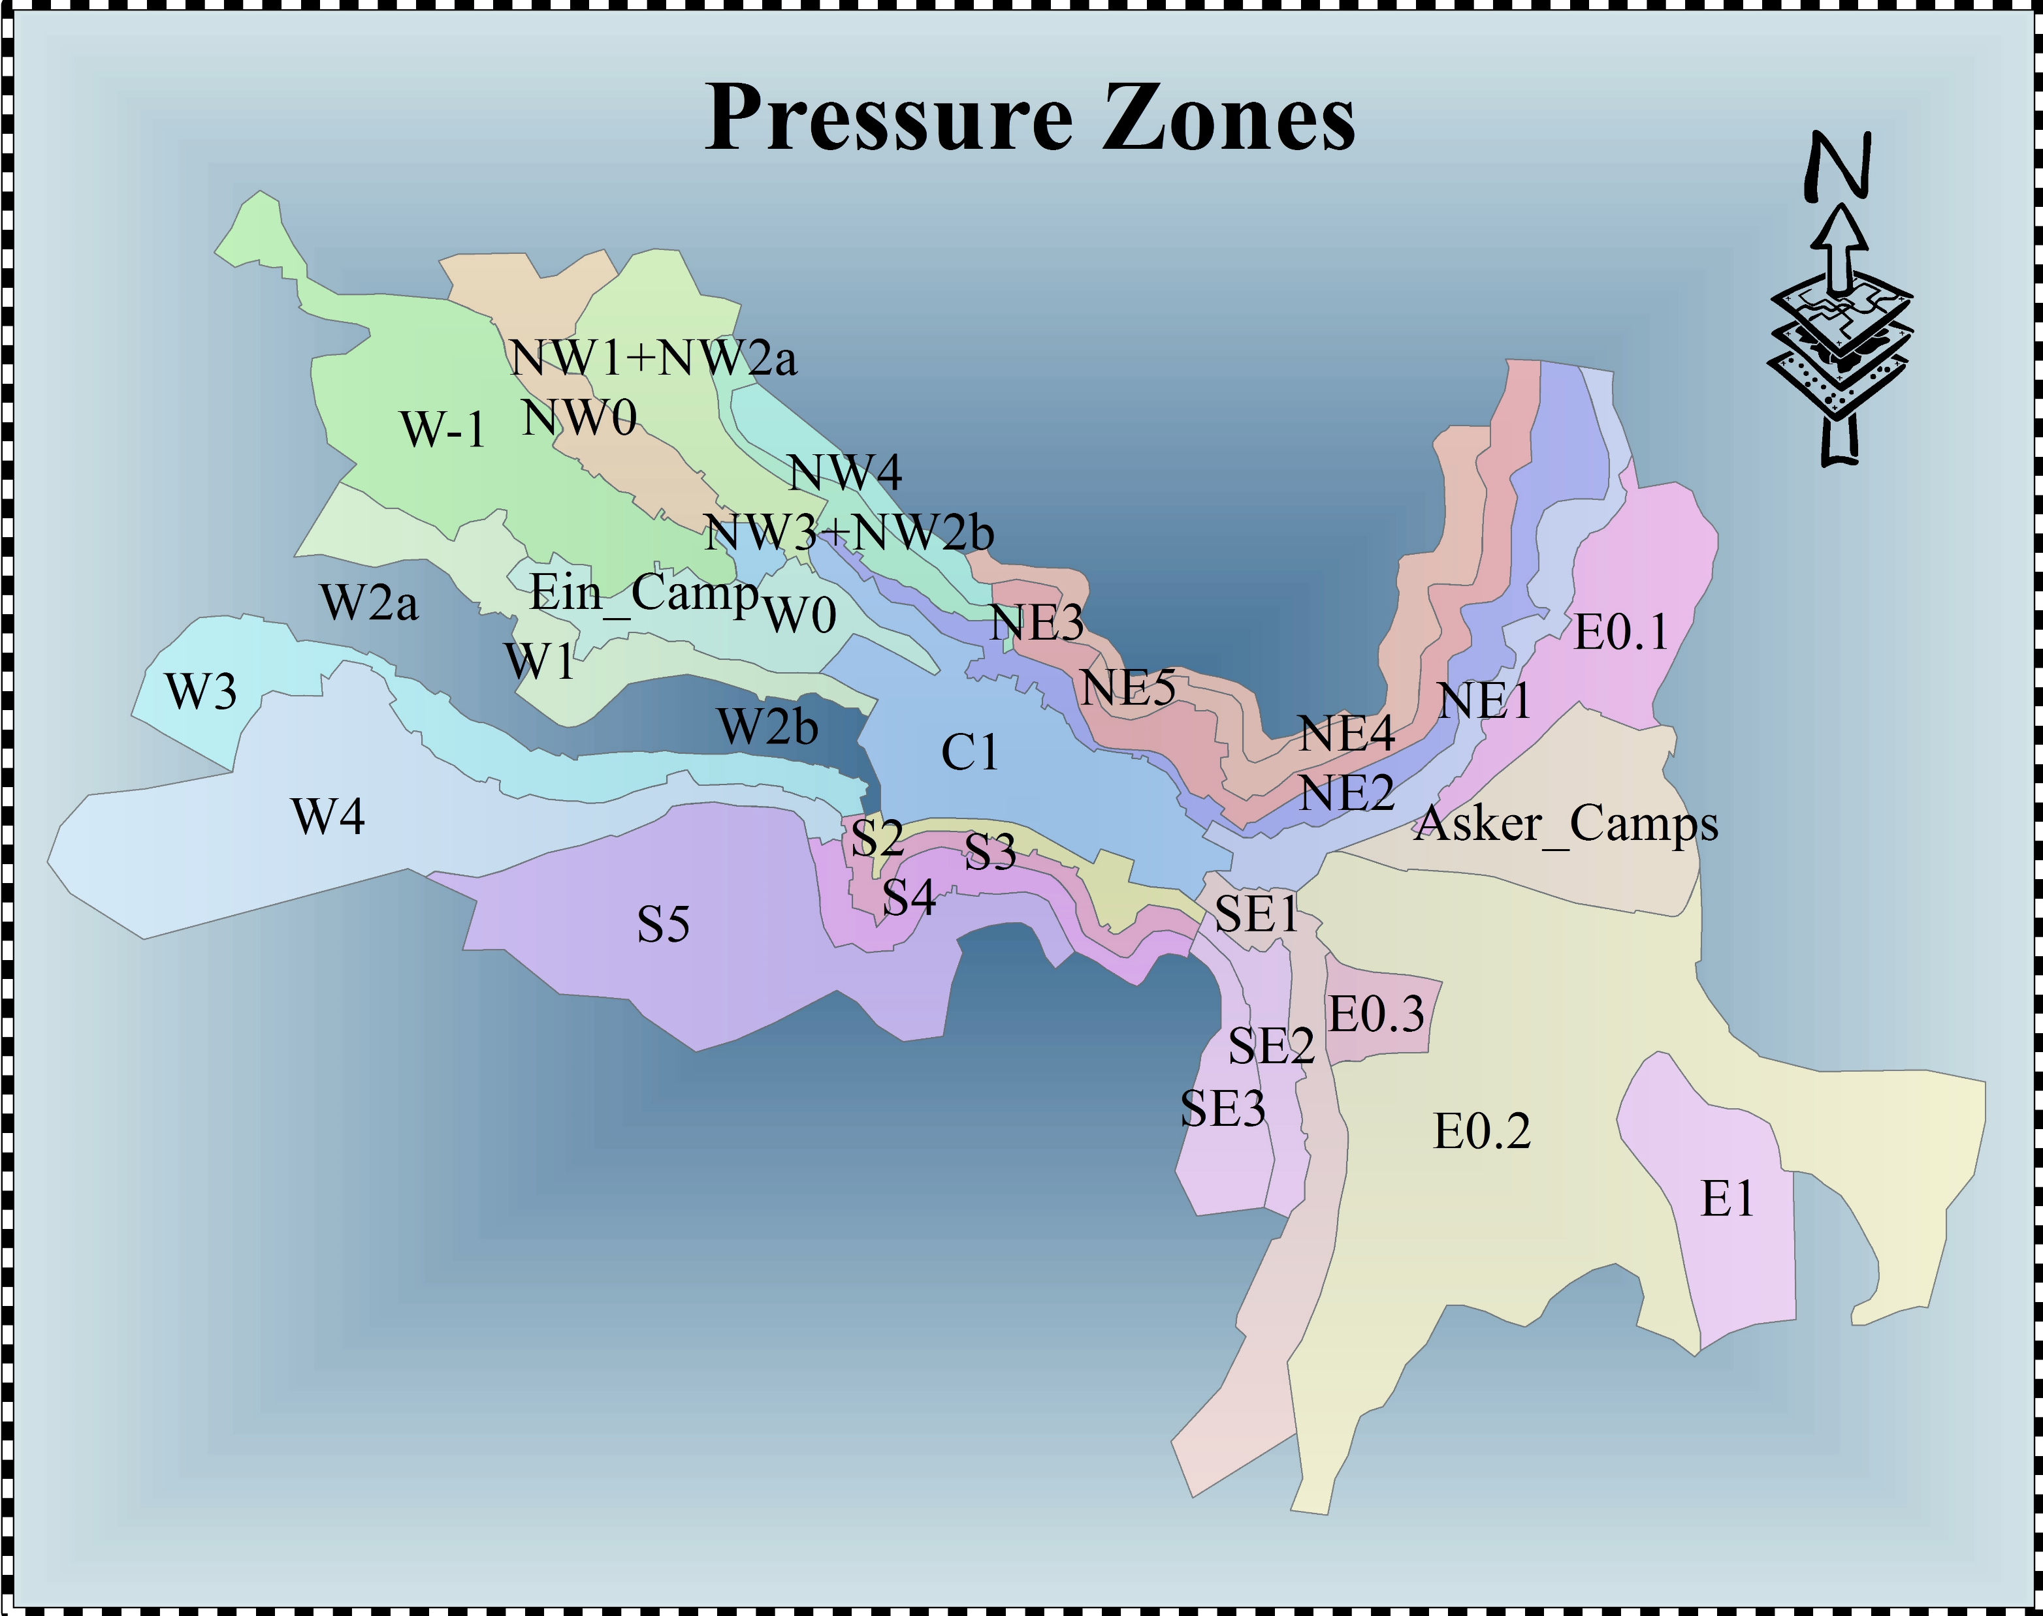
Existing Pressure Zones

Slide 9
Main Results
Total Water Supply: 6,697,200m³/year.
Per Capita Supply: 100.65 L/C/Day.
UFW: 24.9%.
Per Capita Consumption: 75.6 L/C/Day.
Monthly Peak Factor: 1.27.

Slide 10
Main Future Needs
Pop. 2034: 287,300 Capita.
Standard Per Capita Consumption: 120 L/C/Day (PWA).
Standard Water Loss: 15%.
Future Demand: 141.2 L/C/Day.
Total Future Demand: 14,803,500m³.
Additional Needed Quantities: 8.1MCM.

Slide 11
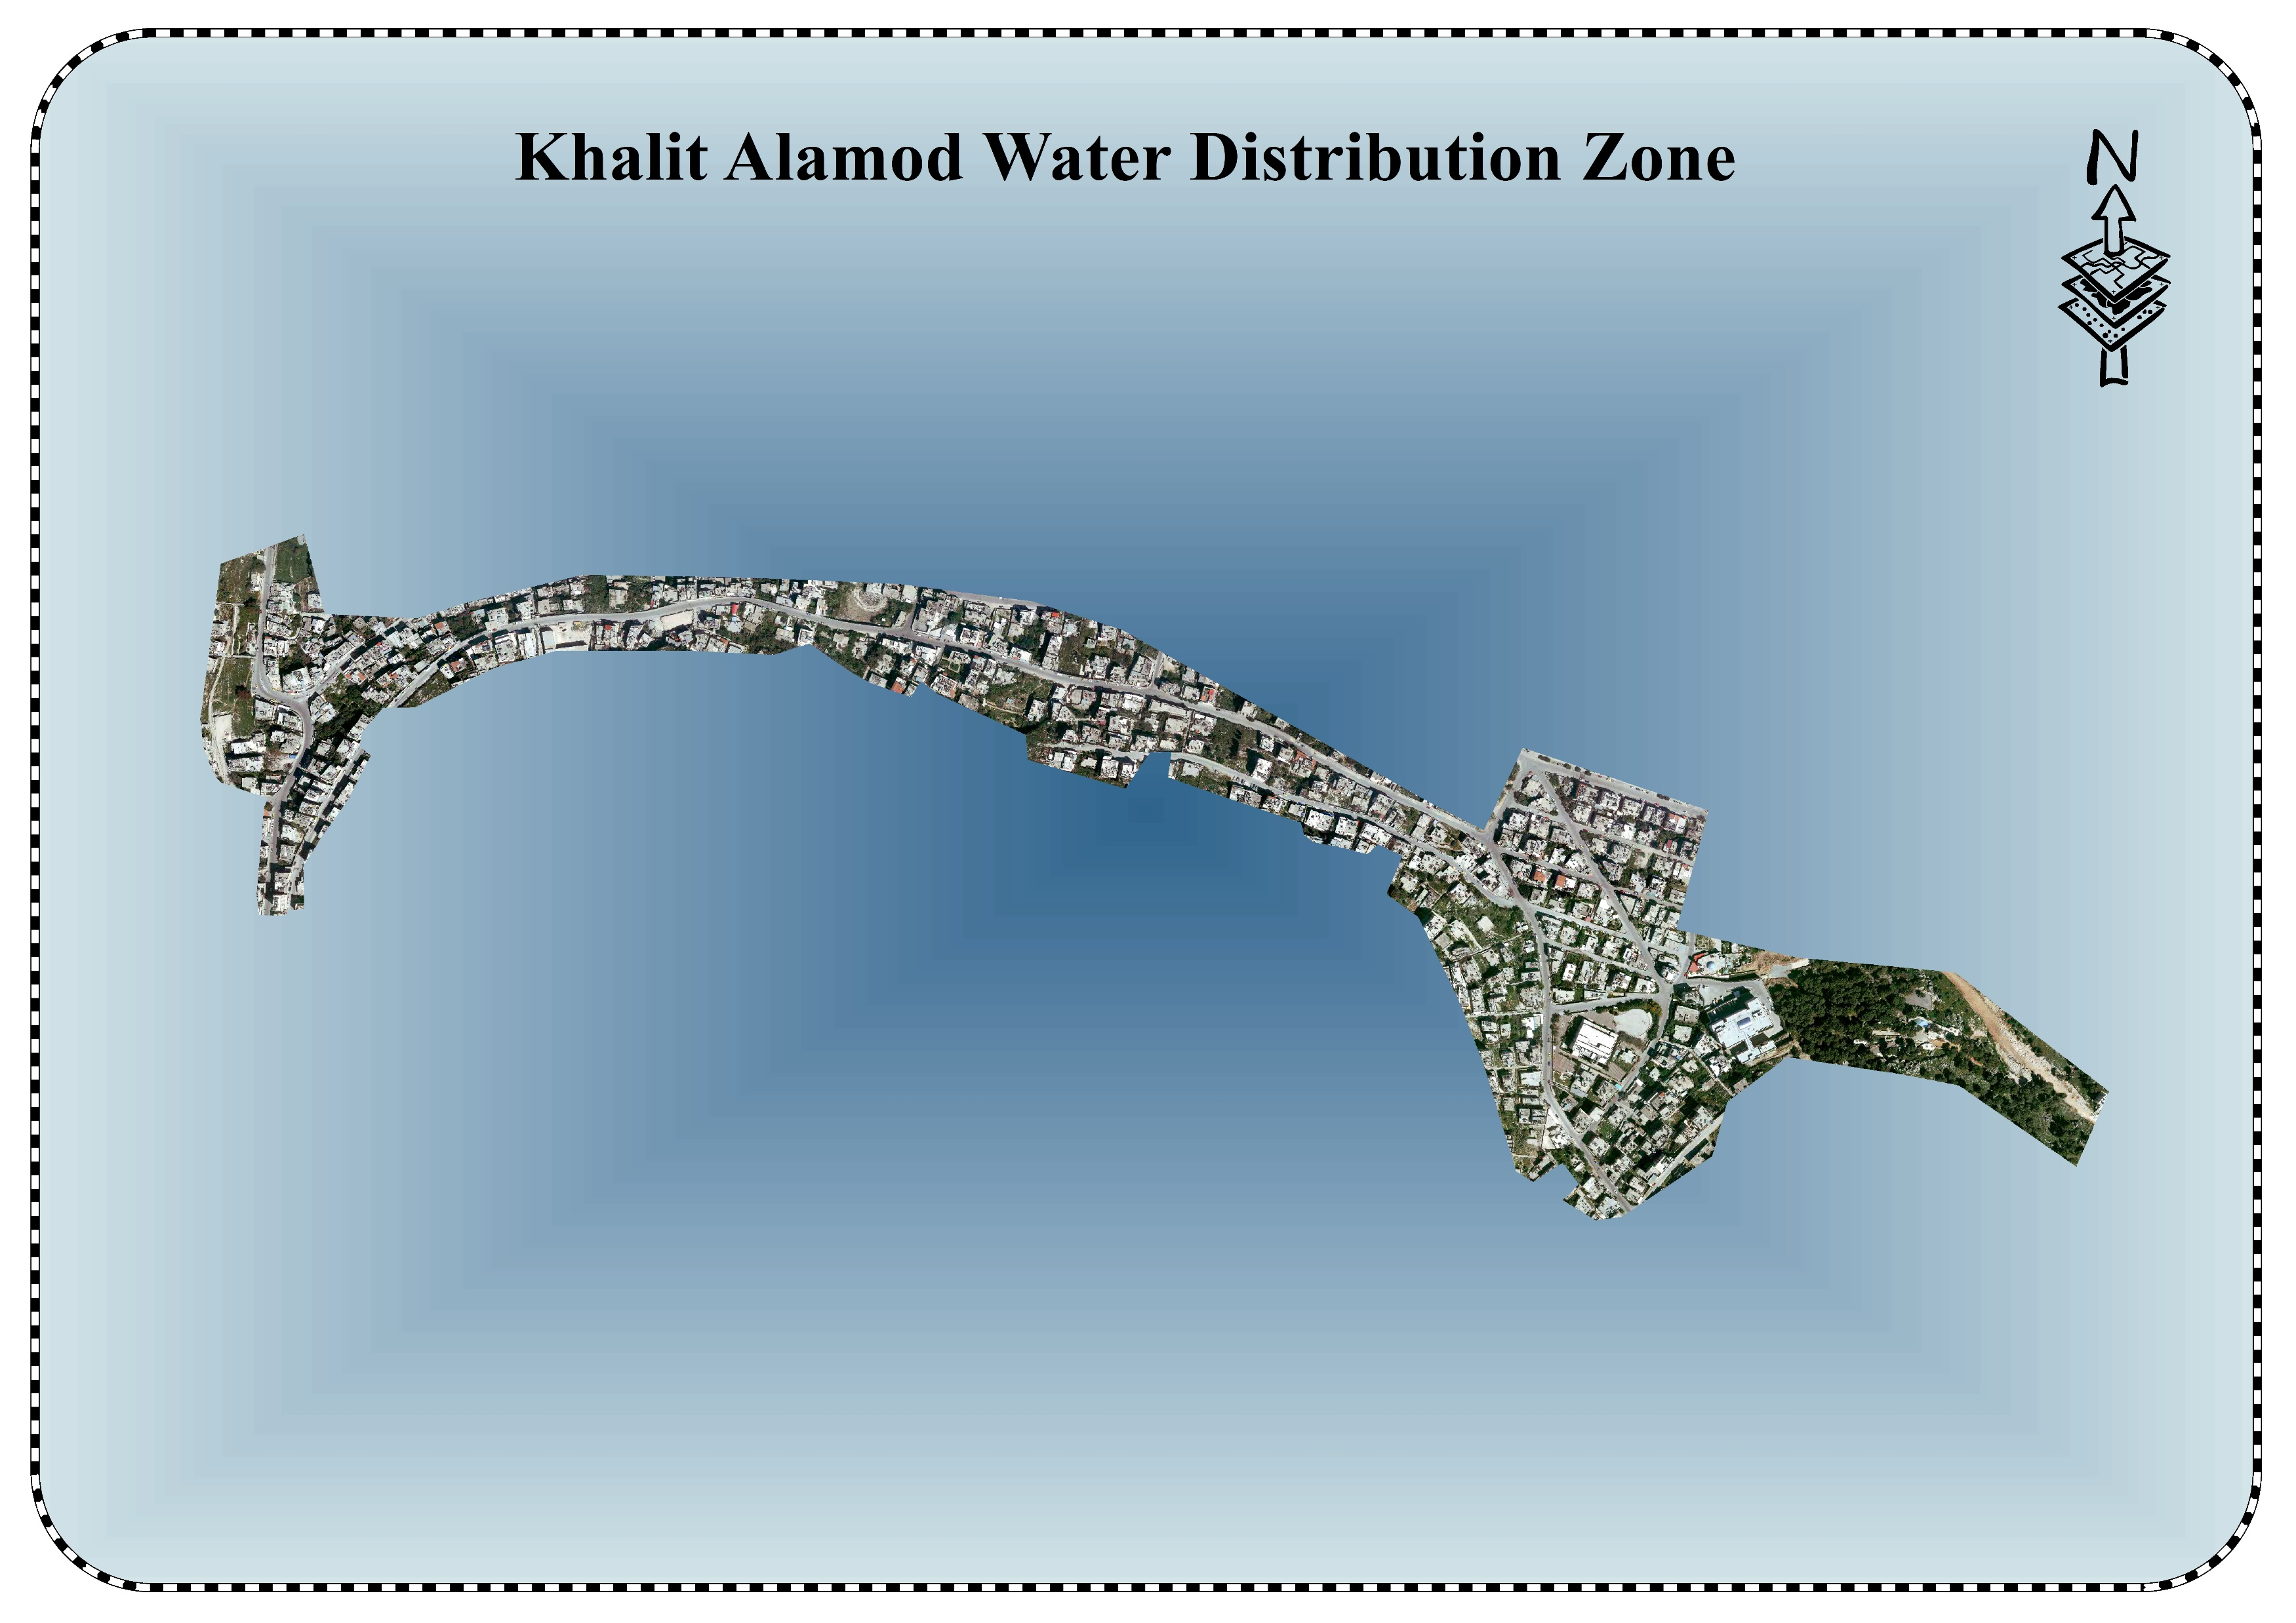

Slide 12
General Characteristics
Location: Southern Part Of The City.
Area: 0.31 Km².
No. Of Meters₂₀₁₄: 1,270 Meter.
Population₂₀₁₄: 6,340 Capita.
Elevation Difference: 105 M (Resource – Highest Point).

Slide 13
Water Conditions
Water Source: Ein Dafna Reservoir.
Water Supplied: 312,800 M³/year.
Water Consumed: 170,500 M³/year.
UFW: 45.5%.
Per Capita Consumption: 74 L/C/Day.
Hourly Peak Factor: 1.36.

Slide 14
Existing Network Condition
Age: (1952-2014).
Length: 10,650 m.
Diameter: 0.5”-8”.
Materials: HDPE, Polypropylene, Steel And Ductile Iron.

Slide 15
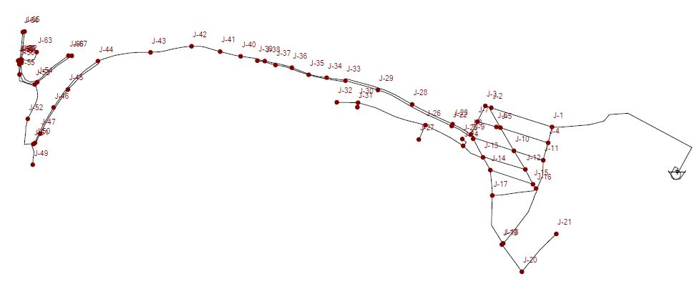
Network Hydraulic Analysis
Water supply was 24 hrs. every 4 days.
Junctions demand was estimated using both Thiessen Polygons & Ortho map.

Slide 16
Results

Slide 17
Main Problems
Uncounted For Water (UFW).
Water Resources.
Reservoir Capacity.
Water Network.
Pumping.
House Connections.

Slide 18
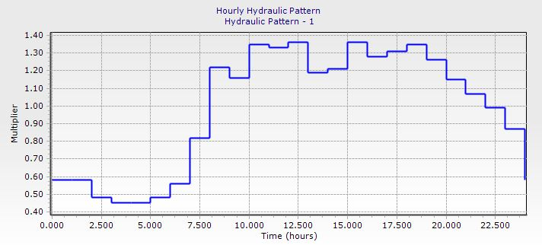
Future Water Demand for the Zone
Population₂₀₃₄: 10,000 c
Saturation Pop.: 12,400 c
Future Demand: 515,400 m³/year → 1412 m³/day
Demand Pattern:

Slide 19
Expected Future Network
Proposed alternatives:
Continuous Direct Pumping
Gravity Flowing Network
Multiple Criteria Decision Analysis.
Proposed Future Network: Gravity Flowing Network.
Attribute |  | Weight of attribute
Process operational complexity |  | 15%
Social aspects |  | 10%
Hydraulic aspects | Pressure | 50% | 15%
 | Velocity | 50% | 15%
Maintenance / Reliability of service |  | 20%
Water quality |  | 20%
Economic |  | 20%

Slide 20
Proposed Actions
Proposed action | Expected date (year)
New network | 2017-2018-2019-2020
New reservoir | 2017-2018
Transmission line | 2019
Meters maintenance | 2020

Slide 21
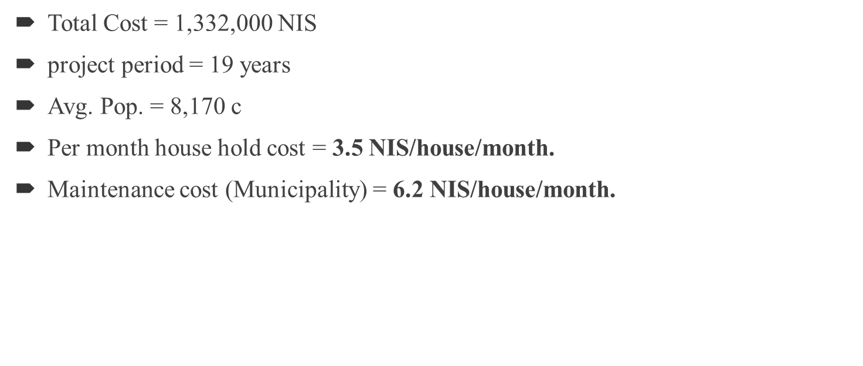
Cost Estimates for The Zone
Total Cost = 1,332,000 $\text{NIS}$
project period = 19 years
Avg. Pop. = 8,170 c
Per month house hold cost = 3.5 NIS/house/month.
Maintenance cost (Municipality) = 6.2 NIS/house/month.

Slide 22
Generalizing the solution for the whole city of Nablus needs the following proposed actions:
Additional resources.
Gravity flowing network:
Trunk lines.
Additional Reservoirs.
Additional Pumps.
Replacement for the existing network.
Replacement for the existing meters.

Slide 23
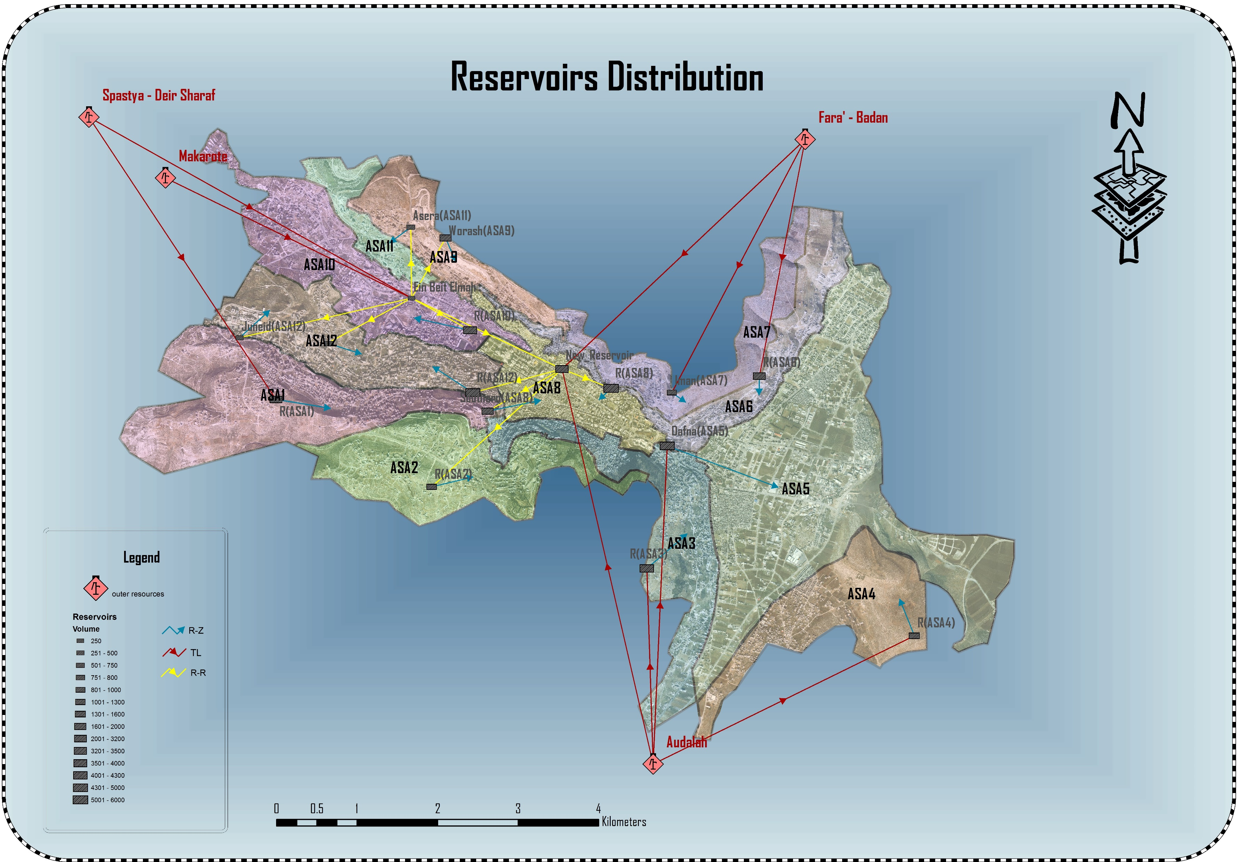

Slide 24
Investments Cash Flow

Slide 25
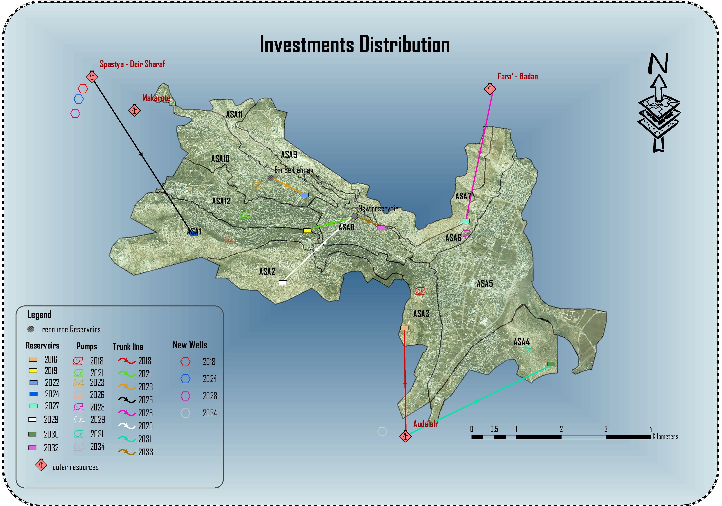

Slide 26
Financial Considerations
Total Project Cost = 15,057,000 €.
Project execution period = 19 years.
Average Pop. of Nablus city = 188,680 c
Per year capita cost = 4.20 €
Per month capita cost = 0.35 € → 1.47 NIS/c/month
Per house hold = 7.35 NIS/house/month.

Slide 27
Conclusion
Studying the Whole city’s water problems.
Analyzing the critical zone and solving its water problems.
Generalizing the solutions from Khalit Alamod to The city of Nablus.
A facility Master Plan for the city was developed.
Future graduation projects could consider the analysis of other zones within the city of Nablus and more detailed design for each zone could be developed. In order to get more specific results.

Slide 28
Questions & Comments
☺

