Slide 1

AN-NAJAH NATIONAL UNIVRESITY
Faculty of Engineering
Structural Analysis & design of Al-Nour Building
By:
Waleed Basheer 11107122
Alaa Hamayel 11142744
Nour Emad Nana 11107147
Under supervision of: Dr. Monther Diab

Slide 2
Content
Introduction.
Design for torsion and shear
Design of shear walls
Design of footing
Deflection of beams and slabs
Design for seismic loads

Slide 3
Project Description
Our project is a Residential Building consists of sixe floors having a total area about 1862 m².Each floor has a total area of 266 m².
The building includes a Parking floor with height of 3.12m and the residential floors have a height of 3.12m.

Slide 4
Project Description
Located in Nablus governorate
Structural dynamic analysis and design.
Model on SAP 2000 .
Hand calculation used to check SAP results .

Slide 5
Significance of the Work
The importance of the project, mainly
apply what learned in engineering courses
improve skills in analysis and design by using computer especially SAP2000.
Secondly, how communicate with engineering office and with contractor through producing skeleton and drawings.

Slide 6
Codes & Standards
Ultimate Design Method to be used.
For Design will Use ACI 318-11 code
For Seismic Design UBC 97 Code.

Slide 7
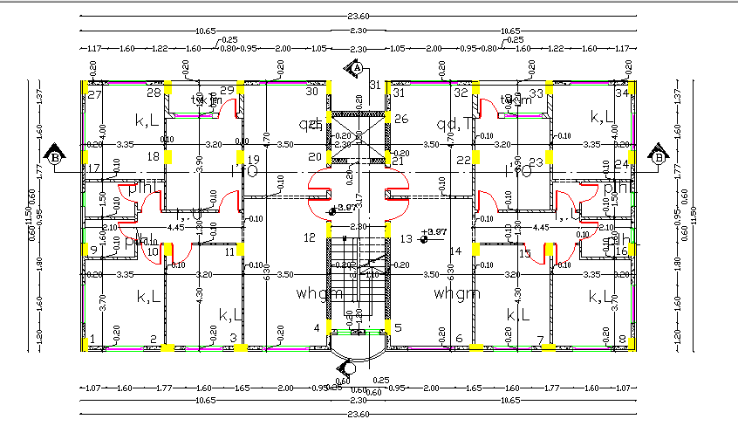
original drawing of the building

Slide 8
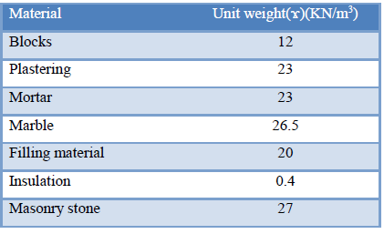
Material Properties
For beams ,slabs, and columns fc=28MPa
modulus of elasticity, E =2.478x107 KN/m2).
Unit weight of concrete, ϫ= 25 KN/ m3.
Reinforcing Steel with yielding strength, Fy = 420 MPa, Modulus of Elasticity ,E = 200 GPa.

Slide 9
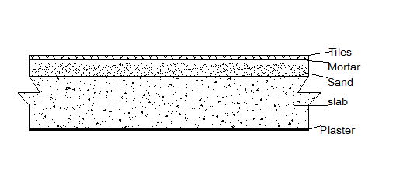
Loads
Super imposed dead load:
100 mm fill under tiles
15 mm mortar under tiles
10 mm tiles
W_{SD}= 4 KN\m2 .

Slide 10
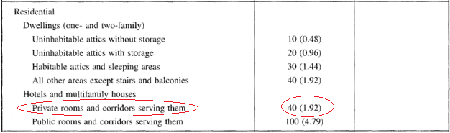
Loads
Dead loads : Own weight of structural elements.
live load
Use ll =2.5 KN/M^2

Slide 11
Load combinations according ubc code
1.4 D
1.2D + 1.6L
1.2D + 1.6(Lr or S) + (f1L or 0.8)
1.2D + 1.3W + f1L +0.5(Lr or S)
1.2D + 1.0E + (f1L +f2S)
0.9D ± (1.0E or 1.3W)

Slide 12
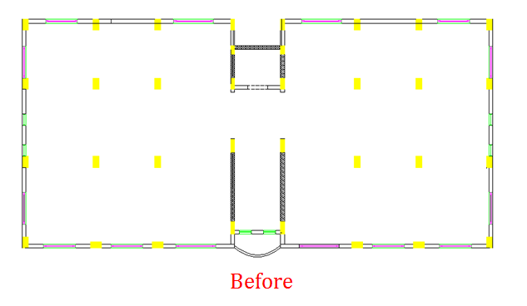
Change in architectural plans

Slide 13
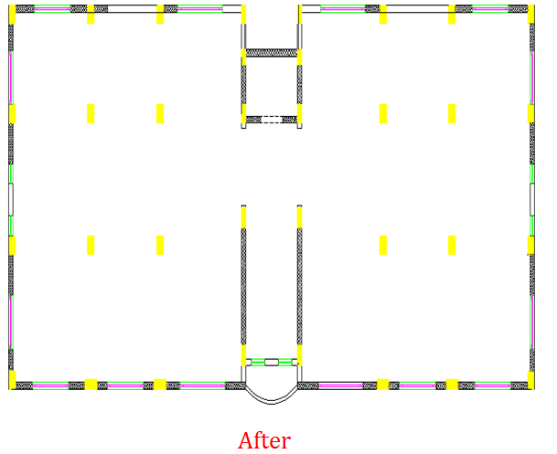
Change in architectural plans

Slide 14
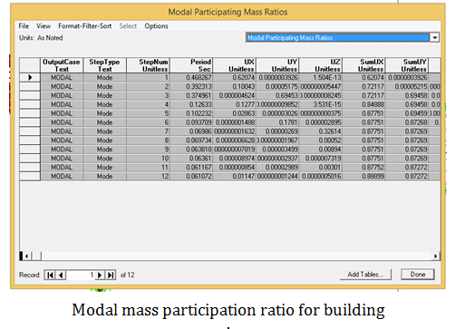
Change in architectural plans

Slide 15
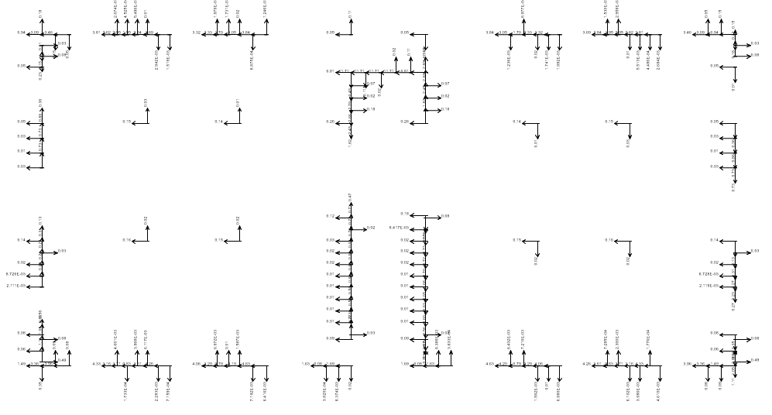

distribution of lateral load on shear walls

Slide 16
Design for seismic loads

Slide 17
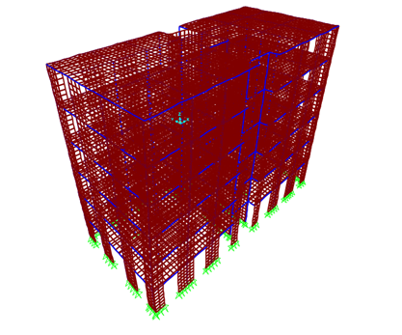
Checks

Slide 18
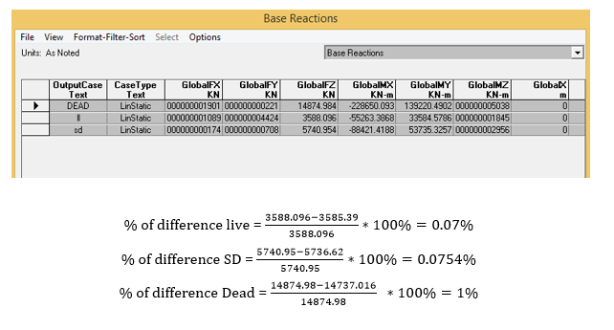
Equilibrium check

Slide 19
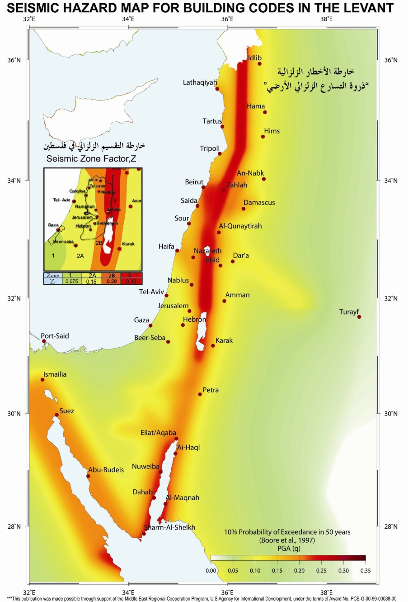
Seismic Design
Zone factor, Z = 0.2
Seismic Coefficient C_{a} = 0.2
Seismic Coefficient C_{v} = 0.2
Since, B.C = 330 KN/M2
The Soil Profile Coefficient is S_{B}
Importance factor = I = 1.25
Over strength factor, R = 5.5

Slide 20
Periodic check
The natural period is the time required to complete one whole cycle during dynamic loading.
The following equation is used to check T:
T= Ct (hn)3/4 , Ct : a constant = 0.0488
The structure has a period T =0.43918 seconds

Slide 21

Periodic check

Slide 22
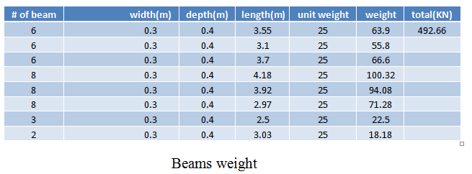
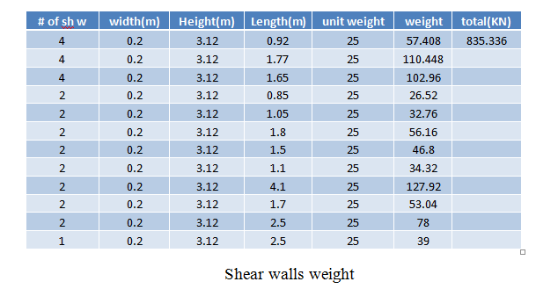
Design base shear

Slide 23
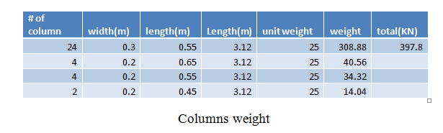
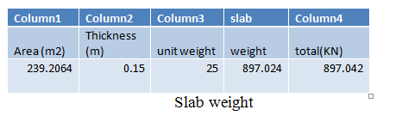
Design base shear

Slide 24





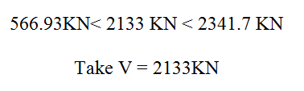
Design base shear

Slide 25
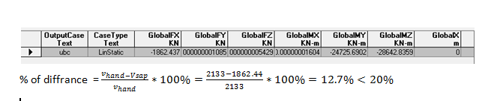
Design base shear

Slide 26
distribution of shear over floors
Ft =0 because T<0.7
 | level | DL | Hx | Wx*H | Fi+Ft | Vx
 | 6 | 3435.99 | 18.72 | 64321.7328 | 609.42857 | 609.4286
 | 5 | 3435.99 | 15.6 | 53601.444 | 507.85714 | 1117.286
 | 4 | 3435.99 | 12.48 | 42881.1552 | 406.28571 | 1523.571
 | 3 | 3435.99 | 9.36 | 32160.8664 | 304.71429 | 1828.286
 | 2 | 3435.99 | 6.24 | 21440.5776 | 203.14286 | 2031.429
 | 1 | 3435.99 | 3.12 | 10720.2888 | 101.57143 | 2133
 |  |  |  | 225126.0648

Slide 27
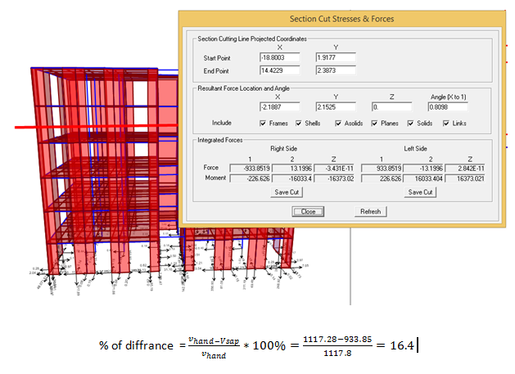
check Base shear distribution

Slide 28
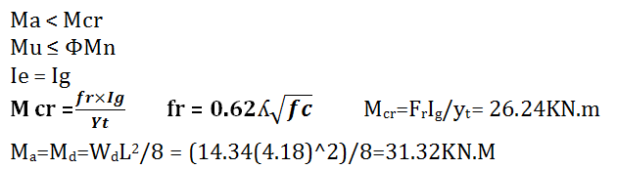

deflection of beams
Stage 1: pre‐cracking stage

Slide 29
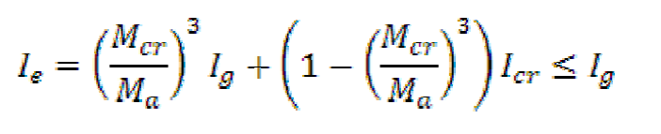
deflection of beams
Stage 2: post‐cracking stage
Ma ≥ Mcr
Mu ≤ ΦMn
Ie ≤ Ig
If Ma ≥ 3Mcr then Ie= Icr

Slide 30
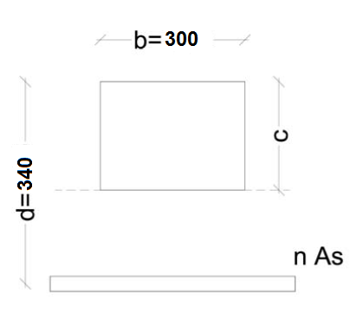
deflection of beams
Stage 3: post‐serviceability
Mu > ΦMn
N= E_{s}/Ec =8.1
300(c²/2)=8.1*(340-c)(402.12)
C=75.75mm
I_{cr} =+8.1*402.12*(340-75.75)² * 270*10⁶= 270.8*10⁶
I_{e}=26.24/31.12)³*160*10⁷ + (1-(26.24/31.12)³)
I_{e}=1.05*10 1.6*10⁹ ok

Slide 31
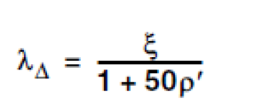
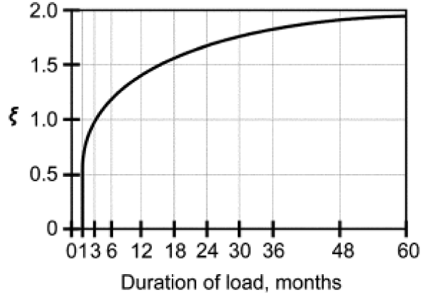
deflection of beams
ΔLT= ΔL + λ∞ ΔD + λ t ΔLS
=0.76 +1.83*2.53+1.83*0.38 = 6mm

Slide 32
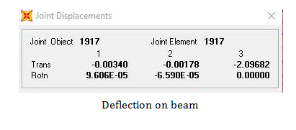
deflection of beams by sap

Slide 33
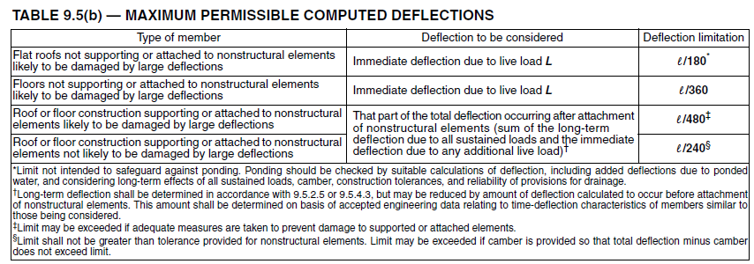
deflection of beams
L/180= 23mm > ΔL=0 .76mm
L/360= 11.6mm > ΔL=0 .76mm
L/480= 8.7mm > ΔLT= 6mm
L/240= 17.4mm > ΔLT= 6mm

Slide 34
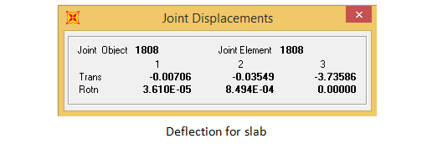
deflection of slab
L/240 = 4100/240 = 17.08 mm.
SO, deformation is okay

Slide 35
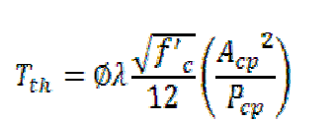
Design for torsion and shear for beam
T_{th} =3.4KN
T_{u}=9.3KN
V_{u}=66KN

Slide 36
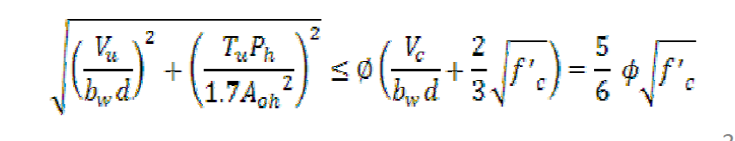
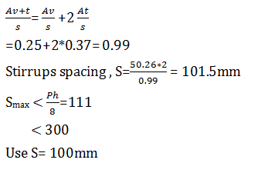
Design for torsion and shear for beam
Check adequacy for the section

Slide 37
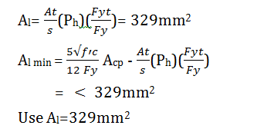
Design for torsion and shear for beam
Torsional longitudinal reinforcement

Slide 38
Design for torsion and shear for beam
Bars distribution
Top bars for torsion = 47.3mm² = 2Ø8
Bottom bars for torsion = 47.3mm² = 2Ø8
Middle bars for torsion = 2Ø10

Slide 39
Check for seismic
The following drawing show that no change in values of
moment before and after seismic

Slide 40
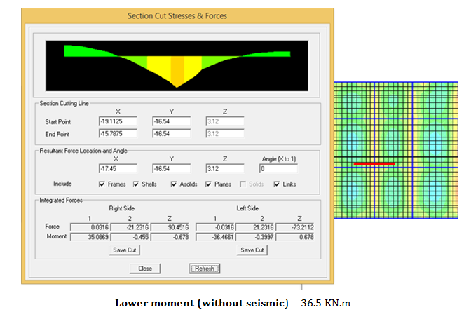
Check for seismic

Slide 41
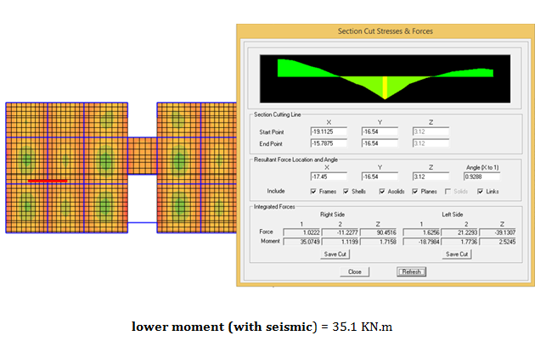
Check for seismic

Slide 42
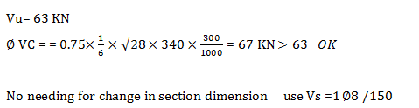
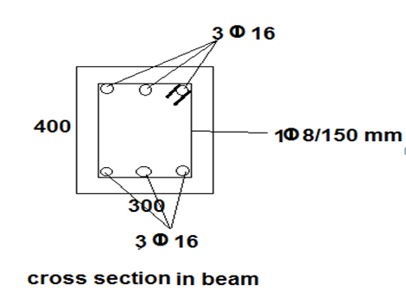
Check for beam under seismic load

Slide 43
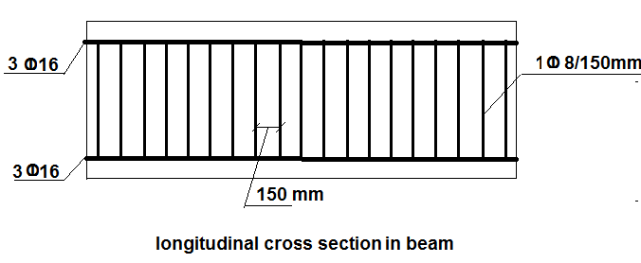
Check for beam under seismic load

Slide 44
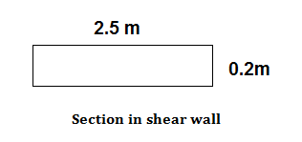
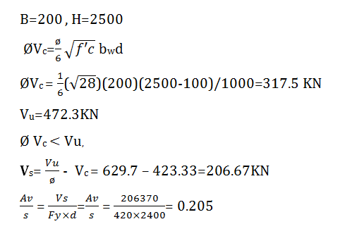
Design of shear wall
Reinforcement for stirrups

Slide 45
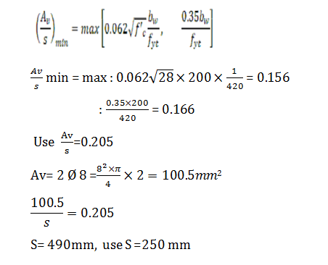
Design of shear wall

Slide 46
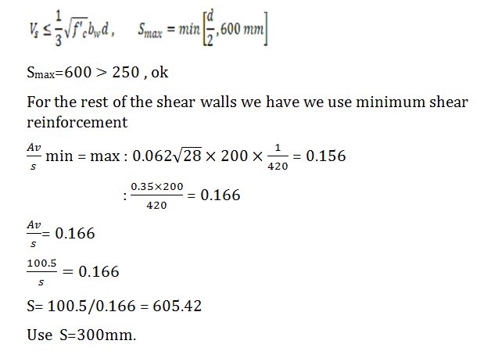
Design of shear wall

Slide 47
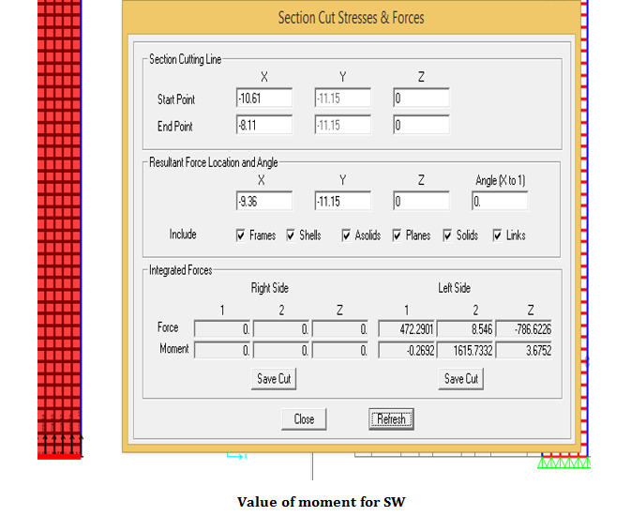
Design of shear wall

Slide 48
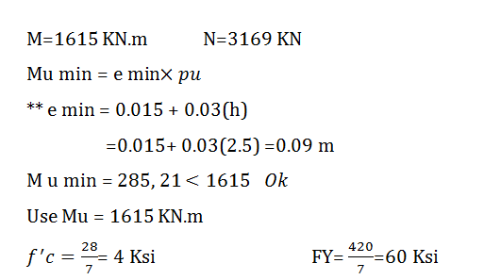
Design of shear wall

Slide 49
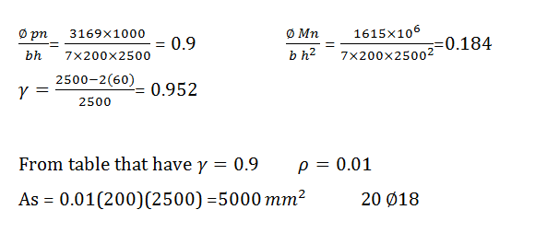
Design of shear wall

Slide 50
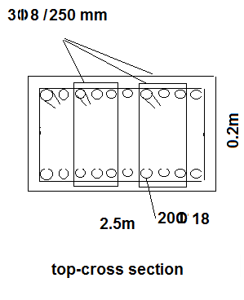
Design of shear wall

Slide 51
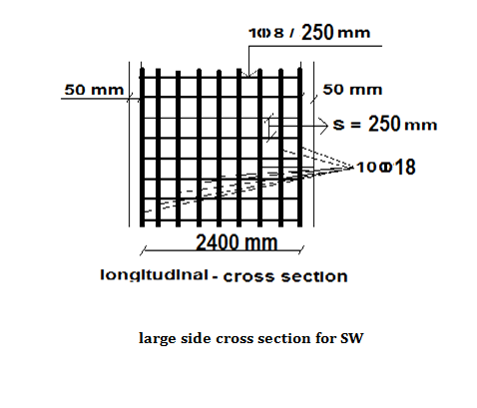
Design of shear wall

Slide 52
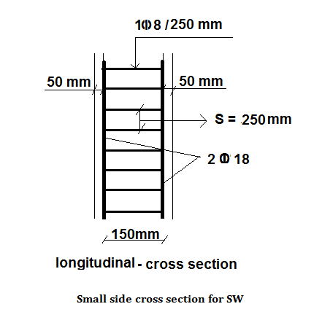
Design of shear wall

Slide 53
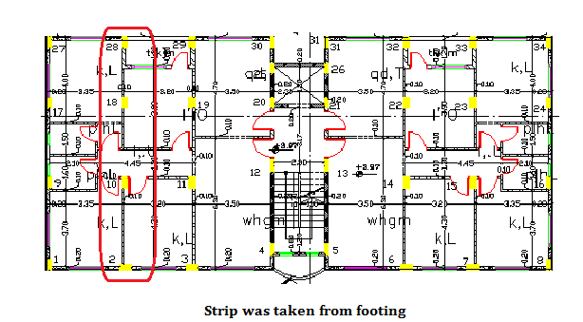
Design of footing

Slide 54
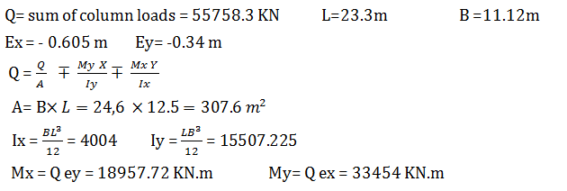
Design of footing

Slide 55
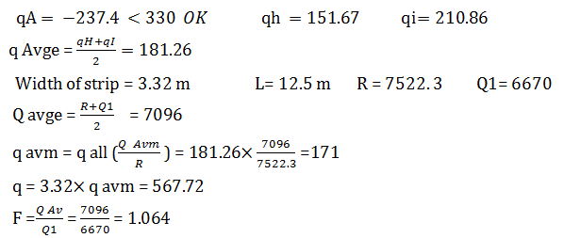
Design of footing

Slide 56
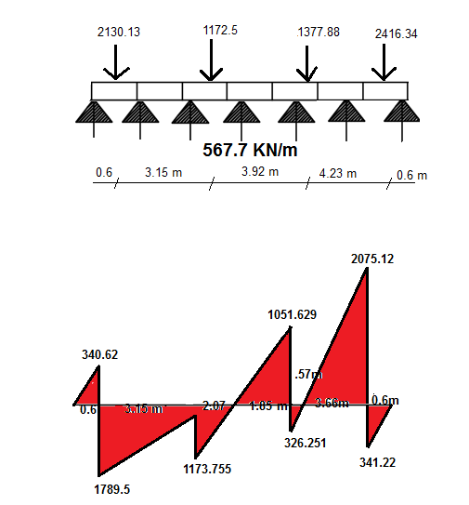
Design of footing

Slide 57
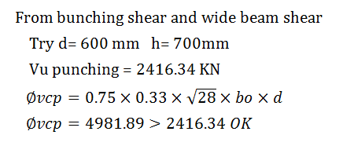

Design of footing
depth of mat
Wide beam shear

Slide 58

Checks of footing
1- Compatibility

Slide 59

Checks of footing
2 -Deflection

Slide 60



Checks of footing
3 - stresses

Slide 61

Design of footing
design moments for footing

Slide 62

Design of footing

Slide 63

Design of footing

Slide 64


design shear for footing

Slide 65

design shear for footing

