Slide 1

An-Najah National University
Faculty of Engineering
Department of Mechatronics Engineering
Whiteboard Notes Tracking-Erasing
System
Supervisor: Dr. Bashir Nouri

Slide 2
Outlines
1
Existing problem
2
Problem Solutions
3
Tracking System
5
4
Erasing System
Conclusions

Slide 3

Existing problem
In traditional learning in which learners are usually forced to take notes, that will :
Consume a lot of time and effort.
Distract learners attention.
So learners will not be interactive.

Slide 4
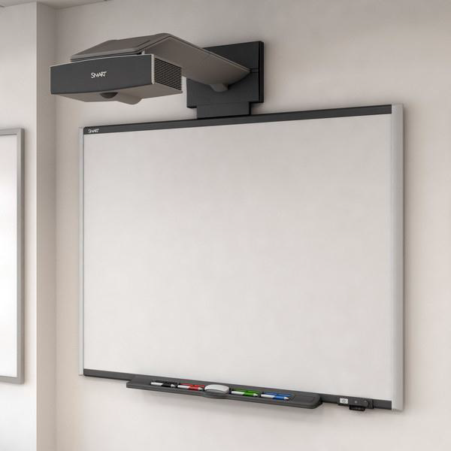
Problem solutions
Interactive boards

Slide 5
Problem solutions
whiteboard
Notes
Tracking
System
Erasing
Whiteboard Notes Tracking-Erasing System
W
N
T
E
S

Slide 6
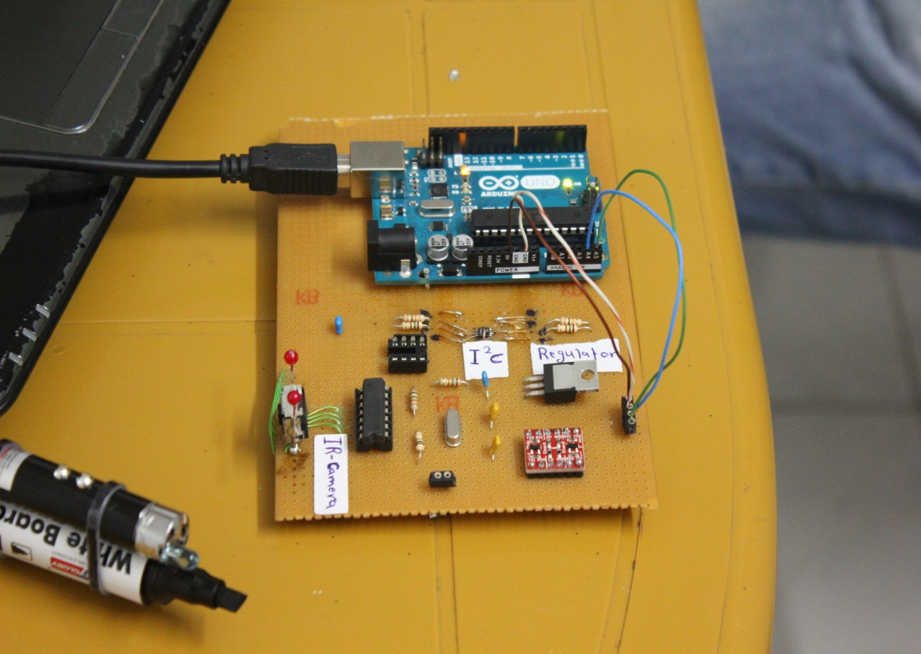
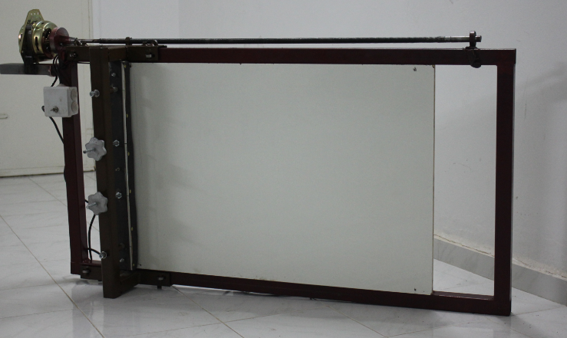
Overview of WNTES

Slide 7
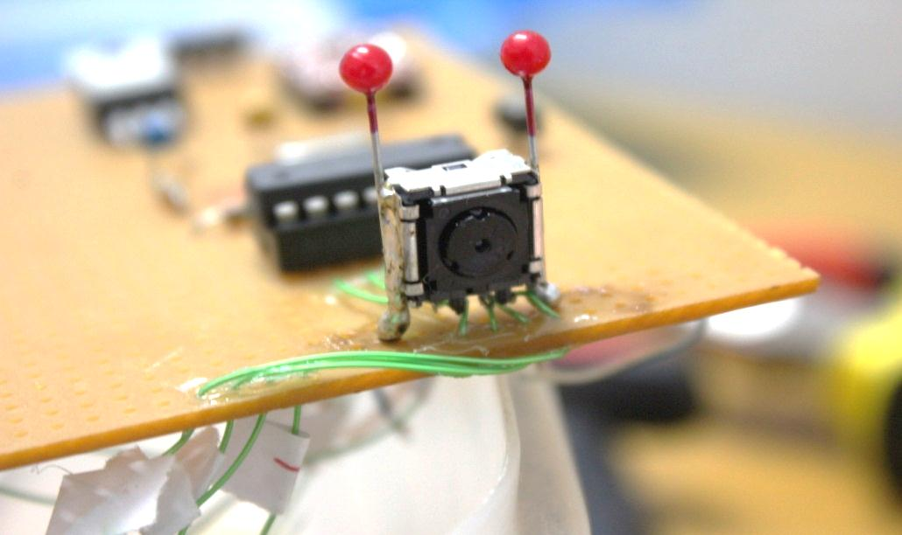
IR Sensitive Camera
Tracking System Components

Slide 8
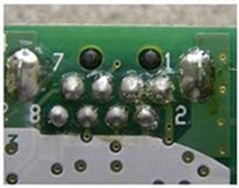
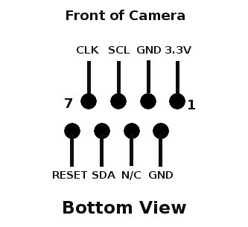
Tracking System Components
IR Sensitive Camera
Pin # | Description
1 | pulled up to +3.3 V
2 , 3 | Grounded
4 | not connected
5 | Serial Clock. (I²C Bus)
6 | Serial Data Line. (I²C Bus)
7 | Components clock. (25 MHz)
8 | Active low Reset (can be pulled up to Vcc)

Slide 9
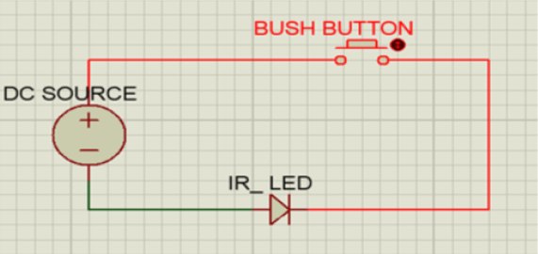
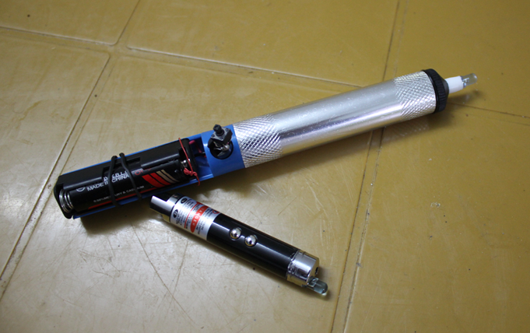
Stimulus (IR light source)
Tracking System Components

Slide 10
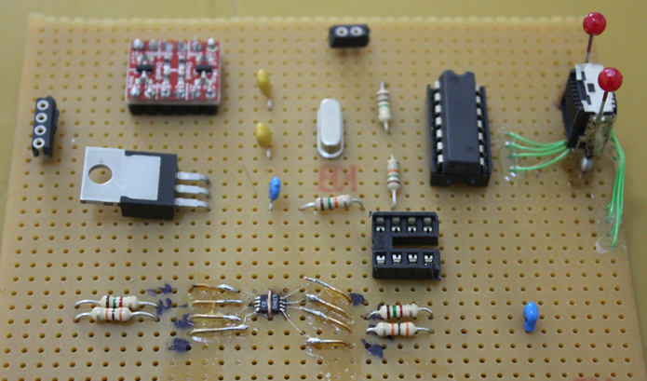
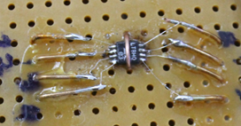
Tracking System Components
I²C level converter

Slide 11
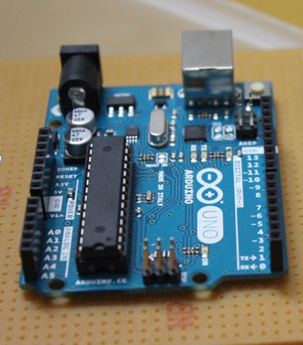
Tracking System Components
Arduino Uno
The Arduino Uno is a microcontroller board based on the ATmega328. It has 14 digital input/output pins, 6 analog inputs, a 16 MHz ceramic resonator.
It contains everything needed to support the microcontroller; simply connect it to a computer with a USB cable.

Slide 12
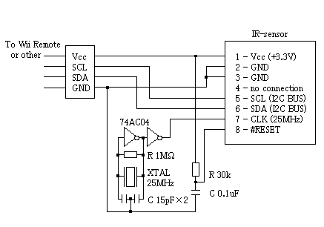
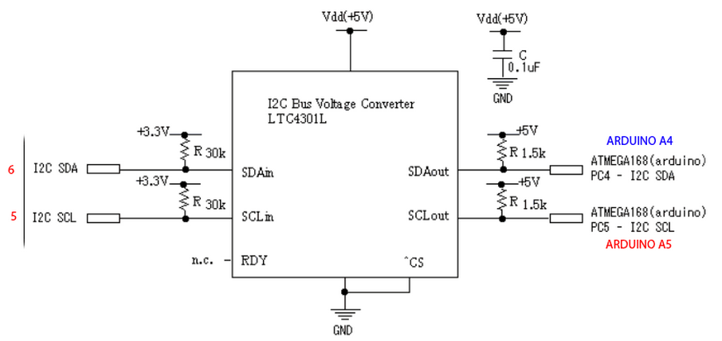
Tracking System Components
IR camera Connections & Interfacing

Slide 13
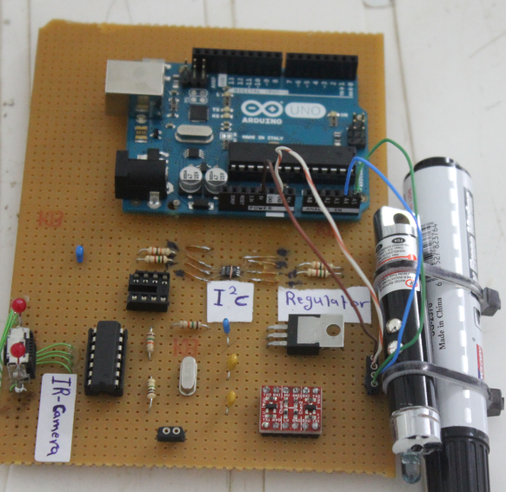
Tracking System Components
IR camera Connections & Interfacing

Slide 14
Erasing System

Slide 15
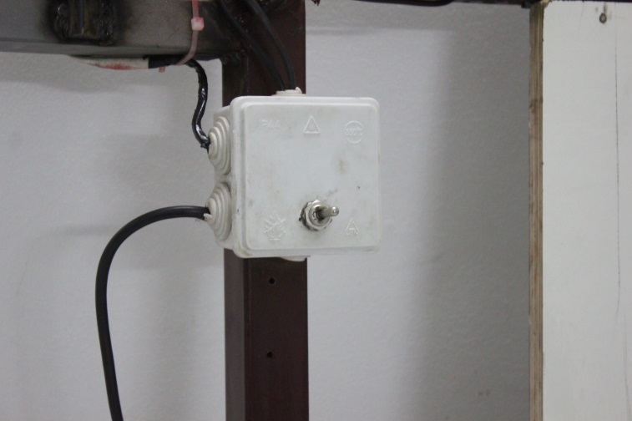
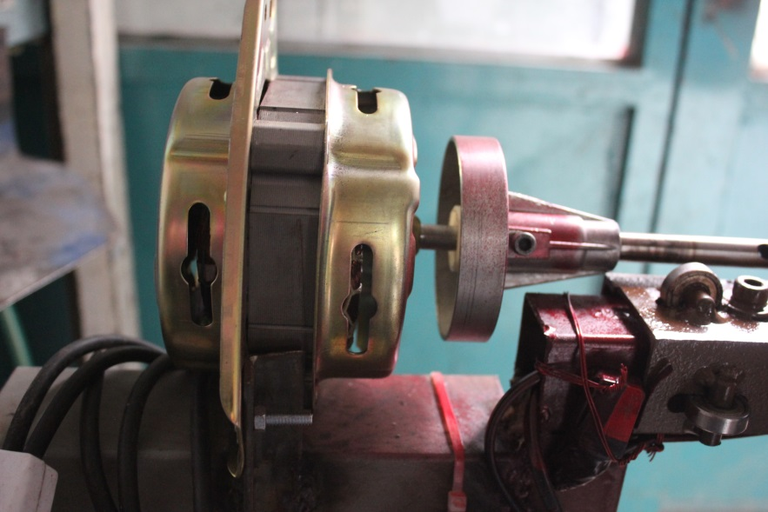
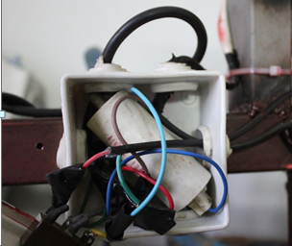
Erasing System Components
System Drive

Slide 16
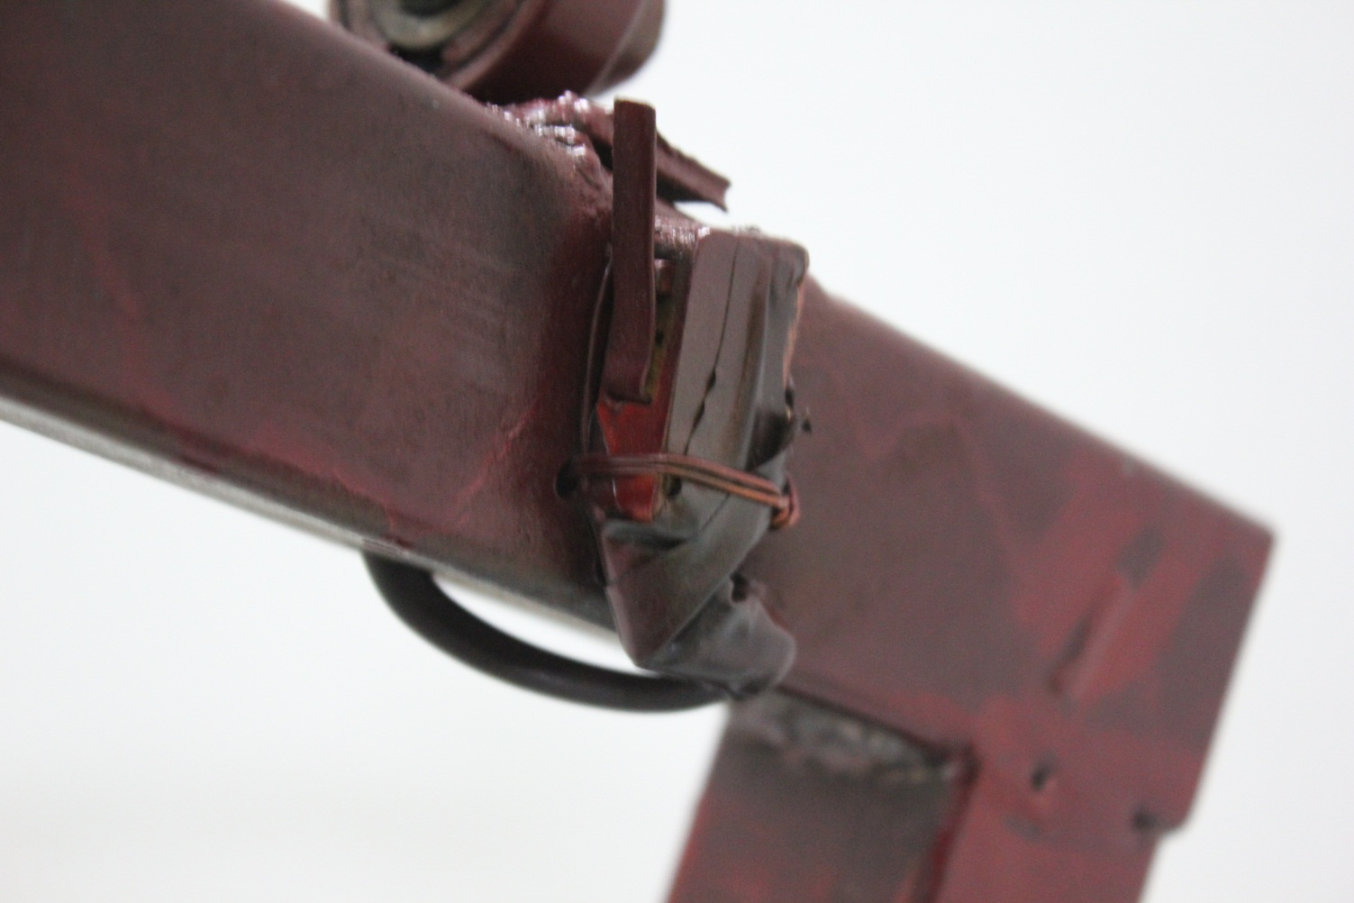
Erasing System Components
Limit Switch Sensor

Slide 17
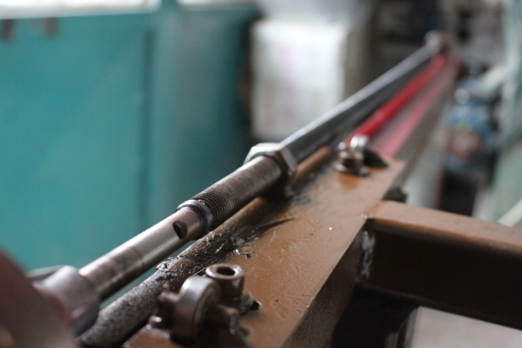
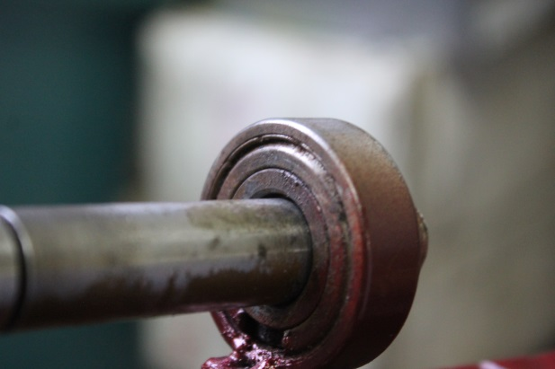
Erasing System Components
Power Screw and Bearing

Slide 18
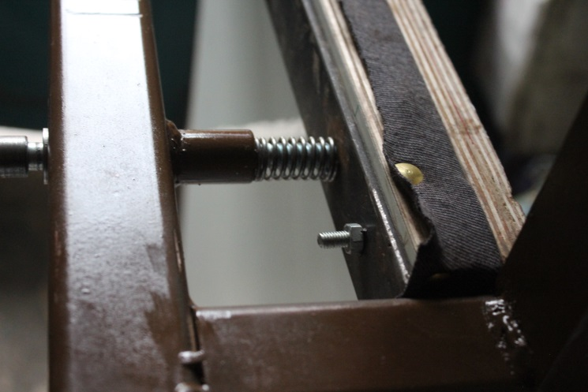
Erasing System Components
Compression Spring

Slide 19
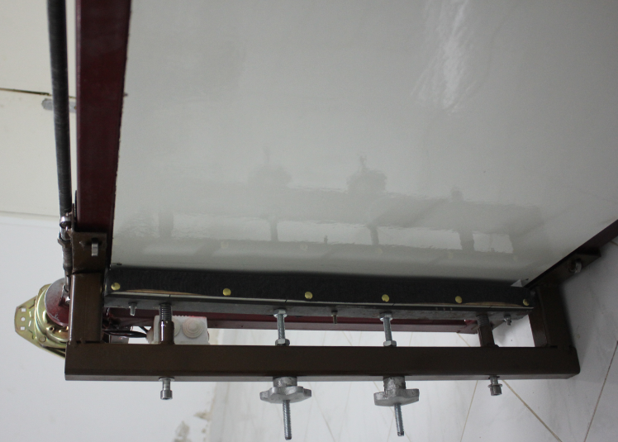
Erasing System Components
Erasing head

