Slide 1
"Numerical study of effect of wall insulation thickness on energy performance for different climate region of Palestine“
Prepared By: Majd qadous
Wajeeh nase
Supervised by : Dr. Ramez khaledy

Slide 2
Introduction
The project will apply on both heating and cooling system
The main problem that the project will treat is the loss of energy from the walls
the main objective is reduced energy consumption by use insulation material thickness
parameters: effect of wall orientation, life cycle and payback period
type of insulation materials are polystyrene and polyurethane

Slide 3
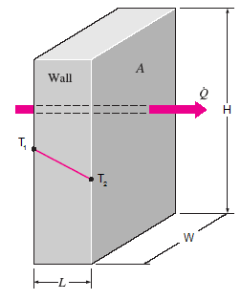
Introduction
First, because Palestine has limited renewable sources of energy, there has to be a way to reduce energy consumption lost through the walls. Therefore, engineers resorted to a way to reduce energy consumption, which is insulation.

Slide 4
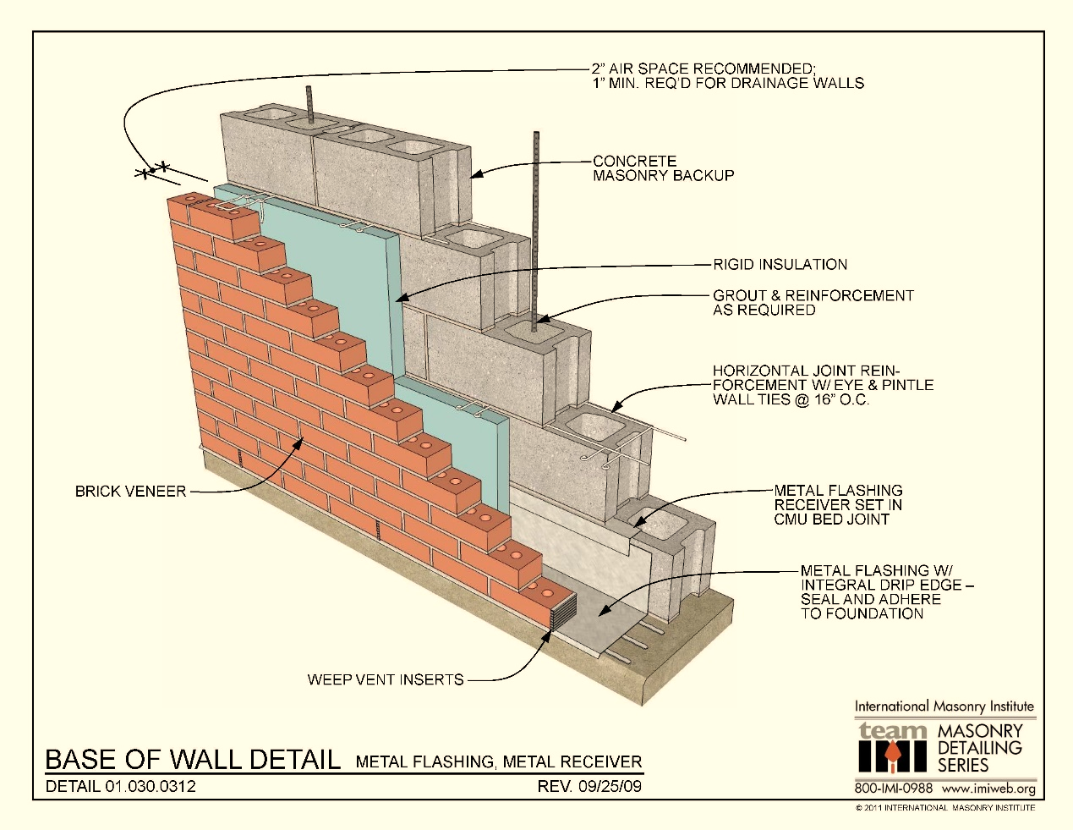
Introduction
insulation material
it was found that the put of the insulating material reduces the energy lost, and when increase thickness of the insulation material then energy lost will decrease and the costs will increase.

Slide 5
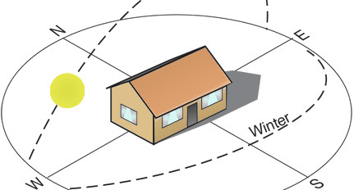
Introduction
Orientation of building
At first, people did not take into account the direction of the walls, but with engineers it was found that the direction of the wall was a very important factor to provide as much energy as possible by absorbing as much of the sun as possible

Slide 6
LITRATURE
REVIEW
Effect of Wall Orientation
.
Saving Energy and Payback Period:
Your logo

Slide 7
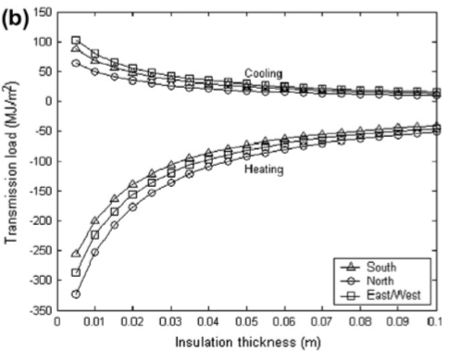
LITRATURE REVIEW
Wall Orientation:
Ozel, M.,(2011)
the optimal insulation thickness for different walls orientations is different between the walls. The lower cooling load is provided for north facing wall while the lower heating load is provided for south-facing walls. The east and west orientation provide the same cooling and heating transmission load

Slide 8
LITRATURE REVIEW
Wall Orientation:
Al-Sanea, S.A., et al. (2002)
The south-facing wall is the most favorite orientation because the minimum heating load in Riyadh. Polystyrene is found to be the most economical type with an optimum thickness of 9.3 cm.

Slide 9
LITRATURE REVIEW
Life cycle and payback period:
M. Ozel (2011)
The optimum insulation thickness material of building walls for heating and cooling system between 2 and 8.2 cm, the energy savings vary between 2.78 and 102.16 $/m2, and the payback periods vary between 1.32 and 10.33 years.

Slide 10
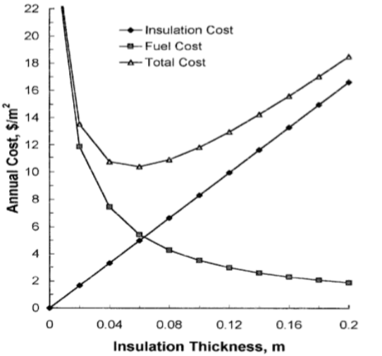
LITRATURE REVIEW
Life cycle and payback period:
Hasan (1999)
The payback period for polystyrene 1.4-2.3 but the life cycle savings over 10 year is 8.27-19.70($/𝑚2)

Slide 11
Methodology

Slide 12
Degree day
Heating degree day :
DDh = (18.3 - Ta)*Nh
cooling degree day :
DDc = (Ta+ 0.026*SHG)
heating and cooling degree day :
𝐷𝐷 =(DDc / 𝐶𝑂𝑃)+(DDh / η)

Slide 13
Optimum insulation thickness
Xopt for heating system by diesel :
Xopt = [(86400 ∗ Cf ∗ DDh ∗ K ∗ PWF)/(Ci ∗ H ∗ η)] 1/2 - K*Rt
Xopt for cooling system by electricity:
Xopt = [(0.024∗ Ce ∗ DDc ∗ K ∗ PWF)/(Ci ∗ cop)] 1/2 - K*Rt

Slide 14
Life cycle saving and payback period
saving by diesel:
Ct1= 86400* PWF *Cf*DDh /(Rt∗H∗ η)
Ct2 = 86400*PWF*Cf*DDh [(Rt+(Xopt/K))/(H∗0.7)] + Ci*Xopt
saving = Ct1-Ct2
cooling degree day :
Ct1= 0.024 * PWF *Ce *DDc /(Rt∗cop)
Ct2 = 0.024* PWF * Ce * DDc [(Rt+(Xopt/K))/(cop)] + Ci*Xopt
saving = Ct1 - Ct2

Slide 15
Result & Discussion

Slide 16
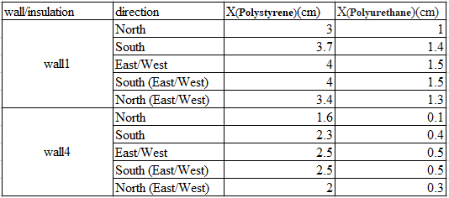
Result & Discussion
The optimum insulation thickness for cooling by electricity(Jericho)
Fig: Cost of cooling (south) for insulated buildings versus insulation thickness for Jerich.

Slide 17

Result & Discussion
The optimum insulation thickness for heating by diesel (Jericho)
Fig : Cost of heating (diesel) for insulated buildings versus insulation thickness for Jericho.

Slide 18
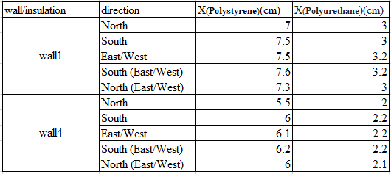

Result & Discussion
The optimum insulation thickness for cooling and heating by electricity(Jericho)
The optimum insulation thickness for heating by electricity (Jericho)

Slide 19
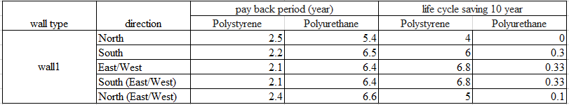

Result & Discussion
life cycle and payback period for cooling by electricity (Jericho)
life cycle and payback period for heating by electricity (Jericho)

Slide 20
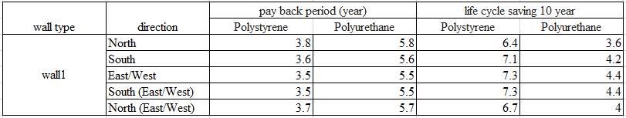

Result & Discussion
life cycle and payback period for heating and cooling by electricity (Jericho)
life cycle and payback period for heating by diesel (Jericho)

Slide 21
Result & Discussion
Optimum insulation thickness versus present worth factor for wall1 heating electricity

Slide 22
Conclusion
In conclusion
We have studied a number of knowledge in the literature review and we have obtained several results. The most important of these results when increasing the insulation thickness, we get less cooling and heating load and also according to research, it was found that the best insulation thickness in the process is 5cm,
Using diesel for heating is better than electricity because the pay pack period and saving for diesel is better .

Slide 23
Future work
In our project, we calculated the best insulation in the West Bank, and we hope that in the future they will calculate the optimum insulation for the Gaza Strip, develop the Matlab program and search for new types of walls spread to calculate the best insulation
it is necessary to study other influencing factors other than the orientation of the walls and save energy. For example, the effect of the arrangement of components on the thickness of the insulation and the effect of the glass should be studied, as well as the study of the insulation of the ceiling and the floor and do not study limited.

Slide 24


