Slide 1
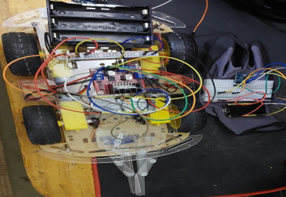
Gesture control car
Accomplished by: Project supervisor:
Mahmoud Basha a. Muhannad Al-Jabi
Mostafa Hab-Romman

Slide 2
OUTLINE:
What is Gesture control car.
Uses of Gesture control car.
Technical choices.
How it works.
Challenges.
Future work.

Slide 3
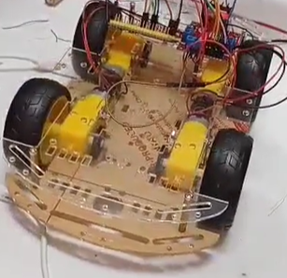
What is Gesture control car
A gesture control automobile is one that can be moved forward, backward, right, or left in many ways, in this project we use hand gestures.

Slide 4
Uses of Gesture control car:
People with mobility difficulties who find it difficult to go everywhere.
To transport items to distant locations where it may be hazardous for someone to reach alone.
Reach closed places like under sofa…

Slide 5
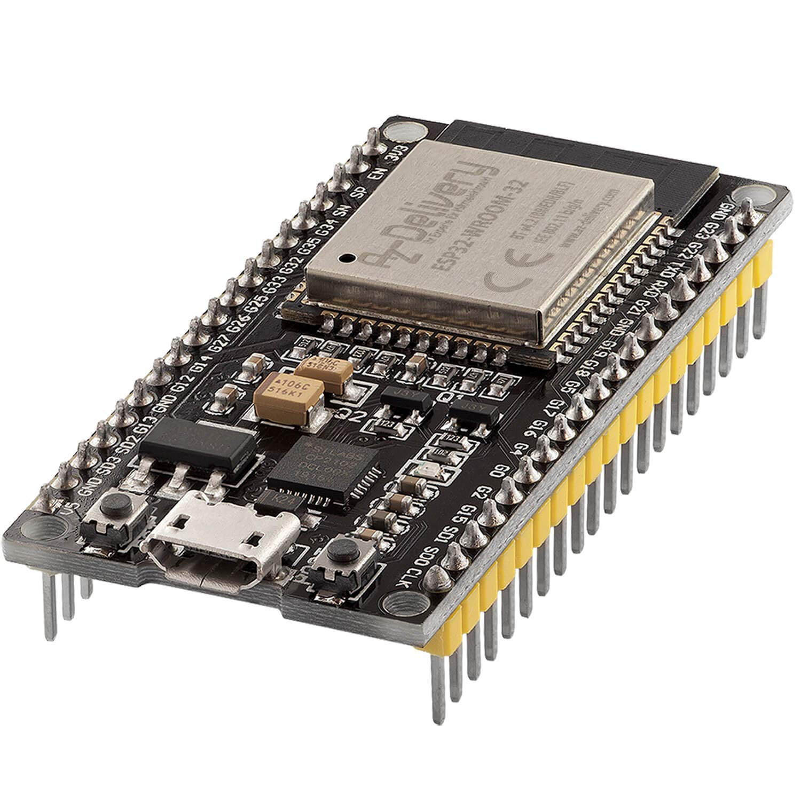
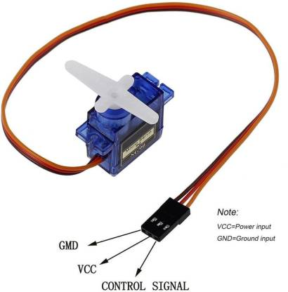
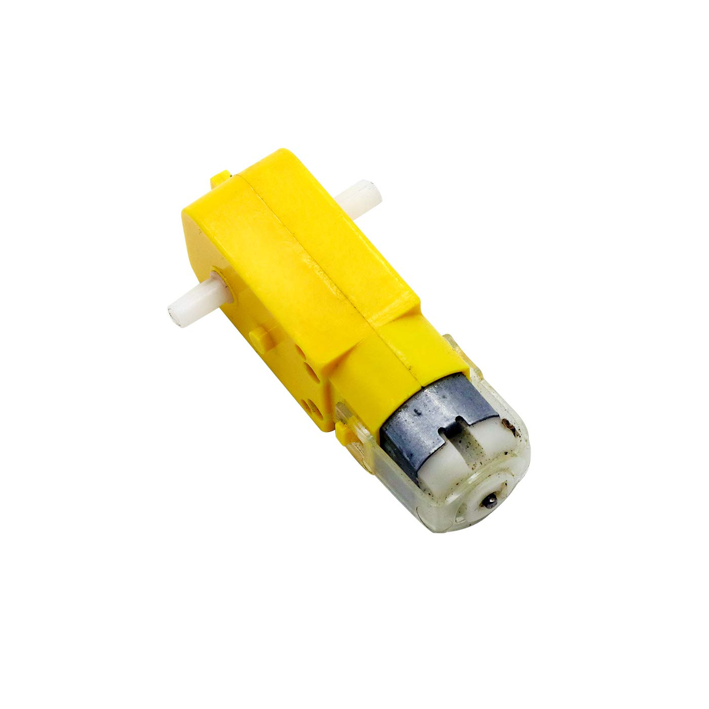
Technical choices:
Hardware:
a. ESP-32
b. DC motor
c. Servo motor

Slide 6
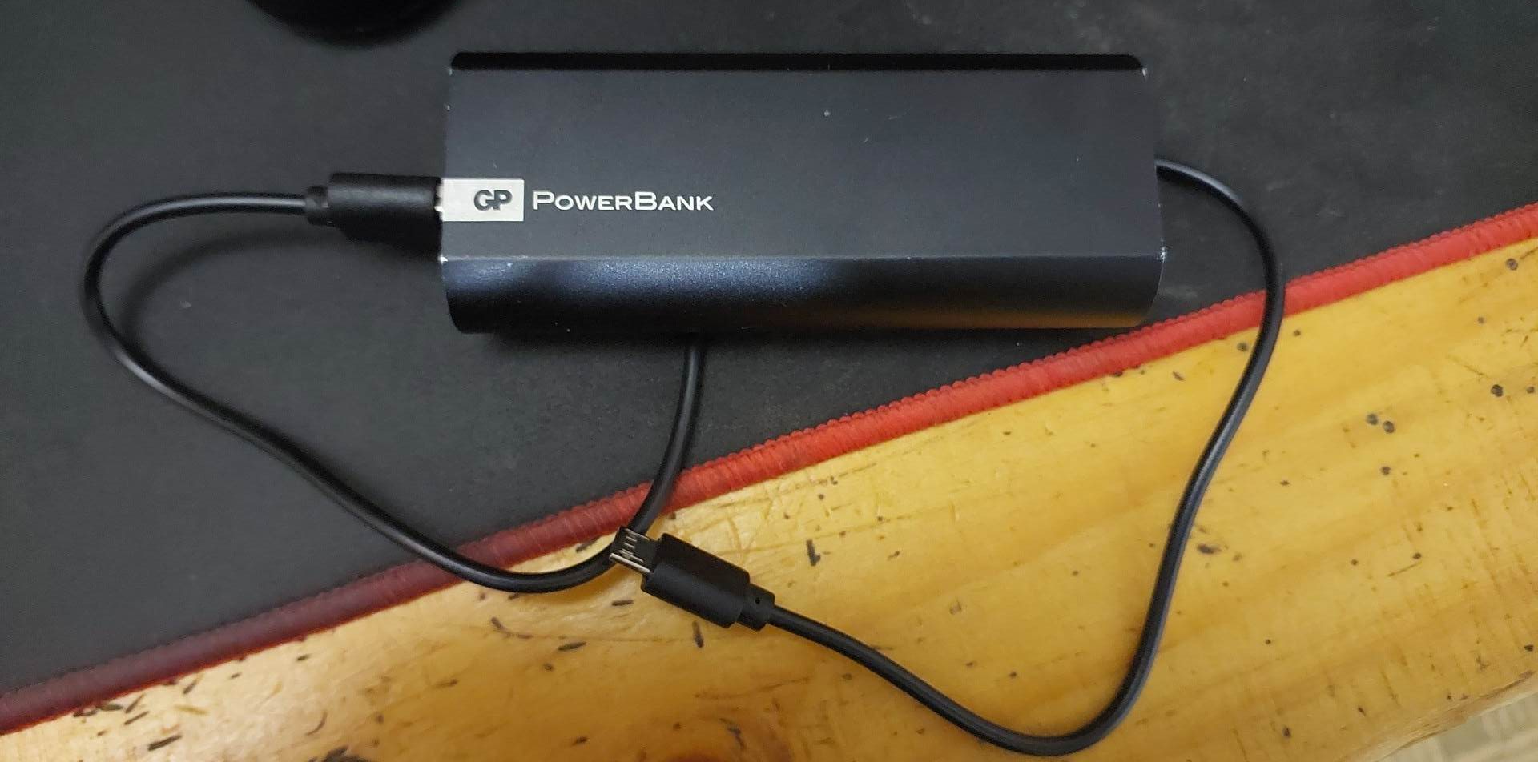
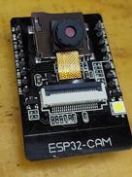
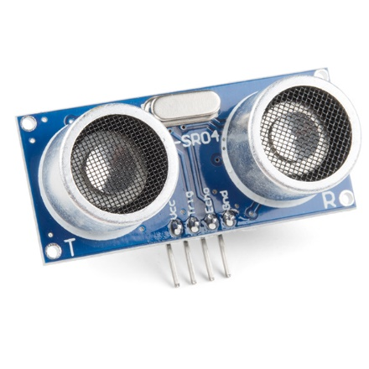
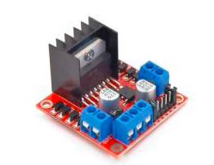
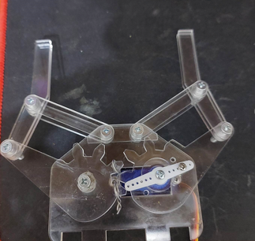
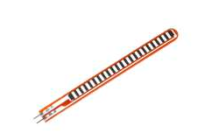
d. Camera
e. Ultrasonic sensor
f. Portable Power
g. Flex sensor
h. H-Bridge
i. Handle

Slide 7
2. Software:
Arduino code IDE: Libraries:
#include <AsyncTCP.h>
#include <ESPAsyncWebServer.h>
#include "esp_camera.h“
#include "I2Cdev.h“
#include "MPU6050_6Axis_MotionApps20.h“
#include <esp_now.h>
#include <WiFi.h>
#include <ESP32Servo.h>

Slide 8
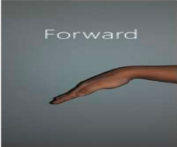
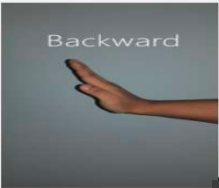
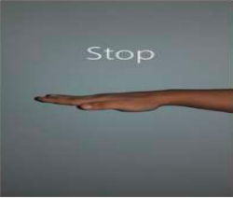
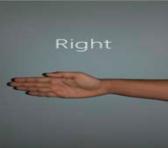
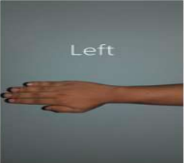
How it works.

Slide 9
The transmitter part:
Determine the hand gesture.
Get and process X ,Y coordinates from the mpu6050, and value of flex sensor.
Pass this data serially to ESP-32.
Send all data from ESP-32 transmitter over WI-FI.

Slide 10
The receiver part:
Receive the data from ESP-32 transmitter part.
Prosses the data and send it to H-Bridge and servo motor.

Slide 11
Challenges:
Get some electronic parts.
Some parts were damaged while working on them.
Try to keep costs reasonable.
Error percentage in connection between transmit-receive ESP-32.

Slide 12
Future work:
Develop the handle to become a full arm.
Car movement accuracy.
Upgrade better camera for better resolution and object detection.

