Slide 1

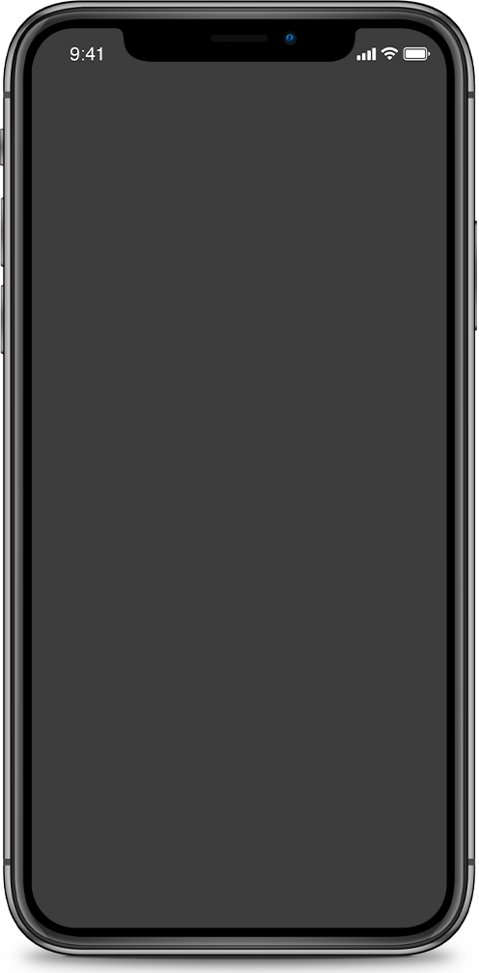




Tredoo
Don't Lose Money
  Qasem Zorba
  Nour Jararah
  Noura Berawi

Slide 2


01
  Problem
02
  Actual Stats
03
  Solution
Contents
04
  Technology
05
  Added Value
TOPICS COVERED
06
  Future Plans
07
  Revenues
08
  Demo
**ALL PHOTO GENERATED BY DEEPAI AND MICROSOFT DESIGNER

Slide 3
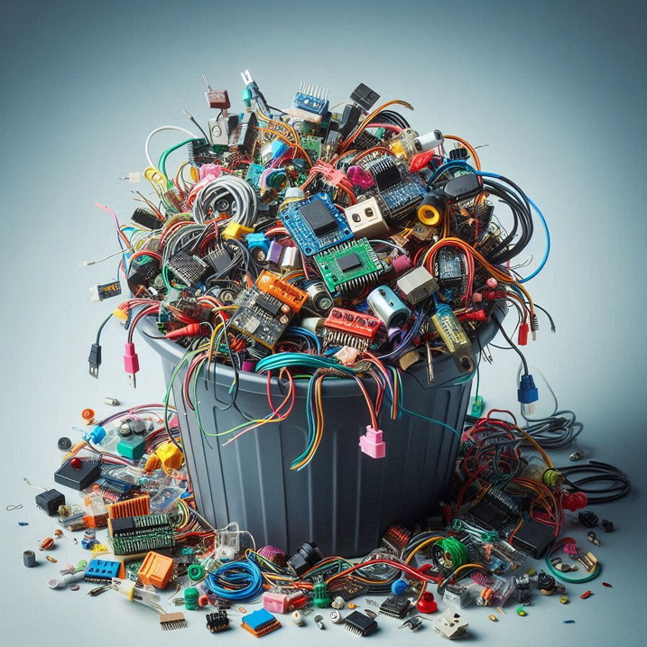

Problem
Wasting devices and equipment

Slide 4





Slide 5


Statistics about the problem
Actual Statistics for An-Najah University Students
A questionnaire was created to collect data on the problem mentioned, and 118 students participated in the response, completing the hardware graduation project.

Slide 6
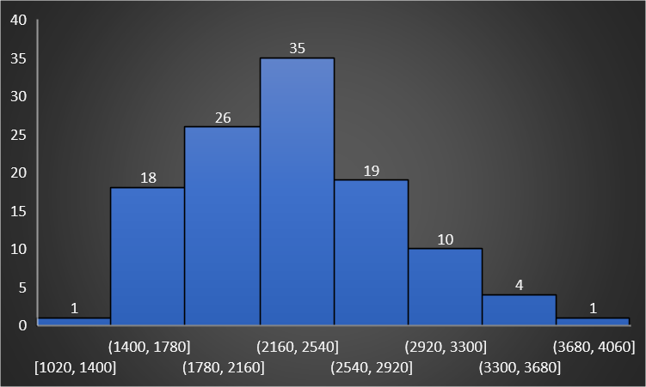
Total project cost?
The values ​​range between 1000 and 4000

Slide 7
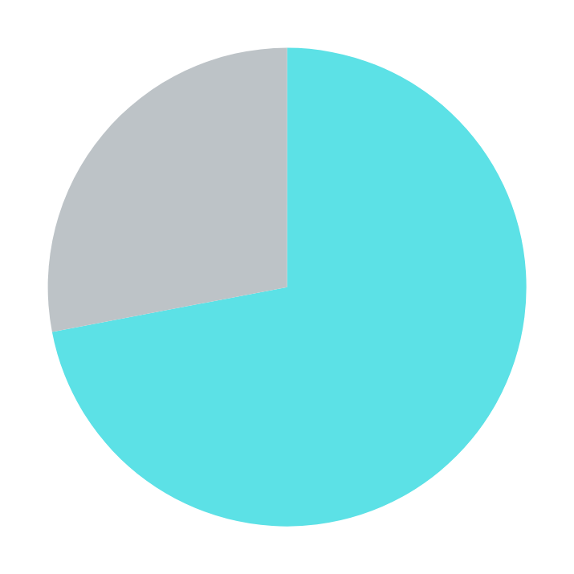
Was it difficult to obtain the devices/parts?

Slide 8
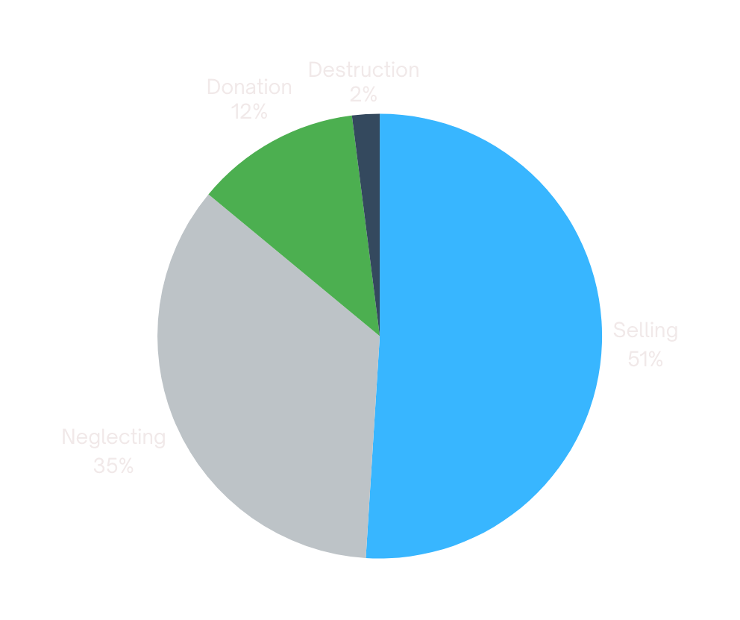
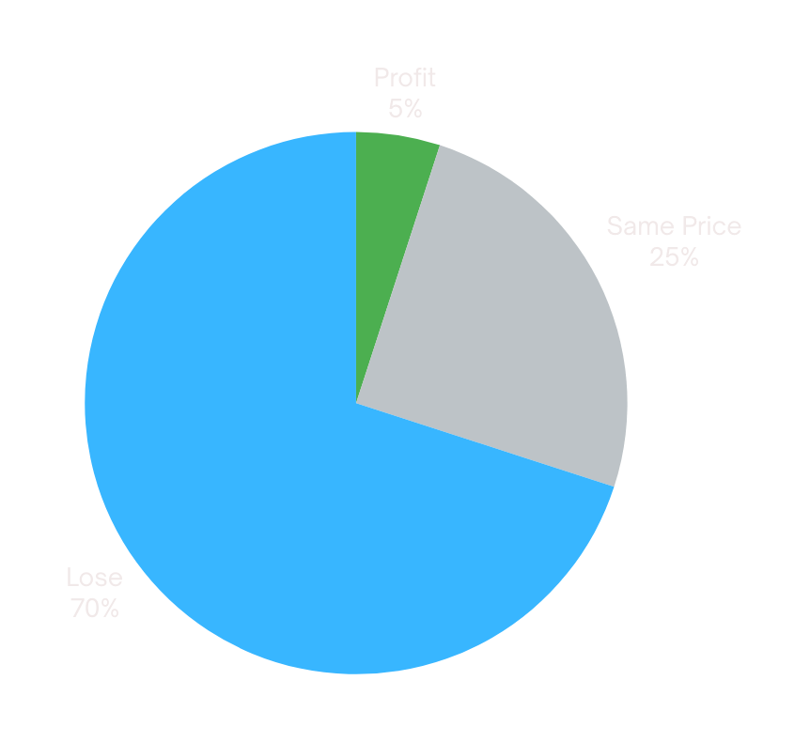
After completing the project, what action was taken?
Students who have taken the action of selling

Slide 9
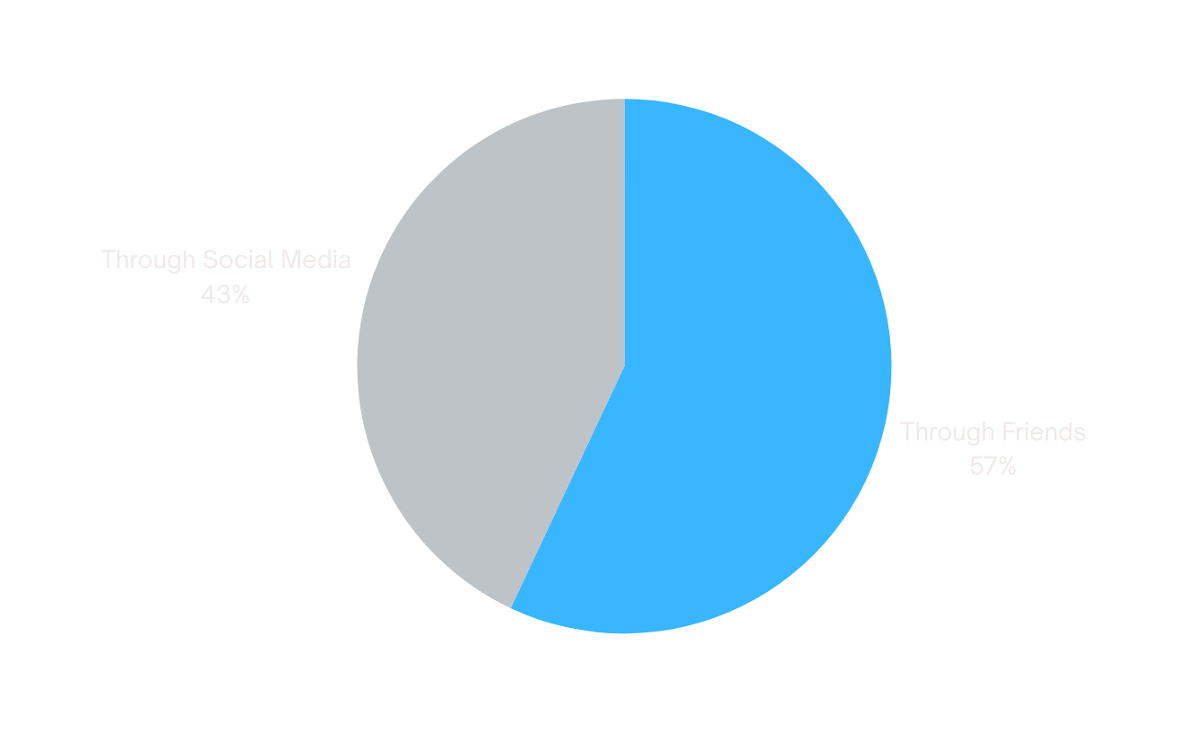
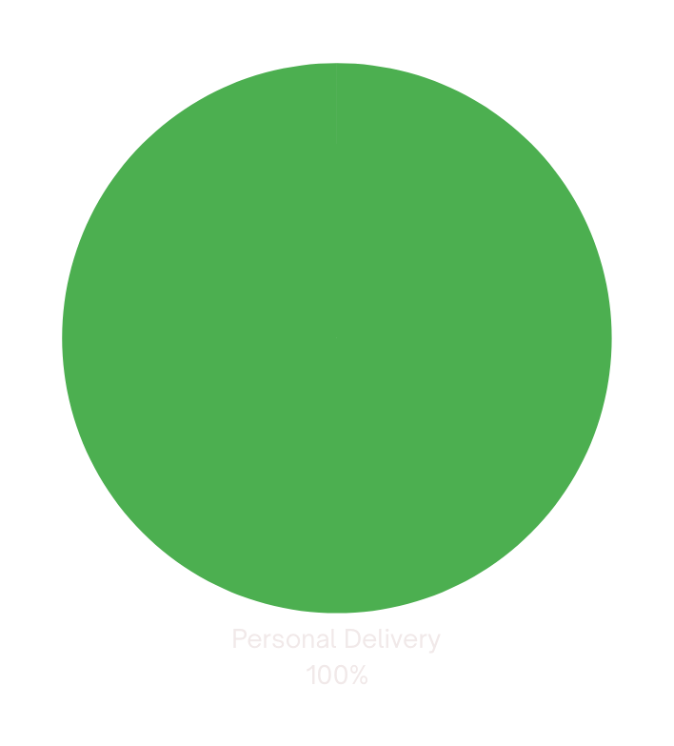
What method did you use to sell?
How was the delivery process?

Slide 10

What is the reason for the destruction/neglect?
DIFFICULTY SELLING
THEY DIDN'T TRY
THERE IS NO TIME
LAZINESS

Slide 11


Solution
Make the most possible use of the devices

Slide 12

Tredoo is a platform for buying and selling devices for students, and prices change according to supply and demand for collective benefit.
WHAT DOES TREDOO DO?

Slide 13




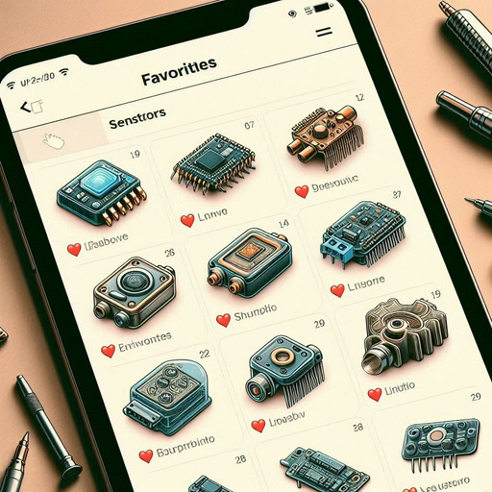

Technology
The website is written in .NET, The site uses session token to protect customer information
Recommendation System
Online Payment
Favorites List
Technical Support
Email System

Slide 14

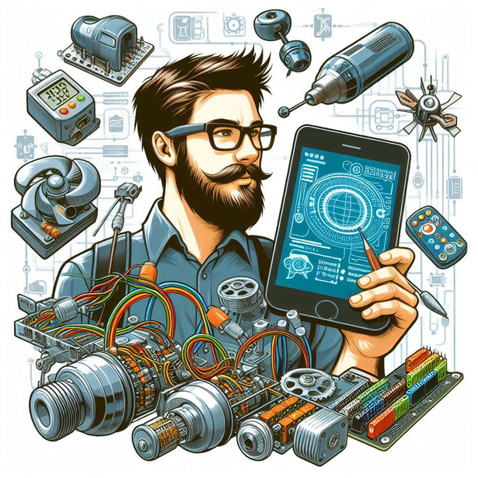

Added Value
from Tredoo?
SELL
BUY
DELIVERY ORDERS
Selling devices according to market demand
Purchasing devices according to market demand
Providing delivery service for products

Slide 15
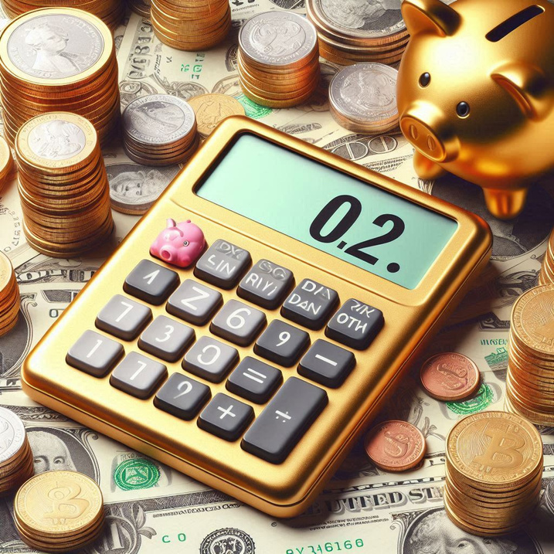
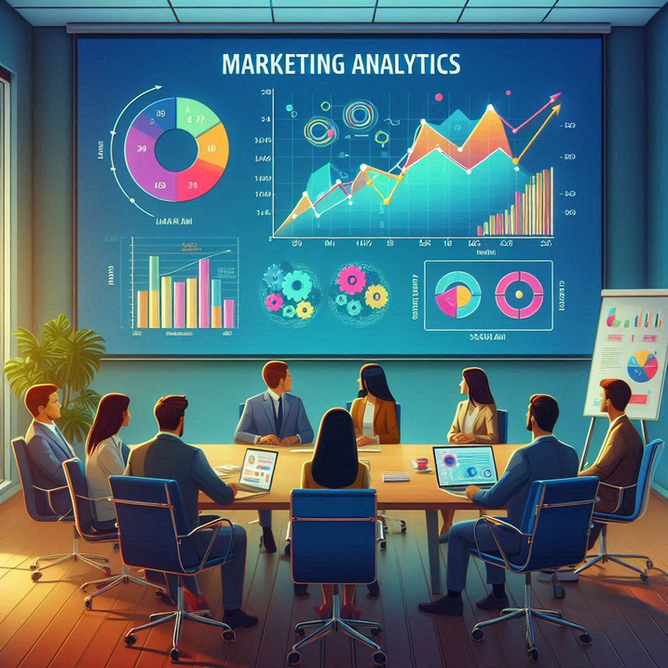

Revenues
COMMISSION
ADVERTISEMENTS
MARKETING

Slide 16

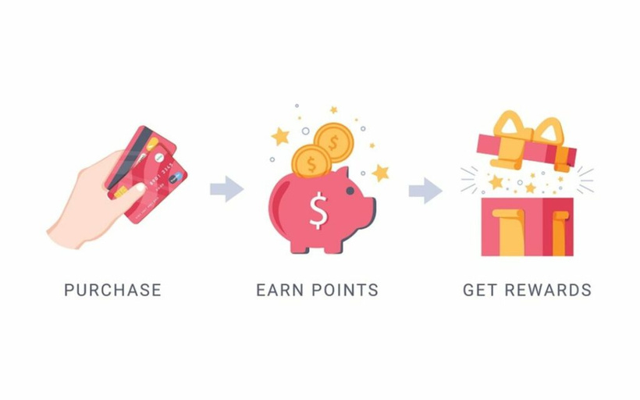

Future Plans
The features that we will work on in the future
PURCHASE AS A GUEST
LOYALTY POINTS
AI ASSISTANT
Transforming the process of accepting and rejecting devices offered to AI
Selling devices according to market demand
Purchasing devices according to market demand

Slide 17

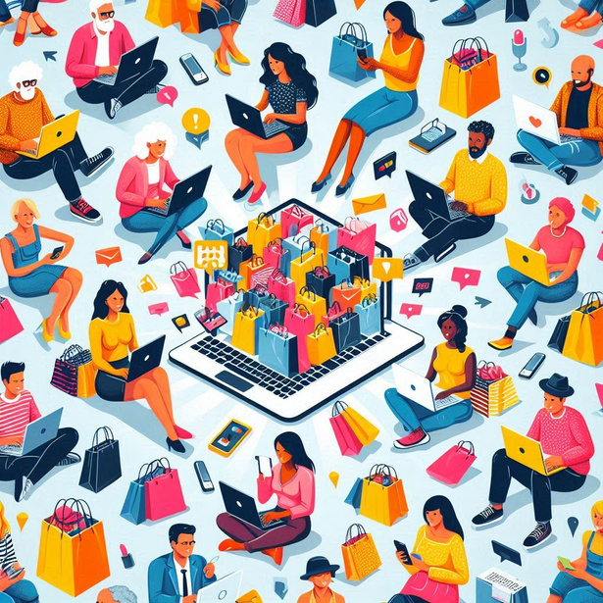



Systems Analysis
E-Commerce
Courses followed in the graduation project
Data Analysis
E-Marketing

Slide 18



Slide 19
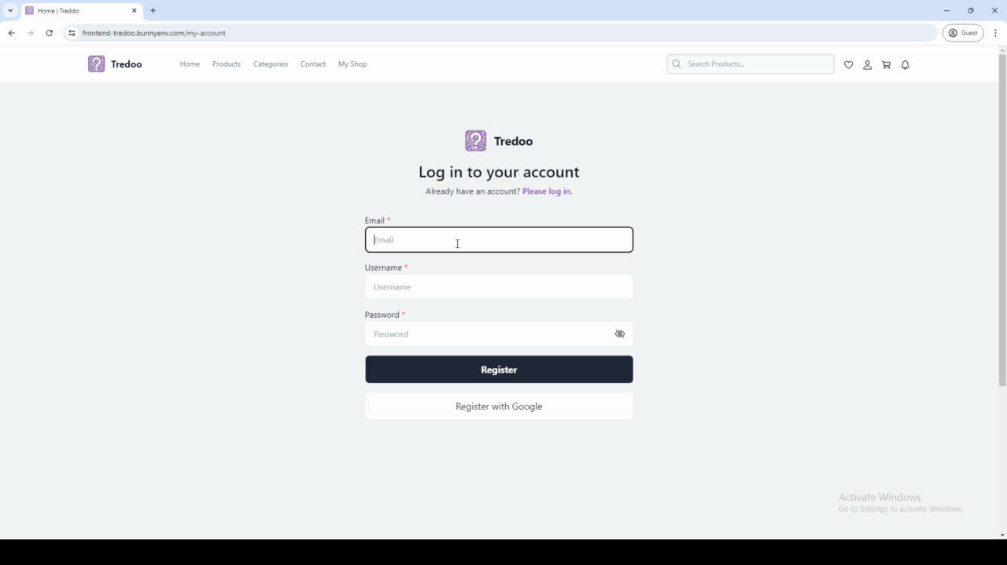

Slide 20
Thank you!
Any Question?

