Slide 1

Garagy
Mustafa Sokar,Amr abu amr

Slide 2
Table of contents
01
02
03
04
05
Project Idea
Motivation
Features
Tools
Future Work

Slide 3
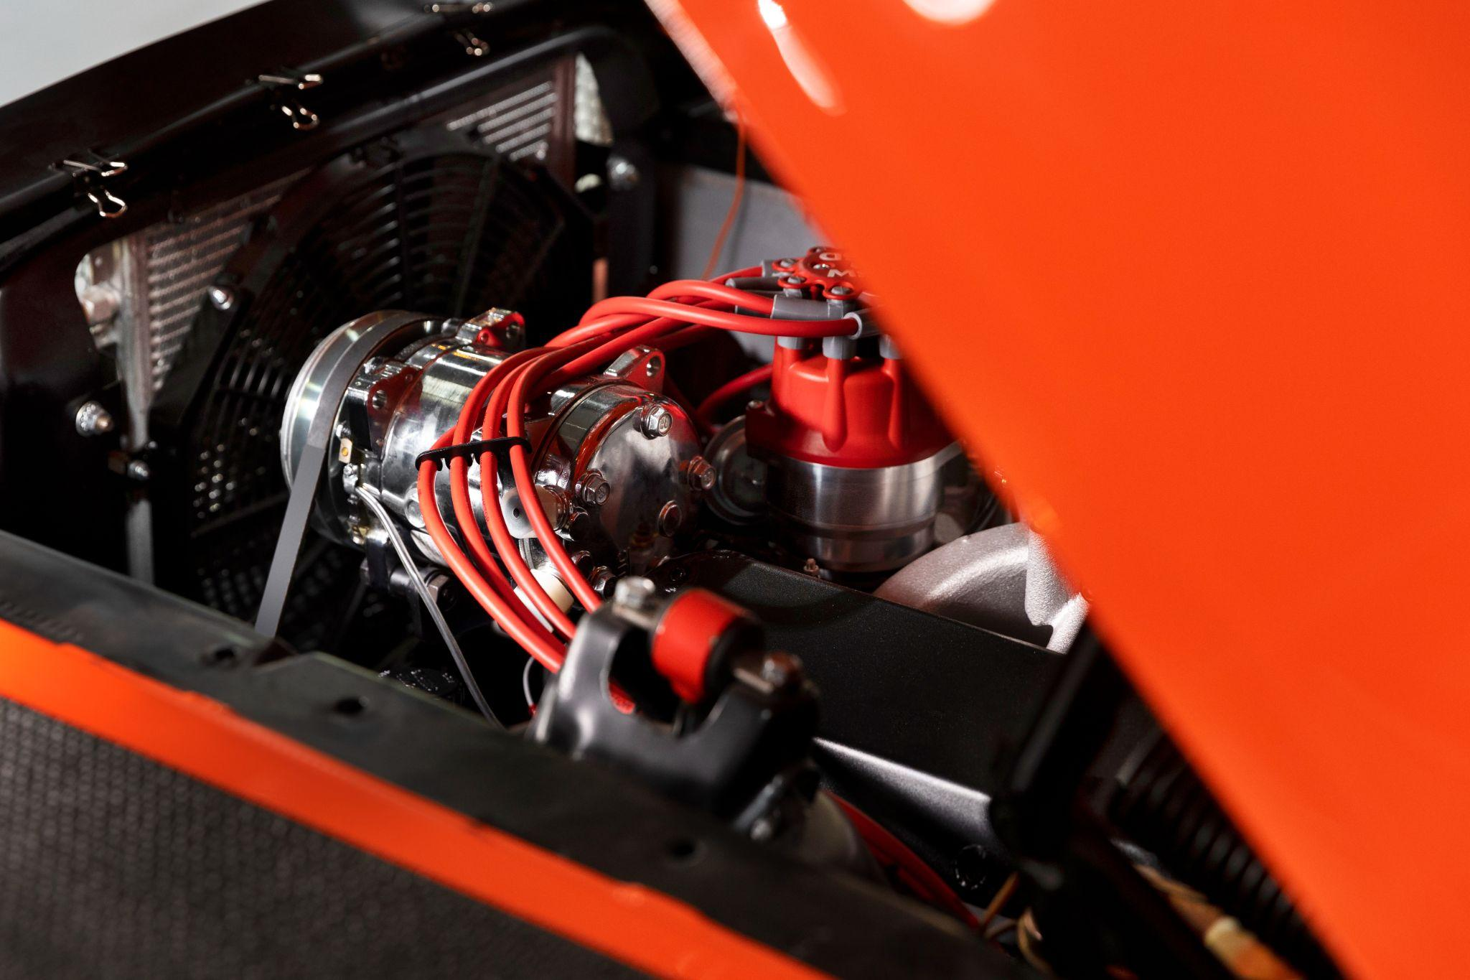
01
Project Idea

Slide 4
Project Idea
The purpose of this project is to help the users to maintain their cars and also to help car technicians finding jobs, linking user to a wide network of car maintenance centers with services that reach them without tiredness or effort, whether they need to transport the car to the workshop, or it’s a small issue and requires a mobile workshop that reaches your location.

Slide 5
02
Motivation

Slide 6
Motivation
Car owners often struggle to find reliable and convenient car maintenance services.
The process of transporting the car to a workshop or waiting is time-consuming.
Car technicians, often face challenges in securing jobs and connecting with potential customers.
Car owners lack a platform to communicate and engage with service providers effectively.

Slide 7
03
Features

Slide 8
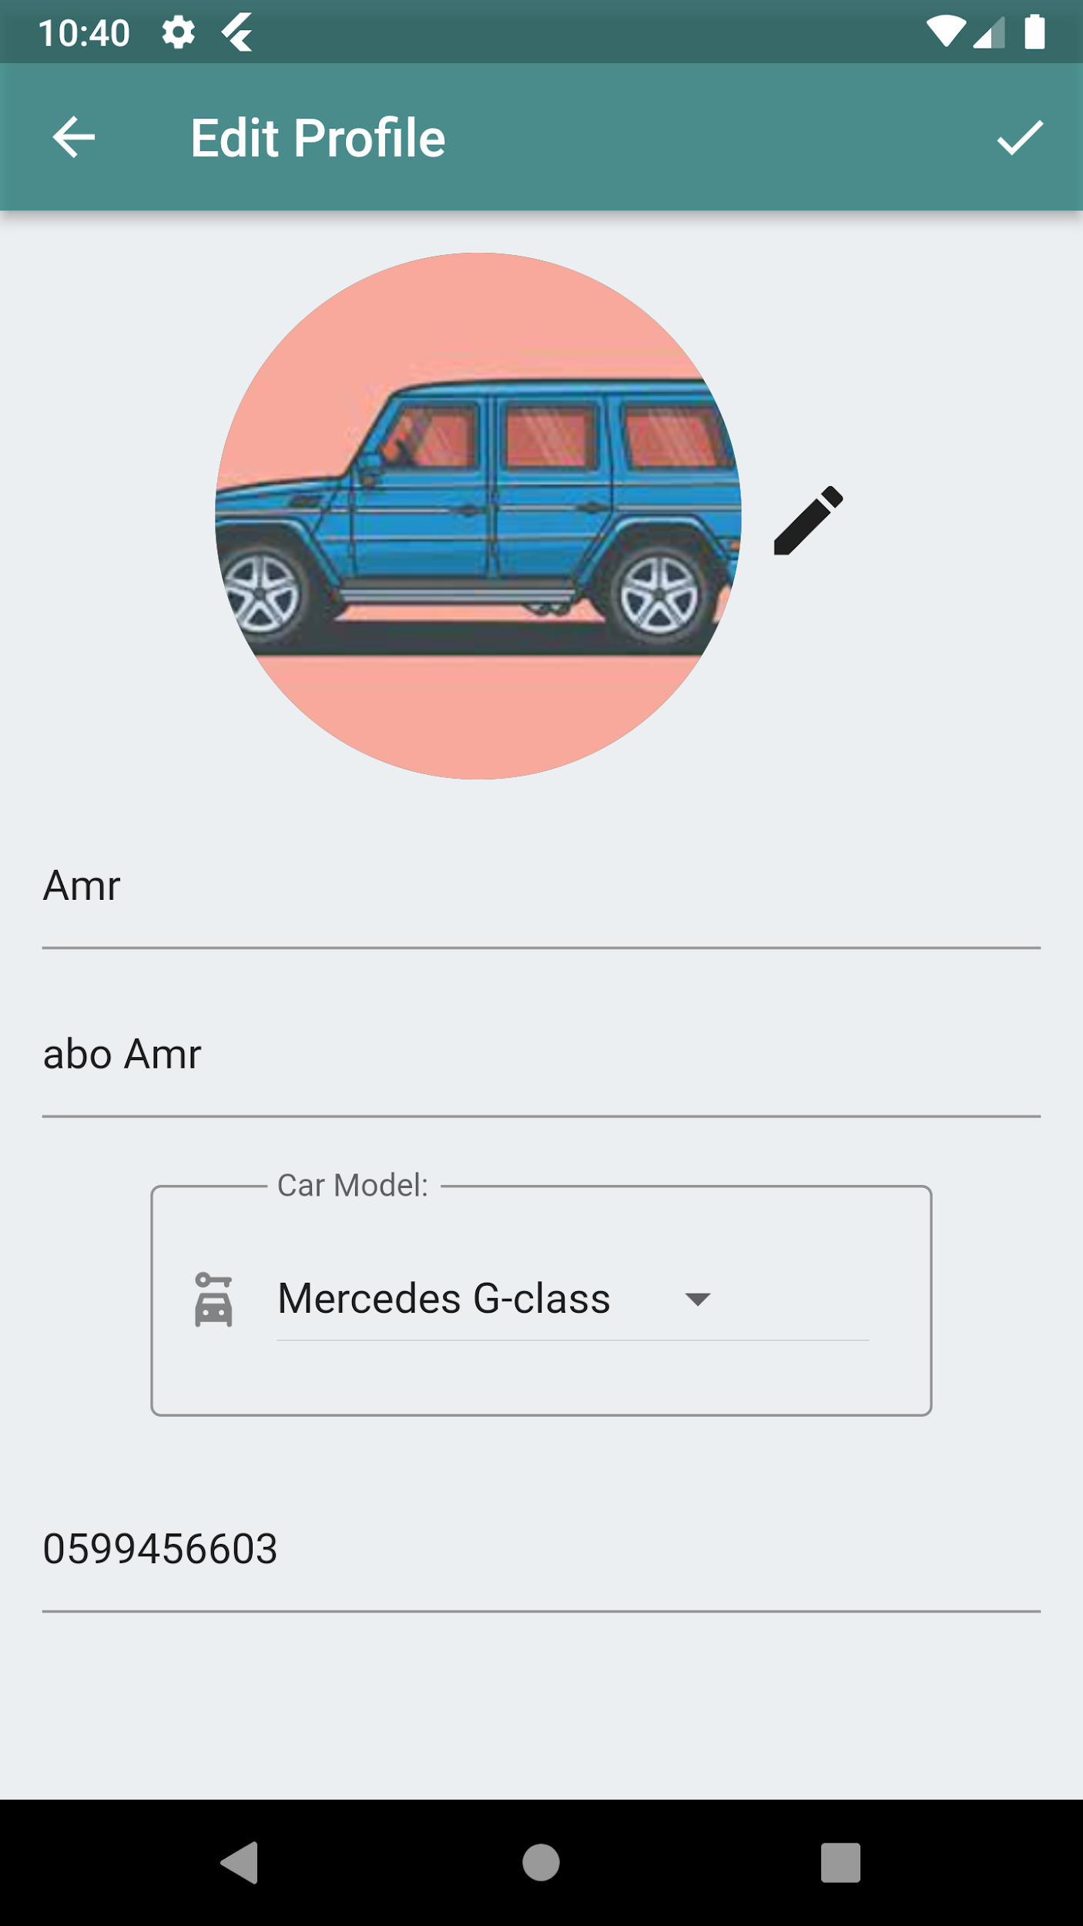
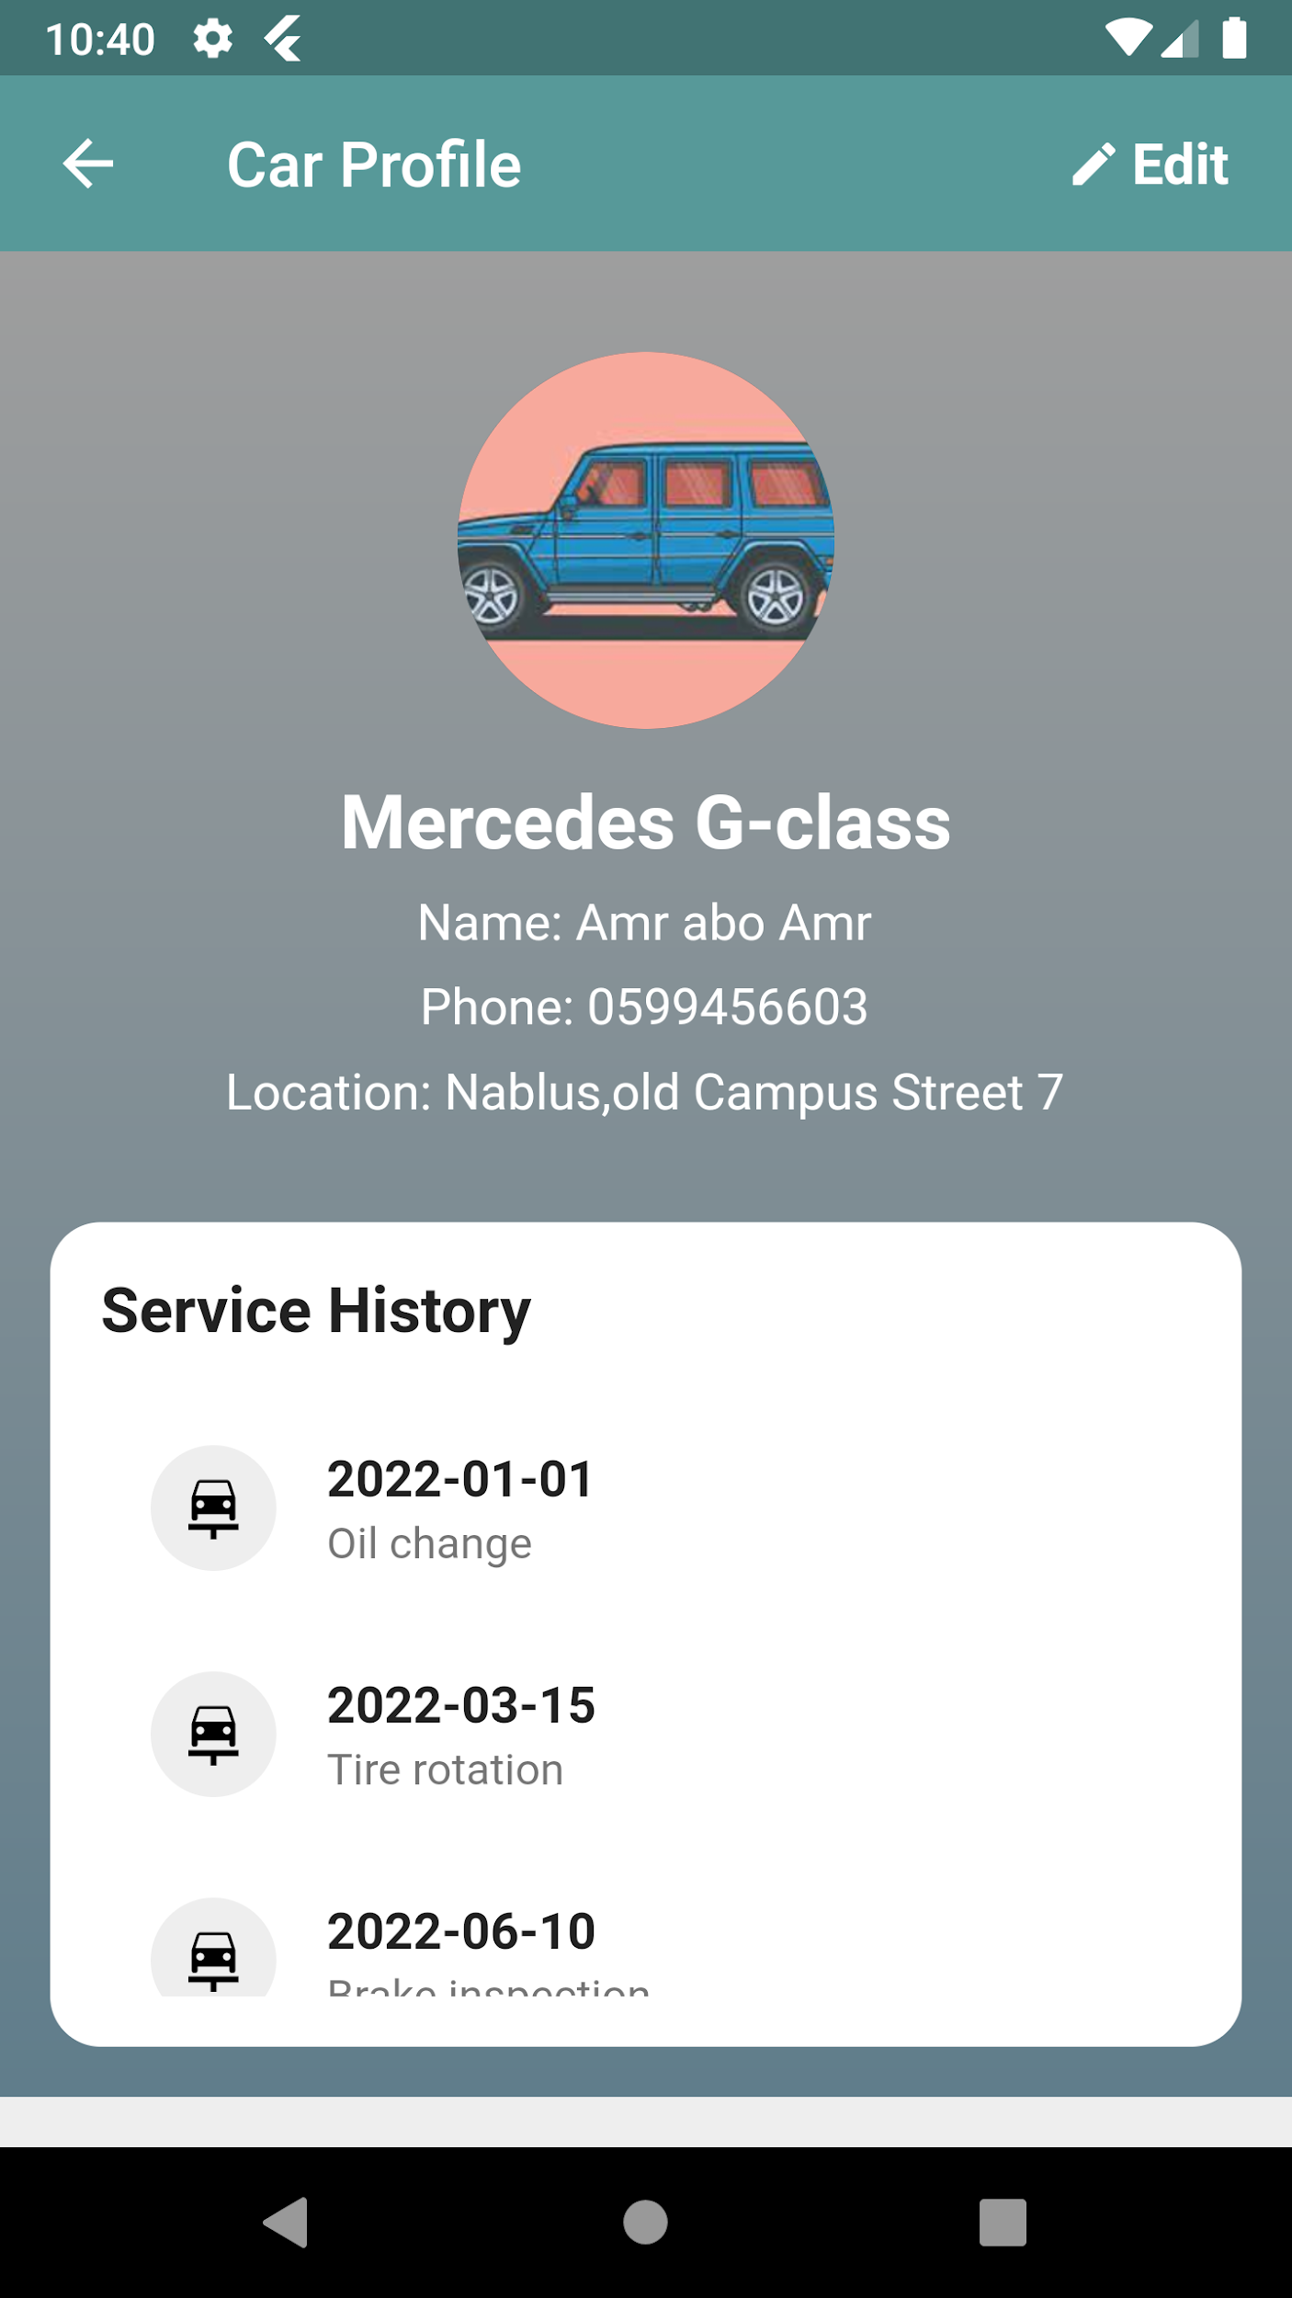
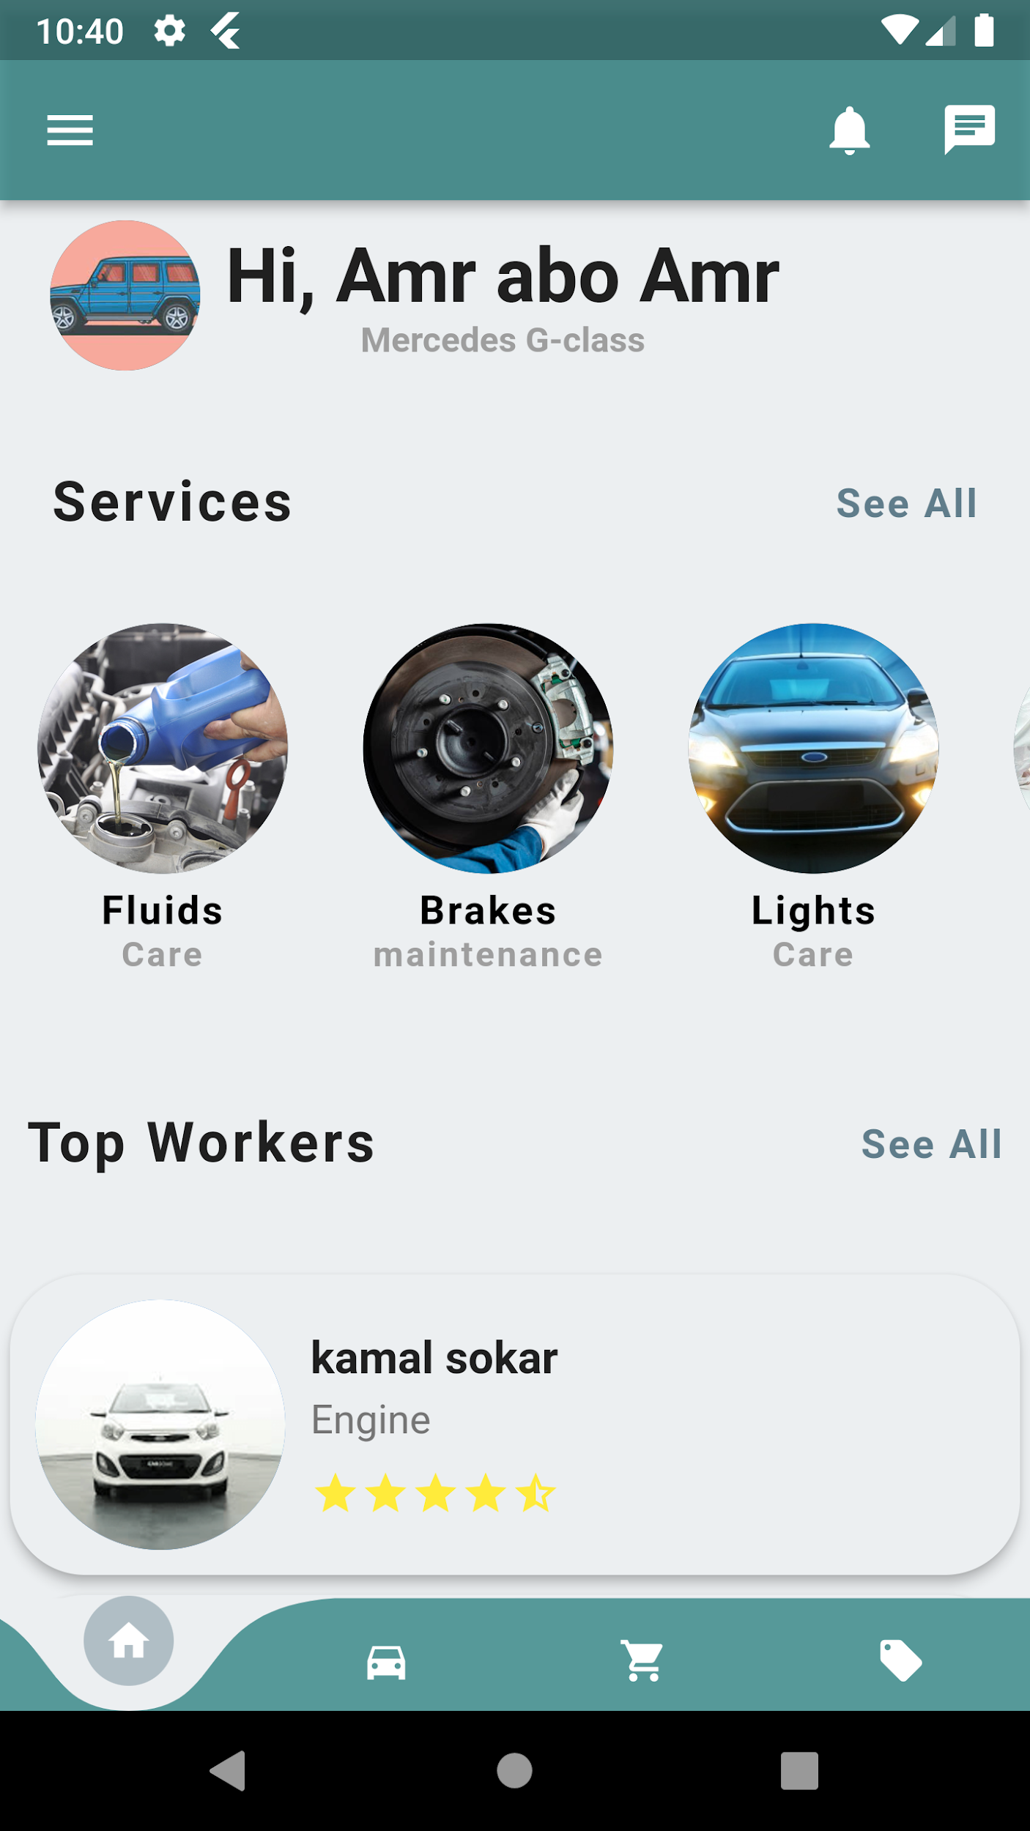

Slide 9
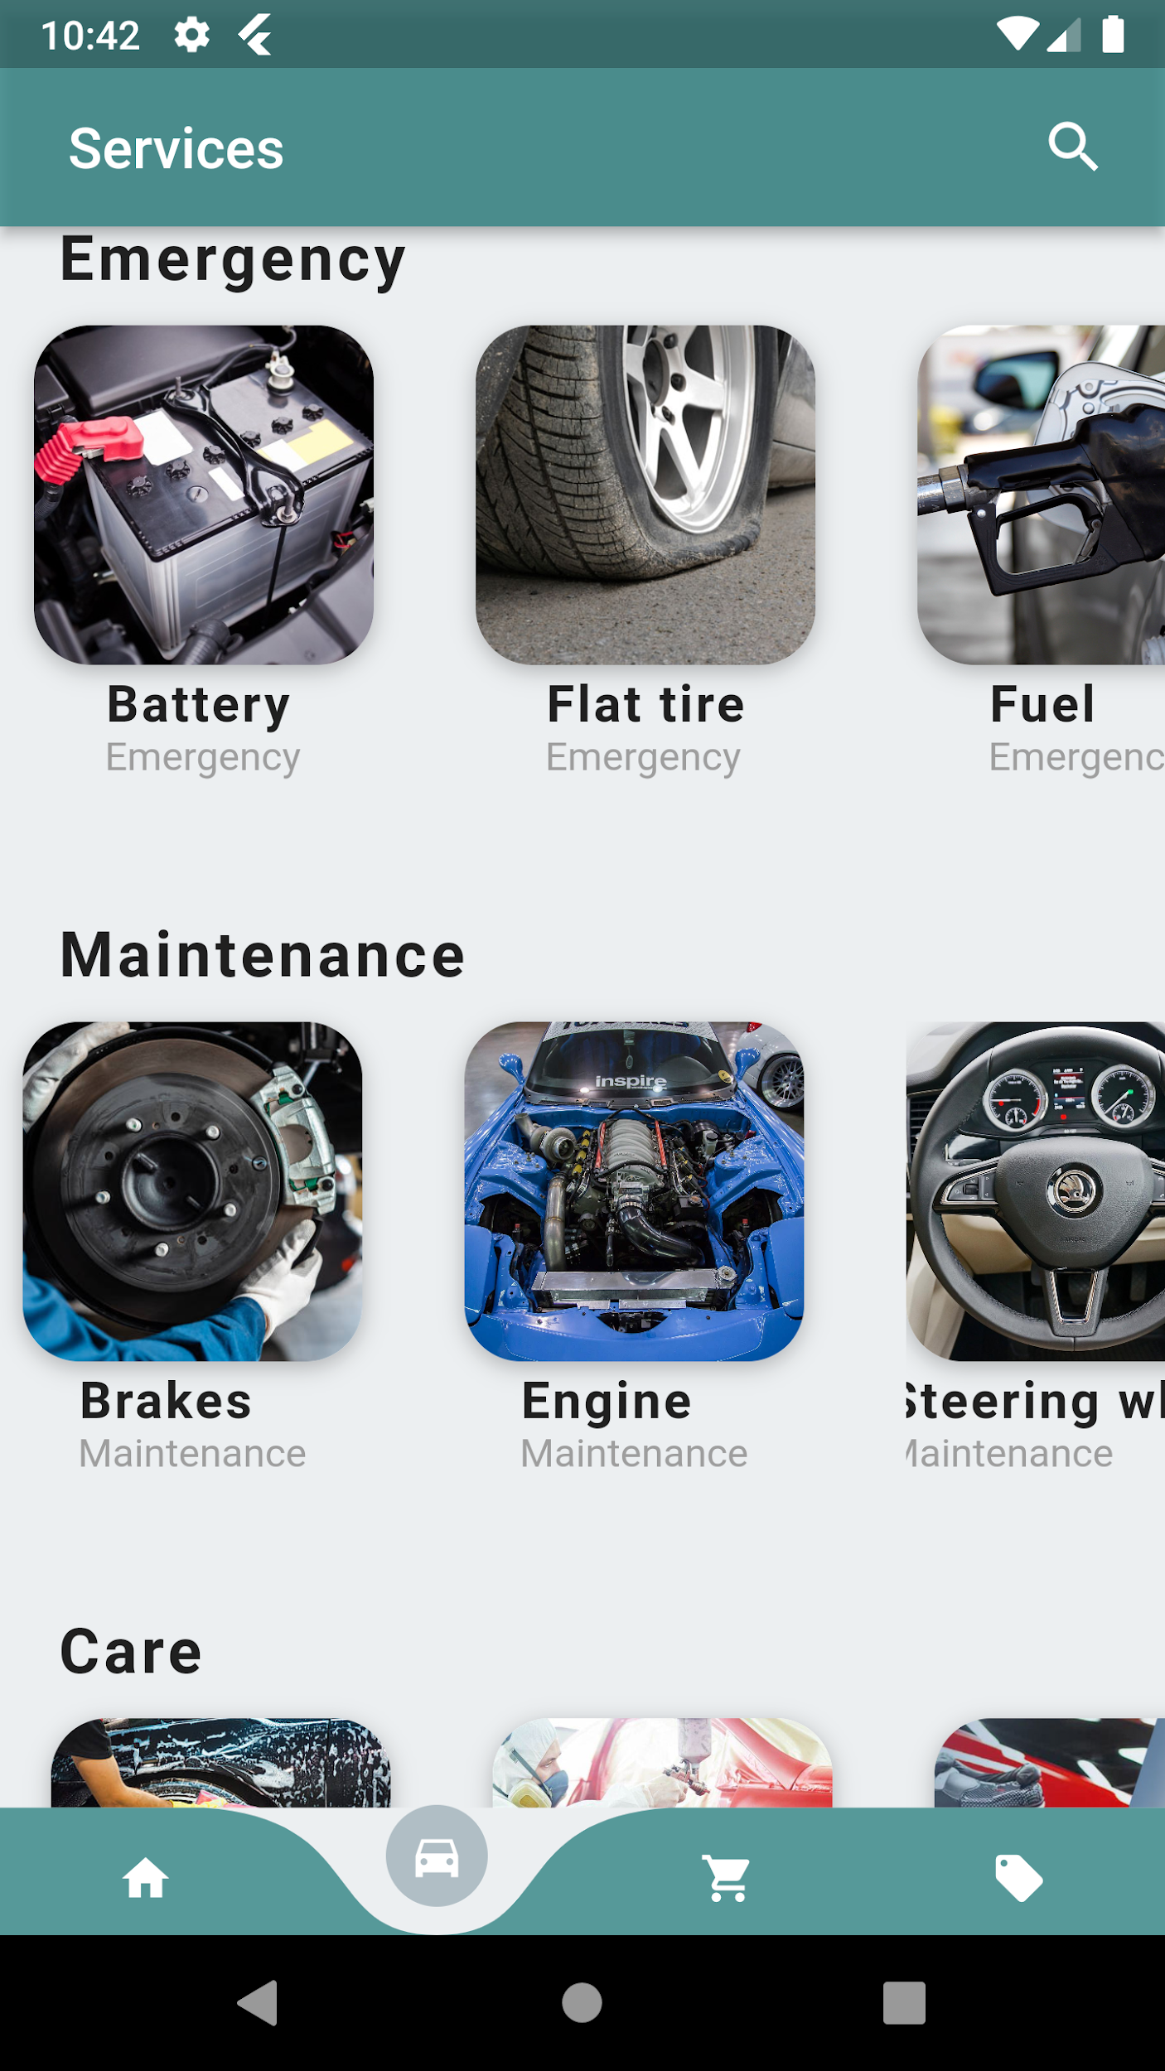
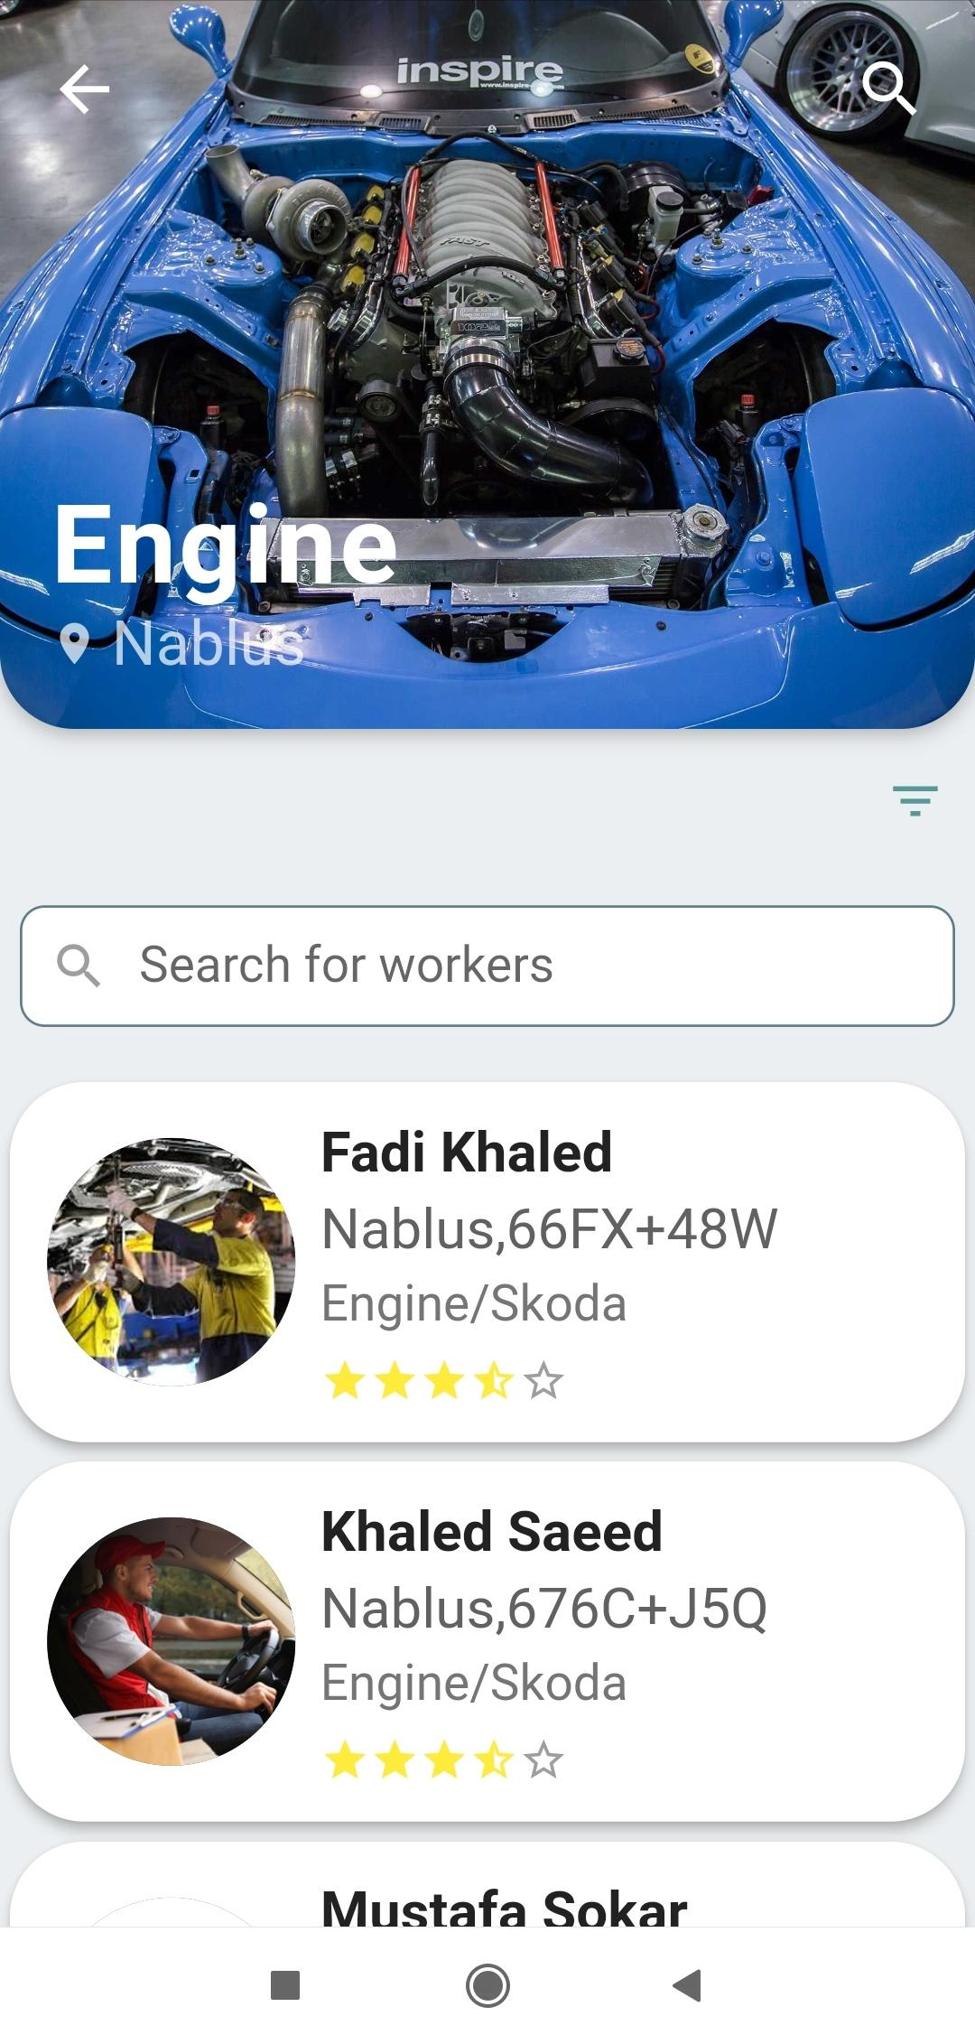
Service Booking

Slide 10
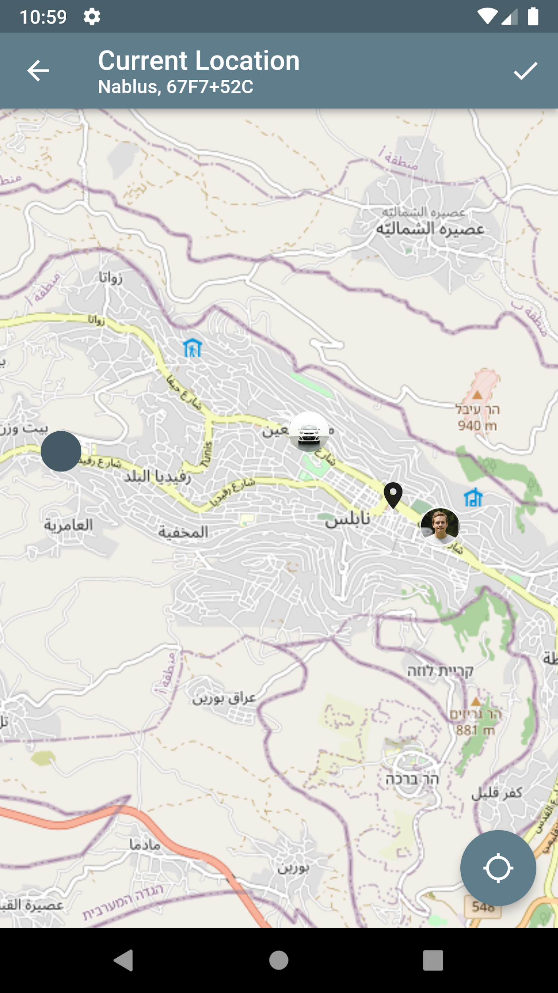
Map

Slide 11
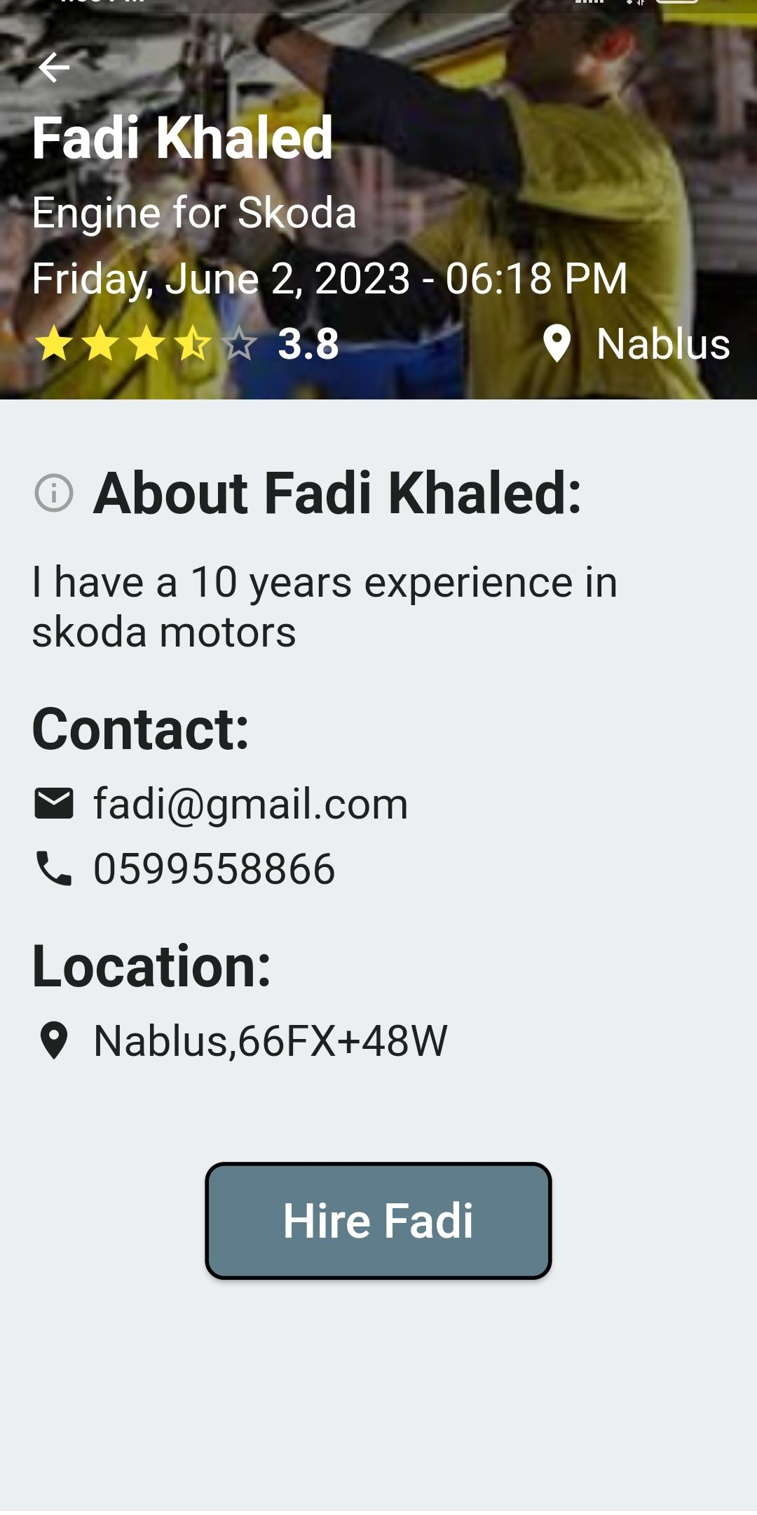
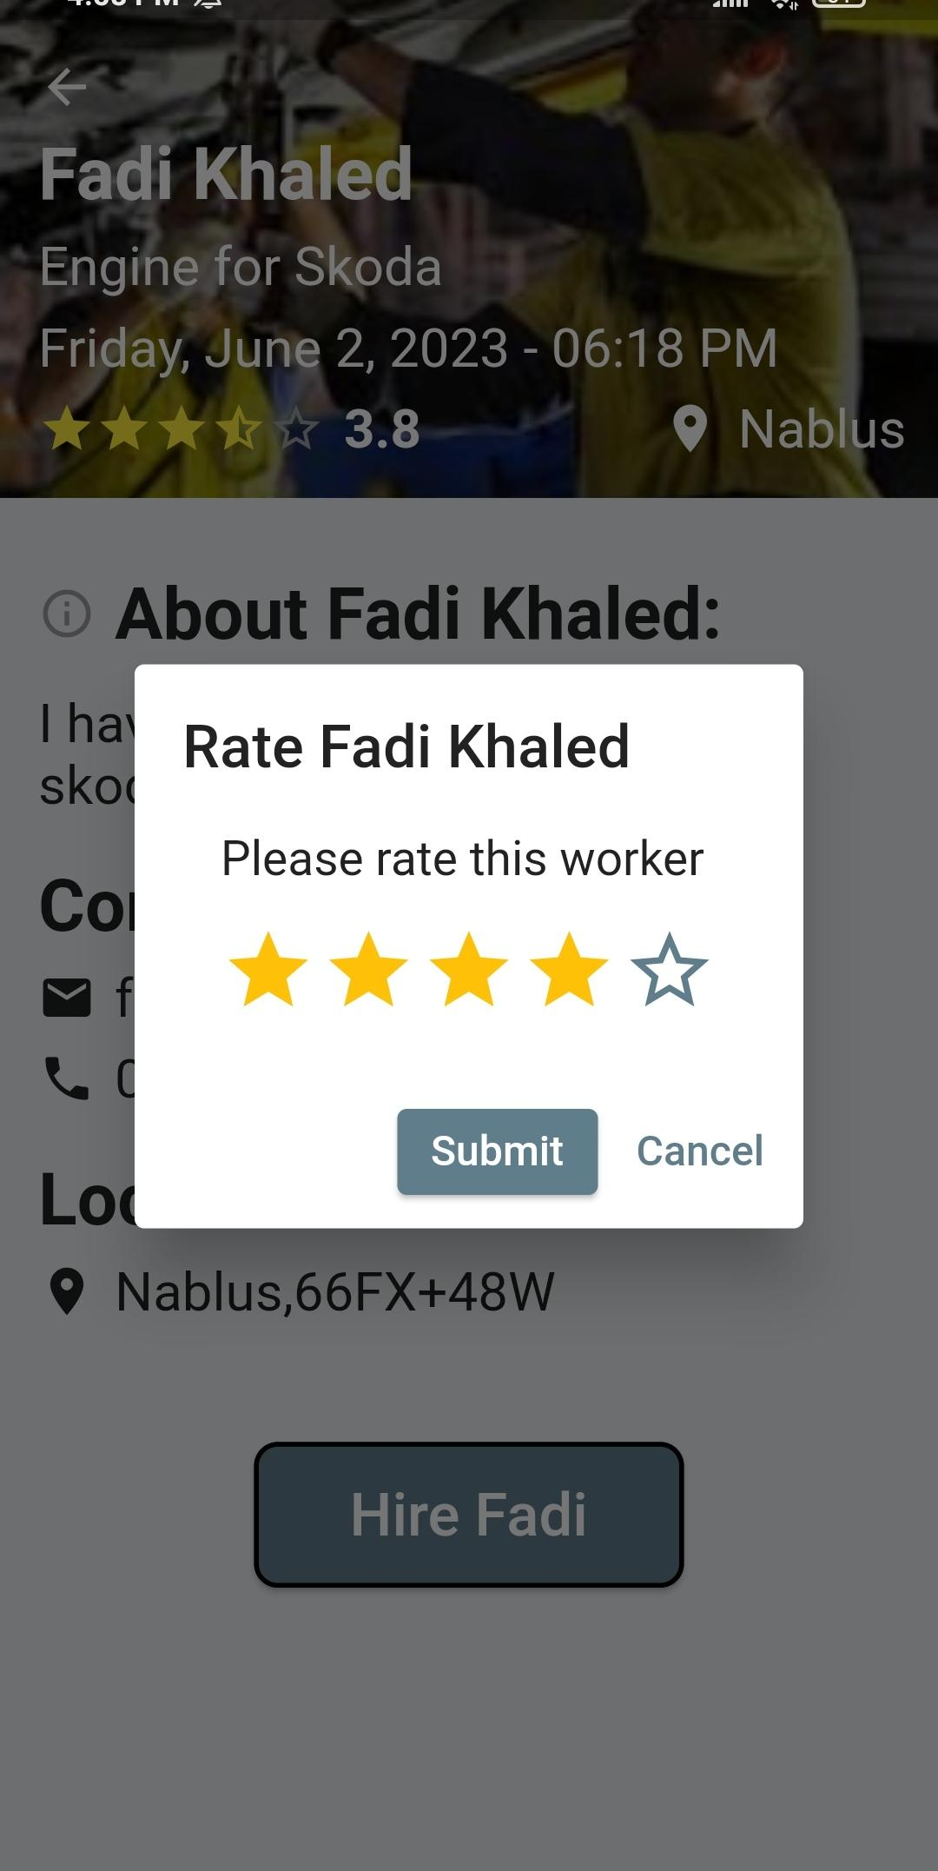
Worker profile

Slide 12
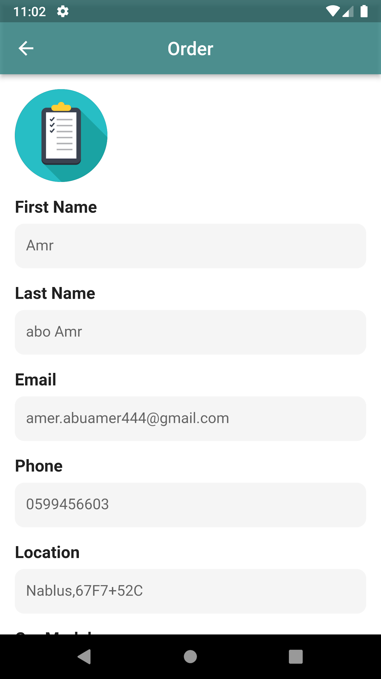
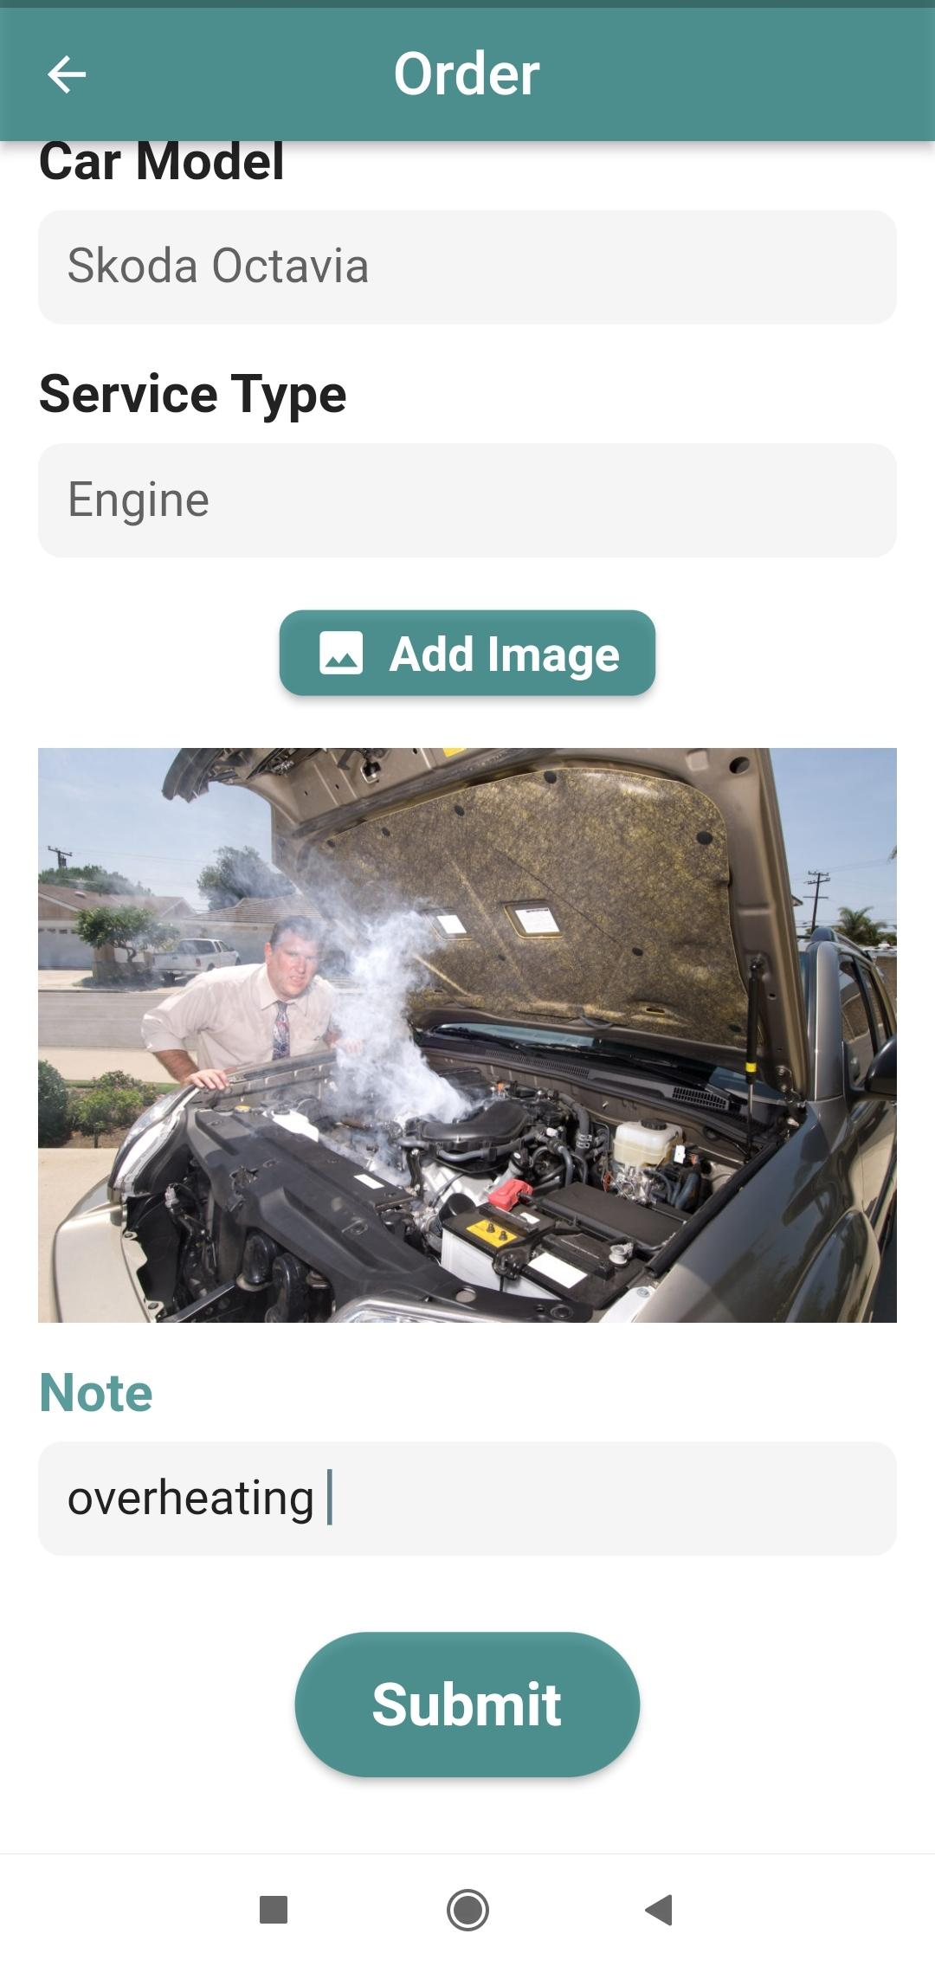
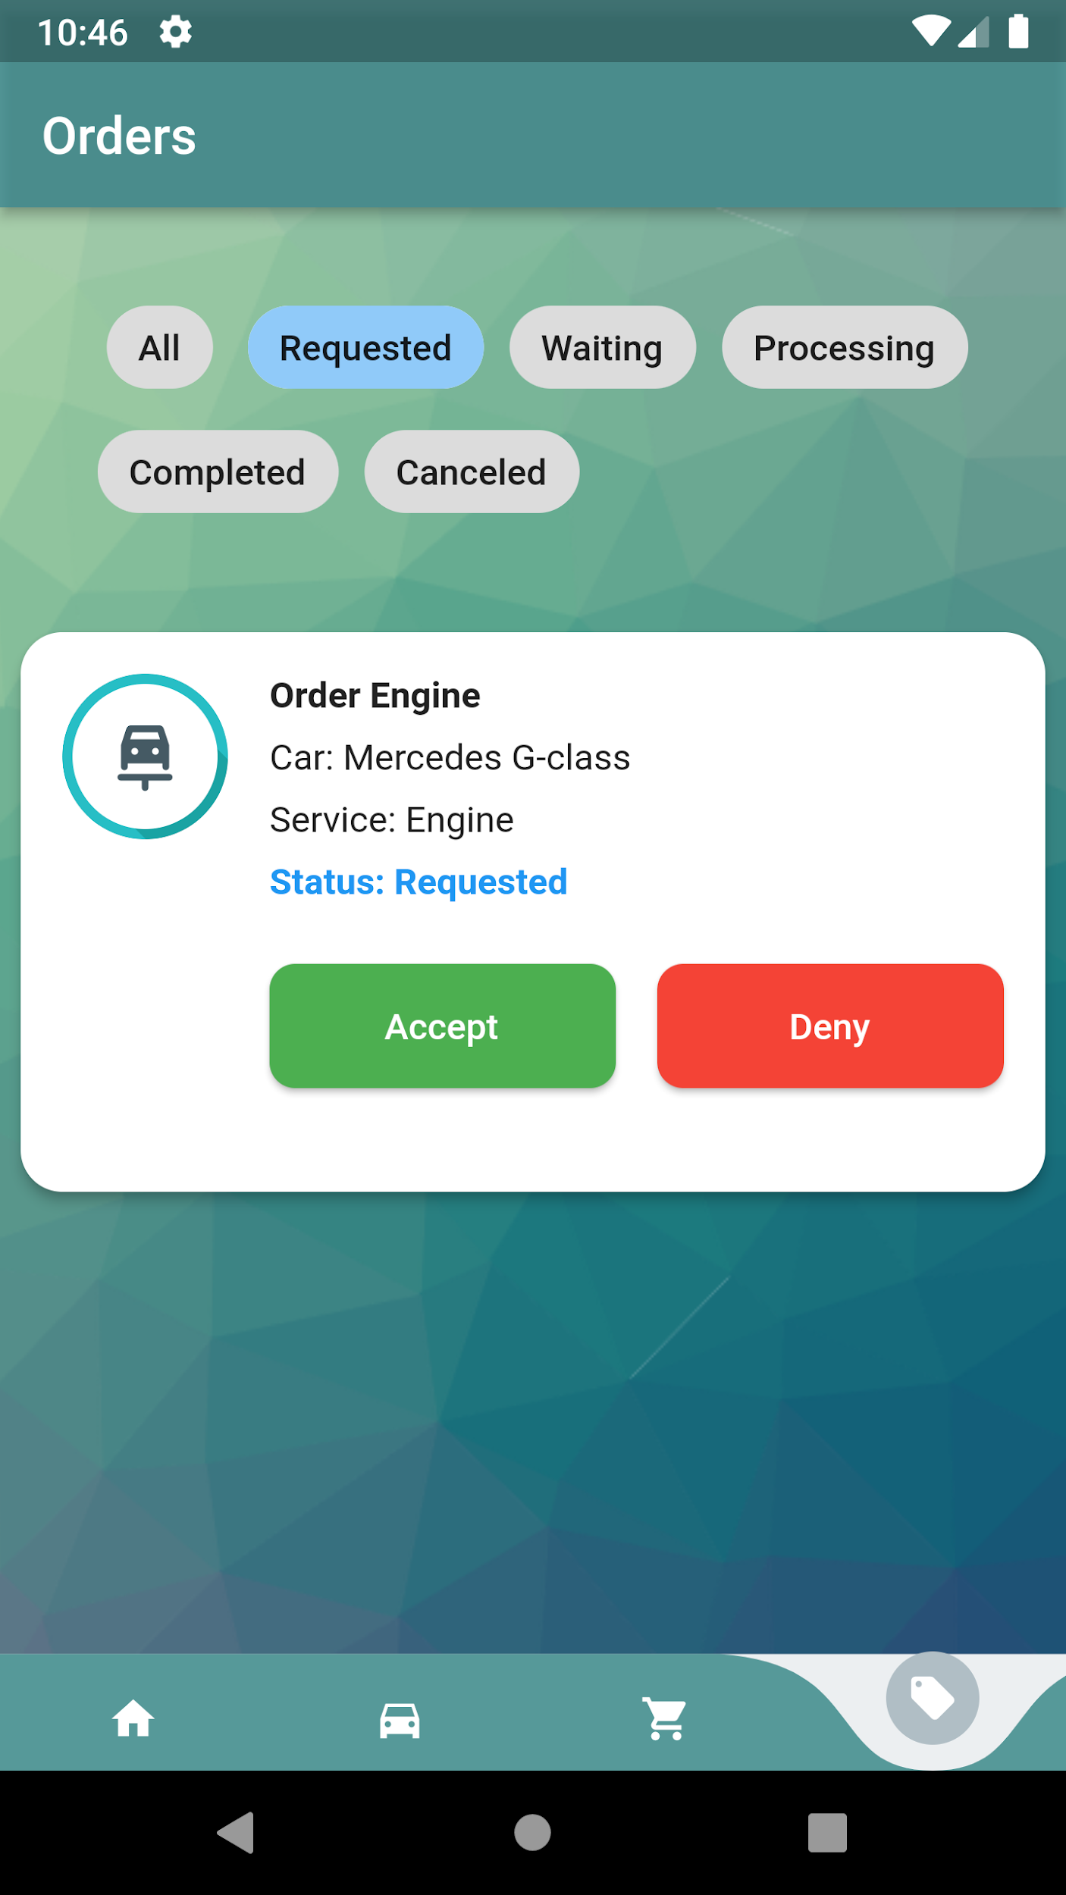
Worker

Slide 13
Car maintenance timeline
Step 1
Step 2
Step 3
Step 4
Apply for the service
Car test to determine
Estimated time and price Range
Worker accepts
Client accept the test results
Notification
Step 5
Start working on the car

Slide 14
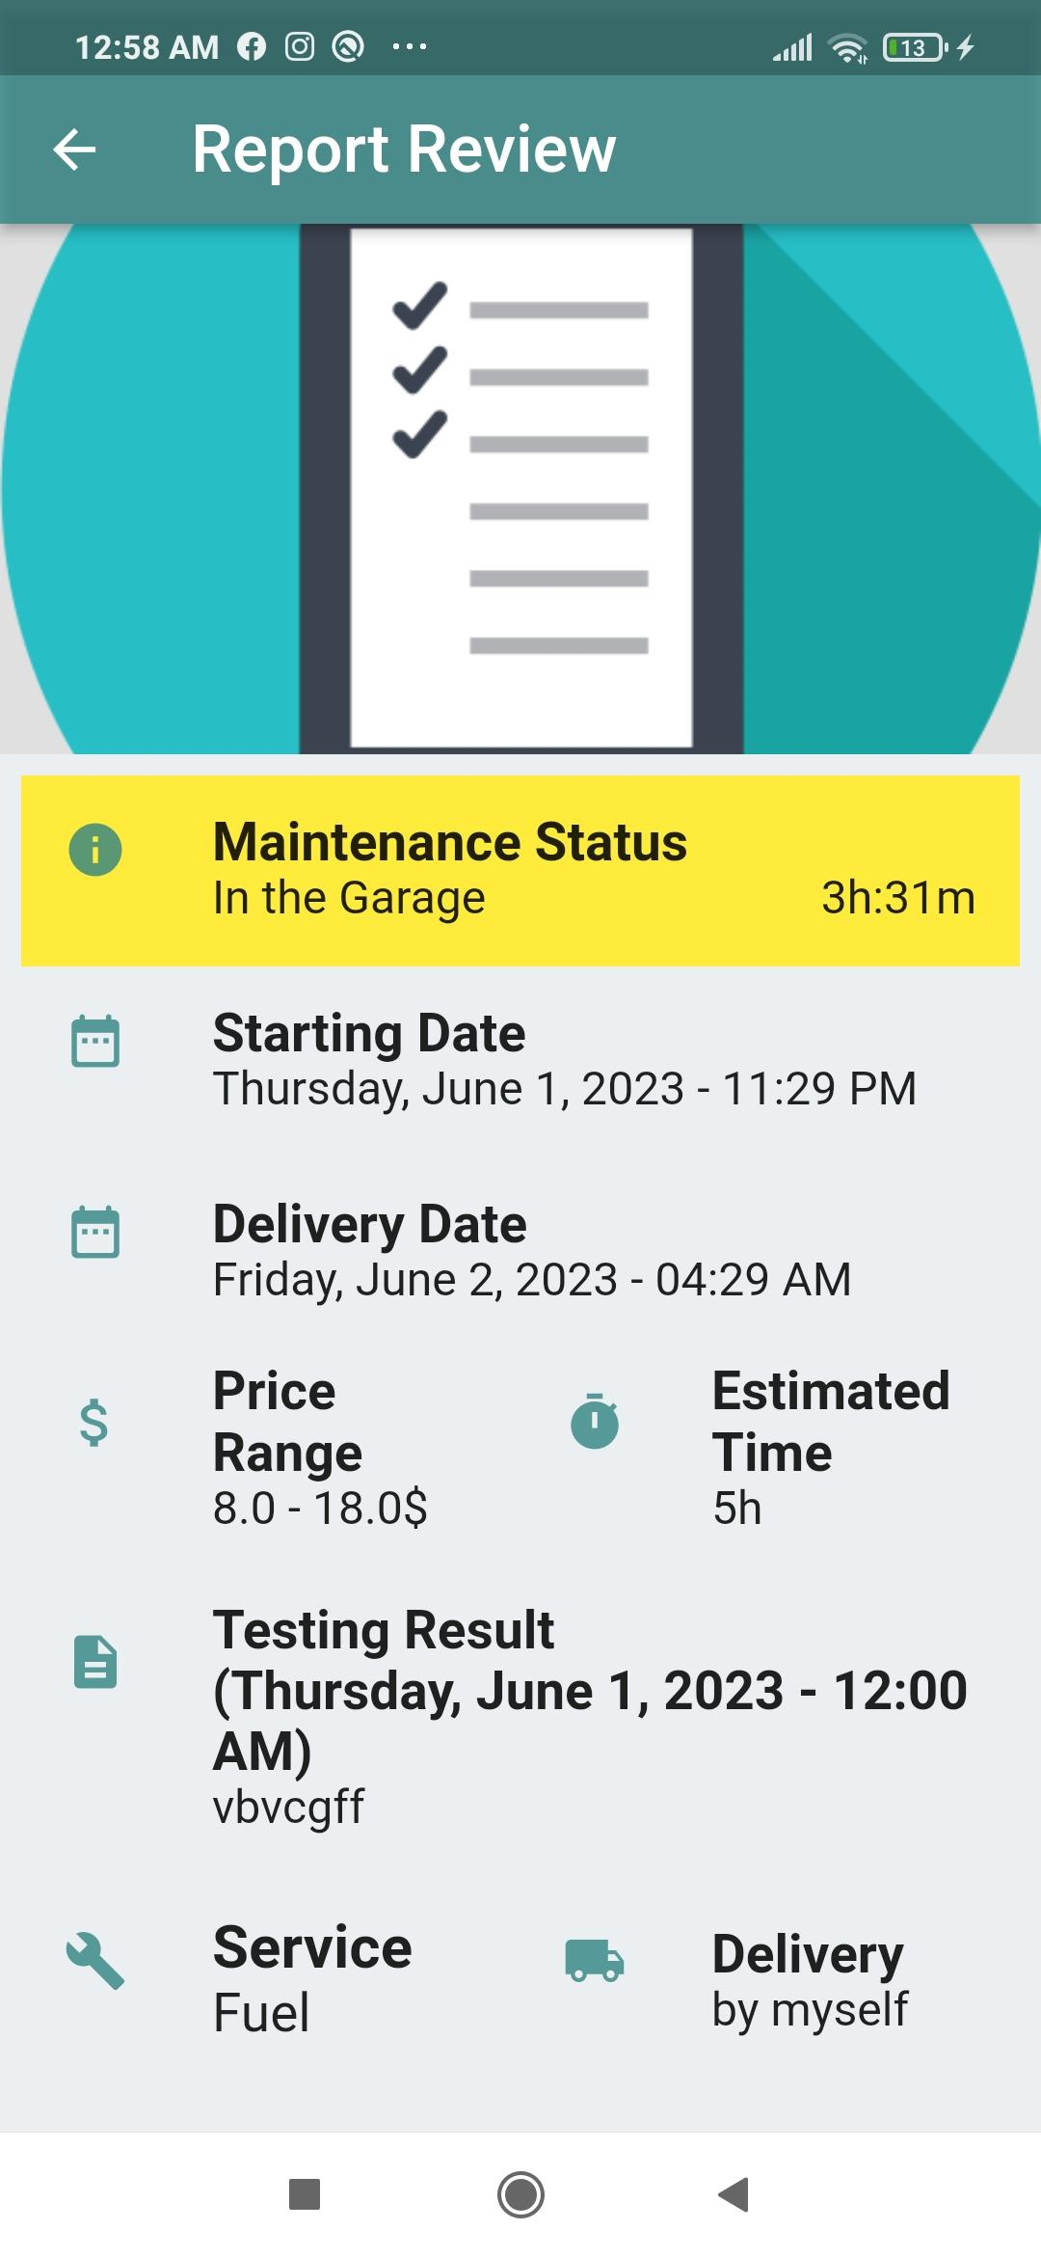
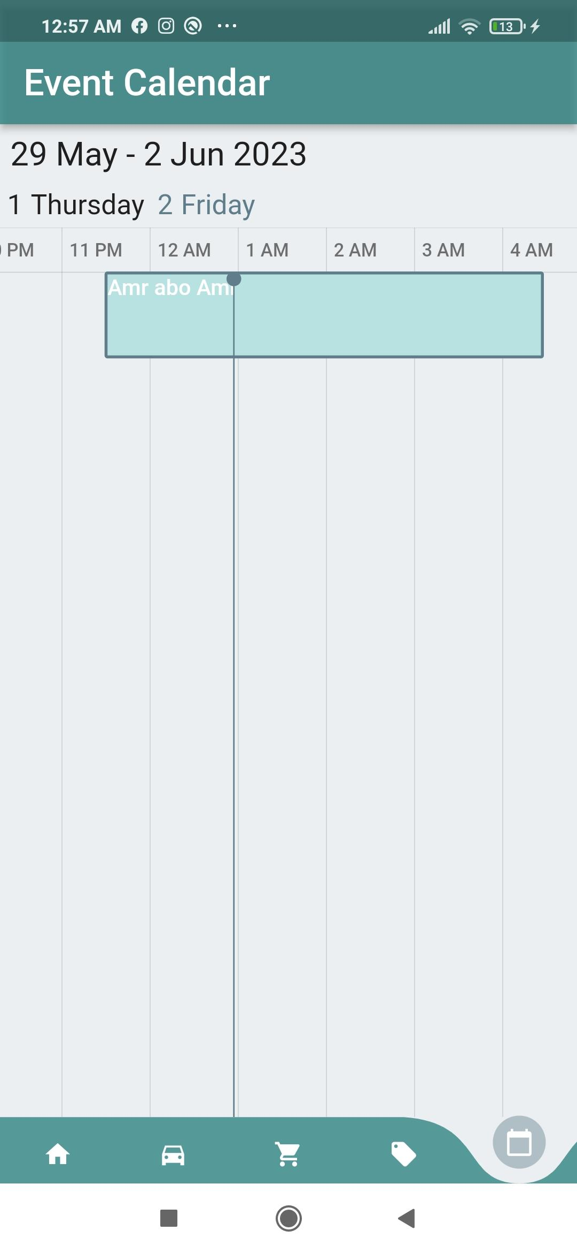

Slide 15
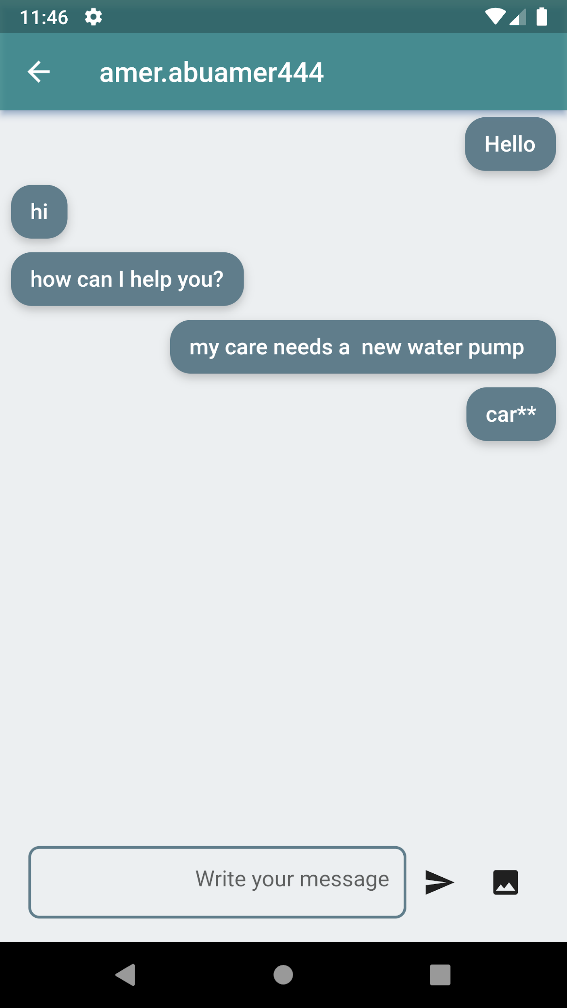

Slide 16
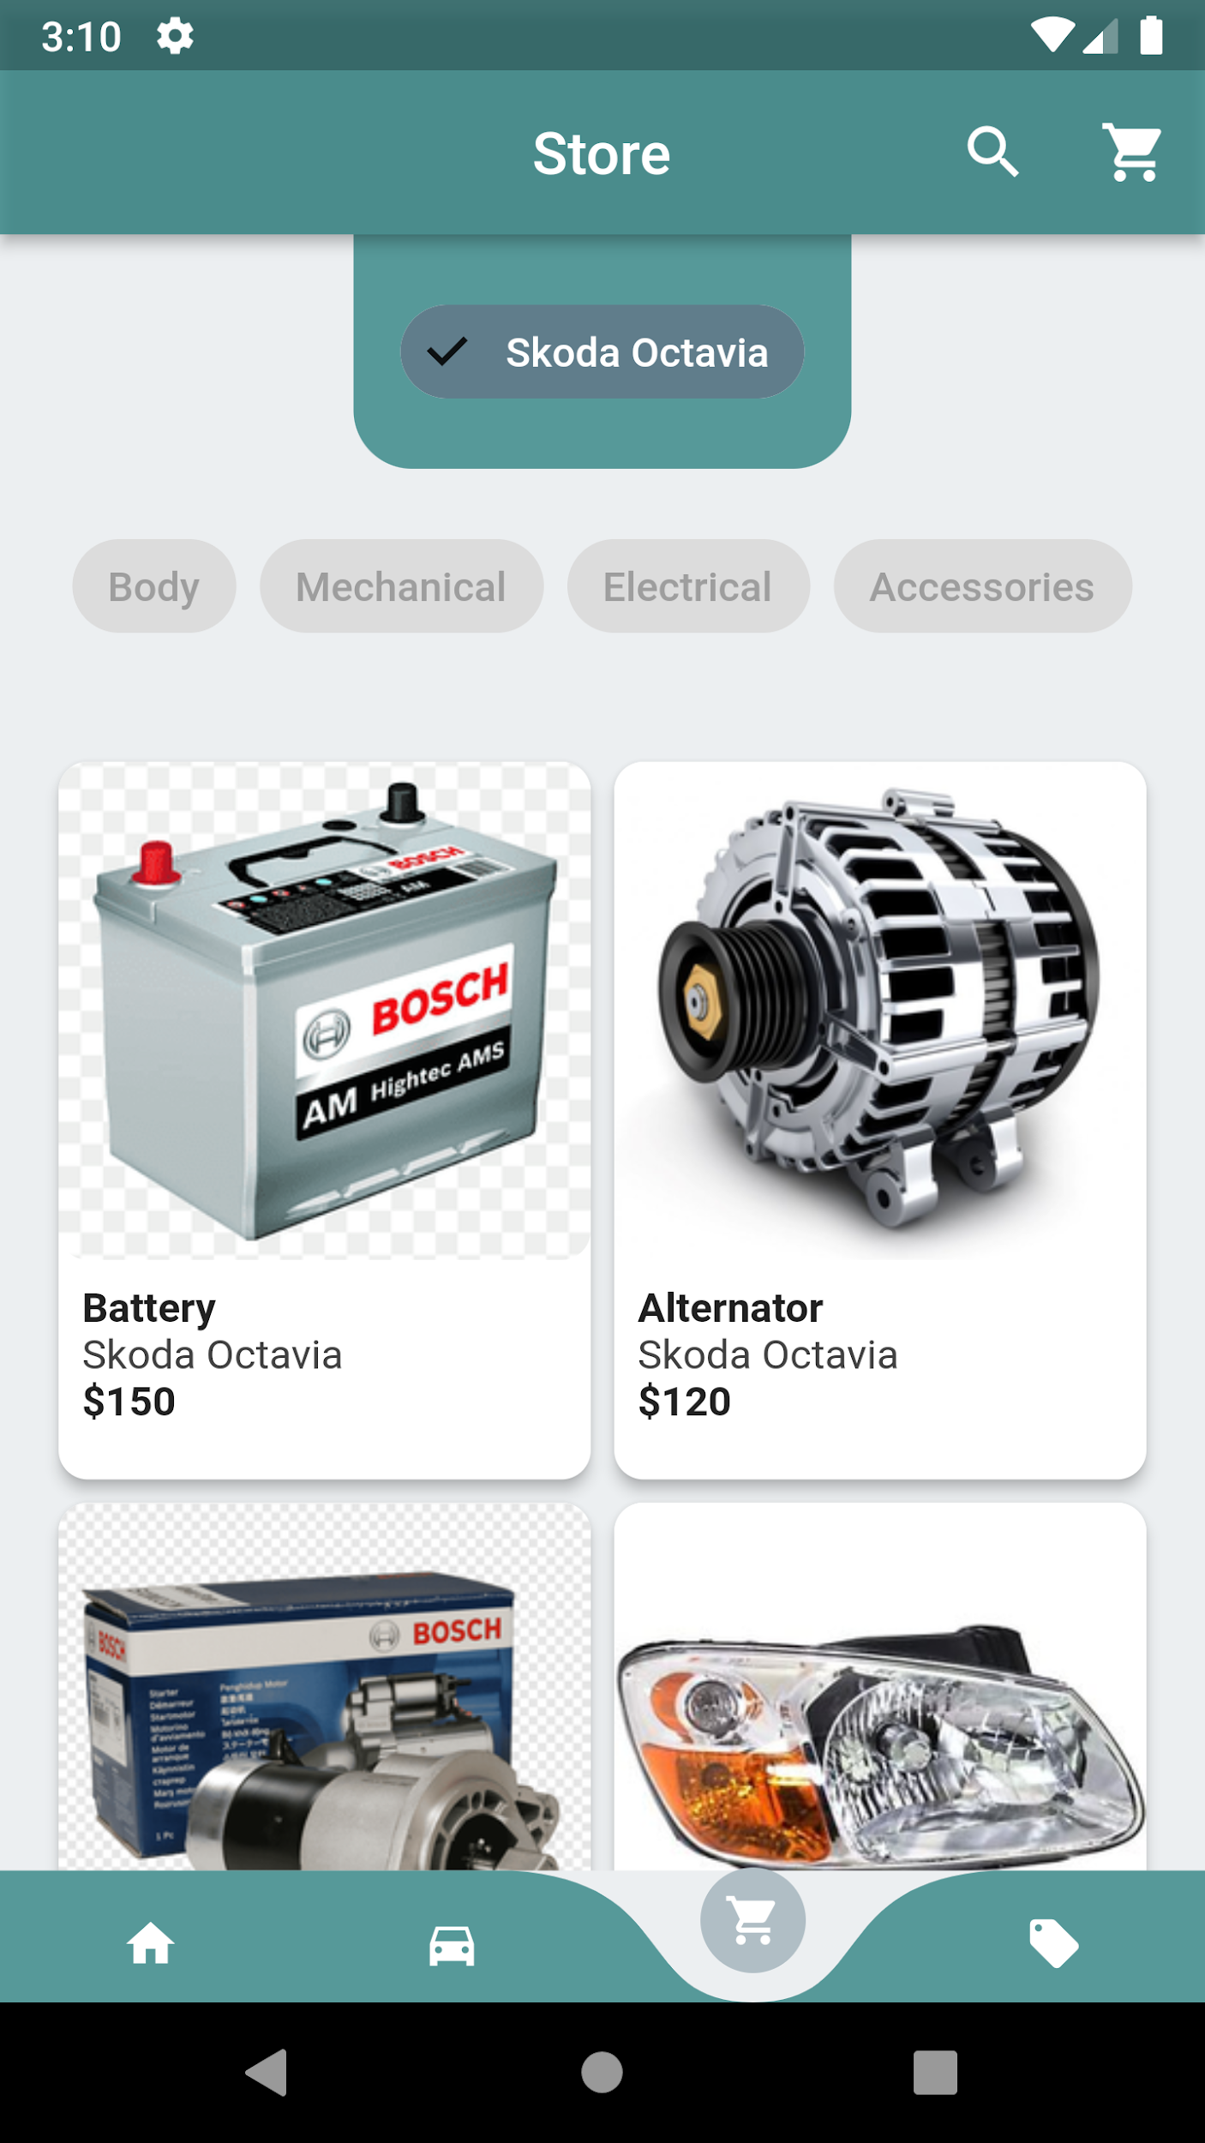
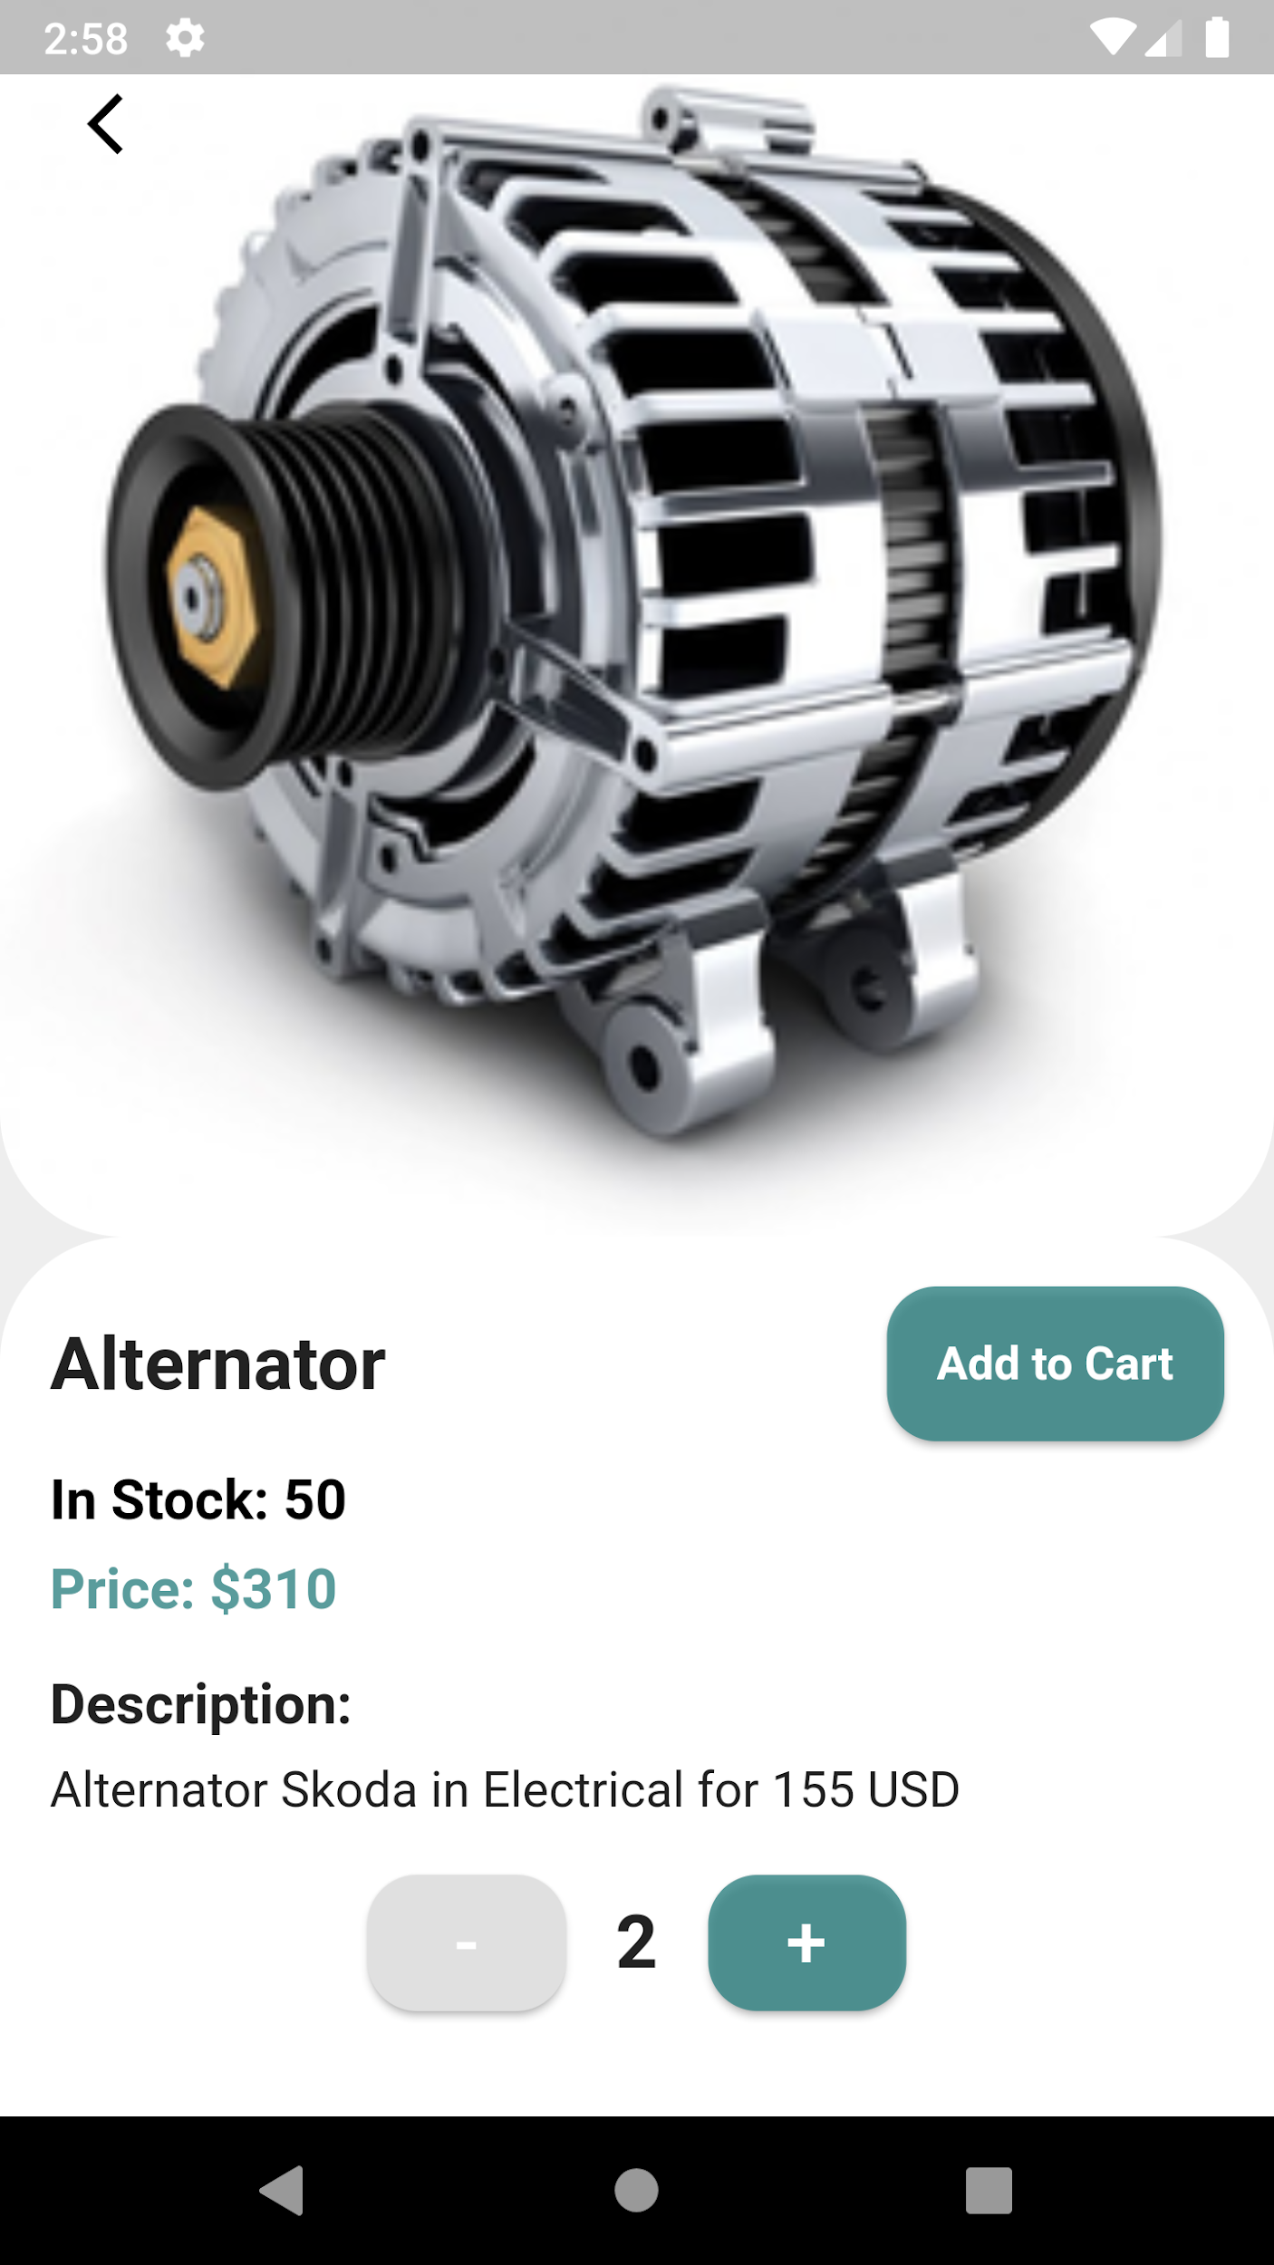

Slide 17
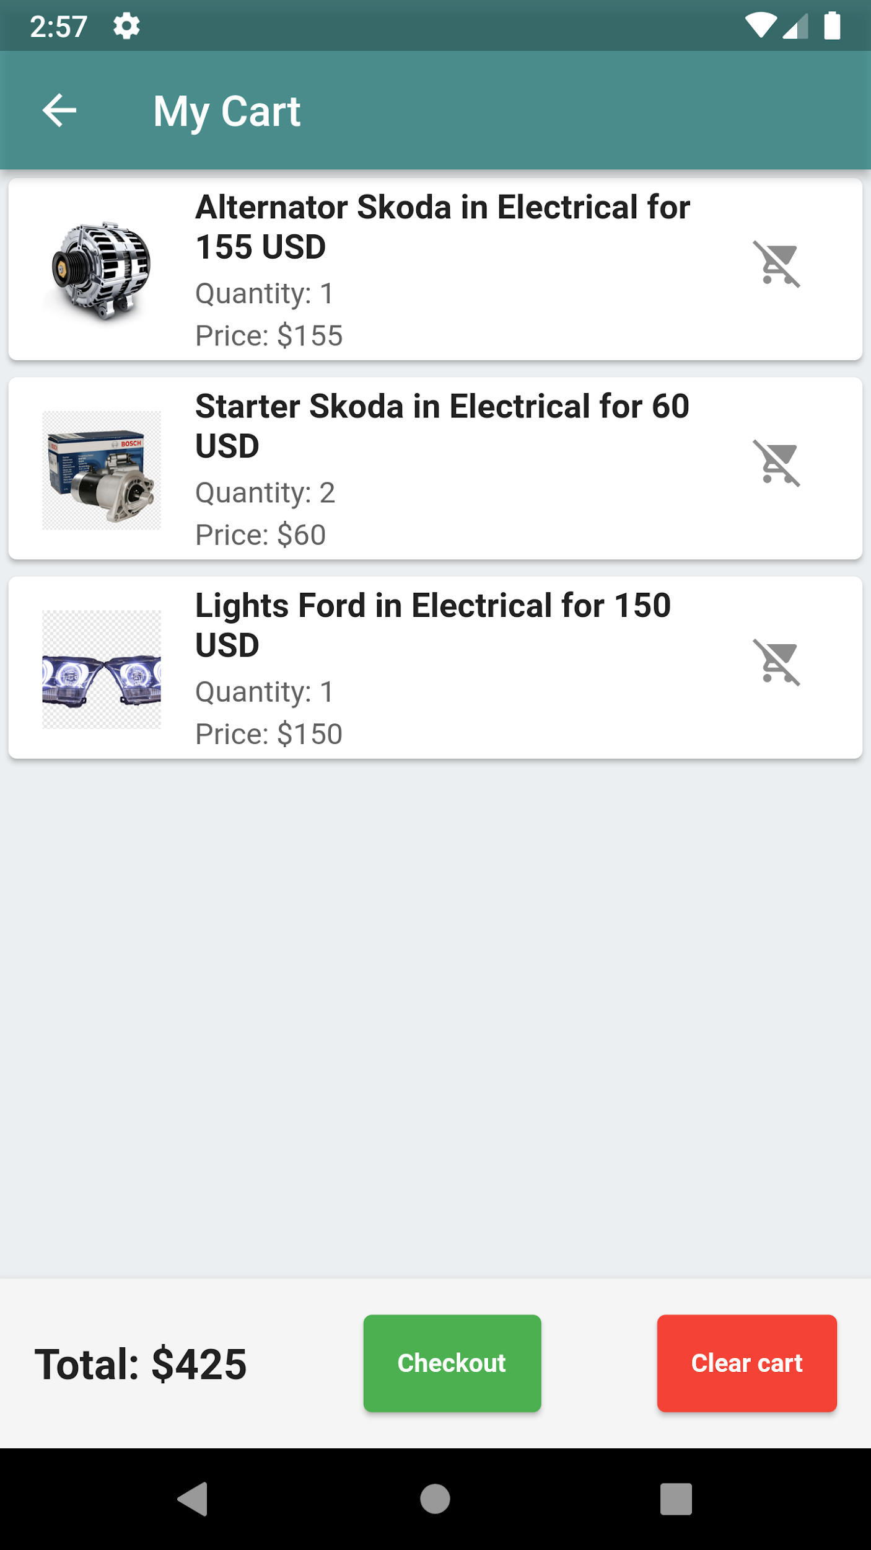
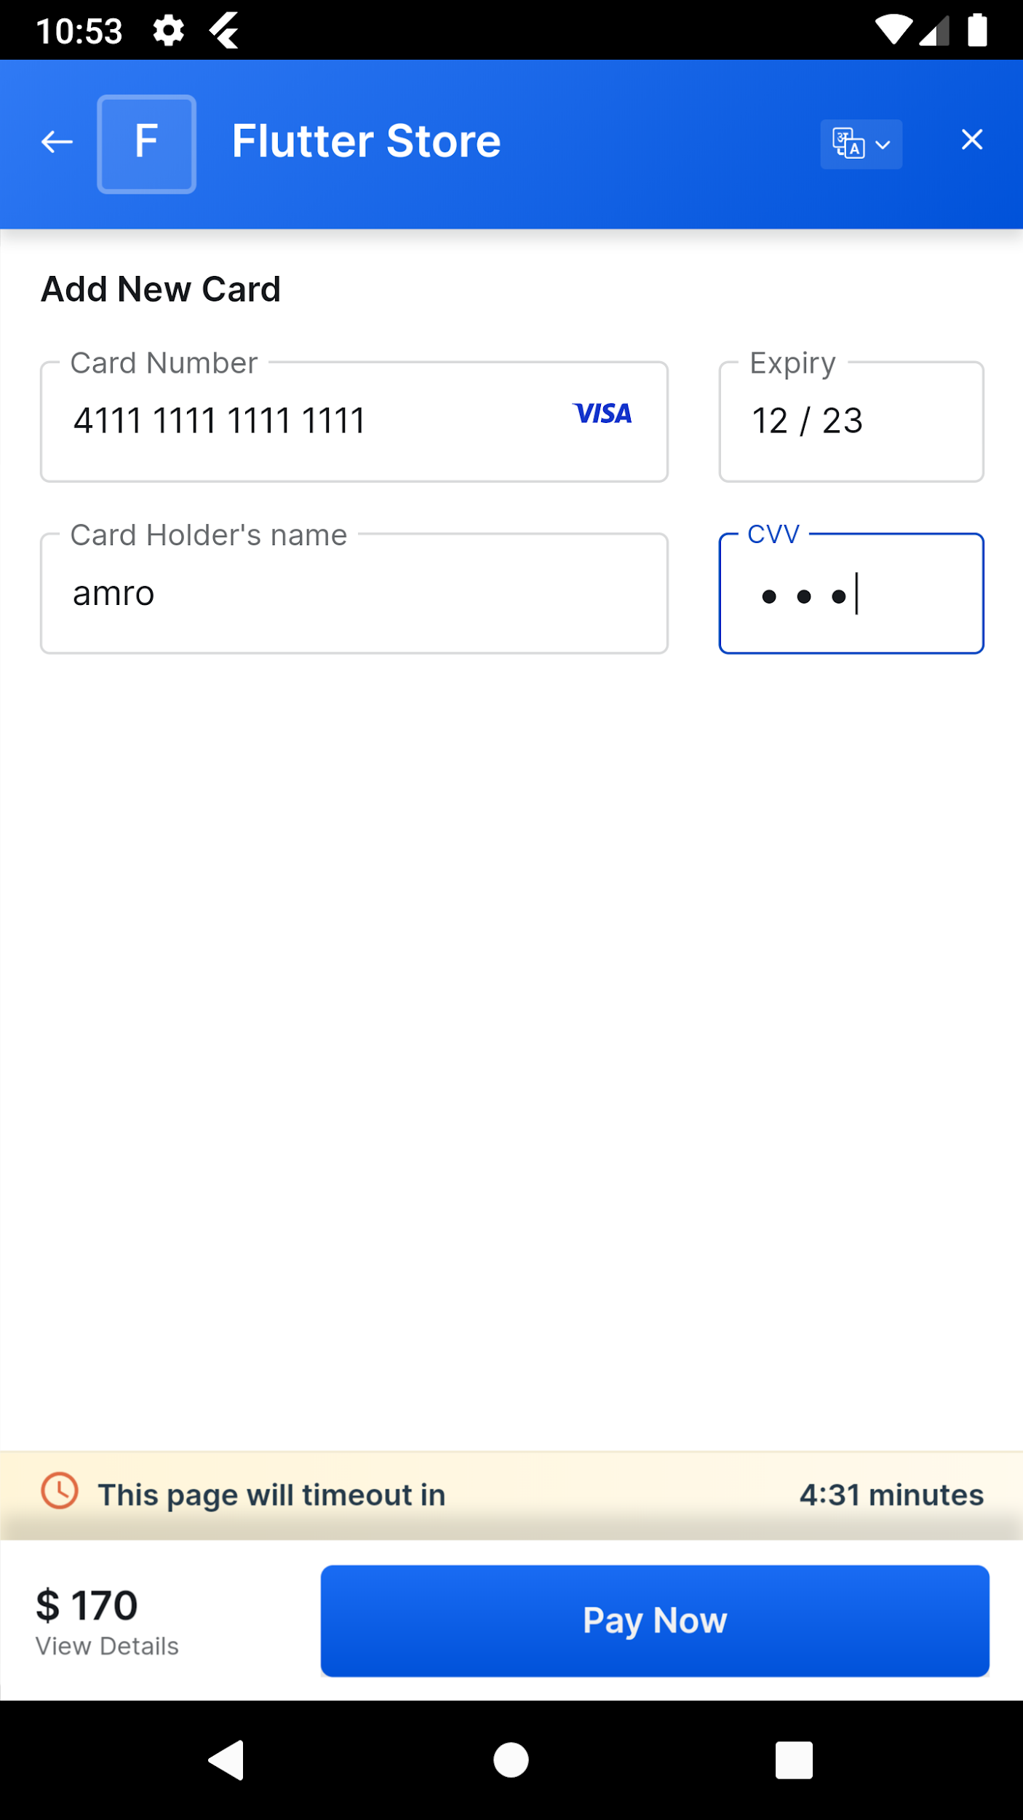

Slide 18
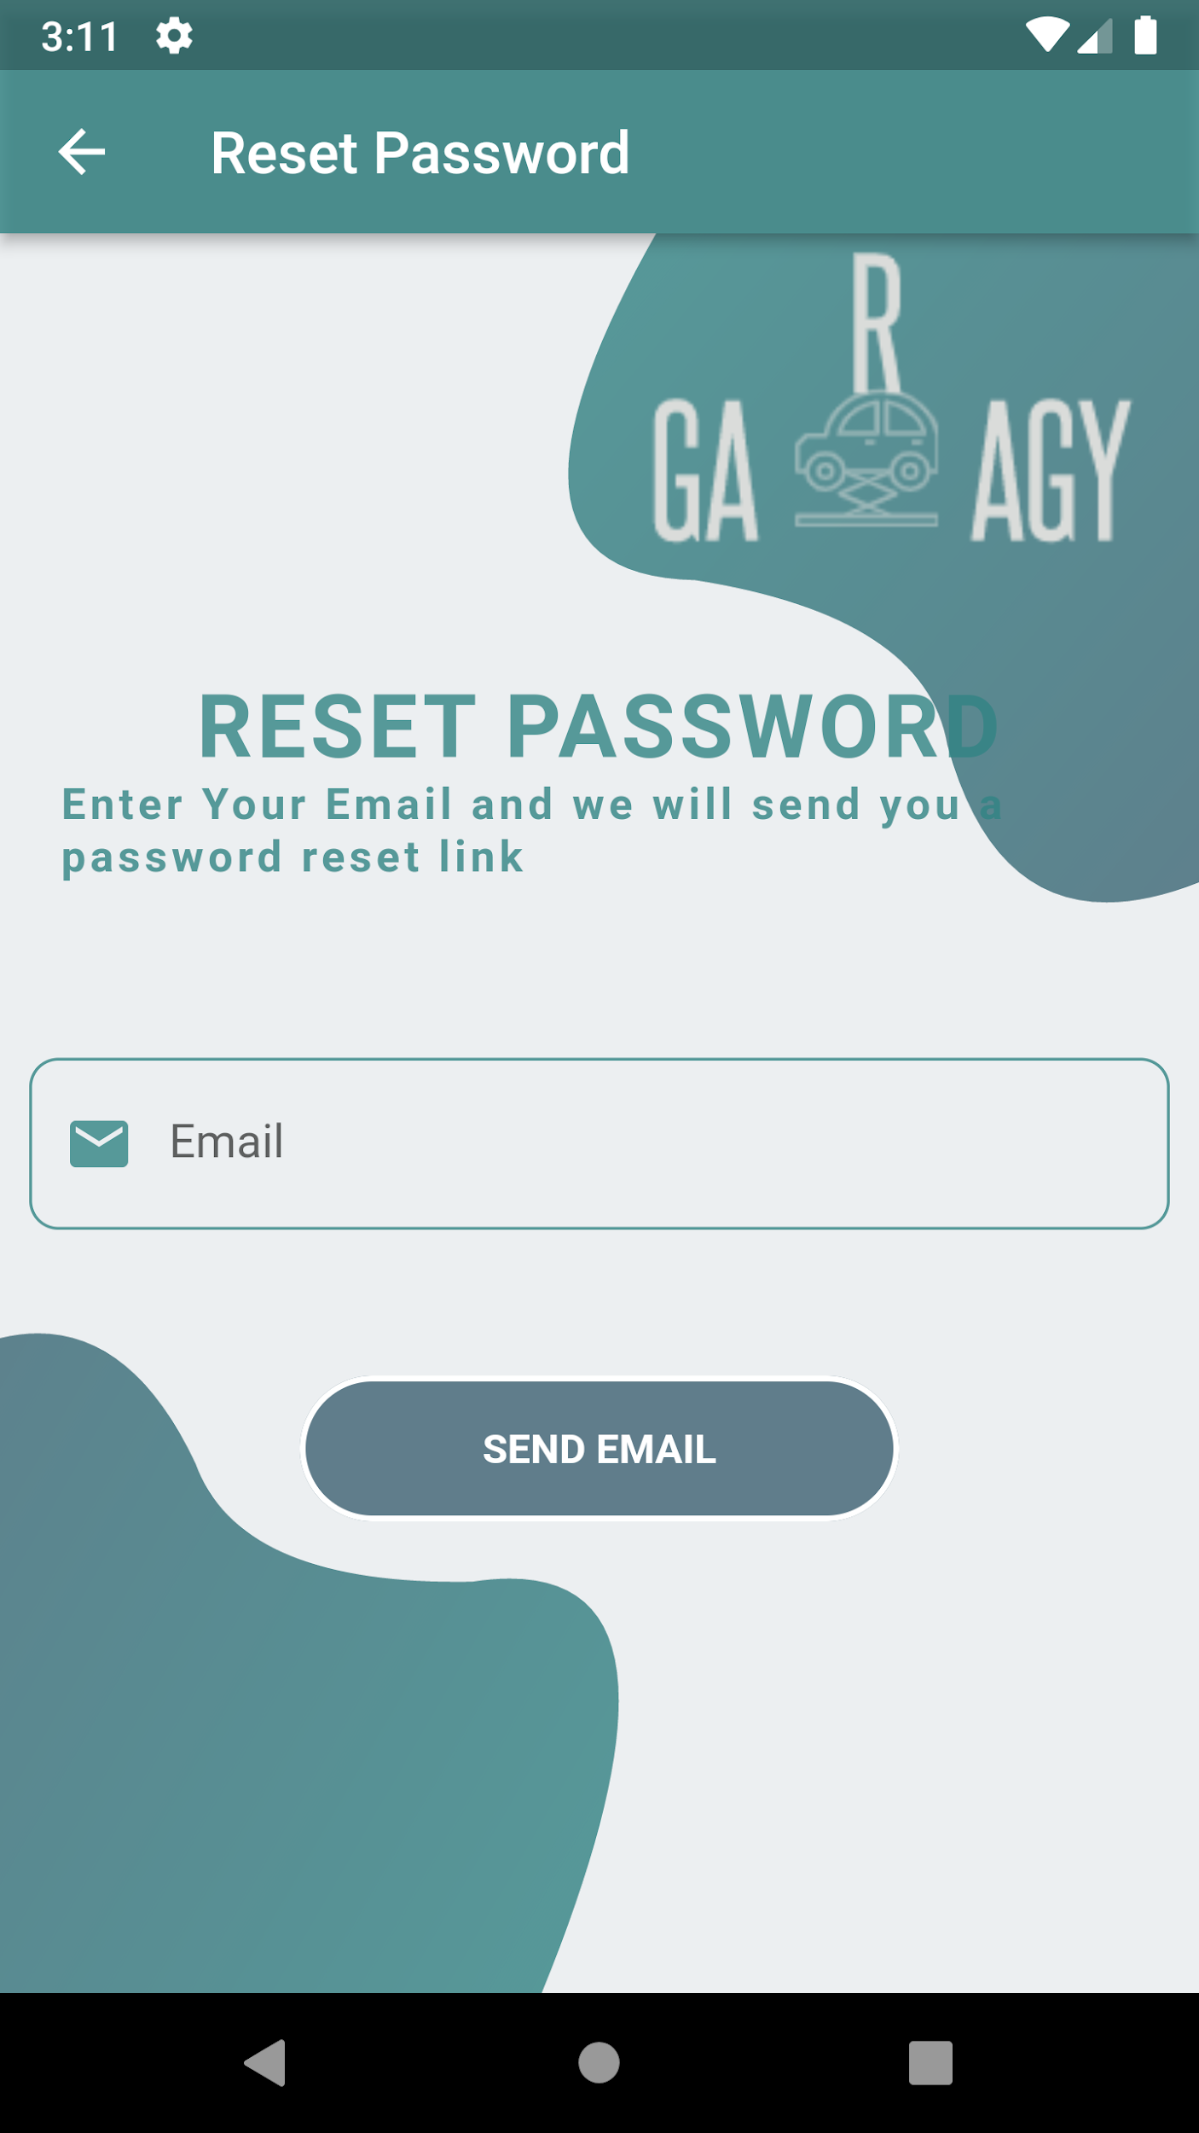
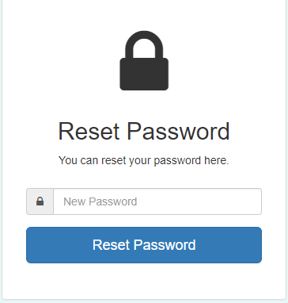
Forget Password

Slide 19
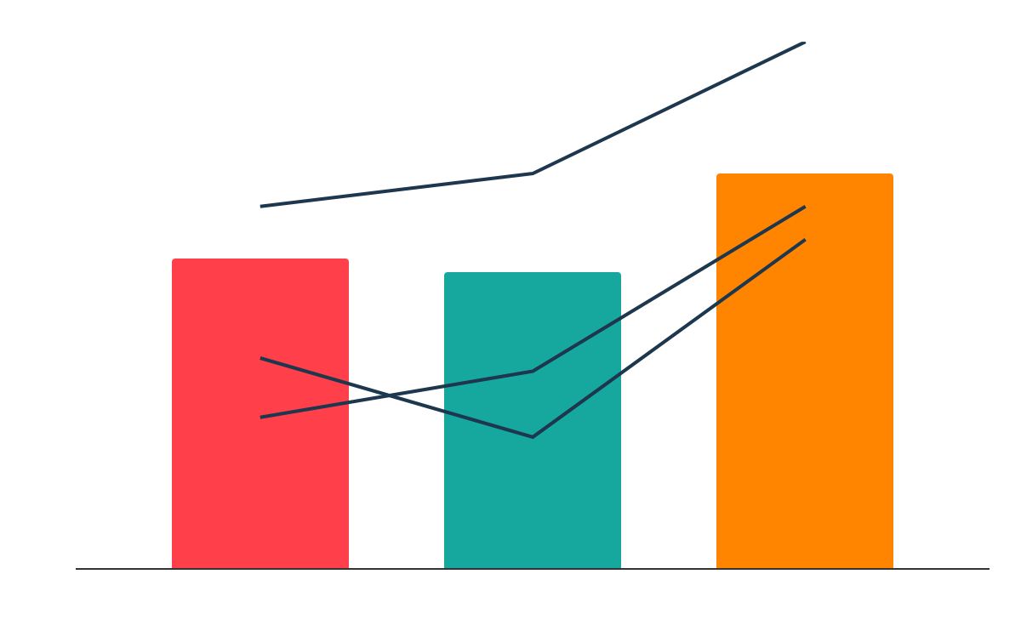
Admin

Slide 20
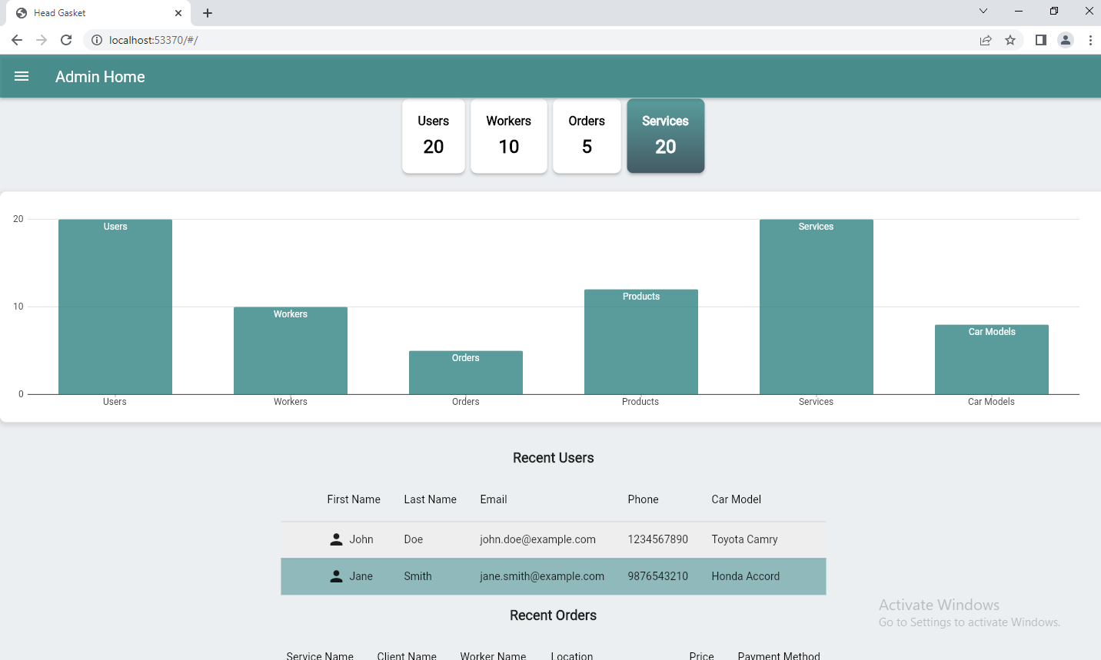
Dashboard

Slide 21
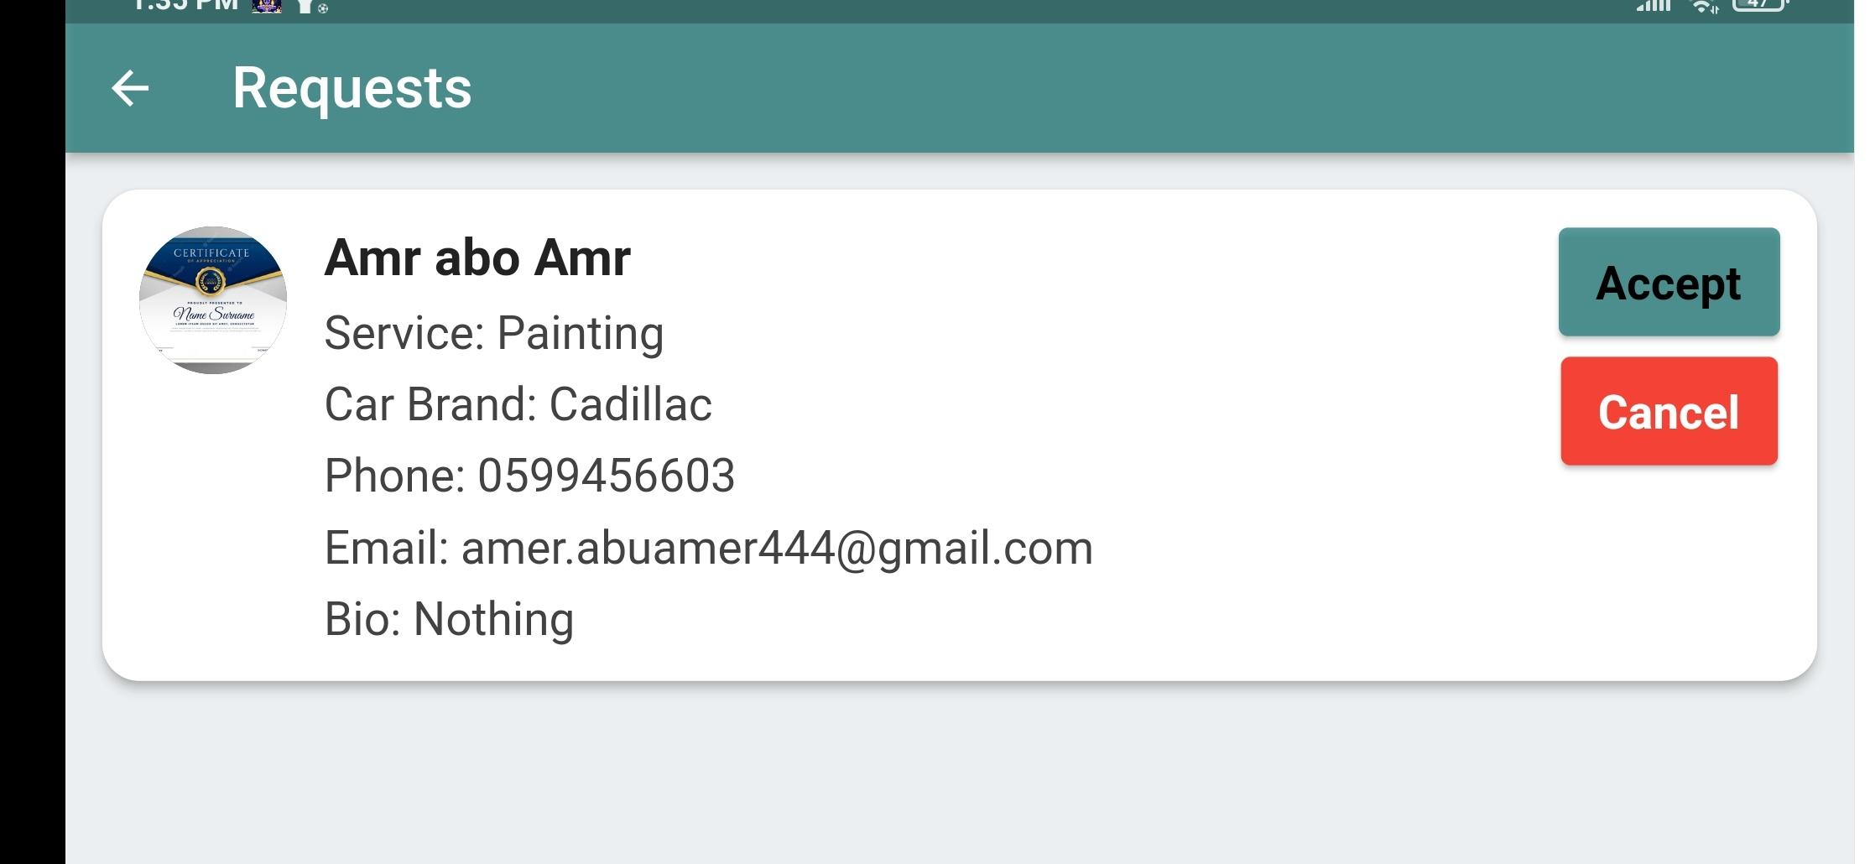
Requests join

Slide 22
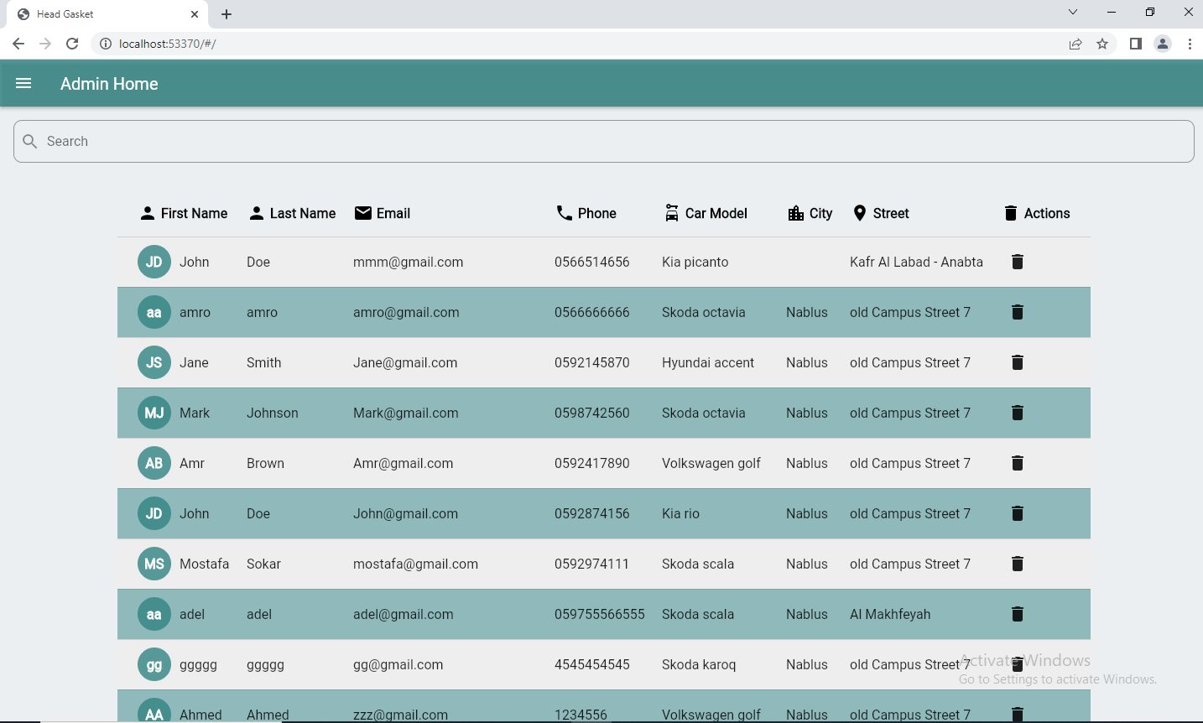
Users Table

Slide 23
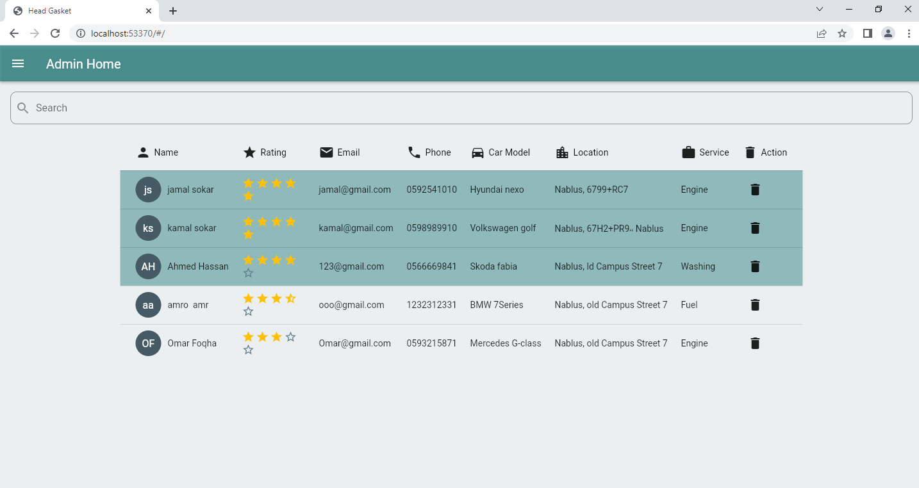
Workers Table

Slide 24
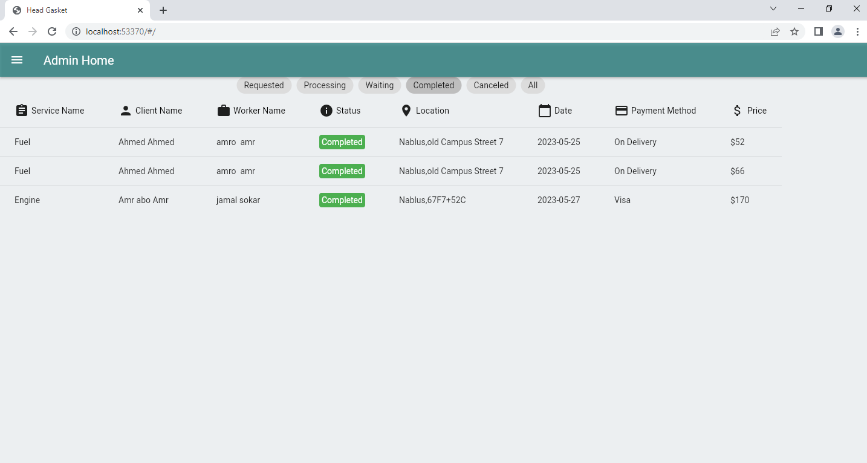
Orders Table

Slide 25
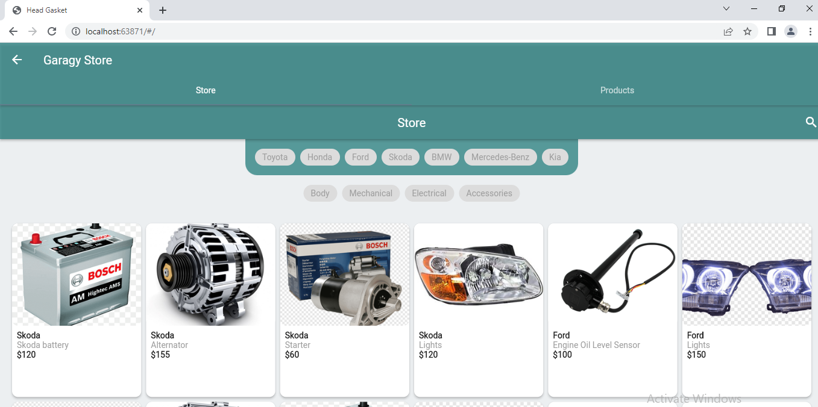
Products

Slide 26
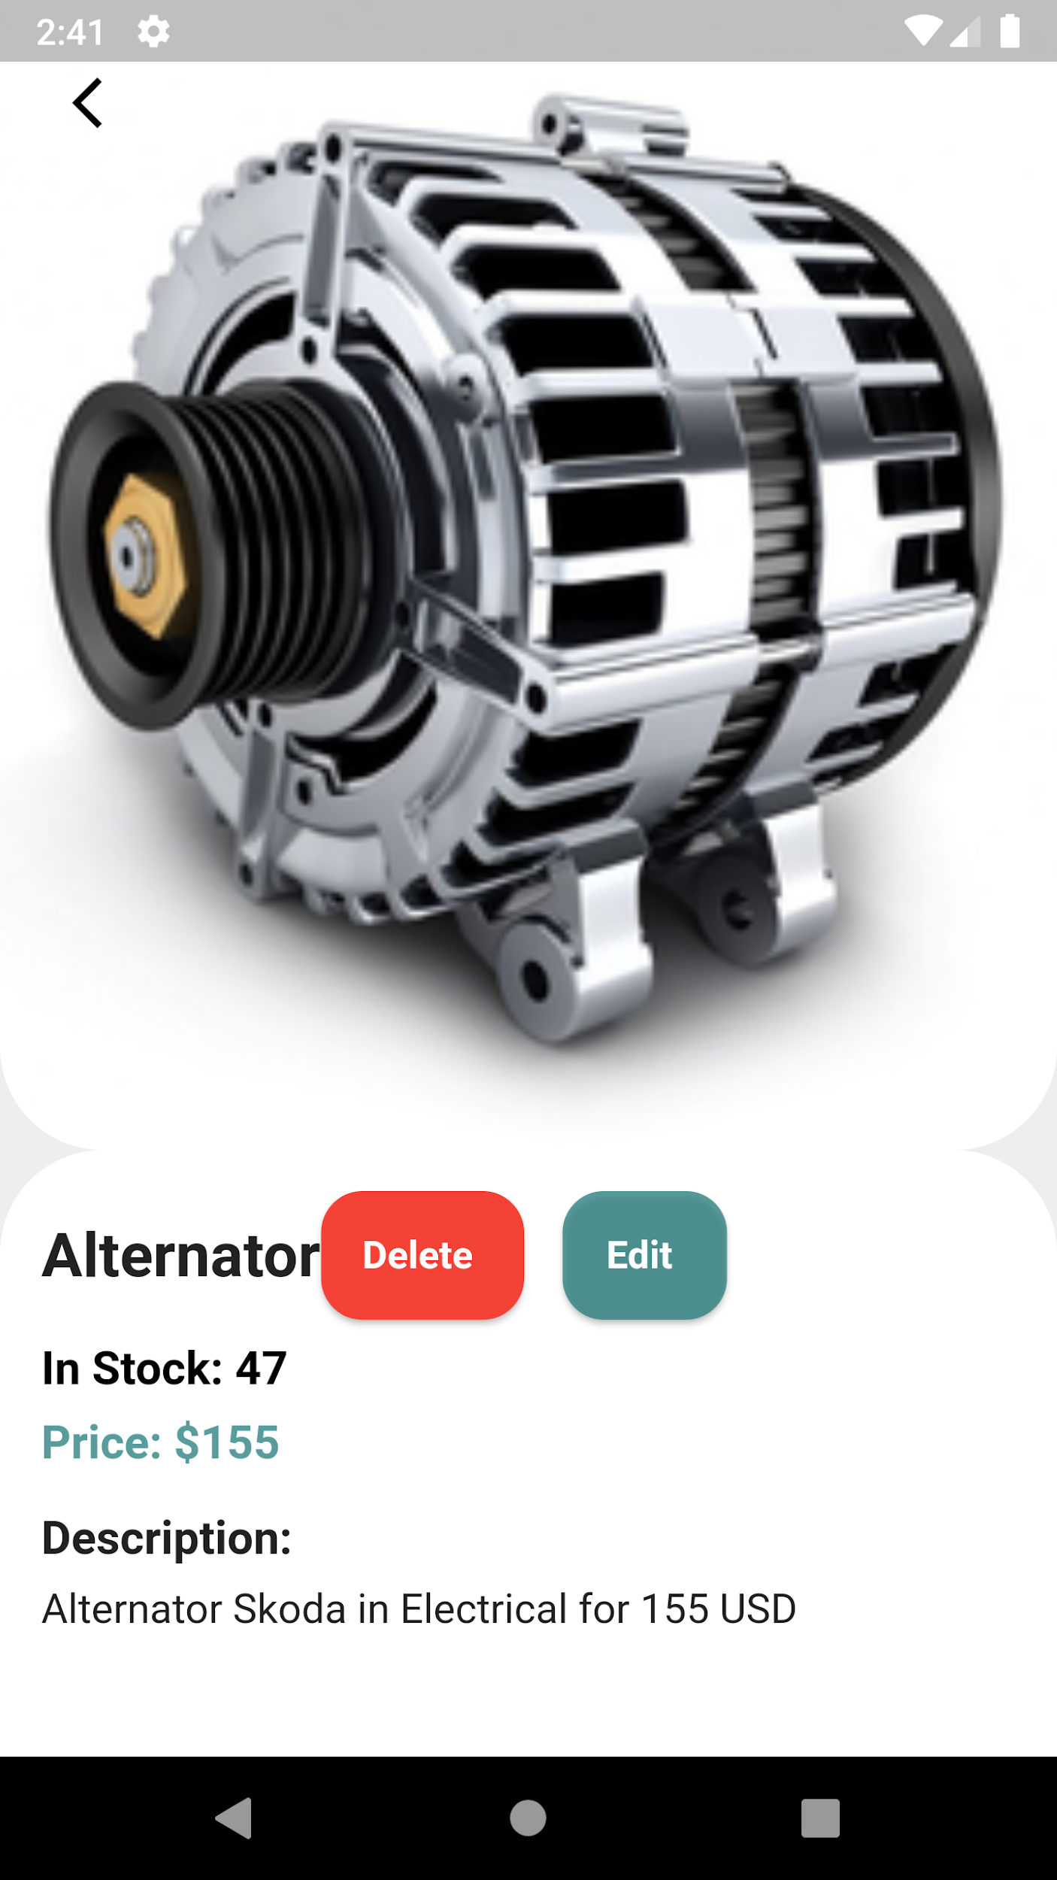
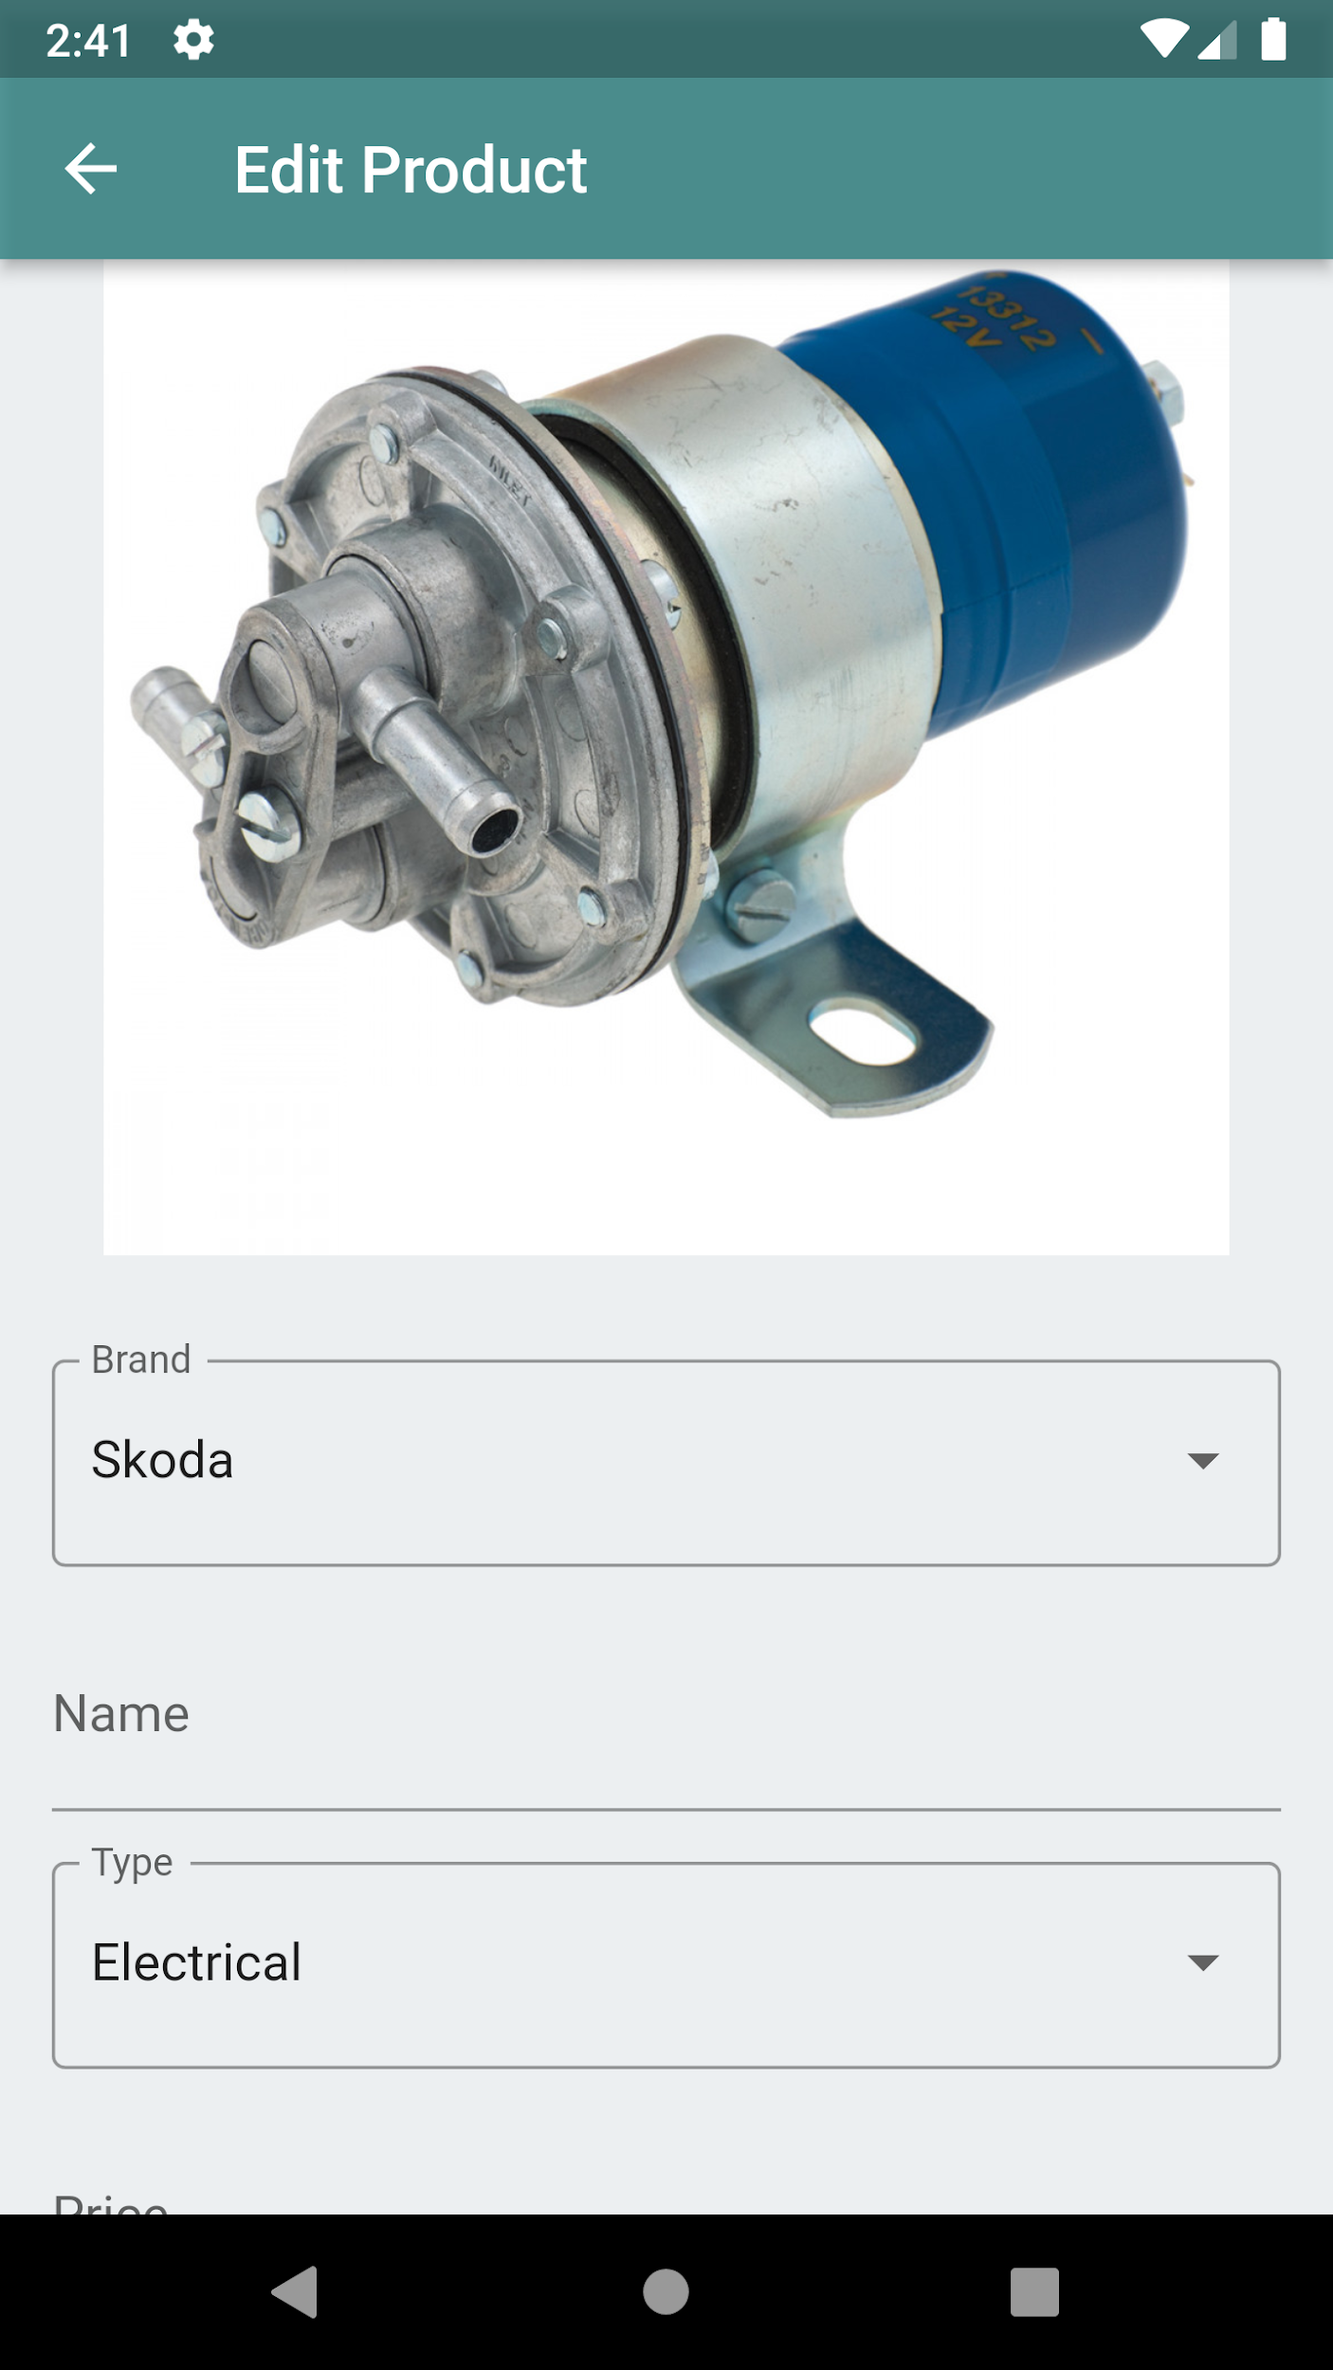

Slide 27
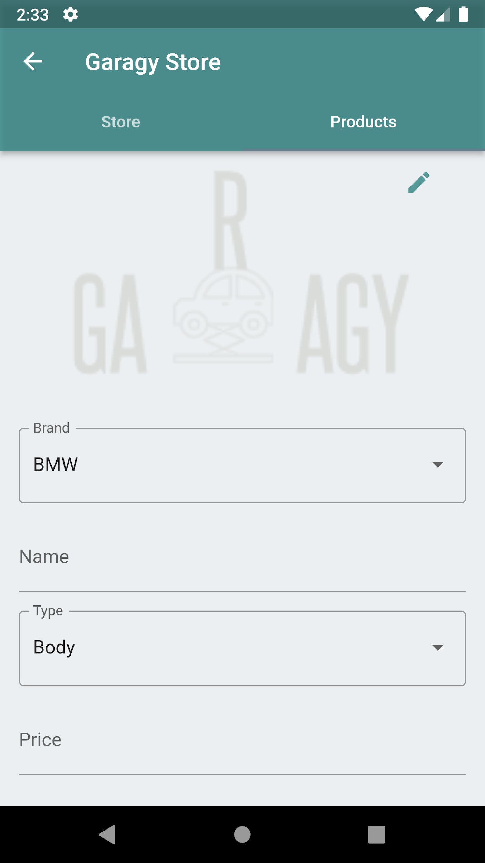
New Product

Slide 28
04
Tools and Technologies

Slide 29



Tools and Technologies
1
2
3
Flutter for the frontend.
Node-JS for the backend.
MongoDB for Database.

Slide 30

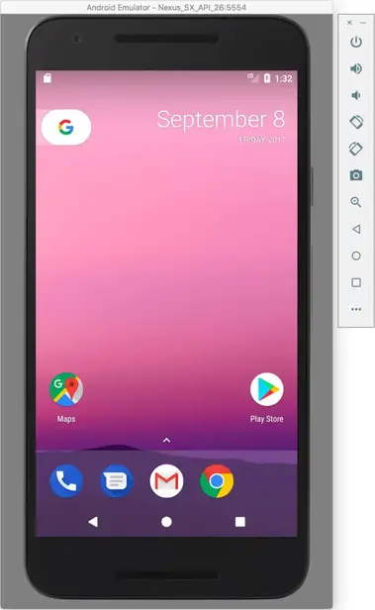

Tools and Technologies
4
5
6
Postman for testing endpoints.
Android emulator.
Firebase.

Slide 31
05
Future Work

Slide 32
Future Work
Expansion of service coverage
Integration with Smart Car Technologies
Advanced Analysis and Reporting
Automation of Joining as a service provider

Slide 33
Thank you
Do you have any questions?

